Slide 1
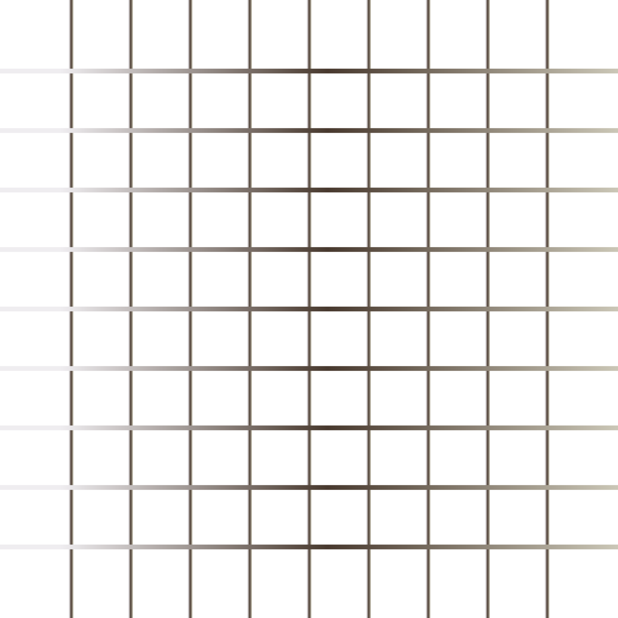
Today’s Agenda
Position
Overflow
Shadow
Flex
Web Fonts

Slide 2
Position
The position property specifies the type of positioning method used for an element.
There are five different position values:
static
relative
fixed
absolute
sticky

Slide 3
Overflow
The CSS overflow property controls what happens to content that is too big to fit into an area.
The overflow property specifies whether to clip the content or to add scrollbars when the content of an element is too big to fit in the specified area.
The overflow property has the following values: visible
hidden
scroll
auto

Slide 4
Shadows
With CSS you can add shadow to text and to elements.
In these chapters you will learn about the following properties:
Text-shadow
Box-shadow
Text Effects

Slide 5
Web Fonts
Web fonts allow Web designers to use fonts that are not installed on the user's computer
When you have found/bought the font you wish to use, just include the font file on your web server, and it will be automatically downloaded to the user when needed.
Your "own" fonts are defined within the CSS @font-face rule.

