Slide 1


Name of Project :- Forest Fire
Detection Using
Deep Learning.
Name:- Astha Princy
AICTE Internship Student Registration ID:- STU67dc2603dcbe01742480899
AICTE Internship ID:-
INTERNSHIP_174099535967c57b1f336c3

Slide 2

Learning Objectives
Understand the use of CNN for FFD(Forest Fire Detection):-
🔍 What is a CNN?
CNN is a type of deep learning model that is great at
recognizing patterns in images.
Think of it like this:
Our brain sees smoke or flames in a photo and recognizes fire.
A CNN can be trained to do the same using a lot of example
images.
🛠️ How CNN helps in detecting forest fires
1.Collect Data Gather thousands of images:
🔥 With fire (smoke, flames)
🌲 Without fire (normal forest, fog, clouds)
GOAL
Source :
www.freepik.com/

Slide 3
Learning Objectives
Train the CNN Model Show the CNN model all these images and tell it:
“This one has fire.”
“This one doesn’t.”
The CNN will learn the features:
Color patterns (like orange, red, grey)
Shapes (like flames, smoke clouds)
Texture differences
Use the Trained CNN Give it a new image, and it will predict:
Fire detected 🔥
No fire 🌲
GOAL
Source :
www.freepik.com/

Slide 4
Learning Objectives
✅ Advantages
Fast detection (real-time from video feeds).
Accurate if trained well.
Can work day and night with proper dataset.
Real-World Use Example
A drone flies over a forest and captures live video. The CNN runs
on the drone or a remote server and:
Sees smoke rising → detects possible fire → alerts rangers
🧪 Simple Analogy
Think of CNN as a robotic firefighter with super vision:
It has learned what smoke and fire look like.
It watches the forest all the time.
The moment it sees danger; it raises the alarm.
GOAL
Source :
www.freepik.com/

Slide 5
Tools and Technology used
Programming Language :- Python
Frameworks:-
Framework | Use
TensorFlow | Widely used for building DL models
Keras | High-level API for TensorFlow (easy to use)
Model :-CNN (Convolutional Neural Networks) for image classification (fire vs. no fire). Developed Environment :- Google Collab Hardware :- GPUs (NVIDIA CUDA) → Required for training large DL models quickly Data Sources :- Satellite Imagery (e.g., NASA MODIS, Sentinel) Drones (UAVs) with cameras (infrared or visible light) CCTV and Surveillance Cameras in forests Kaggle

Slide 6

Methodology
Data Collection:-
Forest Fire Image Dataset: Labelled images with/without fire.
Fire Detection Dataset(includes fire/smoke images from different environments)
Search Kaggle for: forest fire image dataset , smoke detection , or unci forest fire
Data Preprocessing:-
Resize images (common sizes: 224x224 or 150x150)
Normalization (scale pixel values between 0–1)
Data Augmentation (rotate, flip, zoom to prevent overfitting)
Train-Test Split (usually 70-30 or 80-20)
Model Selection:-
CNN- 3 Convolutional layer, Dense layer , 1 Output layer.

Slide 7
Methodology
Model Training
Use GPU/TPU acceleration (from Kaggle settings).
Choose appropriate loss function:
Binary Cross-Entropy (for binary classification).
Categorical Cross-Entropy (for multi-class).
Use Adam optimizer, early stopping, and checkpoints.
We run 12 epochs.
Model Evaluation
Metrics depend on the task:
Accuracy, Precision, Recall, F1-score (for classification)
mAP (mean Average Precision) (for object detection)
Confusion Matrix (to visualize performance)

Slide 8
Problem Statement:
Forest fires are a significant environmental concern, causing the destruction of ecosystems, loss of biodiversity, air pollution, and posing risks to human life and property. Early detection of forest fires is crucial for minimizing their impact. Traditional fire detection methods (like satellite monitoring or manual observation) can be slow, costly, or inaccurate.
With the growth of Deep Learning (DL), especially in image and video analysis, there's an opportunity to automate forest fire detection with high accuracy and in real-time using sensor data, surveillance cameras, and satellite imagery.
Objective:
The primary objective is to develop a Deep Learning-based system that can automatically detect forest fires from visual or sensor data (such as images, videos, thermal data, etc.) with high accuracy, minimal false alarms, and in near real-time.

Slide 9
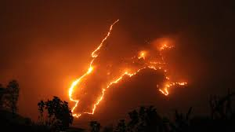
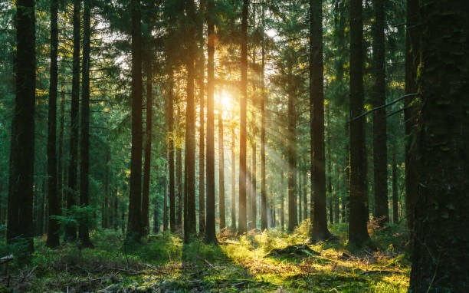
Problem Statement:
Problem Statement:
“Develop an automated forest fire detection system using deep learning techniques capable of accurately identifying fire occurrences from real-world data(images , video streams , or sensor inputs), with the goal of improving early detection , reducing response time , and minimizing false positives and negatives.”
Forest Fire Image
No Forest Fire Image

Slide 10
Solution:
To detect forest fires using Deep Learning (DL), we develop an intelligent system that analyzes visual or sensor data (images, video, thermal images) and identifies the presence of fire or smoke. The system uses neural networks, especially Convolutional Neural Networks (CNNs) and object detection/segmentation models, to learn features and patterns associated with fire.
🔍 Example Use Case
A CCTV camera captures images from a forest every 10 seconds. These images are sent to a DL model running on an edge device. If the model detects fire in 3 consecutive frames with >90% confidence, it sends an alert to the fire control room with the timestamp and location.
Advantages
Faster and more accurate than manual methods
Works in real-time with high-resolution video
Reduces human error and enhances early warning systems
Here is my GitHub link:-https://github.com/Astha606/Week-3.git

Slide 11
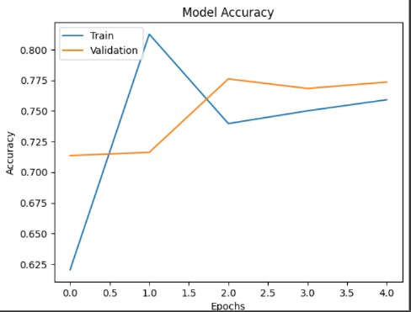
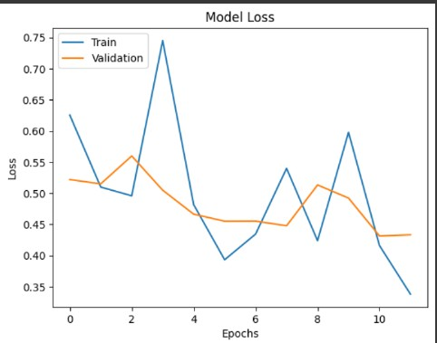
Screenshot of Output:

Slide 12
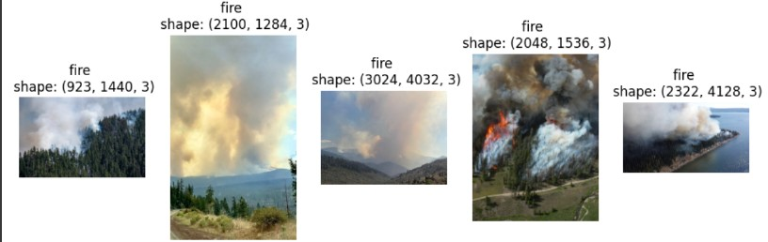
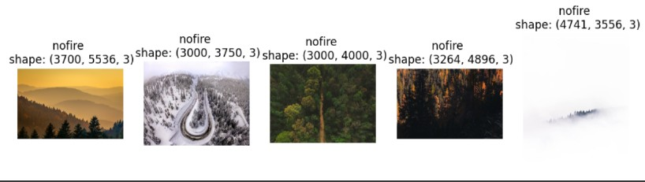
Screenshot of Output:
Fire Image
No Fire Image

Slide 13
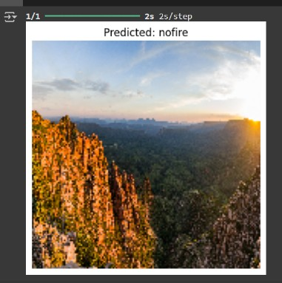
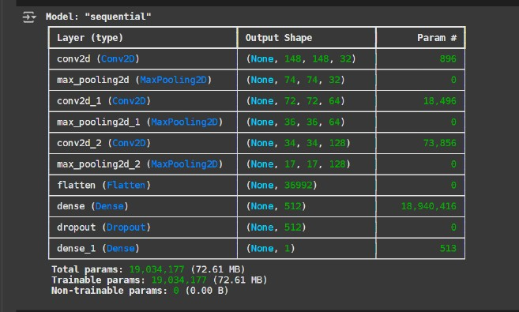
Screenshot of Output:

Slide 14
Conclusion:
Here's a conclusion for our forest fire detection project using Deep Learning (DL), CNN, and a Kaggle dataset, with training over 12 epochs and achieving 80% accuracy, including a note on future scope:
✅ Conclusion:
In this project, we successfully developed a forest fire detection system using Convolutional Neural Networks (CNNs) trained on image data from a Kaggle dataset. The system was trained over 12 epochs and achieved an accuracy of 80%, demonstrating the effectiveness of deep learning techniques in recognizing fire-related patterns in forest environments.
The model was able to distinguish between fire 🔥 and non-fire 🌲 images with reasonably good performance, confirming the capability of CNNs to learn complex visual features such as flames, smoke, and heat signatures. The use of a publicly available dataset from Kaggle accelerated the development process and provided a solid foundation for experimentation.
While the current accuracy shows promising results, it also highlights room for improvement, especially in handling edge cases like fog, sunlight glare, or low-light conditions, which may lead to false positives or negatives.

Slide 15

Conclusion:
Future scope:-
Data Expansion and Diversification:
Use larger and more diverse datasets including satellite, thermal, and real-time video footage.
Incorporate data from different seasons, weather conditions and geographic regions.
Model Optimization:
Experiments with deeper or more efficient CNN architectures(e.g., EfficientNet, MobileNet).
Use transfer learning to improve performance on limited datasets.
Real-Time Deployment:
Integrate the model with edge devices(e.g., drones, forest cameras) for live fire monitoring.
Develop a lightweight version of the model suitable for mobile or low-power environments.
Fire Localization and Segmentation:
Extended the system to not only detect fire but also locate and segment fire regions using object detection(YOLO, Faster R-CNN)or semantic segmentation model(U-Net).
Alert & Monitoring System:
Connect the detection system with a real-time alert mechanism(email/SMS notifications)for quick response.
Build a user-friendly dashboard for forest management teams to visualize and track find incidents.

