Slide 1
PUBLIC FOOD REFRIGERATOR SYSTEM

Slide 2
CONTENT
Problem Statement
Approach
Object Model
Functionalities
Screenshots

Slide 3
PROBLEM STATEMENT
A lot of food is wasted everyday by people like us and the homeless and the people in need of food are left starving.
So, there exists a problem of unequal food distribution in the society.
Our application “Public Refrigerator System” aims to solve this problem by redistributing the extra and donated food to reduce the waste phenomenon.
It is done by installation of public food refrigerators in various locations in the city.

Slide 4
APPROACH
We used the Ecosystem Model to design our application.
We aim to solve the problem of unequal food distribution by letting the privileged people donate the food.
This donated food once checked for its quality, is kept in the public refrigerators at various locations in a city.
We have built a food collection, storage, quality check and delivery system to ensure the food is edible and delivered to the public refrigerators.
The work flow will be as follows:
Donor→ Delivery Person→ Keeper at Warehouse → Delivery Person→ Food Inspector at Food Test Lab→ Delivery Person→ Keeper at Warehouse → Delivery Person→ Public Refrigerator

Slide 5
OBJECT MODEL

Slide 6
FUNCTIONALITIES
We have added text to speech functionality so that the homeless who can’t read properly can just press the button and listen to the instructions.
In our application, we have embedded a Google map which gets displayed to the System Administrator. Then the system administrator can check maps of various networks by searching.
The report is analysed and displayed in the form of a bar graph.

Slide 7
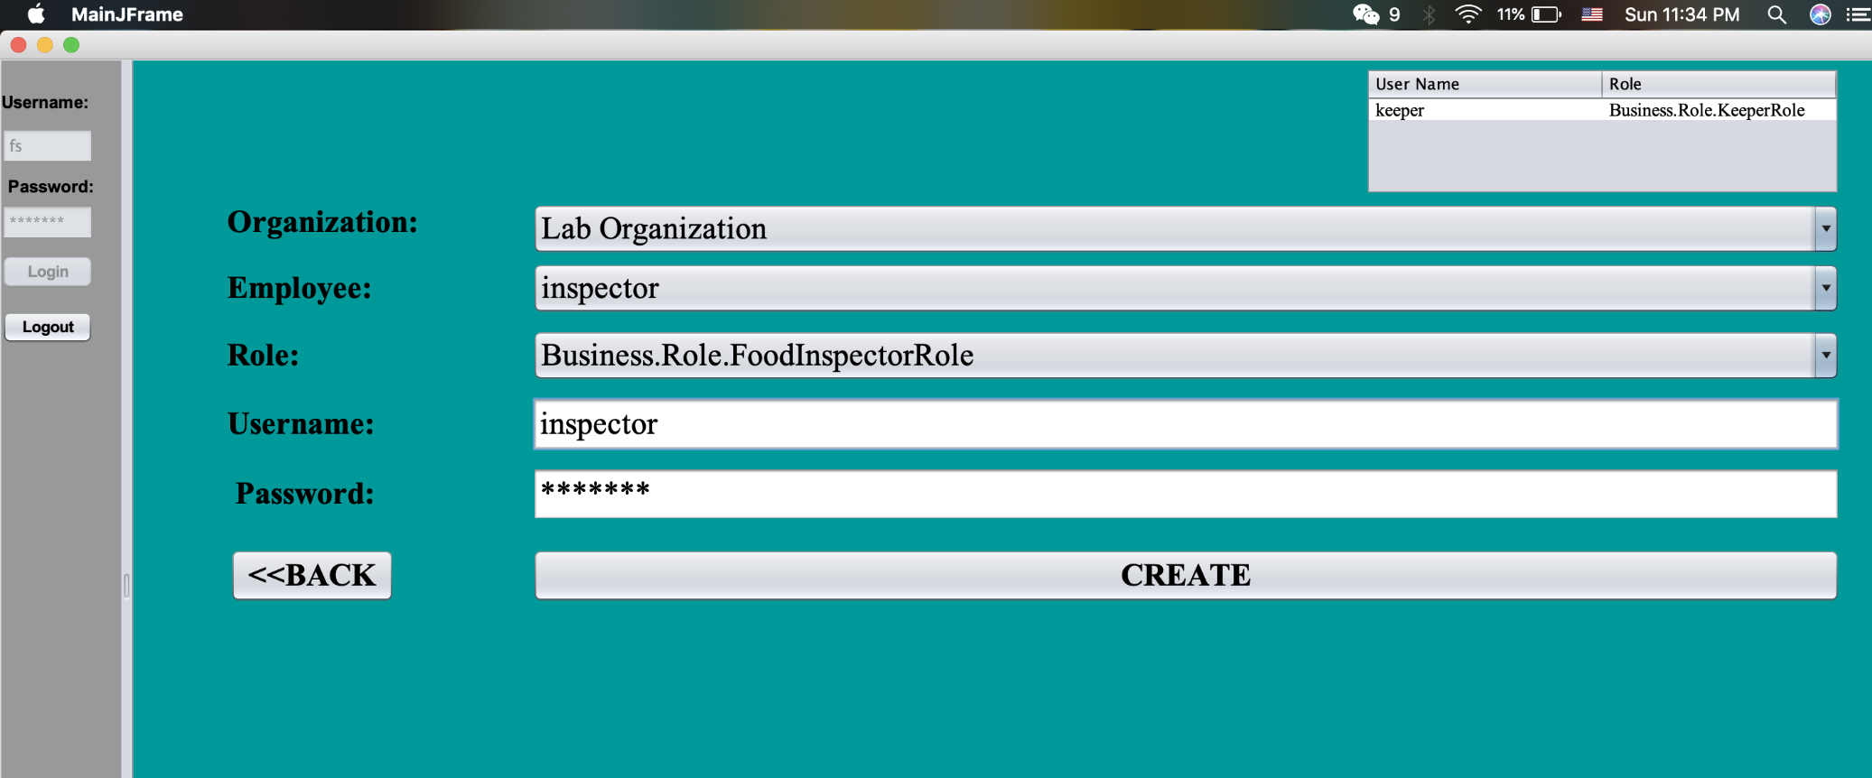
SCREENSHOTS

Slide 8
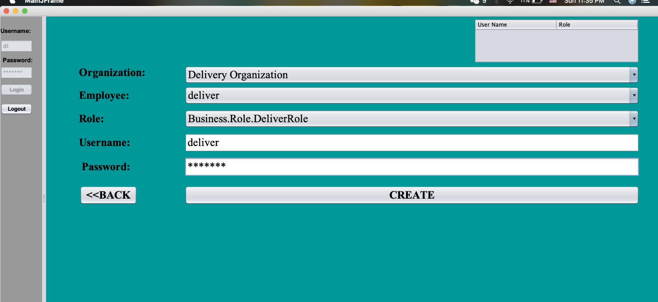
SCREENSHOTS

Slide 9
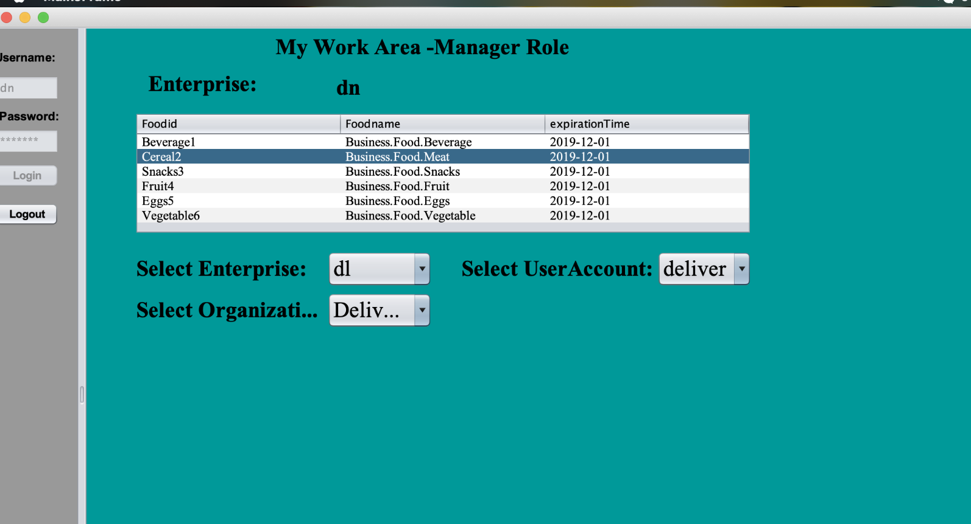
SCREENSHOTS

Slide 10
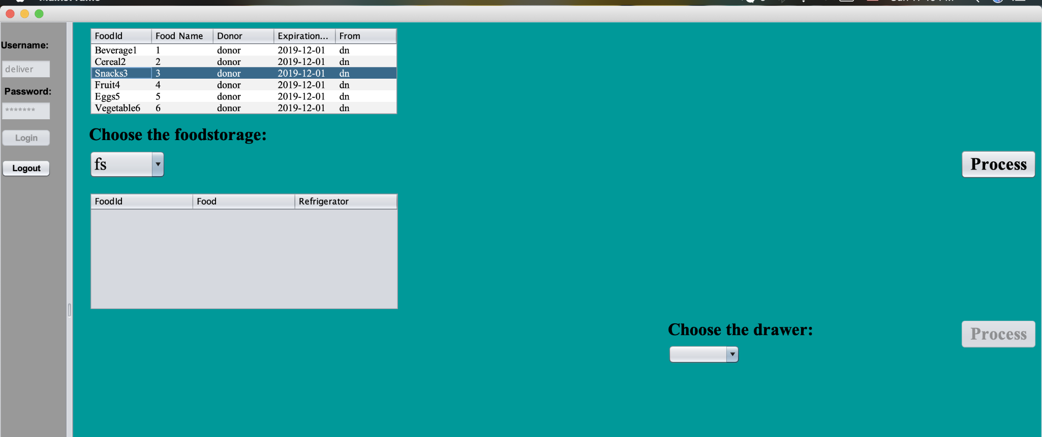
SCREENSHOTS

Slide 11
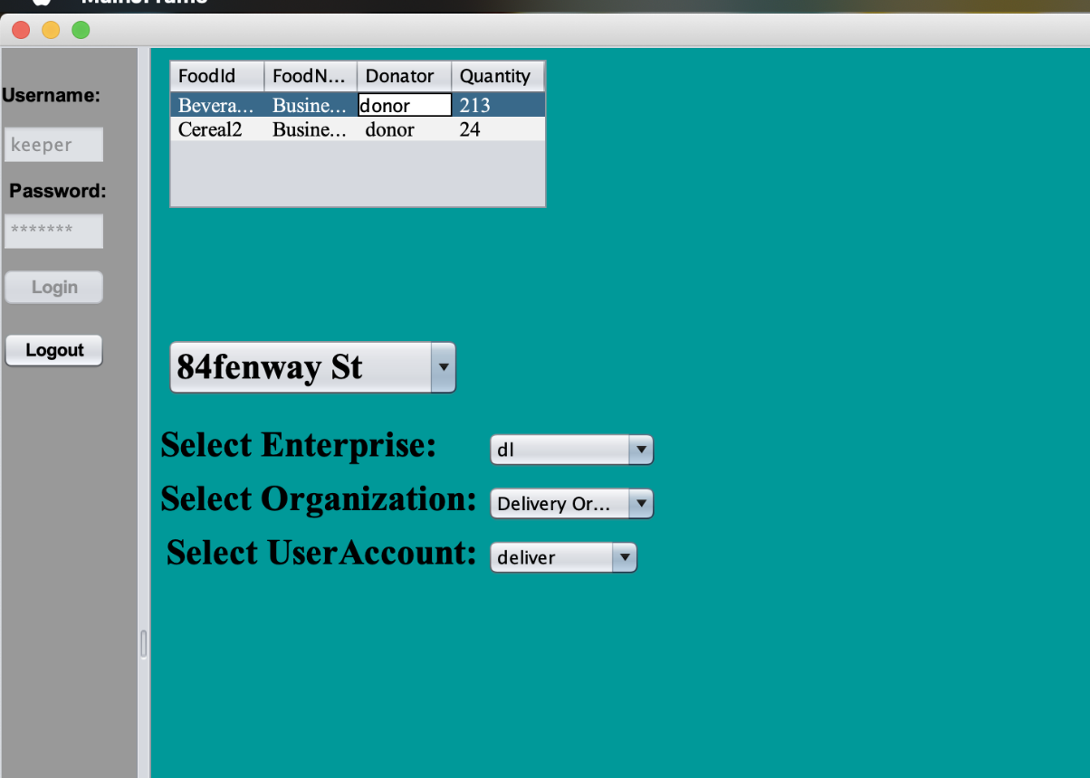
SCREENSHOTS

Slide 12
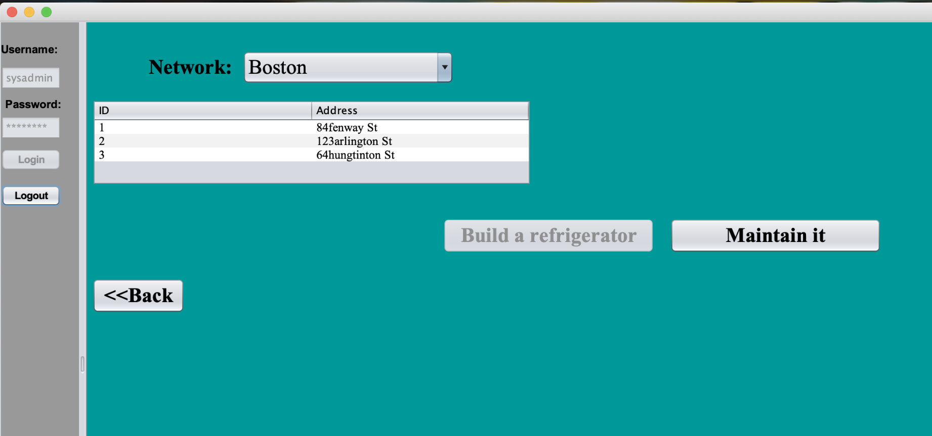
SCREENSHOTS

Slide 13
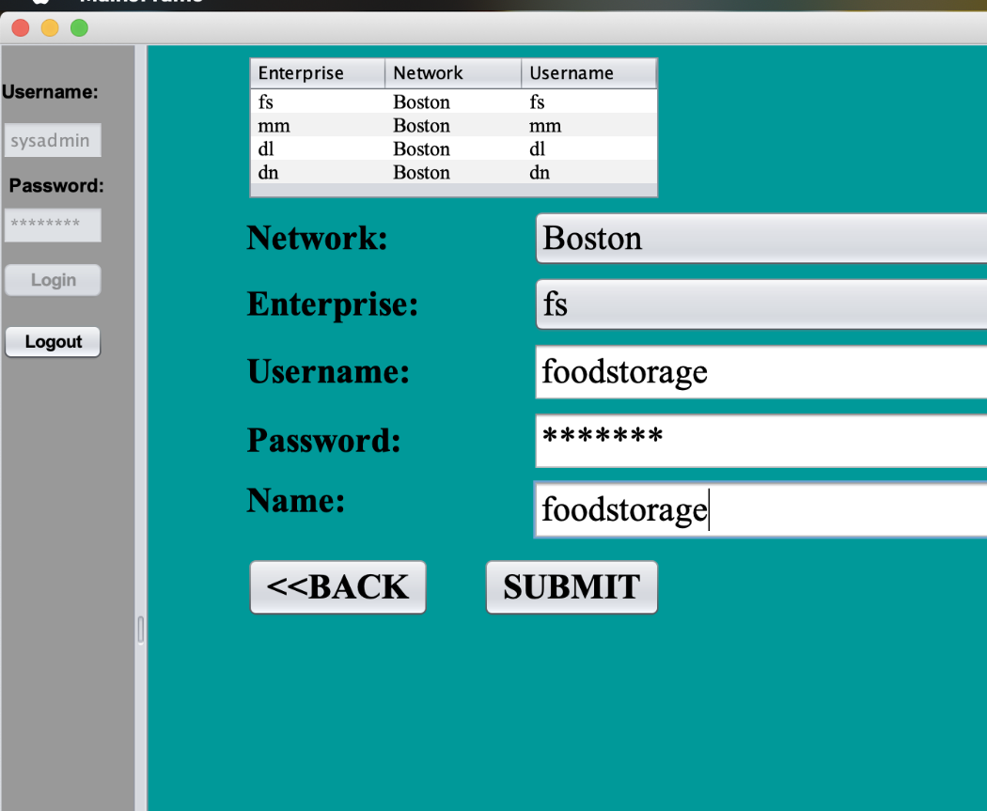
SCREENSHOTS

Slide 14
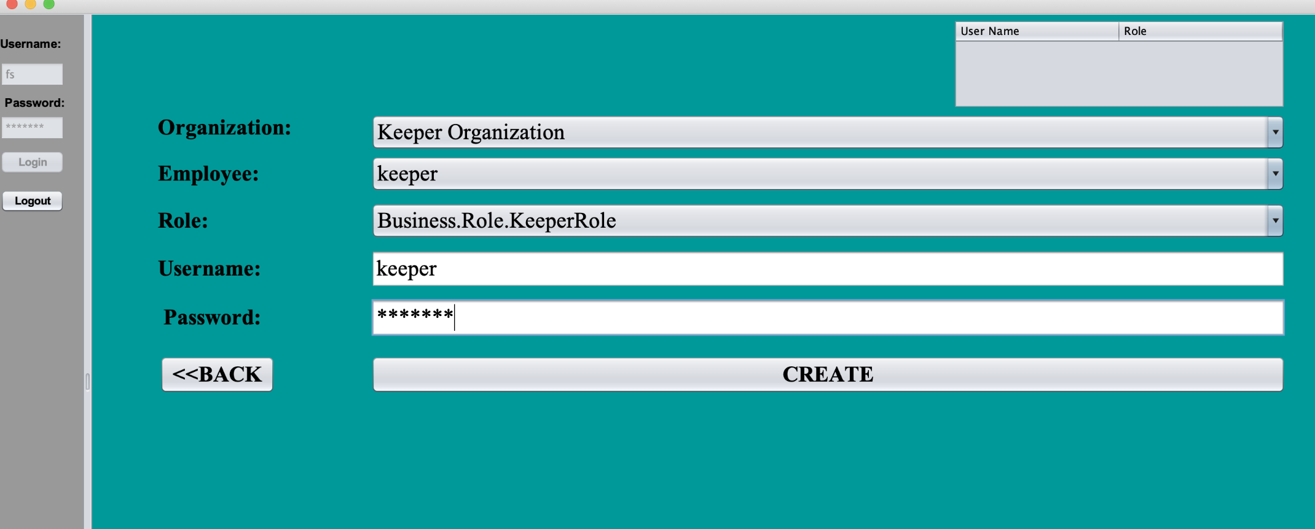
SCREENSHOTS

Slide 15
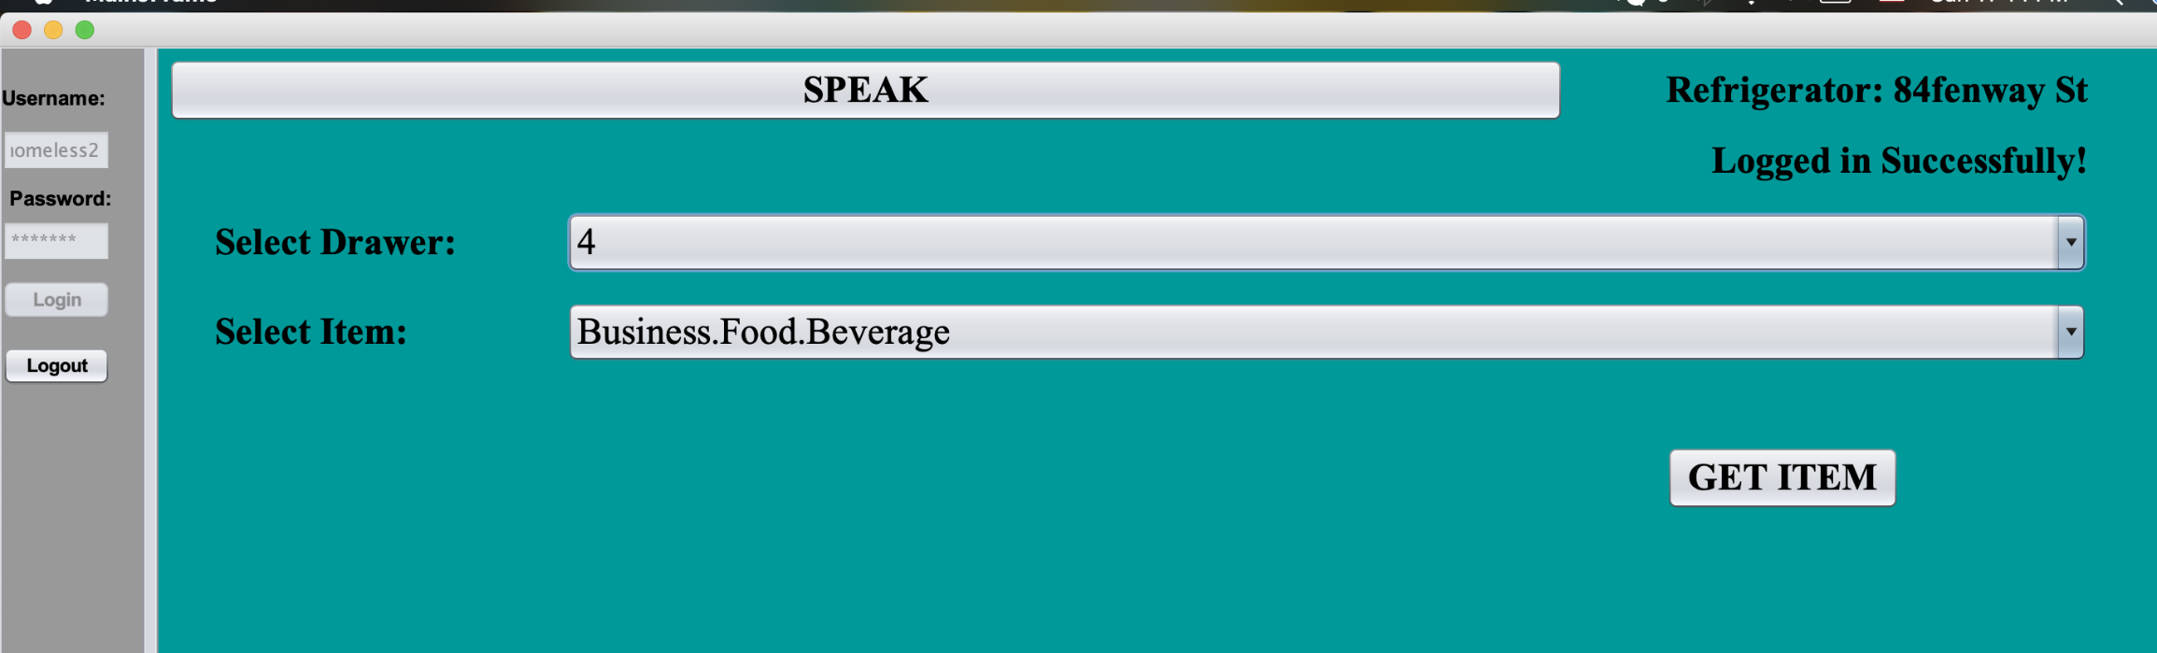
SCREENSHOTS

Slide 16
THANK YOU
Astha Sharma Lingyu Chen Zechuan Miao

