Slide 1
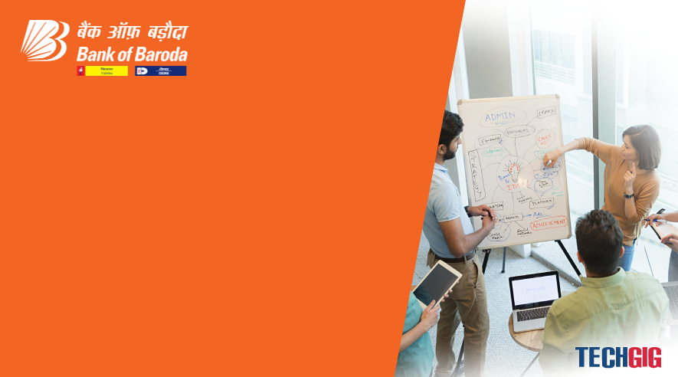

Bank of Baroda Hackathon - 2022
Technology Partner
Your Team Name : Terminal Stack
Your team bio : Explorers, Enthusiast and Emboldened
Date : 20/09/22

Slide 2
Problem Statement?
Why did you decide to solve this Problem statement?
As we all see that there is always a long queue in front of the bank counters. For each and every task, there is a specific section. Though some of the processes are done online but the customers always want the security of their possesions. Sometimes its very difficult for the employees to handle the crowd while the crowd also gets impatient because of the delayed workflow. Not every work requires the customers to stand in that exhausting queue. While the elderly suffer the most, the younger ones have to give up upon their work just to do a mere signature, etc. which could have been done digitally.
This gives rise to the immediate need of some companion which can guide the customers throughout their journey of undergoing bank processess while maintaining the accuracy of data as record by the bank itself and creating the engaging user experience. What else could be more relieving and exciting than doing all these work in a virtual environment along with one’s issues getting resolved at the same time.

Slide 3
User Segment & Pain Points
Which user /advertiser segment would be early adopter of your product & why?
Youth
Adults
Banks
Online payment apps/companies
Insurance companies

Slide 4
Pre-Requisite
What are the alternatives/competitive products for the problem you are solving?
According to the stats we have analysed, there is no such direct competitor in India with no such a system at present. With a billion dollar growing market of the virtual world, our product would definetly be an asset contributing to the economy. While this engaging world will boost the economy, it will also be eco-friendlyproduct. It will not only lower the usage of paper in the banks but also save the precious time of the customers.

Slide 5
Azure tools or resources
Azure tools or resources which are likely to be used by you for the prototype, if your idea gets selected. 1) Microsoft Azure AI Fundamentals 2) Microsoft Azure AI Fundamentals- Machine Learning 3) Microsoft Azure AI Fundamentals- Natural Language Processing 4) Speech-to-text REST API v3.0

Slide 6
Any Supporting Functional Documents
Present your solution, talk about methodology, architecture & scalability
Solution
We intend to solve this problem by developing an engaging virtual environment for the customers to solve their queries and reduce unnecessary paperwork at the counters. Hence, presenting our app- Saarthi that will guide the customers about the processes of the bank like opening of the account, KYC, etc. through VR experience by creating a virtual avatar and maintaining the accurate record accessible by the Bank.
Methodology
The UI will contain different modules according to the work process of the Bank.
Before entering the modules, the users can make their own Avatars to have the true to life experience.
Customers can keep a track of their activities on the Dashboard of Saarthi.
The Avatars will be multilingual for the comfort of the user.

Slide 7
Scalability
Saarthi is a unique app that is not available at present in the Indian Market.
Banks are available pan India which will add a brownie point to our Product in the process of making it Scalable.
Customers need an assistant for managing their work in Banks at the comfort of their place.

Slide 8
Key Differentiators & Adoption Plan
How is your solution better than alternatives and how do you plan to build adoption?
There is no such direct alternative or product existing in the Indian market. The concept has to be unique and feasible for which we have worked on this quirky solution of creating such a flexible environment for the customers, engaging them throughout the whole process and while guiding them with their activities by maintaining a proper and accurate record.
Adoption
We will sell our product directly to the Banks using a B2B business model.
There will always be an upgradation of the features of Saarthi according to the requirements of the Bank.

Slide 9
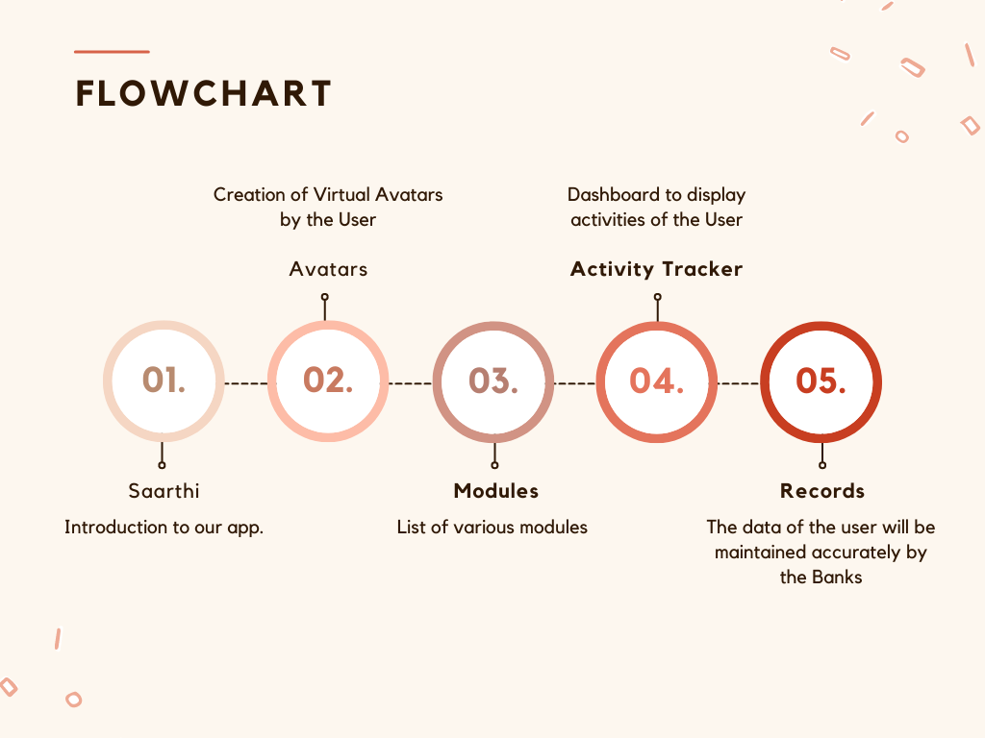
GitHub Repository Link & supporting diagrams, screenshots, if any
How far it can go?
https://github.com/AsthaVarshney99/BankOfBaroda

Slide 10
Thank You
Team member names
Astha Varshney
Vidushi Pandey
Anany Tiwari
Anvansh Singh

