Slide 1


Analysis of Covid-19 data using Machine learning
Megha Sajwan 05690302018
Astha Jain 01990302018
BCA M1

Slide 2
INTRODUCTION
Our society is in the era of unbelievable attempts to struggle upon the spread of this life-threatening condition in terms of infrastructure, finance, business, manufacturing, and several other resources. Artificial Intelligence (AI) researchers strengthen their proficiency in developing mathematical paradigms for investigating this pandemic using nationwide distributed data. This project intends to apply the machine learning models simultaneously with the forecast of expected reach ability of the COVID-19 over the nations by using the real-time data.

Slide 3
OBJECTIVE
In this project, we will analyze the outbreak of coronavirus around different regions of India, visualize them using charts and graphs, and predict the number of cases. Using Linear Regression Model and Support Vector Machine using python. We’ll use machine learning algorithms to make prediction on such sensitive issues, we will certainly cover the current scenario and the impact it has created in India.
Importing COVID19 dataset and preparing it for the analysis by dropping columns and aggregating rows.
Deciding on and calculating a good measure for our analysis.
Merging two datasets into one datasets and finding correlations among our data.
Visualizing our analysis results using Seaborn.

Slide 4
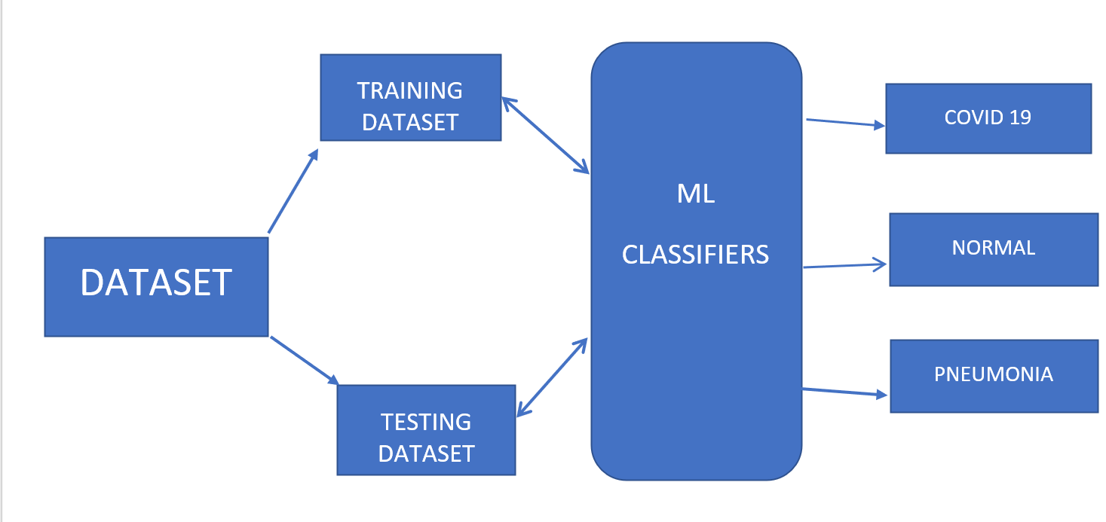
BLOCK DIAGRAM

Slide 5
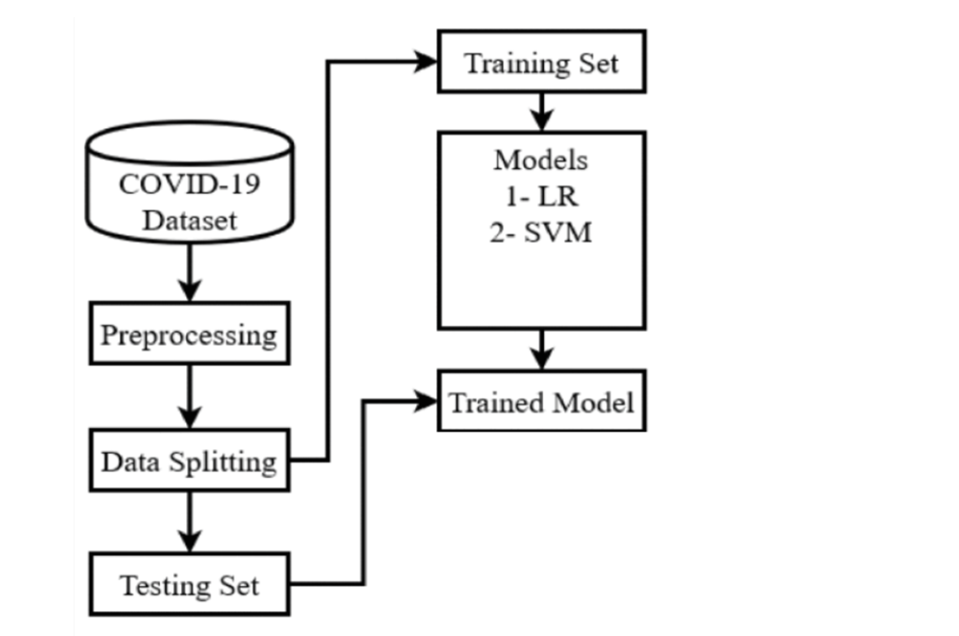
DFD Data Flow DIAGRAM

Slide 6
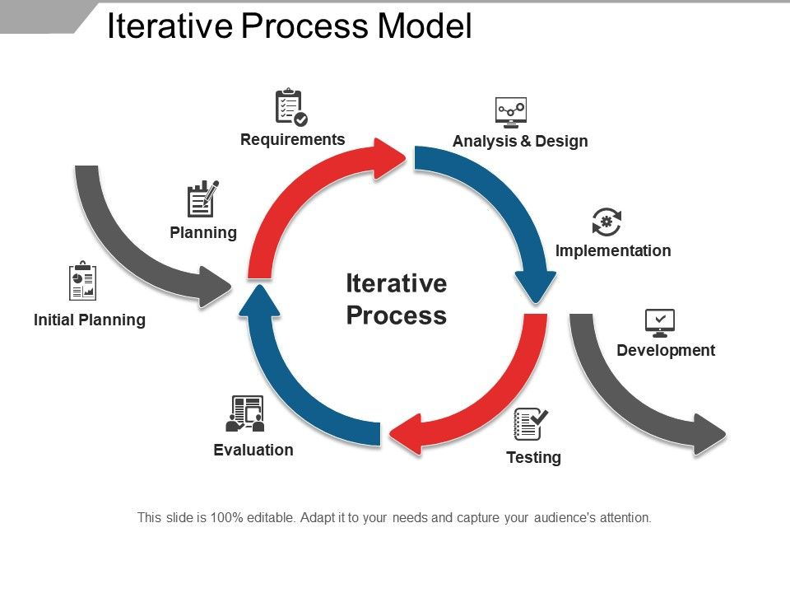
METHODOLOGY
Iterative Process Model
The Iterative model is repetition incarnate. Instead of starting with fully known requirements, you implement a set of software requirements, then test, evaluate and pinpoint further requirements. A new version of the software is produced with each phase, or iteration. Rinse and repeat until the complete system is ready. This model gives you a working version early in the process and makes it less expensive to implement changes.
Steps used in this project are:
Requirement: check for dataset
Analysis & Design: Analysis dataset of confirmed, death and active
cases using sum function. And design graphs for analysis.
Implementation: Using seaborn graphs are made and then check for
accuracy.
Testing: then the accuracy of predictions are confirmed

Slide 7
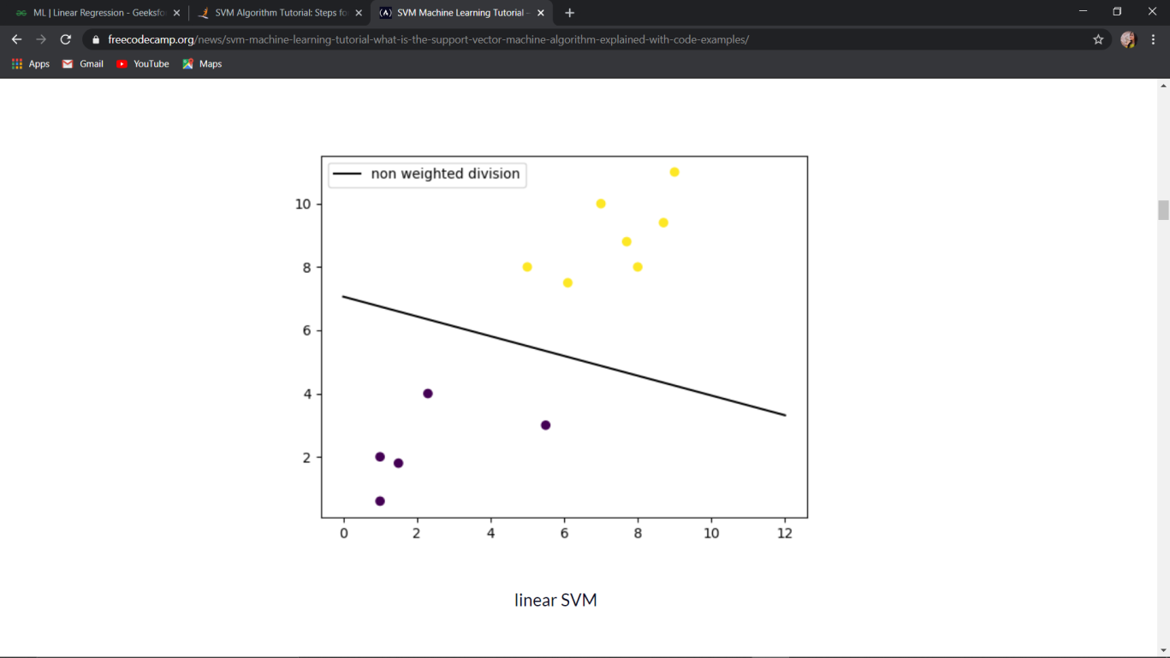
Algorithm
Support Vector Machines (SVM)
Support vector machines are a set of supervised learning methods used for classification, regression, and outlier’s detection. All of these are common tasks in machine learning.
A simple linear SVM classifier works by making a straight line between two classes. That means all of the data points on one side of the line will represent a category and the data points on the other side of the line will be put into a different category. This means there can be an infinite number of lines to choose from, that it chooses the best line to classify your data points. It chooses the line that separates the data and is the furthest away from the closet data points as possible.

Slide 8
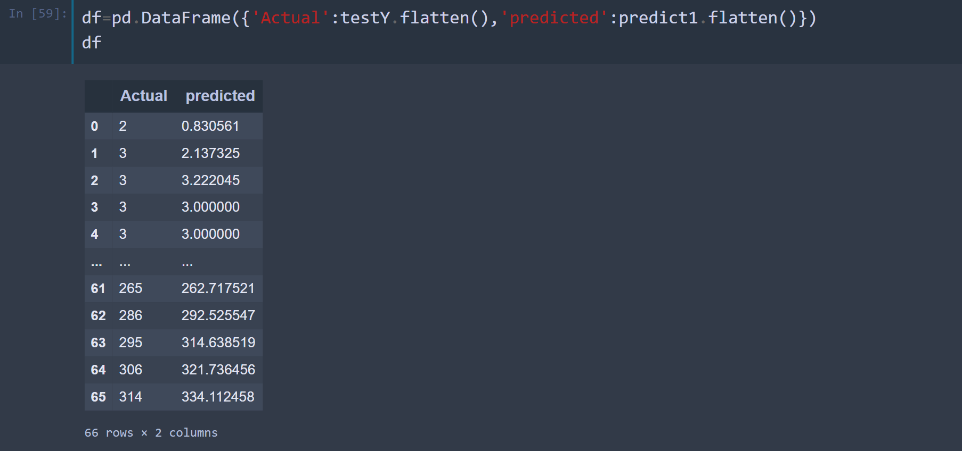
OUTPUT

Slide 9
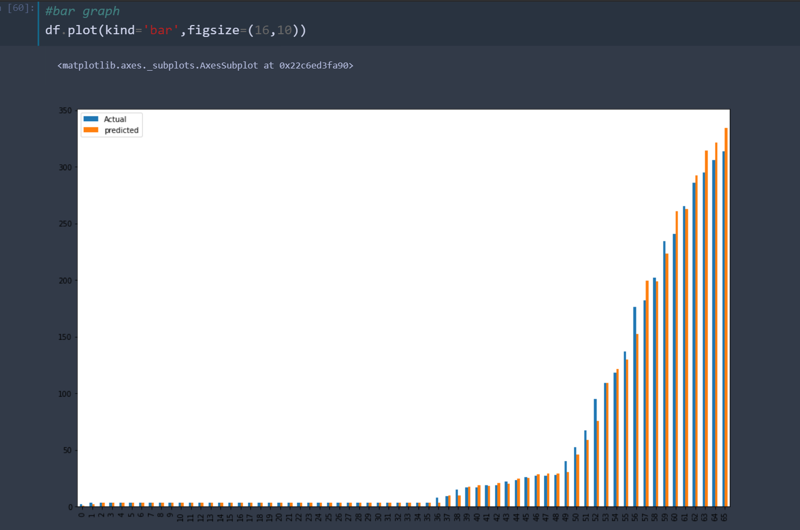
OUTPUT

Slide 10
TOOLS & PLATFORM
Software Requirement Specifications
Operating system - Windows (7/8/10)
Visual Code editor/ Pycharm
Jupyter Notebook
Hardware Requirement Specifications
4 GB RAM
VGA monitor
Intel 3.0 GHz or higher processor
Keyboard and mouse

Slide 11
DATASET COLLECTION
SECONDARY SOURCES :
Covid-19 data of India which confirms the active cases, number of death, and confirmed cases.
India state and population, which describes the sate wise adhere assigned and the land.
Personal details in which traveling details and personal details are mentioned.

Slide 12
FUTURE SCOPE
Currently, the data being labeled by humans, has a lot of uncertainty, and it’s hard to achieve good accuracy and we’re using ML and in the future, we’ll predict the 10 days data and we could apply django for more enhancement and could use it as a dashboard application for all the recent updates for a large amount of data overall world and could use the data for a comparison for further analysis. This project could be enhanced to some future predictions based on previous data using deep learning.

Slide 13
ADVANTAGES
Open-source,
Can be replicated,
Interactive, and
Can adjust the defaults

Slide 14
LIMITATIONS
The models predicting infection rates, total mortality, and intensive care capacity are simpler constructs. They are adjusted when the conditions on the ground materially change, such as when states reopen; otherwise, they remain static. The problem with such an approach lies partly in the complexity of COVID-19’s different variables. These variables mean the results of typical COVID-19 projections do not have linear relationships with the inputs used to create them. AI comes into play here, due to its ability to ignore assumptions about the ways the predictors building the models might assist or ultimately influence the prediction.

Slide 15
REFERENCES
www.google.com
www.kaggle.com
www.simplelearn.com
www.greeksforgreeks
www.github.com

