Slide 1
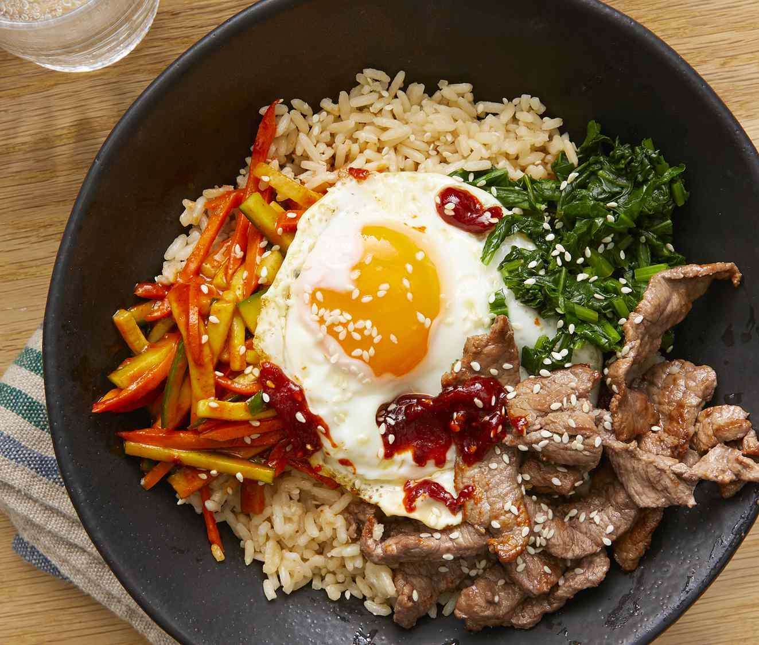
ONLINE FOOD ORDERING SYSTEM
A modern solution for Smooth restaurant operation

Slide 2
Table of Contents
﻿﻿Introduction
Background
Problem Statement
Methodology
Experiments
Discussion
Conclusion

Slide 3
Introduction
Online food ordering is rapidly growing
Project: Create responsive food order website
Supports search, order, and payment
Separate admin and user interface
Built with HTML, CSS, JavaScript
Backend: Node.js and Express
Database executed for persistent storage

Slide 4
Background
Slow and manual traditional orders
Direct solution for small businesses.
Common errors in phone-based orders
High Commissions charged by Delivery apps
﻿﻿Web-based tools increase efficiency
Enhance user control and experience
Improve profit with in-house system

Slide 5
Problem Statement
﻿﻿Loss of control using third-party apps
Hard to track customer preferences
Need for user-friendly online solution
Easy and User-friendly ordering and payment for clients
Order and menu control for the admin
Goal: Build all-in-one food platform

Slide 6
Methodology
Agile Methodology
﻿﻿Iterative development with regular stakeholder feedback.
﻿﻿Focus on meeting customer and administrator needs.
﻿﻿Step-by-step development plan includes design, testing, and deployment.
﻿﻿Ensures adaptability and continuous improvement.

Slide 7
Experiments:
Implemented real-time item search
Cart updated instantly with JavaScript
Payment handled via API
Admin panel for full CRUD control
﻿﻿Orders stored in the database
Authentication used for protected routes
Responsive design passed multiple tests

Slide 8
Discussion
﻿﻿﻿﻿Customers: Browse, search, order items, and view order history.
Admins: Manage stocks, track sales, generate reports.
﻿﻿User-friendly interface for seamless interactions.
﻿﻿Secure payment and data management systems.
Future: Add reviews and tracking

Slide 9
Conclusion
Towards a Modern Food Ordering Experience
Responsive system meets user needs.
Custom control for both ﻿﻿restaurant owners and customers.
Improves restaurant operations and reach.
﻿﻿Leverages modern technology for efficiency and security.
﻿﻿Addresses all functional, non-functional, and usability requirements.
﻿﻿Sets the foundation for future growth and enhancement.

