Slide 1

AI Agent Based Development
Slides template credit to Marco Gasparri
Week 1

Slide 2
Project Alfred: presentation
Goal: We want AI to become a regular part of how R&D teams work every day. Teams should be encouraged to explore and use AI in their own workflows, while leadership provides the support, tools, and guidance needed as AI technology continues to evolve.
Special Note: I’m not an AI expert or genius — I’ve simply followed Alfred’s training sessions and applied AI practically in my day-to-day development work. I’ll share the key topics and learnings that helped me, and we can discuss and learn together.

Slide 3

Project Alfred: presentation
Week 1: Foundations & The "Pilot" Mindset
  Objective: LLMs, Context Windows, and Effective Prompting.
Week 2: Test-Driven AI Development (TDAI) & Context driven AI Development (CDAI)
  Objective: using AI to bridge the gap between "code that works" and "code that is robust."
Week 3: Agentic Workflows & System Architecture
  Objective: moving beyond single-file edits to multi-file, complex system changes.
  Objective: use advanced features of Claude to maximize the context window for fastest results at the lowest cost.
Week 4: Security, Ethics, and Human-in-the-Loop
  Objective: ensuring AI productivity doesn't introduce legal or security liabilities.

Slide 4
Project Alfred: presentation
Java class repository:
https://github.com/LakshithaD/ai-excercise
The repository contains:
  additional materials for each week (deep-dive docs, original docs used to extract information for the presentations, eventual videos, etc.)
  exercises for each week
  any resource that could be useful for the class

Slide 5
Introduction

Slide 6
Where are you with the AI?
Do you already use AI in your daily activities?
What kind of AI?
What kind of tasks do you usually demand to the AI?
Do you have typical workflows using AI?
What do you expect to analyze during the 5 weeks?
[IMPORTANT] Do you all have been provided with Claude Code access?

Slide 7
Week 1 - Overview
Week 1: Foundations & The "Pilot" Mindset
Objective: Mastering the art of context and moving away from "magic box" expectations.
The Physics (concepts) of LLMs. Understanding tokens, context windows, and non-deterministic output. Why does the same prompt give different results?
Context-Driven Prompting. Learning the CO-STAR framework (Context, Objective, Style, Tone, Audience, Response).
IDE Deep Dive. Configuring Claude.md to enforce project-specific linting and architectural patterns.
The Week 1 Challenge. Refactor one "messy" function using AI by providing it with the original code plus your team’s style guide.

Slide 8
LLMs Overview

Slide 9
A step back: ML
Machine Learning: subset of artificial intelligence (AI) that enables computer systems to learn, improve, and identify patterns from data without being explicitly programmed
ML is good at:
  Learns patterns from data
  Identifies relationships
  Predicts outcomes
  Makes decisions with minimal human intervention
Notes:
ML leans patterns and relationships based on the data we used for training. Basically knowledge. This knowledge is used to produce output for the input

Slide 10
ML: complementary perspectives
Pattern Matching
Machine Learning
Reflection: distilled patterns from training data
Prediction: uses past patterns to infer new outputs

Slide 11
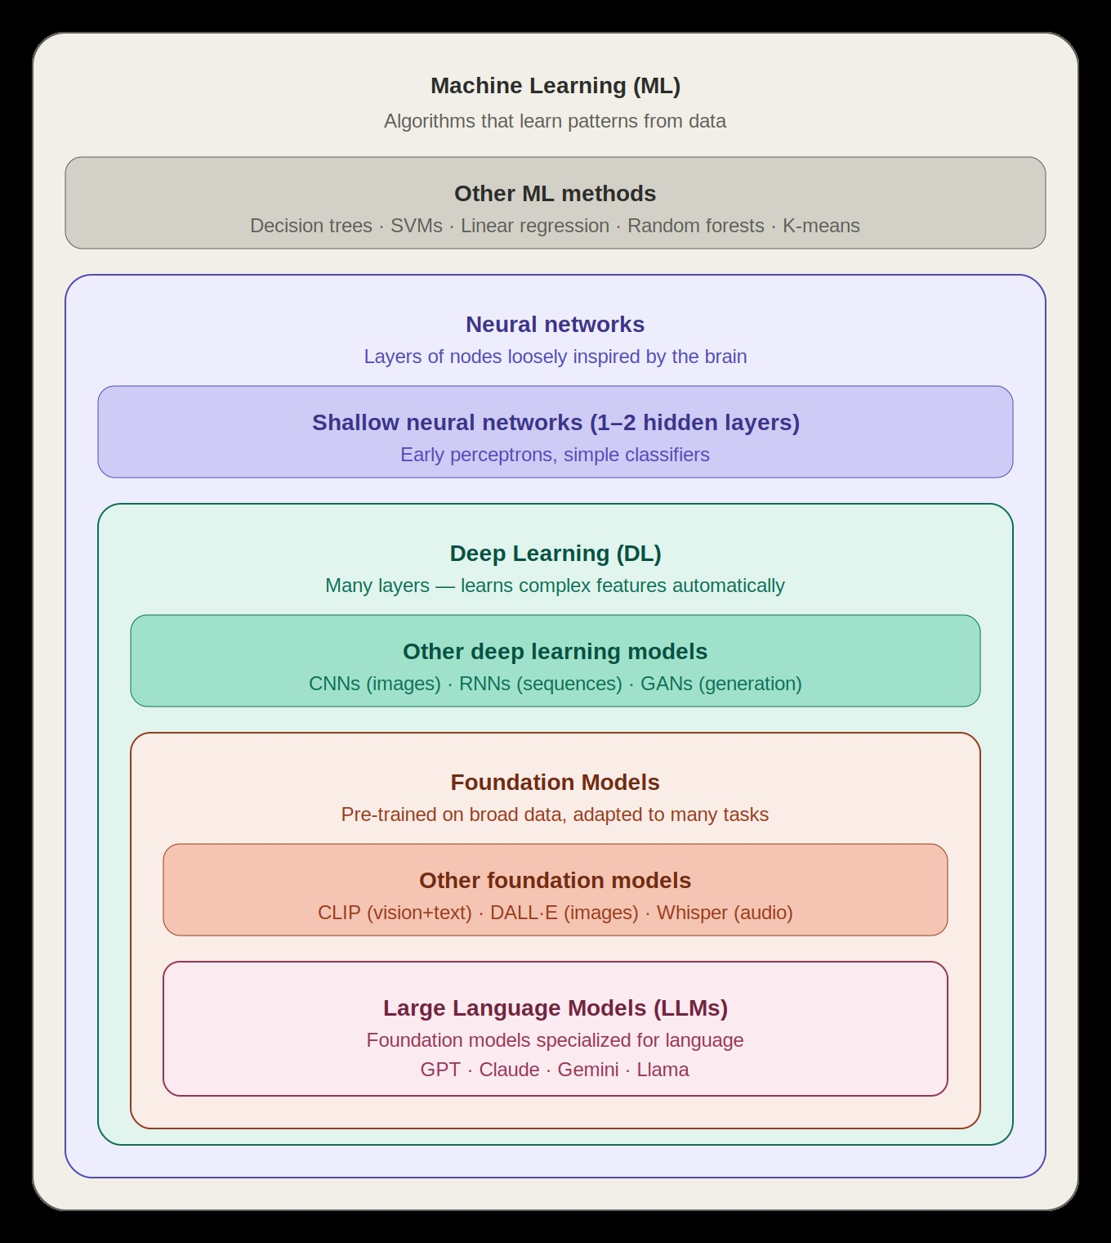
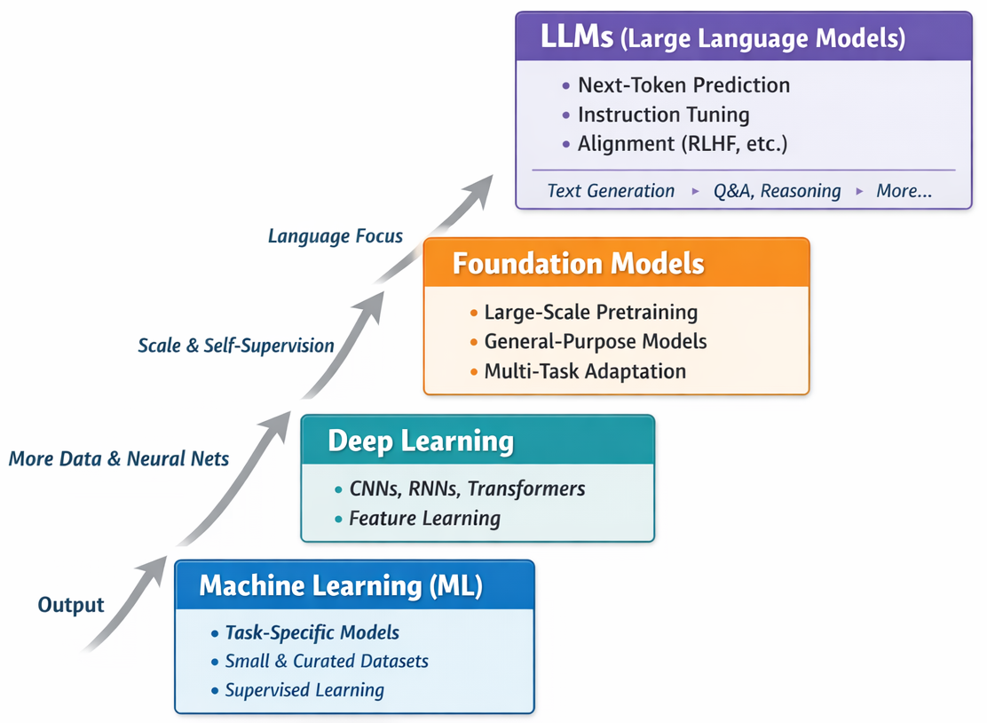
From ML to LLMs
Notes:
ML - trained for specific taks
Neural

Slide 12
LLMs
AI systems trained on massive amounts of text (docs, books, code, web, etc.)
Understand and generate human-like text
Core capabilities:
  Summaries
  Code generation
  Text rewriting
  Q&A
  Reasoning

Slide 13
LLM: training and prompting
Querying (prompting)
LLM
Information for training + tuning
Answer
Massive dataset of text/book/articles…
Learns patterns and relationships between words and concepts
Public and private data
Fine tuned for specific tasks and behaviors

Slide 14
LLM: local vs remote
 | Pros | Cons
Local | Security, control, ownership, free | Infrastructure and hardware requirements, maintenance
Remote | “Pay as you go” model | Security, data training accuracy, costs, Internet access

Slide 15
What LLMs are good at
Natural Language Understanding
  Comprehend complex instructions and queries
  Extract meaning from ambiguous text
Content Generation
  Write essays, reports, code, emails, texts summaries
  Adapt their style and tone to diﬀerent styles, as requested
Knowledge Access
  Answer questions on a wide range of topics → internal knowledge and/or web search*
  Recall information from training data
Problem Solving
  Follow logical steps to solve problems → Chain of Thought
  Reason through multi-step processes

Slide 16
Limitations of LLMs (1) verbose
Knowledge Cutoffs
  Every LLM has a cutoff date based on the end of its training process, meaning the information retrieved from it is limited to what it knows.
Temporary Web Search Information
  Although an LLM can perform a "deep search" or access the web for current information, that knowledge is usually only for the current session and is not permanently remembered by the LLM. LLMs are "read-only".
Unreliable Web Search Information
  Web search results, while potentially very useful, have a potential for biased data, and LLMs do not have an easy way to distinguish the correctness of that information.
Hallucinations
  LLMs can generate plausible but incorrect information, or be confidently wrong without indicating it. This is due to their underlying core pattern, the Transformer model, which is a predictive model that generates text based on previous text.

Slide 17
Limitations of LLMs (2)
Limited Context Window
  Every conversation happens within a context window, and its size is limited. An LLM can only process a limited amount of text.
  Degraded output quality: the quality of the responses degrades as the context window becomes more occupied. It is recommended to start a new session when the context window reaches about 40%-50% of its size to prevent output quality degradation.
  Forgetting details: an LLM might forget details from earlier in the conversation because the context window acts like a sliding window.
  Evolving size: the size of the context window is evolving for some models; for instance, Opus has evolved from 200,000 towards 1 million tokens. Gemini 2.5 and 3 are thought to have a 1 million token context window. However, this larger size means it can remember more, not that it can focus equally well with the same performance.
Limited Reasoning
  LLMs struggle with some complex math and logical puzzles. They mostly rely on correlations and lack a true understanding of cause and effect.

Slide 18
Reasoning models
How they work:
  Step-by-step analysis (‘Chain of Thought’) → the models are designed to self-reflect
  They use search, code & math tools, then aggregate the results in the response
  Bigger context windows (100 K+ tokens) → read docs & multi-file codebases in a single prompt
Flagship models:
  OpenAI – GPT‑5.2 (flagship GPT series): most advanced general‑purpose GPT model for professional work and agents.
  Google – Gemini 3.1 Pro (Gemini 3 Deep Think line): latest top‑end Gemini model; described as a step forward in core reasoning.​
  Anthropic – Claude Opus 4.6: current largest Claude “Opus” model; positioned as Anthropic’s flagship for coding, long‑running tasks, and high‑end enterprise use.
  DeepSeek – DeepSeek‑R1 671B: main flagship reasoning model; 671B‑parameter MoE, described as DeepSeek’s top reasoning model.
  Meta – Llama 4 Maverick (Llama‑4 family): Meta’s current Llama‑4 flagship.

Slide 19
Context Window
and Prompt Engineering

Slide 20
Key concepts
Prompt Engineering: iterative process of designing, refining, and optimizing text-based inputs (prompts) to guide generative AI models, such as LLMs, to produce accurate, relevant, and high-quality outputs.
Token: the fundamental units of text (words, subwords, or characters) that LLMs use to process and generate language. The number of tokens influences the cost of using LLMs.
Context Window: the maximum amount of information (measured in tokens) that a model can process, "remember", and consider simultaneously during a single interaction. It’s like the memory of the LLM.
Non-determinism: the same prompt can, and most likely will, yield different results.
Stateless: each session is independent, especially for API access.
Loss of Focus: LLMs can lose their focus during a conversation, meaning they might partially shift their focus from the initial request.
Context Rot: the pattern of lower quality outputs in longer conversations. Most models lose approximately 20% to 40% of their accuracy at about 50% of their context limit.
Notes:
Best to use engliush since optimized utilization of token

Slide 21
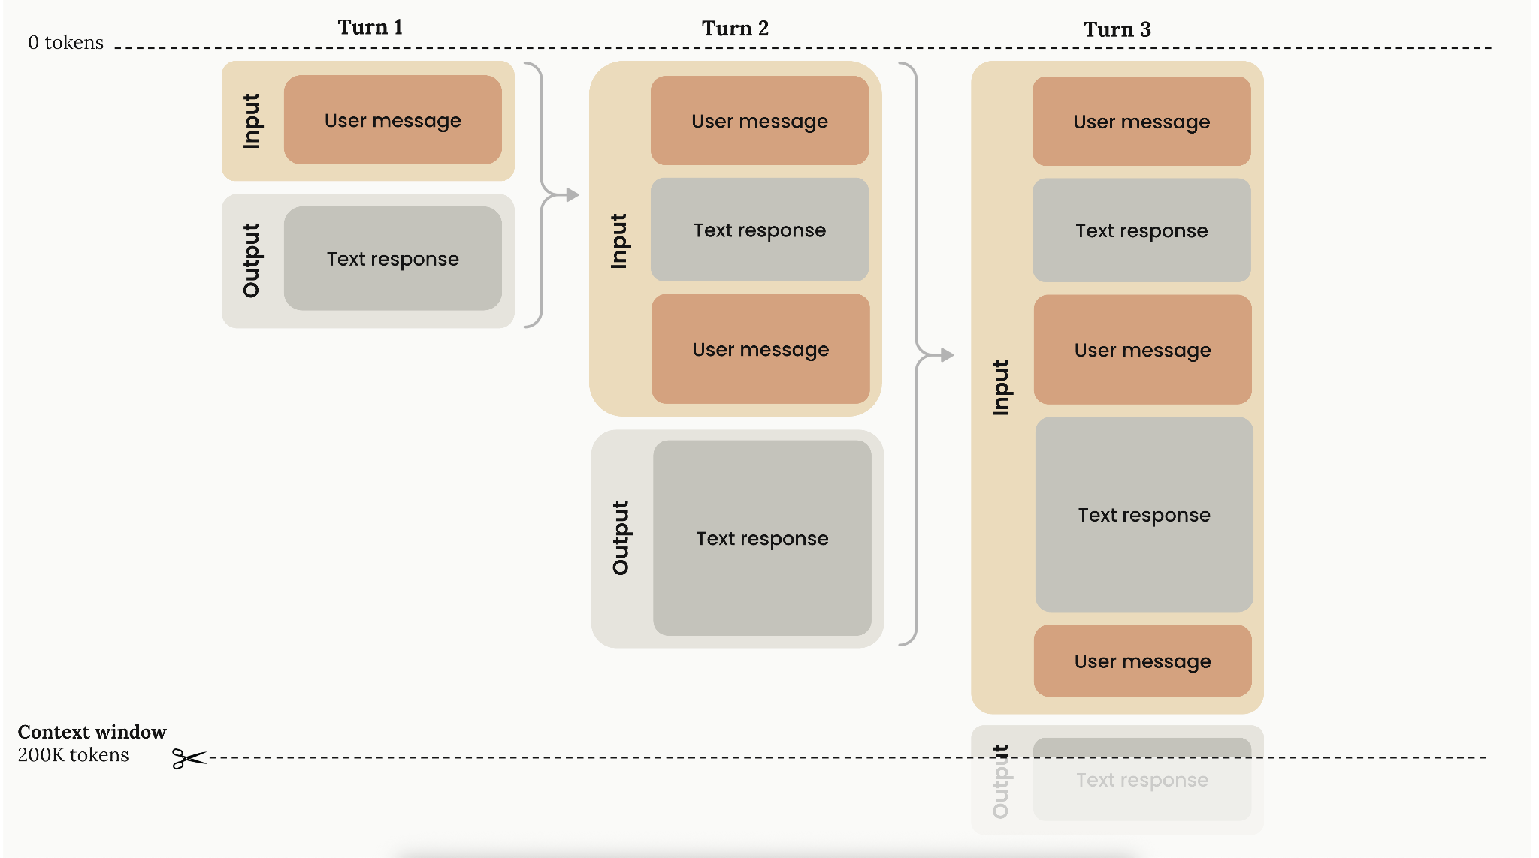
Context Window Overview (Anthropic)
Notes:
Summarize at 80%. We must do summarize at 50% with guide line

Slide 22
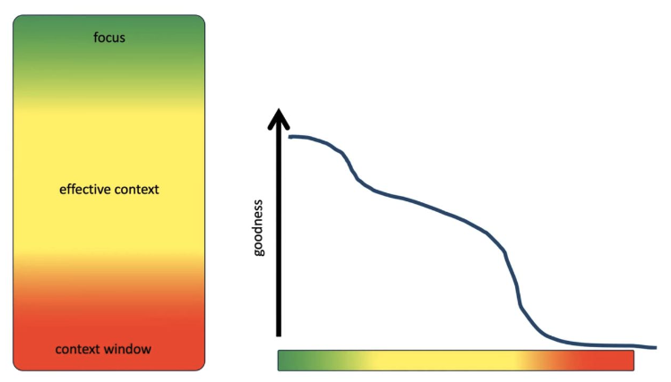
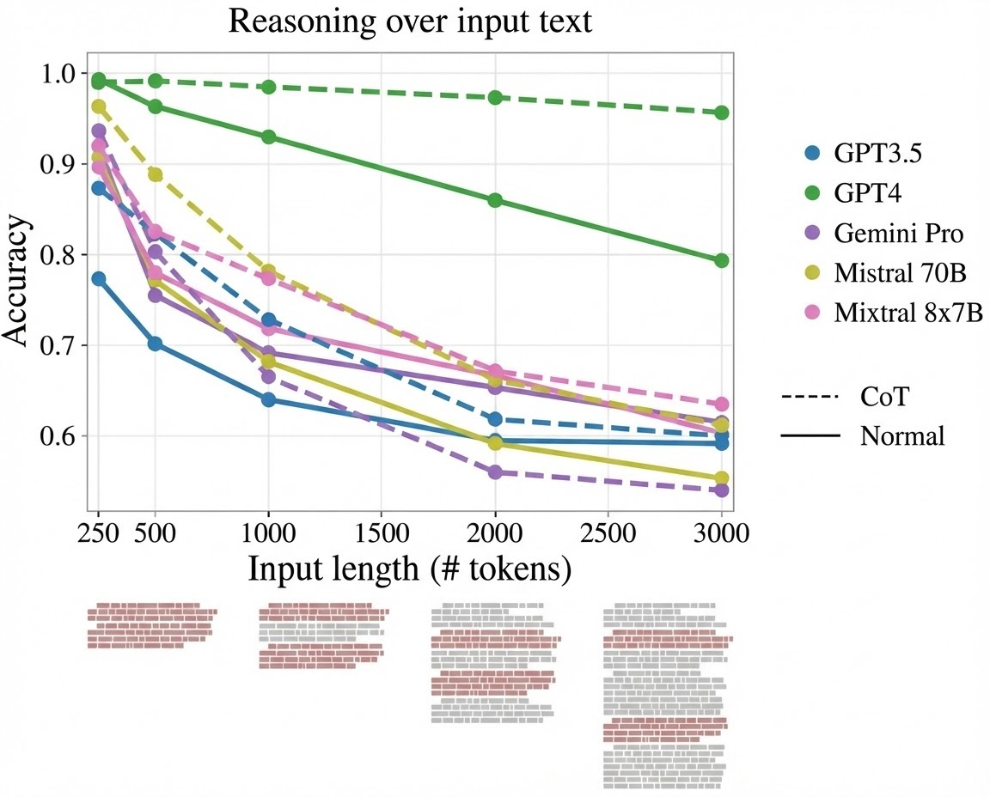
Context Degradation
The Problem
  Performance drops significantly, as the context window fills
  Longer conversations → lower quality outputs
  Information from early in conversation may be "forgotten”
Research Data
  Most models lose ~20-40% accuracy at ~50% context capacity → Context Rot
  LLMs performance is improved in newer versions, but still degrades
Development Impact
  ❌: Long debugging session → AI may (partially) forget the initial error context
  ✅: Generate a summary at ~40-50%, start a fresh conversation from the summary

Slide 23
Context Management and Workflows
Mid-Conversation Summarization
  At ~50% of the context window, ask the LLM to produce a structured summary of the conversation so far. Then start a new session feeding the summary as initial context. This preserves intent and decisions while freeing up token space.
  "We're approaching the context window limit. Create a Markdown file and/or a Mermaid diagram with a thorough description of our key discussion points & decisions The file(s) must be reviewable by a <role>"
Sliding Window with Anchoring
  Keep the system prompt and the last N exchanges, drop the middle. This preserves your instructions and recent context while sacrificing older turns.
Hierarchical Context
  Separate "always present" context (role, rules, key facts) from "ephemeral" context (current task details). Only inject what's relevant to the current step.
Chunking for Long Documents
  Split large inputs into chunks, process each independently, then merge results. Map-reduce pattern: summarize parts, then summarize summaries.
Rule of thumb: if you're copy-pasting your entire conversation back into the prompt, you're doing it wrong.

Slide 24
Workflow example
Write the initial prompt (feature, refactoring etc), in a text editor. Optimize it
Send the optimized prompt, ask the AI to:
  Act as the desired role
  Ask all the clarifying questions, before answering
Answer the questions, ask the LLM to:
  Review the answers
  Ask any remaining questions, before answering
Repeat #3, at least 2-3 times
When the Context Window approaches ~40-50%:
  Request a Markdown / Mermaid file with the discussion summary, to be continued in a new session
  Start a new session, with the Markdown / Mermaid file as the input
Commit the end result, create/update the PR, review it/ask an AI to review it

Slide 25
Exercise 1
week-01/exercise-1

Slide 26
Effective Prompt Anatomy
CO-STAR is a mnemonic to build effective prompts systematically:
C - Context [+ Role]: background information the model needs. "We are migrating a monolith to microservices on AWS."
O - Objective [+ Constraints]: what you want the model to do. "Generate a migration plan for the payment service."
S - Style: the voice or approach. "Write as a senior solutions architect."
T - Tone: the emotional register. "Professional but pragmatic, no buzzwords."
A - Audience: who will read the output. "The audience is backend engineers with no cloud experience."
R - Response format [ + Examples]: How you want the output structured. Consider here that the LLMs are useful verbose “by default”. "Return a numbered checklist with estimated effort per item."
Why it works: most bad prompts are missing one or more of these elements. CO-STAR forces you to be explicit about what the model can't infer on its own. You don't need all six every time, but when results are poor, check which letter you forgot.

Slide 27
Effective Prompt Anatomy - Examples
Example (bad): “Review this code, provide recommendations”
Example (good): “You are a senior architect, expert in Java, TypeScript and Python distributed services. Review for the developer this REST endpoint for security vulnerabilities (especially injection attacks), performance bottlenecks, code maintainability issues, best practices violations. For each issue present: Severity (Critical/High/Medium/Low), Risk explanations and Recommended fix (with code example). Output format: Markdown table.
Role and context
Objective
Audience
Response

Slide 28
Exercise 2
week-01/exercise-2

Slide 29
Prompt improvements
Chain of Thought (CoT)
  Ask the model to reason step-by-step before giving the final answer. Dramatically improves accuracy on math, logic, and multi-step problems. Useful for debugging multi-layered issues, for architecture decisions and for algorithms.
  Can help in reducing context degradation.
  Trigger it with: "Let's think step by step" or "Explain your reasoning before answering."

Slide 30
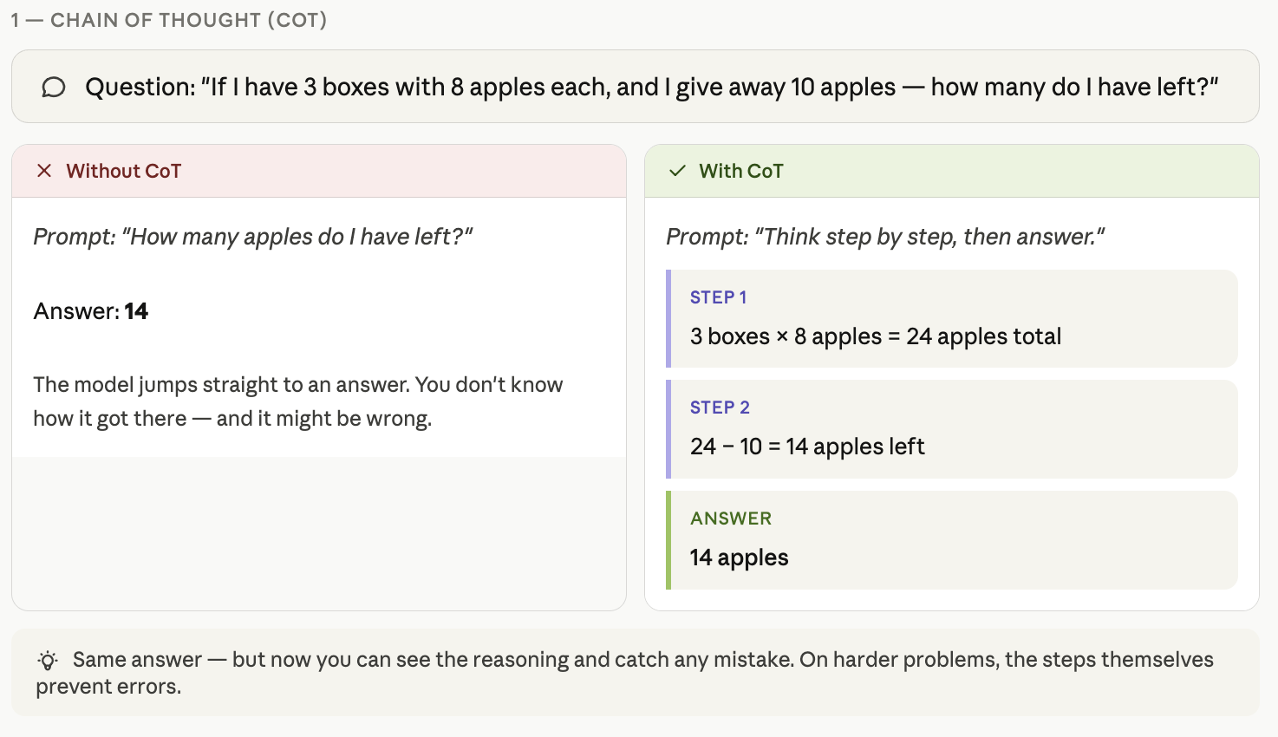
Prompt improvements

Slide 31
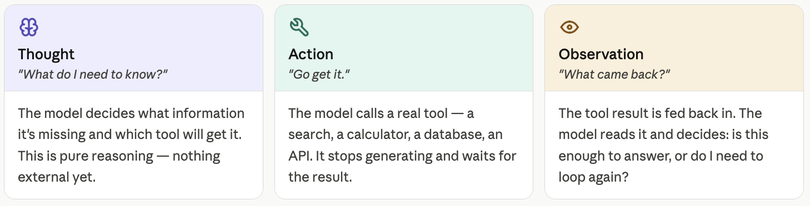
Prompt improvements
ReAct (Reason + Act)
  Combines reasoning with tool use. The model alternates between Thought ("I need to check the API docs to know the rate limit"), Action ("search: API rate limits"), and Observation ("The limit is 100 req/min"). This is the foundation of most AI agents today.

Slide 32
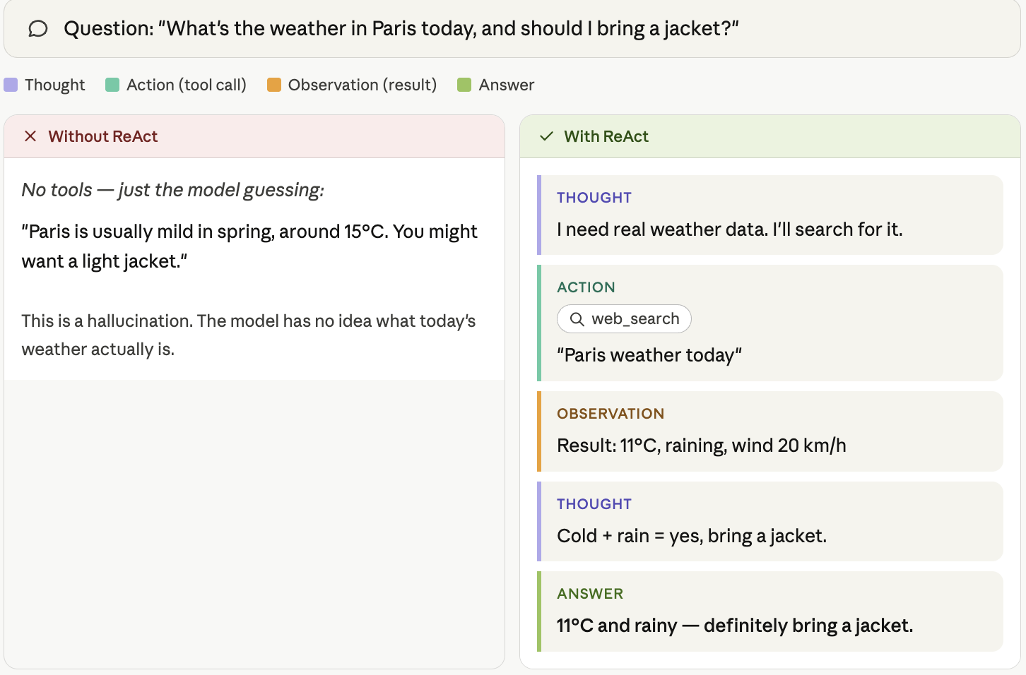
Prompt improvements

Slide 33
Prompt improvements
Ask the LLM to Ask You Questions
  Instead of trying to write the perfect prompt upfront, instruct the model: "Before starting, ask me clarifying questions about anything that's ambiguous." This flips the dynamic — the LLM helps you refine the task. Especially powerful for complex or underspecified tasks where you don't know what you don't know.
Key insight: these techniques work because LLMs don't "think" unless you explicitly create space for thinking in the output.

Slide 34
Divide & Conquer: larger changes (features and refactoring)
Use Research → Plan → Implement approach:
  Step 1 - ask the LLM to:
    Research the code for the changes needed to implement the feature / refactoring
    Ask all the clarifying questions, for ensuring the Mental Alignment
    Create a Markdown document with the research output → Work Unit 1
  Step 2 - ask the LLM to:
    Create an implementation plan document, from the research doc → n implementation phases
    Ask all the clarifying questions, for ensuring the Mental Alignment
    Create a Markdown document with the implementation phases plan output → Work Unit 2
MD
MD
MD
Research
Plan
Implement
Review
Review
n x Review

Slide 35
Divide & Conquer: larger changes (features and refactoring)
  Step 3 - for each created phase, ask the LLM to:
    Create the minimal series of implementation tasks, for the referenced phase → m implementation tasks + tests / TDD
    Ask all the clarifying questions, for ensuring the Mental Alignment
    Create a Markdown document with the task implementation plan output → Work Unit 3
  Example reference criteria:
    Implementable in < 1h / by the reviewer’s role (Developer / QA / DevOps / …)
    Max changed & created files: 3
Unit of work
Verification step
Unit of work
Verification step
Unit of work
Verification step
Project progress
Each Unit of Work could be split into task: review & commit each task; then create and update the PR, assign an AI reviewer

Slide 36
Exercise
STEP 1 — RESEARCH. "What are the key concepts I need to understand before creating a Java class? Explain in simple terms with a real-world analogy. Format your response in Markdown."
Then immediately follow with: "Save that research as a Markdown file called research.md"
STEP 2 — PLAN: "I want to create a Java class to represent a Student in a school system. What fields, constructors, and methods should it have? Format your response in Markdown with clear headings and a checklist." Then follow with: "Save that as plan.md"
STEP 3 — IMPLEMENT (referring back to the saved plan): "Read the plan in plan.md and implement the Java Student class exactly as planned. Follow every item in the checklist."

Slide 37
Exercise 0
week-01/exercise-0

Slide 38
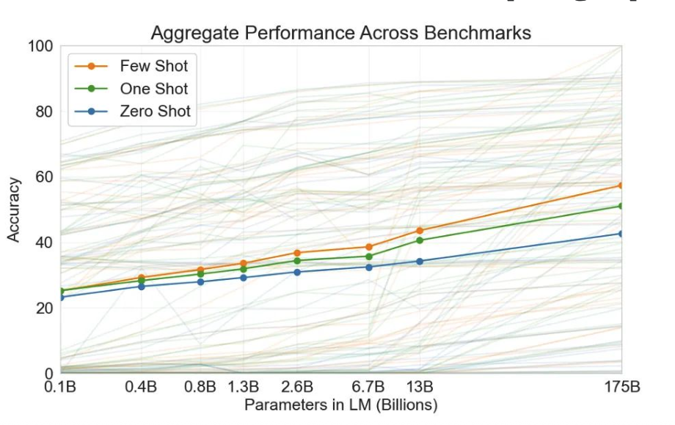
Provide the LLM with examples
Zero-Shot Prompting
  You give instructions only, no examples.
  Works for simple, well-defined tasks.
  Example: "Translate this sentence to French."
One-Shot Prompting
  You provide one input → output example before your actual request.
  Helps the model understand format and tone.
  Example: "Input: 'The server is down' → Output: 'SEV1 - Infrastructure - Immediate'. Now classify: 'Login button is misaligned'"
Few-Shot Prompting
  You provide 2-5 examples.
  Best for complex or ambiguous tasks where the pattern isn't obvious from instructions alone.
  The model “learns” the shape/format of your expected output.
When to use which?
  Start with zero-shot.
  If the output format or quality isn't right, add examples progressively.
  Few-shot is your best friend for classification, structured extraction, and consistent formatting.
  Example: “Ex. 1: function add(a, b) { return a + b; } - Doc: Adds two numbers and returns the sum. @param a - first nr, @param b - second nr
  Ex. 2: function multiply(x, y) { return x * y; } - Doc: Multiplies two numbers, returns the product. @param x - first nr, @param y - second nr
  Your task - document: function divide(num, den) { return num / den; }”

Slide 39
Final considerations
LLMs aren't psychic. If information is neither in training or in the prompt, then they don't know it.
LLMs are not aware of the nuances of your company and its work.
LLMs get distracted. Don't fill the prompt with lots of "just in case" information.
LLMs need documents that make sense. They prefer familiar text.
LLMs can do most any well-contained task involving text.

Slide 40
We have just started scratching the surface…
We focused on the interaction with LLM, mentioning also several points we will discuss during the next weeks.
Now, with a little more context, what are your expectations?

Slide 41
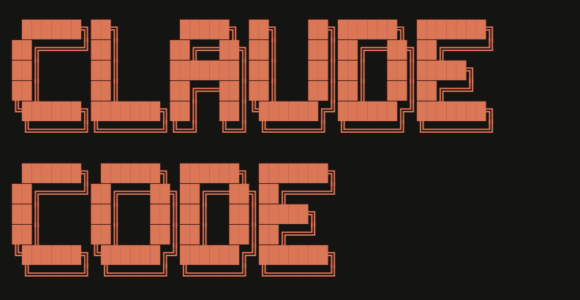
Claude Code

Slide 42
Claude Code: from Chatbot to Agent
LLM (the brain)
Loop (the workflow)
Tools (the hands)
Context (the memory)

Slide 43
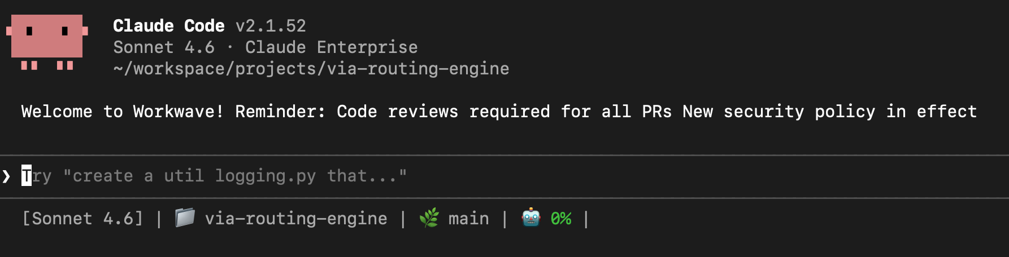
Claude Code CLI: overview

Slide 44
Useful (first) Claude Code commands
Command | Description
/clear | Reset context: the single most important command. Use between tasks.
/compact [+ details] | Manually trigger compaction when quality degrades
/context | Show context window usage breakdown
/model | Switch model
/resume | Resume a previous session
/rewind | Restore previous conversation and code state

Slide 45
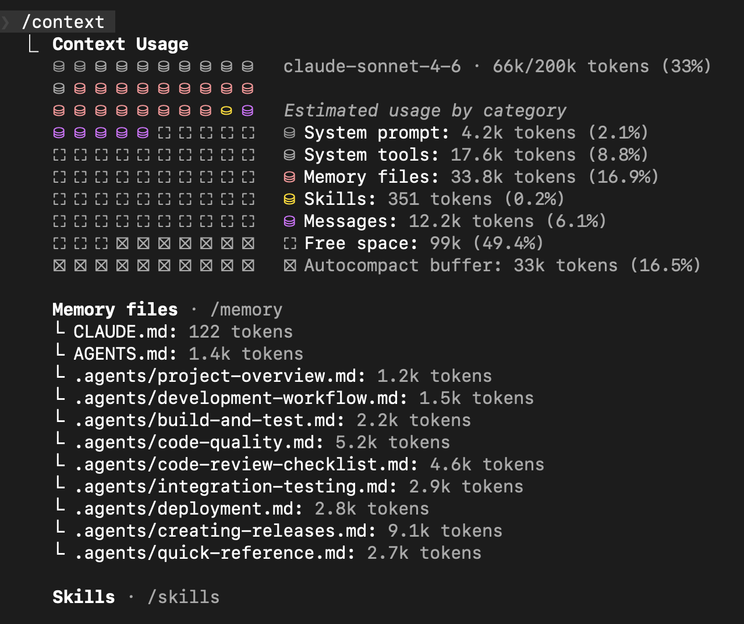
Claude Code CLI: context
Note:
Memory → Long Term (stored on fs)
Context → Short Term (conversation)

Slide 46
CLAUDE.md
Markdown file placed at the root of your project (or any other directory, it is recursively considered) that gives Claude Code persistent context.
Project overview & architecture
Coding conventions & style rules
Preferred libraries & frameworks
Testing & deployment instructions
Common commands & workflows
Do's and Don'ts for the codebase
Useful, but do not completely rely on it

Slide 47
Hands-on

