Slide 1


Customer Behaviour Analysis
A structured retail/e-commerce dataset used for customer behavior analysis and business decision-making for exploring purchase patterns, segmentation, and revenue optimization through Python EDA, SQL, and Power BI.

Slide 2
About the Dataset
This dataset provides a detailed look into retail e-commerce customer behavior, structured at the transaction level. It's designed for advanced analytics, helping to uncover purchasing patterns, demographic influences, and payment preferences.
Records
1
Approximately 5,000 unique transactions, representing a diverse customer base.
Key Features
2
Customer Demographics (Age, Location)
Purchase Details (Amount, Category, Previous Purchases)
Transaction Specifics (Payment Method, Season)
Data Types
3
Mix of numerical (integers, floats) for quantities and categorical (strings) for attributes, ensuring comprehensive analysis.

Slide 3




Why This Data Matters
High-Value Customers
Identify frequent buyers and one-time purchasers
Purchase Patterns
Understand what, how often, and how much customers buy
Discount Strategy
Optimize promo codes and campaign effectiveness
Customer Lifetime Value
Increase CLV through targeted retention efforts

Slide 4
Business Problems to Solve
Low Customer Retention
Who are frequent buyers vs. one-time buyers?
Ineffective Marketing Campaigns
Do discounts increase purchases? Which customers respond to promo codes?
Product Demand Understanding
Which category performs best? Which products generate the highest revenue?
Payment Behavior Insights
Which payment methods are preferred? Are digital payments increasing?
Seasonal Demand Variation
Does season impact sales? Which season drives maximum purchases?
Customer Segmentation
Identify high-value, frequent, and discount-sensitive customers

Slide 5
Data Dictionary
Customer ID
Unique identifier for each customer
Age / Gender
Customer demographics
Item Purchased / Category
Product & category (Clothing, Electronics, etc.)
Purchase Amount
Amount spent by the customer
Location
Customer's geographic location
Size / Color
Product size (S, M, L) & color
Season
Season of purchase (Winter, Summer, etc.)
Review Rating
Customer rating for the product
Subscription Status
Whether customer is subscribed (Yes/No)
Shipping Type
Type of shipping selected
Discount Applied
Whether discount was applied
Previous Purchases
Number of past purchases
Payment Method
Mode of payment
Frequency of Purchases
Purchase frequency (Weekly, Monthly, etc.)

Slide 6

EDA — Exploratory Data Analysis (Python)
Load Data
Initial Exploration
Data Cleaning
Export to SQL
Key cleaning steps included: category mapping corrections, smart imputation (product-level mean for ratings, mode for clothing sizes, zero for new customers), duplicate removal, and column standardization for SQL/Power BI compatibility.

Slide 7
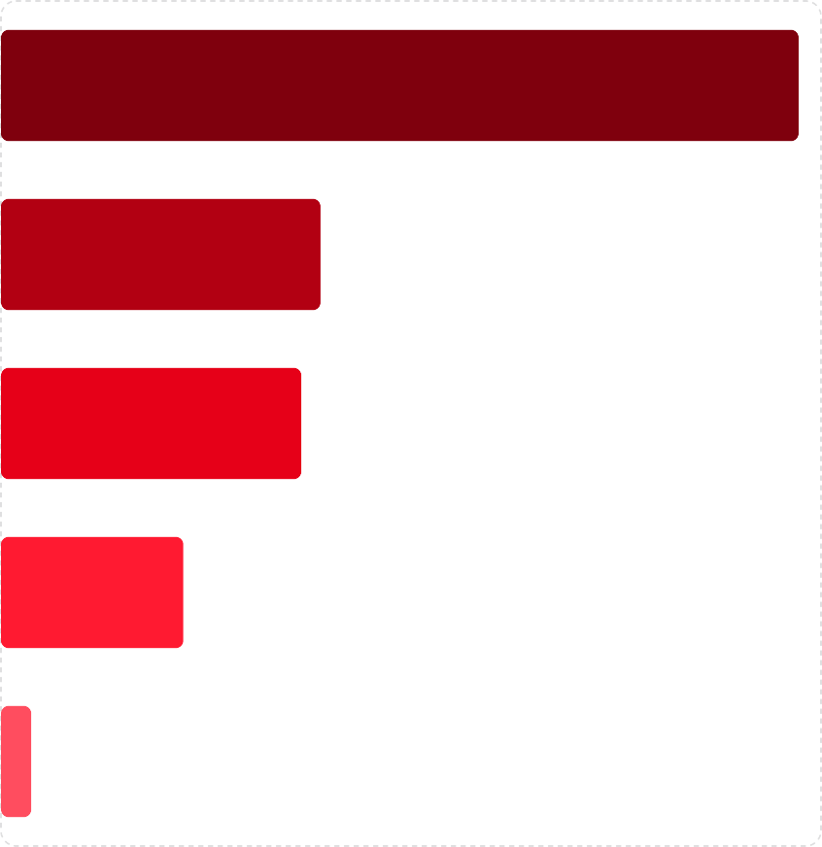
SQL Analysis — Revenue & Discounts
Category
Key Findings
Electronics leads revenue at $486K
Discounts increase avg. purchase: $219 (discounted) vs.
$182 (no discount)
Subscribers spend 63% more: $270.58 avg vs. $165.72 for non-subscribers
Male: $391K · Female: $352K · Other: $251K revenue
Electronics
Accessories
Clothing
Footwear
Outerwear
0
100k
200k
300k
400k
500k

Slide 8
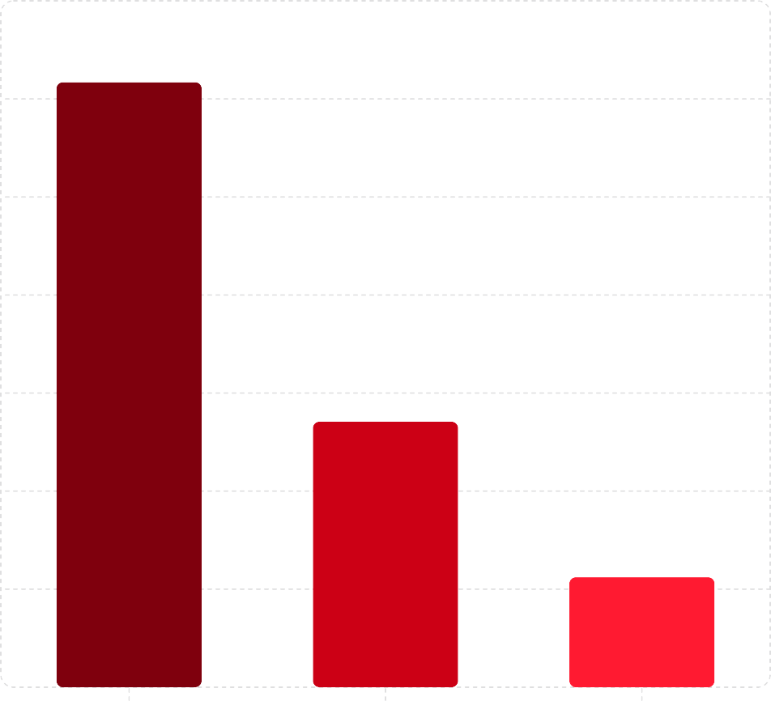
Customer Segmentation & Age Insights
Customers
3.5k
Segmentation Logic
Customers segmented by previous purchases into Loyal
(3,085), Returning (1,354), and New (561).
Revenue by Age Group
51+: $399K (40.2%)
36–50: $267K (26.8%)
26–35: $177K (17.8%)
18–25: $151K (15.2%)
3k
2.5k
2k
1.5k
1k
Repeat buyers (5+ purchases) show strong subscription uptake: 1,190 subscribed vs. 2,763 not subscribed.
500
Loyal Customers
Returning Customers Segment
New Customers
0

Slide 9

Power BI Dashboard — Key Metrics
5000
Total Customers
30
Unique Items
3.62
Average Rating
994K
Total Spend ($)
198
Avg. Spend ($)
Highlights
Revenue by Gender: Male $391K (39.3%), Female $354K (35.4%), Other $251K (25.3%)
Top Locations: New York $144K, Los Angeles $126K, Phoenix $119K
Seasonal: Spring $244K leads; Fall lowest at $68K
Shipping: Standard (1,199 orders) vs. Express (avg.
$358/order)
Debit Card · 25.47%
Cash · 23.48%
Credit Card · 22.68%
PayPal · 20.88%
Venmo · 3.8%
Bank Transfer · 3.7%

Slide 10











Key Takeaways
Electronics Dominate
Highest revenue category at $486K
— focus inventory and marketing here
Discounts Raise AOV
Discounted orders average $219 vs.
$182 — target strategically
Loyal Customers Lead
3,085 loyal customers drive the majority of repeat revenue
51+ Age Group Spends Most
$399K revenue — highest-spending demographic by far
Subscribers Spend 63% More
$270 avg vs. $166 — subscription programs boost lifetime value

Slide 11
Recommendations
Customer-Centric Growth
Optimized Product & Inventory
Targeted marketing efforts, loyalty programs, and product recommendations can be developed by leveraging insights from Customer Lifetime Value (CLV) and Age Distribution analysis. Focus on nurturing high-value segments.
Prioritize stock replenishment for Top 5 Most Purchased Items and invest in high-performing Product Categories. This ensures availability and maximizes sales from popular offerings.
Enhanced Marketing Effectiveness
Valuing Subscription Programs
Align promotional calendars with Seasonal Purchase Trends to capitalize on peak demand. Continuously evaluate the Impact of Discounts to optimize campaign profitability and customer acquisition costs.
Quantify the long-term value of subscribers and invest in strategies to increase Subscription Status. Highlight exclusive benefits to incentivize sign-ups and improve retention, driving predictable revenue.
Streamlined Payment Experience
Ensure seamless integration and prominent display of preferred Payment Methods to reduce checkout friction and improve conversion rates. Consider adding new options based on emerging trends.

