Slide 1


“Mid-Term Project”
“CLINIC OPD Management System”
Submitted by: Astitva Ghanmode
Submission type : Individual
Name: Astitva Ghanmode
Batch : 12
LMS Id : astitva.ghanmode18@vit.edu
Program : Axis Fintech Full Stack Developer
Date: 31/05/2023
GitHub : https://github.com/AstitvaGhanmode7/Clinic-OPD-Management-System/tree/master

Slide 2

Table of contents
Introduction
Project Overview
Architecture Design
User Interface Design
Back-end Development
Front-end Development
Conclusion
Future Work
References
Appendices

Slide 3


Introduction
The Clinic OPD booking system is an essential requirement for our healthcare organization to efficiently manage patient appointments and improve the overall patient experience. The objective of this system is to streamline the patient booking process, reduce wait times, and enhance the quality of care provided to patients.

Slide 4
Project Overview I
FUNCTIONALITIES
Login/Logout : Patient , Doctor , Admin , Receptionist can Login/Logout.
2. Admin : create Specialization , Register Doctor.
3. Receptionist : book Appointment for Patients.
4. Doctor : view Appointments , Provide Prescription.
5. Patient : view Doctor List , View Prescription.

Slide 5

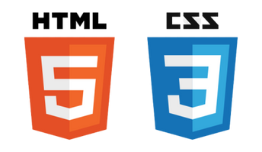






Project Overview II
TECHNOLOGIES USED :
Front-End :
Thymeleaf (Spring Boot Framework), HTML, CSS
Back-End :
Spring Boot , Java
Dependencies : spring dev tools, spring web, spring JPA,
Lombok, MYSQL Driver, Thymeleaf
Database :
MYSQL
Tools :
Eclipse(IDE), MYSQL WorkBench, VsCode, Postman

Slide 6
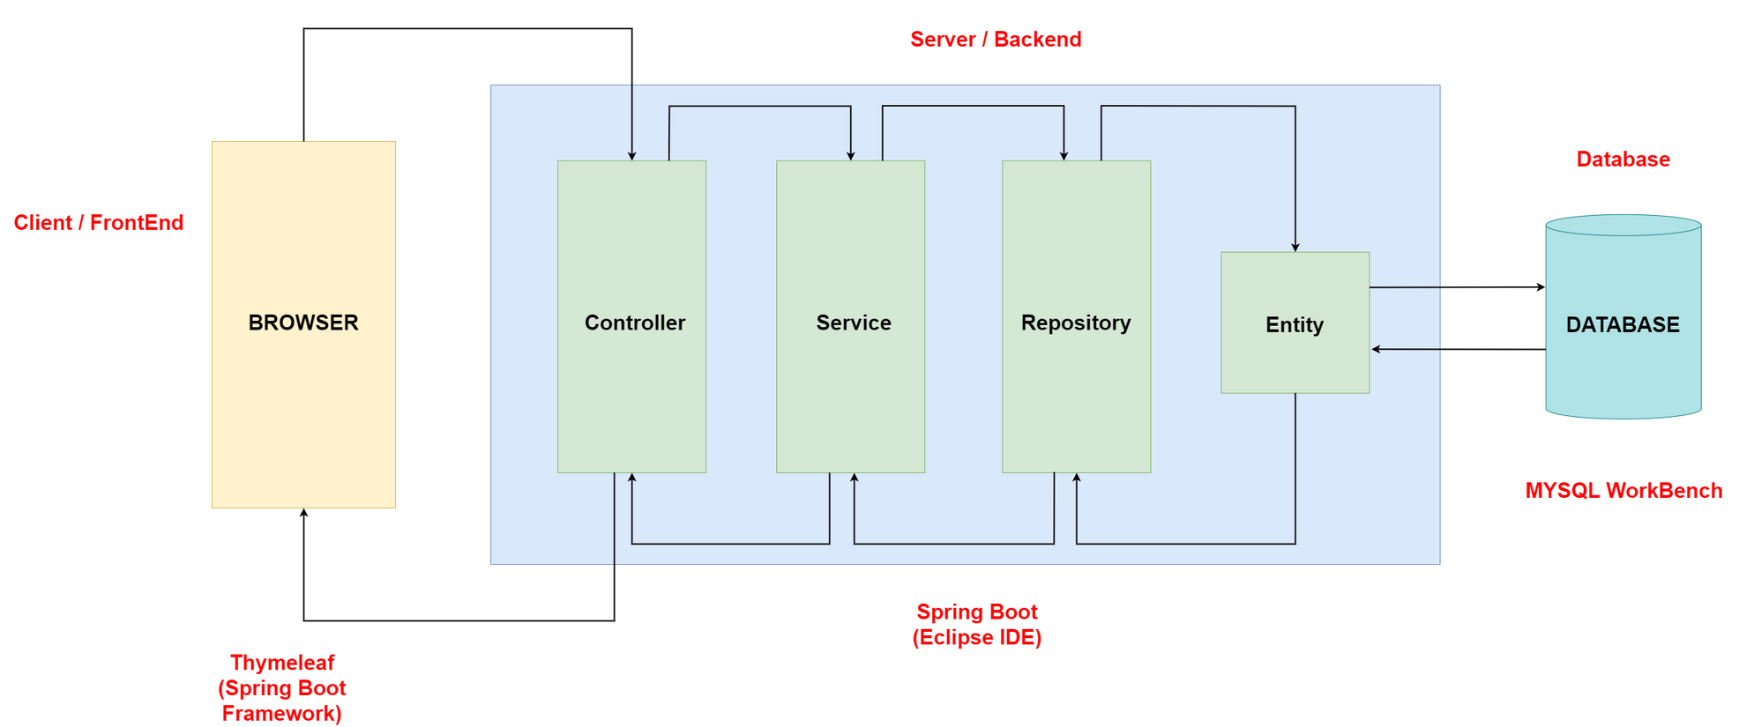
Architecture Design
Data Flow :

Slide 7
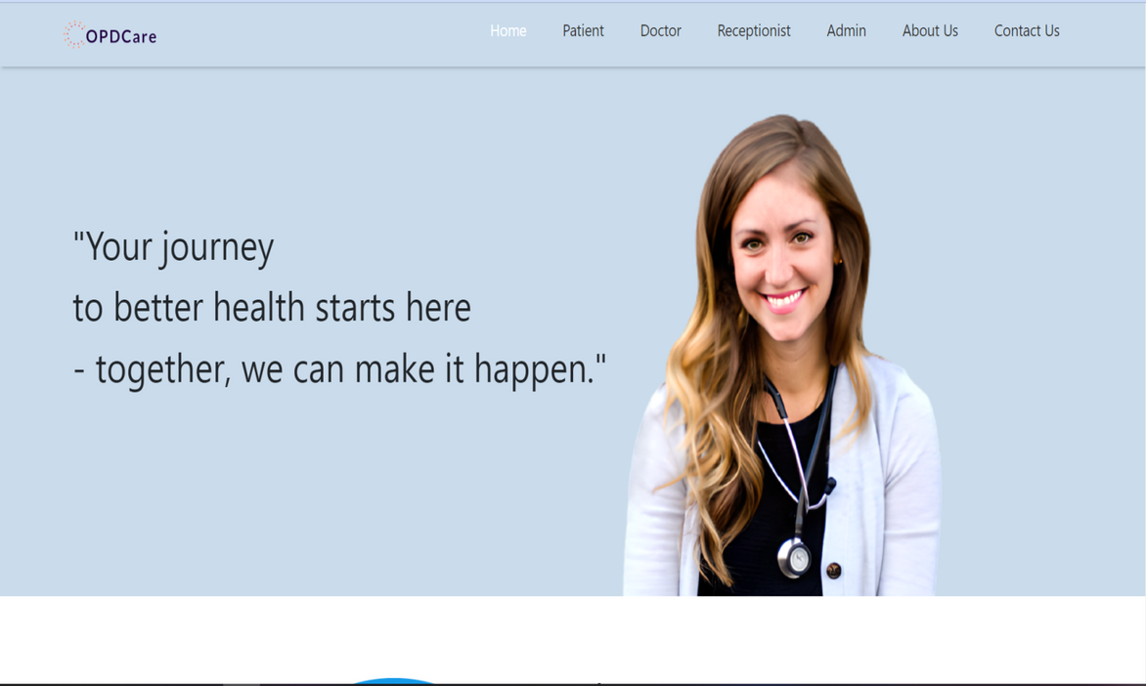
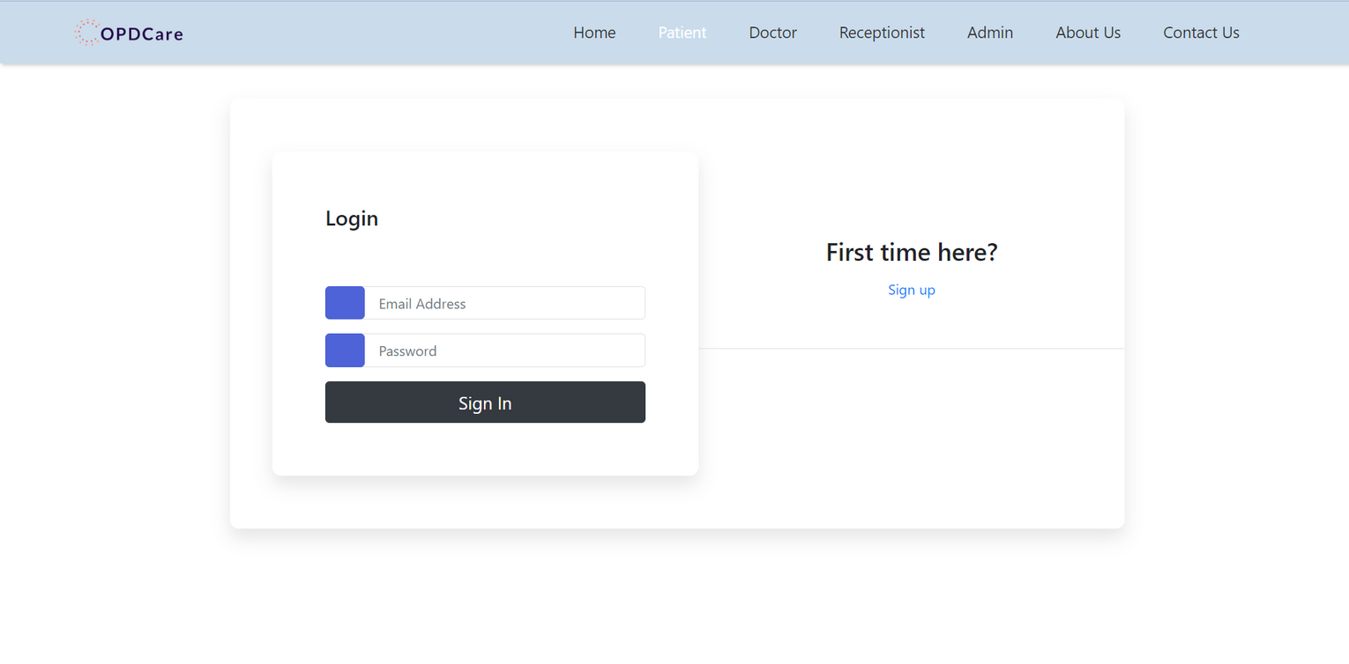
User Interface Design

Slide 8
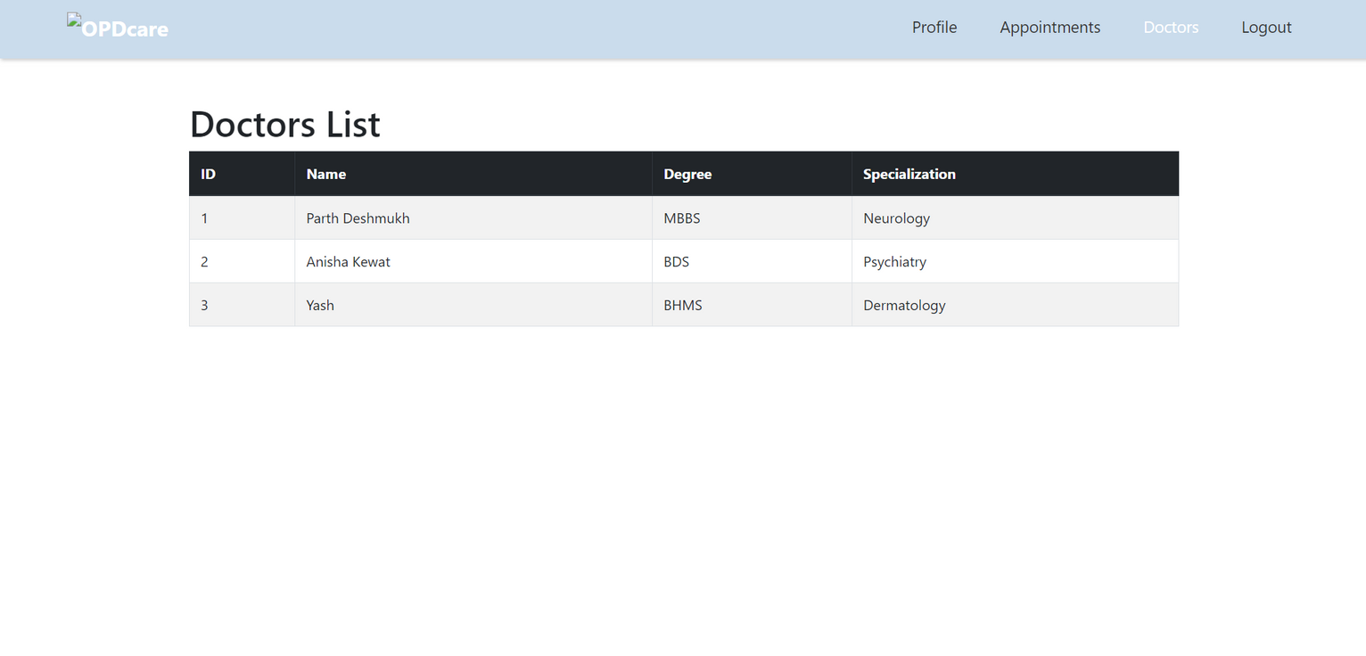
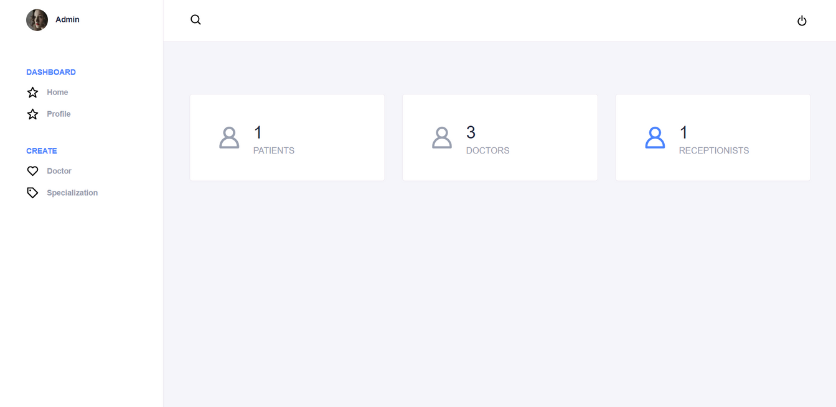
User Interface Design

Slide 9
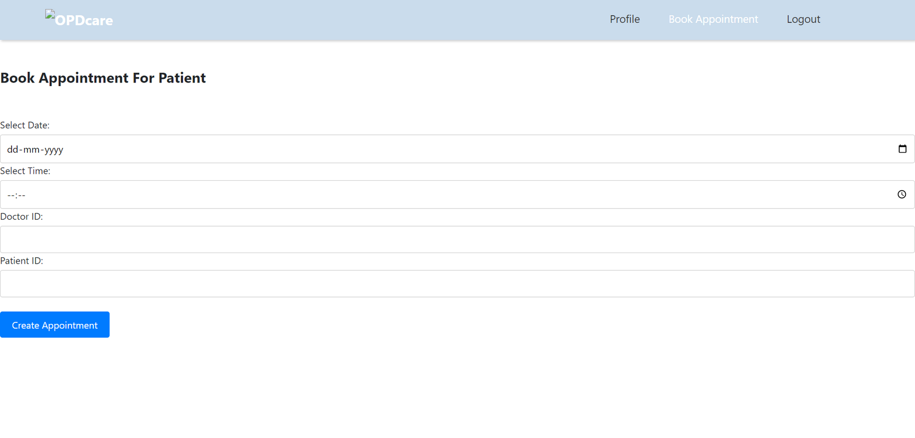
User Interface Design

Slide 10
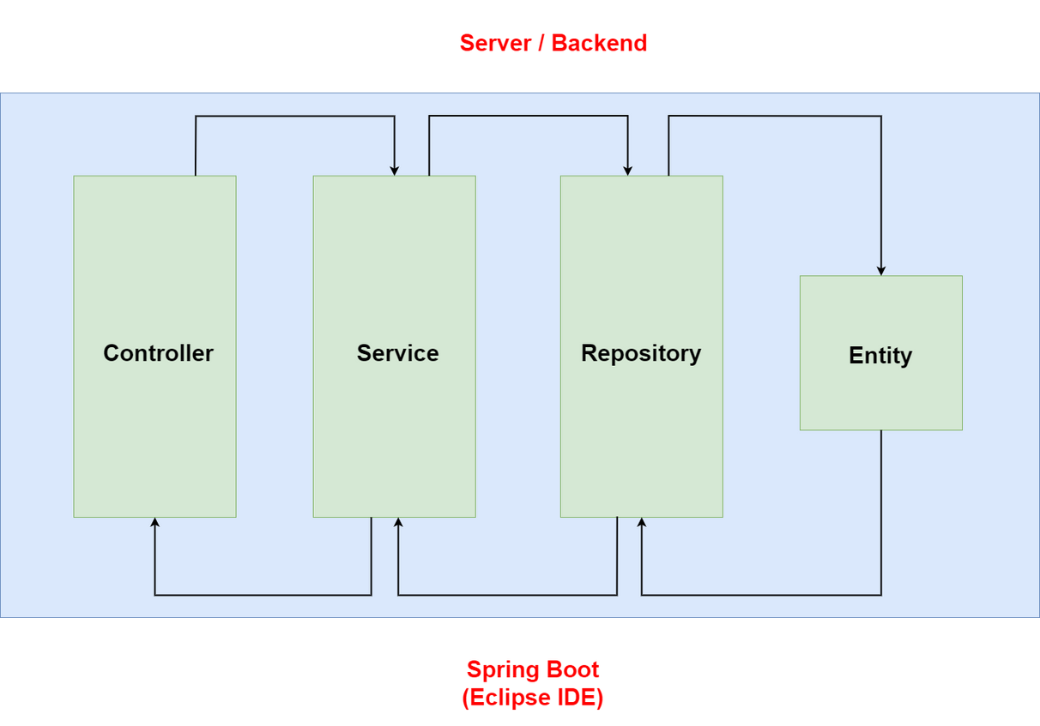


Back-end Development
TECHNOLOGIES USED :
Back-End :
Spring Boot , Java
2. Dependencies :
Spring dev tools
Spring web
Spring JPA
Lombok
MYSQL Driver
Thymeleaf

Slide 11
Project Flow Table
Entity | Repository | Service | Service Impl | Controller
Admin | AdminRepository | AdminService | AdminServiceImpl | AdminController
Patient | PatientRepository | PatientService | PatientServiceImpl | PatientController
Doctor | DoctorRepository | DoctorService | DoctorServiceImpl | DoctorController
Receptionist | ReceptionistRepository | ReceptionistService | ReceptionistServiceImpl | ReceptionistController
Appointment | AppointmentRepository | AppointmentService | AppointmentServiceImpl | AppointmentController
Specialization | SpecializationRepository | SpecializationService | SpecializationServiceImpl | SpecializationController
Prescription | PrescriptionRepository | PrescriptionService | PrescriptionServiceImpl | PrescriptionController

Slide 12
Front-end Development
TECHNOLOGIES USED :
Front-End :
Thymeleaf
Thymeleaf is a template engine framework that allows us to define the DOM nodes.
HTML, CSS

Slide 13
Conclusion
The Clinic OPD Booking System is a critical requirement for our healthcare organization to improve patient care and manage appointments efficiently.

Slide 14
Future Work
Future Scope :
Billing & Payment Integration
2. Reporting and Analytics
3. Notification
4. Feedback

Slide 15
References
1. https://projectworlds.in/tag/clinic-management-system-spring-boot-projects-with-source-code/
2. https://www.freeprojectz.com/free-java-spring-boot-angular-project-source-code-download/clinic-management-system
3. https://codebun.com/hospital-management-project-in-spring-boot-with-source-code/

Slide 16


