Slide 1
Some Continuous Probability Distributions

Slide 2
Uniform Distribution
A Uniform Distribution has equally likely values over the range of possible outcomes.

Slide 3
Uniform Distribution
A Uniform Distribution has equally likely values over the range of possible outcomes.
A graph of the uniform probability distribution is a rectangle with area equal to 1.

Slide 4
Example
The figure below depicts the probability distribution for temperatures in a manufacturing process. The temperatures are controlled so that they range between 0 and 5 degrees Celsius, and every possible temperature is equally likely.
P(x)
0.2
0
x
0 1 2 3 4 5
Temperature (degrees Celsius)

Slide 5
Example
Note that the total area under the “curve” is 1.
P(x)
0.2
0
x
0 1 2 3 4 5
Temperature (degrees Celsius)

Slide 6
Example
P(x)
0.2
0
x
0 1 2 3 4 5
Temperature (degrees Celsius)
What is the Probability that the temperature is exactly 4 degrees?

Slide 7
Example
P(x)
0.2
0
x
0 1 2 3 4 5
Temperature (degrees Celsius)
What is the Probability that the temperature is exactly 4 degrees?
Answer: 0

Slide 8
Explanation
Since we have a continuous random variable there are an infinite number of possible outcomes between 0 and 5, the probability of one number out of an infinite set of numbers is 0.

Slide 9
Example
What is the probability the temperature is between 1⁰C and 4⁰C?
P(x)
0.2
0
x
0 1 2 3 4 5
Temperature (degrees Celsius)

Slide 10
Example
What is the probability the temperature is between 1⁰C and 4⁰C?
P(x)
0.2
0
x
0 1 2 3 4 5
Temperature (degrees Celsius)

Slide 11
What is the probability the temperature is between 1⁰C and 4⁰C?
We know that the total area of the rectangle is 1, and we can see that the part of the rectangle between 1 and 4 is 3/5 of the total, so P(1 ≤ x ≤ 4) = 3/5*(1) = 0.6.
P(x)
0.2
0
x
0 1 2 3 4 5
Temperature (degrees Celsius)

Slide 12
Review: Probabilities and Area
For a density curve depicting the probability distribution of a continuous random variable,
the total area under the curve is 1,
there is a direct correspondence between area and probability.
Only the probability of an event occurring in some interval can be evaluated.
The probability that a continuous random variable takes on any particular value is zero.

Slide 19
Buses arrive at a specified stop at 15-minute intervals starting at 7 A.M. That is, they arrive at 7, 7:15, 7:30, 7:45, and so on. If a passenger arrives at the stop at a time that is uniformly distributed between 7 and 7:30, find the probability that he waits
(a) less than 5 minutes for a bus;
(b) more than 10 minutes for a bus.

Slide 20
Let X denote the number of minutes past 7 that the passenger arrives at the stop. The passenger arrives at the stop at a time that is uniformly distributed between 7 and 7:30, that is the probability that he arrives any time between 7 and 730 is the same

Slide 21
Since X is a uniform random variable over the interval (0, 30), it follows that the passenger will have to wait less than 5 minutes if (and only if) he arrives between
7:10 and 7:15 or between 7:25 and 7:30. (between 7:10 and 7:15 difference is 5 minutes)
Hence, the desired probability for part (a) is

Slide 23
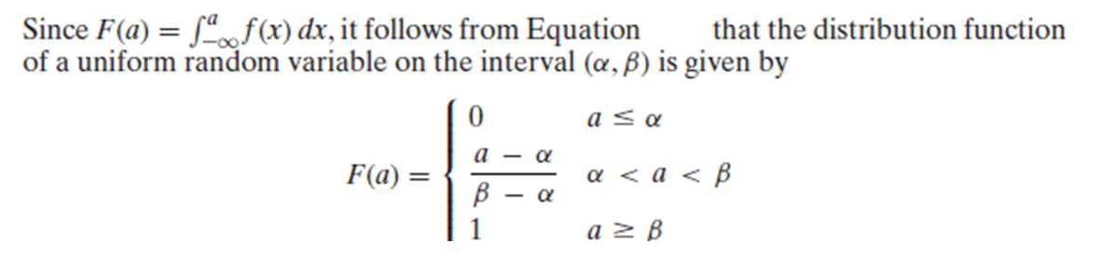

Slide 25
The passenger is in the station from 7 Am
The first train to arrive is after 5 minutes going to B,
so his train to A is from after 5 min to 15 minutes ,
then the next train to B arrives at 20 min,
so his train to A is from after 20 min to 30 minutes and so on till 60 min

Slide 26
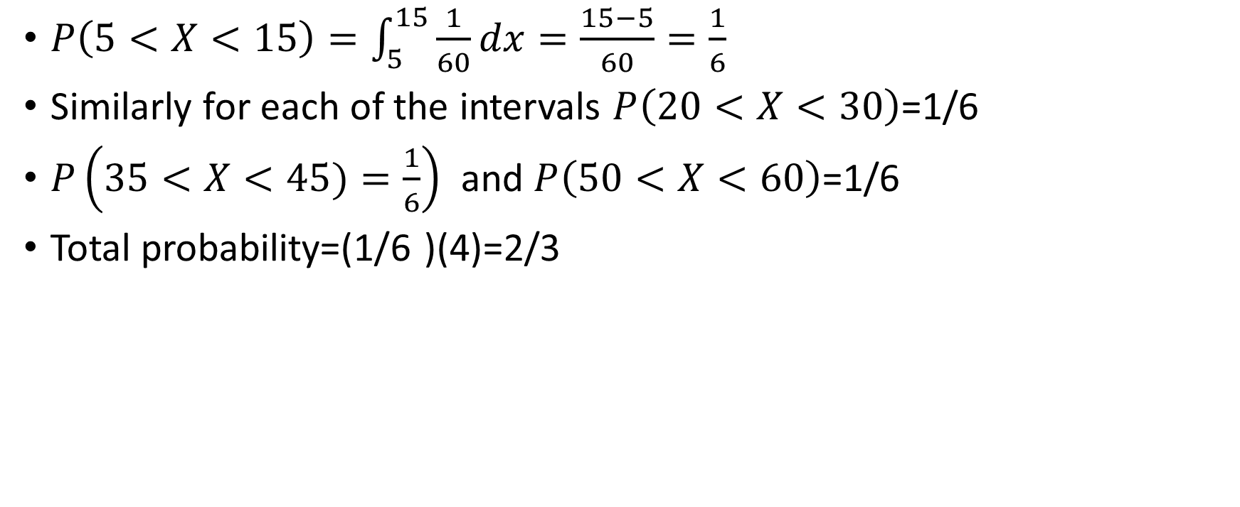
Similarly for each of the intervals =1/6
and =1/6
Total probability=(1/6 )(4)=2/3

Slide 28
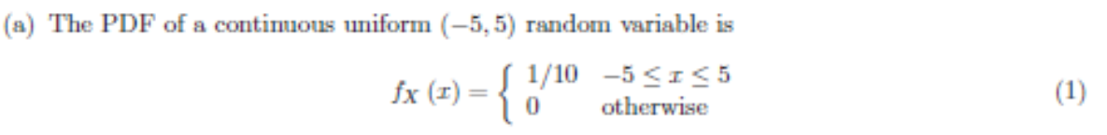


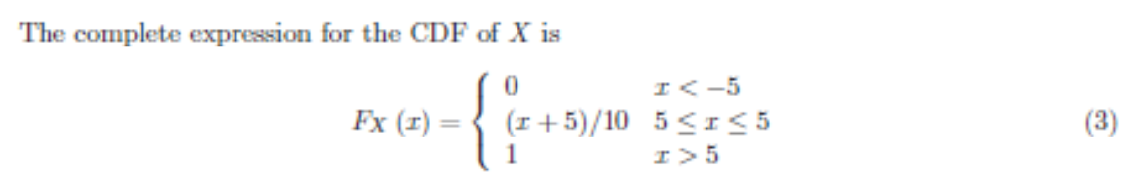
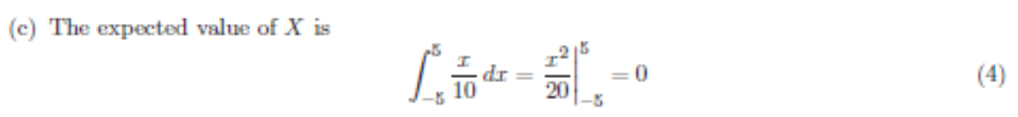

Slide 29
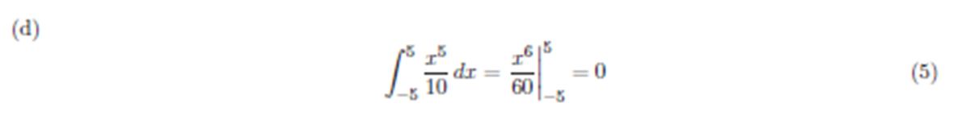
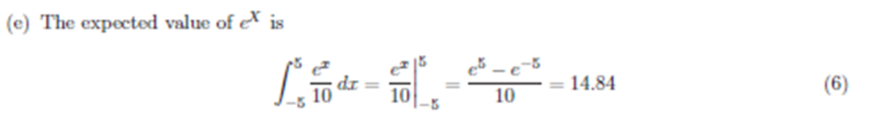

Slide 32
Gaussian Random Variables
Bell-shaped curves appear in many applications of probability theory.
The probability models in these applications are members of the family of Gaussian random variables.
Because they occur so frequently in practice,
Gaussian random variables
are sometimes referred to as normal random variables.

Slide 33
Gaussian Random Variable

Slide 34
The Normal Distribution: as mathematical function (pdf)
This is a bell shaped curve with different centers and spreads depending on μ and σ
Note constants:
π=3.14159
e=2.71828

Slide 35
The Normal PDF
It’s a probability function, so no matter what the values of μ and σ, must integrate to 1!
Notes:
<number>

Slide 36
Normal distribution is defined by its mean and standard dev.
E(X)=μ =
Var(X)=σ² =
Standard Deviation(X)=σ

Slide 37
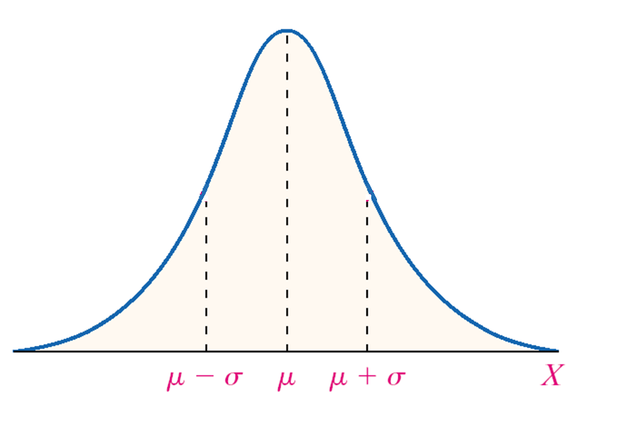
Notes:
<number>

Slide 38
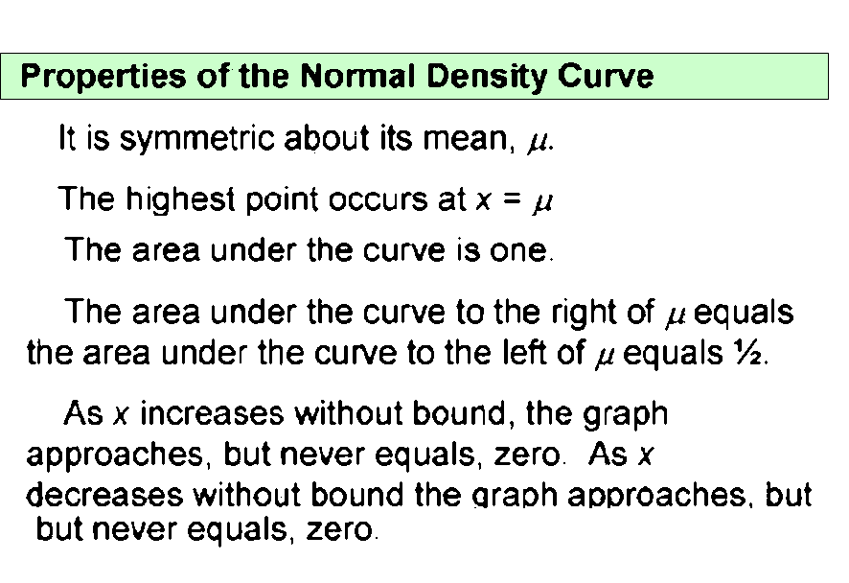

Slide 40
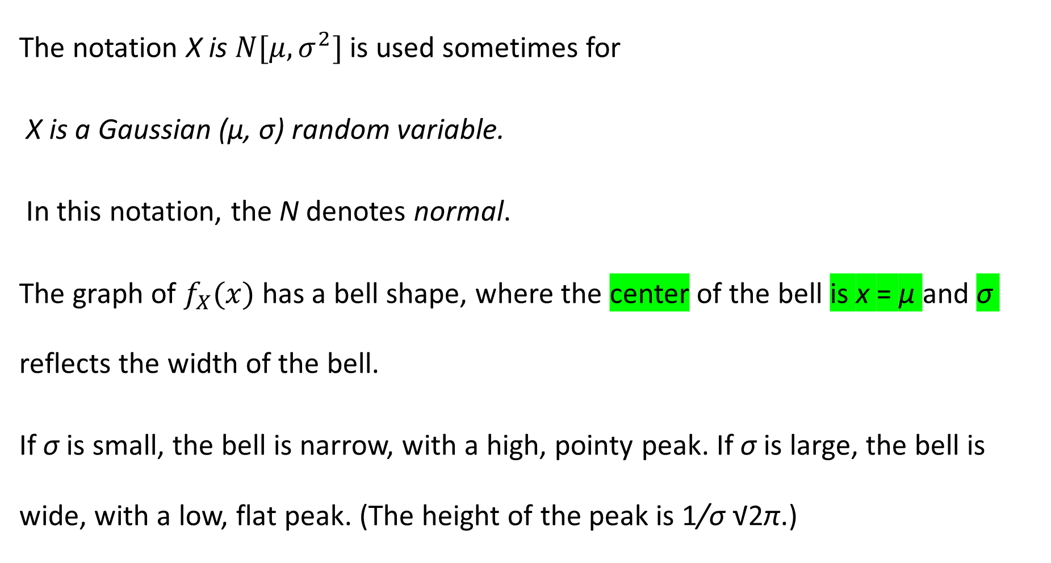

Slide 41
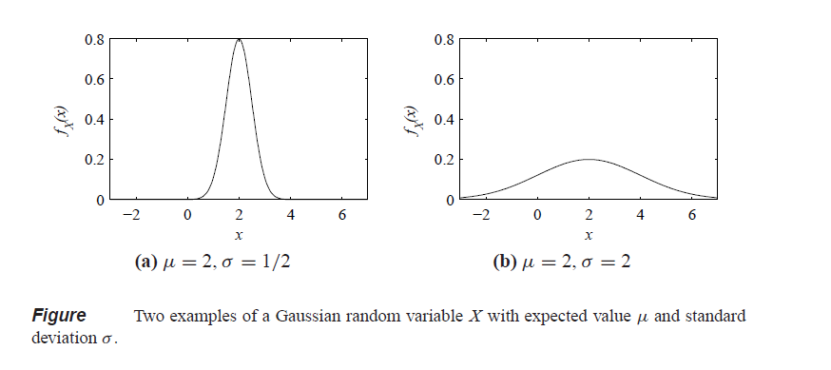
Figure contains two examples of Gaussian
PDFs with μ = 2. In Figure (a), σ = 0.5, and in Figure (b), σ = 2.

Slide 42
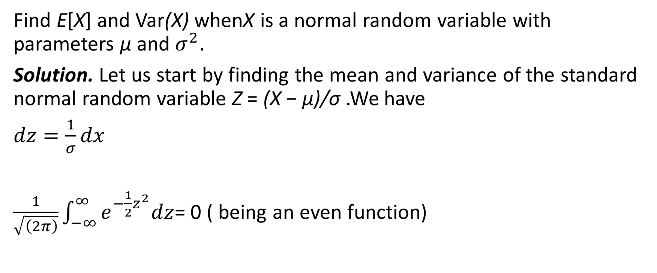
Find E[X] and Var(X) whenX is a normal random variable with parameters μ and .
Solution. Let us start by finding the mean and variance of the standard normal random variable Z = (X − μ)/σ .We have
= 0 ( being an even function)

Slide 43
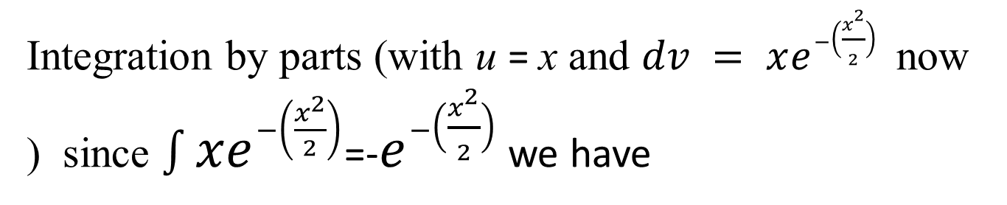
Integration by parts (with u = x and now ) since =- we have

Slide 44
Also since

Slide 45
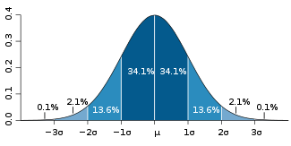

One standard deviation away from the mean ( ) in either direction on the horizontal axis accounts for around 68 percent of the data. Two standard deviations away from the mean accounts for roughly 95 percent of the data with three standard deviations representing about 99.7 percent of the data.

Slide 46
Standard Normal Distribution
The mean of the data in a standard normal distribution is 0 and the standard deviation is 1.
A standard normal distribution is the set of all z-scores.

Slide 47
z-scores
When a set of data values are normally distributed, we can standardize each score by converting it into a z-score.
z-scores make it easier to compare data values measured on different scales.

Slide 48
z-scores
A z-score reflects how many standard deviations above or below the mean a raw score is.
The z-score is positive if the data value lies above the mean and negative if the data value lies below the mean.

Slide 49
z-score formula
Where x represents an element of the data set, the mean is represented by and standard deviation by .

Slide 50
Analyzing the data
Suppose SAT scores among college students are normally distributed with a mean of 500 and a standard deviation of 100. If a student scores a 700, what would be her z-score?
Her z-score would be 2 which means her score is two standard deviations above the mean.

Slide 51
Analyzing the data
A set of math test scores has a mean of 70 and a standard deviation of 8.
A set of English test scores has a mean of 74 and a standard deviation of 16.
For which test would a score of 78 have a higher standing?

Slide 52
Analyzing the data
A set of math test scores has a mean of 70 and a standard deviation of 8.
A set of English test scores has a mean of 74 and a standard deviation of 16.
For which test would a score of 78 have a higher standing?
To solve: Find the z-score for each test.
The math score would have the highest standing since it is 1 standard deviation above the mean while the English score is only .25 standard deviation above the mean.

Slide 53
Analyzing the data
What will be the miles per gallon for a Toyota Camry when the average mpg is 23, it has a z value of 1.5 and a standard deviation of 5?

Slide 54
Analyzing the data
What will be the miles per gallon for a Toyota Camry when the average mpg is 23, it has a
z value of 1.5 and a standard deviation of 2?
Using the formula for z-scores:
The Toyota Camry would be expected to use 26 mpg of gasoline.

Slide 55
EXAMPLE A Normal Random Variable
The following data represent the heights (in inches) of a random sample of 50 two-year old persons.
(a) Create a relative frequency distribution with the lower class limit of the first class equal to 31.5 and a class width of 1.
(b) Draw a histogram of the data.
(c ) Do you think that the variable “height of 2-year old people” is normally distributed?
Notes:
<number>

Slide 56
36.0 36.2 34.8 36.0 34.6 38.4 35.4 36.8
34.7 33.4 37.4 38.2 31.5 37.7 36.9 34.0
34.4 35.7 37.9 39.3 34.0 36.9 35.1 37.0
33.2 36.1 35.2 35.6 33.0 36.8 33.5 35.0
35.1 35.2 34.4 36.7 36.0 36.0 35.7 35.7
38.3 33.6 39.8 37.0 37.2 34.8 35.7 38.9
37.2 39.3
Notes:
<number>

Slide 57
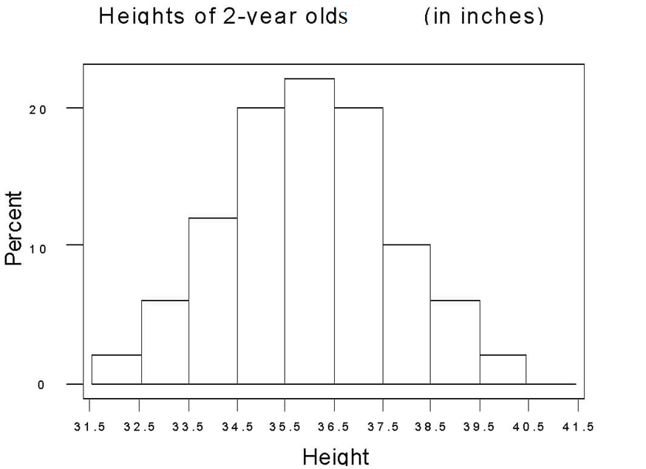
Notes:
<number>

Slide 58
In the next slide, there is a normal density curve drawn over the histogram. How does the area of the rectangle corresponding to a height between 34.5 and 35.5 inches relate to the area under the curve between these two heights?
Notes:
<number>

Slide 59
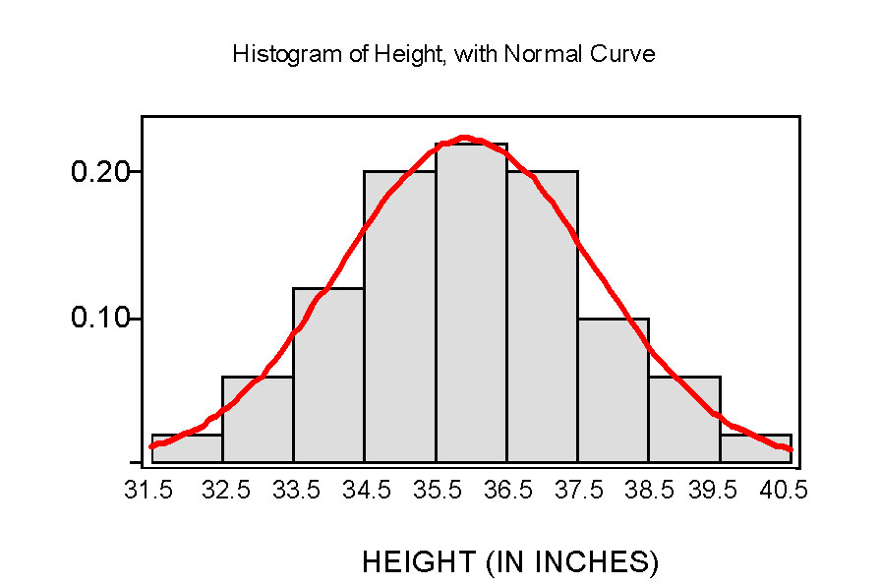
Notes:
<number>

Slide 60
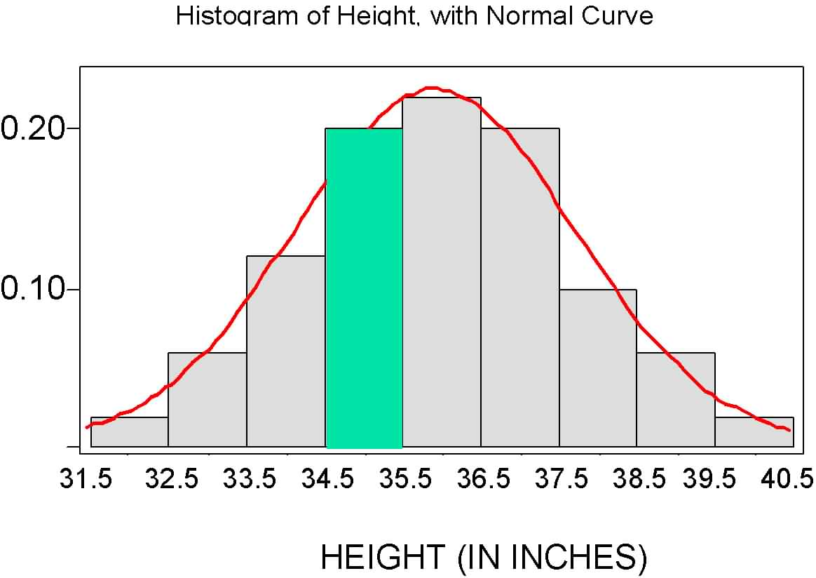
Notes:
<number>

Slide 61
The Standard Normal Distribution

Slide 62
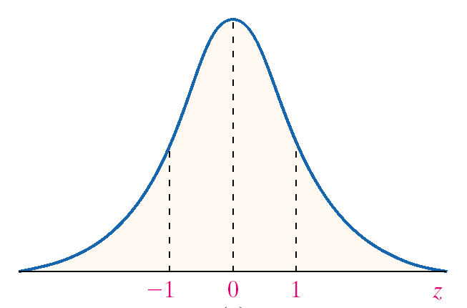
Notes:
<number>

Slide 63
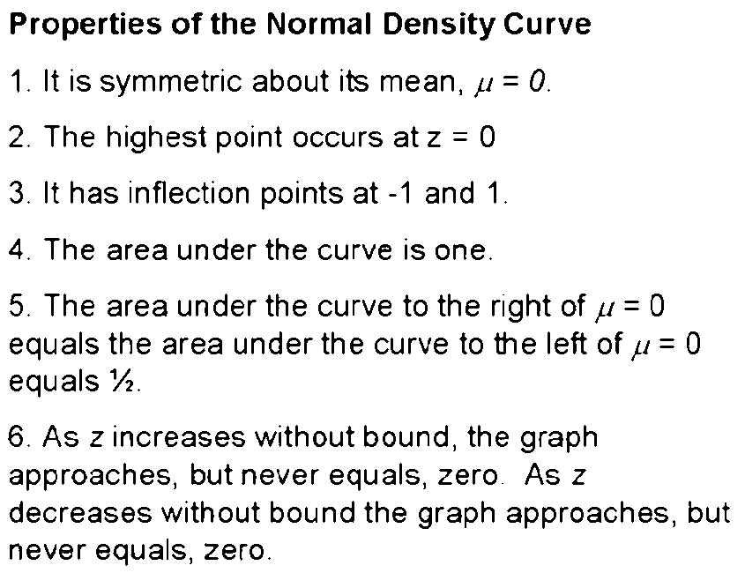
Notes:
<number>

Slide 64
Properties of the Normal Density Curve
7. The Empirical Rule: About 68% of the area under the graph is between -1 and 1; about 95% of the area under the graph is between -2 and 2; about 99.7% of the area under the graph is between -3 and 3.
Notes:
<number>

Slide 65
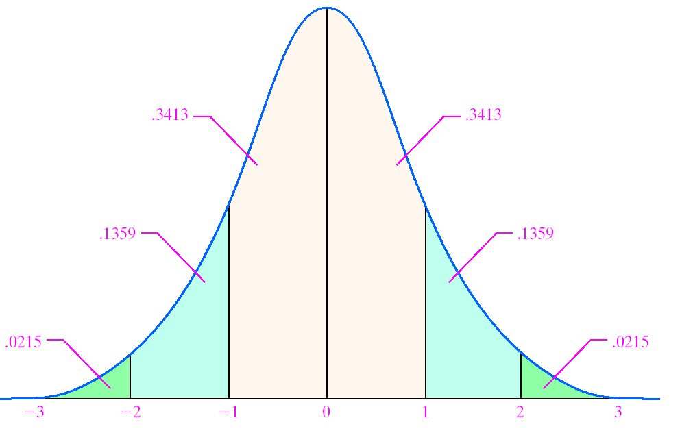
Notes:
<number>

Slide 66
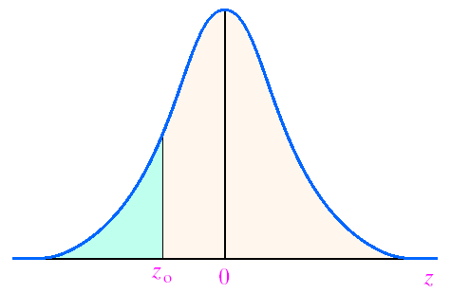
The table gives the area under the standard normal curve for values to the left of a specified Z-score, z_{o}, as shown in the figure.
Notes:
<number>

Slide 67
EXAMPLE Finding the Area Under the Standard Normal Curve
Find the area under the standard normal curve to the left of Z = -0.38.
Notes:
<number>

Slide 68
Area under the normal curve to the right of z_{o}
= 1 – Area to the left of z_{o}
Notes:
<number>

Slide 69
EXAMPLE Finding the Area Under the Standard Normal Curve
Find the area under the standard normal curve to the right of Z = 1.25.
Look in the Normal distribution table:
P(x>=1.25) =1-P(x<1.25)=1-0.8944=0.1056
Notes:
<number>

Slide 70
EXAMPLE Finding the Area Under the Standard Normal Curve
Find the area under the standard normal curve between Z = -1.02 and Z = 2.94.
P(-1.02<x<2.94)=P(x<2.94)-p(x<-1.02)
=0.9984-0.1539
=0.8445
Notes:
<number>

Slide 71
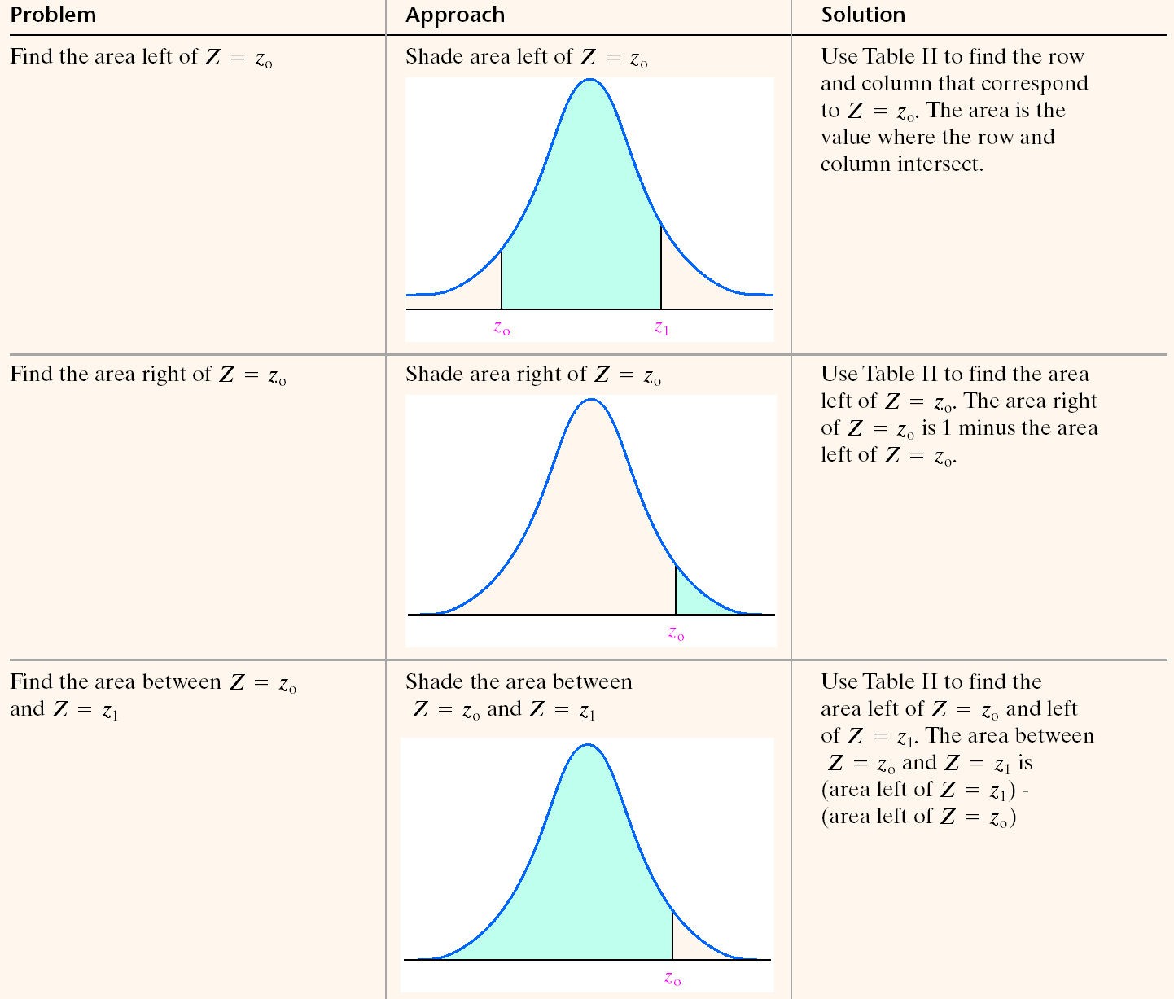
Notes:
<number>

