Slide 2
Probability

Slide 3
Text books:

Slide 4
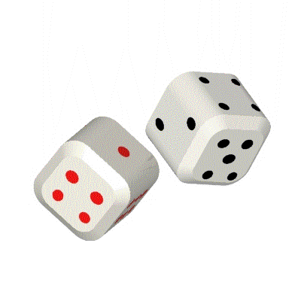
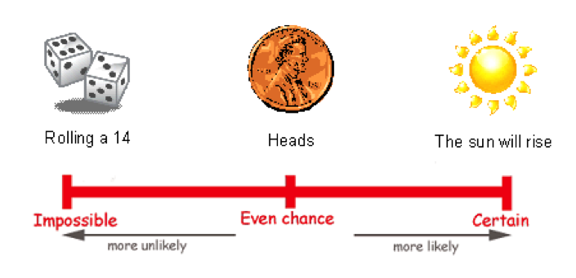
Probability

Slide 5
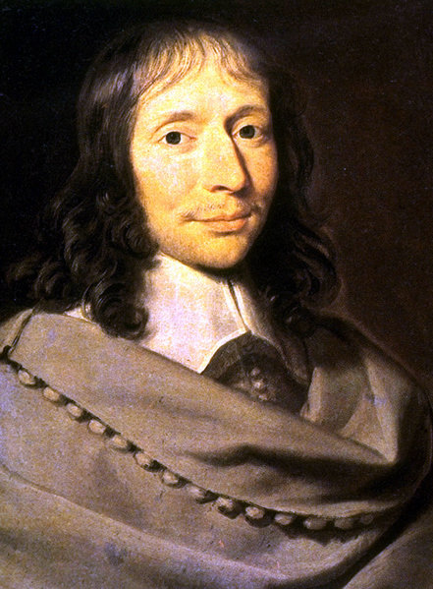
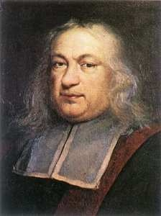
The Pascal – Fermat correspondence of 1654
Often cited in histories of mathematics as the origin of probability theory.

Slide 6
Question was posed by a gambler, Chevalier De Mere and then discussed by Pascal and Fermat.
Pascal and Fermat together came to a resolution
Pascal and Fermat were great mathematical minds. Others simply not up to the task.
All of a sudden around 1650, many problems of probability became commonplace and were understood widely.

Slide 7
…how likely something is…
Probability is how likely something is to happen. You might also hear it called chance.
Probability can be expressed as fractions, decimals or percentages, or on a probability scale.

Slide 8
What is Probability
Probability or chance is how likely something is to happen:
If something has a low probability, it is unlikely to happen.
If something has a high probability, it is likely to happen.

Slide 9
How to Express Probability
Probabilities are most commonly shown as fractions:
The probability of getting 'tails' when you toss a coin is a 1 in 2 chance, or ½
The probability of getting a 3 when you roll a dice is a 1 in 6 chance, or ¹/₆

Slide 10
Can you tell me what the probability is as a fraction?
What is the probability of rolling a 4 with a dice?
What is the probability of rolling an odd number with a dice?
A bag contains 7 buttons. 3 of them are green. What is the probability of picking a green button from the bag?
A bag contains 3 red and 5 green marbles. What is the probability of picking a red.

Slide 11
Can you tell me what the probability is as a fraction?
What is the probability of rolling a 4 with a dice? – 1/6
What is the probability of rolling an odd number with a dice? – 3/6 or 1/2
A bag contains 7 buttons. 3 of them are green. What is the probability of picking a green button from the bag? – 3/7
A bag contains 3 red and 5 green marbles. What is the probability of picking a red. – 3/8

Slide 12
How to Express Probability
Probabilities can also be shown as decimals or percentages:
The probability of getting 'tails' when you toss a coin is a 1 in 2 chance, or ½ or 0.5 or 50%
A probability of ³/₄ can also be shown as 0.75 or 75%

Slide 13
Can you tell me what the probability is?
What is the probability, as a decimal, of getting 'heads' when you toss a coin?
Something that has an even chance of happening has a probability of what percentage?
A bag contains just 5 buttons, all of which are blue. What is the probability of picking a red button from the bag?
A bag contains 4 white buttons. How many black buttons must be added so there is an even chance of picking a white button?

Slide 14
Can you tell me what the probability is?
What is the probability, as a decimal, of getting 'heads' when you toss a coin? 0.5
Something that has an even chance of happening has a probability of what percentage? 50%
A bag contains just 5 buttons, all of which are blue. What is the probability of picking a red button from the bag? 0
A bag contains 4 white buttons. How many black buttons must be added so there is an even chance of picking a white button? 4

Slide 15
How to work out probability…
Work out the probability of throwing an even number on a dice.
Count up the total number of possible results.
When throwing a dice, for example, there are 6 possible numbers the dice can land on (1, 2 ,3 ,4, 5, 6).
Then count up the number of results you are interested in.
In this example, you are only interested in throwing a 2, 4 or 6 (all the even numbers on a dice). So you are interested in 3 numbers.
The probability of getting an even number on a dice is 3 chances out of 6 chances which you write as ³/₆.

Slide 16
Probability Scales

■
●
❍

Unlikely
Even Chance
Likely
Impossible
Certain
The sun will rise tomorrow.
You will live to be 500.
You spin a coin and get a head.
You will see a bus on your way home.
You will see an ambulance on your way home.

Slide 17
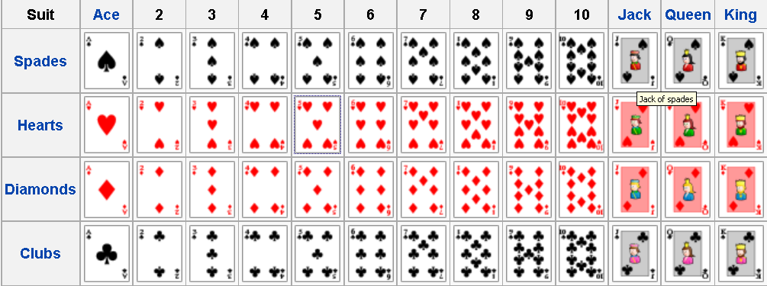
Useful Information
52 Playing Cards in a pack
4 Suits (Clubs, Spades, Diamonds and Hearts)
13 cards in each suit (A,2,3,4,5,6,7,8,9,10,J,K,Q)
A regular dice has the numbers 1,2,3,4,5&6

Slide 18
Definitions

Slide 19
The sample Space, S
The sample space, S, for a random phenomena is the set of all possible outcomes.

Slide 20
Examples
Tossing a coin – outcomes S ={Head, Tail}
Rolling a die – outcomes
S ={ , , , , , }
={1, 2, 3, 4, 5, 6}

Slide 21
An Event , E
The event, E, is any subset of the sample space, S. i.e. any set of outcomes (not necessarily all outcomes) of the random phenomena
Venn diagram
S
E

Slide 22
The event, E, is said to have occurred if after the outcome has been observed the outcome lies in E.
S
E

Slide 23
Examples
Rolling a die – outcomes
S ={ , , , , , }
={1, 2, 3, 4, 5, 6}
E = the event that an even number is rolled
= {2, 4, 6}
={ , , }

Slide 24
Special Events
The Null Event, The empty event - φ
φ = { } = the event that contains no outcomes
The Entire Event, The Sample Space - S
S = the event that contains all outcomes
The empty event, φ , never occurs.
The entire event, S, always occurs.

Slide 25
Set operations on Events
Union
Let A and B be two events, then the union of A and B is the event (denoted by A∪B) defined by:
A ∪ B = {e| e belongs to A or e belongs to B}
A ∪ B
A
B

Slide 26
The event A ∪ B occurs if the event A occurs or the event and B occurs .
A ∪ B
A
B

Slide 27
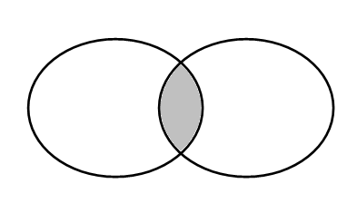
Intersection
Let A and B be two events, then the intersection of A and B is the event (denoted by A∩B) defined by:
A ∩ B = {e| e belongs to A and e belongs to B}
A ∩ B
A
B

Slide 28
The event A ∩ B occurs if the event A occurs and the event and B occurs .
A ∩ B
A
B

Slide 29
Complement
Let A be any event, then the complement of A (denoted by ) defined by:
= {e| e does not belongs to A}
A

Slide 30
The event occurs if the event A does not occur
A

Slide 31
In problems you will recognize that you are working with:
Union if you see the word or,
Intersection if you see the word and,
Complement if you see the word not.

Slide 32
Definition: mutually exclusive
Two events A and B are called mutually exclusive if:
A
B

Slide 33
If two events A and B are are mutually exclusive then:
They have no outcomes in common. They can’t occur at the same time. The outcome of the random experiment can not belong to both A and B.
A
B

Slide 35
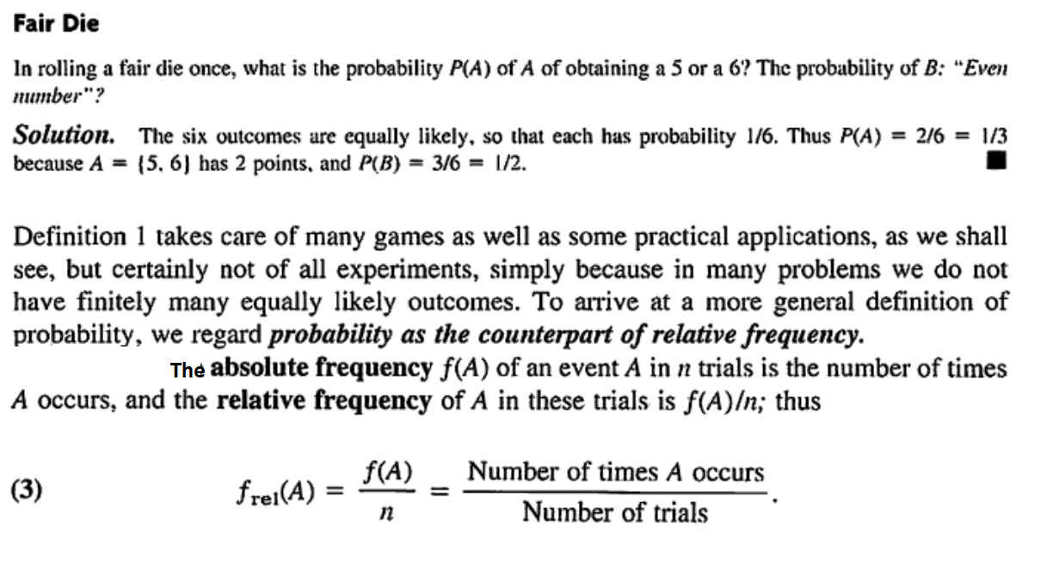

Slide 36
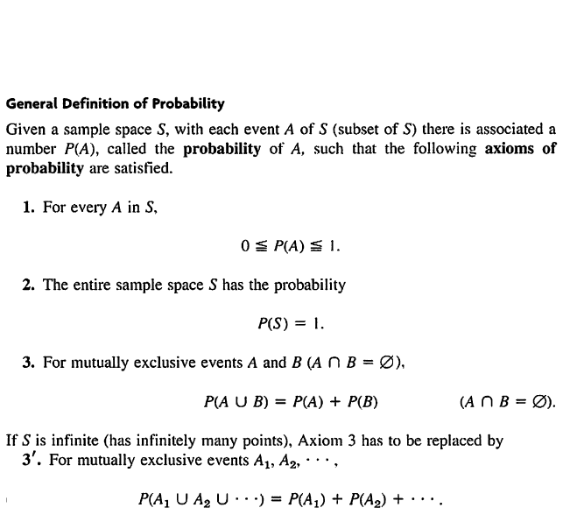

Slide 37
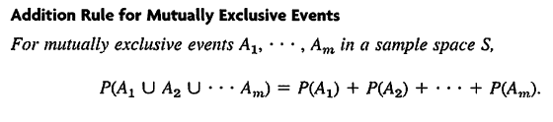


Slide 40
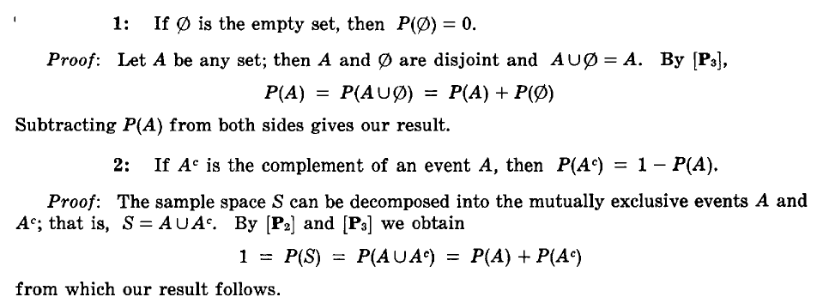

Slide 41
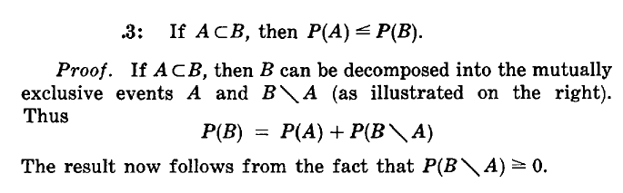

Slide 42
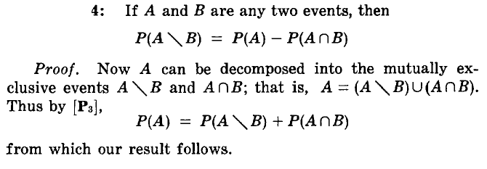
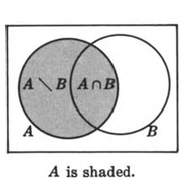

Slide 43
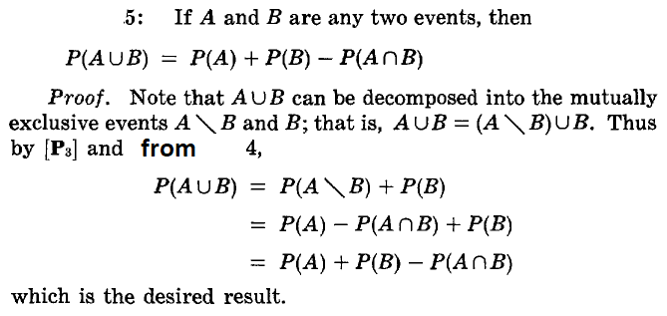
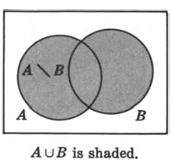

Slide 48
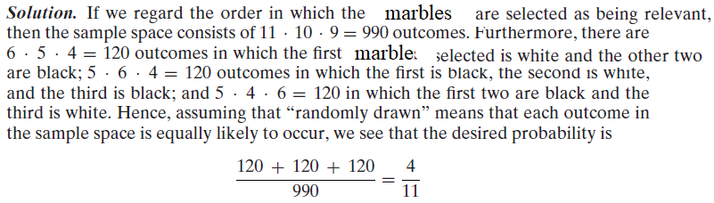
Notes:
This is a permutation not a combination

Slide 51
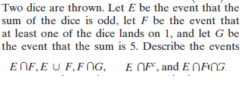

Slide 56
.5 +.3 =.8
If A happens then B does not happen as both are mutually exclusive
Ans: .3=p(A)
c) 0 as they are both are mutually exclusive

Slide 62


Slide 64
Conditional Probability

Slide 65
Suppose that we toss 2 dice, and suppose that each of the 36 possible outcomes is equally likely to occur and hence has probability 1/36 .
Suppose further that we observe that the first die is a 3. Then, given this information, what is the probability that the sum of the 2 dice equals 8?
To calculate this probability, we reason as follows:
Given that the initial die is a 3, there can be at most 6 possible outcomes of our experiment,
namely, (3, 1), (3, 2), (3, 3), (3, 4), (3, 5), and (3, 6).

Slide 66
Since each of these outcomes originally had the same probability of occurring, the outcomes should still have equal probabilities.
That is, given that the first die is a 3, the (conditional) probability of
each of the outcomes (3, 1), (3, 2), (3, 3), (3, 4), (3, 5), and (3, 6) is 1/6, whereas the
(conditional) probability of the other 30 points in the sample space is 0. Hence, the desired probability will be 1/6

Slide 67
If we let E and F denote, respectively, the event that the sum of the dice is 8 and the
event that the first die is a 3, then the probability just obtained is called the conditional
probability that E occurs given that F has occurred and is denoted by
P(E|F)

Slide 68
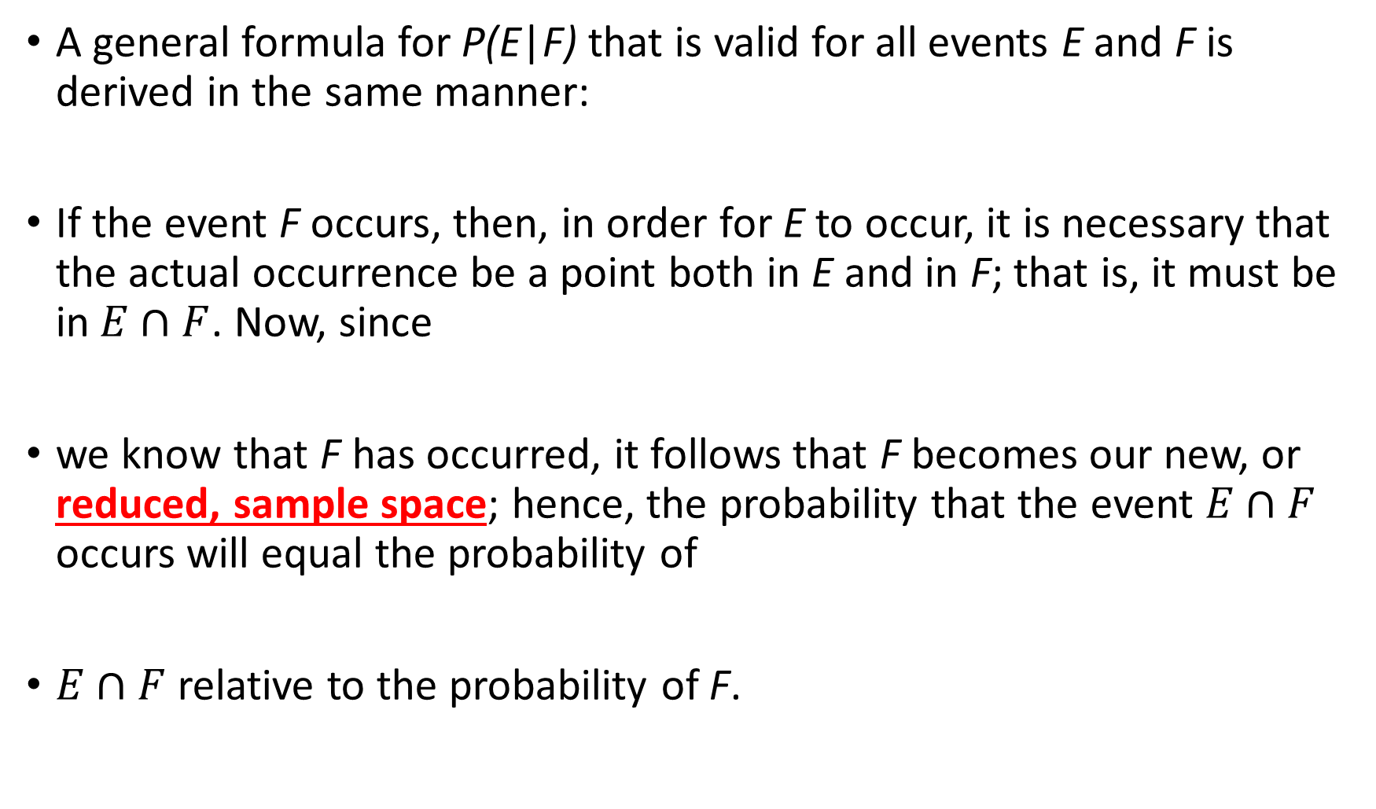
A general formula for P(E|F) that is valid for all events E and F is derived in the same manner:
If the event F occurs, then, in order for E to occur, it is necessary that the actual occurrence be a point both in E and in F; that is, it must be in$E∩F$. Now, since
we know that F has occurred, it follows that F becomes our new, or reduced, sample space; hence, the probability that the event $E∩F$ occurs will equal the probability of
$E∩F$ relative to the probability of F.

Slide 69
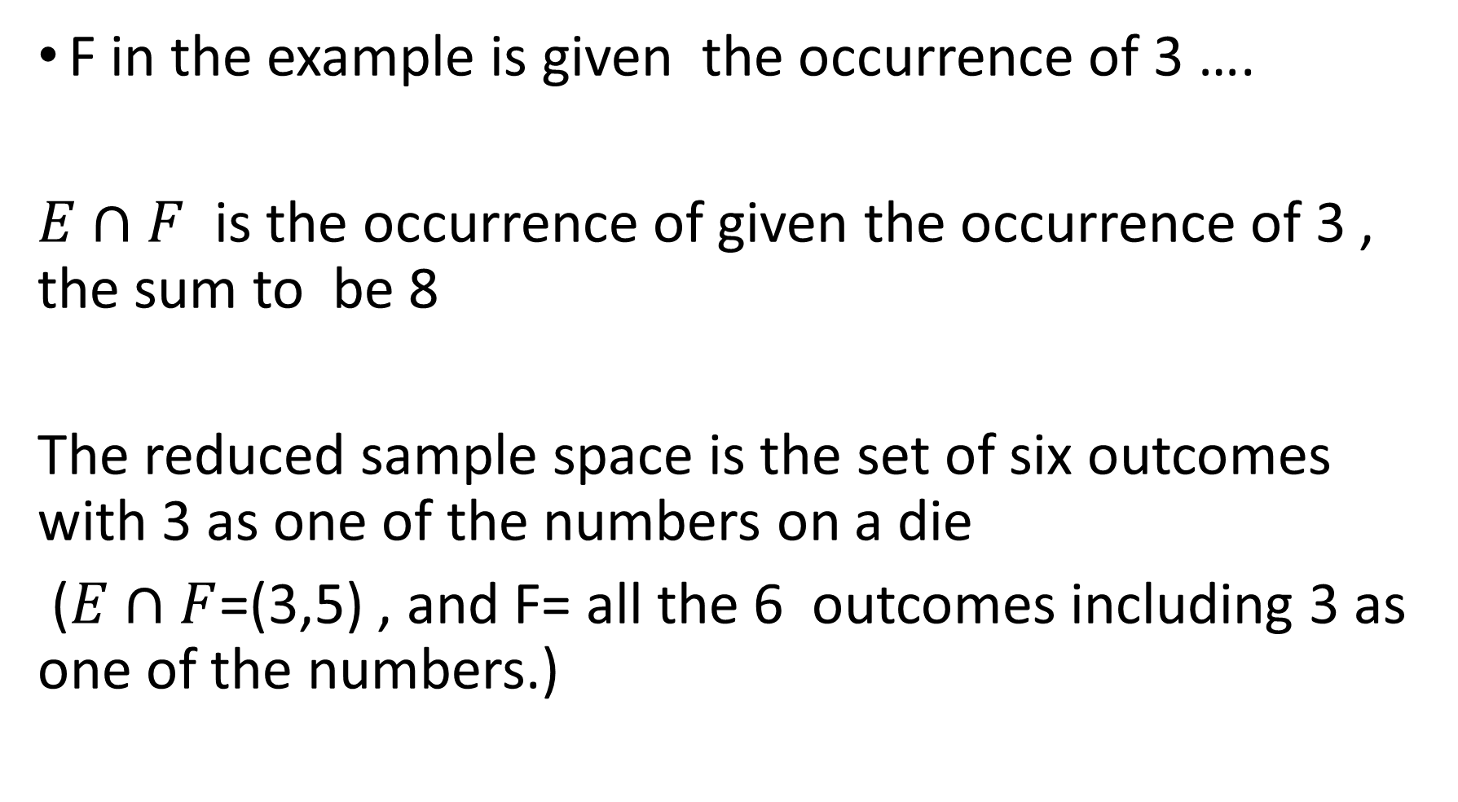
F in the example is given the occurrence of 3 ….
$E∩F$ is the occurrence of given the occurrence of 3 , the sum to be 8
The reduced sample space is the set of six outcomes with 3 as one of the numbers on a die
($E∩F$=(3,5) , and F= all the 6 outcomes including 3 as one of the numbers.)

Slide 70

Definition
If P(F) > 0, then
P(E|F) = $\frac{P\left(E∩F\right)}{P\left(F\right)}$

Slide 71
A coin is flipped twice. Assuming that all four points in the sample space S = {(h, h),(h, t), (t, h), (t, t)} are equally likely,
what is the conditional probability that both flips land on heads, given that
(a) the first flip lands on heads? (b) at least one flip lands on heads?

Slide 72
Let B = {(h, h)} be the event that both flips land on heads;
let F = {(h, h), (h, t)} be the event that the first flip lands on heads; and let A = {(h, h), (h, t), (t, h)} be the event that at least one flip lands on heads.
The probability for (a) can be obtained from

Slide 73

$P\left(B | F\right)=\frac{P\left(B∩F\right)}{P\left(F\right)}$
= $\frac{P\left(\left\{\left(h, h\right)\right\}\right)}{P\left(\left\{\left(h, h\right), \left(h, t\right)\right\}\right)}$= $\frac{\frac{1}{4}}{\frac{2}{4}}=$½

Slide 74
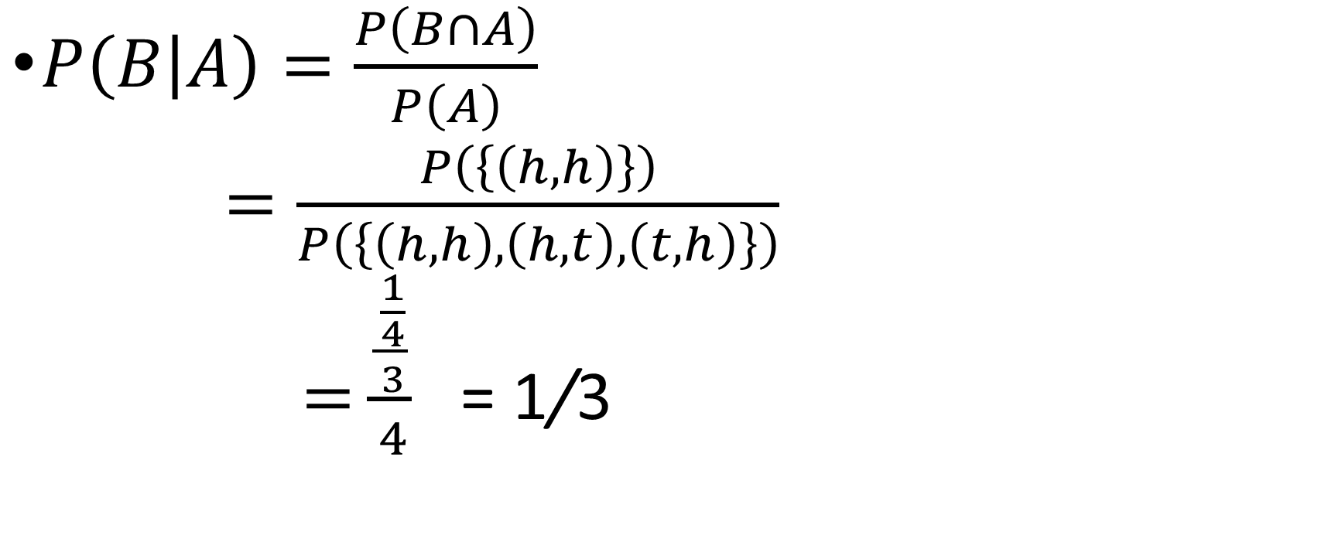
$P\left(B | A\right)=\frac{P\left(B∩A\right)}{P\left(A\right)}$
$=\frac{P\left(\left\{\left(h, h\right)\right\}\right)}{P\left(\left\{\left(h, h\right), \left(h, t\right), \left(t, h\right)\right\}\right)}$
$=\frac{\frac{\frac{1}{4}}{3}}{4}$ = 1/3
Notes:
Thus, the conditional probability that both flips land on heads given that the first one does is 1/2, whereas the conditional probability that both flips land on heads given that at least one does is only 1/3. Many students initially find this latter result
surprising. They reason that, given that at least one flip lands on heads, there are two possible results: Either they both land on heads or only one does. Their mistake,however, is in assuming that these two possibilities are equally likely. For, initially,
there are 4 equally likely outcomes. Because the information that at least one flip lands on heads is equivalent to the information that the outcome is not (t, t), we are
left with the 3 equally likely outcomes (h, h), (h, t), (t, h), only one of which results in both flips landing on heads.

Slide 76
