Slide 1
Team 6
Mobile based voting system
Faculty Mentor - Dr. Kavita Vemuri
TA Mentor - Suhan Prabhu

Slide 2
Introduction
Mobile-based voting system.
For whom?
Youth: a feasible target for a system (~40-60%)
Embrace, Extend, Extinguish.

Slide 3
Application Development & User Interface Architecture

Slide 4
Overview
Focus of this subsystem is to make UI easy to use, attractive, efficient and responsive.
The UI should be as user-friendly and lightweight to allow minimal loading speeds even with poor connectivity.

Slide 5
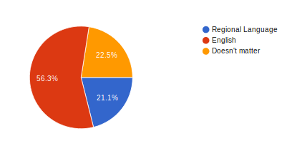
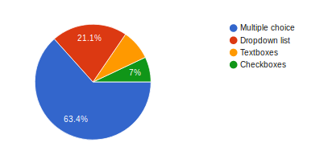
What language do you prefer for the user-interface?
How do you want the names of the eligible candidates to be displayed?

Slide 6
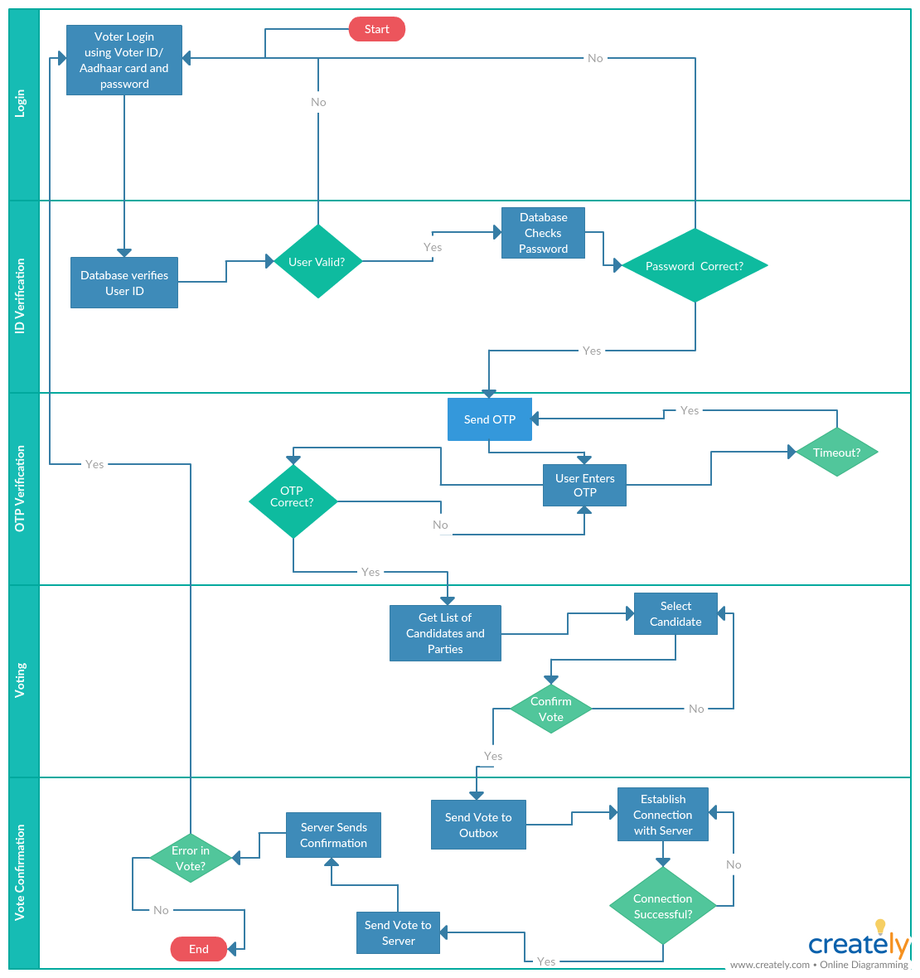

Slide 7
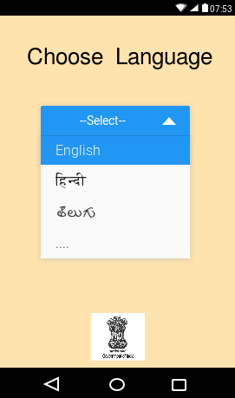
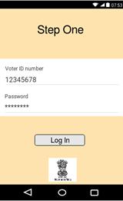
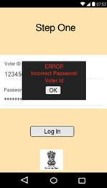
Mockups

Slide 8
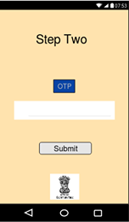
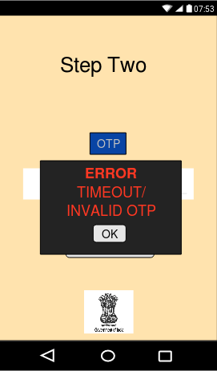
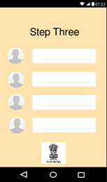

Slide 9
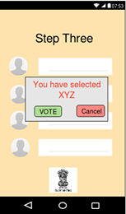
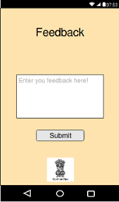
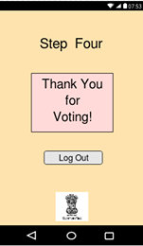

Slide 10
Security

Slide 11
Overview
Why security?
What does our subsystem propose?

Slide 12
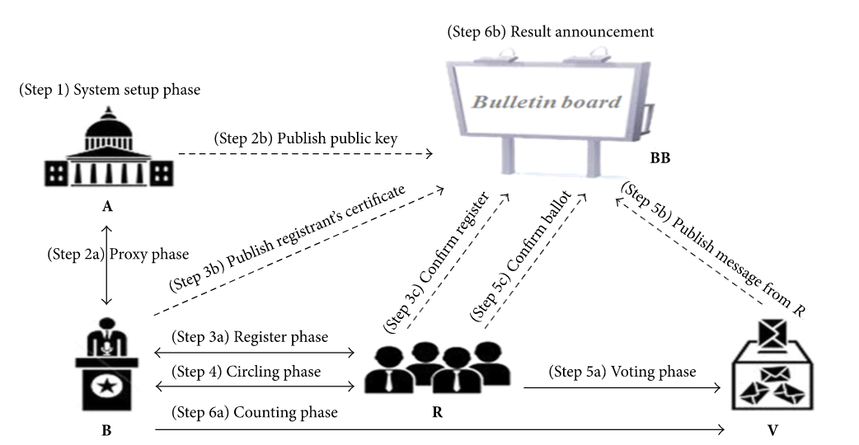
Network security

Slide 13
Social security
Some measures to provide social security…
Is 100% social security possible?

Slide 14
Backend and Maintenance

Slide 15
PURPOSE AND OVERVIEW

Slide 16
Services
Load balancers
Databases
Web servers
Redundant backups
Public bulletin board
Ensure Data Integrity.
Seamless election procedure.
Secure voting procedure.

Slide 17
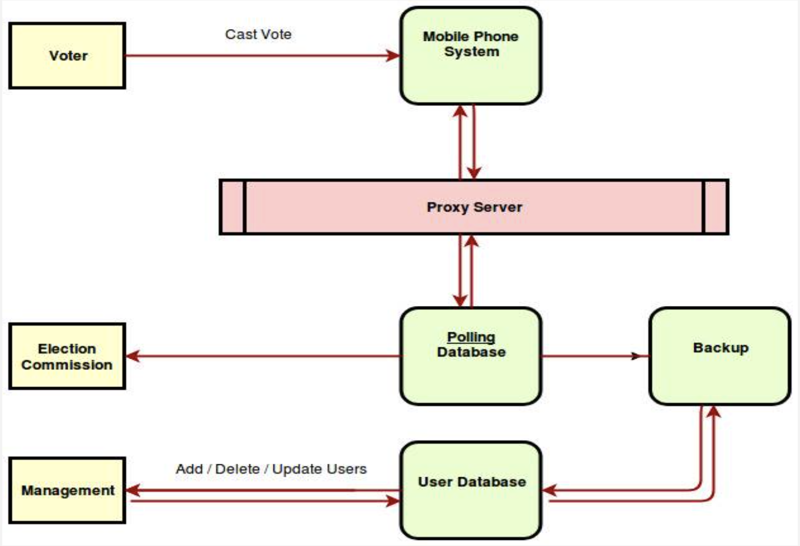
Type to enter a caption.

Slide 18
MAINTENANCE
1. Corrective Maintenance
2. Adaptive Maintenance
3. Perfective Maintenance

Slide 19
Statistics And Data Analysis

Slide 20
Overview
The subsystem primarily deals with handling huge volumes of data and extracting useful information out of it.

Slide 21
Methodology
Processing data by employing various techniques like:
Machine Learning
Regression Analysis
Sentiment Analysis

Slide 22
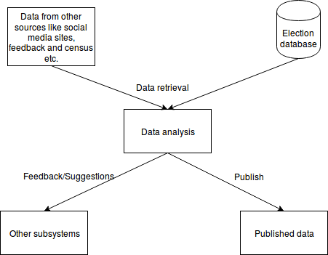

Slide 23
Awareness and Reaching Out

Slide 24
Overview
Why “awareness and reaching out”?
What purpose does it serve?

Slide 25
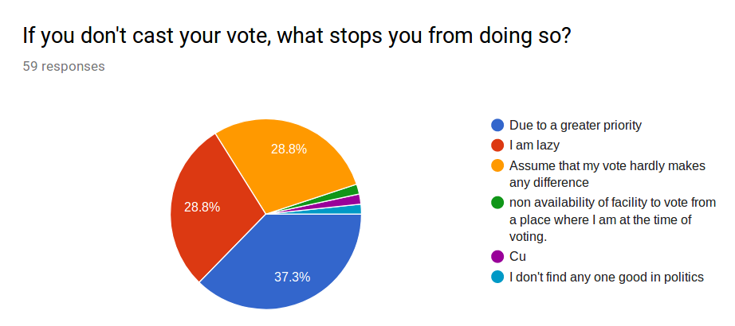
Characteristics
Motivate people
Conserve cost and time

Slide 26
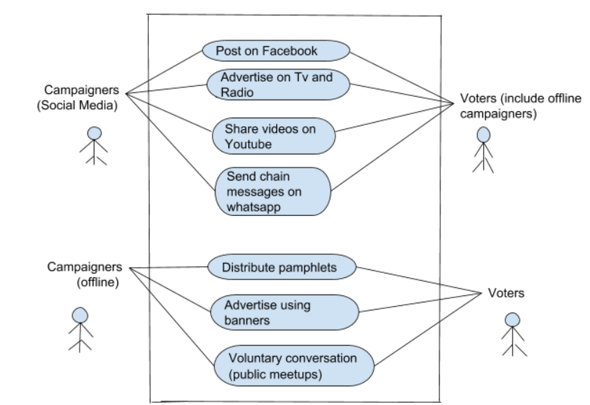
Implementation

Slide 27
Challenges
Can everyone be reached?

Slide 28
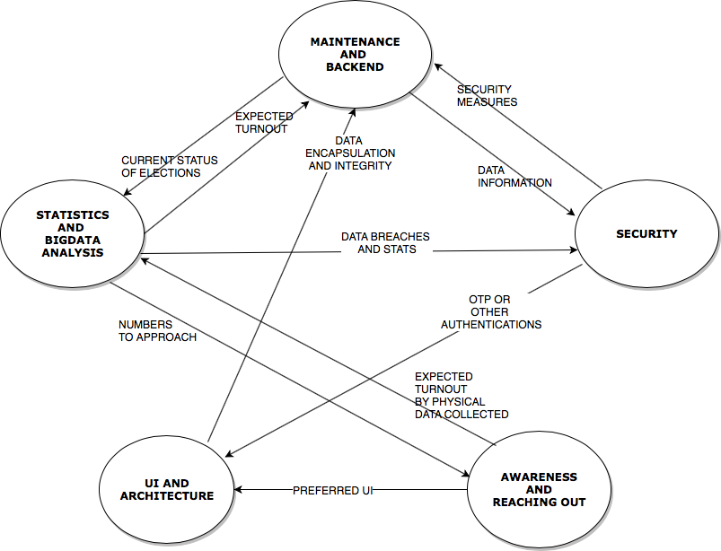
INTERACTION

Slide 29
Our belief in democracy, our values of tolerance, fairness and justice all compel us to uphold the basic right given by DEMOCRACY, RIGHT TO VOTE to choose our leaders on our own and this is an attempt to make it more comfortable and secure.

Slide 30
Thank You

Slide 31
Q&A

