Slide 1
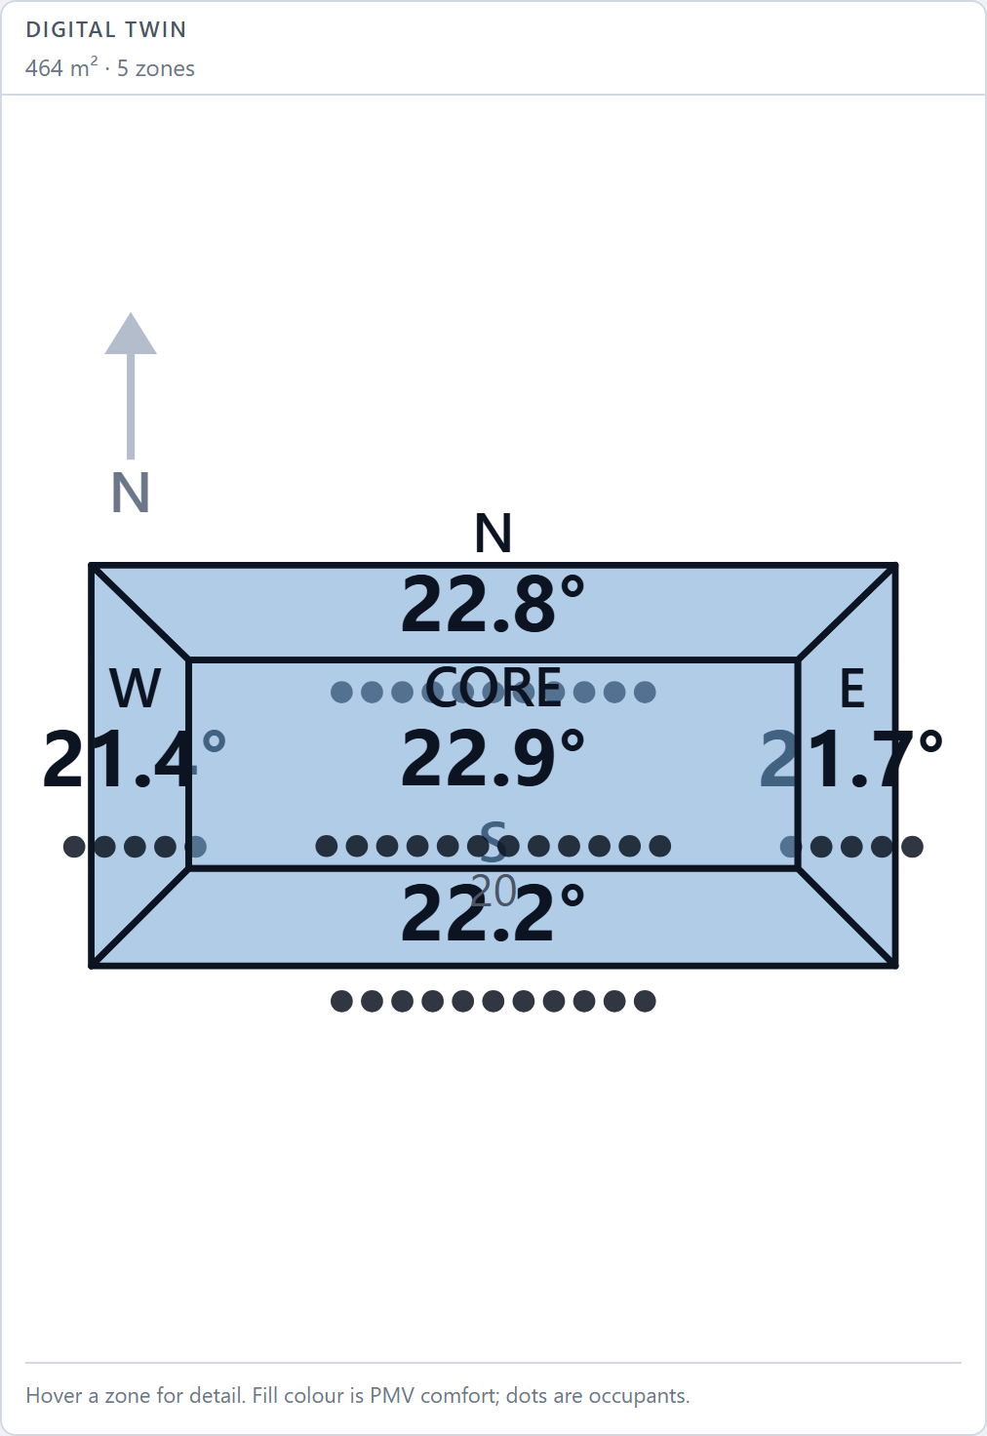
Autonomous Building Management System
An AI agent that reads a live EnergyPlus building, reasons about comfort and energy, and writes control decisions back — inside a safety envelope it cannot exceed.
37%
less cooling energy
87% → 20%
time uncomfortable
0
safety violations
Problem Statement ID: 1
Problem Statement Title: AI-driven autonomous Building Management System
Theme: Smart Automation / Sustainability
PS Category: Software
Team / Student Name: Astitwa Tanmay
Student ID: 1RV23cs056
Notes:
Open with the outcome, not the architecture. We built an AI agent that runs a real EnergyPlus building simulation in closed loop. Measured on an identical summer day, it cut cooling energy 37 percent while reducing time-outside-comfort from 87 percent to 20 percent. The building on the right is the real five-zone geometry from the EnergyPlus model, not a drawing. Fill in the portal fields before submitting.

Slide 2
IDEA — CLOSED-LOOP AI BUILDING CONTROL
A supervisory AI layer over a live physics simulation — sensing, reasoning, and actuation on a real closed loop.
THE PROBLEM
Buildings are ~40% of global energy use.
Fixed schedules ignore live occupancy and weather.
Our baseline building was over-cooled AND wasteful:
occupants uncomfortable 87% of occupied hours.
WHAT I BUILT
EnergyPlus runs live; the agent reads 38 sensors + 9 meters.
Llama 3 picks one of four actions and explains why.
Deterministic code turns the action into a setpoint.
Every command is clamped before it reaches an actuator.
WHY IT IS NOVEL
The LLM never emits a number — only a labelled action.
A rule engine runs alongside as a measured baseline,
replacing fabricated “confidence” with real agreement.
Operator, agent and MCP share one safety-clamped path.
THE AUTONOMOUS LOOP — VISIBLE ON THE DASHBOARD AT ALL TIMES
OBSERVE
38 sensors
9 meters
REASON
Llama 3
~5.6 s
DECIDE
1 of 4
actions
VALIDATE
Safety
envelope
ACT
Actuators
written
RESPOND
Building
reacts
RESPOND feeds the next OBSERVE — control writes back into EnergyPlus, so the loop is genuinely closed.
Notes:
Three columns: the problem, what we built, why it is novel. The single most important design decision is in column three — the language model never produces a number. It selects one of four labelled actions and explains the choice; deterministic code does the arithmetic. That removes unit confusion and hallucinated precision, and makes an unrecognised response detectable rather than plausible. The strip along the bottom is the loop the dashboard renders live.

Slide 3
TECHNICAL APPROACH
Ports-and-adapters: the agent and the dashboard talk to a service layer, never to the simulation.
EnergyPlus 26.1
Annual run · 15-min timesteps · pyenergyplus C API, own thread
STACK
Simulation EnergyPlus 26.1 · pyenergyplus · 5ZoneAirCooled.idf
Backend Python 3.10 · FastAPI · WebSocket · 201 tests
AI Ollama · Llama 3 8B · JSON-constrained, temperature 0
Agent interface Model Context Protocol — 6 tools over stdio
Frontend React 19 · TypeScript · Tailwind 4 · Recharts
Sensor collector
38 output variables, 9 meters · Handles resolved once, cached
Shared state
Immutable snapshots · Sequence-numbered, lock-free reads
Processing
PMV (ISO 7730) · CO₂ mass balance · End-use power breakdown
SAFETY ENVELOPE — APPLIED TO EVERY COMMAND
• Cooling clamped to 22–28 °C, heating to 16–20 °C
• Heating ≤ cooling − 2 °C — an inverted deadband terminates EnergyPlus
• Maximum 1 °C setpoint change per decision
• Non-finite values rejected before clamping (min/max propagate NaN)
• No command → actuators released to the building's own schedule
Policy layer
Llama 3 via Ollama, JSON mode, T=0 · Rule engine as baseline + fallback
Decision engine
Bounds · deadband · rate limit · One ControlStore for every caller
Control
Actuators written before the predictor · Closes the loop into EnergyPlus
↳ Control writes back into EnergyPlus — the loop is closed
Notes:
Left column is the data path, top to bottom, and it is a real closed loop — control writes back into EnergyPlus. Two things to call out. First, timing: sensors are read at the end of a timestep, but actuators must be written before the zone predictor runs, otherwise the write silently does nothing. Second, the safety envelope on the bottom right. The deadband rule is not stylistic — we discovered that an inverted deadband makes EnergyPlus terminate outright, so a hallucinated setpoint would end the demo. That rule is enforced last and unconditionally.

Slide 4
FEASIBILITY AND VIABILITY
Built and measured, not proposed. Same simulated day run three ways under identical conditions.
37%
less cooling energy — measured
Uncomfortable 87% → 20% of occupied time
Metric
No agent
Rule engine
Llama 3
Cooling (kWh)
32.93
21.02
20.72
Total electricity (kWh)
167.85
145.35
145.05
Mean occupied PMV
-0.55
+0.02
+0.04
Time uncomfortable (%)
86.8
14.5
20.0
Model fallbacks
0
0
0
Recorded 07-02 on 5ZoneAirCooled.idf · python scripts/compare_policies.py --date 07-02 --decide-every 4
RISKS AND HOW THEY ARE ALREADY HANDLED
Model is slow, wrong or offline
Rule engine takes over automatically. Verified: a stub failing half its responses produced 100 decisions with zero simulation errors.
Model asks for an unsafe setpoint
Clamped at the actuator boundary. A 4 °C request becomes 27 °C, and the adjustment is logged and displayed.
Results look cherry-picked
One command reproduces the benchmark. Provenance for every figure is on screen: measured, derived or estimated.
Simulation ≠ real building
Nothing above the state store touches EnergyPlus. A BACnet adapter replaces the simulation without changing the agent or safety layer.
NEXT: demand-controlled ventilation (CO₂ is monitored but not yet actuated) · multi-day benchmark · BACnet adapter for real hardware · occupancy forecasting
Notes:
Lead with the measured table — this is the part that separates a built system from a proposal. Both agents cut cooling about 37 percent, and comfort improved at the same time because the unmanaged building was over-cooled: occupants sat at PMV minus 0.55. Be honest that the rule engine and the language model are comparable rather than ranked — this is one simulated day. The risk cards are the answers to the four questions judges always ask, and each one is already implemented.

Slide 5
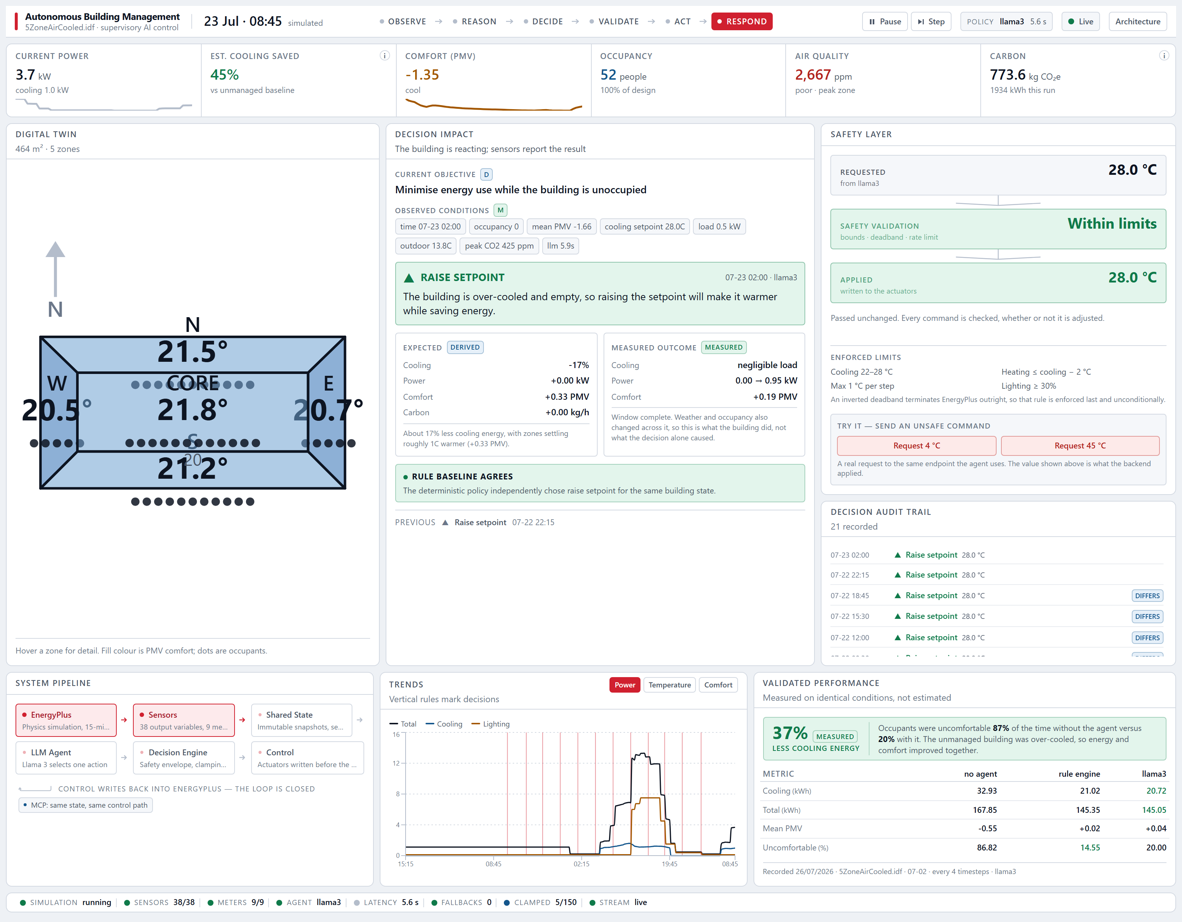
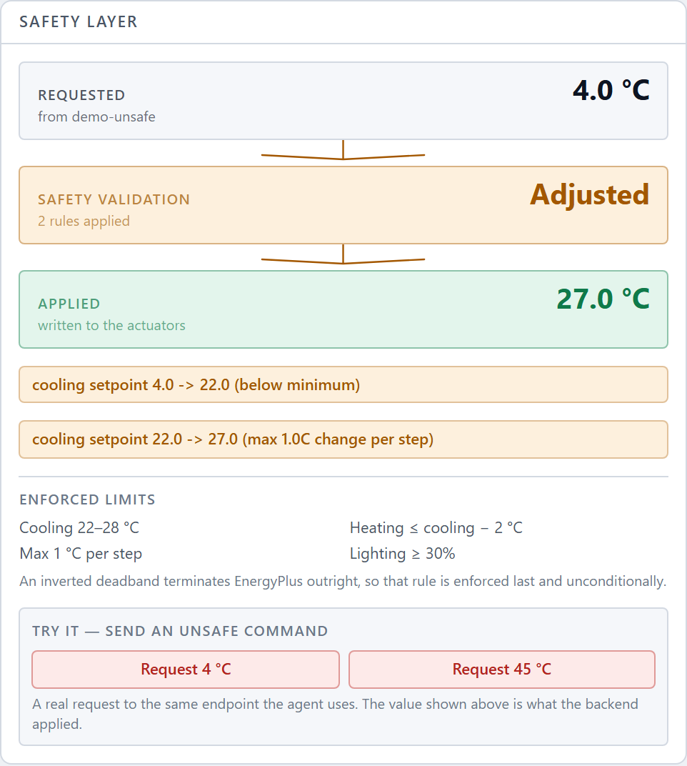
ARTIFACTS
Live operations dashboard — every value labelled Measured, Derived or Estimated, with its basis one hover away.
SAFETY LAYER — A JUDGE CAN TRIGGER THIS
A real request for 4 °C is clamped to 22 °C, then rate-limited to 27 °C. Both rules are shown. The same panel renders commands from the agent, an operator and MCP — one control path, one clamp.
Digital twin uses the real zone polygons from the EnergyPlus model — four perimeter zones around a core.
201 automated tests · 38/38 sensors · 9/9 meters · 0 fallbacks
Notes:
This is one screen, no tabs. Top left is the real building geometry with live comfort colouring. The centre panel is the case file for the current decision: what the agent observed, its own words for why, what it expected, and what actually happened afterwards — we measure the outcome and show the discrepancy rather than hiding it. Right side is the safety layer. Invite the judge to press Request 4 degrees themselves; the clamp is real, it goes through the same endpoint the agent uses.

Slide 6
RESEARCH AND REFERENCES
STANDARDS AND MODELS
• ISO 7730:2005 — Fanger PMV/PPD thermal comfort model
• ASHRAE Standard 55 — Thermal environmental conditions
• ASHRAE Standard 62.1 — Ventilation and CO₂ generation rates
• US EPA eGRID — grid emission factor, 0.40 kg CO₂e/kWh
TOOLS AND PLATFORMS
• EnergyPlus 26.1 — nrel/NatLabRockies, Python plugin API
• 5ZoneAirCooled.idf — DOE reference model shipped with EnergyPlus
• Model Context Protocol — modelcontextprotocol.io
• Ollama · Meta Llama 3 8B — locally hosted, no cloud dependency
REPRODUCING OUR RESULTS
• python scripts/verify_energyplus.py --run — API sanity check
• python scripts/inspect_model.py — which sensors the model exposes
• python scripts/compare_policies.py — regenerates the benchmark
• python scripts/run_server.py --policy llm — dashboard on :8000
Key finding: the unmanaged baseline was over-cooled and wasteful, so energy and comfort improved together rather than trading off.
Notes:
Standards first, because the comfort model is the part judges probe. PMV is ISO 7730; we measure two of its six inputs and state the other four as assumptions. The bottom block is the reproducibility story — four commands take you from a clean machine to the running dashboard, and one of them regenerates the benchmark table on the previous slide.

