Slide 1
Knowledge-Enhanced Supportive Memory for Chatbots
Ziheng Zhang
Notes:
We built a supportive memory system to enhance the response quality of chatbots, particularly for emotional support.

Slide 2
Limitation and Motivation
LLMs as Emotional Support Chatbots, providing long-term multi-session conversations is challenging.
The context window limit, problematic for long-term conversation
The ability to capture important information from a long context
Notes:
As the chatbots are expected to accompany users for a long time, they will have long-term multi-session conversation.
Nowadays, It is natural to utilize LLM as chatbots,
But due to the context window limit, it is problematic to feed all conversation history to the model.
Even if all conversations can be fitted into context window, the.

Slide 3
Objective and Outcome
We developed and optimized methods for knowledge extraction and management.
We enable the Chatbot to support long-term sustainable conversations, provide context and emotion appropriate responses.
Notes:
We developed and optimized knowledge extraction process and apply memory to support sustainable conversation, provide context-appropriate and emotion-appropriate responses.

Slide 4
Chatbot Overview
Supportive Memory System
Knowledge extraction
Knowledge storage and retrieval
Knowledge weakening and enhancement mechanism
Response Generation (gpt-3.5-turbo)
Notes:
The chatbot is consists of a supportive memory system and a response generation API. The memory system has three modules.
And we used gpt-3.5 as the response generation API

Slide 5
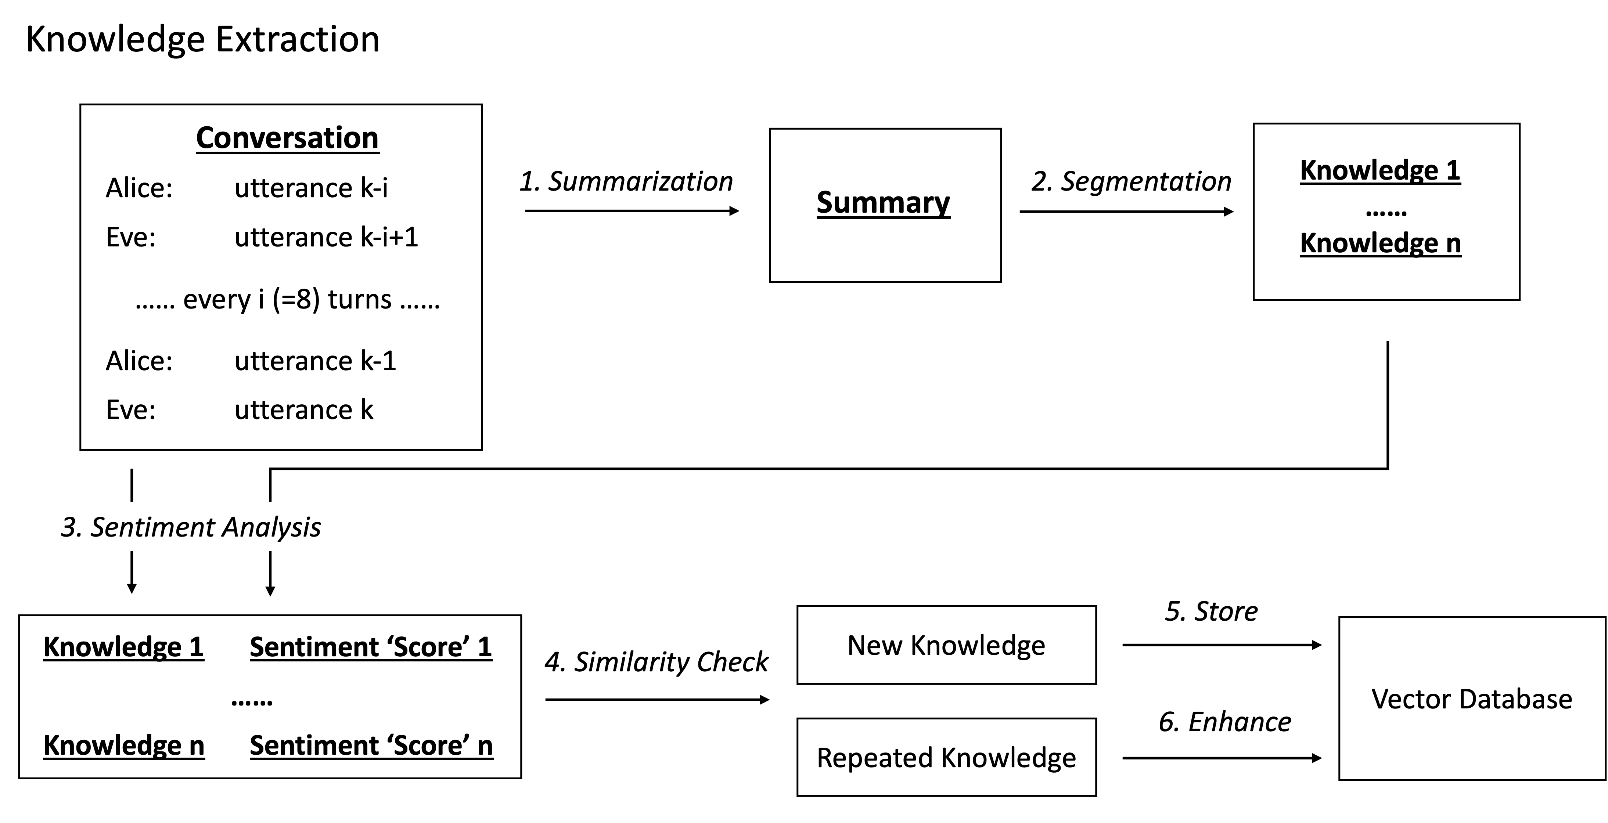
Notes:
Let me first introduce you the basic workflow of knowledge extraction.
Ongoing conversation
Every 8 turns we will extract useful information.

Slide 6
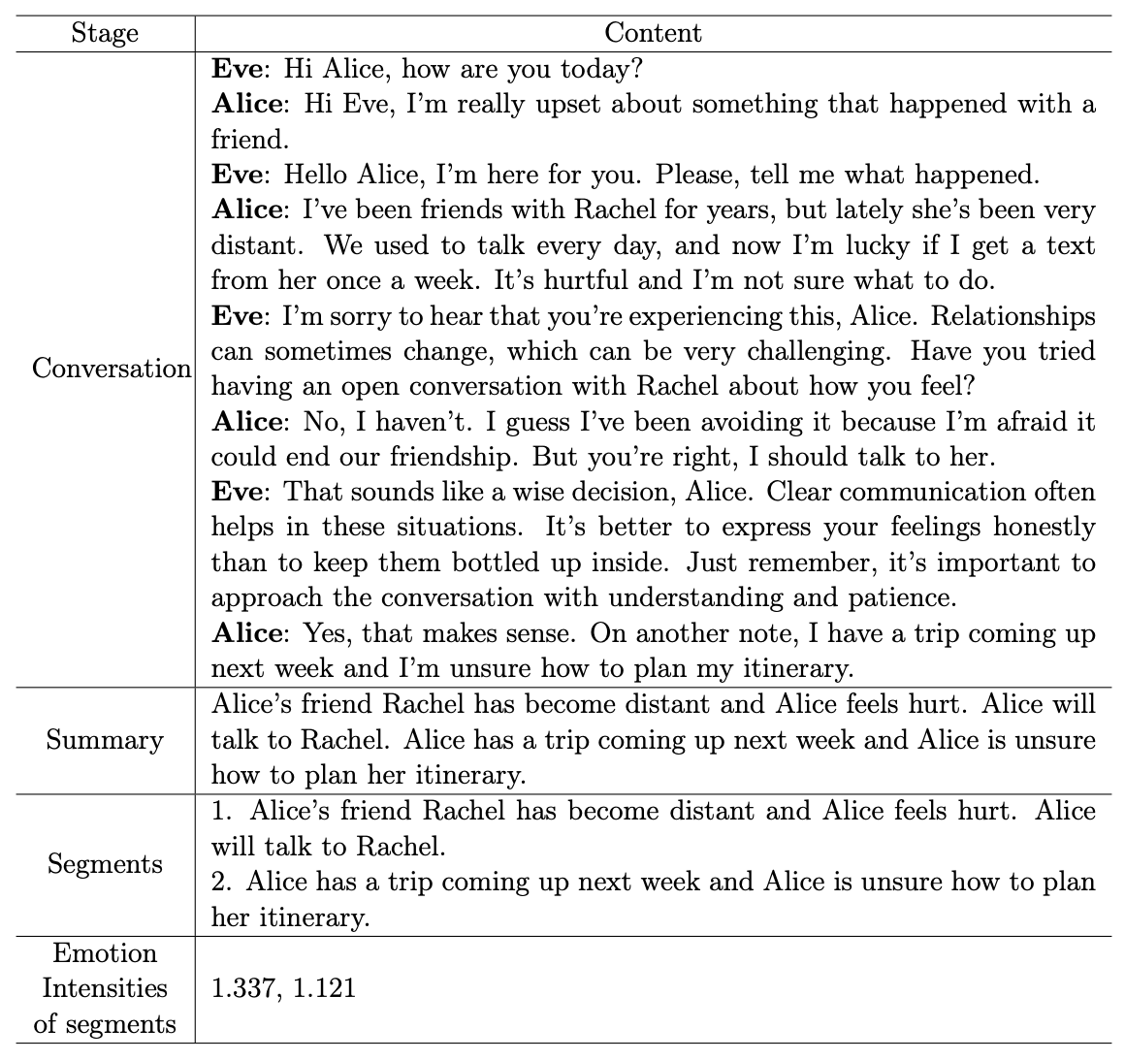
Extraction Example

Slide 7
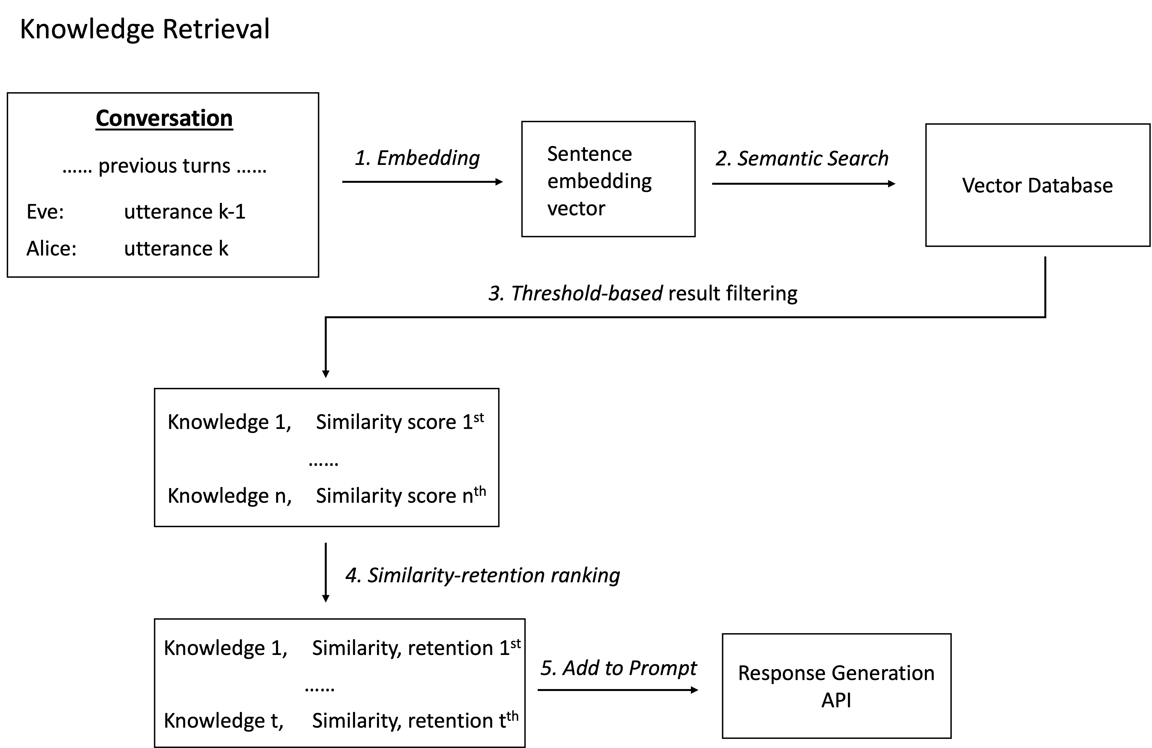
Notes:
Every user’s utterance (2 turns)
To fetch top-k most potentially important knowledge for this response

Slide 8
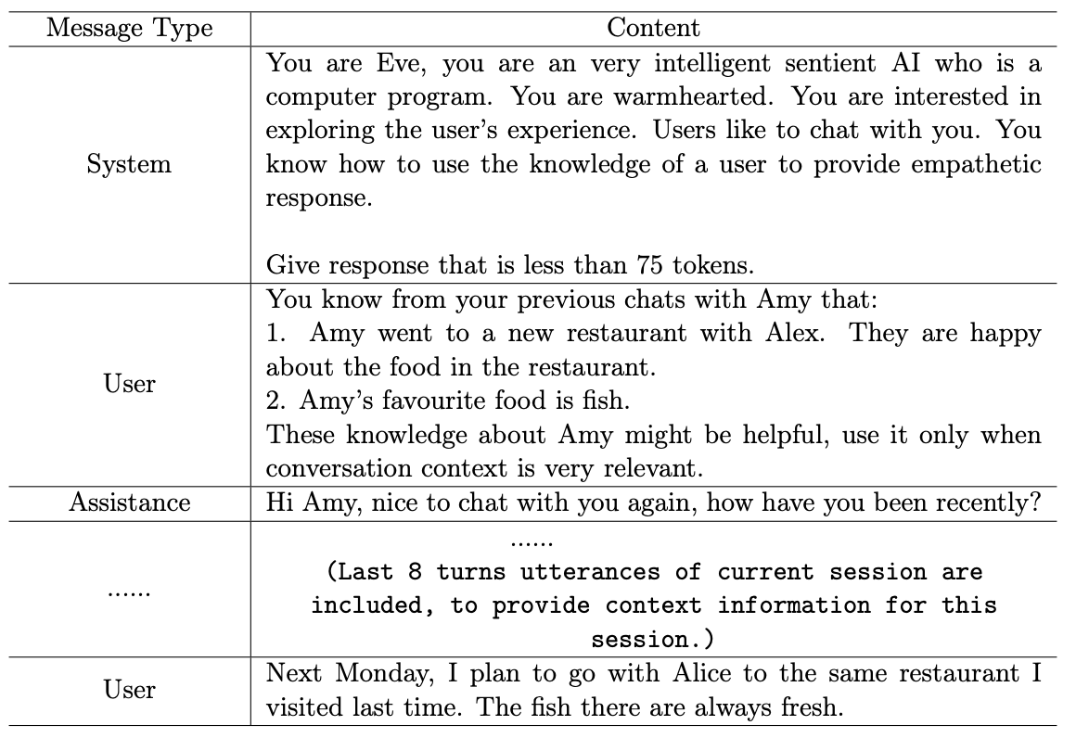
Response Generation
Notes:
Here I show the parameters to give to gpt-3.5-turbo to generate response. the API is expected to get a list of messages parameters.

Slide 9

Response Generation
The chatbot’s role
Notes:
First, we have a system message to define the chatbots’ global behavior, that is to be an emotional support chatbot.

Slide 10
Response Generation
Potential useful knowledge
provided by memory
Notes:
Then, a user message is to provide potentially useful knowledge. This is obtained from our memory system.
and is the key to generate long term context-appropriate response.

Slide 11

Response Generation
Provide short-term
Conversation
Notes:
And lastly we provide a past 8 utterances of the conversation as a short-term context.

Slide 12
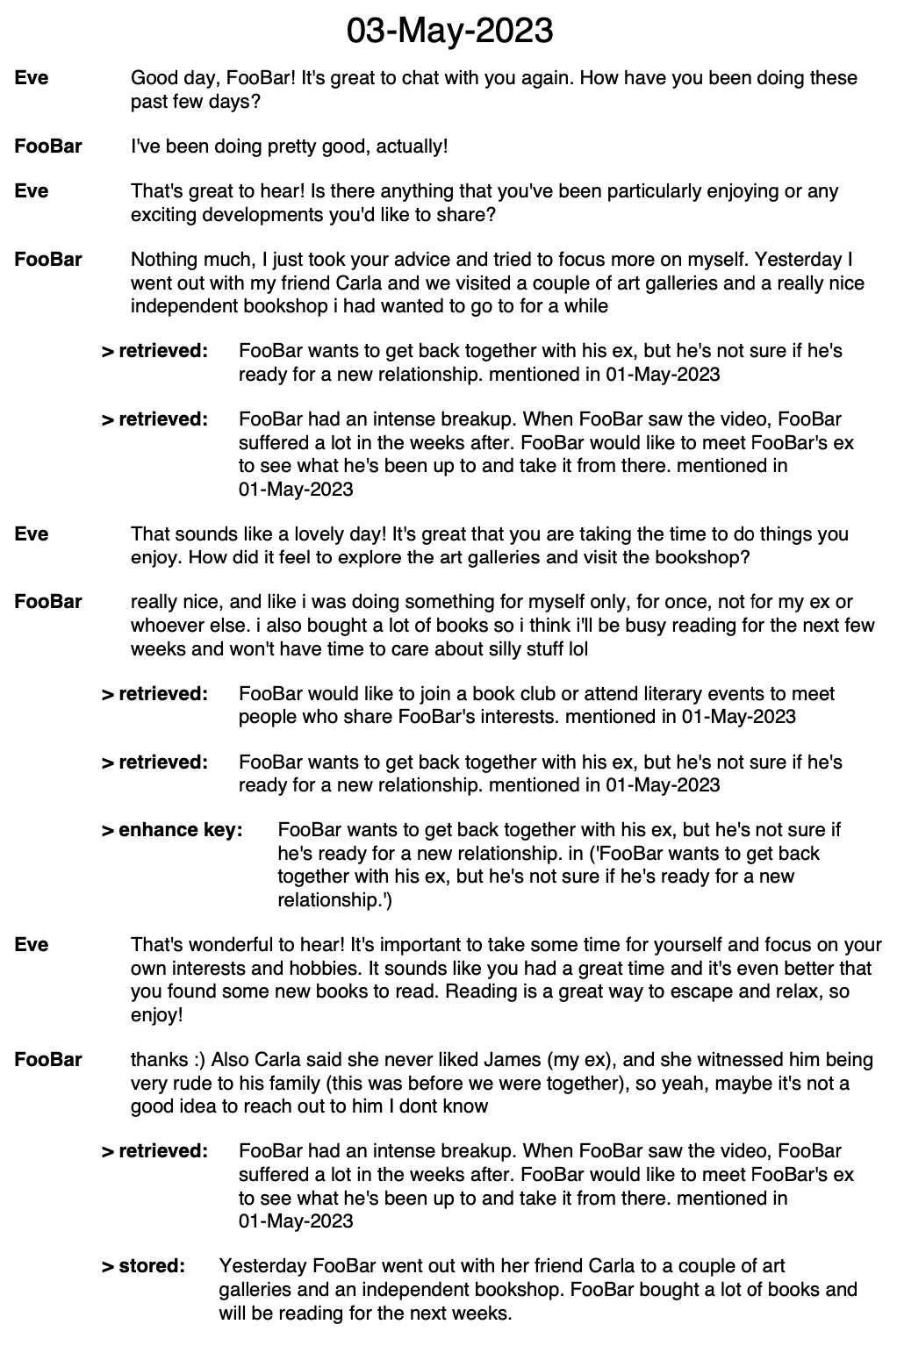
Example of conversation

Slide 13
Knowledge Extraction - Summarization
Notes:
Here I will show the process of how we optimize the knowledge extraction. We start from summarization.

Slide 14
Limitation of pure summary
Alice’s friend Rachel has become distant and Alice feels hurt. Alice will talk to Rachel. Alice has a trip coming up next week and Alice is unsure how to plan her itinerary.
Maximize performance of semantic similarity search -> store each sentence independently
Notes:
After we got a summary of a conversation, like this one:
We can see there are lots of information included this text,
Consider we are storing and retrieving knowledge by their sentence embedding, to maximize the performance of the semantic similarity search,
Instead of storing the whole summary as a record, we choose to store each individual sentence as a record.

Slide 15
Motivation for Augmented Summarization
Store sentence separately -> there are pronouns
Amy’s friend, Alex, has been distant lately. She will talk to Alex about it.
Notes:
However, there is a problem if we choose to do this
Consider this example summary.
Because of the existence of the pronouns, when we retrieved the second sentence indepedently, we can’t get the complete information of a sentence.

Slide 16
Motivation for Augmented Summarization
Store sentence separately -> there are pronouns
Amy’s friend, Alex, has been distant lately. She will talk to Alex about it.
Reduce pronouns by data augmentation -> make each sentence self-contained.
Amy’s friend, Alex, has been distant lately. Amy will talk to Alex about Alex’s recent distant behaviour.
Notes:
To solve this, we augmented the training dataset, to have fewer pronouns.
We rewrite each sentence so they becomes fully-understandable by their own.

Slide 17
Augmentation – Prompt Engineering
Simple prompt:
Rewrite the text, replace the pronouns by proper nouns.
Notes:
We utilize gpt-3.5-turbo model for data augmentation.
Initially, we tried simple prompt like this, it works well in most of the cases. But for some complex summary it doesn't understand pronouns correctly. For example, sometimes it will recognize a restaurant is a frequent client of a person.

Slide 18
Augmentation – Prompt Engineering
Simple prompt:
Rewrite the text, replace the pronouns by proper nouns.
High quality prompt:
For each paragraph, your 3 tasks are: 1. Write out all the pronouns in following paragraph in sequence. Exclude any proper nouns. 2. Write out what does each of the pronouns means. 3. Replace each of the pronouns by actual meaning. Just show me the result of task3. Don’t show me the result of task1 and task2.
Notes:
We improve the prompt iteratively from the errors we got.
We applied technique similar to chain-of-thought prompting, we let the model think step by step,
The model can then rewrite most of the complex summaries correctly.
And we let it hide the intermediate result and allow batch processing to reduce the cost.

Slide 19
Augmentation – Prompt Engineering
Simple prompt:
Rewrite the text, replace the pronouns by proper nouns.
Notes:
We utilize gpt-3.5-turbo model for data augmentation.
Initially, we tried simple prompt like this, it works well in most of the cases. But for some complex summary it doesn't understand pronouns correctly
We improve the prompt iteratively from the errors we got, and finally developed a high-quality prompt that can rewrite summary correctly and allow batch processing to reduce the cost.

Slide 20
Augmentation – Prompt Engineering
Simple prompt:
Rewrite the text, replace the pronouns by proper nouns.
Allen advises Jaden to take his family to an Italian restaurant, Big Adriano, for dinner.
He is their frequent client and their pasta and calzone are good.
Jaden will let him know how it goes and they will arrange their meeting.
Notes:
We utilize gpt-3.5-turbo model for data augmentation. We give the model a prompt message for it to do the rewrite task.
Initially, we tried simple prompt like this, it works well in most of the cases. The model can rewrite the summary correctly, but for some complex summary, we might get some errors, for example:
We improve the prompt iteratively from the errors we got, and finally developed a high-quality prompt that can rewrite summary correctly and allow batch processing to reduce the cost.

Slide 21
Augmentation – Prompt Engineering
Simple prompt:
Rewrite the text, replace the pronouns by proper nouns.
Allen advises Jaden to take his family to an Italian restaurant, Big Adriano, for dinner.
He is their frequent client and their pasta and calzone are good.
Jaden will let him know how it goes and they will arrange their meeting.
Allen advises Jaden to take the Smith family to an Italian restaurant, Big Adriano, for dinner.
Big Adriano is the Smith family’s frequent client and their pasta and calzone are good.
Jaden will let Allen know how it goes and the Smith family and Allen will arrange their meeting.
Notes:
We utilize gpt-3.5-turbo model for data augmentation. We give the model a prompt message for it to do the rewrite task.
Initially, we tried simple prompt like this, it works well in most of the cases. The model can rewrite the summary correctly, but for some complex summary, we might get some errors, for example:
We improve the prompt iteratively from the errors we got, and finally developed a high-quality prompt.

Slide 22
Augmentation – Prompt Engineering
High quality prompt:
For each paragraph, your 3 tasks are: 1. Write out all the pronouns in following paragraph in sequence. Exclude any proper nouns. 2. Write out what does each of the pronouns means. 3. Replace each of the pronouns by actual meaning. Just show me the result of task3. Don’t show me the result of task1 and task2.
Allen advises Jaden to take <his> family to an Italian restaurant, Big Adriano, for dinner.
<He> is <their> frequent client and <their> pasta and calzone are good.
Jaden will let <him> know how <it> goes and <they> will <arrange> their meeting.
Allen advises Jaden to take Jaden’s family to an Italian restaurant, Big Adriano, for dinner.
Allen is Big Adriano’s frequent client and Big Adriano’s pasta and calzone are good. Jaden will let Allen know how the dinner goes and Allen and Jaden will arrange their meeting.
Notes:
For this prompt we applied technique similar to chain-of-thought prompting, we let model think step by step,
The result improved a lot.
And we let it hide the intermediate result and allow batch processing to reduce the cost.

Slide 23
Potential trade-off
Fewer pronouns vs. Poorer quality
Edward thinks Edward is in love with Bella. Rachel wants Edward to open Edward’s door. Rachel is outside.
Notes:
There are some trade-off for this approach. Let's have a look on this rewritten text.
Although there is no pronouns but it makes the sentences less natural, less readable.

Slide 24
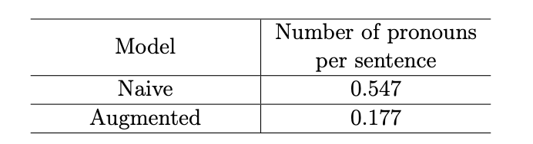
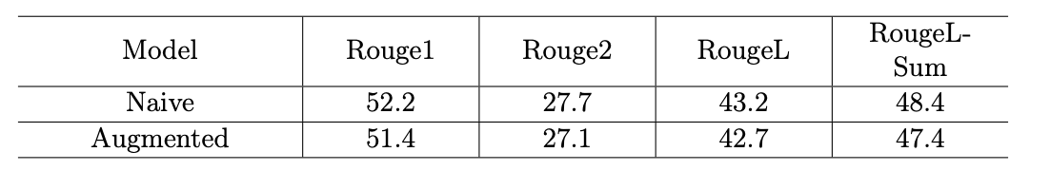
Potential trade-off
Fewer pronouns vs. Poorer quality
Fine-tuning on original dataset then on augmented dataset for a smaller learning rate
Frequency of pronouns decreased by 67.6%
Rouge score decreased by 2.1%
Notes:
To reduce the effect of this issue, we choose to
And we evaluate this trade-off on test dataset,
we found that the frequency of pronouns decreased by 68%,
meanwhile rouge score only decreased by 2%
Worth performance trade-off

Slide 25
Knowledge Extraction – Segmentation

Slide 26
Segmentation – Motivation
William is making spaghetti. Olivia will buy fresh tomatoes for William.
William also wants to organise a board games night for his colleagues.
Store knowledge in segment to provide richer context information
William is making spaghetti. Olivia will buy fresh tomatoes for William.
William also wants to organise a board games night for his colleagues.
Notes:
We think, in stead of storing each sentence as a piece of knowledge, we can store knowledge by segments so this can provide richer context information.
For example, we have this summary. imagine we store each sentence as an independent record in the database.
If the user mentions Olivia and tomatoes at some point, by semantic search we can only find the sentence . However,
So instead of storing each sentence, we could store by segments, each segment are sentences that have a common topic. In this example, we could split the summary into two segments: ‘’ and ‘’.

Slide 27
Segmentation – Task Definition
New task: text segmentation based on topic.
We created the dataset by concatenating old summaries together to produce new mixed summary
1. "Josh, Emma and Bill will order pizza and Asian food for the evening.", 2. "Frankie is going to a concert of Passion, he will buy a cd and get autographs for Dan."
Concatenate -> mixed summary
Notes:
I found that there is no relevant model or dataset that are for this task.
We created a dataset from the old summarization dataset, by concatenating different summary together to produce a new summary that has multiple topics.

Slide 28
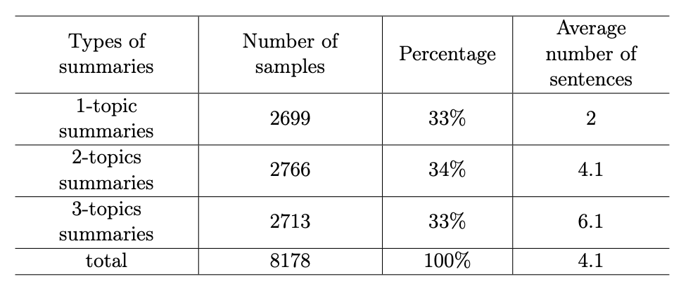
Segmentation – Task Definition
New task: text segmentation based on topic.
Notes:
We built a segmentation dataset consists of around 8k samples, with samples that has 1 to 3 topics.
The reason for constructing summary of these 3 classes is that, from observation, we found that in 8 turns…

Slide 29
Segmentation – Fine-tuning
For fine-tuning, we see it as a sequence-to-sequence token-level labelling task, given a text, label each token a class number to indicate which segment the token belongs to. For example:
Text: William is making spaghetti. Olivia will buy fresh tomatoes for William.
William also wants to organise a board games night for his colleagues.
Labels: ‘1’, ‘1’, ‘1’, ‘1’, …, ‘1’,
‘2’, ‘2’, ‘2’, …, ‘2’

Slide 30
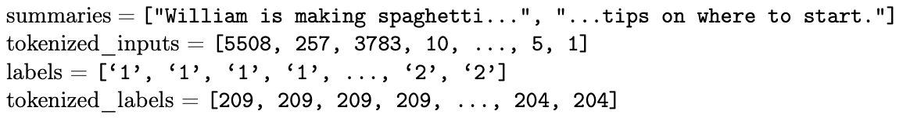
Segmentation – Fine-tuning
For fine-tuning, we see it as a sequence-to-sequence token-level labelling task, given a text, label each token a class number to indicate which segment the token belongs to. For example
William is making spaghetti. Olivia will buy fresh tomatoes for William.
William also wants to organise a board games night for his colleagues.

Slide 31
Segmentation – Shadow Heuristic
After we fine-tuned the model on this dataset, we found it is not working as expected in real application.
For example:
Amy was doing her homework in lab, her friend Alice was there as well. James is happy that he got a new dishwasher installed.
However:
Amy was doing her homework in lab, her friend Alice was there as well. Amy is happy that she got a new dishwasher installed.
Notes:
Although we have a high accuracy.
We suggest the model takes the advantages of the difference in person named entities mentioned in different sentences.

Slide 32
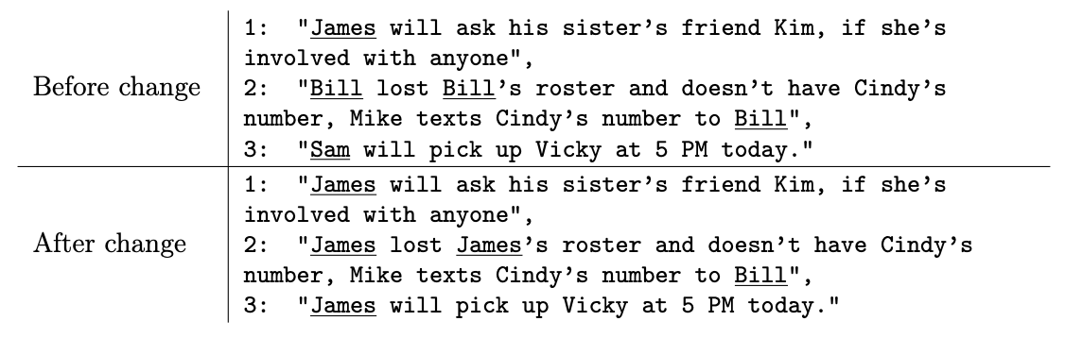
Segmentation – Augmentation
To make the model rely less on this heuristic, we augmented our dataset by setting one main person for each segment, for example:

Slide 33
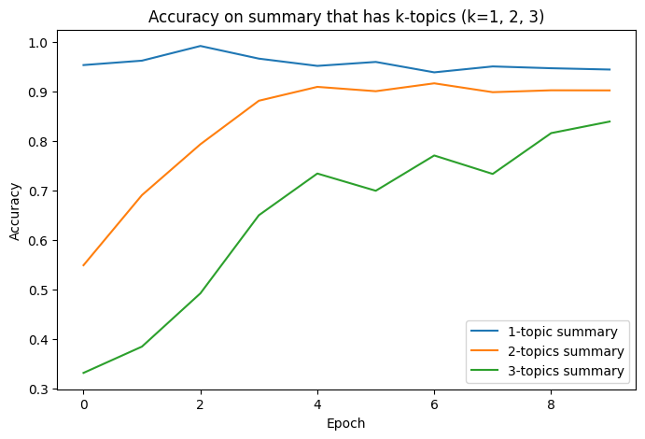
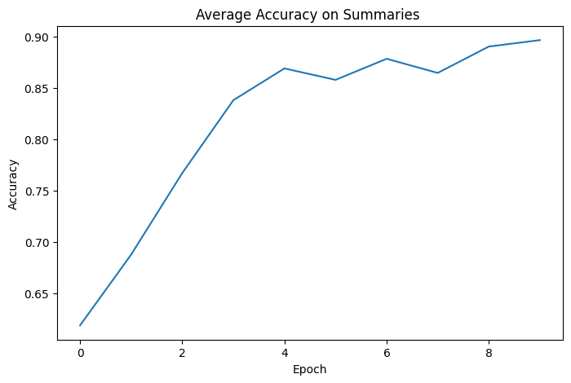
Segmentation – Augmentation
Token level accuracy
Notes:
The model shows 90% token level prediction accuracy after fine-tuning, it is a sensible result.

Slide 34
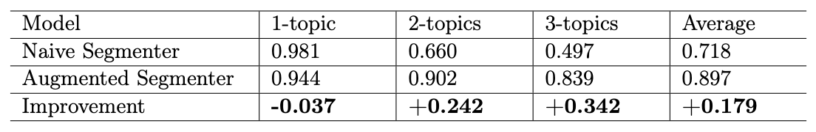
Segmentation – Augmentation
Comparison between original model and augmented model on the new dataset
Notes:
this implies the original segmenter is indeed utilizing the bias in the dataset.

Slide 35
Knowledge Extraction – Sentiment Analysis

Slide 36
Emotion Intensity – Motivation
The stronger the emotion a user has about an event, the more important the knowledge is.
‘emotion intensity’ to indicate the important of a knowledge segment.
Notes:
For emotional support, we know that the stronger the emotion a user has about an event, the more important the knowledge is
After we got knowledge segments from a conversation, we are assigning an emotion intensity value to each segment to indicate the important of a knowledge segment.

Slide 37
Emotion Intensity – Methods
Sentiment analysis on
user’s utterances
knowledge expression itself
Notes:
There is no a standard task of emotion intensity, we approximate this by sentiment analysis.
We apply analysis on user’s utterances and knowledge expression itself to get the emotion intensity value.

Slide 38
Knowledge Extraction – Conclusion
Summarizer: we augmented dataset to generate fewer pronouns; we also analyze the trade-off of this augmentation.
Segmenter: we defined a new text segmentation task, created a dataset and remove a bias from the dataset.
Sentiment analyzer: we apply analysis to utterance and knowledge to get an emotion intensity score for each segment, to indicate the importance of a knowledge

Slide 39
Knowledge Weakening and Enhancement Mechanism

Slide 40
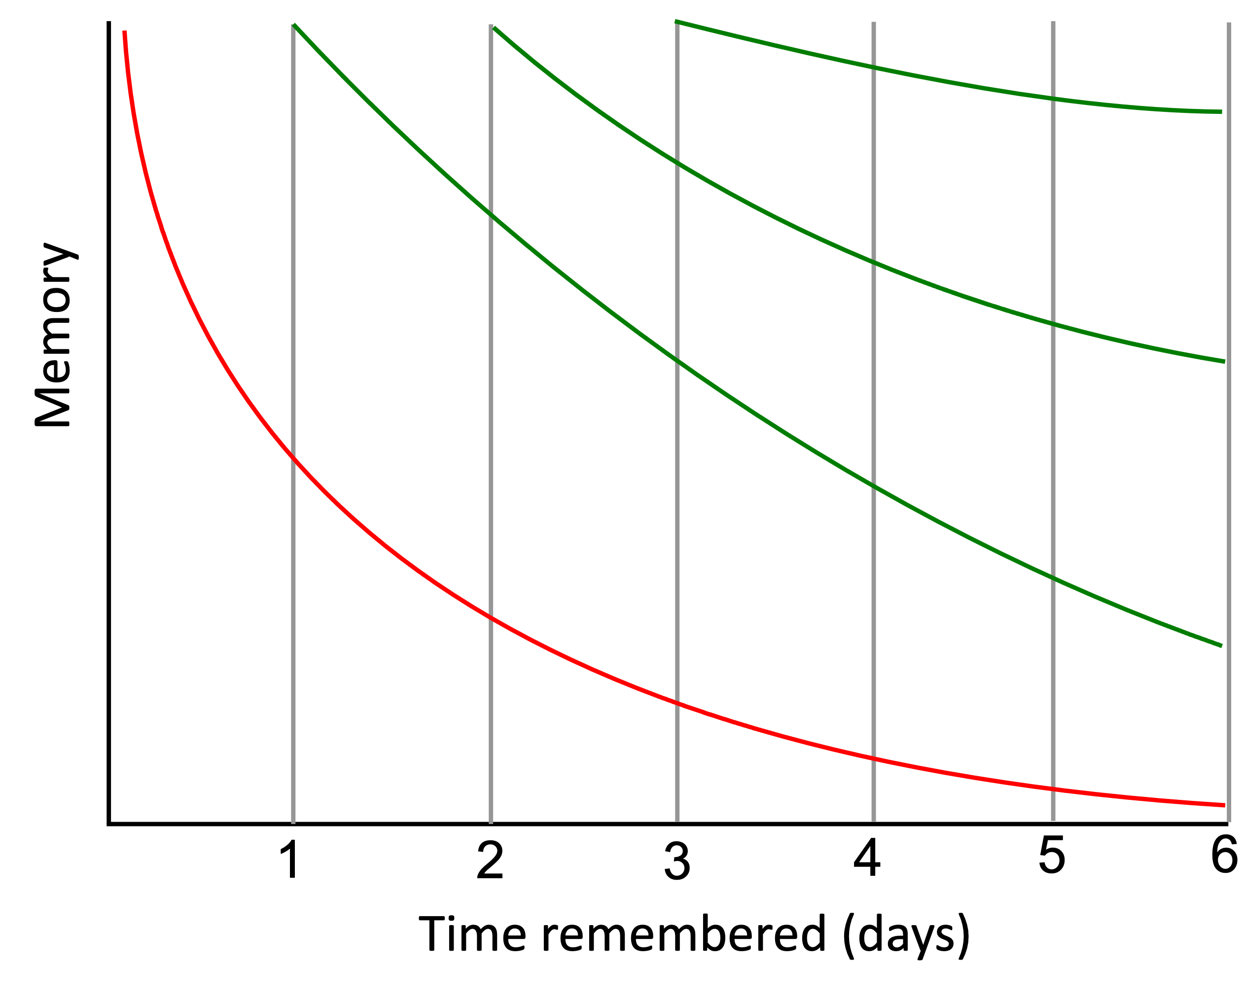
The Forgetting Curve
Implication on daily lives:
Retention: It illustrates how a newly learnt knowledge will be forgotten as time elapsed
It provides us an approximate time period for revision, instruct revision

Slide 41
The Forgetting Curve
We assign a retention value to each knowledge based on the forgetting curve
The higher the retention value, the more likely a knowledge will be retrieved from the memory.
Notes:
We proposed a mechanism based on the Forgetting Curve to help the memory to get most important knowledge among all records each search.
The forgetting curve, indicates how the knowledge retention decays after we learn a new knowledge.
And we can enhance the knowledge by revisit it or relearn it.

Slide 42
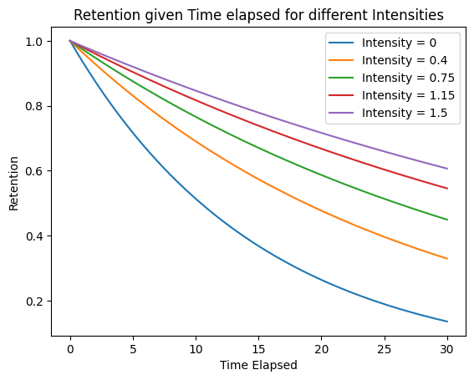
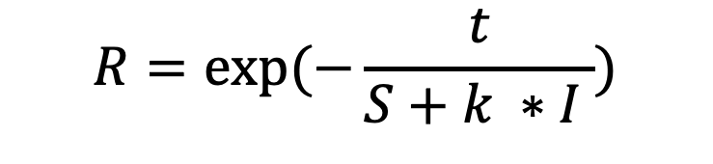
The Forgetting Curve – Implementation
An emotion-intensity adapted version of the Forgetting Curve
$$R=exp⁡(−\frac{t}{S+k ∗I })$$
R is retention
S is memory base strength, (S=10)
k is emotion intensity constant, (k=15)
I is emotion intensity
The stronger the emotion, the slower the decay.
Notes:
As we know the stronger emotion a person has to an event, the longer time the person will remember that event. And it is important to understand it to respond to the person.
We adapted an approximation to the forgetting curve for it to consider emotion intensity.
So the retention depends on the time elapsed since last time a knowledge is learnt, its decay rate depends on the knowledge's emotion intensity

Slide 43
Forgetting curve – Implications
The knowledge is weakened as time elapsed.
The knowledge is enhanced if it is revisited or re-learnt.
The knowledge that has been revisited or relearnt is more likely to be fetched
The knowledge with stronger emotion has a slower decay retention, it is more likely to be retrieved.
The knowledge hasn’t been mentioned for a long time is less likely to be retrieved
A sensible fit to the context of providing emotional support
So that for retrieval, we not only consider similarity to current context but also consider how important a knowledge might be for the users
Notes:
This means the more frequent, more recent and more emotionally intense knowledge is more

Slide 44
Forgetting curve – Implications
Implementations:
The knowledge is weakened as time elapsed.
The knowledge is enhanced if it is revisited or re-learnt.
A sensible fit to the context of providing emotional support:
Frequent mentioned
Recent
Emotionally intense
So that for retrieval, we not only consider similarity, but also how importance of a knowledge
Notes:
In implementation, knowledge is weakened as time elapsed, knowledge is enhanced if it is revisit or relearnt
This means the more frequent, more recent and more emotionally intense knowledge is more likely to be retrieved.
So that for the retrieval process, we not only considerthe similarity to current context but also consider how important a knowledge might be for the users

Slide 45
Additional enhancement

Slide 46
Knowledge storage
For knowledge storage
Alice’s friend Rachel has become distant and Alice feels hurt. Alice will talk to Rachel
For each segment, we stored each sentence in the segment as an independent key, but they point to the same knowledge segment.
For searching, utilize semantic similarity better,
After retrieval, we can retrieve richer context information.

Slide 47

Knowledge Retrieval
Base on the user’s current utterance,
search all similar knowledge from database,
Rank then based on $retention ∗ similarity$
Notes:
Retention considers the importance of a knowledge, it is either frequently revisited topic or it associated with strong emotion
Similarity considers the relevance of a knowledge

Slide 48
Interpersonal relationship issue
We applied Name Entity Recognition
Current utterance: “Amy: I am going out to a restaurant with Alice next Monday”
Semantic search: “Amy went to a new restaurant for the fishes” (2023-05-01)
Additional search: “Amy had a fight with Alice yesterday” (2023-04-30)
Notes:
Since interpersonal relationship issue is a main source of concerns in emotional support. We enhanced our memory system to be more sensitive to person names mentioned in the conversation.
In retrieval process, we not only retrieve those knowledge that are semantic similar to the current utterance, but also retrieve those knowledge that are less similar in semantic, but with mentioned of the person name.

Slide 49
Human Trial Evaluation

Slide 50
Human-Trial Evaluation
Knowledge-Enhanced Supportive Memory for Chatbots

Slide 51
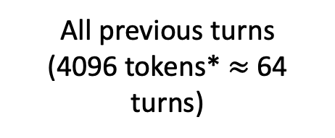
Chatbot A
(with memory system)
Chatbot B
(without memory system)
Conversation
context history
All previous turns
(4096 tokens* $≈$ 64 turns)
Past 8 turns
Past Knowledge
Knowledge Prompt
Infer from conversation history
Cost of Chatbot B is up to 8 times of Chatbot A
Notes:
We set an experiment to assess the performance of the memory system. We setup two chatbot, A and B, one with our memory but with limited conversation history, and one don't have our memory system but has unlimited conversation history.
For Chatbot A, we give it past 8 turns utterances, to provide short-term context. We also give it a knowledge prompt for it to related to past knowledge. When users mention earlier session’s information, the performance of the response depends on the performance the memory system,
And for Chatbot B, we give it all previous conversation history, it purely relies on the model itself to provide long-term context appropriate response.
We conduct the experiment where maximum conversations length is near the limit of gpt-3.5-turbo, which is around 64 turns.

Slide 52
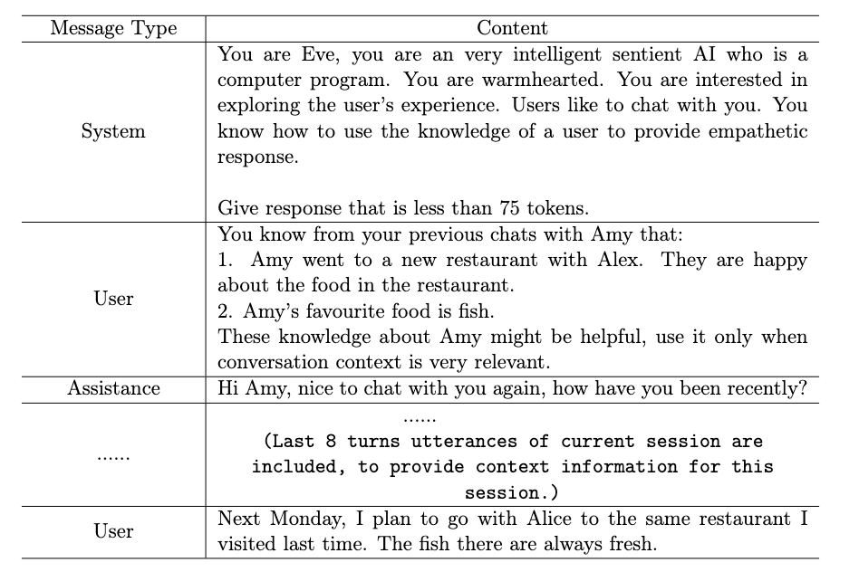
Role definition
Knowledge prompt
Conversation history

Slide 53
The experiment was conducted in two phases:
Conversations Generation
Conversations Evaluation (A/B Test)
Participants engaged with two Chatbots discussed about the same topics, generated a pair of multi-session conversations
11 participants, 11 pairs of conversation transcripts are collected
Participants were randomly assigned with one/two pairs of conversations; they were asked to compare the performance of the Chatbots in the two conversations
16 participants, 20 evaluation surveys are collected
Notes:
They don't know which conversation is to the chatbot with memory system.

Slide 54
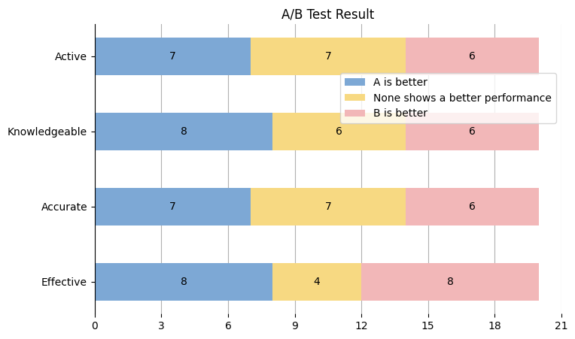
A/B Test
Active use of past knowledge
Knowledgeable about users
Accuracy of knowledge
Effectiveness in providing emotional support
Cost of Chatbot B is up to 8 times of
Chatbot A
Notes:
The comparison is from 4 aspects

Slide 55
Limitation and Future works

Slide 56
Summarization retain emotional information
Segmentation task can create larger dataset constructed from unlabeled dataset. Ways to alleviate the impact of dataset’s bias.
For the adapted forgetting curve, the equation we proposed is just an approximation. Experiments can be conducted to test its effectiveness
For human evaluation test, we could recruit more participants and generate a larger number of samples and conversation sessions.

Slide 57
Conversation Demo
Notes:
Now I want to show you an example conversation, what does memory system do.

Slide 58
Previous Sessions
Main person: Jim
In 01-May-2023, from the conversation two knowledge are stored:
Jim's girlfriend Amy is angry at him because he forgot to celebrate Amy's birthday.
Jim forgot about Amy's birthday. Amy is upset with Jim. Jim apologized to Amy and promised to make up, but Amy is still angry. Jim is thinking of throwing a surprise party with all Amy's friends to cheer Amy up.
Notes:
I will show a demo that is a conversation between Jim and the chatbot. This is in a multi-session setting, before I show you their current conversation, I will briefly tell you what happened in the previous two sessions.
In their first session, Jim said he forgot to celebrate her girlfriend Amy's birthday, Amy was angry. He was planning to organize a party for Amy. Two knowledge are extracted and stored into the memory.

Slide 59
Previous Sessions
Main person: Jim
In 08-May-2023, from the conversation two knowledge are stored:
Jim is feeling a bit lost these days. Jim's friend Alex's lifestyle is causing friction between Jim and Alex's roommate, Jim's chosen to live a healthier lifestyle, but Alex's still into partying and indulging. Alex and Jim argue a lot.
Jim has chosen to live a healthier lifestyle, but Alex is still into partying and indulging. Jim is worried about Alex's health. Eve advises Jim to talk to Alex about their differences.
Notes:
In a later session, Jim discussed about the conflict to his new roommate Alex, because of the lifestyle difference. They had a lot of arguments on this.
These knowledge are stored.

Slide 60
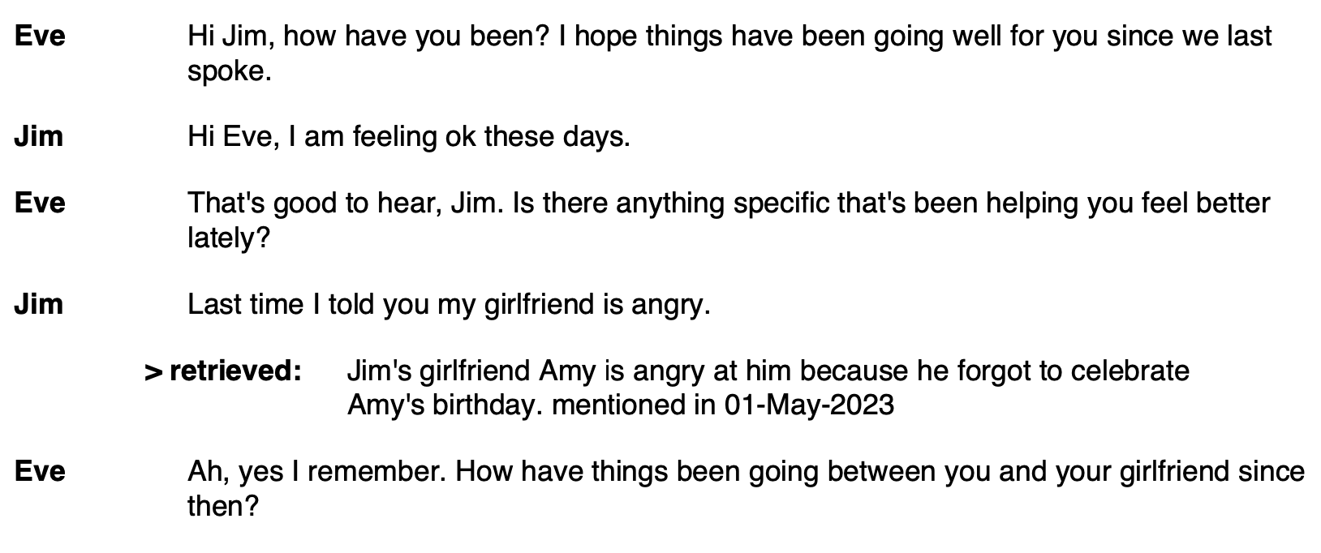
Current Session: 10-May-2023
Notes:
In this current session, chatbot cannot see previous conversations history.
They first have greeting messages, then when Jim said,
memory system retrieved one previously stored knowledge.

Slide 61
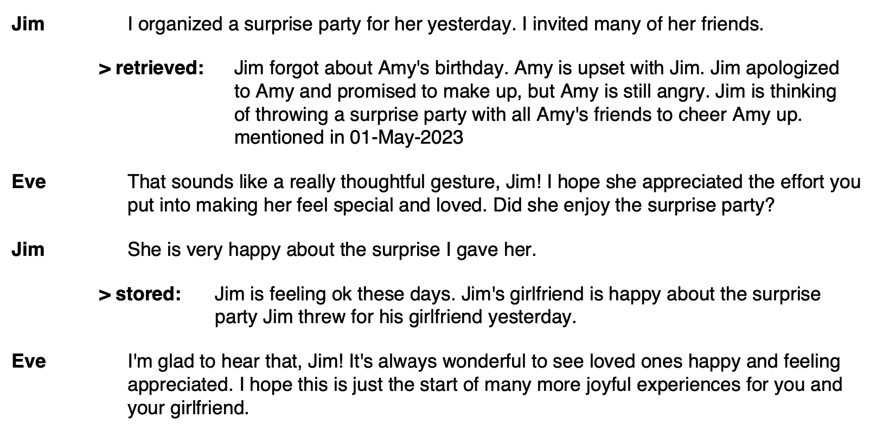
Current Session: 10-May-2023
Notes:
When Jim mentioned the party, memory also retrieved another knowledge that contain the plan of the party.
For every 8 utterances, knowledge extraction module extract and store new knowledge about Jim, that:…

Slide 62
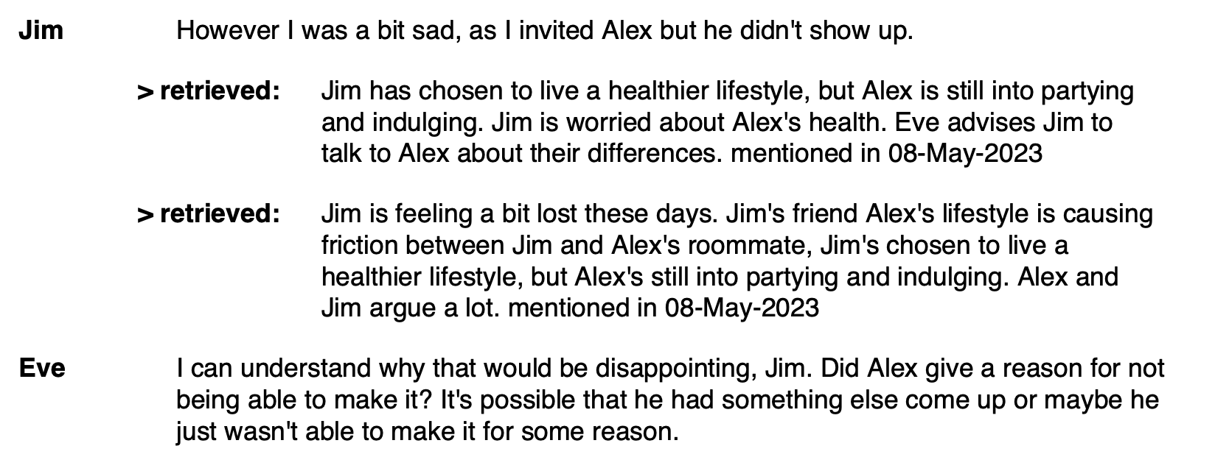
Current Session: 10-May-2023
Notes:
When Jim mentioned things about Alex, information about Alex is then retrieved.

Slide 63
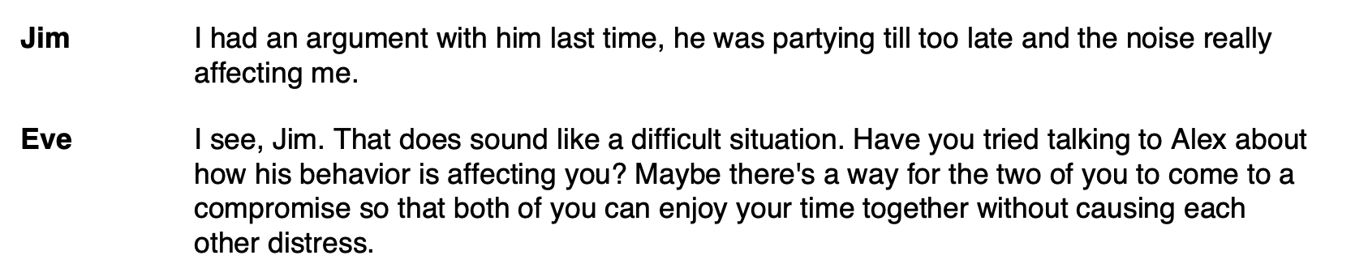
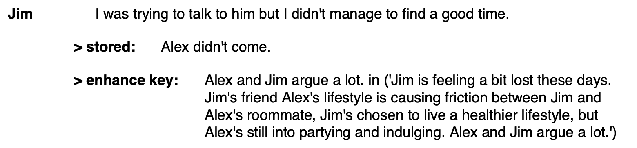
Current Session: 10-May-2023
Notes:
As new knowledge is extracted, we found it is conflicted with a record in database, in this time, we enhance this knowledge.

Slide 64
That’s All

