Slide 1
EX4 Introduction
吳致達
oscarwu217@alum.ccu.edu.tw
Notes:
Hi everyone , I am the teacher assistant of this course , this is my name right here.
So I will make introduction and simple guides of homework 2 today . If you guys have any problems ,you can contact me with this e-mail address or just use e-course system should be fine.

Slide 2
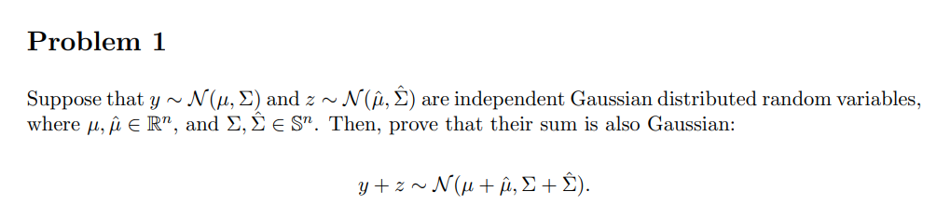


Linearity of Expectation:
covariance matrix:

Slide 3
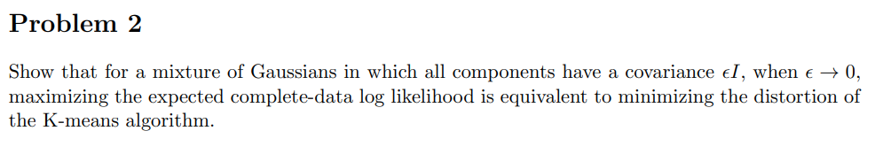
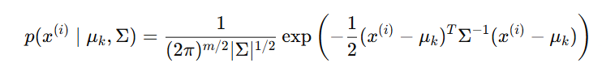
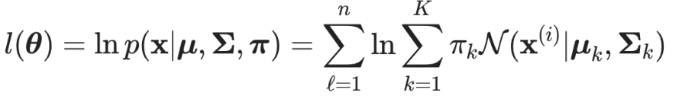
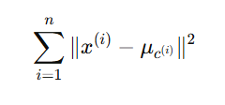
Multivariate Gaussian Density Function:
Log Likelihood in GMM:
K-means objective function:
Notes:
In this problem, we are asked to connect the Gaussian Mixture Model (GMM) and the K-means algorithm by analyzing the complete-data log likelihood under a specific constraint:
aim to show that maximizing the expected complete-data log likelihood becomes equivalent to minimizing K-means distortion under this condition.
Replace Σ\Sigma in the Gaussian density with ϵI\epsilon I
Analyze the Behavior as ϵ→0
Recover the K-means Objective

Slide 4
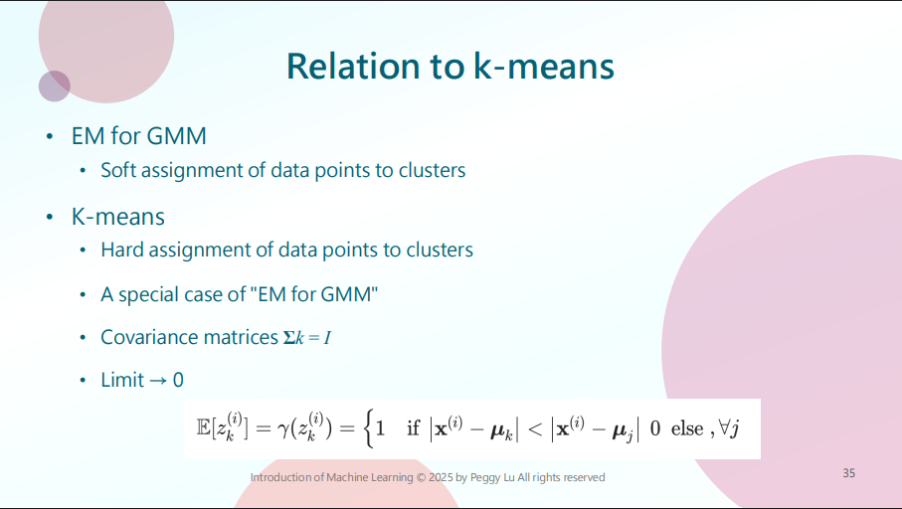
Notes:
If you check out p.35 in course PDF, you will probably have clear idea of how to solve this one.

Slide 5
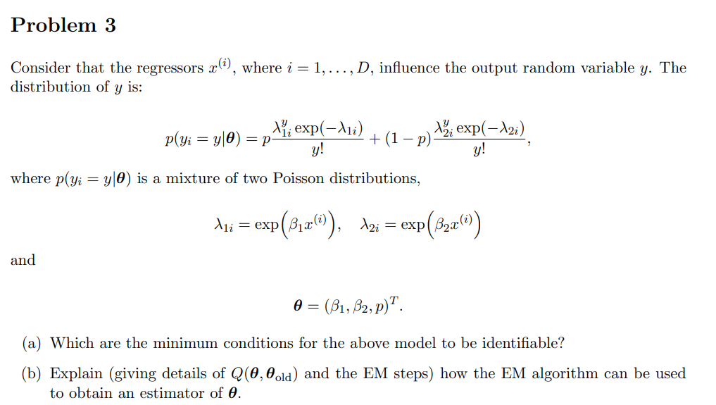
Notes:
You’re given a mixture of two Poisson distributions where the rate parameters λ1i​ and λ2i\​ are regressor-dependent, i.e., influenced by the input x(i). The task is to analyze this model and explain how to estimate its parameters using the EM algorithm.
For(a) Discuss identifiability conditions (e.g., parameter uniqueness and distribution distinguishability)
(b) Define the complete-data log-likelihood Q(θ,θold) and explain the E-step (responsibility computation) and M-step (parameter update).

Slide 6
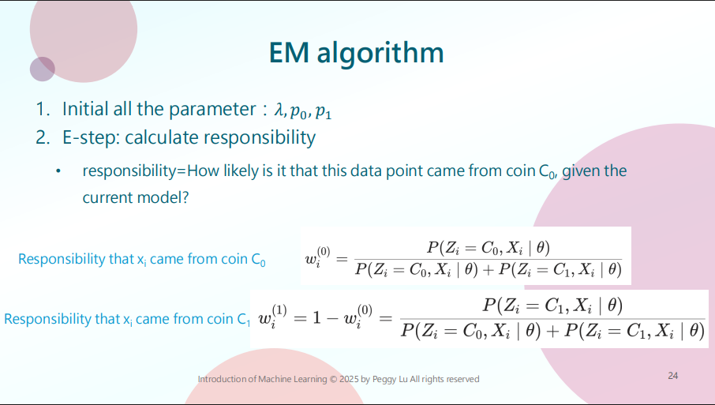
Notes:
If you check out p.35 in course PDF, you will probably have clear idea of how to solve this one.

Slide 7
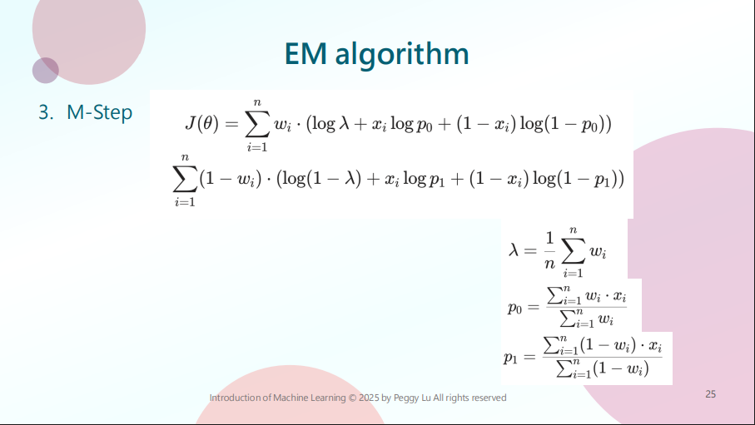
Notes:
I

Slide 8
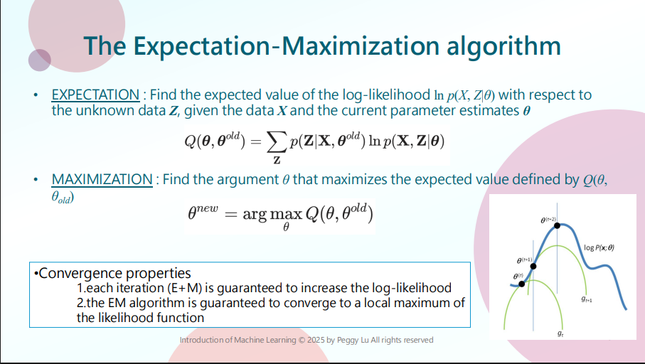
Notes:
I

Slide 9
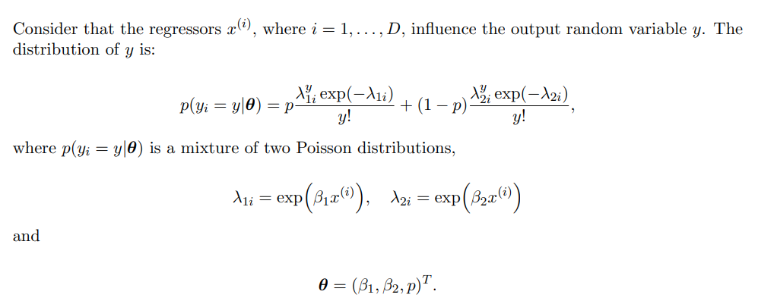

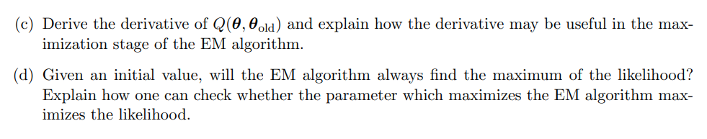
The gradient is used to find optimal θ in the M-step
(e)
Notes:
( c ) Derive the derivative of Q . parameters and explain its role in the M-step.
To address this, consider:
Q(θ, θ_old) is the expected value of the complete-data log-likelihood, given the observed data and the current parameter estimates.
Think about how latent variables (e.g., indicators for which Poisson component each observation came from) help form the complete-data likelihood.
After expressing Q, you need to take partial derivatives with respect to the parameters β1, β2, and p.
Focus on the chain rule (e.g., λ depends on β through an exponential function, and λ is part of the Poisson term).
(d) Discuss EM’s convergence properties (does it always find a local maximum?).
(e) Explain how to verify if the EM solution maximizes the likelihood.

