Slide 1
HW2 Introduction
吳致達
oscarwu217@alum.ccu.edu.tw
Notes:
Hi everyone , I am the teacher assistant of this course , this is my name right here.
So I will make introduction and simple guides of homework 2 today . If you guys have any problems ,you can contact me with this e-mail address or just use e-course system should be fine.

Slide 2
Notes:
Due date: 2025/3/19 23:59
Formulas must be in LaTeX format
It is not necessary to include the entire calculation process, only the reasoning steps
Submit as a PDF
Notes:
Hi everyone , I am the teacher assistant of this course , this is my name right here.
So I will make introduction and simple guides of homework 2 today . If you guys have any problems ,you can contact me with this e-mail address or just use e-course system should be fine.

Slide 3
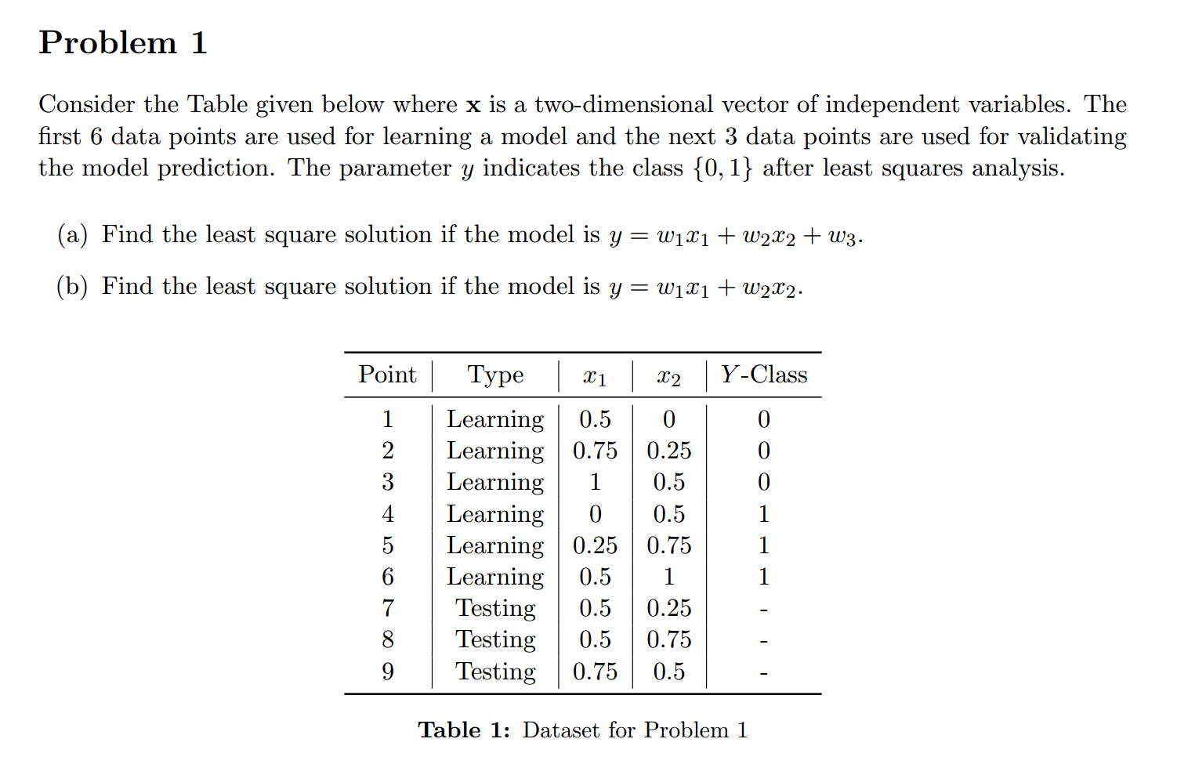


$$Y=XW$$
$$W=?$$
Using normal equation
Notes:
Let’s talk about Problem1
<Read the problem1>
The final request to find the Y value of each testing point according to the given model description . Just right here.
Basically, you have to use learning data to do reasoning and get w1 w2 w3 value right?
So, for how to do that. You should know that Matrix method is needed. For every y value ,they noted as Y(matrix y) , every x value , including x1 and x2 noted as X. And of course for w1 w2 w3 are noted as W.
So there will be a equation like this.
And as for W
you have to use the normal equation method to what W is

Slide 4
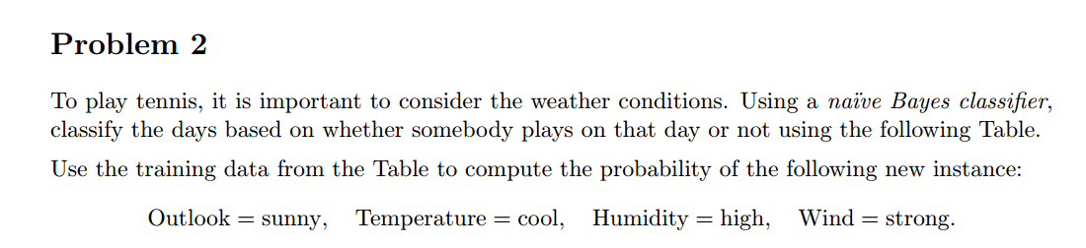
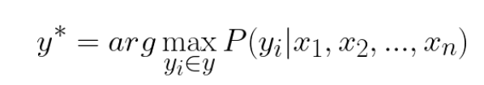
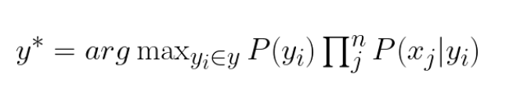
Naive Bayes Classifier
Asking prior probabilities
P(Tennis=Yes) and P(Tennis=No).
Notes:
<read the problem>
Basically ,it want you to use Naive Bayes Classifier to solve this problem , whose formula is basically like this .
And the problem mainly asking prior probability P(Tennis=Yes) and P(Tennis=No).asking P(Tennis=Yes while outlook=sunny …

Slide 5
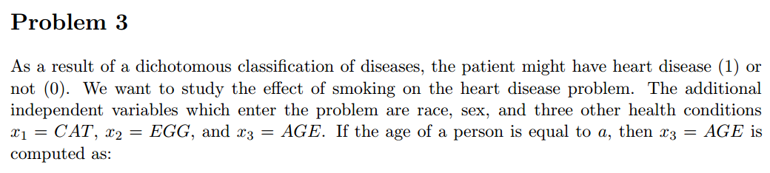
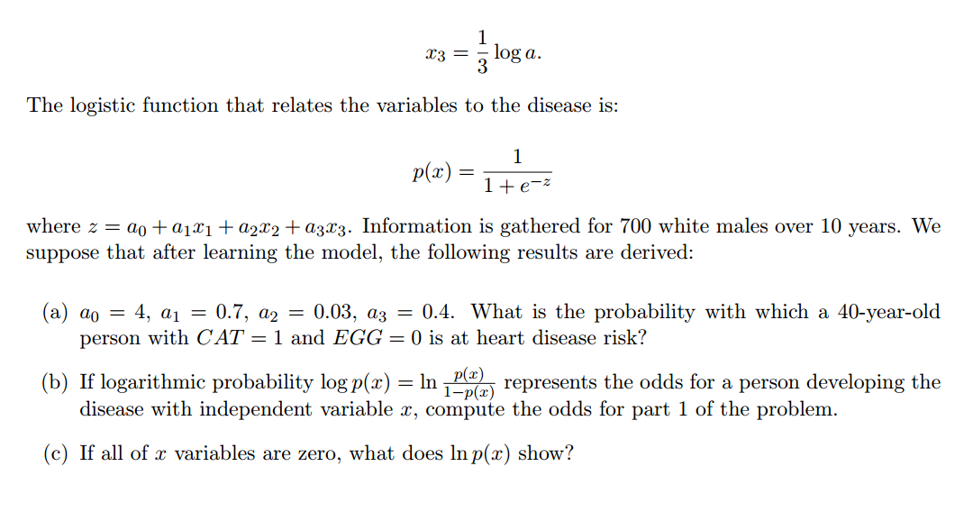
What does it mean in heart disease risk?
Notes:
<read the problem>
So basically ,you can solve problem (a)(b) just simply putting according numbers in and do some simple calculation
Just mention , A is equal to age.so 20-year old means that one third times log 20.
Mainly I want to explain is the (c) .
What does ln p (should be a value) mean in heart disease risk?

