Slide 1
EX2 Explanation
吳致達
oscarwu217@alum.ccu.edu.tw
Notes:
Hi everyone , I am the teacher assistant of this course , this is my name right here.
So I will make introduction and simple guides of homework 2 today . If you guys have any problems ,you can contact me with this e-mail address or just use e-course system should be fine.

Slide 2
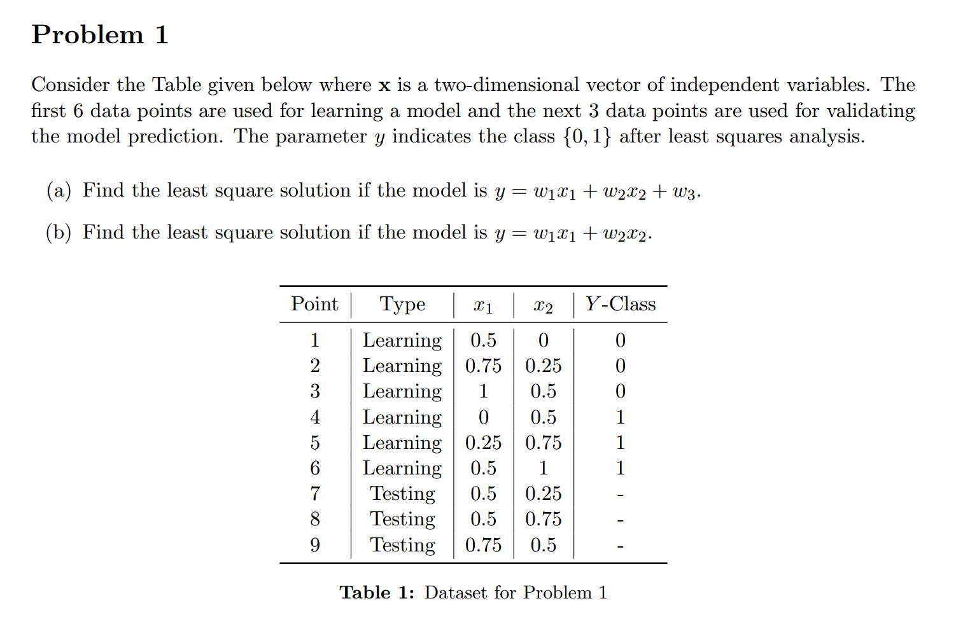


$$Y=XW$$
$$W=?$$
Using normal equation
Notes:
Let’s talk about Problem1
<Read the problem1>
The final request to find the Y value of each testing point according to the given model description . Just right here.
Basically, you have to use learning data to do reasoning and get w1 w2 w3 value right?
So, for how to do that. You should know that Matrix method is needed. For every y value ,they noted as Y(matrix y) , every x value , including x1 and x2 noted as X. And of course for w1 w2 w3 are noted as W.
So there will be a equation like this.
And as for W
you have to use the normal equation method to what W is

Slide 3

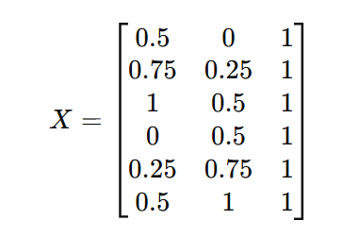

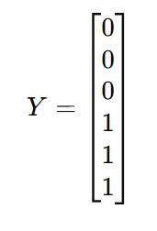



Normal equation
$$Y=XW$$
$$W={\left(X^{T}X\right)}^{−1}X^{T}Y$$
Point 7: 0.25,y=0
Point 8: 0.75,y=1
Point 9: 0.25,y=0
$$W=\left[\begin{matrix}w_{1} \\ w_{2} \\ w_{3}\end{matrix}\right]$$
Notes:
Let’s talk about Problem1
For(a), we need to know that we have to use the given dataset to form the matrix X,Y,W first
because we have w3 alone in model description , we need to set up 1 column in X matrix to satisfy the description
After we using normal equation to reach W value , we have to apply the completed model description to test point7 8 9,
We will get y values of according point , for those y value greater than or equal to 0.5 will be classified as 1 , otherwise 0.

Slide 4

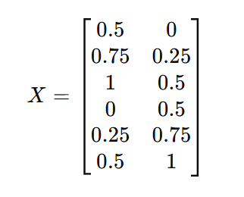

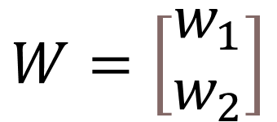
Normal equation
$$Y=XW$$
$$W={\left(X^{T}X\right)}^{−1}X^{T}Y$$
y
Point 7: 0.0714,y=0
Point 8: 0.7857,y=1
Point 9: 0.2857,y=0
$$W=\left[\begin{matrix}w_{1} \\ w_{2}\end{matrix}\right]$$
Notes:
For (b),we just do about same practice to this problem , but this time we don’t have w3 , so naturally we don’t need to add 1 column in X matrix.
Same, we use normal equation to reach W matrix value , and use it on test points.

Slide 5
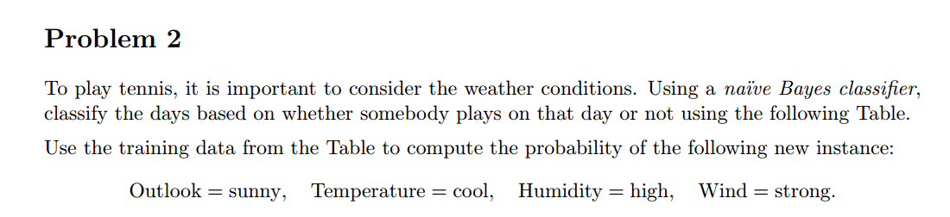
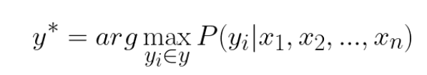
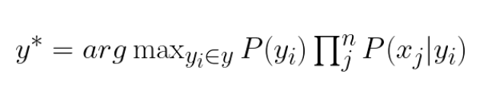
Naive Bayes Classifier
Asking prior probabilities
P(Tennis=Yes) and P(Tennis=No).

Slide 6
Naive Bayes Classifier
Similarly, compute for tennis is No situation
Notes:
For problem 2.
Basically ,it want you to use Naive Bayes Classifier to solve this problem , whose formula is basically like this .
And the problem mainly asking prior probability while Tennis equal to yes and no.
For Tennis equal to yes situation , beside probability of Tennis equal to yes ,probability of outlook is sunny while tennis is yes , Temperature is cool while tennis is yes and so on
Have to be considered.
Similarly, compute for tennis is No situation
beside probability of Tennis equal to no ,probability of outlook is sunny while tennis is no and so on.

Slide 7
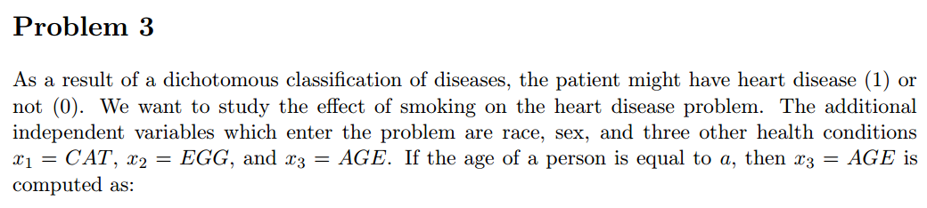
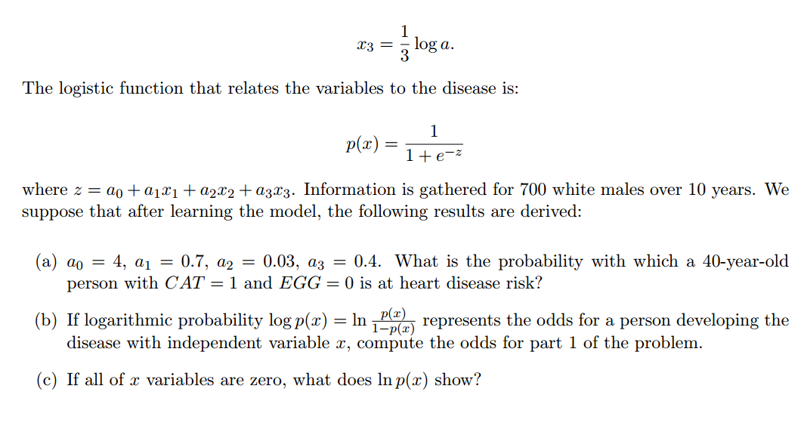
What does it mean in heart disease risk?

Slide 8
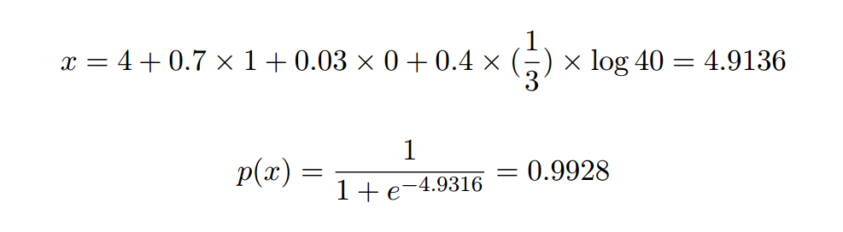
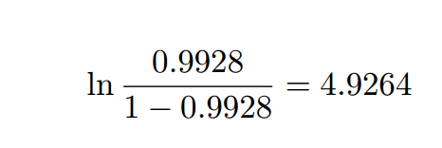

For(a)
For(b)
For(c)
The estimated likelihood of developing the disease in the absence of these specific risk factors.
Notes:
For problem 3 ,
For subproblem (a) and (b), what you have to do is simply put value in according variable and do calculation.
For subproblem (c) , you need to explain what ln(x) stands for if all of x are zero.
If all of x are zero, ln p(x) represents the baseline probability of disease prediction given by the
model, the estimated likelihood of developing the disease in the absence of these specific
risk factors.
Which mean that this is the probability of getting heart disease even without risk factors.

