Slide 1
HW1-2 Introduction
吳致達
oscarwu217@alum.ccu.edu.tw
Notes:
Hi everyone , I am the teacher assistant of this course , this is my name right here.
So I will make introduction and simple guides of homework 2 today . If you guys have any problems ,you can contact me with this e-mail address or just use e-course system should be fine.

Slide 2
Notes:
Due date: 2025/4/10 23:59
The file should contain:
• HW1 StudentID Name.pdf: A PDF file containing the solution to all the exercises.
This file must clearly indicate:
– The problem number and question to which the solution refers.
– Answers to all questions of the 2 problems assigned.
• Subfolders named Hw1-1 and Hw1-2 are needed: These folders should contain the corresponding Python code and result for each problem.
The provided code files should work and output the requested result.
Note
• You should write your full name in your .pdf presentation.
• Do NOT write code in the .pdf file. Provide it in requested folder.

Slide 3
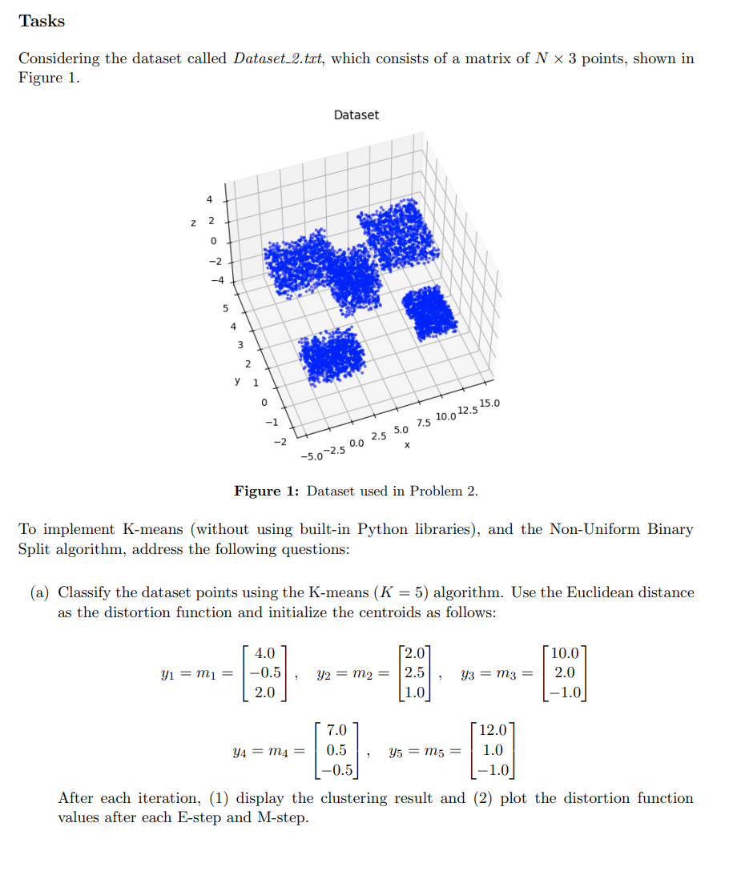
Noted: clustering result of each iteration and the graph of distortion function value of each iteration are needed
Notes:
For this task,
Basically ,you have to use K-means algorithm to process dataset with given initial centroid.
Something that has to be paid attention is clustering result of each iteration and the graph of distortion function value of each iteration are needed.
Which mean that if you do the clustering by 10 iteration , you have to provide 10 graph of each iteration and final distortion function graph.
I will show the example result on next page , which will not be provided on e-course .

Slide 4
K-means algorithm:
Initialization: Start with given centroids.(In most case , we will use random centroid )
E-step: Assign each data point to the nearest centroid.(Using Euclidean distance)
M-step: Recalculate the centroids as the mean of the points assigned to them.
Convergence: Repeat the process until centroids converge or the maximum number of iterations is reached.(distortion function)
Plotting: Visualize the clustering result and the distortion over iterations.
Notes:
Let’s give you simple review and overall concept help you coding.

Slide 5
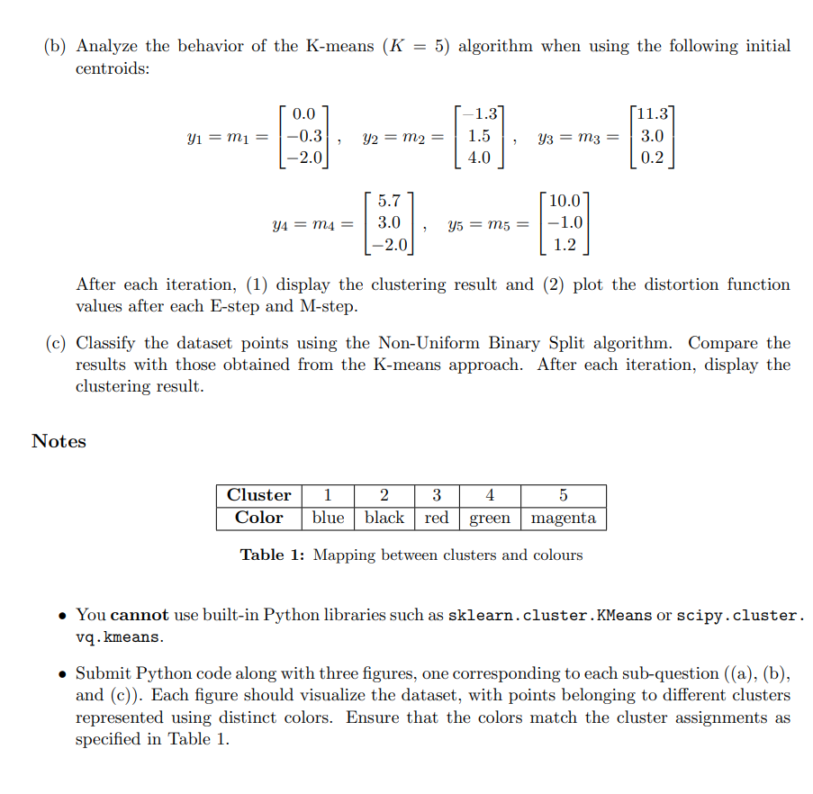
Noted: clustering result of each iteration are needed
(#For getting 5 cluster , we need 4 iteration)
Color must be same as your result
Can’t use python library related to
K-means method
Notes:
The subproblem (a),(b) are quite similar , both of them use k-mean to do clustering.
For subproblem (c) ,we need you to use Non-Uniform Binary Split method to do clustering and compare to k-mean method result.
For comparison , we also need 5 cluster result , so we need 4 iteration by using Non-Uniform Binary Split method , which mean that 5 clustering result of each iteration are needed.
And just note that each cluster visualization has regulated color, color must be same as your result
And of course you can’t use python library related to K-means method to do the task , the specific information is noted on the description.

