Slide 1
Wilson Financial
Group 6

Slide 2
Group 6 members
Derick Waugh
Josue Zamorano
Zoey Naizer
Josh Welch, our fearless leader

Slide 3

Brief History of Wilson Financial
Wilson Financial was founded by Jake and Ned Willson. They have always been interested in finance and investment. They both decided to get a degree in finance, and Ned decided to continue his education by getting an MBA. During the last four years, they noticed that their relatively small town in New Mexico only had one business dedicated to financial management and advising. Understanding that there are many ranchers and farmers that do a good business, and seeing more and more people retiring to the area, they opened their own business.
*Not actual image.

Slide 4
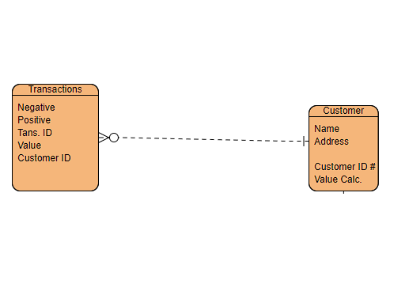
Wilson Financials' ERD
Wilson Financial wanted a simplified way of doing things.
This ERD is our simple way of showing simplicity. Wilson Financial loved the simple concept.
Simply put, this was the final selection. Plain and Simple.

Slide 5
Wilson Financials' Goals
How many clients have been added for each of the past six months?
What is the average amount of assets (in currency) for the entire client list?
How many clients have a high number (more than 10 a month) of transactions?
Wilson Financial (Known as WF from now on for this presentation) is willing to give out this information in only its basic form. Client identities and asset information will not be available unless client has given consent.

Slide 6
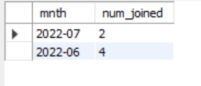
Section 1: Clients
Within the past 6 months, there have been 6 unique accounts created. 4 in June and 2 and July. The accounts have a different client. WF Methods were used to create an account for the client so there are no duplications and to help prevent fraud.
*Images subject to copyright. All rights reserved

Slide 7
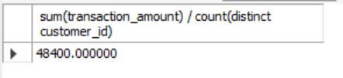
Part 2: Average $$$
WF is proud of how much clients are willing to invest.
$48,400 was the total average of assets within WF from all 6 of their clients!
Go WF!!
*This image is also subject to copyright. All rights are still reserved.

Slide 8
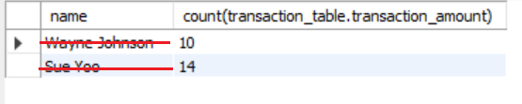
Number 3:
There were 2 clients that were big in multiple transactions. And they were apparently having the time of their lives! (Details would be nice, I know. But alas, I am not allowed to know this information. This was apparently a secret as to what this was used for.)
Both clients have had more than 10 transactions within a 30-day period.
Kinda sus.
*Image legal jargon. All rights blah blah blah

Slide 9
This slide intentionally left blank

