Slide 1
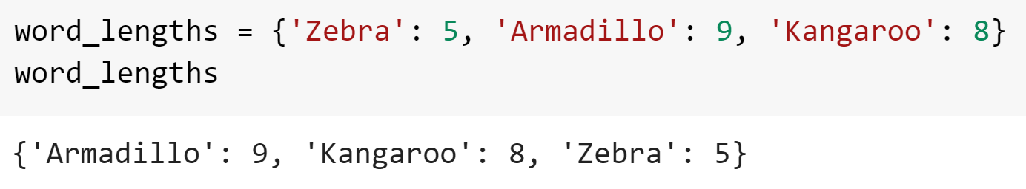

Tangent: Ordered Dictionaries
Python does not keep track of the order of keys in a standard dictionary
For that reason, even if you write items in a specific order when defining a dictionary, you should pretend that they are shuffled up straight after
If you need to keep track of the order then Python offers an ordered dictionary, but this is rarely needed in practice

Slide 2
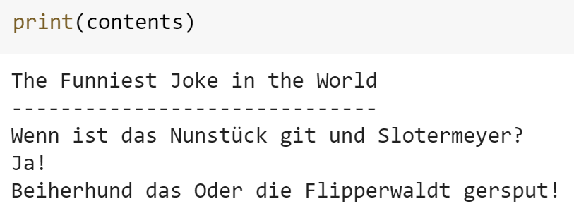
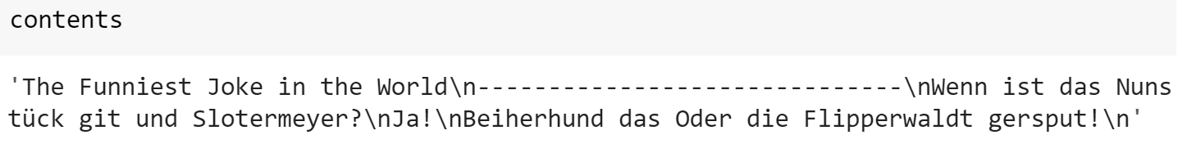
Aside: White lies upon white lies
You may recall that we said you don’t have to use print if you only want to print one output of a cell
There is actually more subtly to this for certain types of objects
Whereas as typing a variable name will print it exactly, the print function will do a bit of tidying first
The most important change is that it evaluates special text characters

Slide 3
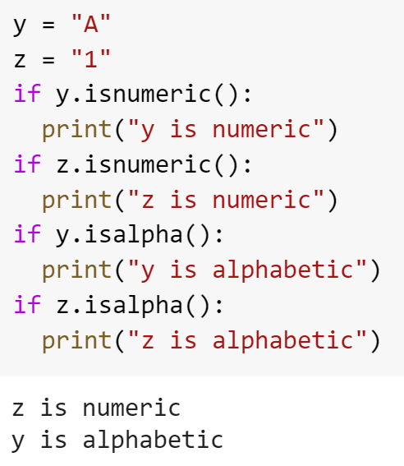
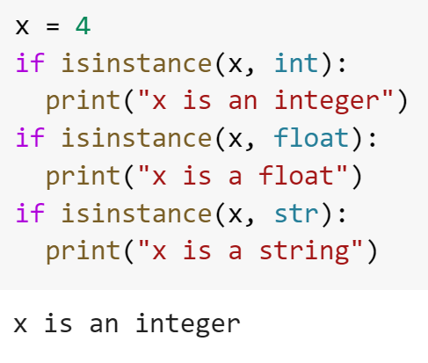
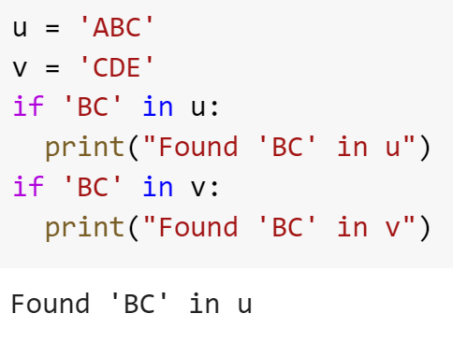
Aside: Validation Helpers
There are many useful functions for validating input. We see a few examples below

Slide 4
Raising Errors
As of yet, the only way we’ve had to inform a user of an error is to print a message and then use control flow to change the code we run
We can do better than this by raising an error
Python has many types of errors built-in and you can define your own too
The most common are:
TypeError: When an object is of an incorrect type
ValueError: When an object has an invalid value
OSError: When a system operation is invalid

Slide 5
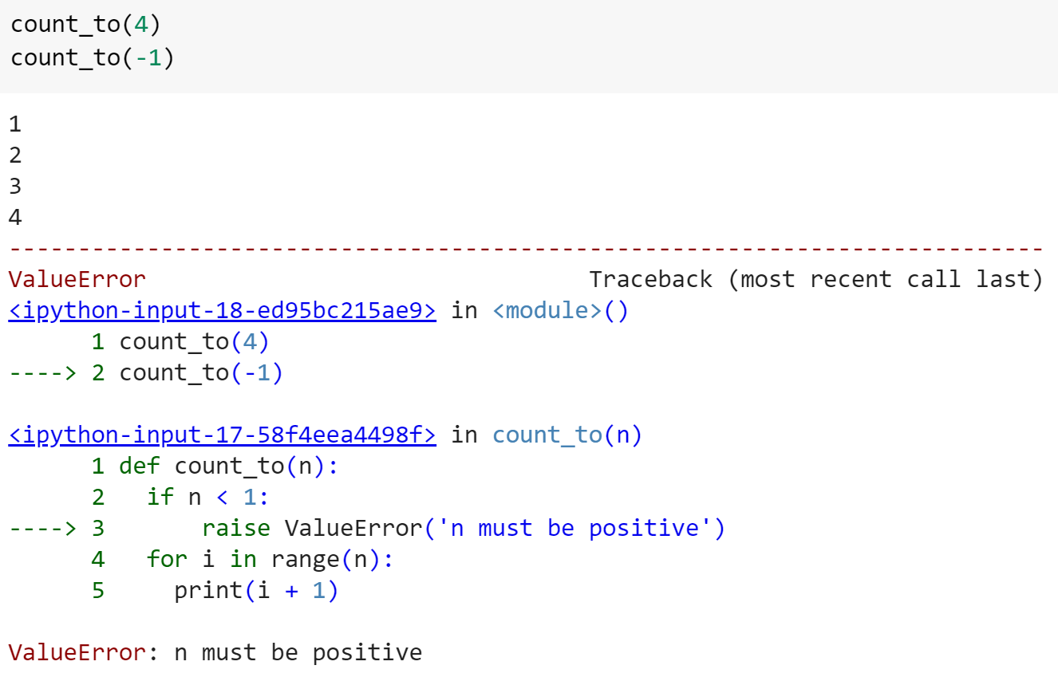
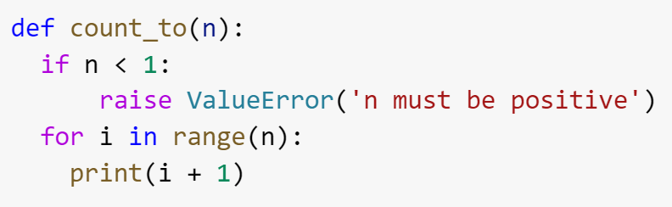
Raising Errors
To raise an error, we use the raise keyword followed by the type of error, with a message passed as the only argument
Raising an error will stop code execution for the entire block

Slide 6
Raising Errors Puzzles
Create a function called print_sentence which accepts a string as its only parameter. First check that the input is a string, and if not, raise a TypeError with an appropriate message
Next, check that the string contains a space character. If not, raise a ValueError
Finally, if the above two conditions are met, print the string
Create a function called forgiving_double which accepts a single argument. If the number is a numeric string, convert it to an integer and double it. If it is a non-numeric string, raise a ValueError with a suitable error message
After possible conversion, double the number and return this new value.

Slide 7
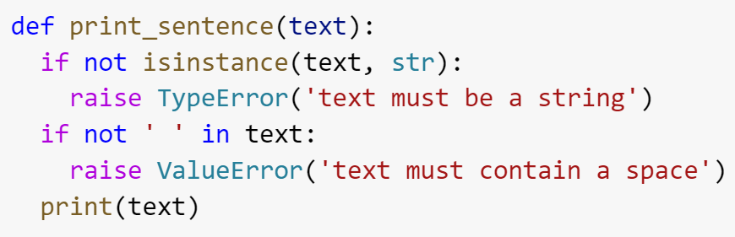
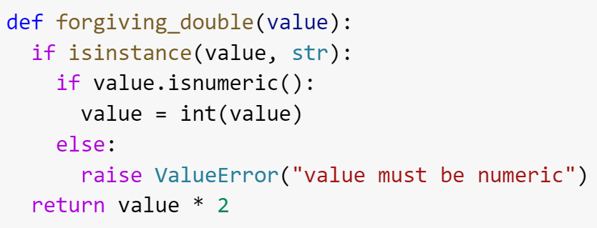
Raising Errors Solutions

Slide 8
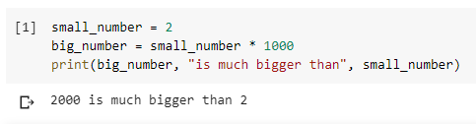
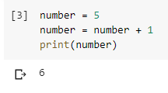
Manipulating Variables
You can define a new variable by manipulating the value of an existing variable
You can even replace the current value of a variable with a new value based on the old one. This is known as overwriting the variable. Be careful: this can make your code confusing!

Slide 9
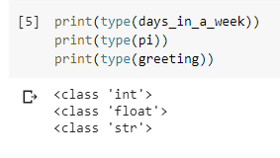

Variable Types
We can examine the type of a variable by passing it as the input to the type() function and then wrapping this in print to show the result
Bonus: what happens if we ignore the print() function and just run type(days_in_a_week)?

Slide 10
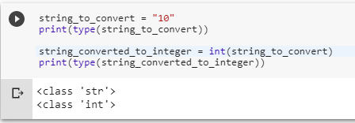
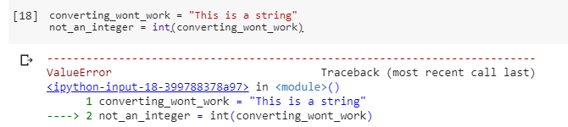
Variable Types
You can use the functions int(), float(), and str() to convert between types
…provided that it is possible to make a conversion. Otherwise you’ll get an error

Slide 11
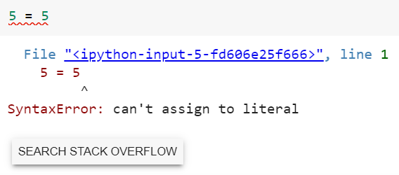
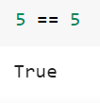
Comparison Operators
Make sure you noticed that to check for equality, we don’t use = but rather ==, a double equals
This is because we are already using = for variable assignment
This is a common mistake and so if Python gives you an error when dealing with comparisons, this should be the first thing to check

Slide 12
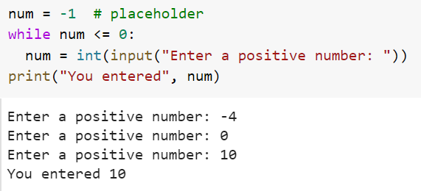
While Loops
We can use while loops to validate user input
Note, if you have a condition in your while loop that never becomes false, you will get stuck in an infinite loop. To escape this, press the stop button next to the code cell

