Slide 1
Practical Python
Tim Hargreaves
Session 2 – Higher or Lower
2020-02-05

Slide 2
Warm-up – List Comprehensions
Use list comprehensions to find the alternating sum (add the first, subtract the second, add the third, etc.) of a list of numbers
Inspiration
[x if x > 0 else –x for x in my_list]
[x for i, x in enumerate(my_list) if i > len(my_list) // 2]
Bonus Puzzle
Can you use list comprehension to reshape a 1D list into a 2D list of lists?

Slide 3
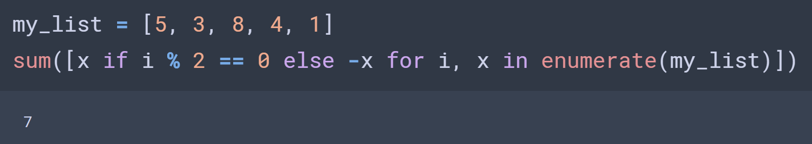
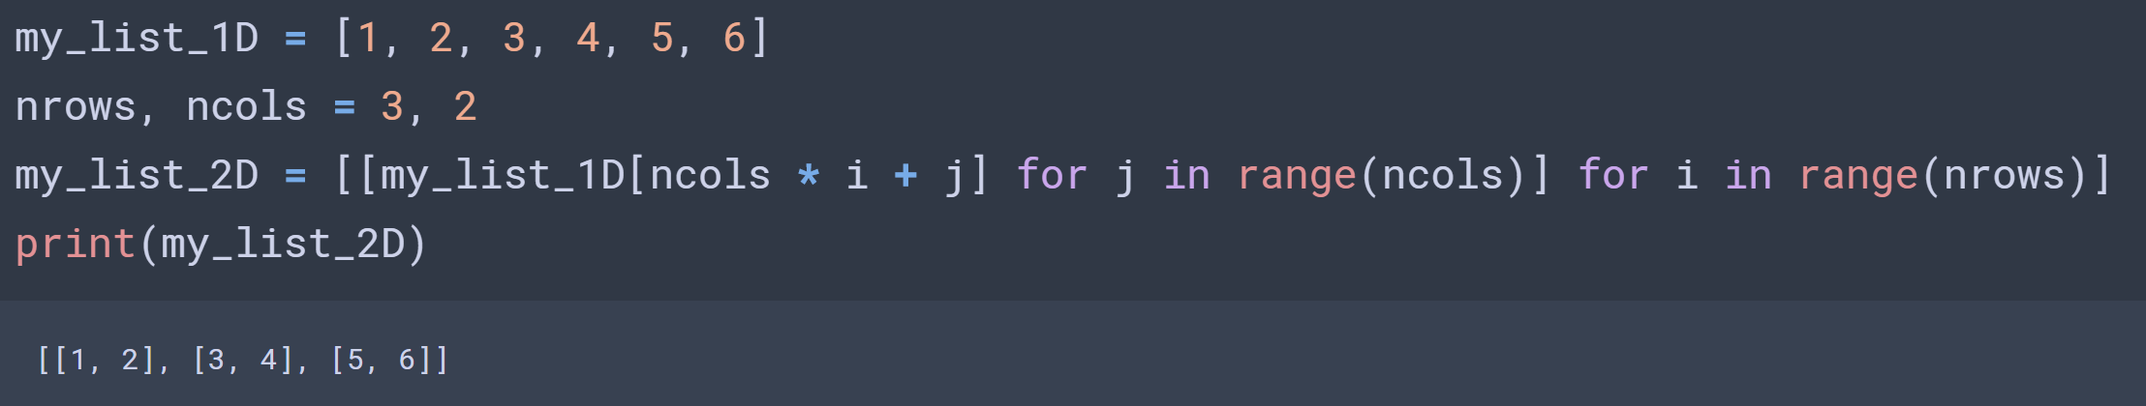
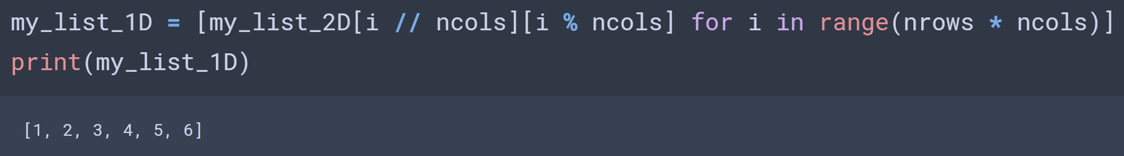
Warm-up – List Comprehensions
Notes:
Alternative: sum([x * (-1) ** i for i, x in enumerate(my_list)])

Slide 4
Dictionaries
Lists are a great way to store data that has a well-defined order
What if we have data that can’t be indexed by a non-negative integer?
In this case, we can use a dictionary
Dictionaries are similar to list except they have no notion of order and are instead indexed by a string (or any hashable object)

Slide 5
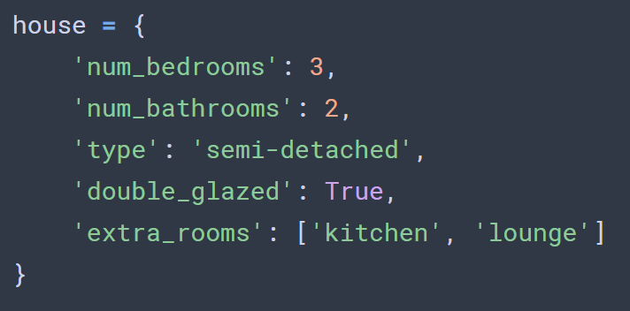
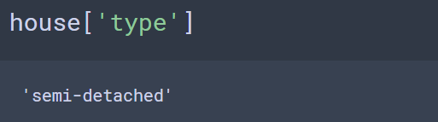
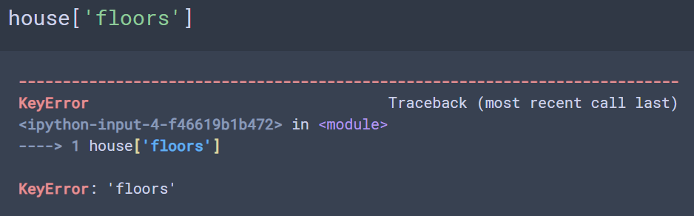
Dictionaries in Python
We create dictionaries using curly brackets rather than square
Each item is then a key-value pair
Keys are typically strings, integers, or floats
Values can be anything (including another dictionary!)
We access dictionaries’ items in the same way as a list

Slide 6
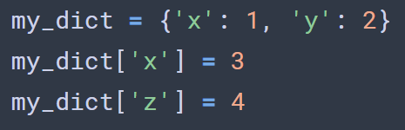
Dictionary Exercises
Create a dictionary with some information about you. Try to include at least one value of each of the types integer, string, list and Boolean.
Print out some of the values of the dictionary
What do you think the following code will do? Try it.
Bonus: You can also access dictionary values using the .get() method. What is the advantage of using this over standard indexing? (Read the docs!)
Bonus: What does the following code do?

Slide 7

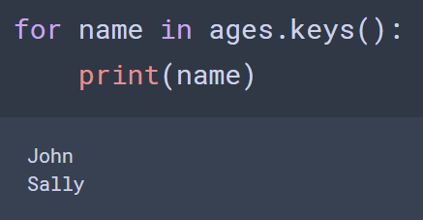
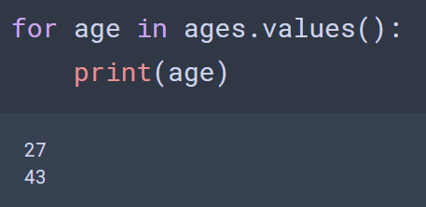
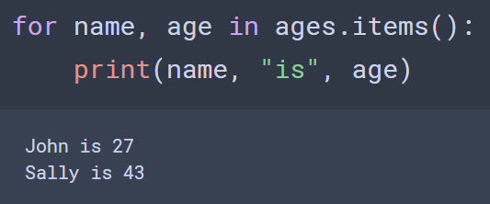
Looping through dictionaries
There are three ways to loop through dictionaries
By Key
By Value
By Item (Both)
Try these for yourself

Slide 8
More Dictionary Exercises
Create a function that accepts a list of strings and counts how many times each string occurs, printing the results in the form
There are 12 occurrences of ‘spam’
Hint: Create an empty dictionary to store these counts. Loop through each string in the list. If the string is already a key for the dictionary, increment its value; otherwise, add it with value one.
Bonus: Add a special case for when there is only one occurrence of a string so that the output is grammatically correct
Bonus: What does this code do?

Slide 9
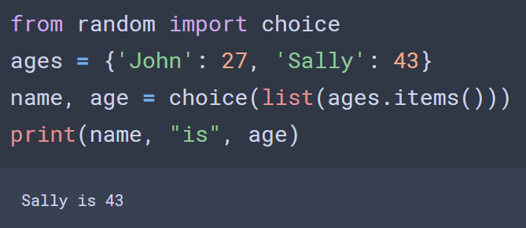
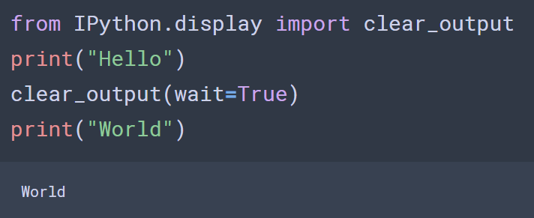
Miscellaneous
Get a random key-value pair from a dictionary
Clear cell output

Slide 10
The Challenge
You will be given helper functions get_celeb_twitters, get_follower_count. Read their documentation so you understand how they work (warning: the get_follower_count function may return None)
Create a game of higher or lower:
A celebrity is chosen at random and their follower count is given to the player
A new celebrity is chosen and their name is revealed
The player has to guess whether the new celeb has more or less followers
The game should run until the player guesses incorrectly
The player’s score (number of correct guesses) should be printed on game over
Bonus: Implement a ‘lives’ system
Bonus: Use a dictionary to keep track of each player’s high score (ask the player’s name before starting). Create a function to print a leader board.

