Slide 1
Practical Python
Tim Hargreaves
Session 3 – Life
April 2020

Slide 2
Warm-up – Dictionary Comprehensions
As well as list comprehensions, Python has dictionary comprehensions
Example
squares = {n: n ** 2 for n in range(10)}
Create a list of strings and then use a for loop to create a dictionary where each key is one of such strings and the corresponding value is the string length
Complete this in a single line using dictionary comprehension
Bonus
Add a new word to your dictionary with its length
Use this dictionary to print all strings that have a length greater than 4

Slide 3
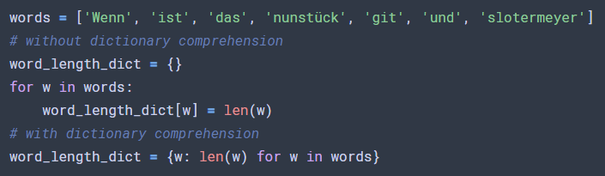
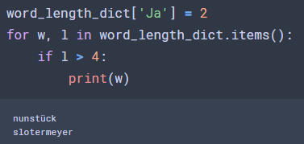
Warm-up – Dictionary Comprehensions
Notes:
Alternative: sum([x * (-1) ** i for i, x in enumerate(my_list)])

Slide 4
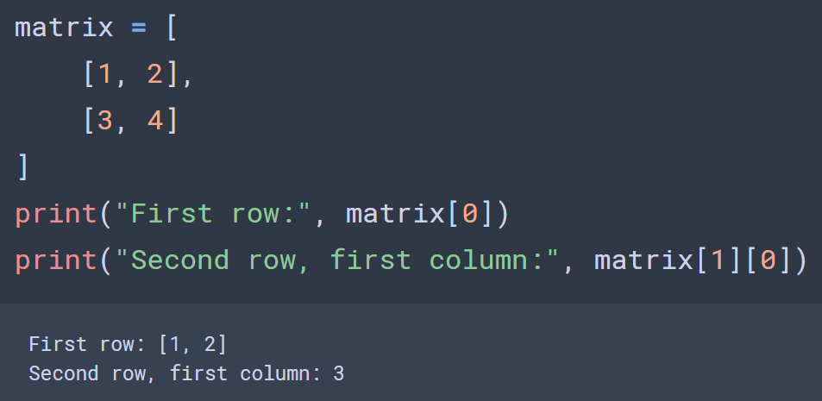
Nested Lists
You may recall that the elements of a list can be any Python object
This means that lists of lists are completely valid
These are useful for create arrays of dimension two or higher
We access elements using standard list notation

Slide 5
Nested Lists Exercises
Create a 3x3 array using nested lists
Print the value of the central entry
Use nested for loops to print each entry of the list, left-to-right then top-to-bottom
Print the sum of each row of the list
Bonus
Experiment with arrays of greater dimensions

Slide 6
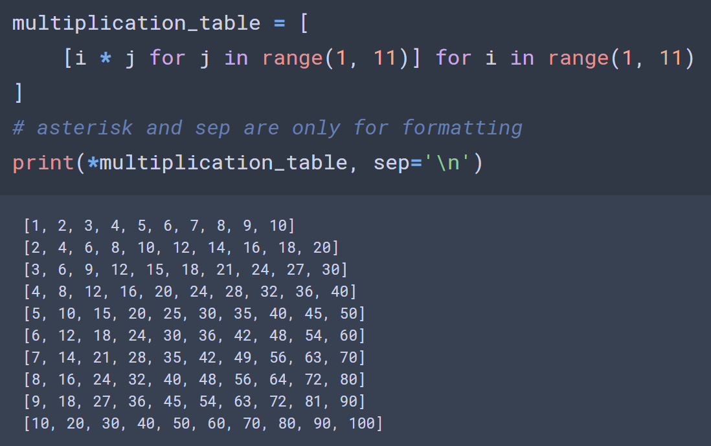
List Comprehensions for Nested Lists
List comprehensions behave the same way with nested lists

Slide 7
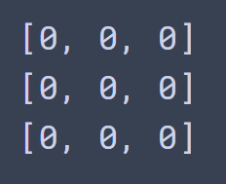
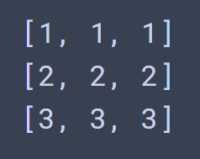
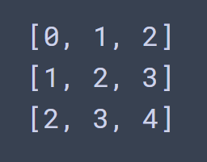
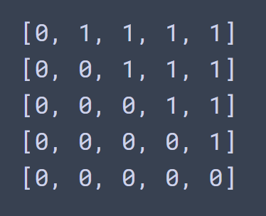
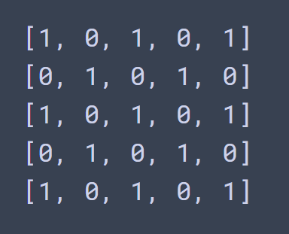
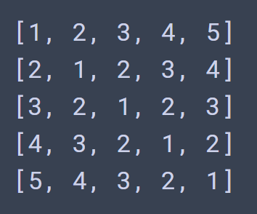
Nested List Comprehension Exercises
Create the following matrices in the most Pythonic way possible
Bonus

Slide 8
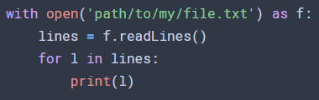
Reading Text Files
In Python, we read the lines of a text file using the following syntax
Older guides may avoid using the with statement but this is now bad practice
Once we leave the with context, the connection with the file disappears. Therefore, all references to the file should occur with the context
You can add files to Colab using the sidebar

Slide 9
Reading Text Files Exercises
Create a text file where each line contains an item of food and a number, separated by a space (i.e. a shopping list)
(If using Colab) upload the file to Colab
Create an empty dictionary called shopping_list
Read each line of the file and use `food, quantity = line.split()` to separate the food and number
Convert the quantity to an integer
Add the food and quantity to the shopping list dictionary as a key-value pair
Bonus
If an item of food appears twice or more in the text file, sum the quantities

Slide 10
Conway’s Game of Life
Simple rules give rise to
beautiful behaviour
2D grid of cells
Each cell is alive (1) or dead (0)
On the next time step:
0-1 neighbours: die of loneliness
2-3 neighbours: stay alive, if already alive
3 neighbours: reproduce (come alive if not already alive)
4+ neighbours: die of overpopulation

Slide 11


Run Length Encoded (RLE) Files
Text files used to store initial states for game
Start with optional comment lines (#...)
Followed by header line giving size of pattern (and optional ruleset)
Followed by <run_count><tag> where <run_count> is the number of occurrences of <tag> or omitted if run of length one and <tag> is one of:
b: dead
o: alive
$: end of line
Read more
Download patterns

Slide 12
The Challenge
Create an instance of Conway’s game of life
To begin, manually code up your starting pattern using True and False to represent alive and dead
Remember how to clear the cell output from last session and search how to make Python pause (hint: use the time module)
You can print the output in a grid format using the code on slide 6
Once this is working, allow the upload of a pattern from conwaylife.com
You can read grid x-dimensions of the pattern using
`x = int(re.search(r‘x = (\d+)’, header_line).group(1))`
Bonus: Let the world optionally ‘wrap-around’, Pac-man style
Bonus: Print the output in a pretty way
Super bonus: Use the NumPy package to make animation faster

