Slide 1
Practical Python
Tim Hargreaves
Session 1 - Cryptography
2020-02-05

Slide 2
Warm-up – Unit Converter
Create a variable called temp by asking the user for a number
Create a variable called unit by asking the user to enter one of 'C' or 'F'
If 'C' was entered, assume the given temperature was in Celsius and print the corresponding value in Fahrenheit
If 'F' was entered, perform the reverse
In each case, round the answer to two decimal places
If any other value is entered, print out an informative error message and don't convert
Reminders
C = F – 32 * (5 / 9)
F = (9 / 5) * C + 32
float(input())
if, elif, else
round()
print()

Slide 3
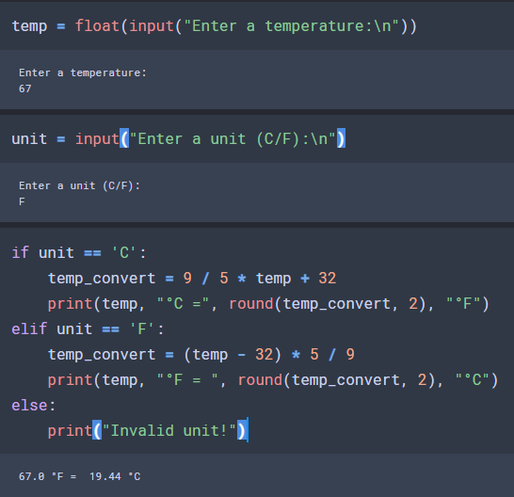
Warm-up – Unit Converter
Newline character
Multiple arguments to print() get separated by spaces

Slide 4
Functions in Python
Functions are blocks of code that only run when called
They are a great way to reuse and organise your code
You can pass in data using the function's parameters
A function can return data as a result
Functions are defined using the def keyword
Examples of Built-in Functions
print(string)
sum(list)
input()

Slide 5




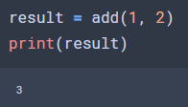

Functions in Python
Defining a function
Calling a function

Slide 6


Functions in Python
Create a function called product() which has two parameters. This function should then return the product of these two numbers
Create a function as follows:
What happens when we call the function with and without specifying a value for the parameter name?
Bonus: Verify using this example that it is okay for a function to call itself:

Slide 7
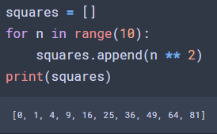
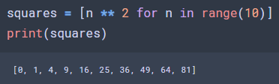
List Comprehensions
The traditional for loop is ugly and long-winded
Python offers an alternative in list comprehensions

Slide 8
List Comprehensions
Define the list numbers = [4, 7, 3, 8]
Use list comprehensions to create a new list remainders which contains the remainder of division by 3 for each number
Given a string, reverse it using list comprehension
Bonus: Try adding if {condition} just before the closing square bracket
Reminders
Modulus: x % y
Turn a list into a string: ''.join(list)
Run through a list backwards: list[::-1]

Slide 9
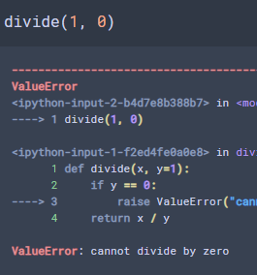
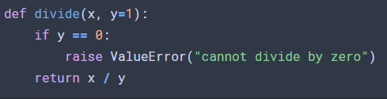
Raising errors
If a user enters an invalid value to your function you don't just want to print a message but also stop your code
You can do this by raising an error
Python has many types of errors; the most useful are ValueError and TypeError
It is important to also add an error message

Slide 10




Miscellaneous
Check the type of an object
Check that a string only contains alphabet characters
Convert between ASCII numeric and letter representations

Slide 11
Cryptography
Cryptography is the process of protecting information through the use of codes
A message is encrypted by a sender at which point it becomes unreadable to anyone who doesn't know how to decrypt the message
One of the simplest encryption methods is called the ROT (rotation) cipher
The encryption key is an integer and a message is encrypted by shifting each letter that many places in the alphabet
If the encryption key is known, a message can be decrypted by reversing these shifts
X | Y | Z | A | B | C | D | E | F
Message:
BYE
Encoded:
DAG
Encryption
Decryption
Key:
2
Z | A | B | C | D | E | F | G | H

Slide 12
The Challenge
Create a function rot_encrypt(msg, rot) which can encrypt a message using the ROT cipher
The default value of rot should be 13
msg should be checked to be a string and rot an integer
msg should be checked to only contain alphabet characters (or see bonus #2)
The message should be converted to upper case before encrypting
Tip: First convert A -> 0, B -> 1, etc.; Can modular arithmetic be of use?
Before you start: plan!
Bonus: Create a decryption function (NB: this can be done in two lines of code!)
Bonus: Allow your function to handle messages with spaces (Hint: list comprehensions along with .split('') and ' '.join() may help)

