Slide 1

INTRODUCTION TO
SYSTEMS ANALYSIS AND DESIGN:
AN AGILE, ITERATIVE APPROACH
SATZINGER | JACKSON | BURD
Chapter 10

Slide 2
Object-Oriented Design: Principles
Chapter 10
Introduction to Systems
Analysis and Design:
An Agile, Iteractive Approach
6th Ed
Satzinger, Jackson & Burd
Notes:
面向对象设计：设计原则

Slide 3
Chapter 10 Outline
Object-Oriented Design: Bridging from Analysis to Implementation（面向对象设计：分析与实施的桥梁）
Object-Oriented Architectural Design（面向对象结构化设计）
Fundamental Principles of Object-Oriented Detailed Design（面向对象细节设计的基本原则）
Design Classes and the Design Class Diagram（类和设计类图）
Detailed Design with CRC Cards（用CRC卡进行细节设计）
Fundamental Detailed Design Principles（细节设计的基本原则）
© 2012 Cengage Learning. All Rights Reserved. This edition is intended for use outside of the U.S. only, with content that may be different from the U.S. Edition.
May not be scanned, copied, duplicated, or posted to a publicly accessible website, in whole or in part.
Notes:
面向对象设计：分析与实施的桥梁
面向对象结构化设计
面向对象细节设计的基本原则
设计类和设计类图
用CRC卡进行细节设计
细节设计的基本原则

Slide 4
Learning Objectives
Explain the purpose and objectives of object-oriented design（面向对象设计的目的和目标）
Develop UML component diagrams（开发UML组件图）
Develop design class diagrams（开发设计类图）
Use CRC cards to define class responsibilities and collaborations（使用CRC卡来定义类的职责和合作关联）
Explain some of the fundamental principles of object-oriented design（面向对象设计的基本原则）
© 2012 Cengage Learning. All Rights Reserved. This edition is intended for use outside of the U.S. only, with content that may be different from the U.S. Edition.
May not be scanned, copied, duplicated, or posted to a publicly accessible website, in whole or in part.
Notes:
解释面向对象设计的目的和目标
开发UML组件图
开发设计类图
使用CRC卡来定义类的职责和合作
解释某些面向对象设计的基本原则

Slide 5
Overview
This chapter and the next focus on designing software for the new system, at both the architectural（架构设计） and detailed level design （详细设计）
For architectural design（架构设计）, the model is shown as a UML component diagram
For detailed design（详细设计）, the main models are design class diagrams and sequence diagrams
In this chapter, the CRC Cards technique is used to design the OO software
© 2012 Cengage Learning. All Rights Reserved. This edition is intended for use outside of the U.S. only, with content that may be different from the U.S. Edition.
May not be scanned, copied, duplicated, or posted to a publicly accessible website, in whole or in part.
Notes:
本章和下一章的重点是为新系统设计软件，包括架构设计和详细设计
对于架构设计，模型为UML组件图
对于详细设计，主要的模型是设计类图和顺序图
在本章中，使用CRC卡技术设计面向对象软件

Slide 6
Chapter 10 Outline
Object-Oriented Design: Bridging from Analysis to Implementation（面向对象设计：分析与实施的桥梁）
Object-Oriented Architectural Design
Fundamental Principles of Object-Oriented Detailed Design
Design Classes and the Design Class Diagram
Detailed Design with CRC Cards
Fundamental Detailed Design Principles
© 2012 Cengage Learning. All Rights Reserved. This edition is intended for use outside of the U.S. only, with content that may be different from the U.S. Edition.
May not be scanned, copied, duplicated, or posted to a publicly accessible website, in whole or in part.
Notes:
面向对象设计：分析与实施的桥梁

Slide 7
OO Design:
The Bridge from Analysis to Design
OO Design: Process by which a set of detailed OO design models are built to be used for coding（ OO设计：构建一组详细的OO设计模型以用编码的过程）
Design models are created in parallel to actual coding/implementation with iterative SDLC（设计模型是通过迭代SDLC与实际编码/实现并行创建的）
Agile approache says create models only if they are necessary. Simple detailed aspects don’t need a design model before coding（敏捷方法认为，只有在必要时才创建模型）
© 2012 Cengage Learning. All Rights Reserved. This edition is intended for use outside of the U.S. only, with content that may be different from the U.S. Edition.
May not be scanned, copied, duplicated, or posted to a publicly accessible website, in whole or in part.
Notes:
OO设计：从分析到设计的桥梁
OO设计:构建一组详细的OO设计模型以用于编码的过程
面向对象的优点是将第3、4和5章中的需求模型扩展到设计模型。没有重新发明轮子
设计模型是通过迭代SDLC与实际编码/实现并行创建的
敏捷方法认为，只有在必要时才创建模型。简单的细节方面在编码前不需要设计模型

Slide 8
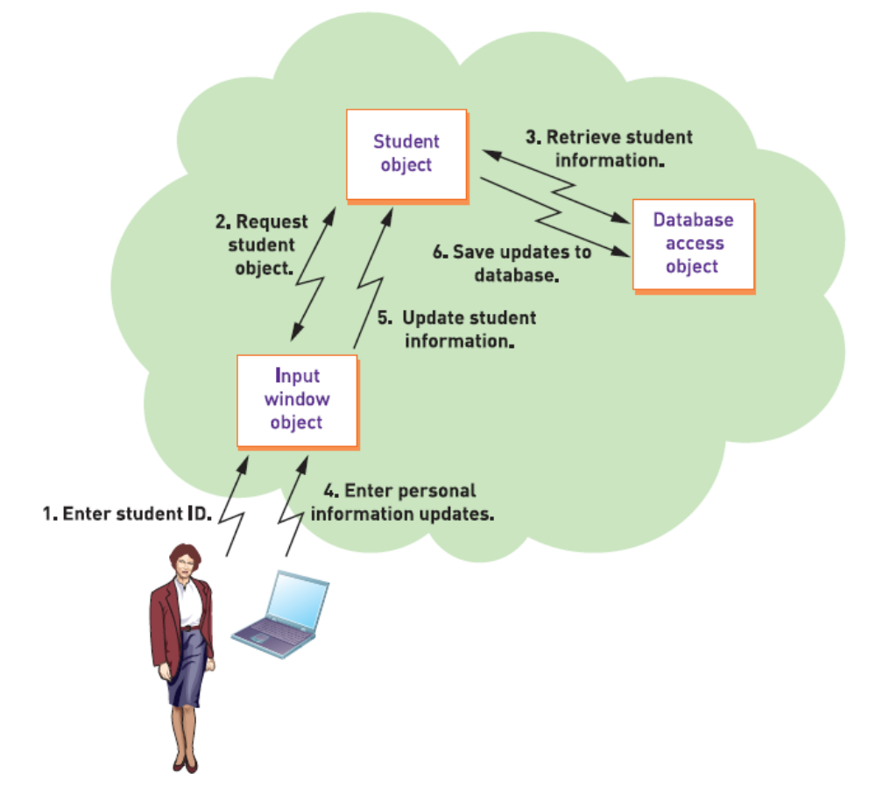
Object-Oriented Program Flow
Three Layer Architecture
© 2012 Cengage Learning. All Rights Reserved. This edition is intended for use outside of the U.S. only, with content that may be different from the U.S. Edition.
May not be scanned, copied, duplicated, or posted to a publicly accessible website, in whole or in part.
Notes:
面向对象事件驱动程序流

Slide 9
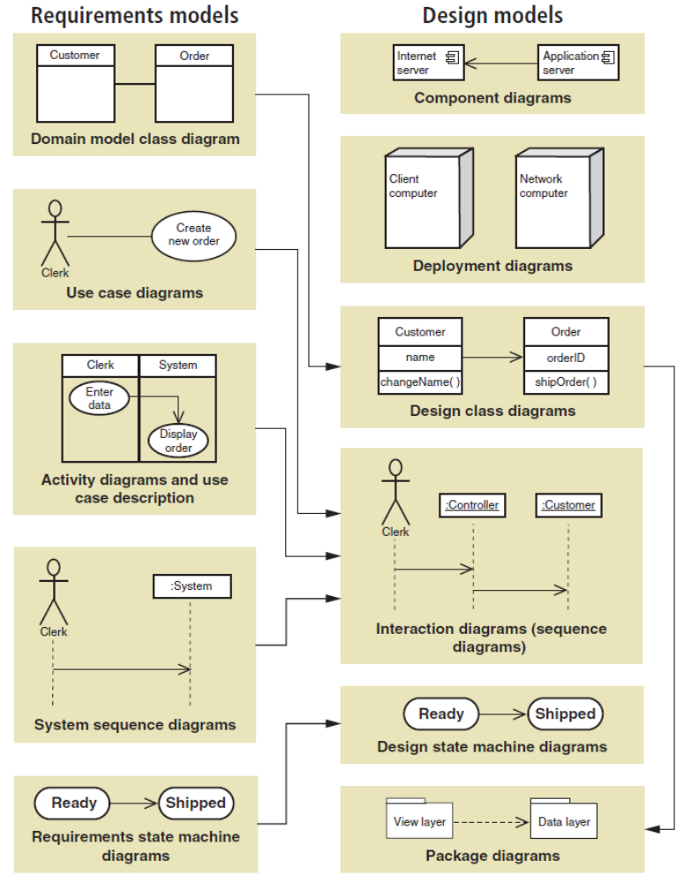
UML Requirements vs. Design Models
Diagrams are enhanced and extended
© 2012 Cengage Learning. All Rights Reserved. This edition is intended for use outside of the U.S. only, with content that may be different from the U.S. Edition.
May not be scanned, copied, duplicated, or posted to a publicly accessible website, in whole or in part.
Notes:
设计模型及其代表性的输入需求模型

Slide 10
UML Requirements vs. Design Models
Diagrams are enhanced and extended
域模型类图
设计类图
包图
© 2012 Cengage Learning. All Rights Reserved. This edition is intended for use outside of the U.S. only, with content that may be different from the U.S. Edition.
May not be scanned, copied, duplicated, or posted to a publicly accessible website, in whole or in part.
Notes:
1. 域模型类图 -> 设计类图 -> 包图

Slide 11
UML Requirements vs. Design Models
Diagrams are enhanced and extended
用例图
活动图
顺序图（交互图）
系统顺序图
© 2012 Cengage Learning. All Rights Reserved. This edition is intended for use outside of the U.S. only, with content that may be different from the U.S. Edition.
May not be scanned, copied, duplicated, or posted to a publicly accessible website, in whole or in part.
Notes:
用例图，活动图和用例描述，系统顺序图 -> 交互图（顺序图）

Slide 12
UML Requirements vs. Design Models
Diagrams are enhanced and extended
设计状态机图
需求状态机图
© 2012 Cengage Learning. All Rights Reserved. This edition is intended for use outside of the U.S. only, with content that may be different from the U.S. Edition.
May not be scanned, copied, duplicated, or posted to a publicly accessible website, in whole or in part.
Notes:
需求状态机图 -> 设计状态机图

Slide 13
Chapter 10 Outline
Object-Oriented Design: Bridging from Analysis to Implementation
Object-Oriented Architectural Design（面向对象结构化设计）
Fundamental Principles of Object-Oriented Detailed Design
Design Classes and the Design Class Diagram
Detailed Design with CRC Cards
Fundamental Detailed Design Principles
© 2012 Cengage Learning. All Rights Reserved. This edition is intended for use outside of the U.S. only, with content that may be different from the U.S. Edition.
May not be scanned, copied, duplicated, or posted to a publicly accessible website, in whole or in part.
Notes:
面向对象结构化设计

Slide 14
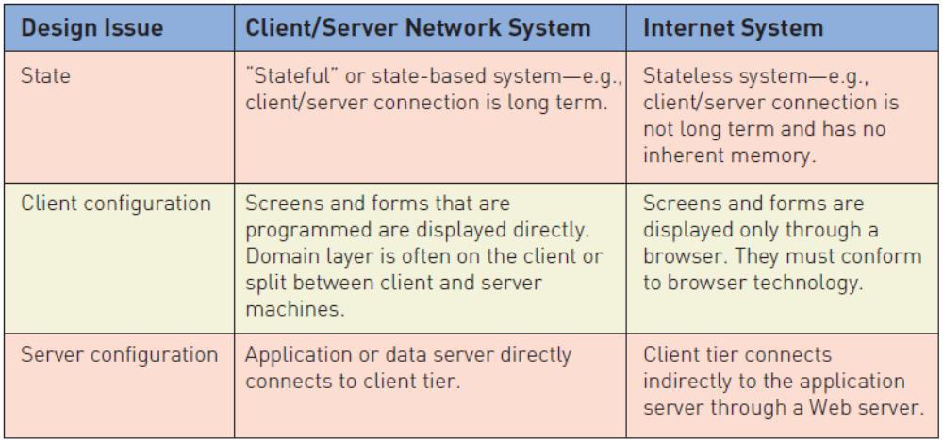
Architectural Design
软件系统一般会分成两类：单用户系统和企业级系统
  企业级系统：在组织中的多个人员或组之间共享资源的系统
两种选择：基于client-server 和 基于网络连接的
C-S的连接是长期的
短期的、无长期记忆的
© 2012 Cengage Learning. All Rights Reserved. This edition is intended for use outside of the U.S. only, with content that may be different from the U.S. Edition.
May not be scanned, copied, duplicated, or posted to a publicly accessible website, in whole or in part.
Notes:
架构设计：
软件系统一般会分成两类：单用户系统和企业级系统
企业级系统：在组织中的多个人员或组之间共享资源的系统
两种选择：基于client-server 和 基于互联网的
对比：C-S的连接是长期的

Slide 15
Architectural Design
Enterprise-level system
  a system that has shared resources among multiple people or groups in an organization
Options are Client-Server or Internet Based
  Each presents different issues
直接显示
通过浏览器显示
© 2012 Cengage Learning. All Rights Reserved. This edition is intended for use outside of the U.S. only, with content that may be different from the U.S. Edition.
May not be scanned, copied, duplicated, or posted to a publicly accessible website, in whole or in part.
Notes:
C-S：直接显示
Internet：通过浏览器显示

Slide 16
Architectural Design
Enterprise-level system
  a system that has shared resources among multiple people or groups in an organization
Options are Client-Server or Internet Based
  Each presents different issues
直接地
间接地
© 2012 Cengage Learning. All Rights Reserved. This edition is intended for use outside of the U.S. only, with content that may be different from the U.S. Edition.
May not be scanned, copied, duplicated, or posted to a publicly accessible website, in whole or in part.

Slide 17
Component Diagram for Architectural Design
Component diagram（组件图） –
  A type of design diagram（设计图） that shows the overall system architecture（系统架构） and the logical components（逻辑组件） within it for how the system will be implemented
  Identifies the logical, reusable, and transportable system components （系统组件）that define the system architecture
  The essential element of a component diagram is the component element with its API（组件图的基本元素）.
Application program interface (API) （应用程序接口）–
  The set of public methods（公用方法） that are available to the outside world
© 2012 Cengage Learning. All Rights Reserved. This edition is intended for use outside of the U.S. only, with content that may be different from the U.S. Edition.
May not be scanned, copied, duplicated, or posted to a publicly accessible website, in whole or in part.
Notes:
组件图
一种设计图，它显示了整个系统体系结构和其中的逻辑组件，用于如何实现系统
标识定义系统体系结构的逻辑的、可重用的和可移植的系统组件
组件图的基本元素是带有API的组件元素
应用程序接口
外部世界可用的一组公共方法

Slide 18
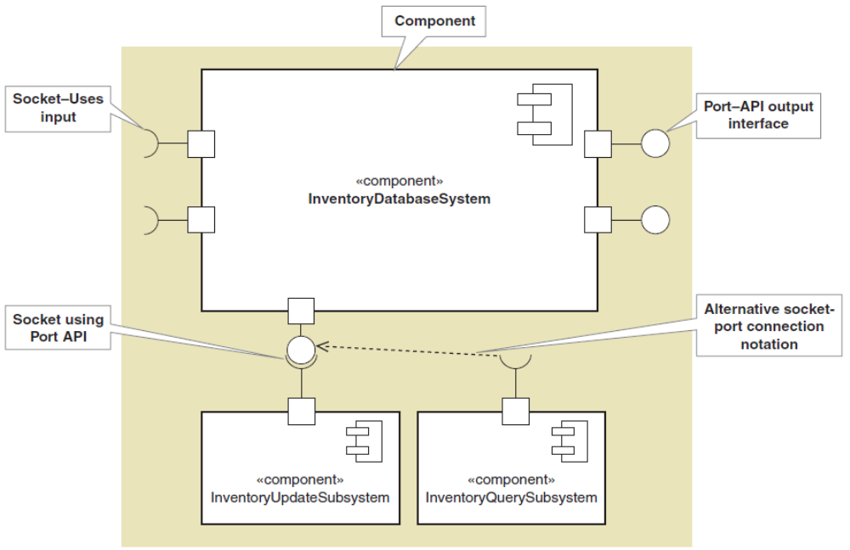
Component Diagram for Architectural Design
可移动、
可执行的组件
© 2012 Cengage Learning. All Rights Reserved. This edition is intended for use outside of the U.S. only, with content that may be different from the U.S. Edition.
May not be scanned, copied, duplicated, or posted to a publicly accessible website, in whole or in part.
Notes:
UML组件图

Slide 19
Component Diagram for Architectural Design
© 2012 Cengage Learning. All Rights Reserved. This edition is intended for use outside of the U.S. only, with content that may be different from the U.S. Edition.
May not be scanned, copied, duplicated, or posted to a publicly accessible website, in whole or in part.
Notes:
UML组件图

Slide 20
Component Diagram for Architectural Design
© 2012 Cengage Learning. All Rights Reserved. This edition is intended for use outside of the U.S. only, with content that may be different from the U.S. Edition.
May not be scanned, copied, duplicated, or posted to a publicly accessible website, in whole or in part.
Notes:
UML组件图

Slide 21
Chapter 10 Outline
Object-Oriented Design: Bridging from Analysis to Implementation
Object-Oriented Architectural Design
Fundamental Principles of Object-Oriented Detailed Design（面向对象细节设计的基本原则）
Design Classes and the Design Class Diagram
Detailed Design with CRC Cards
Fundamental Detailed Design Principles
© 2012 Cengage Learning. All Rights Reserved. This edition is intended for use outside of the U.S. only, with content that may be different from the U.S. Edition.
May not be scanned, copied, duplicated, or posted to a publicly accessible website, in whole or in part.
Notes:
面向对象细节设计的基本原则

Slide 22
面向对象细节设计的基本原则
最核心、最经典的主要有以下 六大原则：
  1. 单一职责原则：
    核心：一个类应该只有一个引起它变化的原因。
    细节体现：在设计类时，不要试图让一个类“万能”。如果一个类承担了多个职责（比如既负责数据库操作，又负责业务逻辑），那么当其中任何一个职责发生变化时，都需要修改这个类，这会增加风险。
    实践：通过拆分接口或类，将不同的关注点分离（如 UserRepository 只负责数据存取，UserService 只负责业务校验）。
© 2012 Cengage Learning. All Rights Reserved. This edition is intended for use outside of the U.S. only, with content that may be different from the U.S. Edition.
May not be scanned, copied, duplicated, or posted to a publicly accessible website, in whole or in part.

Slide 23
面向对象细节设计的基本原则
  2.开闭原则 (OCP)
    核心：对扩展开放，对修改关闭。
    细节体现：这是面向对象设计的终极目标。当需求变更时，我们应优先通过添加新代码（新增子类、实现新接口）来实现，而不是修改已有的、经过测试的底层代码。
    实践：依赖于抽象（接口或抽象类）而非具体实现。例如，设计一个 ReportGenerator 时，注入一个 ExportInterface，而不是直接写死导出 Excel 的逻辑。这样要增加 PDF 导出功能时，只需新增实现类，无需改 ReportGenerator。
© 2012 Cengage Learning. All Rights Reserved. This edition is intended for use outside of the U.S. only, with content that may be different from the U.S. Edition.
May not be scanned, copied, duplicated, or posted to a publicly accessible website, in whole or in part.

Slide 24
面向对象细节设计的基本原则
  3.里氏替换原则 (LSP)
    核心：子类必须能够替换掉它们的父类。
    细节体现：这是保证继承体系不崩塌的关键。子类可以扩展父类的功能，但不能改变父类原有的语义（如输入参数的范围、输出的约定、抛出的异常类型）。
    常见错误：子类重写父类方法时，缩小了输入参数的范围（变得比父类更严格），或者在方法内部抛出了父类从未声明过的非运行时异常。
    实践：避免为了复用代码而强行使用继承。如果子类需要覆写父类的大部分方法且逻辑相悖，应改用组合或重新设计接口。
© 2012 Cengage Learning. All Rights Reserved. This edition is intended for use outside of the U.S. only, with content that may be different from the U.S. Edition.
May not be scanned, copied, duplicated, or posted to a publicly accessible website, in whole or in part.

Slide 25
面向对象细节设计的基本原则
  4.接口隔离原则 (ISP)
    核心：客户端不应该被迫依赖它不需要的接口。
    细节体现：设计接口时要精准。如果一个接口包含了太多方法，对于只需要其中部分方法的实现类来说，就形成了“胖接口”。实现类不得不实现一些无意义的方法（空实现或抛异常），这破坏了接口的纯洁性。
    实践：将庞大的接口拆分成多个功能单一的小接口。例如，将 Worker 接口拆分为 Workable（包含 work()）和 Eatable（包含 eat()），避免机器人实现类被迫实现 eat() 方法。
© 2012 Cengage Learning. All Rights Reserved. This edition is intended for use outside of the U.S. only, with content that may be different from the U.S. Edition.
May not be scanned, copied, duplicated, or posted to a publicly accessible website, in whole or in part.

Slide 26
面向对象细节设计的基本原则
  5. 依赖倒置原则 (DIP)
  核心：高层模块不应依赖低层模块，两者都应依赖抽象；抽象不应依赖细节，细节应依赖抽象。
  细节体现：在编写代码时，引用变量应该尽量是接口或抽象类类型，而不是具体类。这能有效解耦。
  实践：典型的依赖注入（DI）思想。业务逻辑层（高层）不应该直接 new 一个数据库驱动（低层），而是通过构造器或 Setter 传入一个 DatabaseInterface。这样更换数据库时，业务逻辑层一行代码都不用改。
© 2012 Cengage Learning. All Rights Reserved. This edition is intended for use outside of the U.S. only, with content that may be different from the U.S. Edition.
May not be scanned, copied, duplicated, or posted to a publicly accessible website, in whole or in part.

Slide 27
面向对象细节设计的基本原则
  6. 迪米特法则 (LoD) / 最少知识原则
  核心：一个对象应该对其他对象有最少的了解。只与直接的朋友通信。
  细节体现：不要写出一长串的链式调用（如 a.getB().getC().doSomething()）。这会使得调用方深度耦合了 A、B、C 的内部结构。一旦 B 或 C 的结构发生变化，所有调用链上的代码都需要修改。
  实践：在类中，只调用属于自身的方法、传入参数的方法、自己创建实例的方法。如果需要调用深层对象的方法，应由中间类（如 B）封装一个方法来转发请求。
© 2012 Cengage Learning. All Rights Reserved. This edition is intended for use outside of the U.S. only, with content that may be different from the U.S. Edition.
May not be scanned, copied, duplicated, or posted to a publicly accessible website, in whole or in part.

Slide 28
面向对象细节设计的基本原则
  7. 组合优于继承：虽然这不是 SOLID 原则中的一条，但它是面向对象细节设计中极其重要的决策原则。
    继承是白盒复用，子类对父类了解过多，且父类变动容易导致“脆弱的基类”问题。
    组合是黑盒复用，通过持有其他对象的引用来调用其功能，耦合度低，灵活性更高。
    细节体现：在代码设计时，优先考虑“有一个”（has-a）的关系，而不是“是一个”（is-a）的关系。
© 2012 Cengage Learning. All Rights Reserved. This edition is intended for use outside of the U.S. only, with content that may be different from the U.S. Edition.
May not be scanned, copied, duplicated, or posted to a publicly accessible website, in whole or in part.

Slide 29
Detailed Design（详细设计）
Use Case Realization（用例实现）
Design and Implement Use Case by Use Case
  Sequence Diagram（顺序图）—extended for system sequence diagram（系统顺序图） (Chapter 5) adding a controller and the domain classes
  Design Class Diagram（设计类图）—extended from the domain model class diagram（域模型类图） (Chapter 4) and updated from sequence diagram
    Messages to an object become methods of the design class
© 2012 Cengage Learning. All Rights Reserved. This edition is intended for use outside of the U.S. only, with content that may be different from the U.S. Edition.
May not be scanned, copied, duplicated, or posted to a publicly accessible website, in whole or in part.
Notes:
详细设计
用例实现
逐个用例设计和实现用例
顺序图——由系统设计图扩展
设计类图——由与模型类图扩展

Slide 30
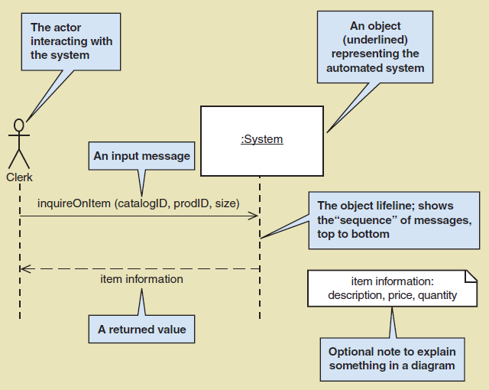
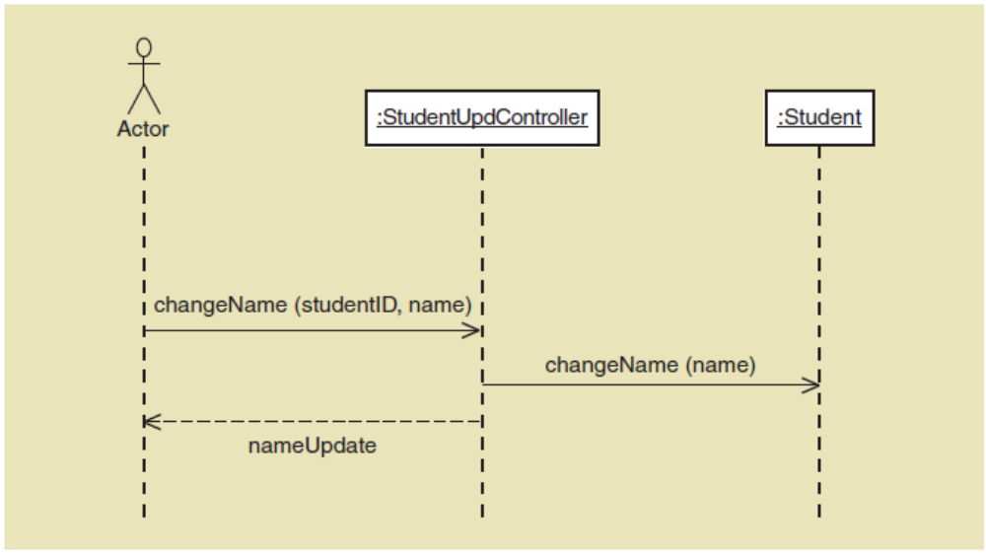
Detailed Design
Sequence Diagram Example
Use case Update student name
第五章：系统顺序图
© 2012 Cengage Learning. All Rights Reserved. This edition is intended for use outside of the U.S. only, with content that may be different from the U.S. Edition.
May not be scanned, copied, duplicated, or posted to a publicly accessible website, in whole or in part.
Notes:
更新学生姓名的顺序图

Slide 31
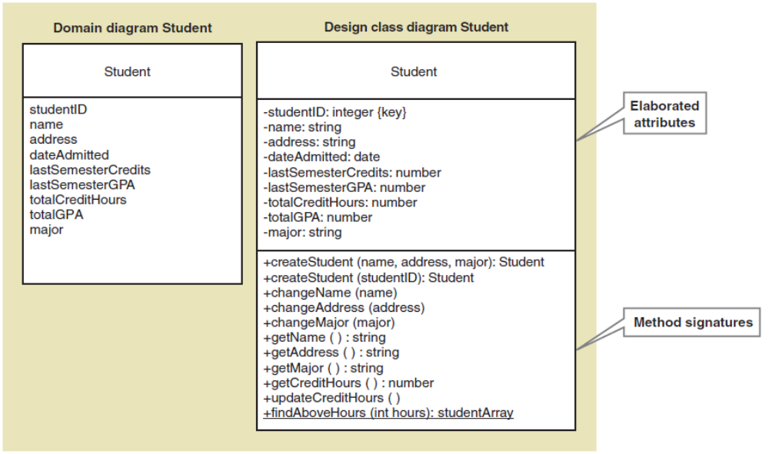
Design Classes in Detailed Design
Elaborate attributes—visibility, type, properties
设计类图：
描述属性：可见性，类型，属性
© 2012 Cengage Learning. All Rights Reserved. This edition is intended for use outside of the U.S. only, with content that may be different from the U.S. Edition.
May not be scanned, copied, duplicated, or posted to a publicly accessible website, in whole or in part.
Notes:
设计类图：
描述属性：可见性，类型，属性

Slide 32
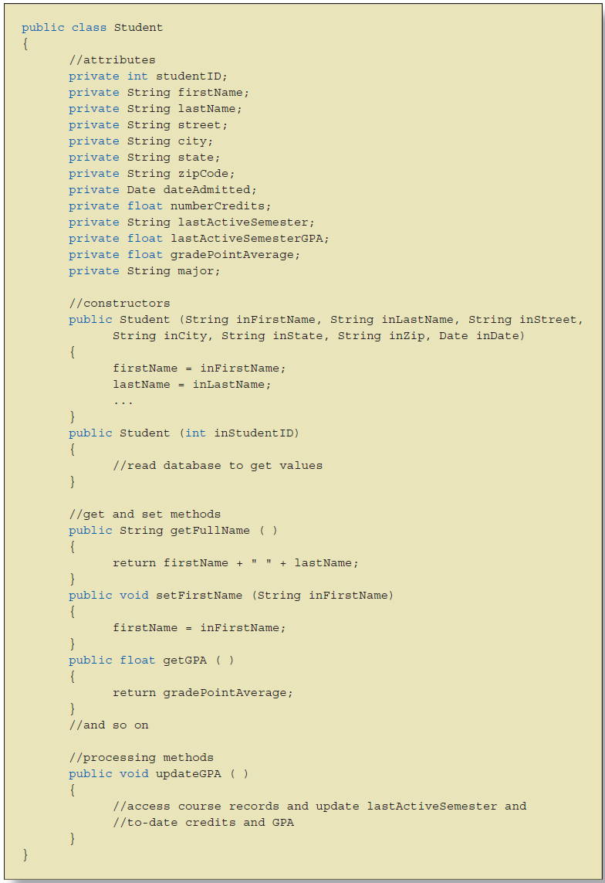
Write the Code for the Design Class to Implement
© 2012 Cengage Learning. All Rights Reserved. This edition is intended for use outside of the U.S. only, with content that may be different from the U.S. Edition.
May not be scanned, copied, duplicated, or posted to a publicly accessible website, in whole or in part.

Slide 33
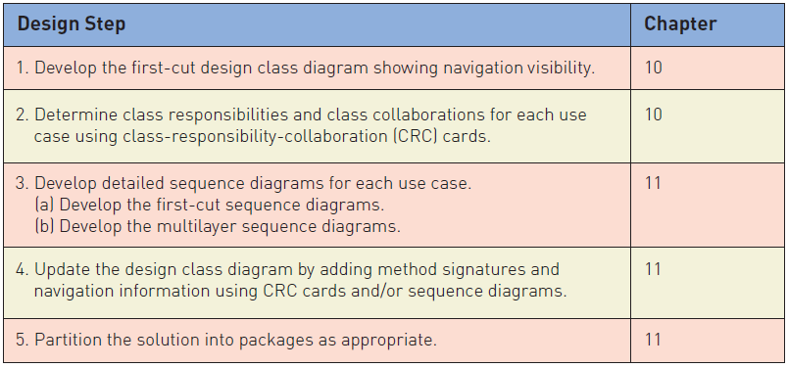
OO Detailed Design Steps
Chapters 10 and 11
开发初步设计类图，显示导航可见性
使用CRC卡为用例决定类的职责和合作使用
为每个用例开发详细的顺序图：1）开发初步顺序图；2）开发多层顺序图
使用CRC卡或顺序图，添加方法特征和导航信息，以此来更新设计类图
将解决方案划分成适当的包
© 2012 Cengage Learning. All Rights Reserved. This edition is intended for use outside of the U.S. only, with content that may be different from the U.S. Edition.
May not be scanned, copied, duplicated, or posted to a publicly accessible website, in whole or in part.
Notes:
开发初步设计类图，显示导航可见性（10）
使用CRC卡位用例决定类的职责和合作（10）
为每个用例开发详细的顺序图：1）开发初步顺序图；2）开发多层顺序图（11）
使用CRC卡或顺序图，添加方法特征和导航信息，以此来更新设计类图（11）
将解决方案划分成适当的包（11）

Slide 34
Chapter 10 Outline
Object-Oriented Design: Bridging from Analysis to Implementation
Object-Oriented Architectural Design
Fundamental Principles of Object-Oriented Detailed Design
Design Classes and the Design Class Diagram（设计类和设计类图）
Detailed Design with CRC Cards
Fundamental Detailed Design Principles
© 2012 Cengage Learning. All Rights Reserved. This edition is intended for use outside of the U.S. only, with content that may be different from the U.S. Edition.
May not be scanned, copied, duplicated, or posted to a publicly accessible website, in whole or in part.
Notes:
设计类和设计类图

Slide 35
Design Class Diagrams（设计类图）
Stereotype（构造型） a way of categorizing a model element by its characteristics, indicated by guillemots (<< >>)（对模型元素以特定的类型分类）
  entity class（实体类） a design identifier for a problem domain class (usually persistent)
    persistent class an class whose objects exist after a system is shut down (data remembered)
  boundary class or view class（边界类/视图类） a class that exists on a system’s automation boundary, such as an input window form or Web page
  control class（控制类） a class that mediates between boundary classes and entity classes, acting as a switchboard between the view layer and domain layer
  data access class（数据访问类）a class that is used to retrieve data from and send data to a database
© 2012 Cengage Learning. All Rights Reserved. This edition is intended for use outside of the U.S. only, with content that may be different from the U.S. Edition.
May not be scanned, copied, duplicated, or posted to a publicly accessible website, in whole or in part.
Notes:
设计类图的符号
设计类图和域模型的目标不同：
域模型类图：用户工作环境下的事务以及他们之间的联系。类不是特指软件类
设计类图：定义软件类
构造型：对模型元素以特定的类型分类
实体类：问题域类的设计标识符
边界类/视图类：系统的自动化边界上的类
控制类：在边界类和实体类之间起协调作用的类。负责从边界类对象获取信息，然后发送给正确的实体类对象
数据访问类：从数据库中获取信息或向数据库发送信息的类

Slide 36
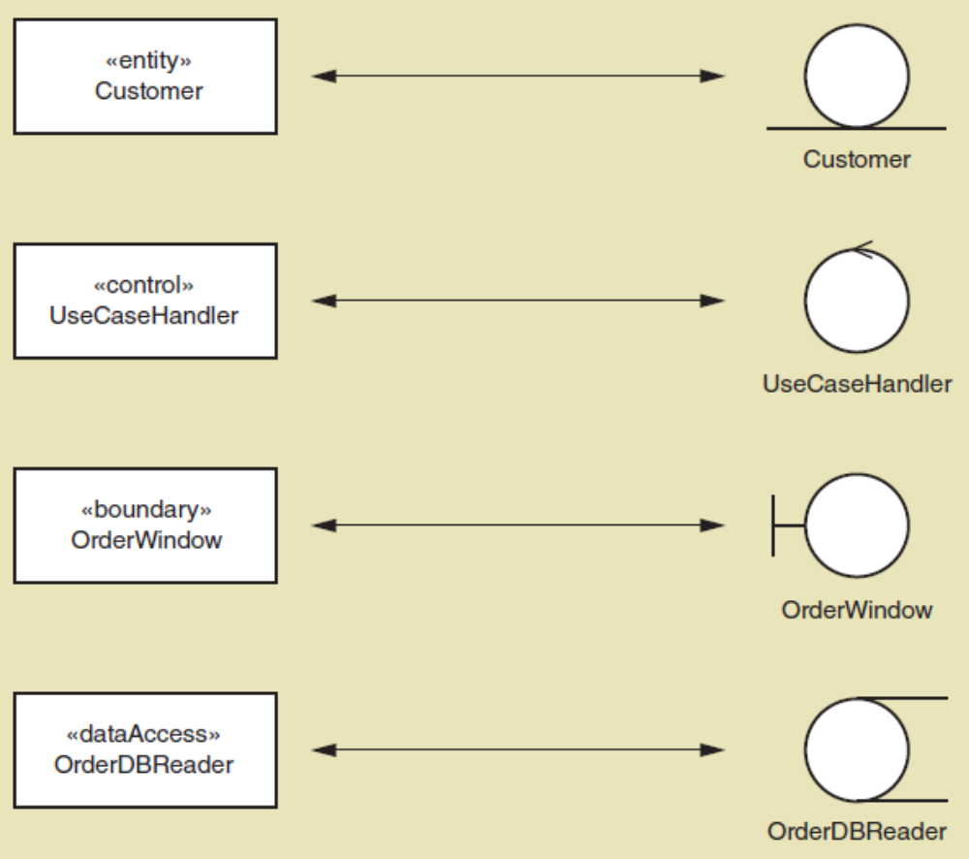
Class Stereotypes in UML
© 2012 Cengage Learning. All Rights Reserved. This edition is intended for use outside of the U.S. only, with content that may be different from the U.S. Edition.
May not be scanned, copied, duplicated, or posted to a publicly accessible website, in whole or in part.
Notes:
UML设计模型中的标准构造型

Slide 37
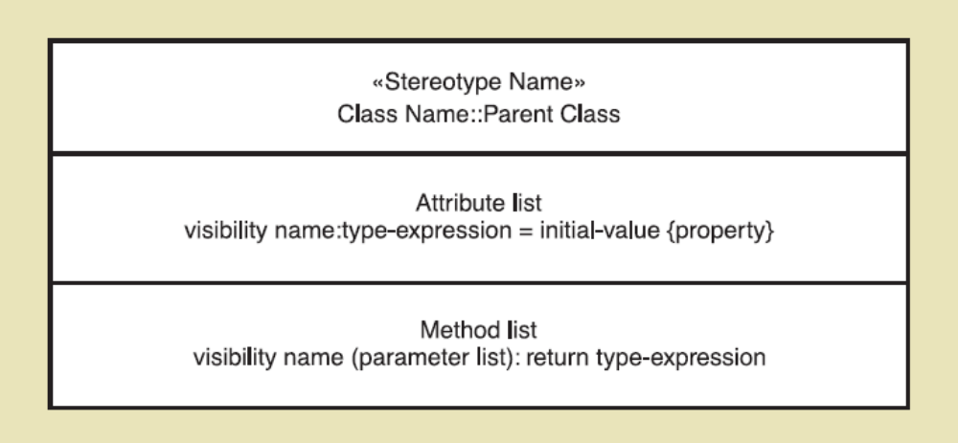
Notation for a Design Class
Syntax for Name, Attributes, and Methods（定义设计类的符号）
模型名
类名：父类名
属性列表
方法列表
© 2012 Cengage Learning. All Rights Reserved. This edition is intended for use outside of the U.S. only, with content that may be different from the U.S. Edition.
May not be scanned, copied, duplicated, or posted to a publicly accessible website, in whole or in part.
Notes:
定义设计类的符号
名称、属性和方法的语法
《模式名》类名：父类名
属性列表：见下页

Slide 38
Notation for Design Classes
Attributes（属性）
  Visibility（可见性）—indicates (+ or -) whether an attribute can be accessed directly by another object. Usually private (-) not public (+)
  Attribute name（属性名称）—Lower case camelback notation
  Type expression（类型表达）—class, string, integer, double, date
  Initial value（初始值）—if applicable the default value
  Property（特性）—if applicable, such as {key}
  Examples:
    -accountNo: String {key}
    -startingJobCode: integer = 01
Notes:
定义属性的格式：
可见性（+ public，- private）
属性名称（驼峰命名法）
类型表达式（类，字符串，整型，浮点型..）
初始值（如果有默认值）
特性（在花括号内），比如{关键字}

Slide 39
Notation for Design Classes
Methods（方法）
  Visibility（方法可见性）—indicates (+ or -) whether an method can be invoked by another object. Usually public (+), can be private if invoked within class like a subroutine
  Method name（方法名称）—Lower case camelback, verb-noun
  Parameters（方法参数列表）—variables passed to a method
  Return type（返回参数类型）—the type of the data returned
  Examples:
    +setName(fName, lName) : void (void is usually let off)
    +getName(): string (what is returned is a string)
    -checkValidity(date) : int (assuming int is a returned code)
Notes:
方法：
方法可见性
方法名称
方法参数列表（输入参数）
方法返回参数的类型

Slide 40
Notation for Design Classes
Class level method（类级方法）—applies to class rather than objects of class (aka static method). （静态方法：应用于类而不是类的对象）
  +findStudentsAboveHours(hours): Array
  +getNumberOfCustomers(): Integer
Class level attribute（类级属性）—applies to the class rather than an object (aka static attribute). （静态属性：应用于类而不是对象）
  -noOfPhoneSales: int
静态：只要定义了类，不必建立类的实例就可以使用
© 2012 Cengage Learning. All Rights Reserved. This edition is intended for use outside of the U.S. only, with content that may be different from the U.S. Edition.
May not be scanned, copied, duplicated, or posted to a publicly accessible website, in whole or in part.
Notes:
类级方法——应用于类而不是类的对象(又名静态方法)。
类级属性——应用于类而不是对象(又名静态属性)。
静态方法只要定义了类，不必建立类的实例就可使用

Slide 41
Notation for Design Classes
Abstract class（抽象类）– class that can’t be instantiated. （不能被实例化的类）
  Only for inheritance. Name in Italics.（仅用于继承）
Concrete class（具体类）—class that can be instantiated. （能被实例化的类）
© 2012 Cengage Learning. All Rights Reserved. This edition is intended for use outside of the U.S. only, with content that may be different from the U.S. Edition.
May not be scanned, copied, duplicated, or posted to a publicly accessible website, in whole or in part.
Notes:
抽象类——不能被实例化的类
仅用于继承（用斜体）
（例如，Sale是一个抽象类，系统的每个订单可以是phonesale，Internetsale或者storesale）
具体类——能被实例化的类

Slide 42
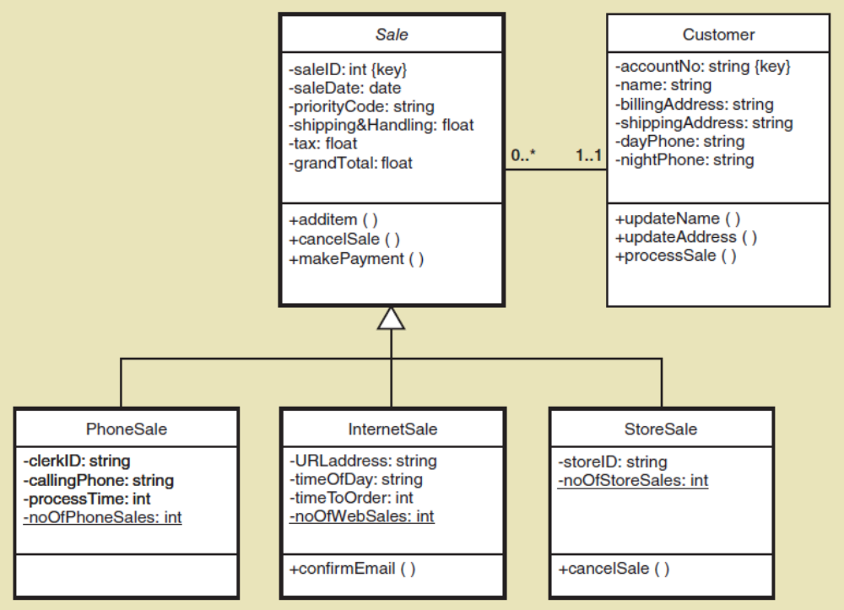
Notation for Design Classes method arguments and return types not shown
© 2012 Cengage Learning. All Rights Reserved. This edition is intended for use outside of the U.S. only, with content that may be different from the U.S. Edition.
May not be scanned, copied, duplicated, or posted to a publicly accessible website, in whole or in part.
Notes:
销售类（抽象）和具有集成关系的三个具体子类

Slide 43

主观题
10分
Write Java code frame according to the following class diagram.
正常使用主观题需2.0以上版本雨课堂
作答

Slide 44
Notation for Design Classes
Navigation Visibility（导航可见性）
  The ability of one object to view and interact with another object（一个对象查看另一个对象并与之交互的能力）
  Accomplished by adding an object reference variable to a class. （通过向类添加对象引用变量来实现）
  Shown as an arrow head on the association line—customer can find and interact with sale because it has mySale reference variable（在关联线上显示为箭头，客户可以找到sale并与之交互，因为它有mysql引用变量）
© 2012 Cengage Learning. All Rights Reserved. This edition is intended for use outside of the U.S. only, with content that may be different from the U.S. Edition.
May not be scanned, copied, duplicated, or posted to a publicly accessible website, in whole or in part.
Notes:
导航可见性
一个对象查看另一个对象并与之交互的能力
通过向类添加对象引用变量来实现
在关联线上显示为箭头，客户可以找到sale并与之交互，因为它有mysql引用变量

Slide 45
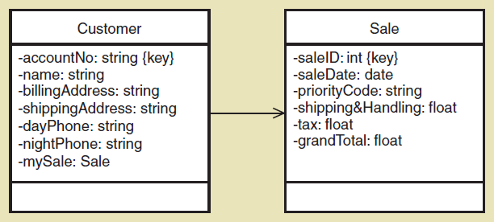
Notation for Design Classes
Navigation Visibility（导航可见性）
© 2012 Cengage Learning. All Rights Reserved. This edition is intended for use outside of the U.S. only, with content that may be different from the U.S. Edition.
May not be scanned, copied, duplicated, or posted to a publicly accessible website, in whole or in part.
Notes:
导航可见性
一个对象查看另一个对象并与之交互的能力
通过向类添加对象引用变量来实现
在关联线上显示为箭头，客户可以找到sale并与之交互，因为它有mysql引用变量

Slide 46
Navigation Visibility Guidelines
One-to-many associations （一对多关联）that indicate a superior/subordinate relationship are usually navigated from the superior to the subordinate（从上级导航到下级）
Mandatory associations（强制关联）, in which objects in one class can’t exist without objects of another class, are usually navigated from the more independent class to the dependent（一个类中的对象不能没有另一个类的对象而存在，通常从更独立的类导航到依赖的类）
When an object needs information from another object, a navigation arrow might be required（当一个对象需要来自另一个对象的信息时，可能需要一个导航箭头）
Navigation arrows may be bidirectional.（导航箭头可以是双向的）
© 2012 Cengage Learning. All Rights Reserved. This edition is intended for use outside of the U.S. only, with content that may be different from the U.S. Edition.
May not be scanned, copied, duplicated, or posted to a publicly accessible website, in whole or in part.
Notes:
表示上下级关系的一对多关联通常从上级导航到下级
强制关联，即一个类中的对象不能没有另一个类的对象而存在，通常从更独立的类导航到依赖的类
当一个对象需要来自另一个对象的信息时，可能需要一个导航箭头
导航箭头可以是双向的

Slide 47
First Cut Design Class Diagram
Proceed use case（用例） by use case, adding to the diagram
Pick the domain classes（域类） that are involved in the use case (see preconditions and post conditions for ideas)
Add a controller class（控制器类） to be in charge of the use case
Determine the initial navigation visibility（导航可见性） requirements using the guidelines and add to diagram
Elaborate the attributes of each class with visibility and type（用可见性和类型详细说明每个类的属性）
© 2012 Cengage Learning. All Rights Reserved. This edition is intended for use outside of the U.S. only, with content that may be different from the U.S. Edition.
May not be scanned, copied, duplicated, or posted to a publicly accessible website, in whole or in part.
Notes:
开发初步的设计类图
一个用例接一个用例，添加到图中
选择用例中涉及的域类(请参阅前提条件和后置条件)
添加一个控制器类来负责用例
确定初始导航可见性需求，并添加到图中
用可见性和类型详细说明每个类的属性

Slide 48
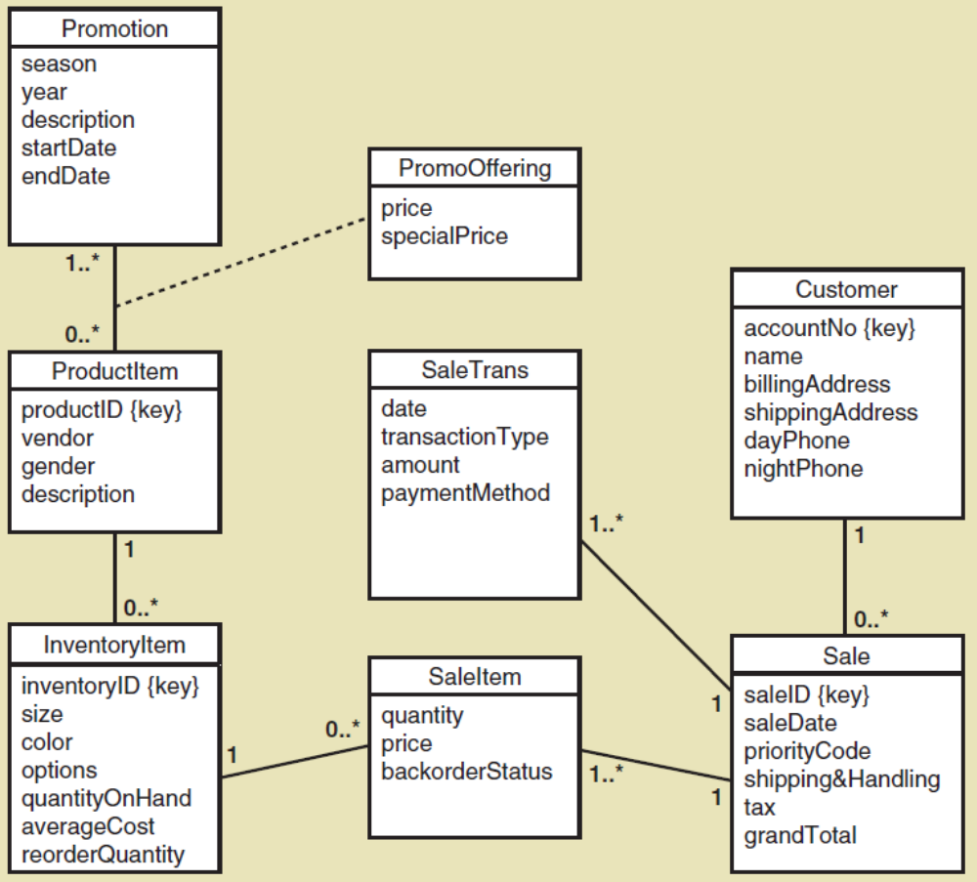
Start with Domain Class
Diagram
（域模型类图：第四章）
RMO Sales Subsystem
© 2012 Cengage Learning. All Rights Reserved. This edition is intended for use outside of the U.S. only, with content that may be different from the U.S. Edition.
May not be scanned, copied, duplicated, or posted to a publicly accessible website, in whole or in part.
Notes:
域模型类图（第四章）

Slide 49
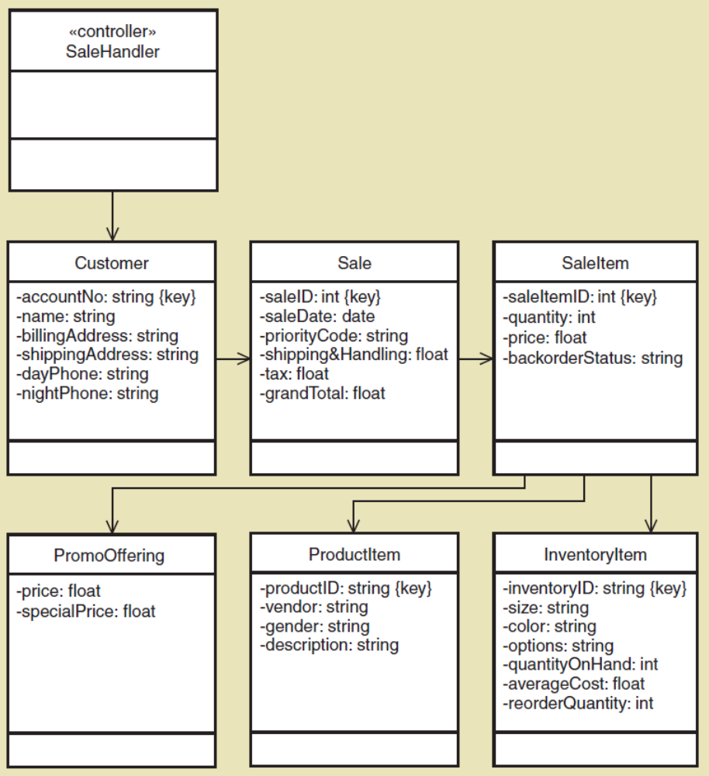
Create First Cut Design Class
Diagram
Use Case Create phone sale with controller added
© 2012 Cengage Learning. All Rights Reserved. This edition is intended for use outside of the U.S. only, with content that may be different from the U.S. Edition.
May not be scanned, copied, duplicated, or posted to a publicly accessible website, in whole or in part.
Notes:
1. 一个用例接一个用例，添加到图中
2. 选择用例中涉及的域类
3. 添加一个控制器类来负责用例
4. 确定初始导航可见性需求，并添加到图中
5. 用可见性和类型详细说明每个类的属性

Slide 50
Chapter 10 Outline
Object-Oriented Design: Bridging from Analysis to Implementation
Object-Oriented Architectural Design
Fundamental Principles of Object-Oriented Detailed Design
Design Classes and the Design Class Diagram
Detailed Design with CRC Cards（详细设计与CRC卡）
Fundamental Detailed Design Principles
© 2012 Cengage Learning. All Rights Reserved. This edition is intended for use outside of the U.S. only, with content that may be different from the U.S. Edition.
May not be scanned, copied, duplicated, or posted to a publicly accessible website, in whole or in part.
Notes:
详细设计与CRC卡

Slide 51
Designing With CRC Cards
CRC Cards—Classes（类）, Responsibilities（职责）, Collaboration（协作） Cards
OO design is about assigning Responsibilities to Classes for how they Collaborate to accomplish a use case（OO设计是关于为类分配职责，以便它们如何协作来完成用例）
Usually a manual process done in a brainstorming session
  One card per class
  Front has responsibilities and collaborations（正面：责任和协作）
  Back has attributes needed（反面：属性）
© 2012 Cengage Learning. All Rights Reserved. This edition is intended for use outside of the U.S. only, with content that may be different from the U.S. Edition.
May not be scanned, copied, duplicated, or posted to a publicly accessible website, in whole or in part.
Notes:
使用CRC卡进行设计:
CRC卡-类，职责，协作卡
OO设计是关于为类分配职责，以便它们如何协作来完成用例
通常是在头脑风暴会议中手动完成的过程
每个类一张卡
正面有责任和协作
反面有需要的属性

Slide 52
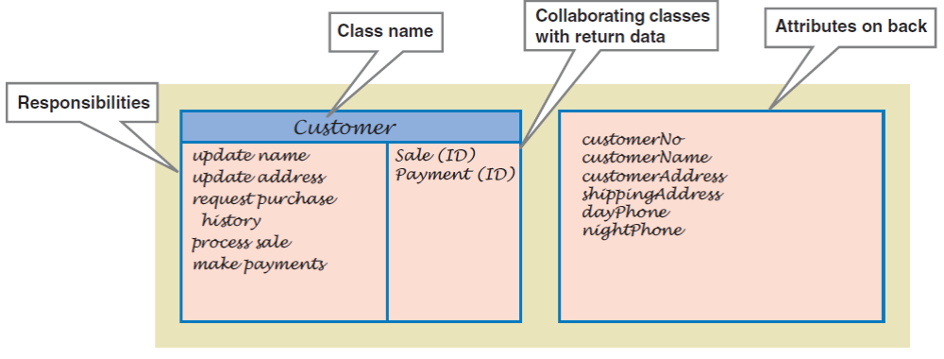
Example of CRC Card
© 2012 Cengage Learning. All Rights Reserved. This edition is intended for use outside of the U.S. only, with content that may be different from the U.S. Edition.
May not be scanned, copied, duplicated, or posted to a publicly accessible website, in whole or in part.

Slide 53
CRC Cards Procedure
Because the process is to design, or realize, a single use case, start with a set of unused CRC cards. Add a controller class (Controller design pattern)（从一组未使用的CRC卡开始，添加一个控制器类）.
Identify a problem domain class that has primary responsibility for this use case that will receive the first message from the use case controller. （确定一个问题域类）
Use the first cut design class diagram to identify other classes that must collaborate with the primary object class to complete the use case.（识别必须与主要对象类协作以完成用例的其他类）
© 2012 Cengage Learning. All Rights Reserved. This edition is intended for use outside of the U.S. only, with content that may be different from the U.S. Edition.
May not be scanned, copied, duplicated, or posted to a publicly accessible website, in whole or in part.
Notes:
CRC卡过程：
因为这个过程是设计或实现一个用例，从一组未使用的CRC卡开始。添加一个控制器类(控制器设计模式)。
确定一个对这个用例负有主要责任的问题域类，它将接收来自用例控制器的第一条消息。
使用第一个设计类图来识别必须与主要对象类协作以完成用例的其他类。

Slide 54
CRC Cards Procedure (continued)
Start with the class that gets the first message from the controller. Name the responsibility（命名职责） and write it on card.
Now ask what this first class needs to carry out the responsibility. Assign other classes responsibilities to satisfy each need（分配其他类职责以满足每个需求。把责任写在卡片上）. Write responsibilities on those cards.
Add collaborators to cards showing which collaborate with which. Add attributes to back when data is used
Eventually, user interface classes（用户交互类） or even data access classes（数据访问类） can be added
© 2012 Cengage Learning. All Rights Reserved. This edition is intended for use outside of the U.S. only, with content that may be different from the U.S. Edition.
May not be scanned, copied, duplicated, or posted to a publicly accessible website, in whole or in part.
Notes:
从控制器获取第一条消息的类开始。并将它的职责写在卡片上
现在问一下，这第一个类需要什么来履行职责。分配其他类职责以满足每个需求。把责任写在卡片上。
将协作者添加到显示哪个与哪个协作的卡片中。在卡片背面添加属性
最后，可以添加用户交互类甚至数据访问类

Slide 55
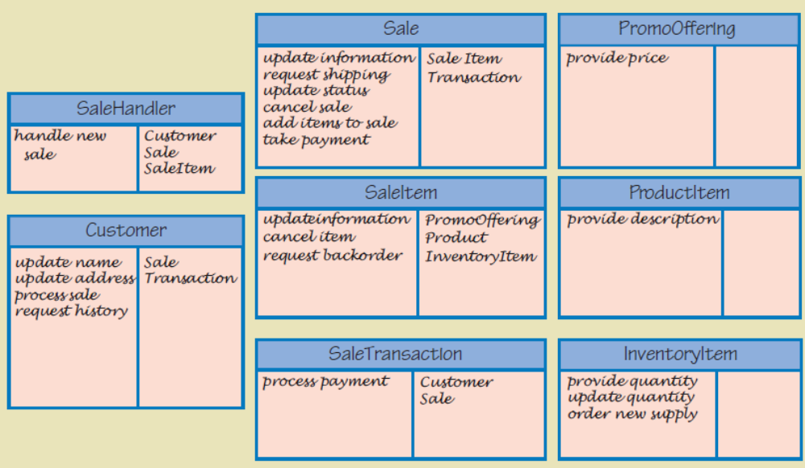
CRC Cards Results
Several Use Cases
© 2012 Cengage Learning. All Rights Reserved. This edition is intended for use outside of the U.S. only, with content that may be different from the U.S. Edition.
May not be scanned, copied, duplicated, or posted to a publicly accessible website, in whole or in part.

Slide 56
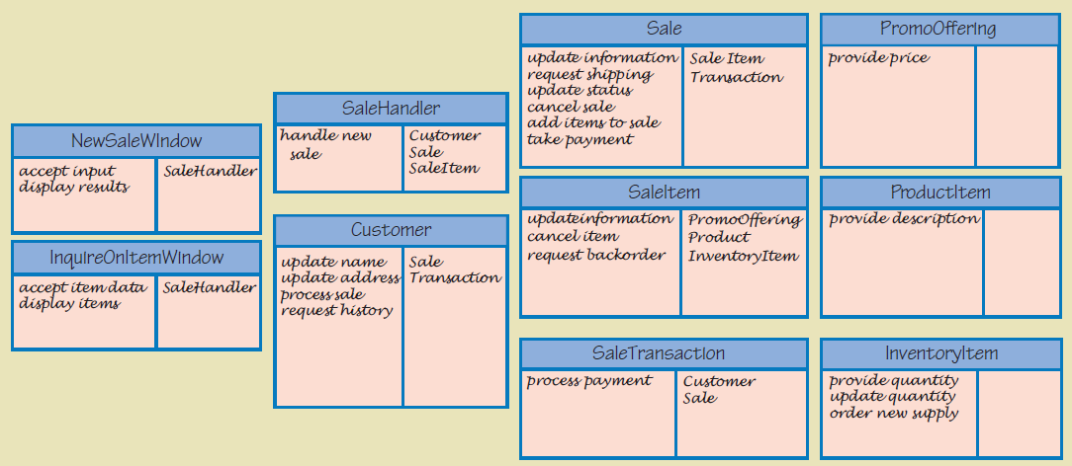
CRC Cards Results
Adding In User Interface Layer
© 2012 Cengage Learning. All Rights Reserved. This edition is intended for use outside of the U.S. only, with content that may be different from the U.S. Edition.
May not be scanned, copied, duplicated, or posted to a publicly accessible website, in whole or in part.

Slide 57
CRC Cards Results
Several Use Cases
© 2012 Cengage Learning. All Rights Reserved. This edition is intended for use outside of the U.S. only, with content that may be different from the U.S. Edition.
May not be scanned, copied, duplicated, or posted to a publicly accessible website, in whole or in part.

Slide 58
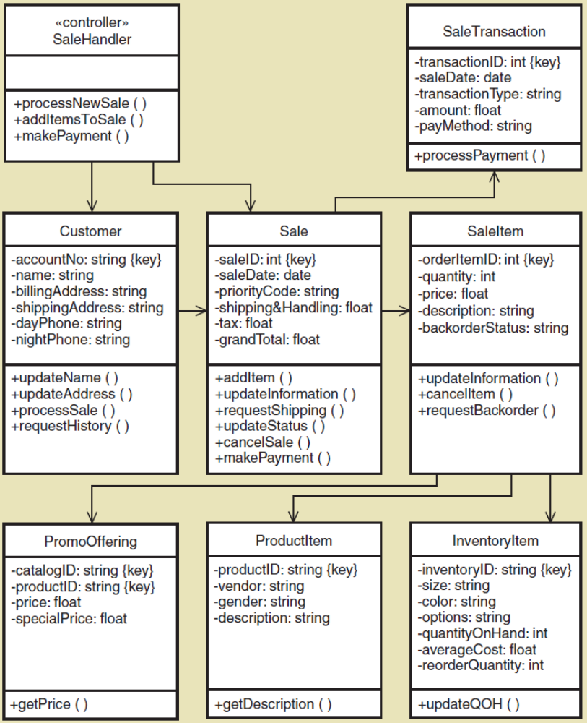
CRC Cards
Update design class diagram based on CRC results
Responsibilities become methods
Arguments and return types not yet added
new
new
© 2012 Cengage Learning. All Rights Reserved. This edition is intended for use outside of the U.S. only, with content that may be different from the U.S. Edition.
May not be scanned, copied, duplicated, or posted to a publicly accessible website, in whole or in part.
Notes:
更新基于CRC结果的设计类图

Slide 59
CRC Cards
Update design class diagram based on CRC results
Responsibilities become methods
Arguments and return types not yet added
© 2012 Cengage Learning. All Rights Reserved. This edition is intended for use outside of the U.S. only, with content that may be different from the U.S. Edition.
May not be scanned, copied, duplicated, or posted to a publicly accessible website, in whole or in part.
Notes:
职责变为尚未添加的方法

Slide 60
CRC Cards
Update design class diagram based on CRC results
Responsibilities become methods
Arguments and return types not yet added
© 2012 Cengage Learning. All Rights Reserved. This edition is intended for use outside of the U.S. only, with content that may be different from the U.S. Edition.
May not be scanned, copied, duplicated, or posted to a publicly accessible website, in whole or in part.
Notes:
参数和返回类型尚未添加

Slide 61
Chapter 10 Outline
Object-Oriented Design: Bridging from Analysis to Implementation
Object-Oriented Architectural Design
Fundamental Principles of Object-Oriented Detailed Design
Design Classes and the Design Class Diagram
Detailed Design with CRC Cards
Fundamental Detailed Design Principles
© 2012 Cengage Learning. All Rights Reserved. This edition is intended for use outside of the U.S. only, with content that may be different from the U.S. Edition.
May not be scanned, copied, duplicated, or posted to a publicly accessible website, in whole or in part.
Notes:
基本详细设计原则

Slide 62
Fundamental Design Principles
Coupling（耦合性）
  A quantitative measure of how closely related classes are linked (tightly or loosely coupled)（对相关类的链接紧密程度（紧密耦合或松散耦合）的定量度量）
  Two classes are tightly coupled of there are lots of associations with another class（两个类是紧密耦合的）
  Two classes are tightly coupled if there are lots of messages to another class（如果有很多传递给另一个类的消息，则两个类是紧密耦合的）（互相通信的对象必须有导航可见性，所以他们就是耦合的）
  It is best to have classes that are loosely coupled（松耦合）（强耦合时，一个类的变化会波及整个系统）
© 2012 Cengage Learning. All Rights Reserved. This edition is intended for use outside of the U.S. only, with content that may be different from the U.S. Edition.
May not be scanned, copied, duplicated, or posted to a publicly accessible website, in whole or in part.
Notes:
耦合
对相关类的链接紧密程度(紧密耦合或松散耦合)的定量度量
两个类是紧密耦合的，即与另一个类有很多关联
如果有很多传递给另一个类的消息，则两个类是紧密耦合的 （互相通信的对象必须有导航可见性，所以他们就是耦合的）
松耦合（强耦合时，一个类的变化会波及整个系统）

Slide 63
Fundamental Design Principles
Cohesion（内聚）
  A quantitative measure of the focus or unity of purpose within a single class (high or low cohesiveness)（内聚是对一个类的功能一致性的定性度量）
  One class has high cohesiveness if all of its responsibilities are consistent and make sense for purpose of the class （如果一个类的所有职责都是一致的，并且对类的目的有意义，则该类具有高内聚性）
  One class has low cohesiveness if its responsibilities are broad or makeshift （如果一个类的职责很宽泛或者是临时的，那么它的内聚性就很低）
  It is best to have classes that are highly cohesive（高内聚性）
© 2012 Cengage Learning. All Rights Reserved. This edition is intended for use outside of the U.S. only, with content that may be different from the U.S. Edition.
May not be scanned, copied, duplicated, or posted to a publicly accessible website, in whole or in part.
Notes:
内聚
内聚是对一个类的功能一致性的定性度量
如果一个类的所有职责都是一致的，并且对类的目的有意义，则该类具有高内聚性。
如果一个类的职责很宽泛或者是临时的，那么它的内聚性就很低
（这个类只完成自己该完成的职责，尽可能地减少与它关联弱的职责）
希望：高内聚
低内聚的负效应：
1）难于维护，对系统内的变化很敏感，容易产生连锁反应
2）很难再次使用这些类，他们有很多㐀的功能
3）难于理解，逻辑负责

Slide 64
Fundamental Design Principles
Protection from Variations（变量保护）
  A design principle that states parts of a system unlikely to change are separated (protected) from those that will surely change（将系统中不太可能改变的部分与那些肯定会改变的部分分开(保护)的设计原则）
  Separate user interface（接口逻辑） forms and pages that are likely to change from application logic（业务逻辑分离）（用户接口）
  Put database connection and SQL logic that is likely to change in a separate classes from application logic （数据库连接和业务逻辑分离）
  Use adaptor classes that are likely to change when interfacing with other systems（使用在与其他系统接口时可能会更改的适配器类）
© 2012 Cengage Learning. All Rights Reserved. This edition is intended for use outside of the U.S. only, with content that may be different from the U.S. Edition.
May not be scanned, copied, duplicated, or posted to a publicly accessible website, in whole or in part.
Notes:
变量保护
将系统中不太可能改变的部分与那些肯定会改变的部分分开(保护)的设计原则
用户接口逻辑和业务逻辑分离（用户接口可以在不影响业务逻辑的情况下被重写）
数据库连接和业务逻辑分离
使用在与其他系统接口时可能会更改的适配器类

Slide 65
Fundamental Design Principles
Indirection（间接）
  A design principle that states an intermediate class is placed between two classes to decouple them but still link them（通过放置一个充当链接的中间件来分离两个类或其他系统组件的原则）
  A controller class（控制器类） between UI classes and problem domain classes is an example
  Supports low coupling（支持低耦合）
  Indirection is used to support security by directing messages to an intermediate class as in a firewall（通过将消息定向到防火墙中的中间类来支持安全性）
© 2012 Cengage Learning. All Rights Reserved. This edition is intended for use outside of the U.S. only, with content that may be different from the U.S. Edition.
May not be scanned, copied, duplicated, or posted to a publicly accessible website, in whole or in part.
Notes:
间接
通过放置一个充当链接的中间件来分离两个类或其他系统组件的原则
UI类和问题域类之间的控制器类就是一个例子
支持低耦合
通过将消息定向到防火墙中的中间类来支持安全性
（许多公司在内网和外网之间设有防火墙和代理服务器，代理服务器可以接收和发送消息）

Slide 66
Fundamental Design Principles
Object Responsibility（对象职责）
  A design principle that states objects（对象） are responsible for carrying out system processing
  Responsibilities include “knowing” and “doing” （职责分为“认识”和“行动”）
  Objects know about other objects (associations) and they know about their attribute values. （对象知道其他关联）
  Objects know how to carry out methods, do what they are asked to do. （对象知道如何执行方法）
  一个对象应该具有对向它提供信息的对象的导航可见性
© 2012 Cengage Learning. All Rights Reserved. This edition is intended for use outside of the U.S. only, with content that may be different from the U.S. Edition.
May not be scanned, copied, duplicated, or posted to a publicly accessible website, in whole or in part.
Notes:
对象职责
由对象负责实施系统过程
职责可以分为两类：认识和行动
对象知道其他对象(关联)，也知道它们的属性值。
对象知道如何执行方法，做被要求做的事情。
（一个对象应该具有对向它提供信息的对象的导航可见性）

Slide 67
Summary
This chapter focused on designing software that solves business problems by bridging the gap between analysis and implementation.（弥合分析和实现）
Architectural design is the first step, and the UML component diagram is used to model the main components and application program interfaces (API)（架构设计是第一步，UML组件图用于对主要组件和应用程序编程接口(API)建模）
Detail design of software proceeds use case by use case, sometimes called “use case driven” and the design of each use case is called use case realization.（软件的详细设计是一个用例接一个用例进行的，有时称为“用例驱动”，每个用例的设计称为用例实现）
Detailed design models used are design class diagrams and sequence diagrams. （详细设计模型使用的是设计类图和顺序图）
© 2012 Cengage Learning. All Rights Reserved. This edition is intended for use outside of the U.S. only, with content that may be different from the U.S. Edition.
May not be scanned, copied, duplicated, or posted to a publicly accessible website, in whole or in part.
Notes:
本章的重点是设计通过弥合分析和实现之间的差距来解决业务问题的软件。
架构设计是第一步，UML组件图用于对主要组件和应用程序编程接口(API)建模。
软件的详细设计是一个用例接一个用例进行的，有时称为“用例驱动”，每个用例的设计称为用例实现。
详细设计模型使用的是设计类图和顺序图。

Slide 68
Summary
The design class diagram is developed is two steps: The first cut diagram is based on the domain model class diagram（设计类图）, but then it is expanded as responsibilities are assigned and sequence diagrams（顺序图） are developed.
Design class diagrams include additional notation because design classes are now software classes, not just work concepts.（设计类图包含了额外的标记，因为设计类现在是软件类，而不仅仅是工作概念）
Key issues are attribute elaboration and adding methods. Method signatures include visibility, method name, arguments, and return types. （关键问题是属性的细化和添加方法。方法签名包括可见性、方法名、参数和返回类型）
Other key terms are abstract vs. concrete classes, navigation visibility, and class level attributes and methods.（其他关键问题包括抽象类与具体类、导航可见性以及类的属性和方法）
© 2012 Cengage Learning. All Rights Reserved. This edition is intended for use outside of the U.S. only, with content that may be different from the U.S. Edition.
May not be scanned, copied, duplicated, or posted to a publicly accessible website, in whole or in part.
Notes:
设计类图的开发分为两个步骤:初步图是基于域模型类图的，但是随着职责的分配和顺序图的开发，它可以被扩展。
设计类图包含了额外的标记，因为设计类现在是软件类，而不仅仅是工作概念。
关键问题是属性的细化和添加方法。方法签名包括可见性、方法名、参数和返回类型。
其他关键问题包括抽象类与具体类、导航可见性以及类的属性和方法

Slide 69
Summary (continued)
CRC Cards technique can be used to design how the classes collaborate to complete each use case. CRC stands for Classes, Responsibilities, and Collaborations.（CRC卡技术可用于设计类如何协作以完成每个用例。CRC代表类、责任和协作）
Sometimes the CRC cards approach is used for the initial design of a use case that is further developed using sequence diagrams (as in the next chapter).（有时CRC卡方法用于用例的初始设计，然后使用顺序图进一步开发）
Decisions about design options are guided by some fundamental design principles. Some of these are coupling, cohesion, protection from variations, indirection, and object responsibility. （关于设计选项的决策是由一些基本的设计原则指导的。其中一些是耦合、内聚、变量保护、间接和对象责任）
© 2012 Cengage Learning. All Rights Reserved. This edition is intended for use outside of the U.S. only, with content that may be different from the U.S. Edition.
May not be scanned, copied, duplicated, or posted to a publicly accessible website, in whole or in part.
Notes:
CRC卡技术可用于设计类如何协作以完成每个用例。CRC代表类、责任和协作。
有时CRC卡方法用于用例的初始设计，然后使用顺序图进一步开发(如下一章所述)。

