Slide 1
INTRODUCTION TO
SYSTEMS ANALYSIS AND DESIGN:
AN AGILE, ITERATIVE APPROACH
SATZINGER | JACKSON | BURD
Chapter 2
CHAPTER 2

Slide 2
Chapter 2 Outline
The RMO Consolidated Sales and Marketing System Project（RMO综合销售项目）
Systems Analysis Activities（系统分析活动）
What Are Requirements?（什么是需求）
Models and Modeling（模型和建模）
Stakeholders（利益相关者）
Information-Gathering Techniques（信息收集技术）
Documenting Workflows with Activity Diagrams（用活动图记录工作流）
Introduction to Systems Analysis and Design, 6th Edition
© 2012 Cengage Learning. All Rights Reserved. This edition is intended for use outside of the U.S. only, with content that may be different from the U.S. Edition.
May not be scanned, copied, duplicated, or posted to a publicly accessible website, in whole or in part.
Notes:
本章提纲
RMO综合销售和市场营销系统项目
系统分析活动
什么是需求
模型和建模
利益相关者
信息收集技术
用活动图记录工作流

Slide 3
Learning Objectives
Describe the activities of systems analysis（描述系统分析的活动）
Explain the difference between functional and nonfunctional requirements（解释功能性需求和非功能性需求之间的区别）
Describe the role of models in systems analysis（描述模型在系统分析中的作用）
© 2012 Cengage Learning. All Rights Reserved. This edition is intended for use outside of the U.S. only, with content that may be different from the U.S. Edition.
May not be scanned, copied, duplicated, or posted to a publicly accessible website, in whole or in part.
Notes:
本章目标：
描述系统分析的活动
解释功能性需求和非功能性需求之间的区别
描述模型在系统分析中的作用
识别并理解不同类型的利益相关者及其对需求定义的贡献
描述信息收集技术，并确定每种技术的最佳应用时机
开发活动图来建模工作流

Slide 4
Learning Objectives
Identify and understand different kinds of stakeholders and their contributions to requirements definition（利益相关者对需求的不同贡献）
Describe information-gathering techniques and determine when each is best applied（信息收集技术）
Develop activity diagrams to model workflows（开发活动图，建模工作流）
© 2012 Cengage Learning. All Rights Reserved. This edition is intended for use outside of the U.S. only, with content that may be different from the U.S. Edition.
May not be scanned, copied, duplicated, or posted to a publicly accessible website, in whole or in part.
Notes:
本章目标：
描述系统分析的活动
解释功能性需求和非功能性需求之间的区别
描述模型在系统分析中的作用
识别并理解不同类型的利益相关者及其对需求定义的贡献
描述信息收集技术，并确定每种技术的最佳应用时机
开发活动图来建模工作流

Slide 5
Chapter 2 Outline
The RMO Consolidated Sales and Marketing System Project（RMO综合销售和市场营销系统项目）
Systems Analysis Activities
What Are Requirements?
Models and Modeling
Stakeholders
Information-Gathering Techniques
Documenting Workflows with Activity Diagrams
Introduction to Systems Analysis and Design, 6th Edition
© 2012 Cengage Learning. All Rights Reserved. This edition is intended for use outside of the U.S. only, with content that may be different from the U.S. Edition.
May not be scanned, copied, duplicated, or posted to a publicly accessible website, in whole or in part.
Notes:
第一部分：RMO综合销售和市场营销系统项目

Slide 6
RMO Existing Application Architecture（RMO现有结构）
Supply Chain Management (SCM)
  5 years old; Java/Oracle
  Tradeshow system will interface with SCM
Phone/Mail Order System
  12 years old; Visual Studio/SQL
  Reached capacity;
Retail Store System
  Older package solution;
Customer Support System (CSS)
  Web based system; evolved over the years, mainly support phone/mail orders
问题：供应链的管理方式发生变化
问题：购物方式发生变化
问题：购物模式发生变化
问题：顾客需求发生变化
© 2012 Cengage Learning. All Rights Reserved. This edition is intended for use outside of the U.S. only, with content that may be different from the U.S. Edition.
May not be scanned, copied, duplicated, or posted to a publicly accessible website, in whole or in part.
Notes:
RMO现有应用程序体系结构
供应链管理(SCM)
使用5年;Java /Oracle
展会系统将与供应链交互
电话/邮购系统
使用12年;Visual Studio/SQL
达到最大产能；
零售商店
系统旧包解决方案;最小的集成
客户支援系统(CSS)
基于Web的系统;
经过多年的发展，主要支持电话/邮购

Slide 7
New Consolidated Sales and Marketing System
(CSMS，新的市场推广系统)
Sales Subsystem（销售子系统）
  Integrates online, phone, and retail stores
Order Fulfillment Subsystem（订单实施子系统）
  Track shipments, rate products and services
Customer Account Subsystem（顾客账务子系统）
  Shopping history, linkups, “mountain bucks” rewards
Marketing Subsystem（市场营销子系统）
  Promotional packages, partner relationships, more complete merchandise information and reporting
© 2012 Cengage Learning. All Rights Reserved. This edition is intended for use outside of the U.S. only, with content that may be different from the U.S. Edition.
May not be scanned, copied, duplicated, or posted to a publicly accessible website, in whole or in part.
Notes:
新的综合销售及市场推广系统(CSMS)
销售子系统：集成在线，电话和零售商店
订单实施子系统：跟踪发货，评估产品和服务
顾客账务子系统：购物记录，“山鹿”积分
市场营销子系统：促销套餐，合作伙伴关系，更完整的商品信息和报告

Slide 8
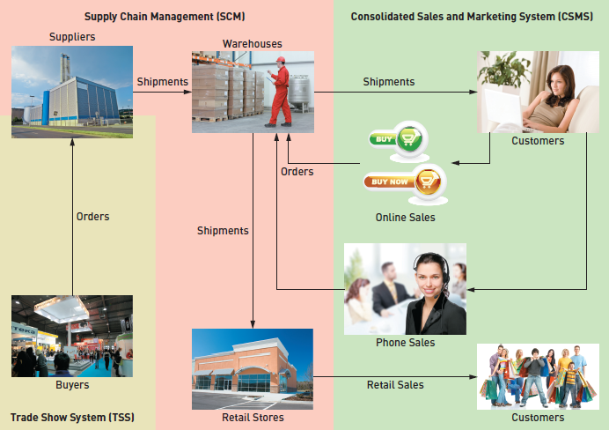
Proposed Application Architecture: Integrate SCM and New CSMS
© 2012 Cengage Learning. All Rights Reserved. This edition is intended for use outside of the U.S. only, with content that may be different from the U.S. Edition.
May not be scanned, copied, duplicated, or posted to a publicly accessible website, in whole or in part.
Notes:
TSS 贸易展系统
供应链管理 （SCM）
综合销售及市场推广系统(CSMS)

Slide 9
Chapter 2 Outline
The RMO Consolidated Sales and Marketing System Project
Systems Analysis Activities（系统分析活动）
What Are Requirements?
Models and Modeling
Stakeholders
Information-Gathering Techniques
Documenting Workflows with Activity Diagrams
Introduction to Systems Analysis and Design, 6th Edition
© 2012 Cengage Learning. All Rights Reserved. This edition is intended for use outside of the U.S. only, with content that may be different from the U.S. Edition.
May not be scanned, copied, duplicated, or posted to a publicly accessible website, in whole or in part.
Notes:
第二部分：系统分析活动

Slide 10
Systems Analysis Activities
Gather Detailed Information（收集信息）
  Interviews, questionnaires, documents, observing business processes, researching vendors, comments and suggestions
Define Requirements（定义需求）
  Modeling functional requirements and non-functional requirements
Prioritize Requirements（优先需求）
  Essential, important, vs. nice to have
Develop User-Interface Dialogs（用户界面对话框）
  Flow of interaction between user and system
Evaluate Requirements with Users（与用户评估需求）
  User involvement, feedback, adapt to changes
© 2012 Cengage Learning. All Rights Reserved. This edition is intended for use outside of the U.S. only, with content that may be different from the U.S. Edition.
May not be scanned, copied, duplicated, or posted to a publicly accessible website, in whole or in part.
Notes:
收集详细信息
访谈，问卷调查，文件，观察业务流程，研究供应商，评论和建议
定义需求
对功能需求和非功能需求进行建模
优先考虑需求
必不可少的，重要的 vs 提升功能性（有很好，没有影响不大）
开发用户界面对话框
用户和系统之间的交互流程
与用户一起评估需求
用户参与，反馈，适应变化

Slide 11
Chapter 2 Outline
The RMO Consolidated Sales and Marketing System Project
Systems Analysis Activities
What Are Requirements?（什么是需求）
Models and Modeling
Stakeholders
Information-Gathering Techniques
Documenting Workflows with Activity Diagrams
Introduction to Systems Analysis and Design, 6th Edition
© 2012 Cengage Learning. All Rights Reserved. This edition is intended for use outside of the U.S. only, with content that may be different from the U.S. Edition.
May not be scanned, copied, duplicated, or posted to a publicly accessible website, in whole or in part.
Notes:
第三部分：什么是需求

Slide 12
What Are Requirements?
System Requirements（系统需求） =
  Functional requirements（功能需求）
  Non-functional requirements（非功能需求）
Functional Requirements（功能需求）– the activities the system must perform（系统必须执行的活动）
  Business uses, functions the users carry out
  Use cases in Chapter 1
Non-Functional Requirements– other system characteristics（非功能需求——其他系统特征）
  Constraints and performance goals
Introduction to Systems Analysis and Design, 6th Edition
© 2012 Cengage Learning. All Rights Reserved. This edition is intended for use outside of the U.S. only, with content that may be different from the U.S. Edition.
May not be scanned, copied, duplicated, or posted to a publicly accessible website, in whole or in part.
Notes:
系统要求=
功能需求
非功能性需求
功能需求——系统必须执行的活动
业务用途、功能由用户执行
第1章中的用例
非功能需求-其他系统特征
约束和性能目标

Slide 13
FURPS+ Requirements Acronym
识别和分类需求的方法——FURPS+
Functional requirements（功能需求）
Usability requirements（可用性需求）
Reliability requirements（可靠性需求）
Performance requirements（性能需求）
Security requirements（安全需求）
+ even more categories…
© 2012 Cengage Learning. All Rights Reserved. This edition is intended for use outside of the U.S. only, with content that may be different from the U.S. Edition.
May not be scanned, copied, duplicated, or posted to a publicly accessible website, in whole or in part.
Notes:
用架构来识别和分类需求是一种常见方法，最常见的方法称为FURPS+
功能需求
可用性需求
可靠性要求
性能需求
安全需求
+更多类别…

Slide 14
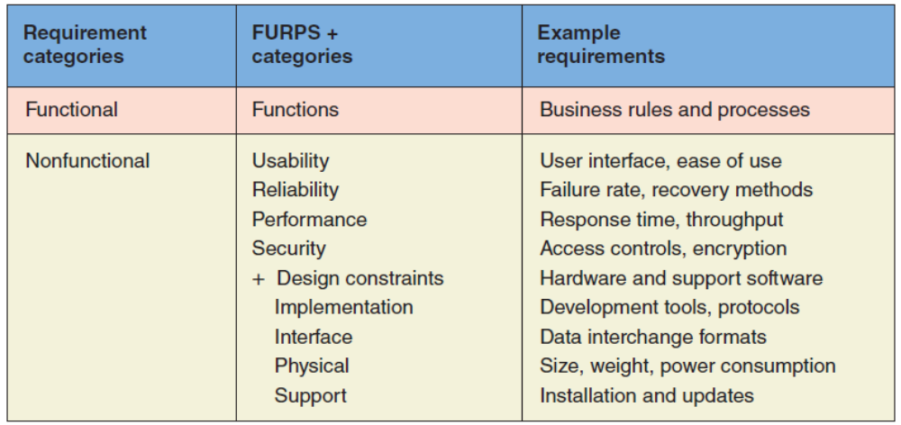
FURPS+ Requirements Acronym
可用性
可靠性
性能
安全
设计限制
开发
接口
物理层
支持
© 2012 Cengage Learning. All Rights Reserved. This edition is intended for use outside of the U.S. only, with content that may be different from the U.S. Edition.
May not be scanned, copied, duplicated, or posted to a publicly accessible website, in whole or in part.
Notes:
功能类别 FRPS+类别 例子
功能性需求 功能性需求 业务规则和流程
非功能性需求 可用性 用户界面，易用性
可靠性 故障率，恢复方法
效能 响应时间，吞吐率
安全 访问控制，加密
+设计限制 硬件条件和软件条件
开发 开发工具，协议
接口 数据交互格式
物理层 大小，重量，能量要求
支持 安装和更新

Slide 15
Chapter 2 Outline
The RMO Consolidated Sales and Marketing System Project
Systems Analysis Activities
What Are Requirements?
Models and Modeling（模型和建模）
Stakeholders
Information-Gathering Techniques
Documenting Workflows with Activity Diagrams
Introduction to Systems Analysis and Design, 6th Edition
© 2012 Cengage Learning. All Rights Reserved. This edition is intended for use outside of the U.S. only, with content that may be different from the U.S. Edition.
May not be scanned, copied, duplicated, or posted to a publicly accessible website, in whole or in part.
Notes:
模型和建模

Slide 16
Models and Modeling
How to represent the requirements?如何表示需求
Model– a representation of some aspect of the system being built
Types of Models（模型类型）
  Textual model（文本）– something written down, described
  Graphical models（图形）– diagram, schematic
  Mathematical models（数学公式）– formulas, statistics, algorithms
Unified Modeling Language (UML，统一建模语言)
  Standard graphical modeling symbols/terminology used for information systems
© 2012 Cengage Learning. All Rights Reserved. This edition is intended for use outside of the U.S. only, with content that may be different from the U.S. Edition.
May not be scanned, copied, duplicated, or posted to a publicly accessible website, in whole or in part.
Notes:
如何表示需求?
模型——正在构建的系统的某些方面的表示
模型类型
文本模型-写下来，描述的东西
图形模型。图解、示意图
数学模型-公式，统计，算法
统一建模语言(UML)
用于信息系统的标准图形建模符号/术语

Slide 17
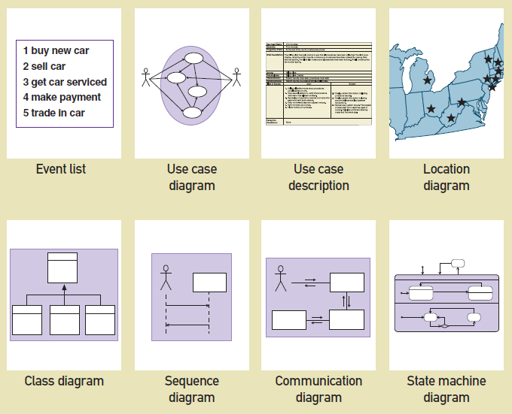
Some Analysis and Design Models
© 2012 Cengage Learning. All Rights Reserved. This edition is intended for use outside of the U.S. only, with content that may be different from the U.S. Edition.
May not be scanned, copied, duplicated, or posted to a publicly accessible website, in whole or in part.
Notes:
一些分析和设计模型
事件列表 用例图 用例描述 位置图
类图 顺序图 通信图 状态机图

Slide 18
Reasons for Modeling
（建模的原因）
Learning from the modeling process（从建模过程中学习）
Reducing complexity by abstraction（通过抽象降低复杂性）
Remembering all the details（记住所有的细节）
Communicating with other development team members（与其他成员/相关人员沟通）
Documenting what was done for future maintenance/enhancement（维护、记录）
© 2012 Cengage Learning. All Rights Reserved. This edition is intended for use outside of the U.S. only, with content that may be different from the U.S. Edition.
May not be scanned, copied, duplicated, or posted to a publicly accessible website, in whole or in part.
Notes:
建模的原因：
从建模过程中学习
通过抽象降低复杂性
记住所有的细节
与其他开发团队成员沟通
与各种用户和相关人员进行沟通
为将来的维护/增强记录所做的工作

Slide 19
Chapter 2 Outline
The RMO Consolidated Sales and Marketing System Project
Systems Analysis Activities
What Are Requirements?
Models and Modeling
Stakeholders（利益相关者）
Information-Gathering Techniques
Documenting Workflows with Activity Diagrams
Introduction to Systems Analysis and Design, 6th Edition
© 2012 Cengage Learning. All Rights Reserved. This edition is intended for use outside of the U.S. only, with content that may be different from the U.S. Edition.
May not be scanned, copied, duplicated, or posted to a publicly accessible website, in whole or in part.
Notes:
利益相关者

Slide 20
Stakeholders
Who do you involve and talk to?
Stakeholders（利益相关者）– persons who have an interest in the successful implementation of the system
Internal Stakeholders（内部利益相关者）– persons within the organization
External stakeholders（外部利益相关者） – persons outside the organization
Operational stakeholders （操作相关者）– persons who regularly interact with the system
Executive stakeholders（执行相关者）– persons who don’t directly interact, but use the information or have financial interest
© 2012 Cengage Learning. All Rights Reserved. This edition is intended for use outside of the U.S. only, with content that may be different from the U.S. Edition.
May not be scanned, copied, duplicated, or posted to a publicly accessible website, in whole or in part.
Notes:
利益相关者
利益相关者-对系统的成功实施有兴趣的人
内部利益相关者——组织内部的人（管理人员）
外部利益相关者——组织外部的人（客户）
操作相关者-定期与系统互动的人（管理人员）
执行相关者——不直接互动，但使用信息或有经济利益的人

Slide 21
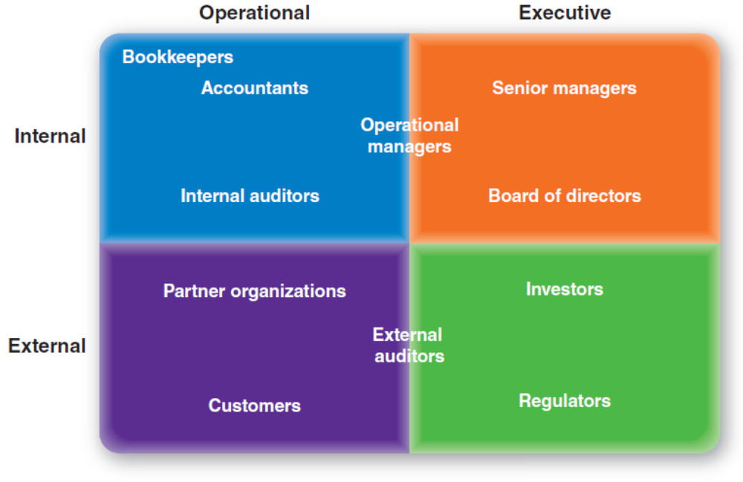
Stakeholders of a comprehensive accounting system for public company
© 2012 Cengage Learning. All Rights Reserved. This edition is intended for use outside of the U.S. only, with content that may be different from the U.S. Edition.
May not be scanned, copied, duplicated, or posted to a publicly accessible website, in whole or in part.
Notes:
例子：上市公司会计系统的利益相关者
内部-操作相关者：出纳，会计，内部审计师
内部-执行相关者：高级经理，董事会
Both：业务经理
外部-操作相关者：合作伙伴组织；客户
外部-执行相关者：投资者，监管机构
Both：外部审计师

Slide 22
Stakeholders
For RMO CSMS Project
Phone/mail sales order clerks（电话/邮件订单员）
Warehouse and shipping personnel（仓库运输人员）
Marketing personnel who maintain online catalog information（维护在线目录的营销人员）
Marketing, sales, and financial managers（市场营销）
Senior executives（高级管理人员）
Customers（客户）
External shippers (e.g., UPS and FedEx)（外部托运人）
© 2012 Cengage Learning. All Rights Reserved. This edition is intended for use outside of the U.S. only, with content that may be different from the U.S. Edition.
May not be scanned, copied, duplicated, or posted to a publicly accessible website, in whole or in part.
Notes:
RMO csmS项目的相关者
电话/邮件销售订单员
仓库和运输人员
维护在线目录信息的营销人员
市场营销、销售和财务经理
高级管理人员
客户
外部托运人(如UPS和FedEx)

Slide 23
Stakeholders
For RMO CSMS Project
Operational
Executive
Order clerks
Warehouse and shipping personnel
Marketing personnel who maintain online catalog information
Marketing, sales, and financial managers
Senior executives
Customers
External shippers (e.g., UPS and FedEx)
Marketing personnel who maintain online catalog information
Senior executives
Internal
Warehouse and shipping personnel
Marketing, sales, and financial managers
Order clerks
External shippers
Customers
External
Notes:
订单订购人员
仓库和运送人员
维护在线目录信息的营销人员
营销、销售、会计和财政经理
高级管理员
消费者
外部运送人员（例如UPS和FedEx）

Slide 24
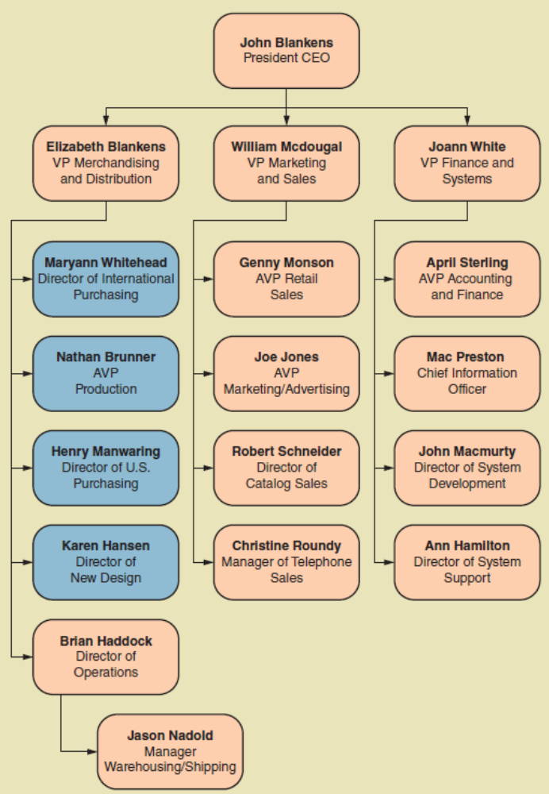
RMO Internal Stakeholders
© 2012 Cengage Learning. All Rights Reserved. This edition is intended for use outside of the U.S. only, with content that may be different from the U.S. Edition.
May not be scanned, copied, duplicated, or posted to a publicly accessible website, in whole or in part.
Notes:
首席CEO
经营和分销副总裁
市场营销和销售副总裁
财务和系统副总裁

Slide 25
Chapter 2 Outline
The RMO Consolidated Sales and Marketing System Project
Systems Analysis Activities
What Are Requirements?
Models and Modeling
Stakeholders
Information-Gathering Techniques（信息收集技术）
Documenting Workflows with Activity Diagrams
Introduction to Systems Analysis and Design, 6th Edition
© 2012 Cengage Learning. All Rights Reserved. This edition is intended for use outside of the U.S. only, with content that may be different from the U.S. Edition.
May not be scanned, copied, duplicated, or posted to a publicly accessible website, in whole or in part.
Notes:
信息收集技术

Slide 26
Information Gathering Techniques
Interviewing users and other stakeholders（采访用户和其他利益相关者）
Distributing and collecting questionnaires（发放问卷）
Reviewing inputs, outputs, and documentation（审查输入、输出和文档）
Observing and documenting business procedures（观察和记录业务流程）
Researching vendor solutions（研究供应商解决方案）
Collecting active user comments and suggestions（收集活跃用户的意见和建议）
© 2012 Cengage Learning. All Rights Reserved. This edition is intended for use outside of the U.S. only, with content that may be different from the U.S. Edition.
May not be scanned, copied, duplicated, or posted to a publicly accessible website, in whole or in part.
Notes:
采访用户和其他利益相关者
发放及收集问卷
审查输入、输出和文档
观察和记录业务流程
研究供应商解决方案
收集活跃用户的意见和建议

Slide 27
Interviewing Users and Other Stakeholders （采访用户）
Prepare detailed questions（准备详细的问题）
Obtain and discuss answers to the questions（讨论并获取答案）
Document the answers（整理答案）
Follow up as needed in future meetings or interviews（后续跟进）
© 2012 Cengage Learning. All Rights Reserved. This edition is intended for use outside of the U.S. only, with content that may be different from the U.S. Edition.
May not be scanned, copied, duplicated, or posted to a publicly accessible website, in whole or in part.
Notes:
方式1：采访用户和其他利益相关者
准备详细的问题
与用户个人或群体会面
获取并讨论问题的答案
记录答案
在以后的会议或面试中跟进

Slide 28
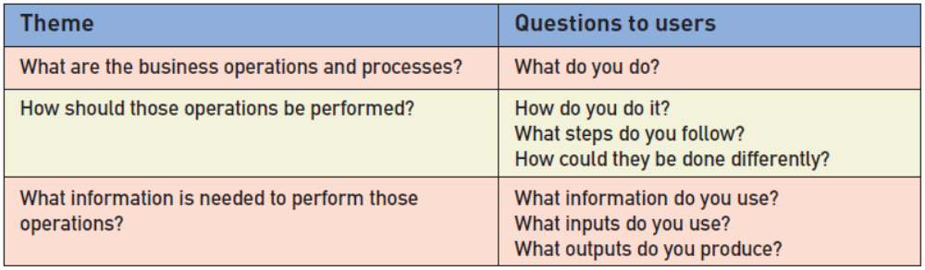
Themes for Information Gathering Questions
© 2012 Cengage Learning. All Rights Reserved. This edition is intended for use outside of the U.S. only, with content that may be different from the U.S. Edition.
May not be scanned, copied, duplicated, or posted to a publicly accessible website, in whole or in part.
Notes:
主题 给用户的提问
业务操作和流程是什么 你做什么？
这些操作如何完成 你如何做这个业务？遵循什么步骤？还有什么不同的操作方法？
完成这些操作哪些信息是需要的？ 你需要什么信息？你需要什么输入？你产生什么输出？

Slide 29
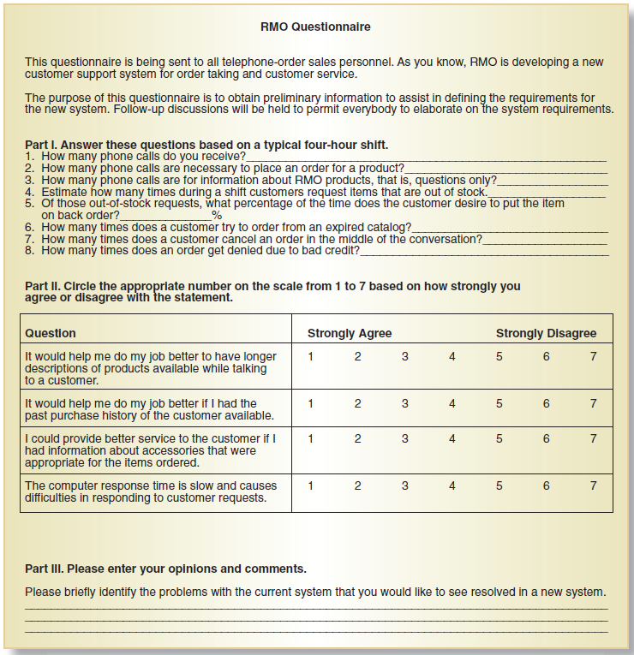
Distribute and Collect Questionnaires
© 2012 Cengage Learning. All Rights Reserved. This edition is intended for use outside of the U.S. only, with content that may be different from the U.S. Edition.
May not be scanned, copied, duplicated, or posted to a publicly accessible website, in whole or in part.
Notes:
方式2：派发及收集问卷
例子：
这个问卷被发给电话订单销售。
第一部分：根据一个典型的四小时轮班来回答这些问题
你收到多少订购电话？
订购一个产品需要打几次电话？

Slide 30
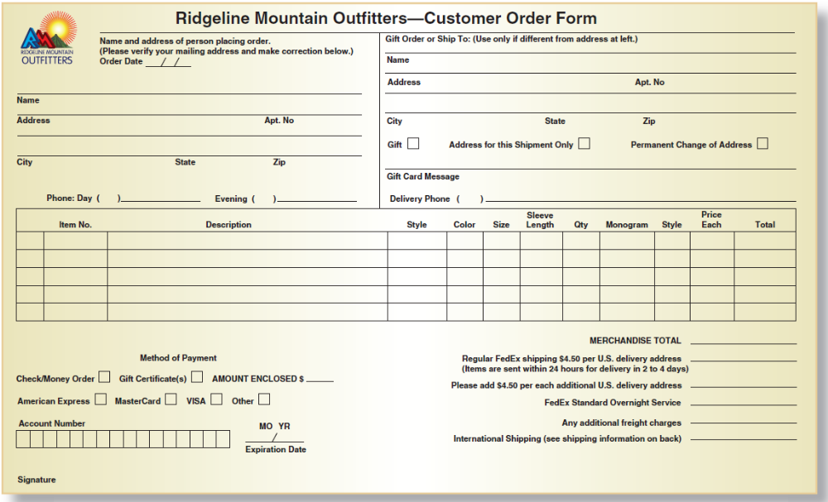
Review Inputs, Outputs, and Procedures
© 2012 Cengage Learning. All Rights Reserved. This edition is intended for use outside of the U.S. only, with content that may be different from the U.S. Edition.
May not be scanned, copied, duplicated, or posted to a publicly accessible website, in whole or in part.
Notes:
审核输入、输出和过程
姓名，地址，电话，是否是礼物，如果是礼物需不需要留message
付款的方式：信用卡，支票，礼品卡
税额计算，运输方式

Slide 31
Additional Techniques
Observe and Document Business Processes（观察和记录业务流程）
  Watch and learn
  Document with Activity diagram (next section)
Research Vendor Solutions（研究供应商解决方案）
  See what others have done for similar situations
  White papers, vendor literature, competitors
Collect Active User Comments and Suggestions（收集用户反馈）
  Feedback on models and tests
  Users know it when the see it
© 2012 Cengage Learning. All Rights Reserved. This edition is intended for use outside of the U.S. only, with content that may be different from the U.S. Edition.
May not be scanned, copied, duplicated, or posted to a publicly accessible website, in whole or in part.
Notes:
其他方式：
观察和记录业务流程
观察和学习
带有活动图的文档(下一节)
研究供应商解决方案
看看其他人在类似情况下是怎么做的
白皮书、供应商文献、竞争对手
收集活跃用户的意见和建议
对模型和测试的反馈
用户看到它就知道了

Slide 32
Chapter 2 Outline
The RMO Consolidated Sales and Marketing System Project
Systems Analysis Activities
What Are Requirements?
Models and Modeling
Stakeholders
Information-Gathering Techniques
Documenting Workflows with Activity Diagrams（用活动图记录工作流）
Introduction to Systems Analysis and Design, 6th Edition
© 2012 Cengage Learning. All Rights Reserved. This edition is intended for use outside of the U.S. only, with content that may be different from the U.S. Edition.
May not be scanned, copied, duplicated, or posted to a publicly accessible website, in whole or in part.
Notes:
用活动图记录工作流

Slide 33
Documenting Workflows with Activity Diagrams
Workflow（工作流）– sequence of processing steps that completely handles one business transaction or customer request（完成处理一个业务的一系列处理步骤）
Activity Diagram（活动图）– describes user (or system) activities, the person who does each activity, and the sequential flow of these activities
  Useful for showing a graphical model of a workflow（用于显示工作流的图形化模型）
  A UML diagram
© 2012 Cengage Learning. All Rights Reserved. This edition is intended for use outside of the U.S. only, with content that may be different from the U.S. Edition.
May not be scanned, copied, duplicated, or posted to a publicly accessible website, in whole or in part.
Notes:
工作流——完成处理一个业务事务或客户请求的一系列处理步骤
活动图——描述用户(或系统)活动、执行每个活动的人员以及这些活动的顺序流
用于显示工作流的图形化模型
UML图

Slide 34
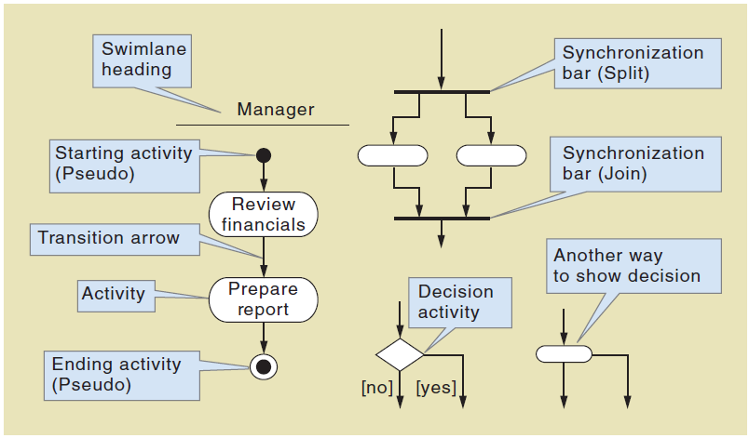
Activity Diagrams Symbols
© 2012 Cengage Learning. All Rights Reserved. This edition is intended for use outside of the U.S. only, with content that may be different from the U.S. Edition.
May not be scanned, copied, duplicated, or posted to a publicly accessible website, in whole or in part.
Notes:
泳道标题
开始活动
转移箭头
活动
结束活动
----------------------
同步条
决策活动

Slide 35
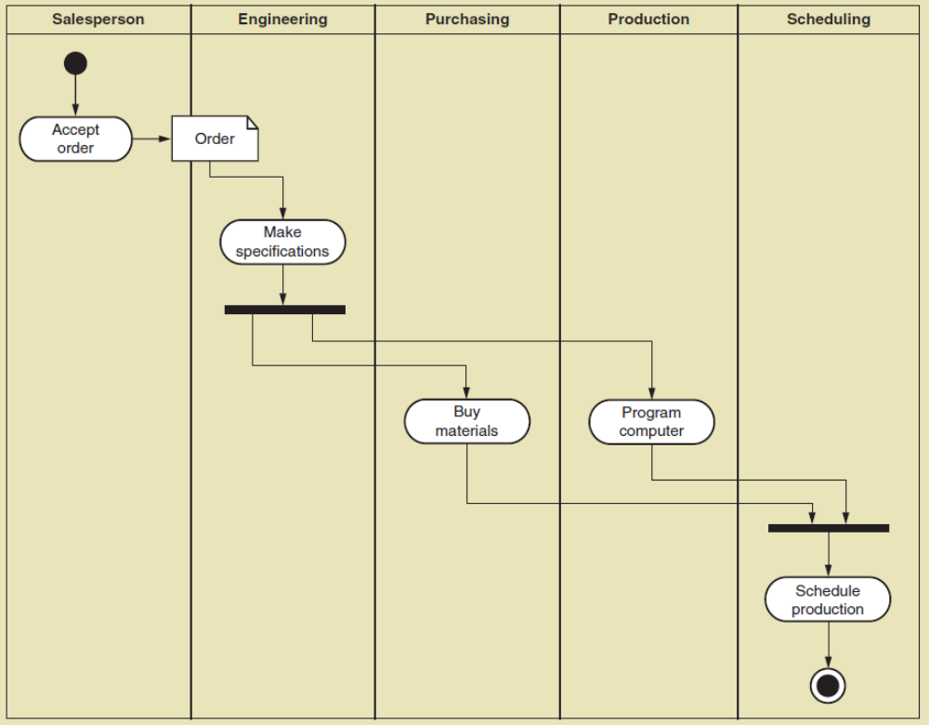
Activity Diagram with Concurrent Paths
对每个item都执行
并行操作一般成对出现，有开始有结束
© 2012 Cengage Learning. All Rights Reserved. This edition is intended for use outside of the U.S. only, with content that may be different from the U.S. Edition.
May not be scanned, copied, duplicated, or posted to a publicly accessible website, in whole or in part.
Notes:
具有并发路径的活动图
销售 （接受订单） 设计（技术参数） 采购（购买材料） 制作（控制计算机） 行程安排（安排生产）

Slide 36
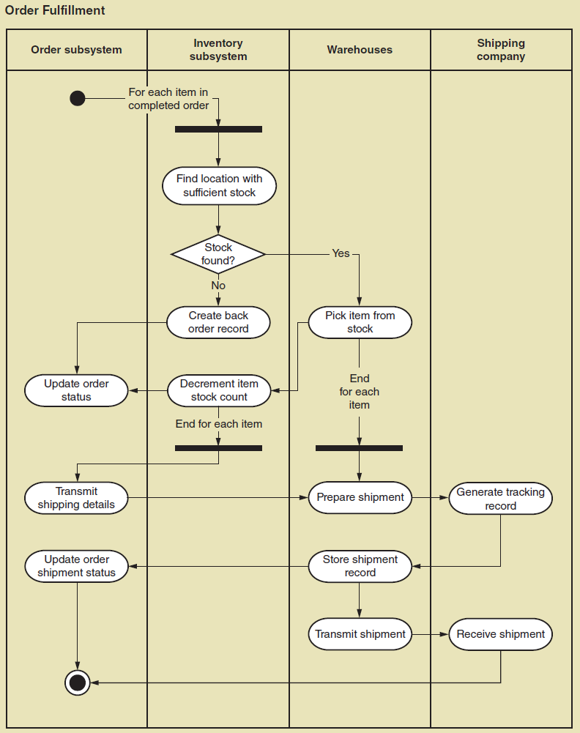
Activity Diagram for RMO Order Fulfillment
© 2012 Cengage Learning. All Rights Reserved. This edition is intended for use outside of the U.S. only, with content that may be different from the U.S. Edition.
May not be scanned, copied, duplicated, or posted to a publicly accessible website, in whole or in part.
Notes:
RMO订单履行的活动图
订单系统 库存系统 仓库 运输公司

Slide 37

主观题
10分
Please analyze the process of ordering a delivery(外卖) from a restaurant website, and then draw an Activity Diagram in UML to reasonably show this process.
正常使用主观题需2.0以上版本雨课堂
作答
Notes:
请分析从一家餐厅网站订购外卖(外卖)的过程，然后用UML绘制一个活动图来合理地展示这个过程

Slide 38
Order subsystem
Restaurant
Subsystem
Shipping
Subsystem
For each item in
Completed order
Check the order
Show the problem
Y
Any problem?
N
Give feedback
Process the order
Update order status
Prepare shipment
Update
tracking records
Update order status
Update order status
N
Receive the order?
Check the feedback
Y
Update order status
Update order status

Slide 39
补充内容：结构化需求分析方法
1. 结构化分析方法概述
1）分析策略
结构化分析（Structured Analysis，简称SA）方法是20世纪70年代由E·Yourdon等人提出的一种面向数据流的分析方法，适用于大型的数据处理系统。由于利用图形来表达需求会使文档清晰、简明、易于学习和掌握，所以软件分析人员仍在广泛使用这种传统的分析方法。
结构化分析方法总的指导思想是“自顶向下，逐步求精”，它的两个基本原则是“抽象”和“分解”，即按照功能分解的原则，对系统进行逐层分解，直到找到所有满足功能要求的可实现软件元素为止。

Slide 40
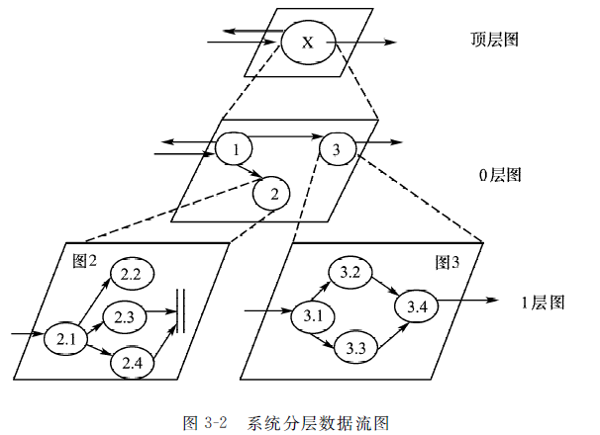
补充内容：结构化需求分析方法
1. 结构化分析方法概述

Slide 41
补充内容：结构化需求分析方法
1. 结构化分析方法概述
2）描述工具
结构化分析方法利用图形等半形式化的描述表达需求，用它们形成需求规格说明书的主要部分，主要工具有：
（1）数据流图（DFD）。描述系统的分解，即描述系统由哪几部分组成，各部分之间有什么联系等。
（2）数据词典（DD）。明确定义数据流图中的数据和加工。它是数据流条目、数据存储条目、数据项条目和基本加工条目的汇集。
（3）结构化语言、判定表和判定树。用于详细描述数据流图中不能再分解的每一个基本加工的处理逻辑。

Slide 42
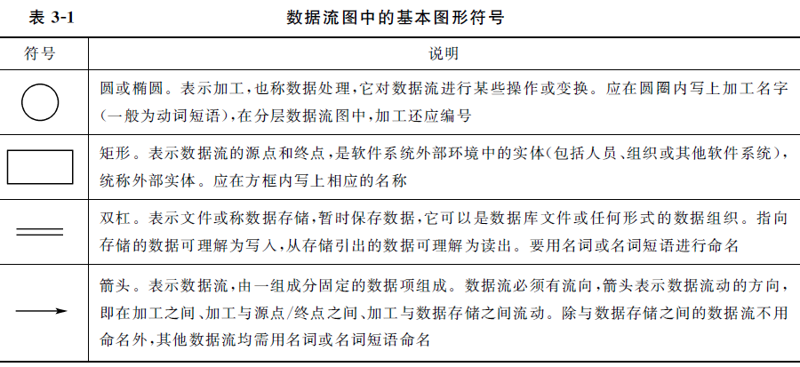
补充内容：结构化需求分析方法
（1）数据流图
1.数据流图的基本符号

Slide 43
补充内容：结构化需求分析方法
（1）数据流图
2.数据流图的绘制步骤
（1）画顶层数据流图
列出系统的全部数据源点和终点，将系统加工处理过程作为一个整体，就可能得到顶层图。具体说就是：画一个圆，在其中写上系统名称，然后在圆的外围画上系统的输入和输出，这一步工作实际上是决定研究的内容和系统的范围。
（2）画各层数据流图
对系统处理过程自顶向下，逐步分解，画出各层的数据流图。
（3）画总的数据流图
这一步对了解整个系统很有好处，但也要根据实际情况来决定总图的布局，不要把数据流图画得太复杂。

Slide 44
补充内容：结构化需求分析方法
（1）数据流图
3.数据流图中的命名规则
（1）数据流
数据流表明数据和数据流向，它通常由一组数据项组成。
（2）加工
加工是对数据的某种操作或变换。
（3）文件
文件起暂时保存数据的作用。
（4）数据源点和终点
数据源点和终点是数据的始发点和终止点，是软件系统外部环境中的实体（包括人员、组织或其他软件系统），统称外部实体。

Slide 45
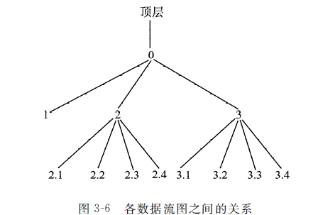
补充内容：结构化需求分析方法
（1）数据流图
4.数据流图中分层技术
对于比较复杂的实际问题，在数据流图上常常出现十几个乃至几十个、上百个加工，这样的数据流图复杂而且难以理解。为了避免这种情况出现，可以采用数据流图的分层技术。分层技术的基本思想是，不是在一个数据流图中一次引入太多的细节，而是有控制地逐步增加细节，实现从抽象到具体的逐步过渡。

Slide 46
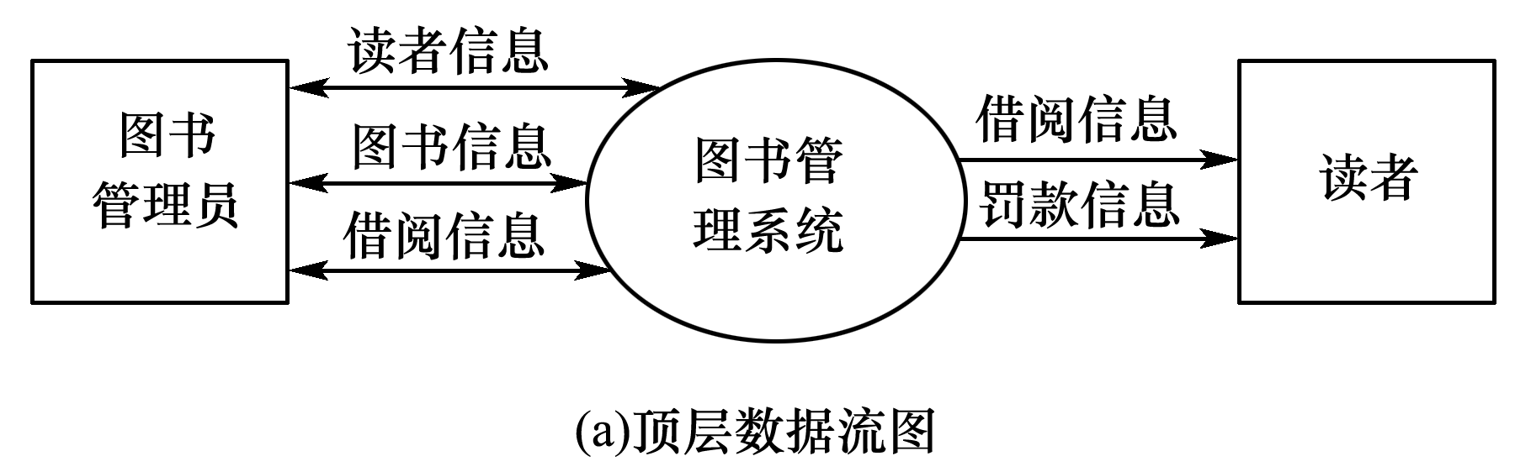
补充内容：结构化需求分析方法
（1）数据流图
下面以第2章的“图书管理系统”为例，绘制数据流图。
在图书馆负责人和计算机系的技术人员通过了“图书管理系统”《项目开发计划》后，项目组随即进入了项目开发阶段，计算机系教师与图书馆相关业务人员紧密合作，经过15天的工作，形成了“图书管理系统”《软件需求说明书》。主要数据流图如下：

Slide 47
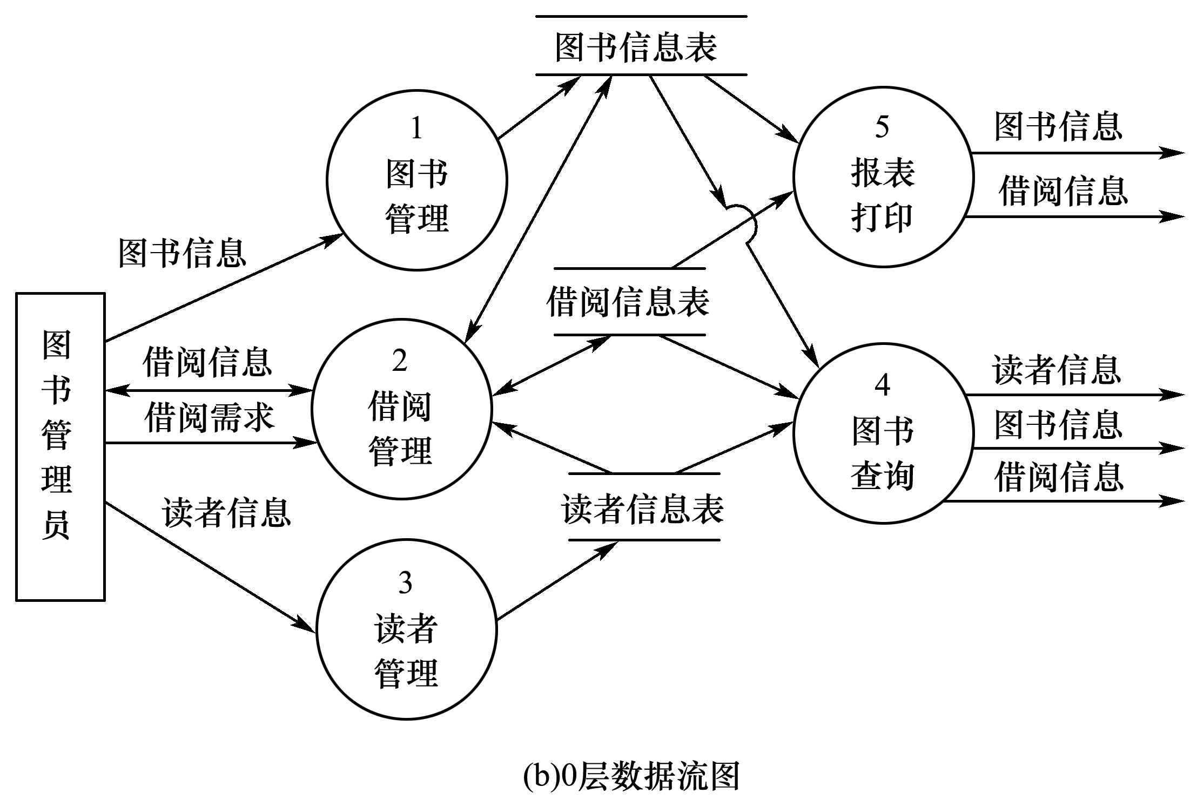
补充内容：结构化需求分析方法

Slide 48
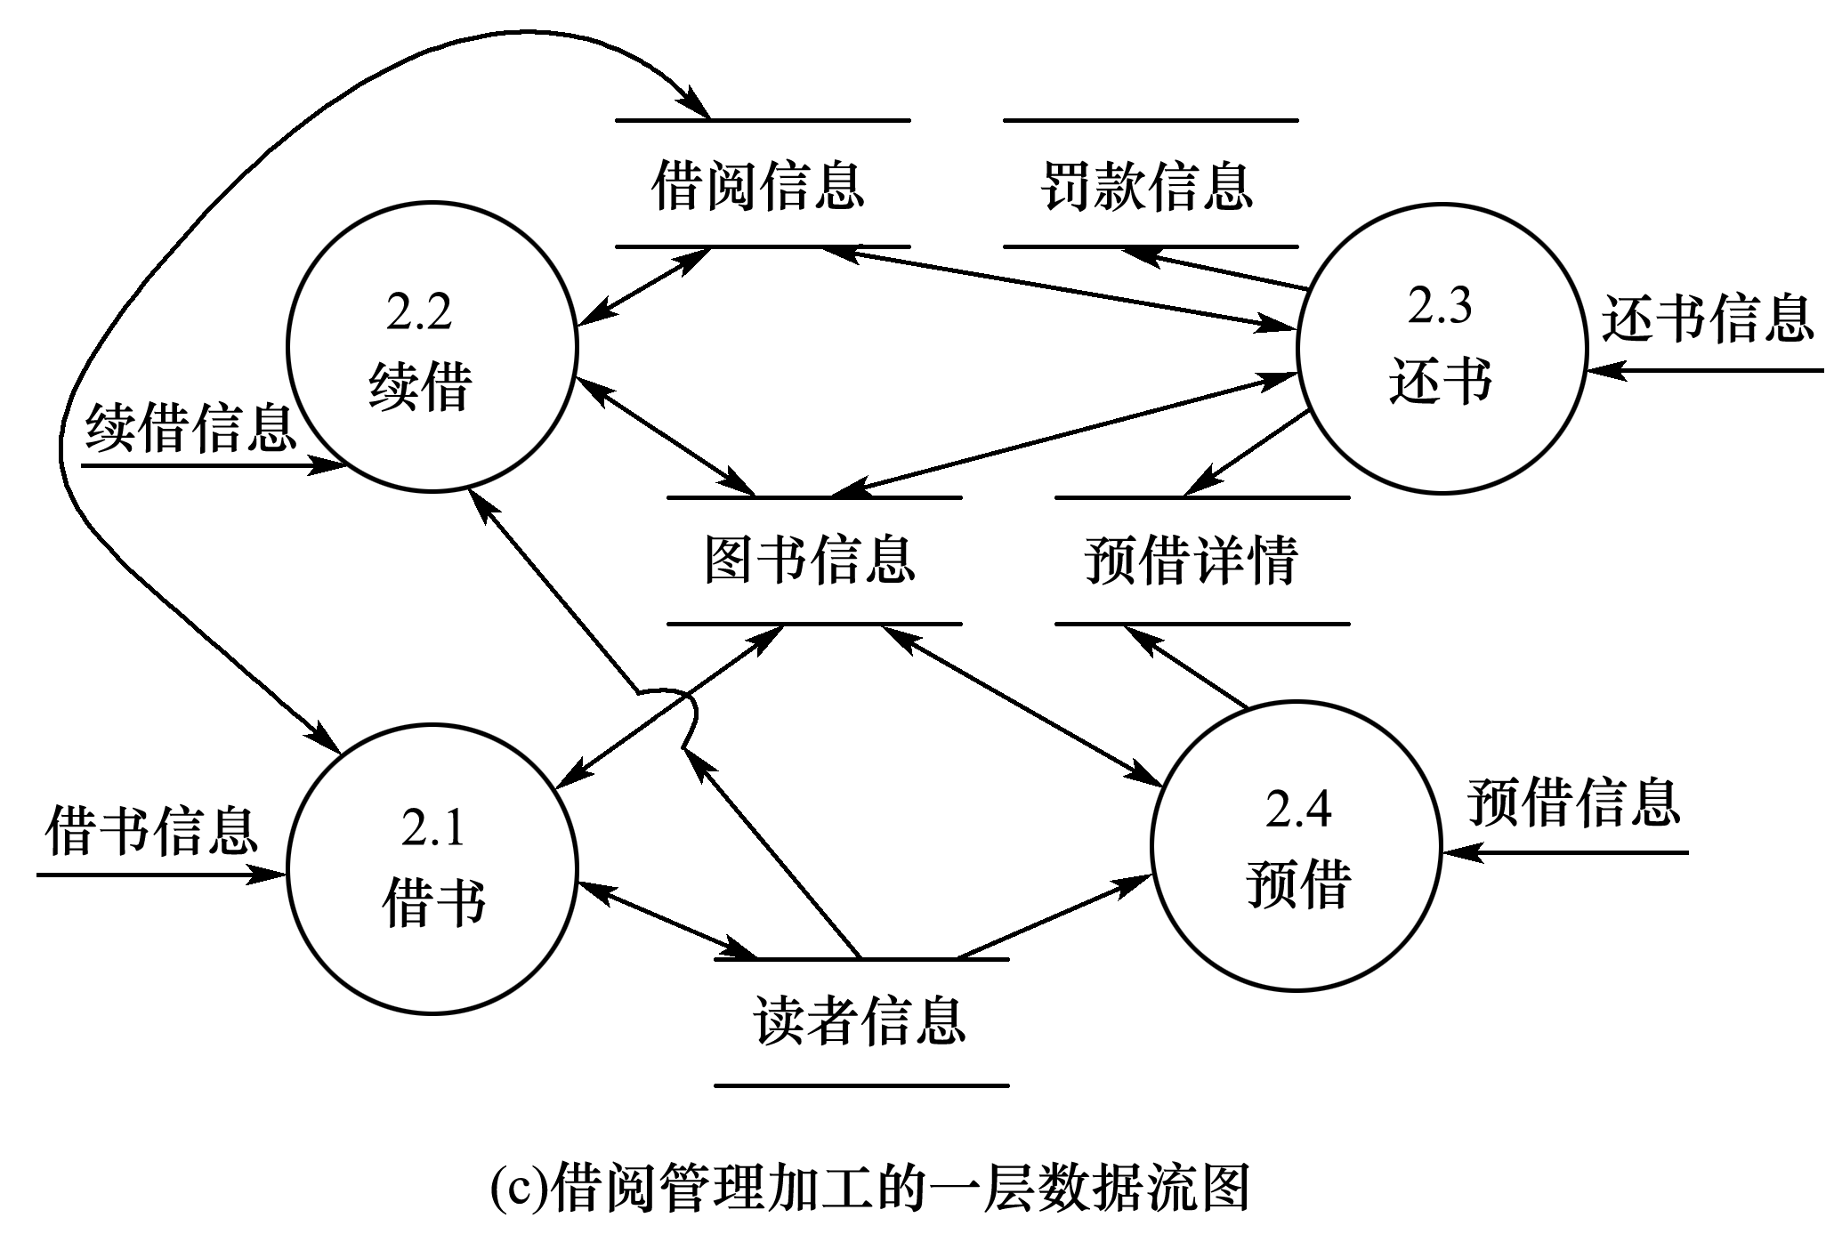
补充内容：结构化需求分析方法

Slide 49
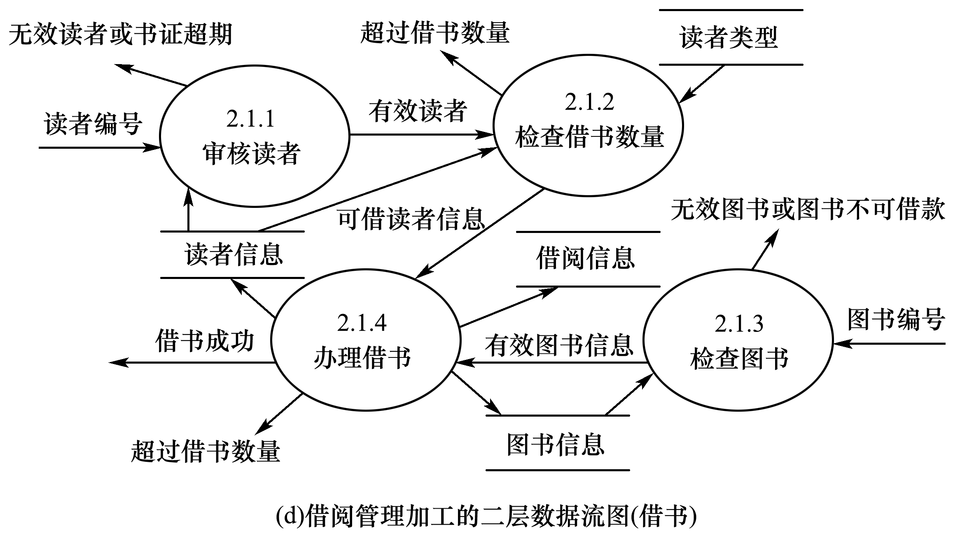
补充内容：结构化需求分析方法

Slide 50
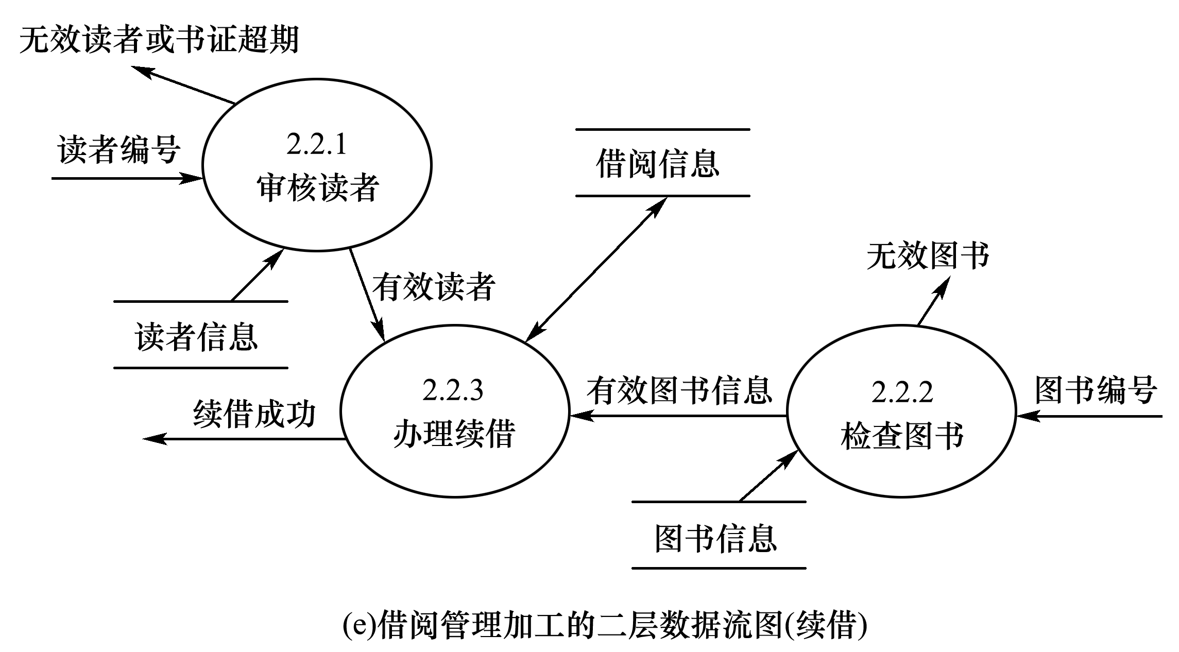
补充内容：结构化需求分析方法

Slide 51
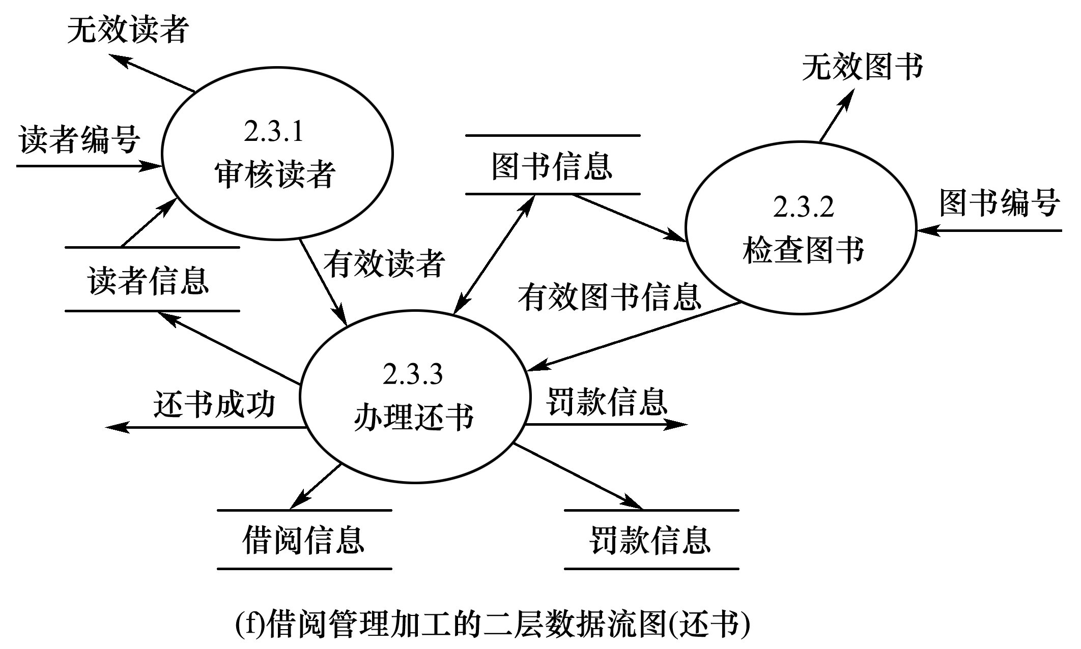
补充内容：结构化需求分析方法

Slide 52
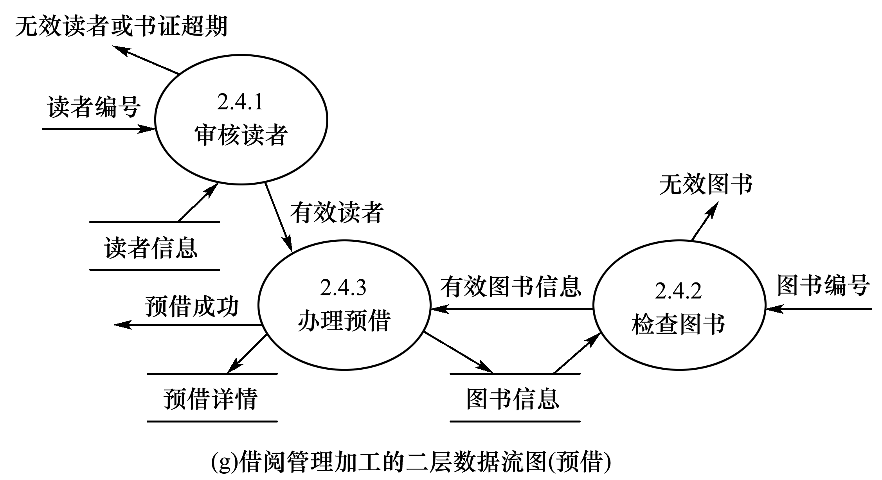
补充内容：结构化需求分析方法

Slide 53
补充内容：结构化需求分析方法
（2）数据词典
1.数据词典的内容
一般说来，数据词典的每个条目中应包括以下信息。
（1）名字：数据流、数据项、数据存储或外部实体的名称。
（2）别名或编号：第（1）项中对象的其他名字。
（3）分类：数据流、数据项、加工、数据存储、外部实体等。
（4）内容描述：描述内容或数据结构等。
（5）何处使用：哪些加工使用该条目。

Slide 54
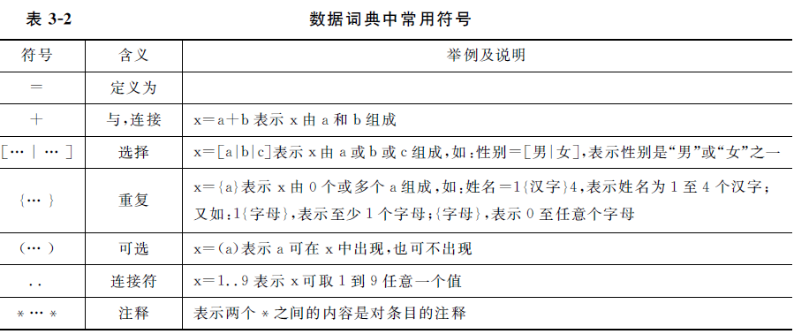
补充内容：结构化需求分析方法
（2）数据词典
2.数据词典中使用的符号

Slide 55
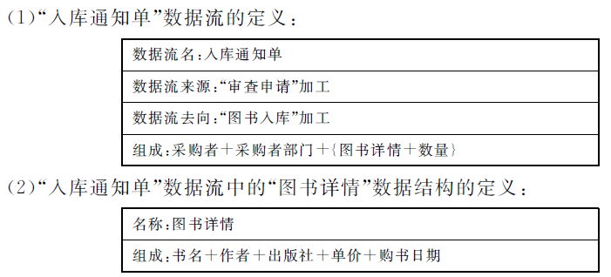
补充内容：结构化需求分析方法
（2）数据词典
3.数据词典书写实例

Slide 56
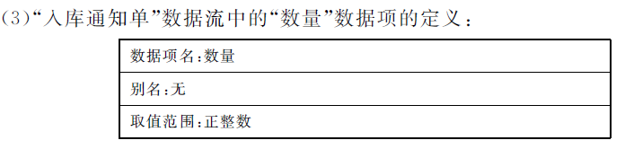
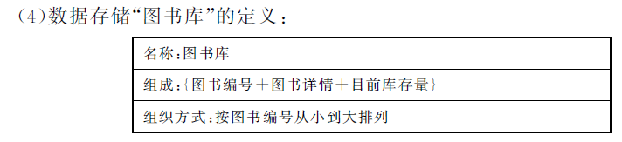
补充内容：结构化需求分析方法
（2）数据词典
3.数据词典书写实例

Slide 57
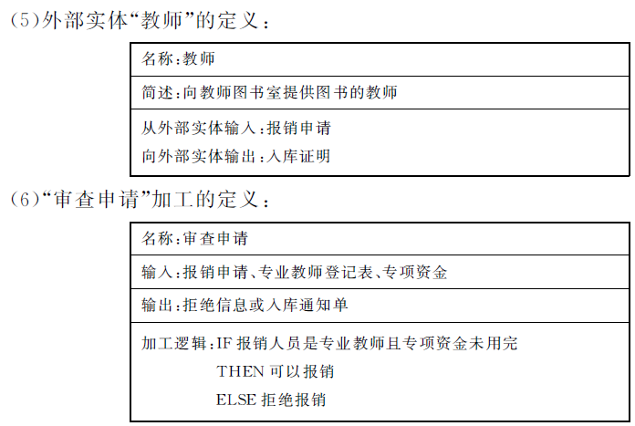
补充内容：结构化需求分析方法
（2）数据词典
3.数据词典书写实例

Slide 58
补充内容：结构化需求分析方法
（2）数据词典
4.数据词典的实现
不论通过哪种途径实现的数据词典都应尽量做到以下几点：
(1)没有冗余：主要指数据定义不能重复。在规格说明书的其他组成部分中已出现的信息不能重复。
(2)查阅方便：通过名字可以方便地查阅数据词典中的每个定义。
(3)定义的书写方法简单、方便、严谨，而且可读性强。
(4)建议采用卡片形式书写。

Slide 59
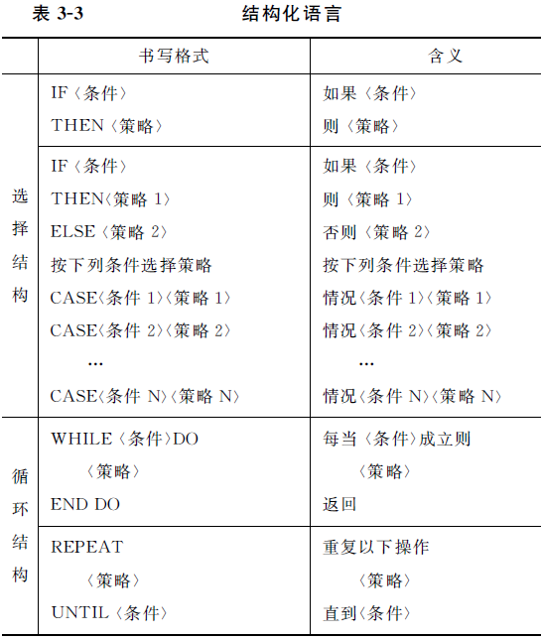
补充内容：结构化需求分析方法
（3） 加工逻辑的描述
1. 结构化语言

Slide 60
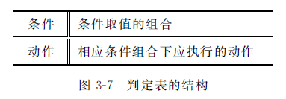
补充内容：结构化需求分析方法
（3） 加工逻辑的描述
2. 判定表
在一些数据处理中，数据流图的加工需要经过多个逻辑条件组合的取值而确定，此时用自然语言或结构化语言难以描述，而运用判定表描述就比较清晰明了。

Slide 61
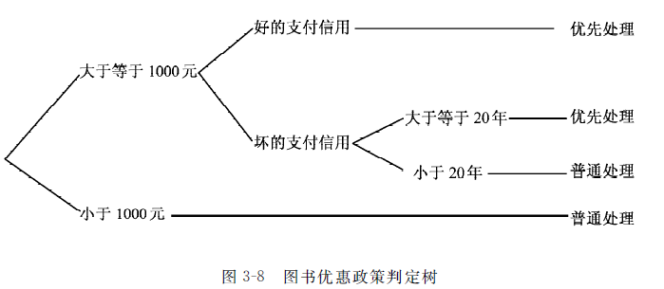
补充内容：结构化需求分析方法
（3） 加工逻辑的描述
3. 判定树
判定树也是用来表达加工逻辑的工具，它是判定表的变形，有时比判定表更直观，更易于理解和使用。图书优惠政策的判定树如图3-8所示。

Slide 62
补充内容：结构化需求分析方法
（4） 需求规格说明书
1．需求规格说明书的编写内容
需求分析阶段应交付的主要文档是软件需求规格说明书。它提供了用户与开发人员对开发软件的共同理解，其作用相当于用户与开发单位之间的技术合同，是后续设计和编码的基础，是测试和验收的依据。
软件需求规格说明书的内容框架可参阅GB/T 8567-2006《计算机软件文档编制规范》。
在编写需求规格说明书时应注意以下几个问题：
（1）说明书中的每一部分都非常重要，因此要慎重对待。
（2）问题的描述要做到准确无误，没有二义性。
（3）说明书的书写形式要规范。
（4）允许用户根据项目的具体情况适当的将书写内容进行调整和筛选。

Slide 63
补充内容：结构化需求分析方法
（4） 需求规格说明书
2．需求分析的评审
在需求分析规格说明书编写完成后，必须进行需求评审，以验证需求的正确性。
如果在评审过程中发现说明书存在错误或缺陷，应及时进行更改或弥补，重新进行相应部分的需求分析、需求建模、修改需求规格说明书，并再行评审。
需求分析评审的主要内容如下：
（1）一致性。所有需求必须是一致的，任何一条需求不能和其他需求相矛盾。
（2）完整性。需求必须是完整的，规格说明书应该包括用户需要的每一个功能或性能。
（3）现实性。指定的需求应该是用现有的软硬件技术基本上可以实现的。对硬件技术的进步可以预测，对软件技术的进步则很难预测，只能从现有技术水平判断需求的现实性。
（4）有效性。必须证明需求是正确而有效的，确实能解决用户所面对的问题。

Slide 64
Summary
Systems analysis involves defining system requirements– functional and non-functional
Analysis activities include（分析活动包括）
  Gather detailed information（收集信息）
  Define requirements（定义需求）
  Prioritize requirements（优先需求）
  Develop user-interface dialogs（用户界面）
  Evaluate requirements with users（评估需求）
FURPS+ is the acronym for functional, usability, reliability, performance, and security requirements
© 2012 Cengage Learning. All Rights Reserved. This edition is intended for use outside of the U.S. only, with content that may be different from the U.S. Edition.
May not be scanned, copied, duplicated, or posted to a publicly accessible website, in whole or in part.
Notes:
系统分析包括定义系统需求——功能性和非功能性
分析活动包括
收集详细信息
定义需求
优先考虑需求
开发用户界面对话框
与用户一起评估需求
FURPS+是功能、可用性、可靠性、性能和安全需求的缩写

Slide 65
Summary
Models and modeling are used to explore and document requirements（模型和建模用于探索和记录需求）
A model represents some aspect of a system, and can include textual, graphical, and mathematical models（模型包括文本、图形、数据模型）
Unified Modeling Language (UML) is the standard set of notations and terminology for information systems models（统一建模语言UML是标准集合）
© 2012 Cengage Learning. All Rights Reserved. This edition is intended for use outside of the U.S. only, with content that may be different from the U.S. Edition.
May not be scanned, copied, duplicated, or posted to a publicly accessible website, in whole or in part.
Notes:
模型和建模用于探索和记录需求
模型表示系统的某些方面，可以包括文本模型、图形模型和数学模型
统一建模语言(UML)是用于信息系统模型的符号和术语的标准集合

Slide 66
Summary
Stakeholders are the people who have an interest in the success of the project（利益相关人是对项目成功感兴趣的人）
There are internal vs. external stakeholders（内部vs外部相关者） and operational vs. executive stakeholders（运营vs执行相关者）
Information gathering techniques are used to collect information about the project（信息收集）
  Interviews, questionnaires, reviewing documents, observing business processes, researching vendors, comments and suggestions（访谈、问卷、文件、观察业务流程等）
© 2012 Cengage Learning. All Rights Reserved. This edition is intended for use outside of the U.S. only, with content that may be different from the U.S. Edition.
May not be scanned, copied, duplicated, or posted to a publicly accessible website, in whole or in part.
Notes:
利益相关人是对项目的成功感兴趣的人
有内部利益相关者与外部利益相关者，运营利益相关者与执行利益相关者
信息收集技术用于收集有关项目的信息
访谈，问卷调查，审查文件，观察业务流程，研究供应商，提出意见和建议
UML活动图用于在收集信息后记录(建模)工作流

