Slide 1
INTRODUCTION TO
SYSTEMS ANALYSIS AND DESIGN:
AN AGILE, ITERATIVE APPROACH
SATZINGER | JACKSON | BURD
CHAPTER 4
Chapter 4

Slide 2
Domain Modeling
Chapter 4
Introduction to Systems
Analysis and Design:
An Agile, Iteractive Approach
6th Ed
Satzinger, Jackson & Burd
Notes:
域类

Slide 3
Chapter 4 Outline
“Things” in the Problem Domain（问题域中的“事物”）
  Data entities（数据实体）
  Domain classes（域类）
The Entity-Relationship Diagram（实体-关系图）
The Domain Model Class Diagram（域模型类图）
The Domain Model Class Diagram in the RMO example （RMO示例中的域模型类图）
© 2012 Cengage Learning. All Rights Reserved. This edition is intended for use outside of the U.S. only, with content that may be different from the U.S. Edition.
May not be scanned, copied, duplicated, or posted to a publicly accessible website, in whole or in part.
Notes:
问题域中的“事物”
数据实体
域类
实体-关系图
域模型类图
RMO示例中的域模型类图

Slide 4
Learning Objectives
Explain how the concept of “things” in the problem domain also define requirements（解释问题域中的“事物”概念如何定义需求）
Identify and analyze data entities（数据实体） and domain classes（域类） needed in the system
Read, interpret, and create an entity-relationship diagram（实体-关系图）
Read, interpret, and create a domain model class diagram（域模型类图）
Understand the domain model class diagram for the RMO Consolidated Sales and Marketing System
© 2012 Cengage Learning. All Rights Reserved. This edition is intended for use outside of the U.S. only, with content that may be different from the U.S. Edition.
May not be scanned, copied, duplicated, or posted to a publicly accessible website, in whole or in part.
Notes:
解释问题域中的“事物”概念如何定义需求
识别和分析系统中需要的数据实体和领域类
阅读、解释和创建一个实体关系图
读取、解释和创建一个领域模型类图
理解RMO统一销售和营销系统的领域模型类图

Slide 5
Overview
Chapter 3 provided an overview of identifying use cases to define functional requirements（第三章描述了如何识别用例来定义功能需求）
This chapter focuses on another key concepts for defining requirements— data entities（数据实体）or domain classes（域类）
  In the RMO Tradeshow System from Chapter 1, some domain classes are Supplier, Product, and Contact
  In this chapter’s opening case Waiters on Call, examples of domain classes are Restaurants, Menu items, Customers, Orders, Drivers, Addresses, Routes, and Payments
© 2012 Cengage Learning. All Rights Reserved. This edition is intended for use outside of the U.S. only, with content that may be different from the U.S. Edition.
May not be scanned, copied, duplicated, or posted to a publicly accessible website, in whole or in part.
Notes:
第3章概述了如何识别用例来定义功能需求
本章着重于定义需求的另一个关键概念——数据实体或域类
在第1章的RMO贸易展示系统中，一些域类是Supplier, Product和Contact
在本章的开头waiters on call的例子里，域类的例子有餐馆，菜单项，顾客，订单，司机，地址，路线和支付

Slide 6
Chapter 4 Outline
“Things” in the Problem Domain（问题域中的“事物”）
  Data entities
  Domain classes
The Entity-Relationship Diagram
The Domain Model Class Diagram
The Domain Model Class Diagram in the RMO example
© 2012 Cengage Learning. All Rights Reserved. This edition is intended for use outside of the U.S. only, with content that may be different from the U.S. Edition.
May not be scanned, copied, duplicated, or posted to a publicly accessible website, in whole or in part.
Notes:
问题域中的“事物”
数据实体
域类

Slide 7
Things in the Problem Domain
Problem domain（问题域）—the specific area (or domain) of the users’ business need that is within the scope of the new system（在新系统范围内的用户业务需求的特定区域/领域）.
“Things” are those items users work with when accomplishing tasks that need to be remembered（“事物”是用户在完成任务时使用的项目）
  Examples of “Things” are products, sales, shippers, customers, invoices, payments, etc.（例如：产品、销售、发货人、客户、发票、付款等）
© 2012 Cengage Learning. All Rights Reserved. This edition is intended for use outside of the U.S. only, with content that may be different from the U.S. Edition.
May not be scanned, copied, duplicated, or posted to a publicly accessible website, in whole or in part.
Notes:
问题域—在新系统范围内的用户业务需求的特定区域(或领域)。
“事物”是用户在完成需要记住的任务时使用的项目
“事物”的例子有产品、销售、发货人、客户、发票、付款等。
这些“事物”被建模为域类或数据实体
在本课程中，我们将称它们为域类。在数据库类中，你称它们为数据实体

Slide 8
Things in the Problem Domain
These “Things” are modeled as domain classes or data entities（这些“事物”被建模为域类或数据实体）
In this course, we will call them domain classes（域类）. In database class you call them data entities（数据实体）
© 2012 Cengage Learning. All Rights Reserved. This edition is intended for use outside of the U.S. only, with content that may be different from the U.S. Edition.
May not be scanned, copied, duplicated, or posted to a publicly accessible website, in whole or in part.
Notes:
问题域—在新系统范围内的用户业务需求的特定区域(或领域)。
“事物”是用户在完成需要记住的任务时使用的项目
“事物”的例子有产品、销售、发货人、客户、发票、付款等。
这些“事物”被建模为域类或数据实体
在本课程中，我们将称它们为域类。在数据库类中，你称它们为数据实体

Slide 9
Things in the Problem Domain
Two Techniques for Identifying them
Brainstorming Technique（头脑风暴法）
  Use a checklist of all of the usual types of things typically found and brainstorm to identify domain classes of each type（使用所有事物类型的清单）
Noun Technique（名词法）
  Identify all of the nouns that come up when the system is described and determine if each is a domain class, an attribute, or not something we need to remember （识别在描述系统时出现的所有名词）
© 2012 Cengage Learning. All Rights Reserved. This edition is intended for use outside of the U.S. only, with content that may be different from the U.S. Edition.
May not be scanned, copied, duplicated, or posted to a publicly accessible website, in whole or in part.
Notes:
识别“事物”的两种技术
头脑风暴法
使用所有通常发现的事物类型的清单，并通过头脑风暴来确定每种类型的领域类
名词技术
识别在描述系统时出现的所有名词，并确定每个名词是一个领域类，一个属性，还是我们不需要记住的东西

Slide 10
Brainstorming Technique:
Steps（头脑风暴法）
Identify a user（用户） and a set of use cases（用例）
Brainstorm with the user to identify things involved when carrying out the use case（定义当实施用例时所包含的事物）—that is, things about which information should be captured by the system.
Use the types of things (categories) to systematically ask questions about potential things, such as the following: Are there any tangible things you store information about? Are there any locations involved? Are there roles played by people that you need to remember?（使用事物类型来系统地询问关于潜在事物的问题）
© 2012 Cengage Learning. All Rights Reserved. This edition is intended for use outside of the U.S. only, with content that may be different from the U.S. Edition.
May not be scanned, copied, duplicated, or posted to a publicly accessible website, in whole or in part.
Notes:
头脑风暴技术步骤：
定义用户和一系列用例
当实施用例时，和用户一起头脑风暴来定义包含在内的事务，即需要从系统中获取信息的事物
使用事物类型（目录）来系统地询问关于潜在事务的问题，例如：你存储的信息中又关于有形事物的嘛？是否包括地址？你需要保存的信息有由人扮演的角色吗？

Slide 11
Brainstorming Technique:
Steps（头脑风暴法）
4. Continue to work with all types of users and stakeholders to expand the brainstorming list（继续与各种类型的用户和利益相关者工作，以此来扩大头脑风暴列表）
5. Merge the results, eliminate any duplicates, and compile an initial list （合并所有的结果，排除所偶的重复内容并编制一个初步列表）
© 2012 Cengage Learning. All Rights Reserved. This edition is intended for use outside of the U.S. only, with content that may be different from the U.S. Edition.
May not be scanned, copied, duplicated, or posted to a publicly accessible website, in whole or in part.
Notes:
头脑风暴技术步骤：
4. 继续与各种类型的用户和利益相关者工作，以此来扩大头脑风暴列表
5. 合并所有的结果，排除所偶的重复内容并编制一个初步列表

Slide 12
Brainstorming Technique:
Example
当你在与航空公司的地勤人员沟通，来帮助完善机场航班规划系统时，他提到：
“作为地勤员工，我们需要在每一架飞机起飞前，安排检修人员对飞机进行全方位的检查，检查至少应当在航班登机时间开始前半小时完成。”
1&2. 根据用例来找出系统中的“Things”，即事物
© 2012 Cengage Learning. All Rights Reserved. This edition is intended for use outside of the U.S. only, with content that may be different from the U.S. Edition.
May not be scanned, copied, duplicated, or posted to a publicly accessible website, in whole or in part.

Slide 13
Brainstorming Technique:
Example
当你在与航空公司的地勤人员沟通，来帮助完善机场航班规划系统时，他提到：
“作为地勤员工，我们需要在每一架飞机起飞前，安排检修人员对飞机进行全方位的检查，检查至少应当在航班登机时间开始前半小时完成。”
1&2. 根据用例来找出系统中的“Things”，即事物
© 2012 Cengage Learning. All Rights Reserved. This edition is intended for use outside of the U.S. only, with content that may be different from the U.S. Edition.
May not be scanned, copied, duplicated, or posted to a publicly accessible website, in whole or in part.
Notes:
定义用户和一系列用例
当实施用例时，和用户一起头脑风暴来定义包含在内的事务，即需要从系统中获取信息的事物
使用事物类型（目录）来系统地询问关于潜在事务的问题，例如：你存储的信息中又关于有形事物的嘛？是否包括地址？你需要保存的信息有由人扮演的角色吗？
坚持与各种类型的用户和利益相关者工作，一次来扩大头脑风暴列表
合并所有的结果，排除所偶的重复内容并编制一个初步列表

Slide 14
Brainstorming Technique:
Example
当你在与航空公司的地勤人员沟通，来帮助完善机场航班规划系统时，他提到：
“作为地勤员工，我们需要在每一架飞机起飞前，安排检修人员对飞机进行全方位的检查，检查至少应当在航班登机时间开始前半小时完成。”
3. 根据事物来系统性地询问关于潜在事物的问题。
© 2012 Cengage Learning. All Rights Reserved. This edition is intended for use outside of the U.S. only, with content that may be different from the U.S. Edition.
May not be scanned, copied, duplicated, or posted to a publicly accessible website, in whole or in part.
Notes:
定义用户和一系列用例
当实施用例时，和用户一起头脑风暴来定义包含在内的事务，即需要从系统中获取信息的事物
使用事物类型（目录）来系统地询问关于潜在事务的问题，例如：你存储的信息中又关于有形事物的嘛？是否包括地址？你需要保存的信息有由人扮演的角色吗？
坚持与各种类型的用户和利益相关者工作，一次来扩大头脑风暴列表
合并所有的结果，排除所偶的重复内容并编制一个初步列表

Slide 15
Brainstorming Technique:
Example
当你在与航空公司的地勤人员沟通，来帮助完善机场航班规划系统时，他提到：
“作为地勤员工，我们需要在每一架飞机起飞前，安排检修人员对飞机进行全方位的检查，检查至少应当在航班登机时间开始前半小时完成。”
3. 根据事物来系统性地询问关于潜在事物的问题。（小Tips：找动词）
潜在事物：
在哪里做检查？
用什么设备进行检查？
这些设备存放在哪里？
潜在事物：
哪家公司？
机长是谁？
乘务员包括谁？
© 2012 Cengage Learning. All Rights Reserved. This edition is intended for use outside of the U.S. only, with content that may be different from the U.S. Edition.
May not be scanned, copied, duplicated, or posted to a publicly accessible website, in whole or in part.
Notes:
定义用户和一系列用例
当实施用例时，和用户一起头脑风暴来定义包含在内的事务，即需要从系统中获取信息的事物
使用事物类型（目录）来系统地询问关于潜在事务的问题，例如：你存储的信息中又关于有形事物的嘛？是否包括地址？你需要保存的信息有由人扮演的角色吗？
坚持与各种类型的用户和利益相关者工作，一次来扩大头脑风暴列表
合并所有的结果，排除所偶的重复内容并编制一个初步列表

Slide 16
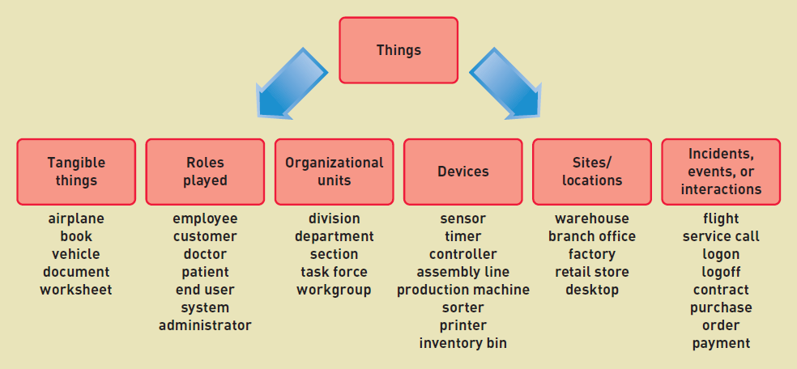
Brainstorming Technique
事物 （飞机；地勤员工；检修人员；航班；检查 ）
潜在事物（存放仓库；检查地点；检查装置；公司；机长；乘务员）
物
人
部门
机
地
事
company
Inspection place
maintainer
inspection
© 2012 Cengage Learning. All Rights Reserved. This edition is intended for use outside of the U.S. only, with content that may be different from the U.S. Edition.
May not be scanned, copied, duplicated, or posted to a publicly accessible website, in whole or in part.

Slide 17
The Noun Technique（名词技术）
A technique to identify problem domain classes (things) by finding, classifying, and refining a list of nouns that come up in in discussions or documents（通过查找、分类和精炼名词来识别问题域类的技术）
Popular technique. Systematic.
Good place to start when there are no users available to help brainstorm（当没有用户可以进行头脑风暴时，是个很好的方式）
© 2012 Cengage Learning. All Rights Reserved. This edition is intended for use outside of the U.S. only, with content that may be different from the U.S. Edition.
May not be scanned, copied, duplicated, or posted to a publicly accessible website, in whole or in part.
Notes:
名词技术：
一种通过查找、分类和精炼讨论或文档中出现的名词列表来识别问题领域类(事物)的技术
流行的技术。系统的。
当没有用户可以帮助进行头脑风暴时，这是一个很好的开始

Slide 18
The Noun Technique:
Steps
Using the use cases, actors, and other information about the system— including inputs and outputs—identify all nouns. （通过用例、参与者和其他系统信息来确定所有名词）
  For the RMO CSMS, the nouns might include customer, product item, sale, confirmation, transaction, shipping, bank, change request, summary report, management, transaction report, accounting, back order, back order notification, return, return confirmation…（对RMO来说，名词包括客户、产品、销售、交易、运输、银行、变更请求、汇总报告、管理、交易报告、会计、退货、退货通知、退货确认）
Using other information from existing systems, current procedures, and current reports or forms, add items or categories of information needed. （通过现有系统的其他信息，例如当前过程、报告或表格来添加）
  For the RMO CSMS, these might include price, size, color, style, season, inventory quantity, payment method, and shipping address. （对于RMO csm，这些可能包括价格、尺寸、颜色、风格、季节、库存数量、付款方式和送货地址。 ）
© 2012 Cengage Learning. All Rights Reserved. This edition is intended for use outside of the U.S. only, with content that may be different from the U.S. Edition.
May not be scanned, copied, duplicated, or posted to a publicly accessible website, in whole or in part.
Notes:
名词技术步骤：
运用用例、参与者和其他系统信息（包括输入/输出）来确定所有名词。
对于RMO csmS，名词可能包括客户、产品、销售、确认、交易、运输、银行、变更请求、汇总报告、管理、交易报告、会计、退货、退货通知、退货确认
2. 运用现有系统、当前的程序、报告或表格中的其他信息，添加所需信息的条款或目录
对于RMO csm，这些可能包括价格、尺寸、颜色、风格、季节、库存数量、付款方式和送货地址。

Slide 19
The Noun Technique:
Steps (continued)
As this list of nouns builds, refine it. Ask these questions about each noun to help you decide whether you should include it：（针对每个名词问下面这些问题来决定是否应该保留）
  Is it a unique thing the system needs to know about?（这是系统需要了解的独特的事物吗？）
  Is it inside the scope of the system I am working on?（这个事物是在我处理的系统范围之内吗？）
Ask these questions to decide to exclude it（问下面这些问题能帮助你决定是否应该排除）:
  Is it really a synonym for some other thing I have identified?（这真的是我已经确认的其他事物的同义词吗？）
  Is it really just an output of the system produced from other information I have identified?（是否是我定义的其他系统的输出？）
  Is it really just an input that results in recording some other information I have identified?（是否是我定义的其他信息的输入？）
© 2012 Cengage Learning. All Rights Reserved. This edition is intended for use outside of the U.S. only, with content that may be different from the U.S. Edition.
May not be scanned, copied, duplicated, or posted to a publicly accessible website, in whole or in part.
Notes:
3. 这份名词列表建立完成后，你需要进行修改。针对每个每个名词问一下这些问题能帮助你决定是否应该保留：
这是系统需要了解的独特的事物吗？（飞机有公司，高铁没有公司）
这个事物是在我处理的系统范围之内吗？（产品的材质）
问一下这些问题能帮助你决定是否应该排除：
这真的是我已经确认的其他事物的同义词吗？（银行客户、银行用户？）
这真的是从你已经定义的其他信息中产生的系统输出吗？（直接调用其他系统的输出）
这真的只是我已经定义的导致记录其他信息的输入吗？（用户信息？）

Slide 20
The Noun Technique:
Steps (continued)
Ask these questions to research it（问一下这些问题能帮助你决定是否应该研究它）:
  Is it likely to be a specific piece of information (attribute) about some other thing I have identified?（ 这像是我已经确定的事务信息的属性吗？）
  Is it something I might need if assumptions change? （如果属性变了我会需要这些事物吗？）
4. Create a master list of all nouns identified and then note whether each one should be included, excluded, or researched further.（创建所有已确认名词的主要列表，然后注意每个名词是否要保留、排除或是研究。）
5. Review the list with users, stakeholders, and team members and then define the list of things in the problem domain.（与用户、利益相关者和团队成员一起评审，然后修改问题域中的事物列表。 ）
© 2012 Cengage Learning. All Rights Reserved. This edition is intended for use outside of the U.S. only, with content that may be different from the U.S. Edition.
May not be scanned, copied, duplicated, or posted to a publicly accessible website, in whole or in part.
Notes:
3. 问一下这些问题能帮助你决定是否应该研究它：
这像是我已经确定的事务信息的更多特殊部分（称为属性）吗？（客户姓名）
如果属性变了我会需要这些事物吗？（用户名改成手机号登录）
4. 创建所有已确认名词的主要列表，然后注意每个名词是否要保留、排除或是研究。
5. 与用户、利益相关者和团队成员一起评审，然后修改问题域中的事物列表。

Slide 21
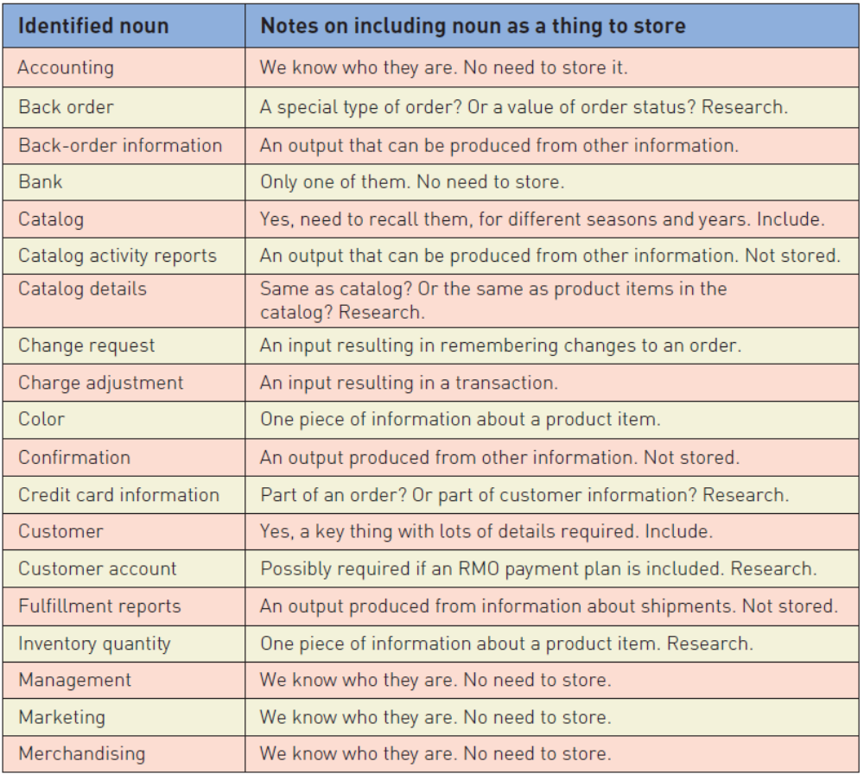
Partial List of Nouns for RMO
With notes on whether to include as domain class
© 2012 Cengage Learning. All Rights Reserved. This edition is intended for use outside of the U.S. only, with content that may be different from the U.S. Edition.
May not be scanned, copied, duplicated, or posted to a publicly accessible website, in whole or in part.
Notes:
RMO的部分名词表（包含是否作为域类包含的注释）
返回订单：一种特殊订单，是否是订单的一种状态？
信用卡信息：是否是订单的一部分？是否是客户信息的一部分？

Slide 22
Details about Domain Classes
Attribute（属性）— describes one piece of information about each instance of the class（描述类的每个实例的一条信息）
  Customer has first name, last name, phone number
Identifier or key（标识符/键）
  One attribute uniquely identifies an instance of the class （唯一地标识类的实例）. Required for data entities, optional for domain classes. Customer ID identifies a customer
Compound attribute（复合属性）
  Two or more attributes combined into one structure（两个或多个属性组合成一个结构以简化模型） to simplify the model. (E.g., address rather than including number, street, city, state, zip separately). Sometimes an identifier or key is a compound attribute.
Notes:
关于域类的详细信息
属性——描述类的每个实例的一条信息
客户有名字，姓氏，电话号码
标识符或键
一个属性唯一地标识类的实例。数据实体必需，域类可选。客户ID标识客户
复合属性
将两个或多个属性组合成一个结构以简化模型。(例如，地址而不包括号码、街道、城市、州、邮政编码)。有时标识符或键是复合属性。

Slide 23
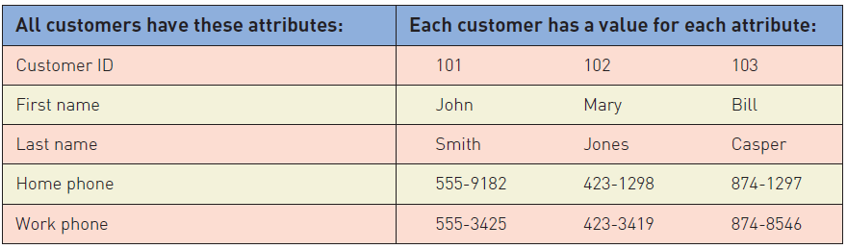
Attributes and Values
Class is a type of thing.（类是一种“事物”类型）
Object is a specific instance of the class. Each instance has its own values for an attribute（对象是类的特定实例。每个实例都有自己的属性值）
© 2012 Cengage Learning. All Rights Reserved. This edition is intended for use outside of the U.S. only, with content that may be different from the U.S. Edition.
May not be scanned, copied, duplicated, or posted to a publicly accessible website, in whole or in part.
Notes:
属性和值：
类是一种“事物”类型。
对象是类的特定实例。每个实例都有自己的属性值

Slide 24
Chapter 4 Outline
“Things” in the Problem Domain
  Data entities
  Domain classes
The Entity-Relationship Diagram（实体-关系图）
The Domain Model Class Diagram
The Domain Model Class Diagram in the RMO example
© 2012 Cengage Learning. All Rights Reserved. This edition is intended for use outside of the U.S. only, with content that may be different from the U.S. Edition.
May not be scanned, copied, duplicated, or posted to a publicly accessible website, in whole or in part.
Notes:
实体-关系图

Slide 25
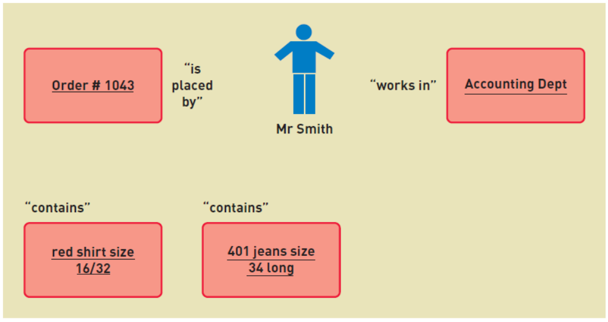
Associations Among Things
Association（关联）— a naturally occurring relationship between classes （类之间自然发生的关系)
© 2012 Cengage Learning. All Rights Reserved. This edition is intended for use outside of the U.S. only, with content that may be different from the U.S. Edition.
May not be scanned, copied, duplicated, or posted to a publicly accessible website, in whole or in part.
Notes:
关联——类之间自然发生的关系(UML术语)

Slide 26
Just to Clarify…
Called association（关联） on class diagram in UML
  Multiplicity（重数） is term for the number of associations between classes（类）: 1 to 1 or 1 to many
  We are emphasizing UML in this text
Called relationship（关系） on ERD in database class
  Cardinality（基数） is term for number of relationships in entity relationship diagrams（实体关系图）: 1 to 1 or 1 to many
Associations and Relationships apply in two directions（关联和关系是双向的）
  A customer places an order（客户下订单）
  An order is placed by a customer（订单是由客户下的）
Notes:
在本课中，称为重数（association）
在数据库中，称为基数（relationship）
在UML中称为类图上的“重数”
多重性是类之间关联数量的术语:1对1或1对多
在数据库中成为“基数”
基数是实体关系图中关系数量的术语:1对1或1对多
关联和关系是双向的
客户下订单
订单是由客户下的

Slide 27
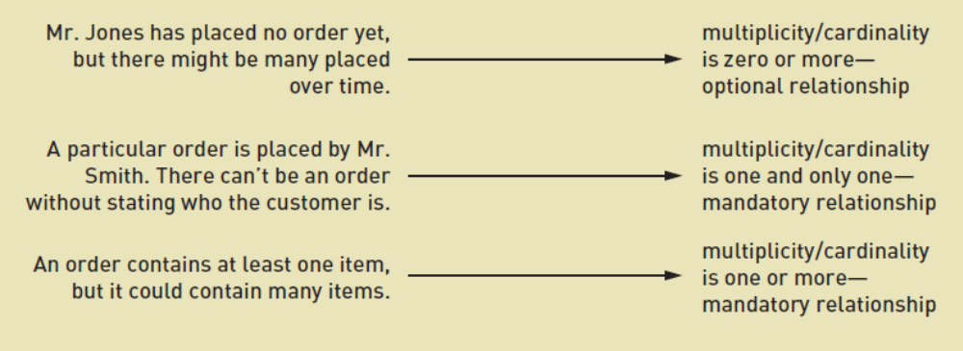
Minimum and Maximum Multiplicity
Associations have minimum and maximum constraints（关联具有最小和最大约束）
  minimum is zero, the association is optional（可选的）
  If minimum is at least one, the association is mandatory（强制的）
© 2012 Cengage Learning. All Rights Reserved. This edition is intended for use outside of the U.S. only, with content that may be different from the U.S. Edition.
May not be scanned, copied, duplicated, or posted to a publicly accessible website, in whole or in part.
Notes:
最小和最大多重性
关联有最小和最大约束
最小为零，则关联是可选的
如果最小至少为1，则该关联是强制性的

Slide 28
Types of Associations
Binary Association（二元关系）
  Associations between exactly two different classes（两种不同事物之间的关系）
    Course Section includes Students（课程组包括学生）
    Members join Club （会员加入俱乐部）
Unary Association (recursive)（一元关系/回归关系）
  Associations between two instances of the same class（同一件类型的两件不同事物间的关系）
    Person married to person（人与人结婚）
    Part is made using parts（零件是由零件构成的）
Ternary Association (three)（三元关系）
N-ary Association (between n)（N元关系）
© 2012 Cengage Learning. All Rights Reserved. This edition is intended for use outside of the U.S. only, with content that may be different from the U.S. Edition.
May not be scanned, copied, duplicated, or posted to a publicly accessible website, in whole or in part.
Notes:
二元关系：两种不同事物之间的关系
课程组包括学生
会员加入俱乐部
一元关系（回归关系）：同一类型的两件不同事物间的关系
人与人结婚
零件是用零件做成的
三元关系
N元关系

Slide 29
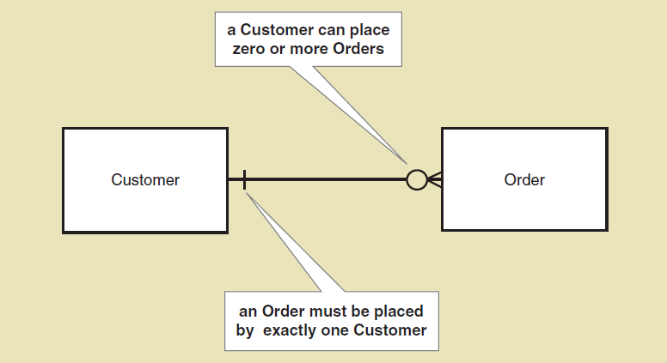
Example of ERD Notation
Entity-Relationship Diagrams： ERD（实体关系图）
A simple ERD without showing attributes
  矩形：数据实体
  连接矩形的直线：数据实体之间的联系
© 2012 Cengage Learning. All Rights Reserved. This edition is intended for use outside of the U.S. only, with content that may be different from the U.S. Edition.
May not be scanned, copied, duplicated, or posted to a publicly accessible website, in whole or in part.
Notes:
实体-关系图例子：
Entity-Relationship Diagram(ERD)实体关系图
一个简单的ERD例子：不显示属性
矩形：数据实体
连接矩形的直线：数据实体之间的联系

Slide 30
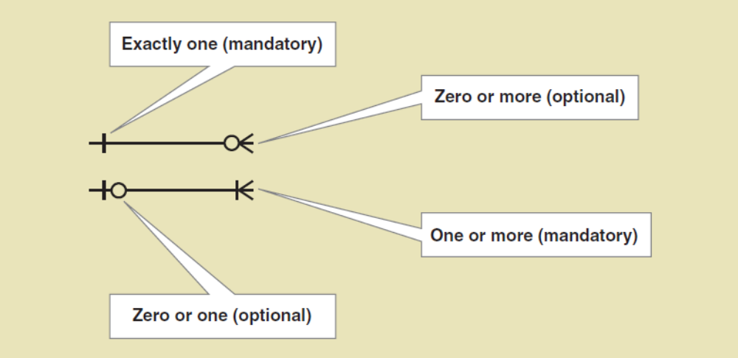
ERD Cardinality Symbols often called the crows feet notation（鱼尾纹计数法）
© 2012 Cengage Learning. All Rights Reserved. This edition is intended for use outside of the U.S. only, with content that may be different from the U.S. Edition.
May not be scanned, copied, duplicated, or posted to a publicly accessible website, in whole or in part.

Slide 31
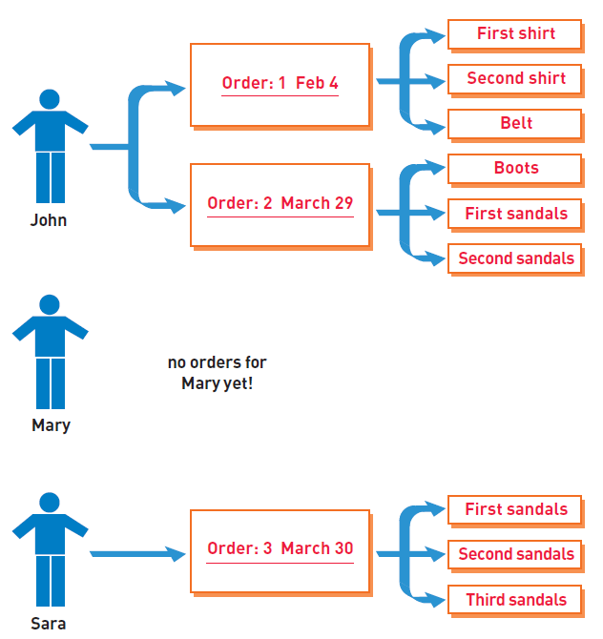
Semantic Net
Shows instances and how they are linked（显示实例及其链接方式）
Example shows instances of three classes（示例展示了三个类的实例）
Quick quiz:
How many associations are there?
What are the minimum and maximum multiplicities in each direction?
What type of associations are they?
© 2012 Cengage Learning. All Rights Reserved. This edition is intended for use outside of the U.S. only, with content that may be different from the U.S. Edition.
May not be scanned, copied, duplicated, or posted to a publicly accessible website, in whole or in part.
Notes:
语义网络
显示实例及其链接方式
示例显示了三个类的实例
快速测验：
有多少种关联?
每个方向上的最小和最大多重度是多少?
它们是什么类型的关联?

Slide 32
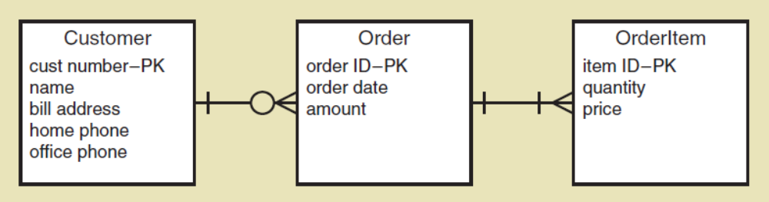
Expanded ERD with Attributes
© 2012 Cengage Learning. All Rights Reserved. This edition is intended for use outside of the U.S. only, with content that may be different from the U.S. Edition.
May not be scanned, copied, duplicated, or posted to a publicly accessible website, in whole or in part.

Slide 33
Expanded ERD with Attributes
© 2012 Cengage Learning. All Rights Reserved. This edition is intended for use outside of the U.S. only, with content that may be different from the U.S. Edition.
May not be scanned, copied, duplicated, or posted to a publicly accessible website, in whole or in part.

Slide 34
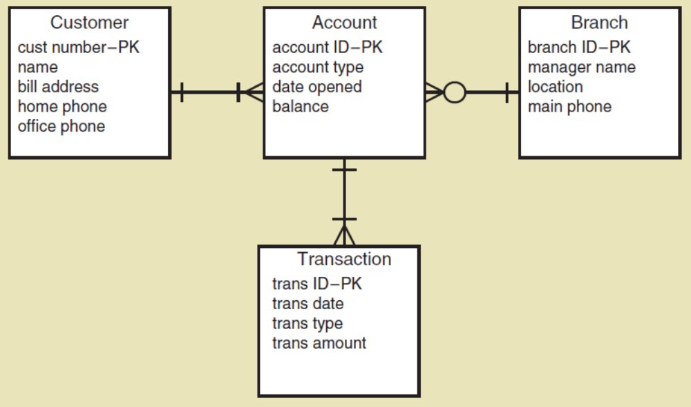
An ERD for a Bank
© 2012 Cengage Learning. All Rights Reserved. This edition is intended for use outside of the U.S. only, with content that may be different from the U.S. Edition.
May not be scanned, copied, duplicated, or posted to a publicly accessible website, in whole or in part.

Slide 35
An ERD for a Bank
© 2012 Cengage Learning. All Rights Reserved. This edition is intended for use outside of the U.S. only, with content that may be different from the U.S. Edition.
May not be scanned, copied, duplicated, or posted to a publicly accessible website, in whole or in part.

Slide 36
An ERD for a Bank
© 2012 Cengage Learning. All Rights Reserved. This edition is intended for use outside of the U.S. only, with content that may be different from the U.S. Edition.
May not be scanned, copied, duplicated, or posted to a publicly accessible website, in whole or in part.

Slide 37
Entity-Relationship Diagrams
ERD
It is not a UML diagram, but it is widely used by data analysts in database management（不是UML图，但在数据库管理中被广泛使用）
There really is no standard notation, but most developers use the entity and crows feet notation shown in this text
An ERD is not good for showing generalization/specialization relationships and whole part relationships（ERD不适合显示泛化/特化的关系和整体-部分的关系）
© 2012 Cengage Learning. All Rights Reserved. This edition is intended for use outside of the U.S. only, with content that may be different from the U.S. Edition.
May not be scanned, copied, duplicated, or posted to a publicly accessible website, in whole or in part.
Notes:
它不是UML图，但在数据库管理中被数据分析人员广泛使用
确实没有标准的表示法，但大多数开发人员使用本文中显示的实体和鱼尾纹表示法
ERD不适合显示泛化/专门化关系和整体部分关系

Slide 38
Chapter 4 Outline
“Things” in the Problem Domain
  Data entities
  Domain classes
The Entity-Relationship Diagram
The Domain Model Class Diagram（域模型类图）
The Domain Model Class Diagram in the RMO example
© 2012 Cengage Learning. All Rights Reserved. This edition is intended for use outside of the U.S. only, with content that may be different from the U.S. Edition.
May not be scanned, copied, duplicated, or posted to a publicly accessible website, in whole or in part.
Notes:
域模型类图

Slide 39
The Domain Model Class Diagram
Class（类）
  A category of classification used to describe a collection of objects（用于描述一组对象的分类范畴）
Domain Class（域类）
  Classes that describe objects in the problem domain（问题域中的类）
Class Diagram（类图）
  A UML diagram that shows classes with attributes and associations (plus methods if it models software classes)
Domain Model Class Diagram（域模型类图）
  A class diagram that only includes classes from the problem domain, not software classes so no methods
© 2012 Cengage Learning. All Rights Reserved. This edition is intended for use outside of the U.S. only, with content that may be different from the U.S. Edition.
May not be scanned, copied, duplicated, or posted to a publicly accessible website, in whole or in part.
Notes:
类
用于描述一组对象的分类范畴
域类
类描述问题域中的对象
类图
显示带有属性和关联的类的UML图(如果它对软件类建模，则加上方法)
域模型类图
类图只包括问题域的类，而不包括软件类，因此没有方法

Slide 40
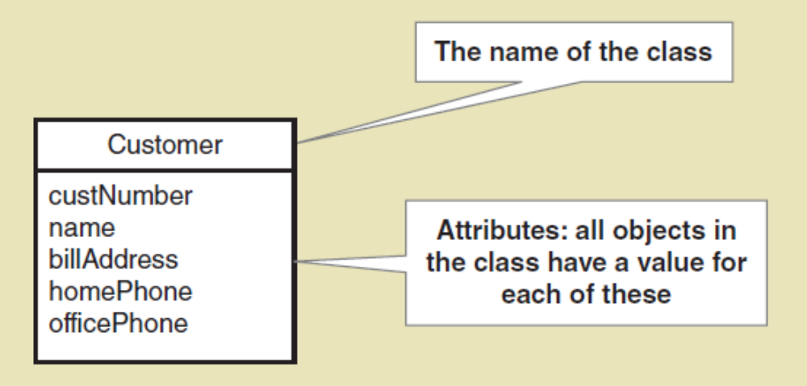
Domain Class Notation
Class name is always capitalized
Attribute names are not capitalized and use camelback notation (words run together and second word is capitalized)
© 2012 Cengage Learning. All Rights Reserved. This edition is intended for use outside of the U.S. only, with content that may be different from the U.S. Edition.
May not be scanned, copied, duplicated, or posted to a publicly accessible website, in whole or in part.
Notes:
类名总是大写的
属性名不大写，使用驼峰命名法(单词一起出现，第二个单词大写)

Slide 41
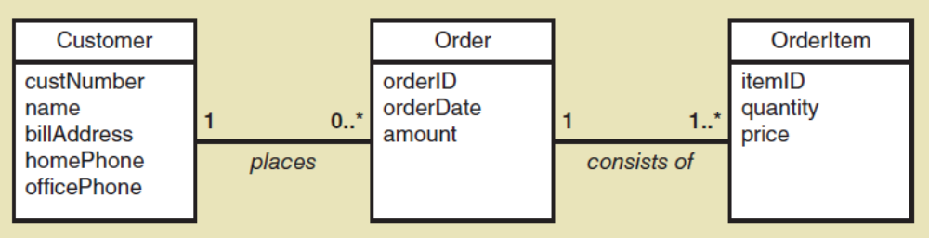
A Simple Domain Model Class Diagram
上：Domain Model Class Diagram; 下： Entity-Relationship Diagrams
© 2012 Cengage Learning. All Rights Reserved. This edition is intended for use outside of the U.S. only, with content that may be different from the U.S. Edition.
May not be scanned, copied, duplicated, or posted to a publicly accessible website, in whole or in part.

Slide 42
A Simple Domain Model Class Diagram
Note: This diagram matches the semantic net shown previously
  A customer places zero or more orders
  An order is placed by exactly one customer
  An order consists of one or more order items
  An order item is part of exactly one order
© 2012 Cengage Learning. All Rights Reserved. This edition is intended for use outside of the U.S. only, with content that may be different from the U.S. Edition.
May not be scanned, copied, duplicated, or posted to a publicly accessible website, in whole or in part.
Notes:
注意:此图与前面所示的语义网相匹配
客户下零个或多个订单
一个订单是由一个客户下的
一个订单由一个或多个订单项组成
一个订单项目只能是一个订单的一部分

Slide 43
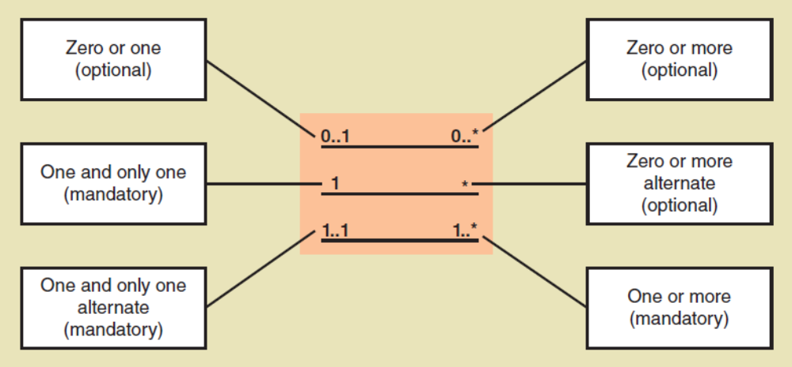
UML Notation for Multiplicity
只要可以为0，就是optional
© 2012 Cengage Learning. All Rights Reserved. This edition is intended for use outside of the U.S. only, with content that may be different from the U.S. Edition.
May not be scanned, copied, duplicated, or posted to a publicly accessible website, in whole or in part.

Slide 44
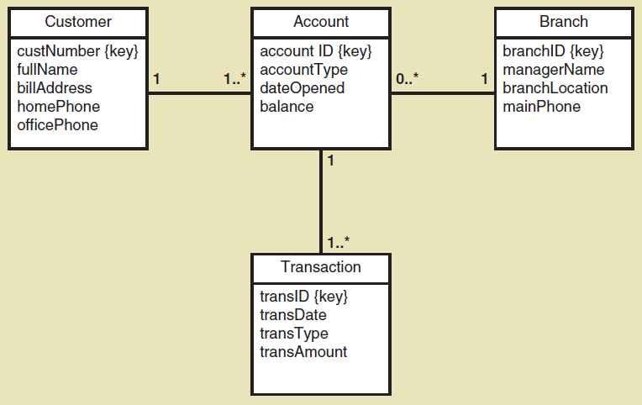
Domain Model Class Diagram for a bank with many branches
© 2012 Cengage Learning. All Rights Reserved. This edition is intended for use outside of the U.S. only, with content that may be different from the U.S. Edition.
May not be scanned, copied, duplicated, or posted to a publicly accessible website, in whole or in part.
Notes:
具有许多分支机构的银行的域模型类图

Slide 45
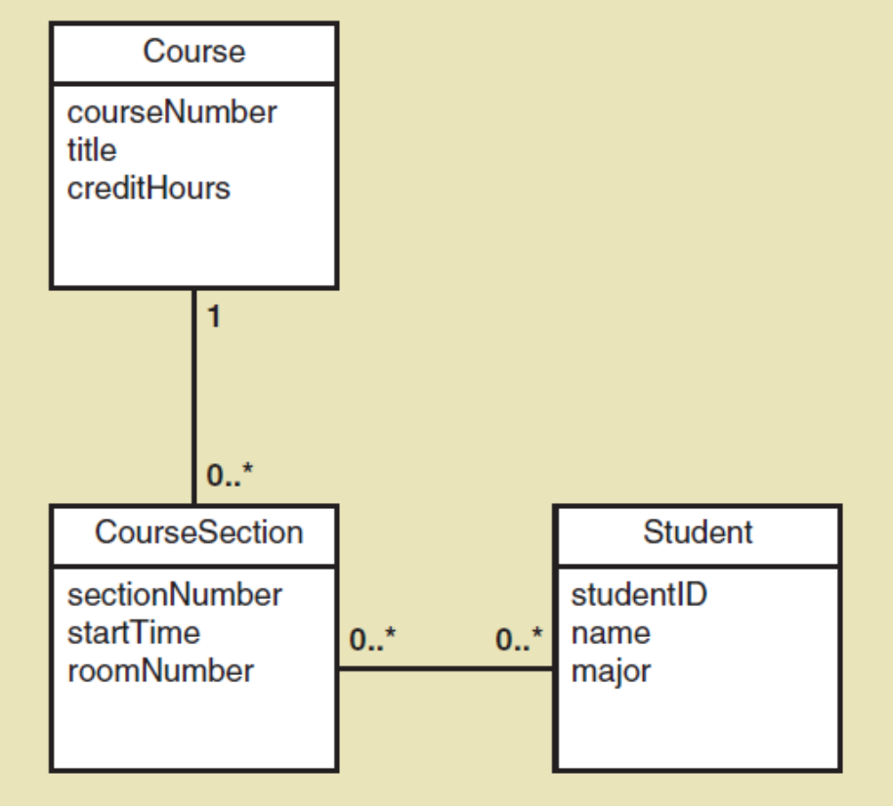
Domain Model Class Diagram for course enrollment at a university
Where is each student’s grade remembered in this model?（在这个模型中，每个学生的成绩记在哪里？）
  Each section has many grades and each grade is association with a student
  Each student has many grades and each grade is association with a section
© 2012 Cengage Learning. All Rights Reserved. This edition is intended for use outside of the U.S. only, with content that may be different from the U.S. Edition.
May not be scanned, copied, duplicated, or posted to a publicly accessible website, in whole or in part.
Notes:
用于大学课程注册的域模型类图
在这个模型中，每个学生的成绩记在哪里?
每个课程有许多学生成绩，每个学生成绩与一个学生相关联
每个学生都有很多成绩，每个成绩都与一个课程相关联

Slide 46
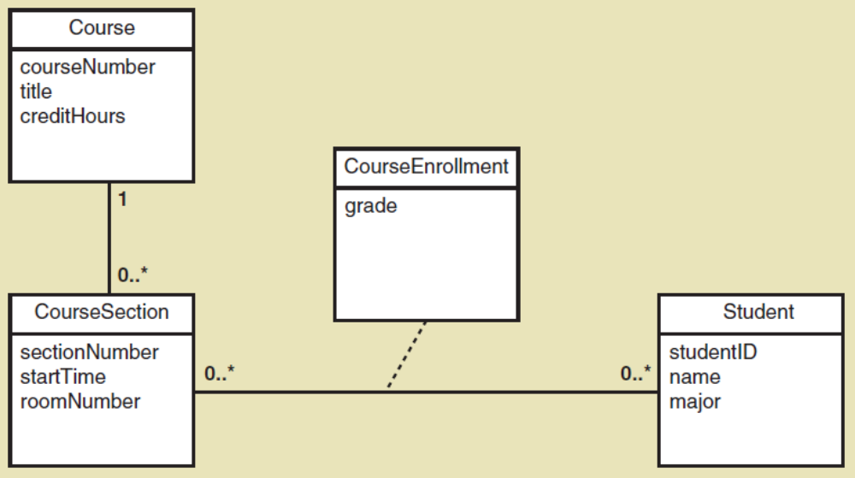
Refined Course Enrollment Model with an Association Class CourseEnrollment
Association class（关联类）— an association that is treated as a class in a many to many association because it has attributes that need to be remembered, such as grade
© 2012 Cengage Learning. All Rights Reserved. This edition is intended for use outside of the U.S. only, with content that may be different from the U.S. Edition.
May not be scanned, copied, duplicated, or posted to a publicly accessible website, in whole or in part.
Notes:
关联类——在多对多关联中被视为类的关联，因为它具有需要记住的属性，比如成绩

Slide 47
More Complex Issues about Classes:
Generalization/Specialization Relationships
Generalization/Specialization（泛化/特化）
  A hierarchical relationship where subordinate classes are special types of the superior classes. Often called an Inheritance Hierarchy
Superclass（超类）
  the superior or more general class in a generalization/specialization hierarchy（泛化/特化中更通用的类）
Subclass （子类）
  the subordinate or more specialized class in a generalization/specialization hierarchy（泛化/特化中从属的类）
Inheritance （继承）
  the concept that subclasses classes inherit characteristics of the more general superclass
© 2012 Cengage Learning. All Rights Reserved. This edition is intended for use outside of the U.S. only, with content that may be different from the U.S. Edition.
May not be scanned, copied, duplicated, or posted to a publicly accessible website, in whole or in part.
Notes:
泛化/特化
一种层次关系，其中从属类是上级类的特殊类型。通常称为继承层次结构
超类泛化/专门化层次结构中的高级或更通用的类
子类化泛化/专门化层次结构中的从属类或更专门化的类
继承:子类继承父类的特征的概念

Slide 48
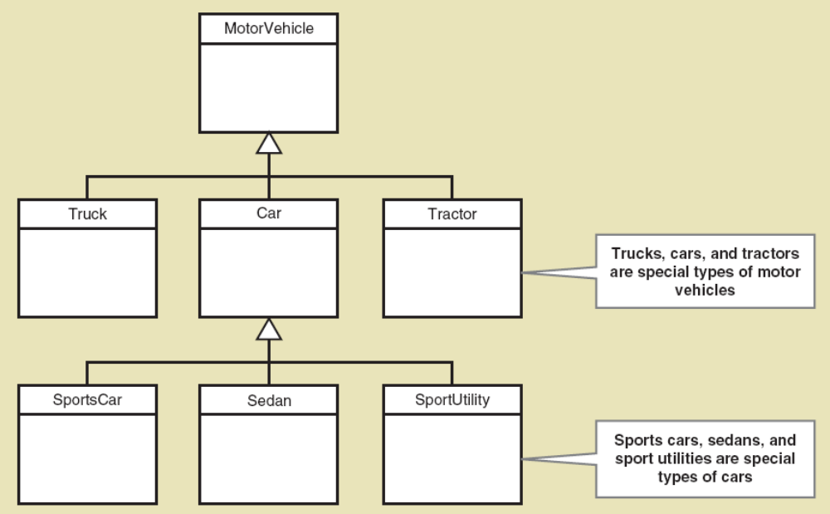
Generalization/Specialization
Inheritance
© 2012 Cengage Learning. All Rights Reserved. This edition is intended for use outside of the U.S. only, with content that may be different from the U.S. Edition.
May not be scanned, copied, duplicated, or posted to a publicly accessible website, in whole or in part.
Notes:
泛化和特化
继承
运动型车辆，轿车，运动型多用途车（SUV）

Slide 49
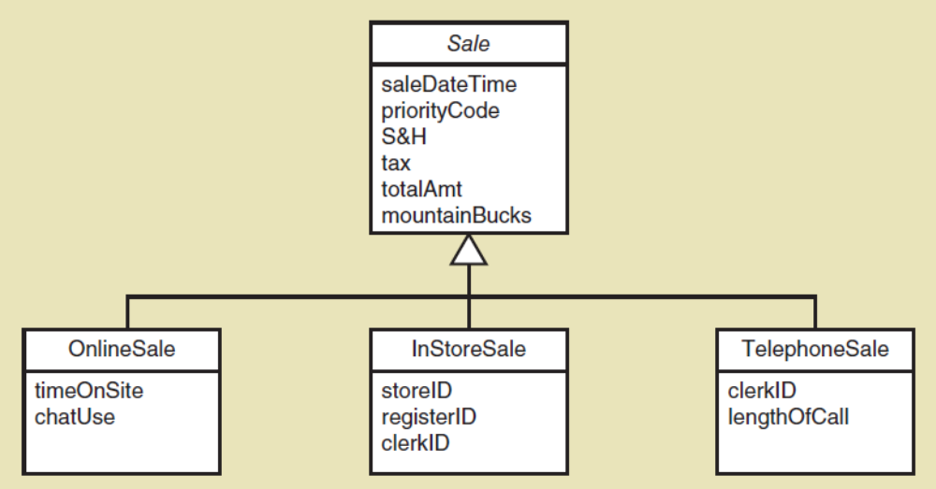
Generalization/Specialization
Inheritance for RMO Three Types of Sales
Abstract class（抽象类）— a class that allow subclasses to inherit characteristics but never gets instantiated（永远不会被实例化）. In Italics (Sale above)
Concrete class（具体类）— a class that can have instances（可以有实例的类）
© 2012 Cengage Learning. All Rights Reserved. This edition is intended for use outside of the U.S. only, with content that may be different from the U.S. Edition.
May not be scanned, copied, duplicated, or posted to a publicly accessible website, in whole or in part.
Notes:
抽象类
具体类
抽象类——允许子类继承特征但永远不会被实例化的类。斜体字(以上销售)
具体类——可以有实例的类

Slide 50
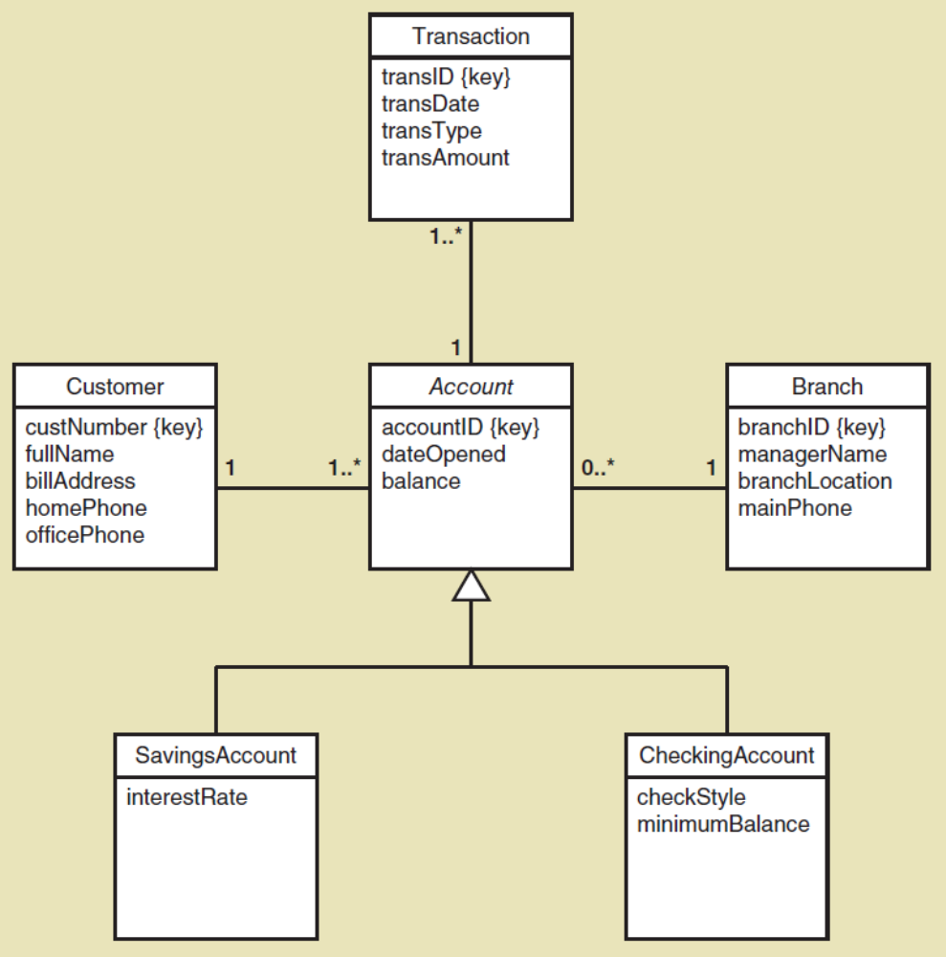
Generalization/Specialization
Inheritance for the Bank with Special Types of Accounts
A SavingsAccount（储蓄账户） has 4 attributes
A CheckingAccount（支票账户）Has 5 attributes
Note: the subclasses inherit the associations, too
© 2012 Cengage Learning. All Rights Reserved. This edition is intended for use outside of the U.S. only, with content that may be different from the U.S. Edition.
May not be scanned, copied, duplicated, or posted to a publicly accessible website, in whole or in part.
Notes:
特殊类型账户银行的继承
SavingsAccount（储蓄账户）有4个属性
CheckingAccount（支票账户）有5个属性
注意:子类也继承了关联

Slide 51
More Complex Issues about Classes:
Whole Part Relationships
Whole-part relationship（整体-部分关联）— a relationship between classes where one class is part of or a component portion of another class（其中一个类是另一个类的一部分或组成部分）
Aggregation（聚合）— a whole part relationship where the component part exists separately and can be removed and replaced (UML diamond symbol, next slide)
  Computer has disk storage devices（计算机有磁盘存储）
  Car has wheels（汽车有轮子）
Composition（合成）— a whole part relationship where the parts can no longer be removed (filled in diamond symbol)
  Hand has fingers（手有手指）
  Chip has circuits （芯片有电路）
Notes:
关于类的更复杂的问题:整体部分关系
整体-部分关系-类之间的关系，其中一个类是另一个类的一部分或组成部分
聚合——一个整体部分关系，其中组件部分单独存在，并且可以被删除和替换(UML菱形符号，下一张幻灯片)
计算机有磁盘存储设备
汽车有轮子
合成-一个整体的部分关系，部分不能再被移除(用菱形符号填充)
手有手指
芯片有电路

Slide 52
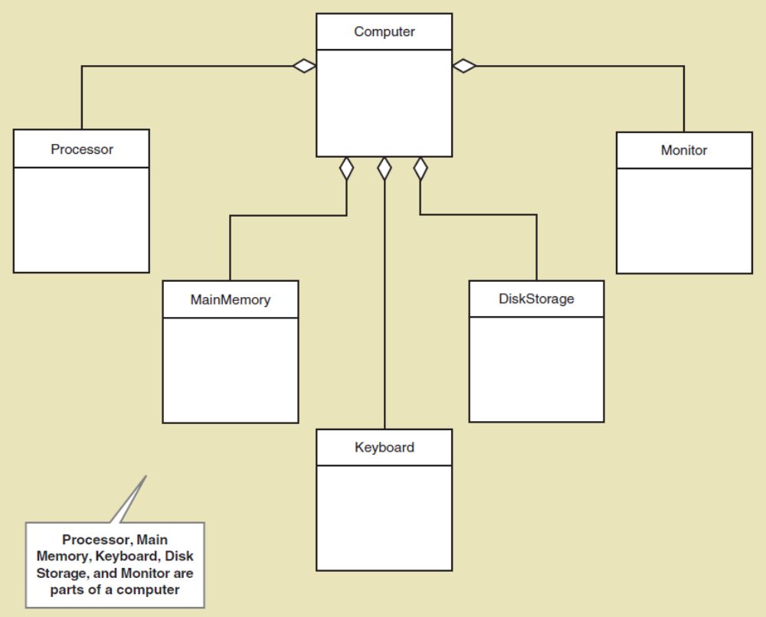
Whole Part Relationships
Computer and its Parts
Note: this is aggregation, with diamond symbol.
Whole part can have multiplicity symbols, too (not shown)
© 2012 Cengage Learning. All Rights Reserved. This edition is intended for use outside of the U.S. only, with content that may be different from the U.S. Edition.
May not be scanned, copied, duplicated, or posted to a publicly accessible website, in whole or in part.
Notes:
整体部件关系计算机及其部件
注:这是聚合，带有菱形符号。
整个部分也可以有多重符号(未显示)

Slide 53
More on UML Relationships
There are actually three types of relationships in class diagrams（在类图中有三种类型的关系）
  Association Relationships（关联关系）
    These are associations discussed previously, just like ERD relationships
  Whole Part Relationships（整体-部分关系）
    One class is a component or part of another class
  Generalizations/Specialization Relationships（泛化/特化关系）
    Inheritance
© 2012 Cengage Learning. All Rights Reserved. This edition is intended for use outside of the U.S. only, with content that may be different from the U.S. Edition.
May not be scanned, copied, duplicated, or posted to a publicly accessible website, in whole or in part.
Notes:
在类图中实际上有三种类型的关系
关联关系
这些是前面讨论过的关联，就像ERD关系一样
整体部分关系
一个类是另一个类的组件或一部分
泛化/特化关系
继承

Slide 54
Chapter 4 Outline
“Things” in the Problem Domain
  Data entities
  Domain classes
The Entity-Relationship Diagram
The Domain Model Class Diagram
The Domain Model Class Diagram in the RMO example
© 2012 Cengage Learning. All Rights Reserved. This edition is intended for use outside of the U.S. only, with content that may be different from the U.S. Edition.
May not be scanned, copied, duplicated, or posted to a publicly accessible website, in whole or in part.
Notes:
RMO示例中的域模型类图

Slide 55
RMO CSMS Project
Domain Model Class Diagrams
There are several ways to create the domain model class diagram for a project
RMO CSMS has 27 domain classes overall （RMO CSMS总共有27个域类）
Can create one domain model class diagram per subsystem for those working on a subsystem（可以为每个子系统创建一个域模型类图）
Can create one overall domain model class diagram to provide an overview of the whole system（可以创建一个整体的域模型类图来提供整个系统的概览）
© 2012 Cengage Learning. All Rights Reserved. This edition is intended for use outside of the U.S. only, with content that may be different from the U.S. Edition.
May not be scanned, copied, duplicated, or posted to a publicly accessible website, in whole or in part.
Notes:
MO csmS项目域模型类图
有几种方法可以为项目创建域模型类图
RMO CSMS总共有27个域类
可以为每个子系统创建一个域模型类图
可以创建一个整体的域模型类图来提供整个系统的概览
通常在早期的迭代中，完成域模型类图的初始草案以指导开发并保持更新

Slide 56
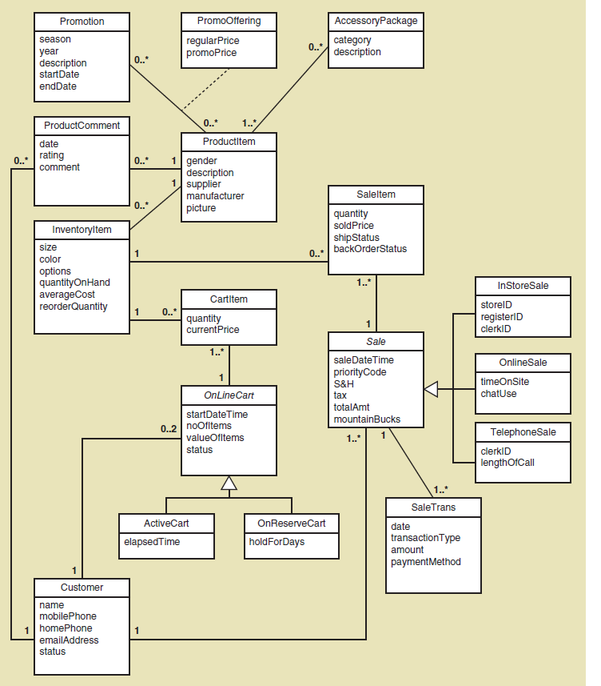
RMO CSMS Project
Sales Subsystem Domain Model Class Diagrams
销售子系统
域模型类图
© 2012 Cengage Learning. All Rights Reserved. This edition is intended for use outside of the U.S. only, with content that may be different from the U.S. Edition.
May not be scanned, copied, duplicated, or posted to a publicly accessible website, in whole or in part.
Notes:
销售子系统领域模型类图
产品，促销，促销方式，配件列表

Slide 57
RMO CSMS Project
Sales Subsystem Domain Model Class Diagrams
© 2012 Cengage Learning. All Rights Reserved. This edition is intended for use outside of the U.S. only, with content that may be different from the U.S. Edition.
May not be scanned, copied, duplicated, or posted to a publicly accessible website, in whole or in part.
Notes:
产品，产品评价

Slide 58
RMO CSMS Project
Sales Subsystem Domain Model Class Diagrams
© 2012 Cengage Learning. All Rights Reserved. This edition is intended for use outside of the U.S. only, with content that may be different from the U.S. Edition.
May not be scanned, copied, duplicated, or posted to a publicly accessible website, in whole or in part.
Notes:
库存产品（购物车产品，销售产品）

Slide 59
RMO CSMS Project
Sales Subsystem Domain Model Class Diagrams
© 2012 Cengage Learning. All Rights Reserved. This edition is intended for use outside of the U.S. only, with content that may be different from the U.S. Edition.
May not be scanned, copied, duplicated, or posted to a publicly accessible website, in whole or in part.
Notes:
销售：店内销售，线上销售，电话销售
销售交易

Slide 60
RMO CSMS Project
Sales Subsystem Domain Model Class Diagrams
© 2012 Cengage Learning. All Rights Reserved. This edition is intended for use outside of the U.S. only, with content that may be different from the U.S. Edition.
May not be scanned, copied, duplicated, or posted to a publicly accessible website, in whole or in part.
Notes:
线上购物车（活跃的购物车，预定购物车）

Slide 61
RMO CSMS Project
Sales Subsystem Domain Model Class Diagrams
© 2012 Cengage Learning. All Rights Reserved. This edition is intended for use outside of the U.S. only, with content that may be different from the U.S. Edition.
May not be scanned, copied, duplicated, or posted to a publicly accessible website, in whole or in part.
Notes:
客户

Slide 62
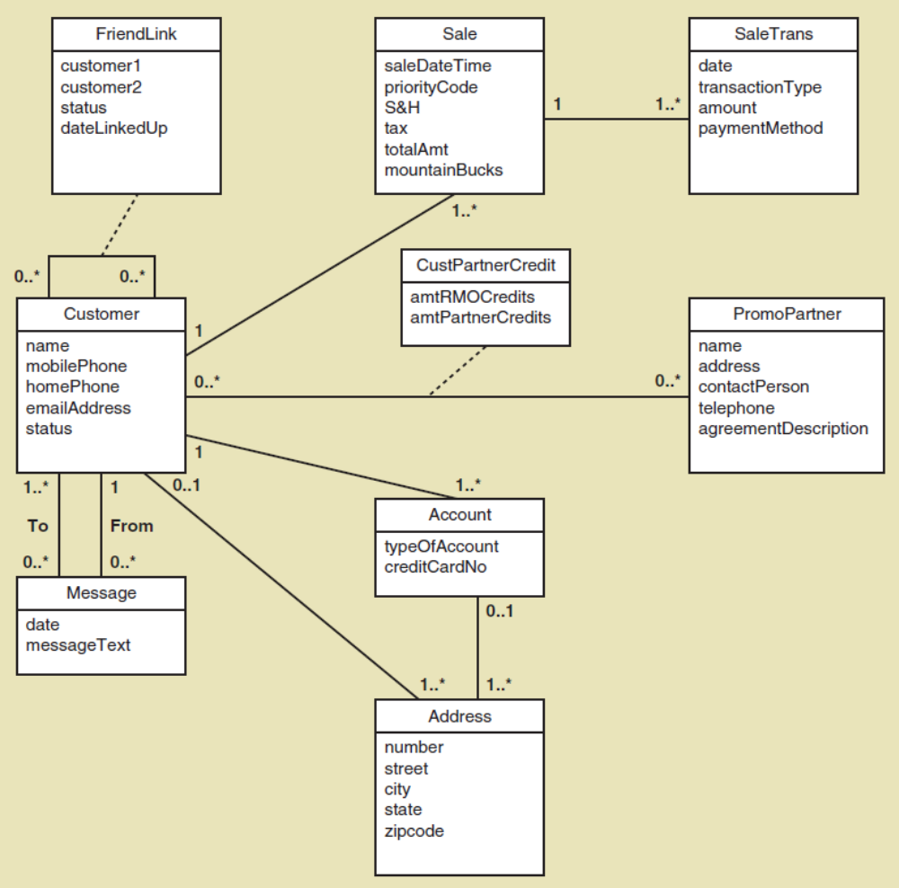
RMO CSMS Project
Customer Account Subsystem Domain Model Class Diagram
客户帐户子系统
域模型类图
© 2012 Cengage Learning. All Rights Reserved. This edition is intended for use outside of the U.S. only, with content that may be different from the U.S. Edition.
May not be scanned, copied, duplicated, or posted to a publicly accessible website, in whole or in part.
Notes:
客户帐户子系统域模型类图：
客户
好友链接

Slide 63
RMO CSMS Project
Customer Account Subsystem Domain Model Class Diagram
© 2012 Cengage Learning. All Rights Reserved. This edition is intended for use outside of the U.S. only, with content that may be different from the U.S. Edition.
May not be scanned, copied, duplicated, or posted to a publicly accessible website, in whole or in part.
Notes:
销售，销售交易

Slide 64
RMO CSMS Project
Customer Account Subsystem Domain Model Class Diagram
© 2012 Cengage Learning. All Rights Reserved. This edition is intended for use outside of the U.S. only, with content that may be different from the U.S. Edition.
May not be scanned, copied, duplicated, or posted to a publicly accessible website, in whole or in part.
Notes:
促销合作对象 合作对象中的信用点数

Slide 65
RMO CSMS Project
Customer Account Subsystem Domain Model Class Diagram
© 2012 Cengage Learning. All Rights Reserved. This edition is intended for use outside of the U.S. only, with content that may be different from the U.S. Edition.
May not be scanned, copied, duplicated, or posted to a publicly accessible website, in whole or in part.
Notes:
账户 地址

Slide 66
RMO CSMS Project
Customer Account Subsystem Domain Model Class Diagram
© 2012 Cengage Learning. All Rights Reserved. This edition is intended for use outside of the U.S. only, with content that may be different from the U.S. Edition.
May not be scanned, copied, duplicated, or posted to a publicly accessible website, in whole or in part.
Notes:
客户 信息

Slide 67
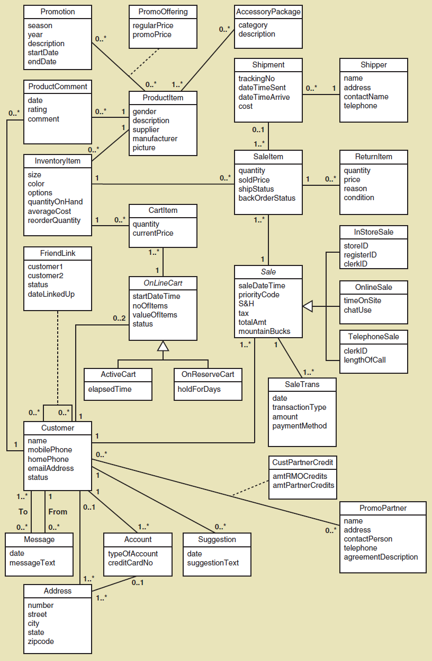
RMO CSMS Project
Complete Domain Model Class Diagram
© 2012 Cengage Learning. All Rights Reserved. This edition is intended for use outside of the U.S. only, with content that may be different from the U.S. Edition.
May not be scanned, copied, duplicated, or posted to a publicly accessible website, in whole or in part.

Slide 68
RMO CSMS Project
Domain Model Class Diagrams
Given the complete RMO CSMS Domain Model
Class Diagram and Sales and Customer Account subsystem examples:
  Try completing the Order Fulfilment Subsystem（订单履行子系统） Domain Model Class Diagram
  Try Completing the Marketing Subsystem（市场营销子系统） Domain Model Class Diagram
  Try Completing the Reporting Subsystem（报告子系统） Domain Model Class Diagram
© 2012 Cengage Learning. All Rights Reserved. This edition is intended for use outside of the U.S. only, with content that may be different from the U.S. Edition.
May not be scanned, copied, duplicated, or posted to a publicly accessible website, in whole or in part.

Slide 69
Summary
This chapter is the second of three that focuses
on modeling functional requirements（功能需求建模） as a part of systems analysis
“Things” in the problem domain are identified and modeled, called domain classes or data entities（问题域中的“事物”被识别并建模）
Two techniques for identifying domain classes/data entities are the brainstorming technique （头脑风暴）and the noun technique（名词技术）
Domain classes have attributes（属性） and associations（关联）
© 2012 Cengage Learning. All Rights Reserved. This edition is intended for use outside of the U.S. only, with content that may be different from the U.S. Edition.
May not be scanned, copied, duplicated, or posted to a publicly accessible website, in whole or in part.
Notes:
本章是将功能需求建模作为系统分析一部分的三章中的第二章
问题域中的“事物”被识别和建模，称为领域类或数据实体
识别域类/数据实体的两种技术是头脑风暴技术和名词技术
域类具有属性和关联
关联是类之间自然发生的关系，并且关联具有最小和最大的多样性

Slide 70
Summary
Associations are naturally occurring relationships among classes, and associations have minimum and maximum multiplicity （关联是类之间自然存在的关系，并且关联具有最小和最大基数）
The UML class diagram notation is used to create
a domain model class diagram for a system. The domain model classes do not have methods because they are not yet software classes.
There are actually three UML class diagram relationships: association relationships, generalization/specialization (inheritance) relationships, and whole part relationships（三种类图关系：关联关系，泛化-特化，整体部分）
© 2012 Cengage Learning. All Rights Reserved. This edition is intended for use outside of the U.S. only, with content that may be different from the U.S. Edition.
May not be scanned, copied, duplicated, or posted to a publicly accessible website, in whole or in part.
Notes:
关联是类之间自然存在的关系，并且关联具有最小和最大基数。
UML类图符号用于为系统创建领域模型类图。领域模型类没有方法，因为它们还不是软件类。
实际上有三种UML类图关系:关联关系、泛化/专门化(继承)关系和整体部分关系
其他类图概念包括抽象类与具体类、复合属性、组合与聚合、关联类、超类和子类

Slide 71
Summary
Entity-relationship diagrams (ERDs) show the
same information as a domain model class
diagram（实体关系图(erd)显示与领域模型类图相同的信息）
ERDs are preferred by database analysts and are widely used（erd是数据库分析人员的首选，并且被广泛使用）
ERDs are not UML diagrams, and an association is called a relationship, multiplicity is called cardinality, and generalization/specialization (inheritance) and whole part relationships are usually not shown
© 2012 Cengage Learning. All Rights Reserved. This edition is intended for use outside of the U.S. only, with content that may be different from the U.S. Edition.
May not be scanned, copied, duplicated, or posted to a publicly accessible website, in whole or in part.
Notes:
实体关系图(erd)显示与领域模型类图相同的信息
erd是数据库分析人员的首选，并且被广泛使用
erd不是UML图，关联称为关系，多样性称为基数，泛化/专门化(继承)和整体部分关系通常不显示

Slide 72
课后习题
再次思考上图，添加以下内容：
一个教师经常教授很多课程部分，但为了保证授课质量，一个教师一学期最多教授4门课。每个课程部分必须至少有一个教师来教授。同时，每个课程需要安排一位教师作为课程协调者来监督这个课程。

Slide 73
课后习题
teacherID
Name
major
Teacher
0..4
再次思考上图，添加以下内容：
一个教师经常教授很多课程部分，但为了保证授课质量，一个教师一学期最多教授4门课。每个课程部分必须至少有一个教师来教授。同时，每个课程需要安排一位教师作为课程协调者来监督这个课程。

Slide 74
课后习题
teacherID
Name
major
Teacher
1..*
0..4
再次思考上图，添加以下内容：
一个教师经常教授很多课程部分，但为了保证授课质量，一个教师一学期最多教授4门课。每个课程部分必须至少有一个教师来教授。同时，每个课程需要安排一位教师作为课程协调者来监督这个课程。

Slide 75
课后习题
Coordinator
teacherID
Name
major
Teacher
1..*
0..4
再次思考上图，添加以下内容：
一个教师经常教授很多课程部分，但为了保证授课质量，一个教师一学期最多教授4门课。每个课程部分必须至少有一个教师来教授。同时，每个课程需要安排一位教师作为课程协调者来监督这个课程。

Slide 76
课后习题
Coordinator
teacherID
Name
major
Teacher
1..*
0..4
再次思考上图，添加以下内容：
一个教师经常教授很多课程部分，但为了保证授课质量，一个教师一学期最多教授4门课。每个课程部分必须至少有一个教师来教授。同时，每个课程需要安排一位教师作为课程协调者来监督这个课程。

Slide 77
课后习题
Coordinator
teacherID
Name
major
Teacher
1..*
0..4
再次思考上图，添加以下内容：
一个教师经常教授很多课程部分，但为了保证授课质量，一个教师一学期最多教授4门课。每个课程部分必须至少有一个教师来教授。同时，每个课程需要安排一位教师作为课程协调者来监督这个课程。

Slide 78
课后习题
Coordinator
teacherID
Name
major
Teacher
1..*
0..4
课后思考：
添加后的域模型类图显示了教师与课程部分之间多对多的关系，那么更进一步地观察这个关系可能会揭露存储一些附加信息的需求。这样的需求包括：
每个学期课程的教师有特定的工作时间吗？
你会给每个课程部分的指导者一些评估吗？
…

