Slide 1
L
O
A
D
I
N
G
O
F
C
O
N
S
C
I
O
U
S
N
E
S
S

Slide 2
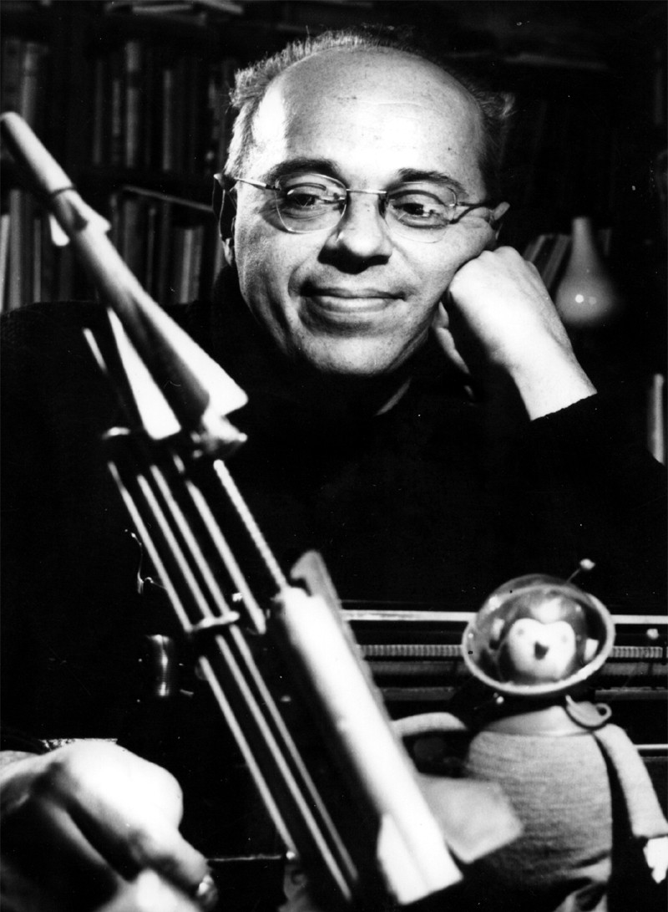
Stanislav Lem

Slide 3
What is the consciousness?

Slide 4
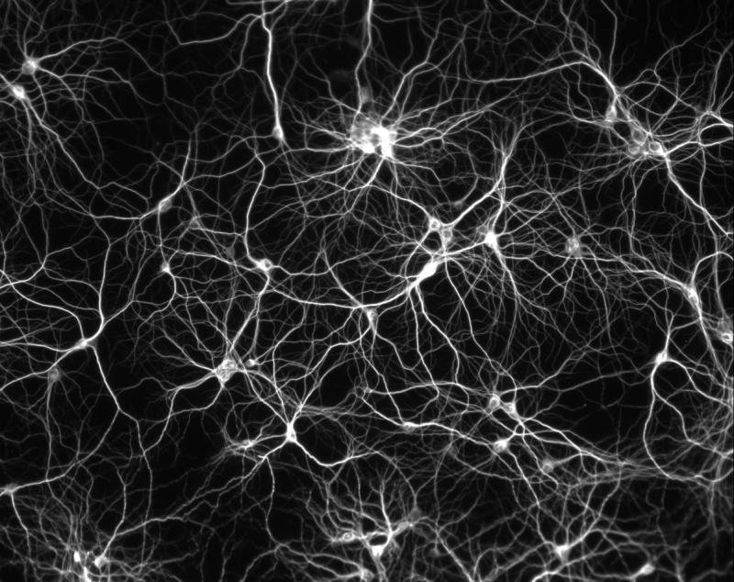
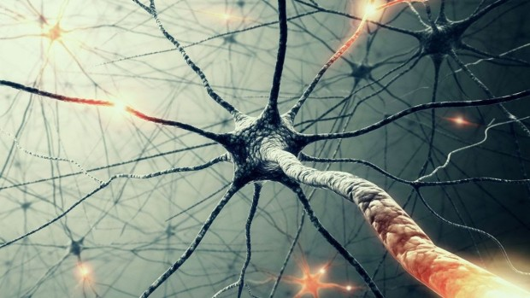
Neurons and their connections

Slide 5
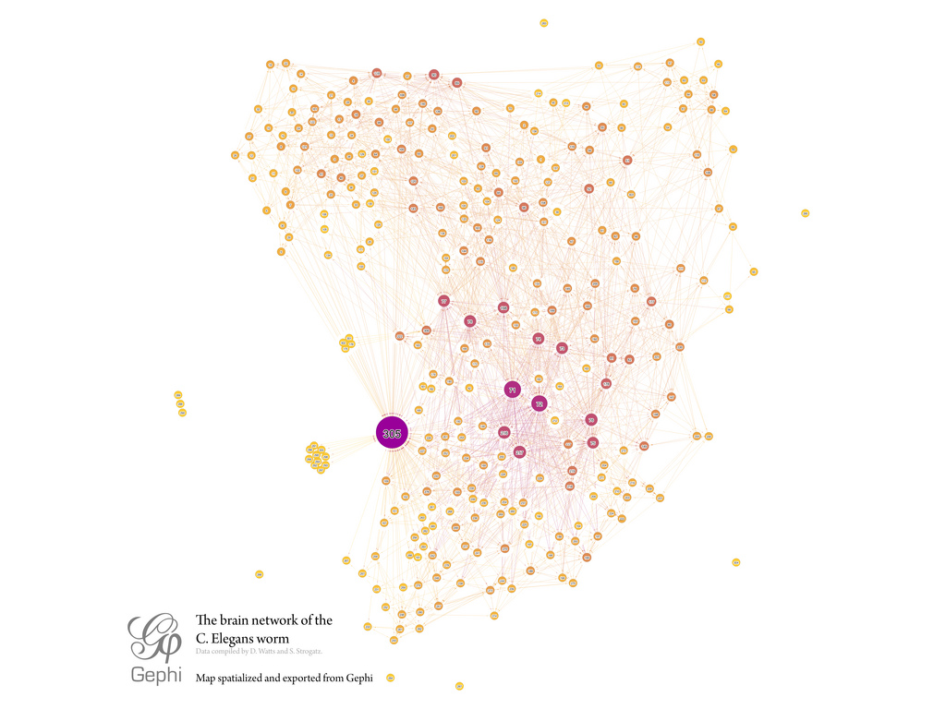
First steps for our immortality.

Slide 6
First steps for our immortality.
Blue Brain Project
Human Brain Project

Slide 7
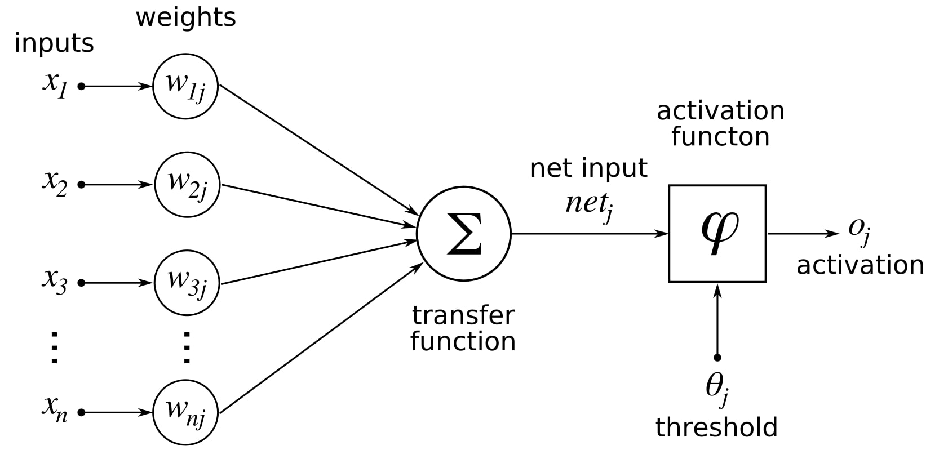
First steps for our immortality.

Slide 8
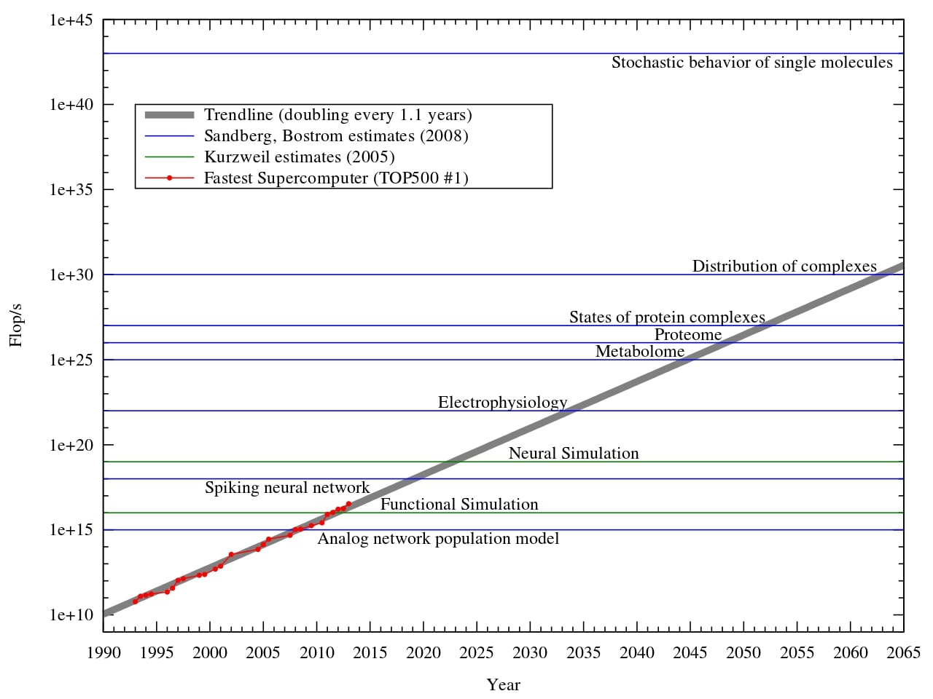
So, is it real?

Slide 9
Can we say that it is ethical?

Slide 10
Thank you for your attention

