Slide 1
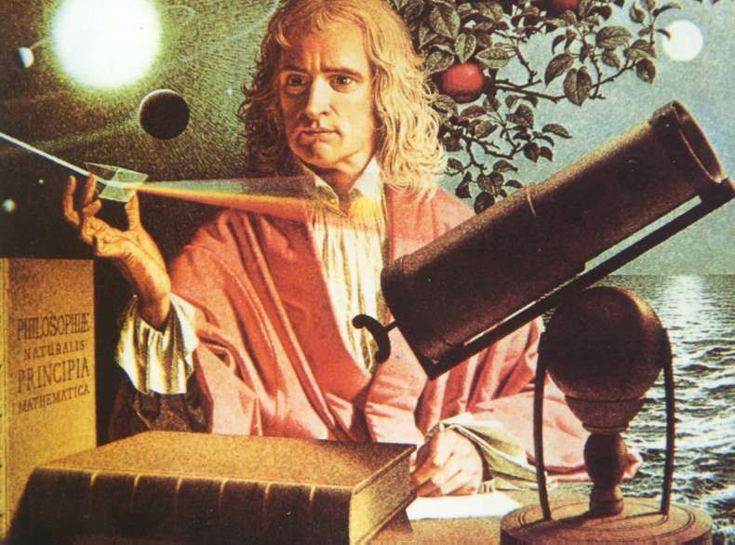
Scientific Revolution.

Slide 2
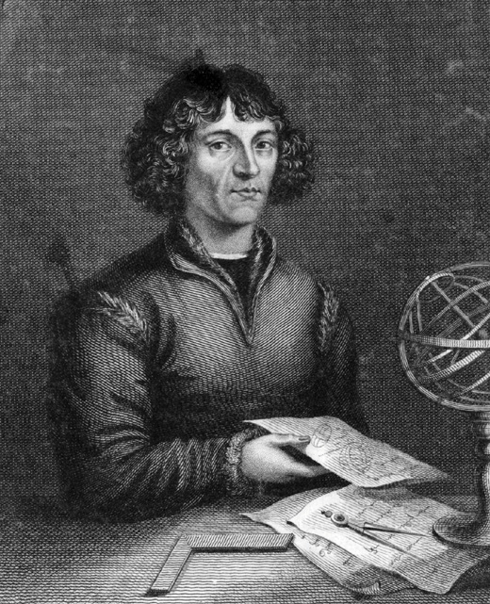

The beginning of a new era.
Copernicus publishes On the Revolutions of the Heavenly Spheres in 1543
Newton publishes Principia in 1687

