Slide 1
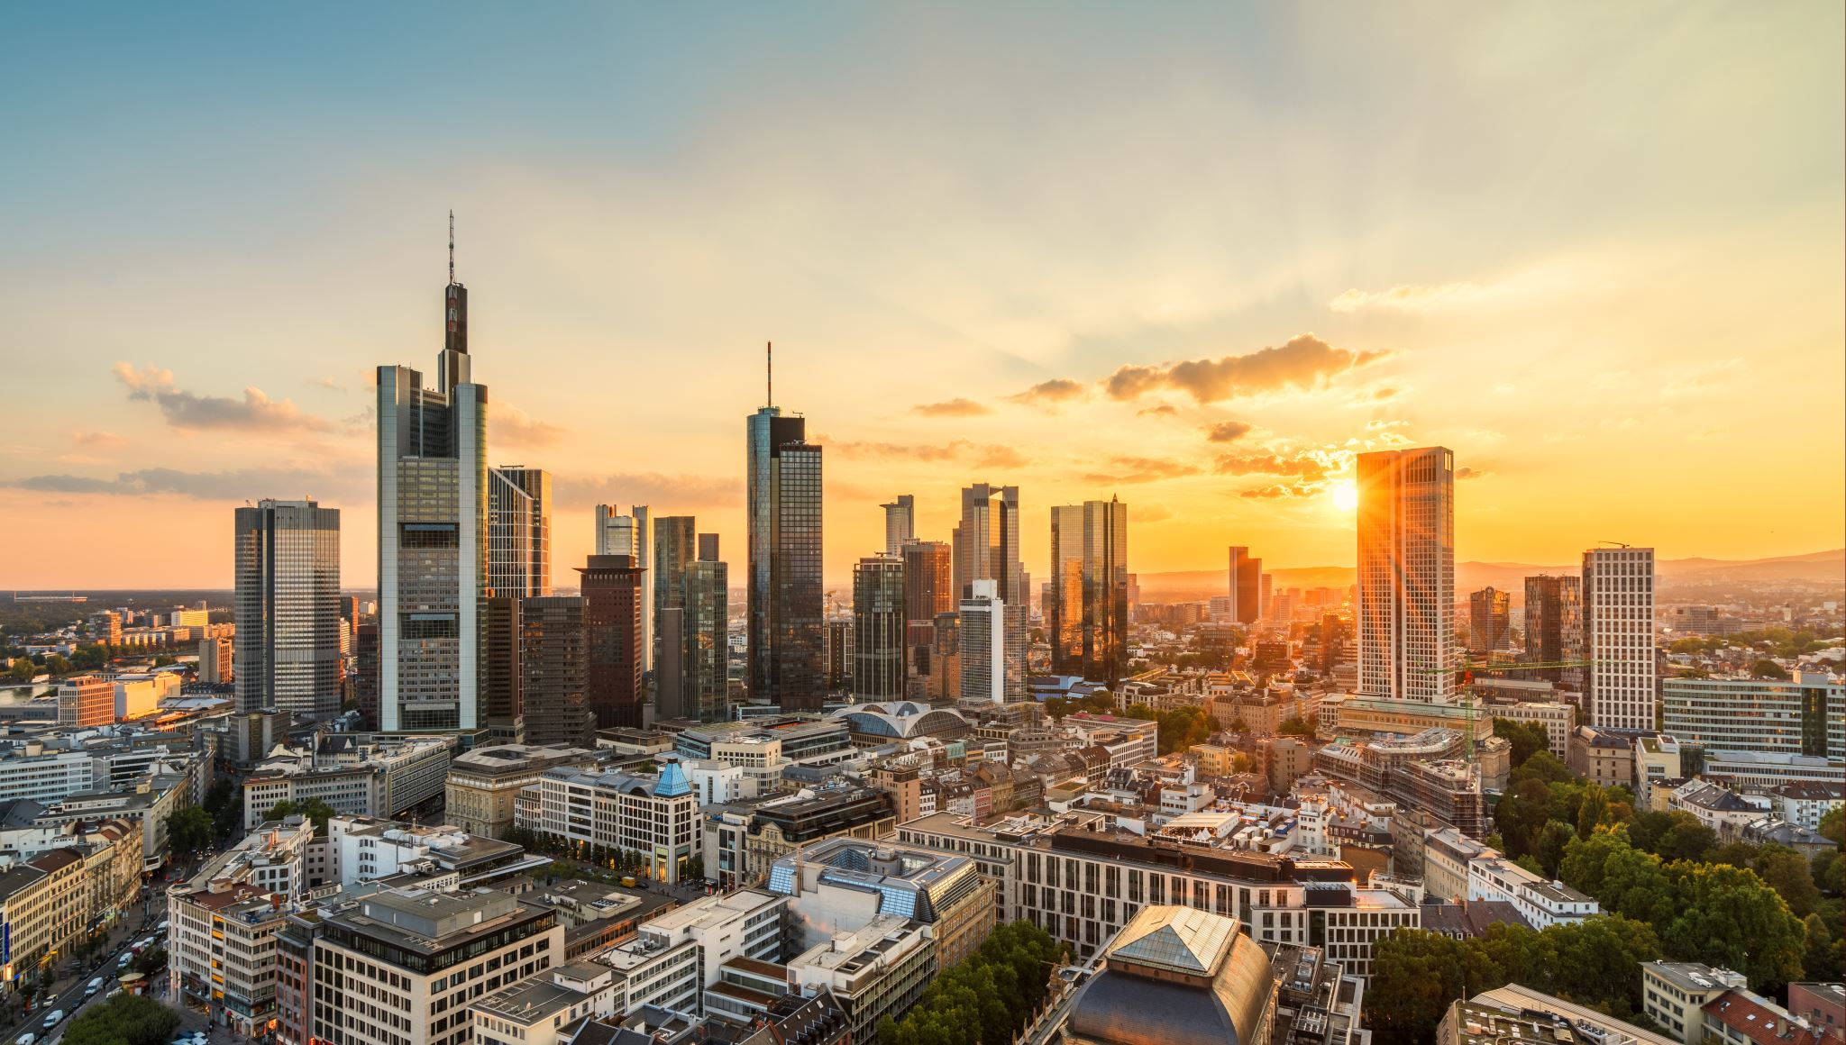
Democracy is impossible. Mathematical proof
Astrakhantsev Roman
Cyber security
HSE

Slide 2

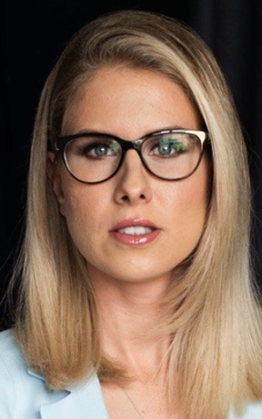
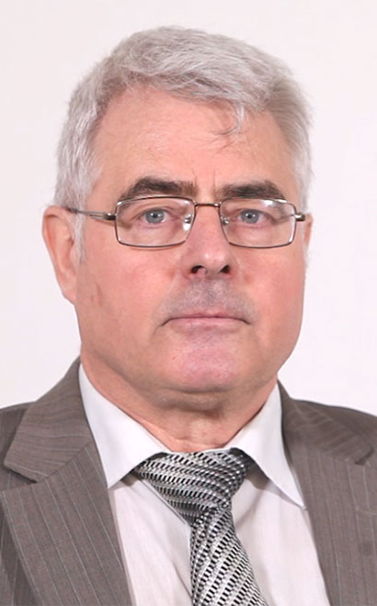
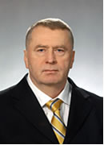
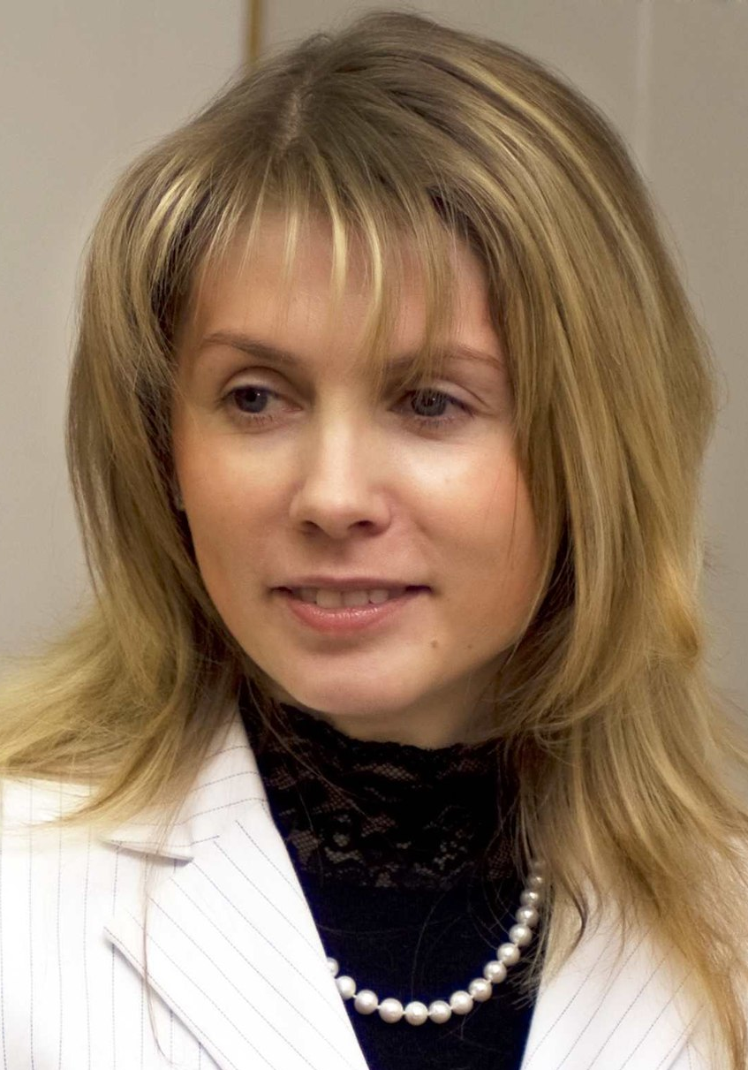




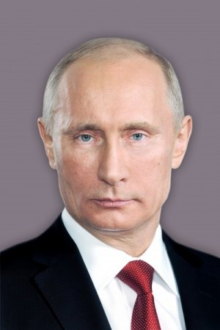
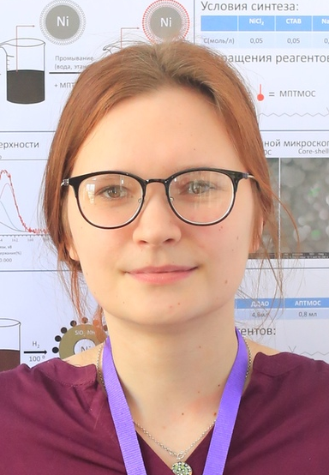
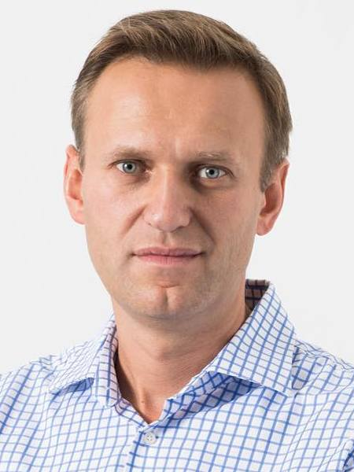
Formulation of the problem
We have
Options
Choosers

Slide 3
Formulation of the problem
We want
Collegial decision
Priority
TOP 1
TOP 2
TOP 3
TOP 4
Notes:
Независимо от других вариантов

Slide 4

Principles. Unitarity
Collegial decision
Priority
TOP 1
ANY
TOP 2
TOP 3
TOP 4
Notes:
Независимо от других вариантов

Slide 5
Principles. Monotonous
Collegial decision
>
>
>
>
>
>
>
>
>

Slide 6

Arrow’
s theorem
Collegial decision
Priority
TOP 1
TOP 2
TOP 3
TOP 4
Notes:
Независимо от других вариантов

Slide 7

Democracy IS possible
Collegial decision
Priority
TOP 1
TOP 2
Notes:
Независимо от других вариантов

Slide 8
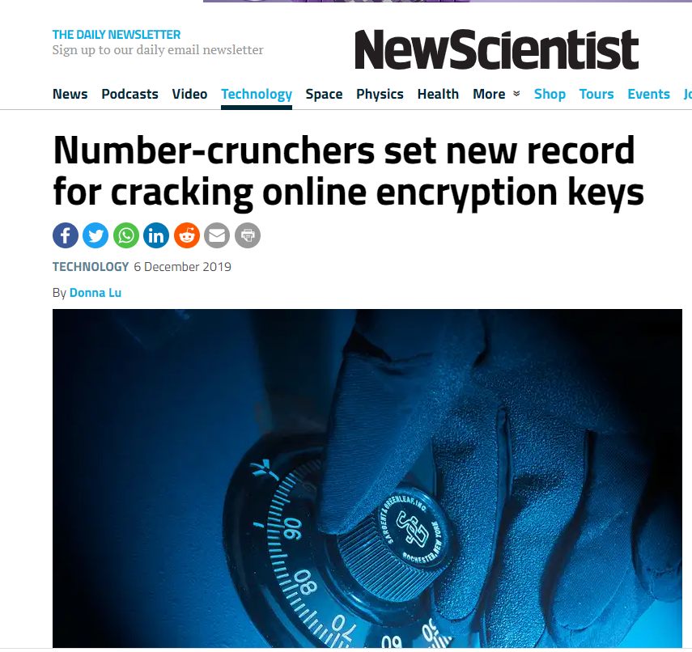
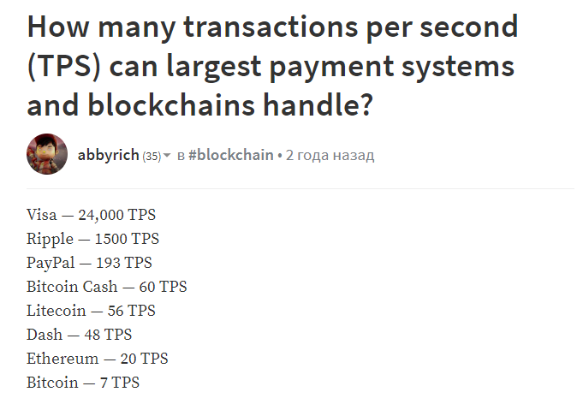
Always check
Fake
Notes:
Независимо от других вариантов

Slide 9
Beware of ignorance
Thank you!

