Slide 1
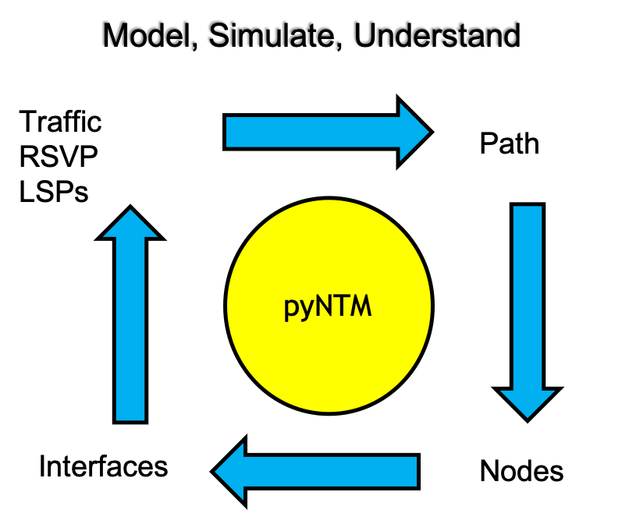
pyNTM Training Module 1 - intro to pyNTM and modeling basics
python3 Network Traffic Modeler (pyNTM)
Tim Fiola

Slide 2
NANOG Session: open sourcing the network model and unlocking the value of understanding the wide area network
python3 Network Traffic Modeler (pyNTM)
Tim Fiola – Network Modeling and Automation Enthusiast

Slide 3
Versioning
Training v1.0
pyNTM v1.5

Slide 4
Agenda
Problem statement
Network modeling provides value
Wide area network model components
What roles dan leverage a wide area network model?
Objects in a network model
Simulations
Network modeling use cases
We need open source tools in this space
What is pyNTM?
Why is pyNTM helpful?
pyNTM mechanics
pyNTM features
Wide area network modeling options
Who is pyNTM for?

Slide 5
Problem Statement – Understanding the wide area network during failure states and maintenances and how to grow the network
In a large, meshy network, it becomes difficult to understand how a given failure will truly impact interface utilization in other parts of the network
leads to educated guessing and general rules of thumb
WAN capacity cannot be solved simply throwing money at the problem
WAN circuits are expensive
WAN circuits are not always available
Capital in the WAN must be efficiently allocated

Slide 6
Network modeling provides strategic value
Modeling allows unique, data-based understanding of how network will behave during
Failover
Changes in the traffic matrix
Changes in topology, such as adding RSVP mesh or changing a link metric
This understanding prevents
overbuilding WAN links, which strands capital
Underbuilding WAN links, which increases risk

Slide 7
A network model provides value for people in the following roles (to name a few)
Capacity Planner
Plan network to optimize latency, cost, simplest topology, etc
Network Engineer
Test different topologies
Anyone working a maintenance
Simulate the effects of taking down a router (Node) for a maintenance
Anyone with interest in network performance

Slide 8
A network model has two inputs
Traffic Matrix
Each entry describes a demand
Each demand has
magnitude, which describes how much traffic is in that demand
A source and destination node
The traffic matrix for a network will vary throughout the day, month, season, etc
Getting good traffic matrices can be challenging
Understanding your network’s traffic matrices allows for truly effective engineering and planning
Topology
Layer 3 nodes
Circuits (comprised of 2 interfaces) between layer 3 nodes
Shared Risk Link Groups (SRLGs)
RSVP LSPs
Sample traffic matrix (Mbps)
Destination Source | A | B | C
A | - | 45 | 120
B | 60 | -
C | 75 | 150 | -
This example traffic matrix shows traffic sourced from Node A destined to Node C with a magnitude of 120Mbps
How will this traffic transit the network?

Slide 9
Objects you’ll find in a network model
Interface
Represents an interface on one end of a Circuit
Circuit
Two-way link between 2 Nodes
Comprised of an Interface on each side
Each component Interface sends traffic in a single direction (toward remote Node)
Node
Layer 3 device
Demand
Represents traffic load from a source Node to a destination Node
Has a magnitude that represents the amount of traffic
RSVP LSP
Shared Risk Link Group (SRLG)
A grouping of Interfaces and/or Nodes that share a similar risk
When the SRLG fails, all component objects fail

Slide 10
Network modeling provides simulation capability
Applying the traffic matrix to the topology and converging the model produces a simulation
The modeling engine governs behaviors of demands, LSPs, etc in the model
pyNTM has a modeling engine
For a given day, you can produce a simulation for different parts of the day by creating a traffic matrix that reflects source and destination traffic entries for each part of the day
What happens during a given failure if it were to occur at different parts of the day?
What is the best time to conduct a maintenance on a given router?
Where is the best place to augment the network to best handle our holiday traffic matrices?

Slide 11
Wide area network modeling vs legacy techniques
Non-modeling techniques
Modeling
Rules of thumb, such as augmenting a circuit when it reaches 50% utilization, don’t guarantee that a given circuit will be able to handle the events you are interested in
Planning an auto-bandwidth RSVP network adds additional complexity
The demands a link handles can change throughout the day/week/season
Simulations allow for
Understanding how your network traffic will behave during a failure event
Understanding how your network will behave with additional traffic
Better understanding of how RSVP LSP meshes will behave
Understanding your network allows you to
Efficiently allocate capacity/capital where it’s really needed
Plan for and understand events you care about
At a minimum, allows you to make a more educated estimation

Slide 12
Some example use cases for network model
Understanding current network topology
How many ECMP paths does a given demand take across the network?
Understanding failover by modeling failures
Link(s)
Node(s)
Shared risk link group(s) (SRLG)
Understanding where it makes sense to augment a network
Deploy capital where it’s most needed
Don’t strand capital

Slide 13
More example use cases for network model
Understanding how changes in the network affect traffic flow
More/less traffic
RSVP Implementations
Adding RSVP overlay to IGP network
Adding capacity to existing link(s)
New link(s)
Metric changes
Adding/removing parallel LSPs
Failover

Slide 14
The need
Open-source tools that allow programmatic network modeling and simulation
Specifically, there are two needed components
Open source modeling engines
Open source tools to create reasonable traffic matrices
Nice to have: open source GUI for visualizaton

Slide 15
So, what is pyNTM?
pyNTM is the python3 Network Traffic Modeler
pyNTM is an open source WAN modeling engine
Applies a traffic matrix to a network topology to route traffic as the network would
Uses networkx module to get the topology path info
networkx is a GREAT tool to get path info in a topology
There’s more to modeling than just path info

Slide 16
Why is pyNTM helpful?
PyNTM leverages path information from networkx in a network state-specific context, allowing for modeling of network-specific state:
Modeling utilization on interfaces
Modeling traffic demands consuming interface bandwidth
Modeling RSVP LSPs consuming reservable interface bandwidth
Associating a traffic demand with the specific interfaces along the path(s)
Determining the available path(s) that have a given amount of reservable bandwidth
pyNTM APIs allow for programmatic network modeling capability

Slide 17
Why is pyNTM helpful? (continued)
pyNTM allows users to easily modify the network topology and determine alternate network state based on that change
Failing layer3 Nodes, Circuits, SRLGs, etc
Adding new Nodes, Interfaces, traffic Demands, etc to the topology
Adding new/additional auto-bandwidth LSPs to the network
pyNTM is specifically designed to easily relate the following items:
Traffic Demands
RSVP LSPs
Path info
Interfaces
Nodes

Slide 18
pyNTM Mechanics
pyNTM Model object describes the network topology
The Model object contains the following objects:
Interfaces/Circuits
Nodes
Demands (traffic)
RSVP LSPs
Shared Risk Link Groups
The Model object applies the traffic matrix to the topology, allowing the traffic to flow as it would in a real network
This produces a simulation
Valuable data can be mined from simulation results

Slide 19
pyNTM features (as of 1.5)
IGP (OSPF/ISIS)
RSVP LSPs
Supports full mesh
IGP shortcuts is on the roadmap
Auto-bandwidth
Fixed/manually-assigned setup bandwidth
Shared Risk Link Groups (SRLGs)
Feature requests are accepted on GitHub!

Slide 20
Options for modeling/simulation
Feature | Commercial Options | pyNTM
Cost | $tens-hundreds of thousands | $0
APIs for programmatic modeling | Y | Y
Includes capability to create traffic matrix | Y | N
Sophisticated GUI for visualization | Y | N
Open Source | N | Y
Dependent on vendor | Y | N
Commercial option examples
Cariden MATE/Cisco Wan Automation Engine
WANDL/Juniper Northstar

Slide 21

So who is pyNTM for?
If your org/company can generate a reasonable traffic matrix
Access to data scientists
PMACCT and NetFlow
Forecasted traffic demands
If your org has basic python coding skills
If your org does not want to rely on and/or manage external modeling vendors
pyNTM provides the open source modeling and simulation engine and can help you today

Slide 22

Recorded Demo

Slide 23
FIN

Slide 24
Backup slides

Slide 25
The value proposition for network modeling
In a large, meshy network it becomes very difficult to understand what traffic flow will look like for a given failure event
This difficulty causes operators to augment and/or turn up additional, expensive WAN circuits in response, using general rules of thumb which don’t guarantee that a given circuit will be able to handle failure events that you are interested in
augmenting a circuit when it reaches 50% utilization
This difficulty causes network planners to spend hours/days/months understanding how their network should be planned to deal with any given event (new traffic, failures, etc.)
WAN capacity cannot be solved by throwing money at the problem
WAN circuits are expensive
WAN circuits are not always available
Simulations allow for
Understanding how your network traffic will behave during a failure event
Understanding how your network will behave with additional traffic

Slide 26
The value proposition for network modeling (continued)
Understanding your network allows you to
Smartly augment your network
Don’t augment where it’s not needed (stranding capital) for the failure scenarios you care about
Ensure you augment where it will be needed for the failure scenarios you care about
Understand how new traffic will affect the existing network in steady state and failover

Slide 27
Modeling options
Commercial options
pyNTM
Examples (cost$$)
Cariden MATE/Cisco Wan Automation Engine
WANDL/Juniper Northstar
Commercial options typically provide
GUI for humans
Capability to automatically create a traffic matrix for your network via gathering network gear stats
API set for programmatic modeling
Cost - $0
API set for programmatic modeling
With basic python skills, you can run network simulations
Does not create a traffic matrix

