Slide 1
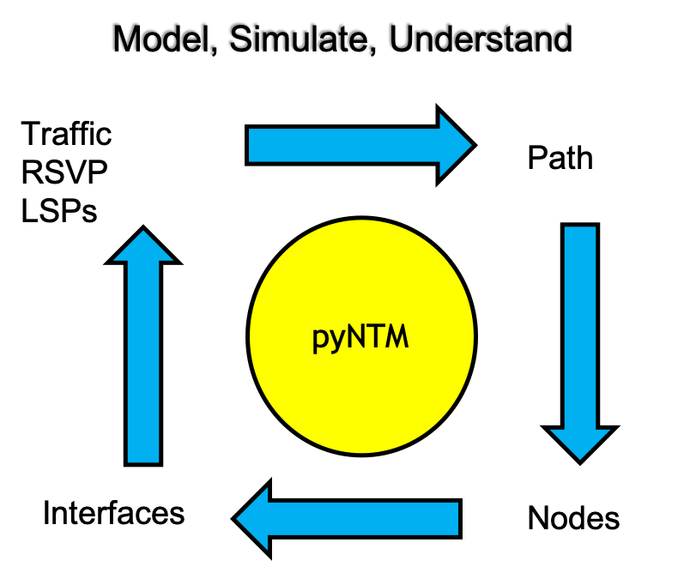
pyNTM Training Module 3 – modifying the Model and what if simulations
Network Traffic Modeler in Python3

Slide 2
Course Topics
Adding a new Node
Adding a new link
Adding traffic to the traffic matrix
Changing Interface/Circuit capacity
Changing an Interface metric
Working with RSVP LSPs

Slide 3
Exercise setup

Slide 4
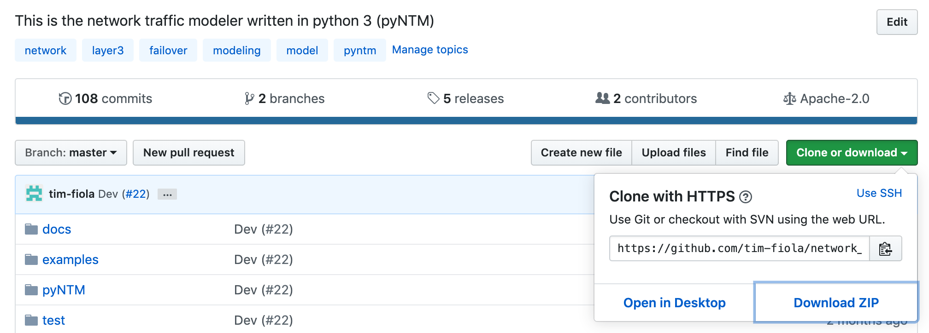
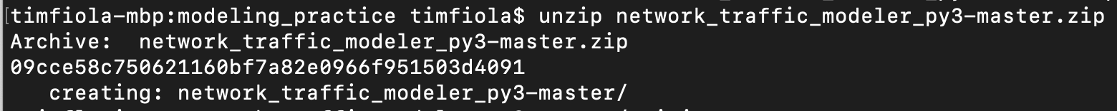
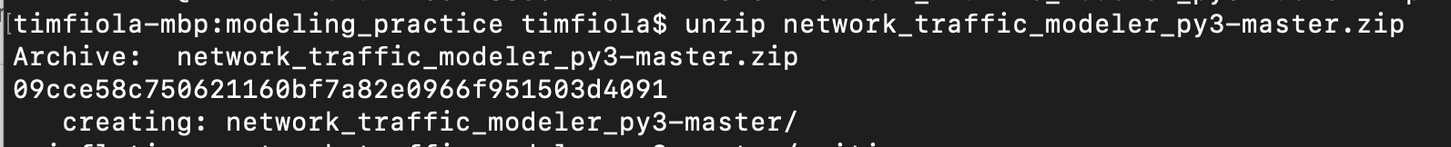
Copy the repository zip file to a practice directory and unzip it
Copying the repository will allow you to use some of the additional tools to improve your user experience
Visualization
Simple user interface

Slide 5
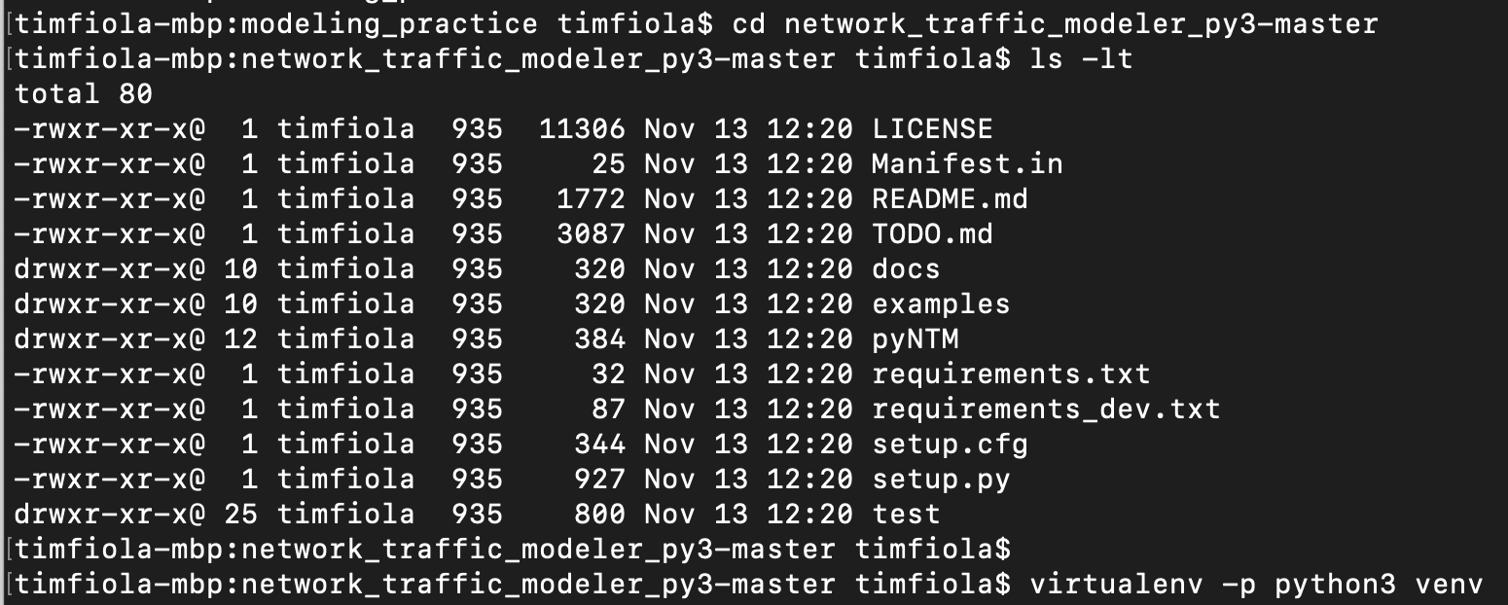
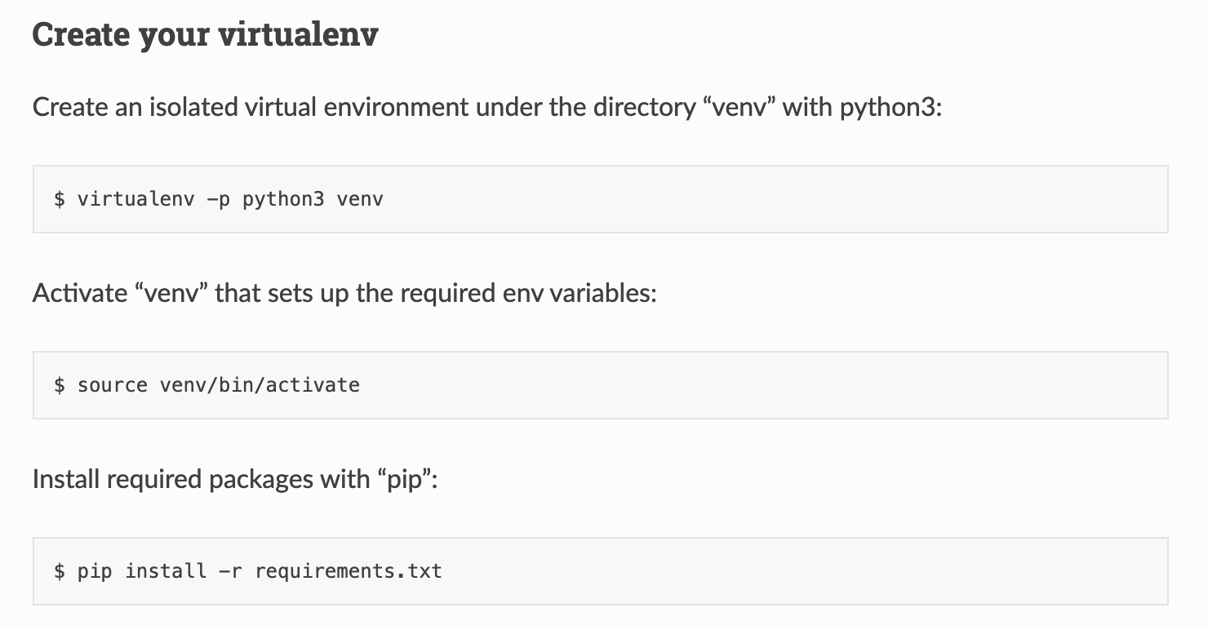
Set up your virtual environment (optional)
A virtual environment provides an isolated environment and ensures no interference from existing installations and/or dependencies
Go into the archive directory
Look for requirements.txt
Follow directions below to create the virtual environment
Example is to the right →

Slide 6

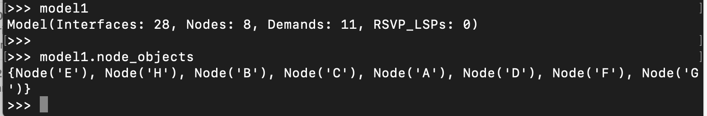
Let’s get started!
Switch to the examples directory in the repository
Start python3
Append parent directory to your sys path
Allows imports from folders in the parent
Import the Model object
Load Model from data file
sample_network_model_file.csv has Interfaces, Nodes, and Demands
IGP only
no RSVP LSPs in the file
Observe node objects

Slide 7
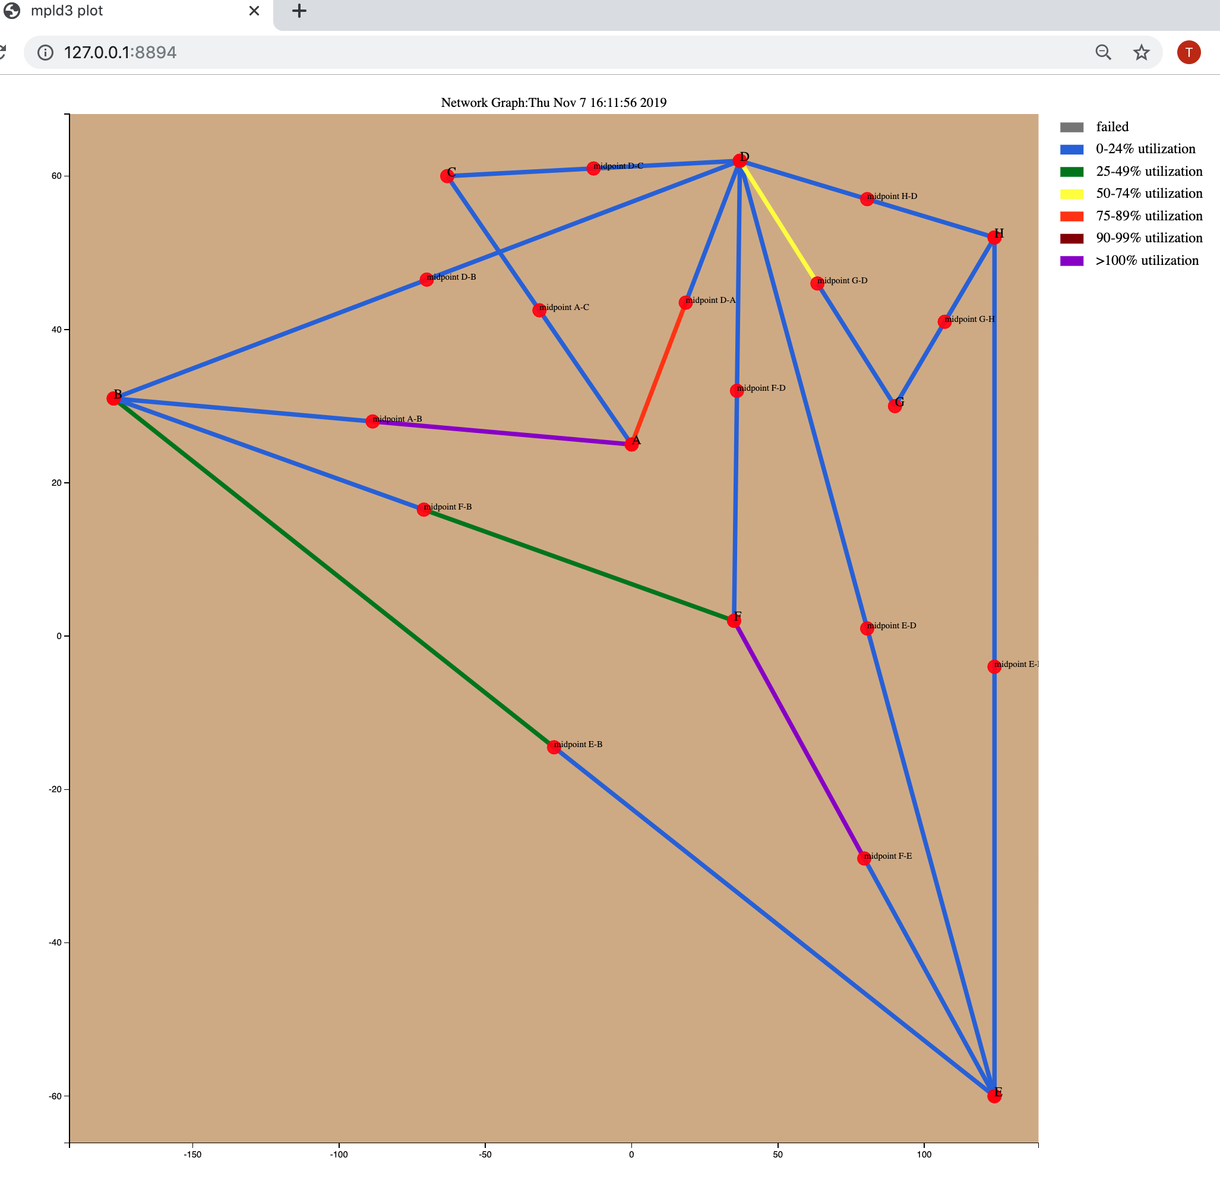

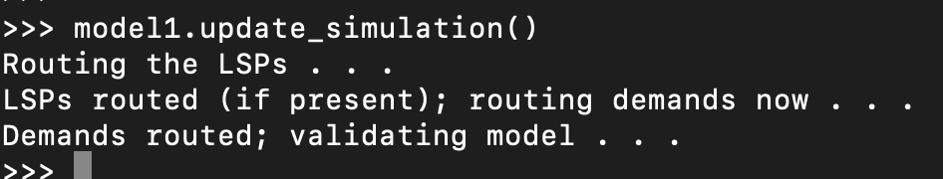
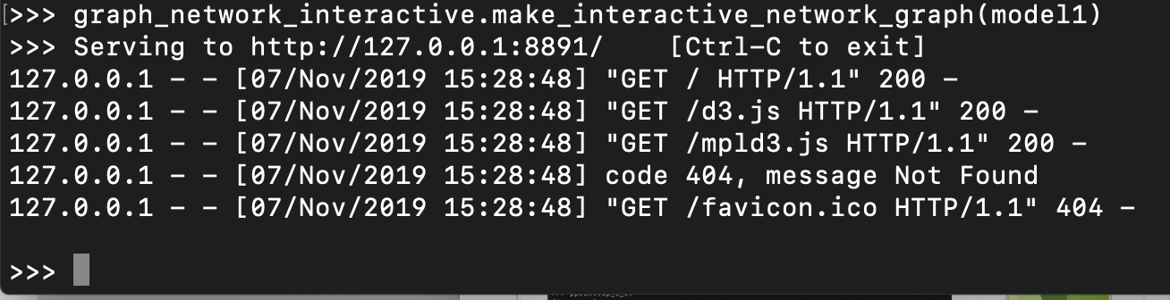
Visualization (beta) - optional
Requires full repository download from github or extract the module
Easy access via the virtual environment setup from earlier in this guide
Reference the Exercise setup earlier in this presentation for full instructions to set up the environment to use the repository
Make sure the model is converged!
model1.update_simulation() ← model1 is the Model object
graph_network_interactive.make_interactive_network_graph call
Takes Model object as argument
uses mpld3 python package under the covers
Produces interactive graph in browser with tool tips, an interactive legend, and draggable Nodes and Interface endpoints for easier viewing
Uses a Node’s lat/lon (y,x) attributes to position Node on layout
The Interface from B to A is 0-24% utilized
Interactive legend
Tooltips appear when hovering over interfaces and nodes
All nodes and circuit midpoints are movable
The Interface from A to B is over 100%

Slide 8
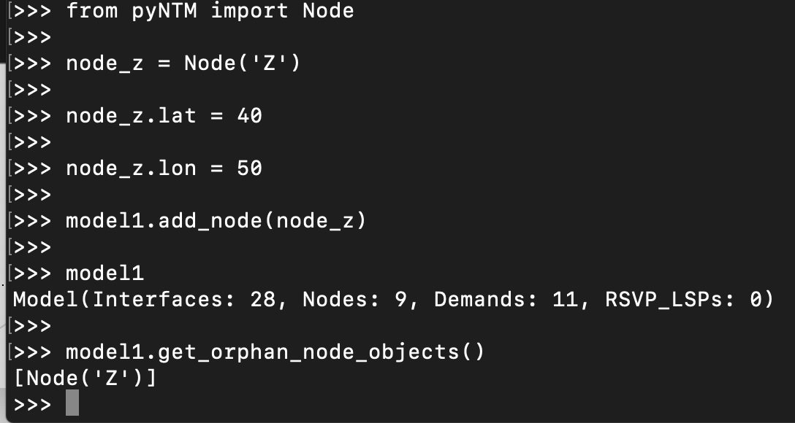
Add a new Node
Import the Node object
Define Node(‘Z’)
Assign latitude/longitude (y, x) coordinates
Add Node(‘Z’) to the Model
Examine the Model
Now there are 9 Nodes
An orphan Node has no interfaces

Slide 9
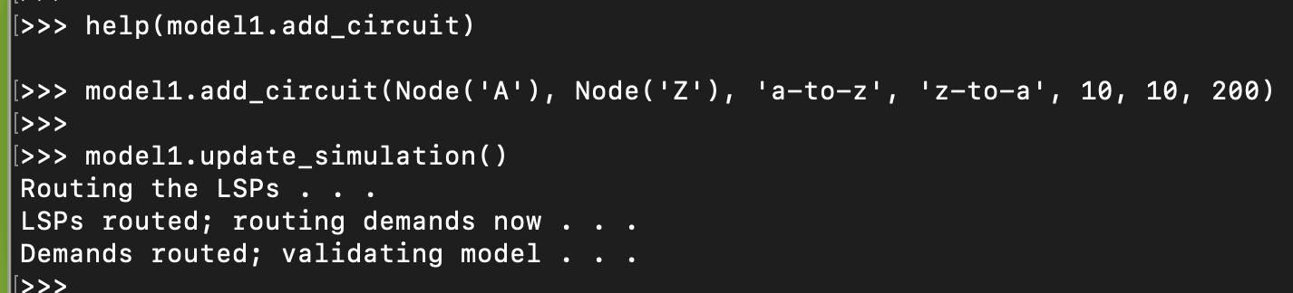
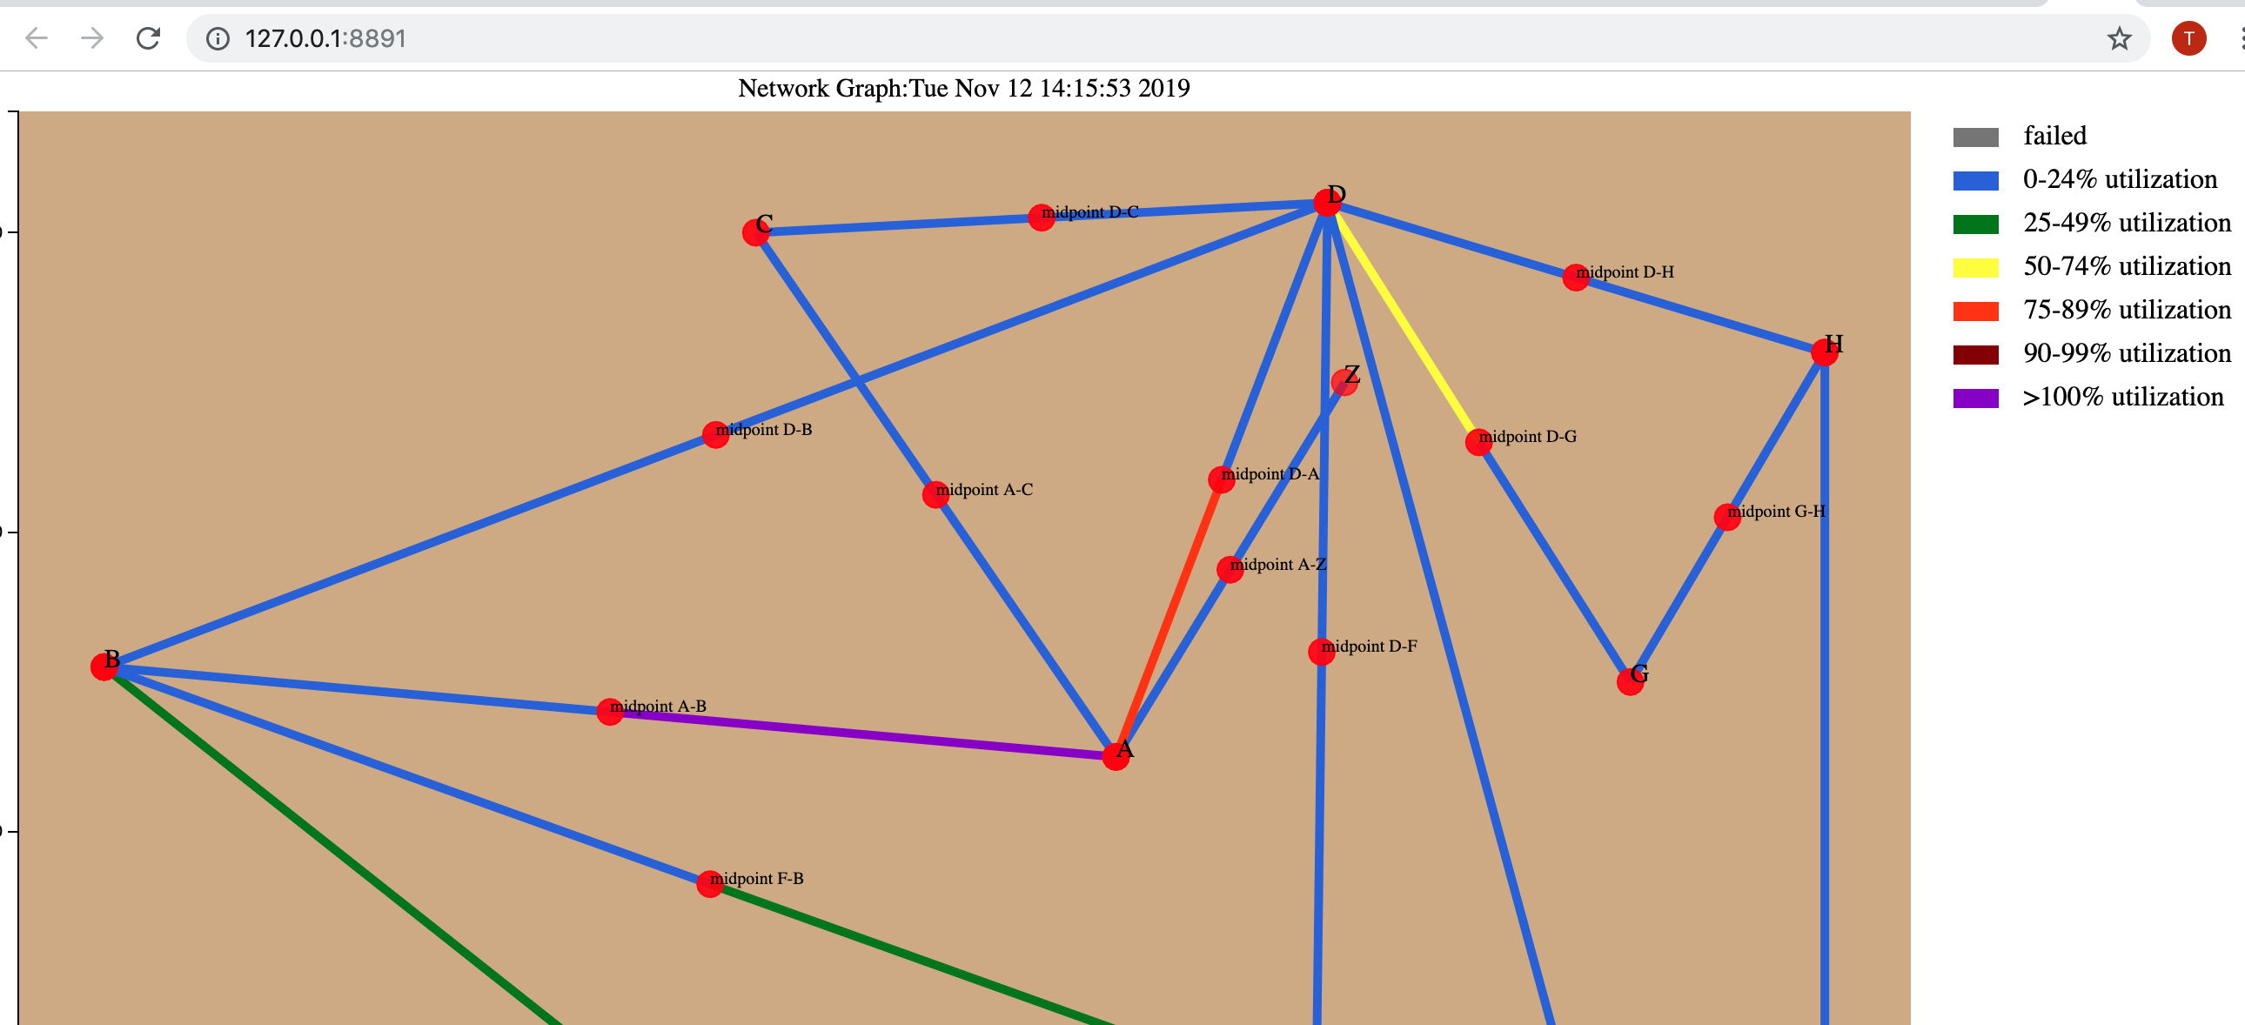
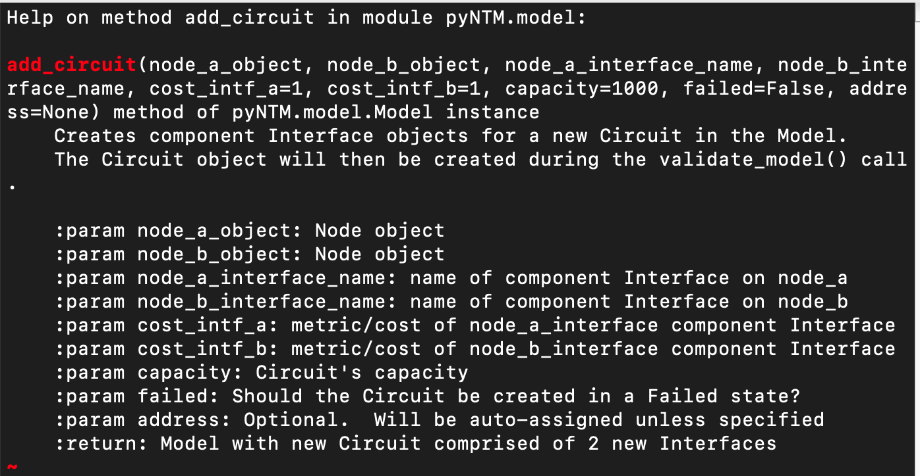
Add a new Circuit between Node(‘A’) and Node(‘Z’)
Use the Model add_circuit call
New circuit will have a metric of 10 on both sides and a capacity of 200
Update the simulation
Visualize topology with new Node(‘Z’) (optional)

Slide 10
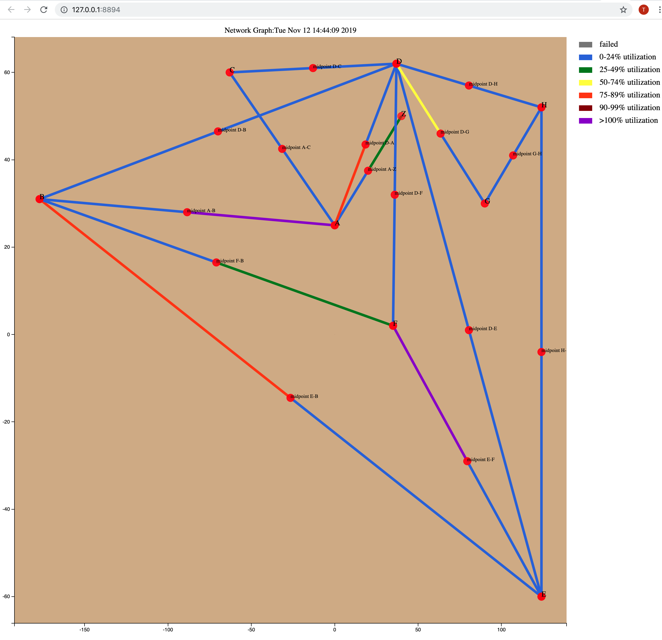
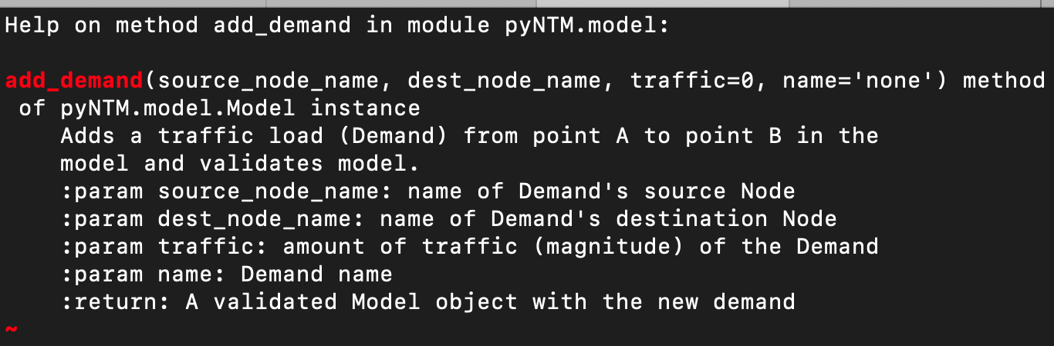
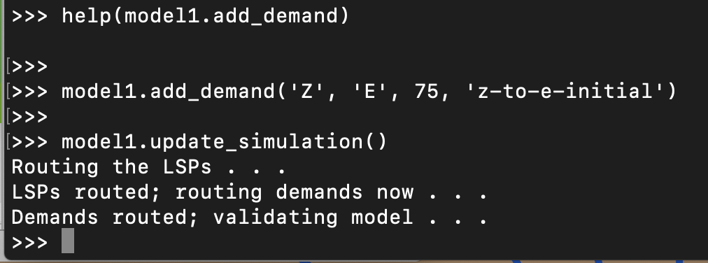
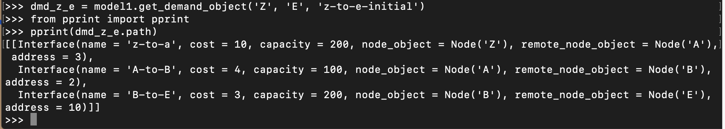
Adding a Demand to the traffic matrix
Use the Model add_demand method
Find new demand’s path

Slide 11
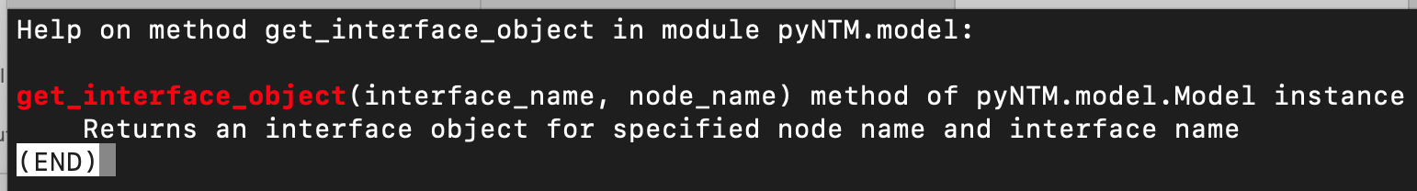
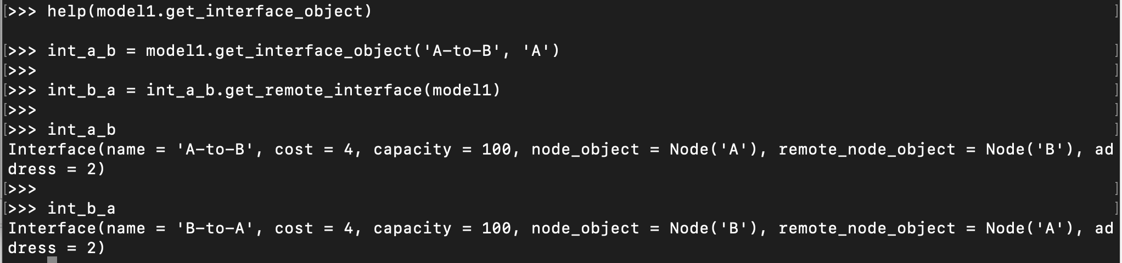
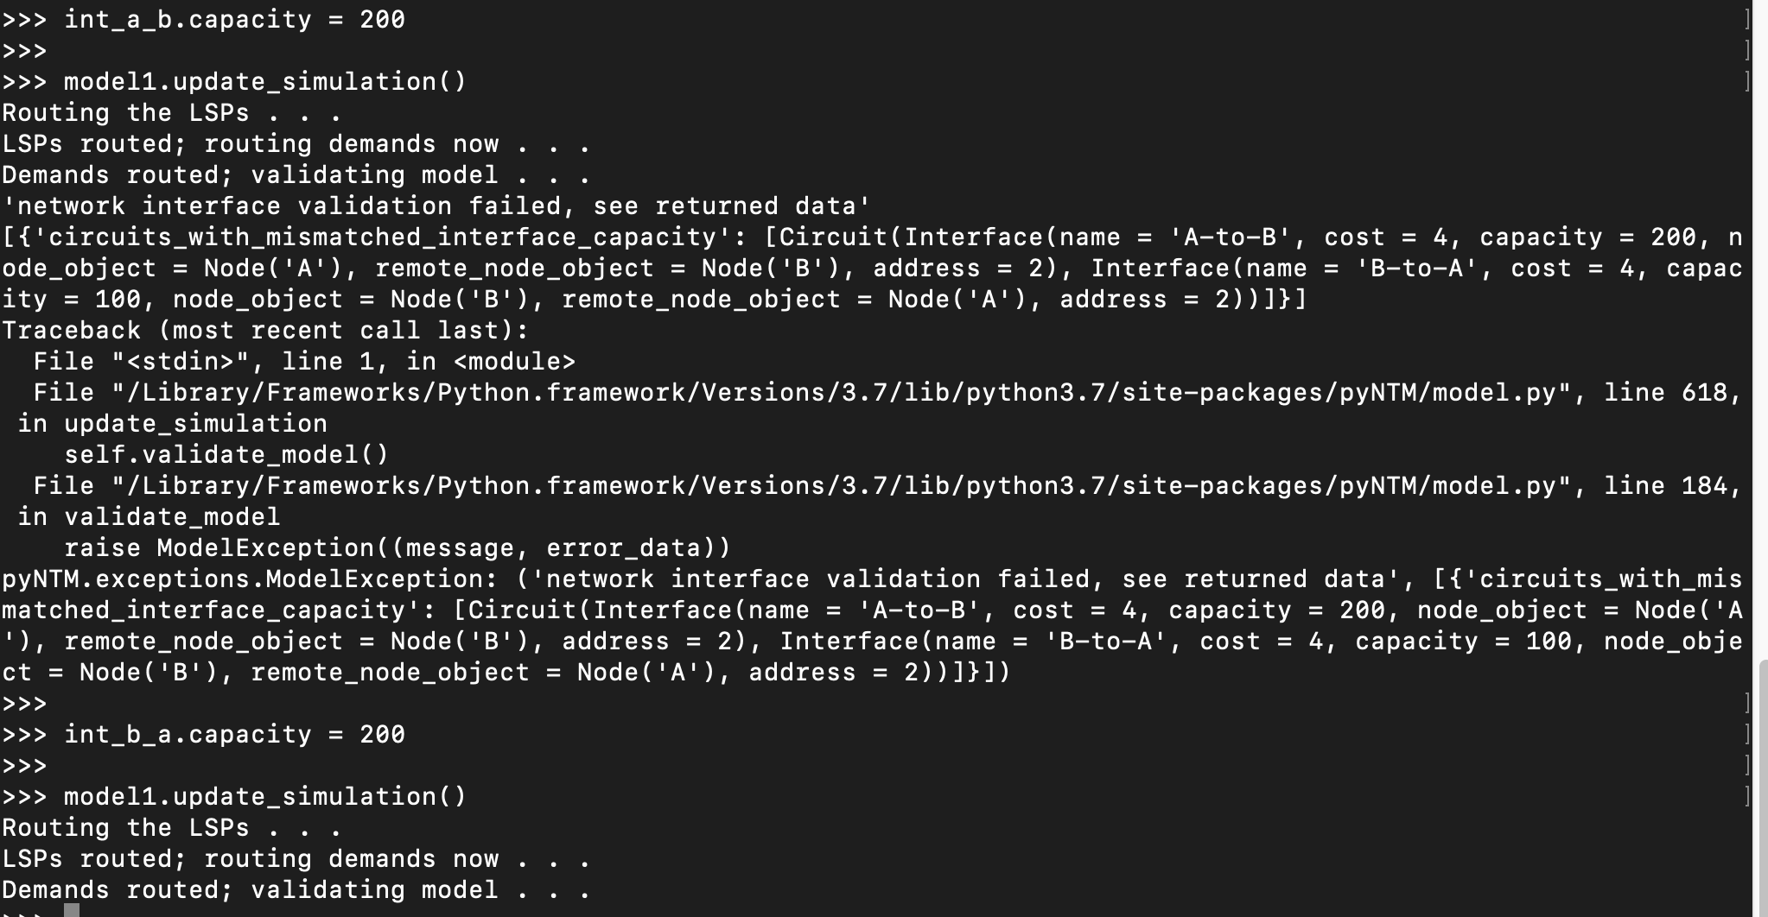
Changing Circuit Capacity
Change the capacity of the Circuit between Node(‘A’) and Node(‘B’) from 100 to 200
Change capacity attribute of each Interface in the Circuit
circuits_with_mismatched_interface_capacity
Capacities must match or Model will throw a ModelException
Be sure to update the simulation after the change!
model1.update_simulation()

Slide 12
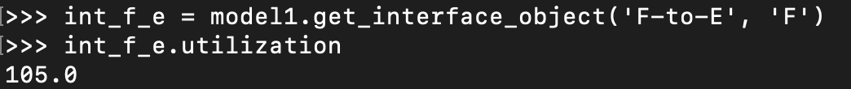
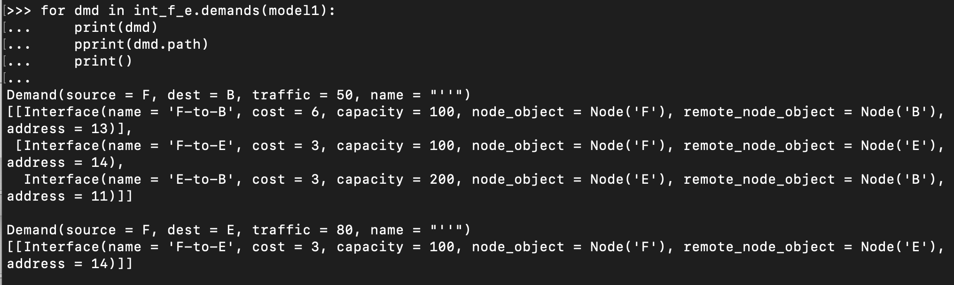
Changing Interface cost (metric): Use Case
From our prior visualization, we see the Interface on Node(‘F’) facing Node(‘E’) is over 100% utilized
There are two demands on that Interface; below we see the path(s) for each demand
Notice that the demand from Node(‘F’) to Node(‘B’) splits over 2 ECMP paths

Slide 13

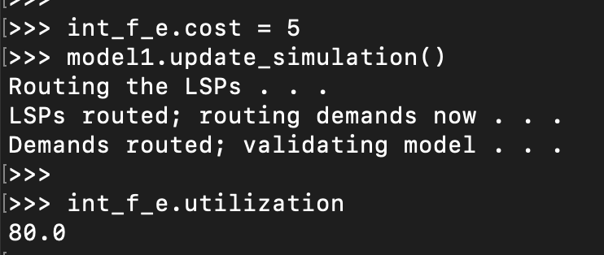
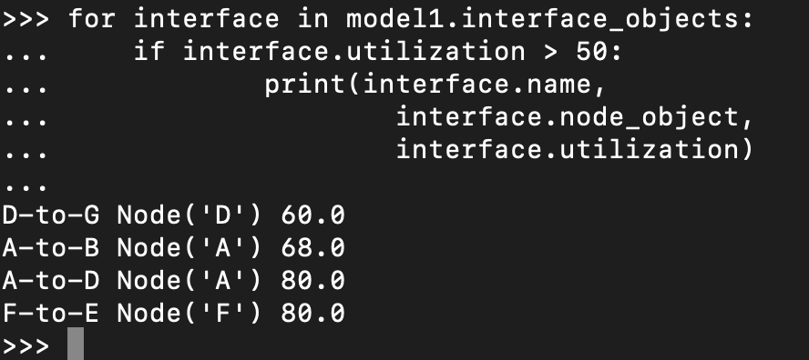
Changing Interface cost (metric)
Let’s see how changing the metric on the Interface on Node(‘F’) facing Node(‘E’)
Simply modify the cost attribute on the Interface and update the simulation
Examine the utilization

Slide 14
FIN

