Slide 1
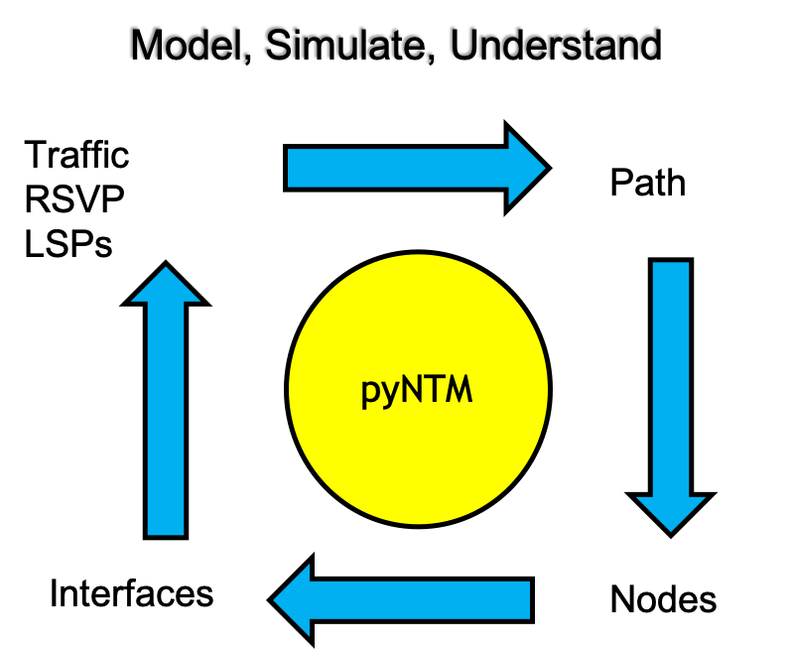
pyNTM Training Module 4 – RSVP LSPs and Shared Risk Link Groups (SRLGs)
Network Traffic Modeler in Python3

Slide 2
Course Topics
RSVP LSP model data files
RSVP types and behaviors
Auto bandwidth
Fixed bandwidth
LSPs and Demands
Getting an LSP path
Seeing demands on an LSP
Demand path when demand is on LSP
Shared Risk Link Groups (SRLGs)
Adding an SRLG
Failing an SRLG

Slide 3
Exercise setup

Slide 4
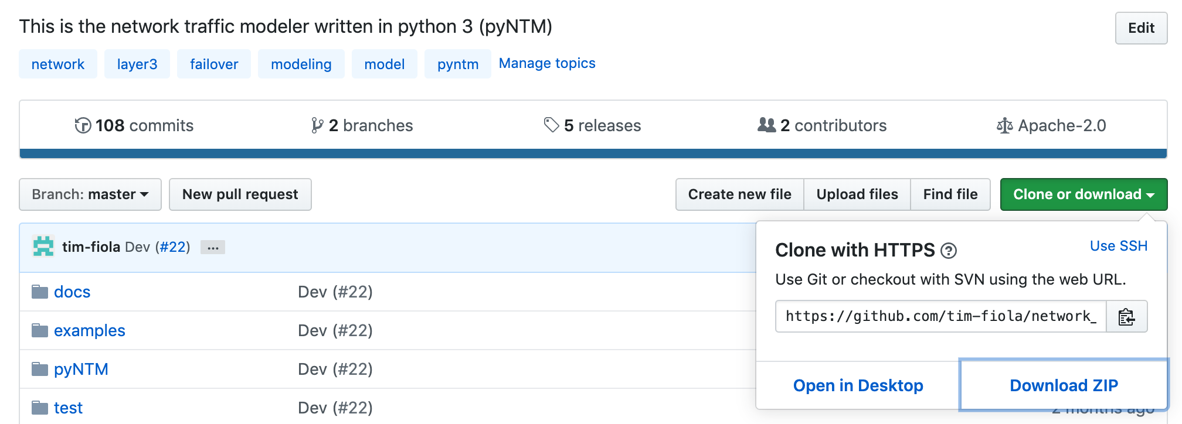
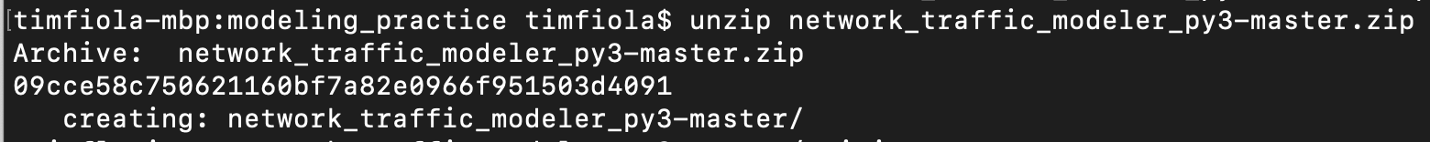
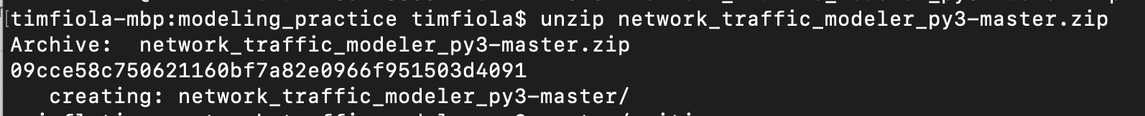
Copy the repository zip file to a practice directory and unzip it
Copying the repository will allow you to use some of the additional tools to improve your user experience
Visualization
Simple user interface

Slide 5
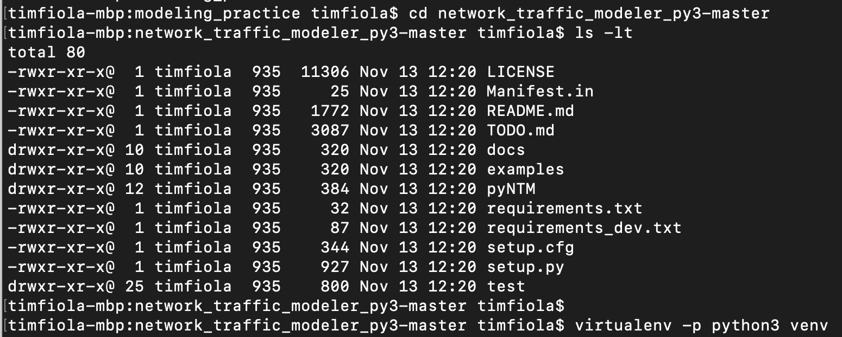
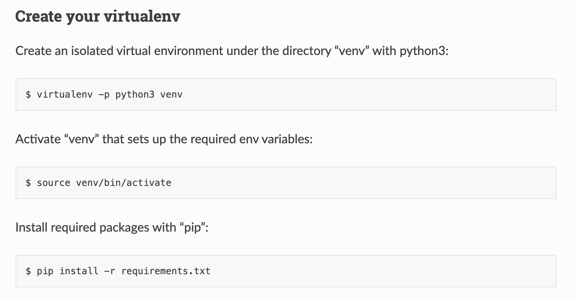
Set up your virtual environment (optional)
A virtual environment provides an isolated environment and ensures no interference from existing installations and/or dependencies
Go into the archive directory
Look for requirements.txt
Follow directions below to create the virtual environment
Example is to the right →

Slide 6
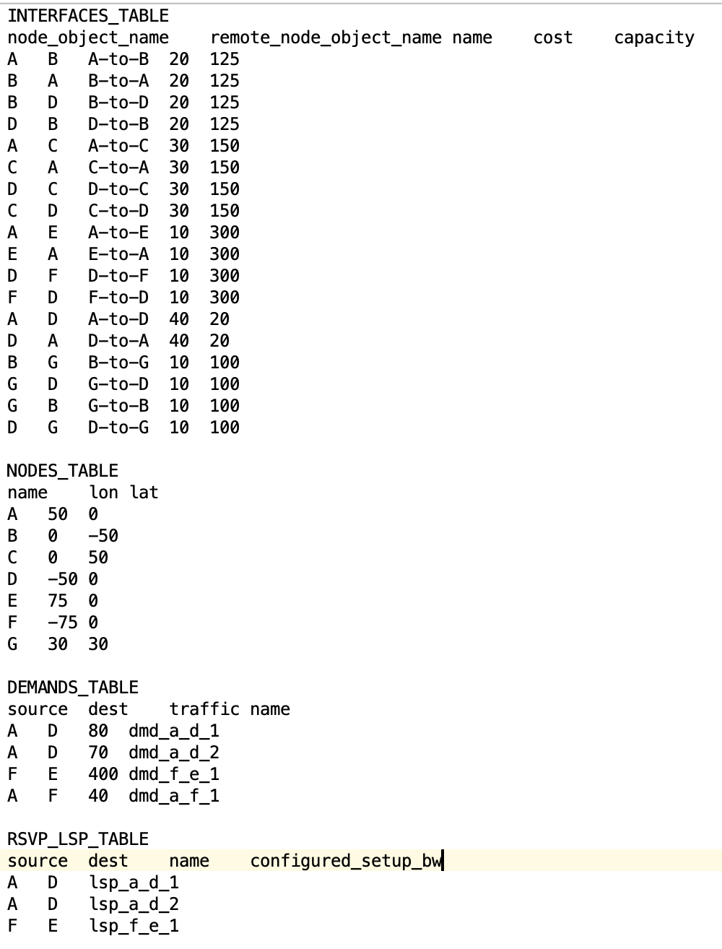
About the model file
Tab separated
RSVP_LSP_TABLE has 4 columns
source – LSP source node
dest – LSP destination node
name – name of LSP
configured_setup_bw
If fixed bandwidth reservation LSP, populate a value for the configured_setup_bw
If auto-bandwidth LSP, leave blank

Slide 7

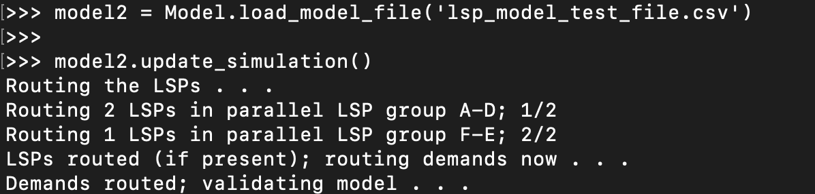
Let’s get started! (RSVP)
Switch to the examples directory in the repository
Start python3
Append parent directory to your sys path
Allows imports from folders in the parent
Import the Model object
Load Model from data file
lsp_model_test_file.csv has Interfaces, Nodes, Demands, and RSVP LSPs
Observe model file

Slide 8
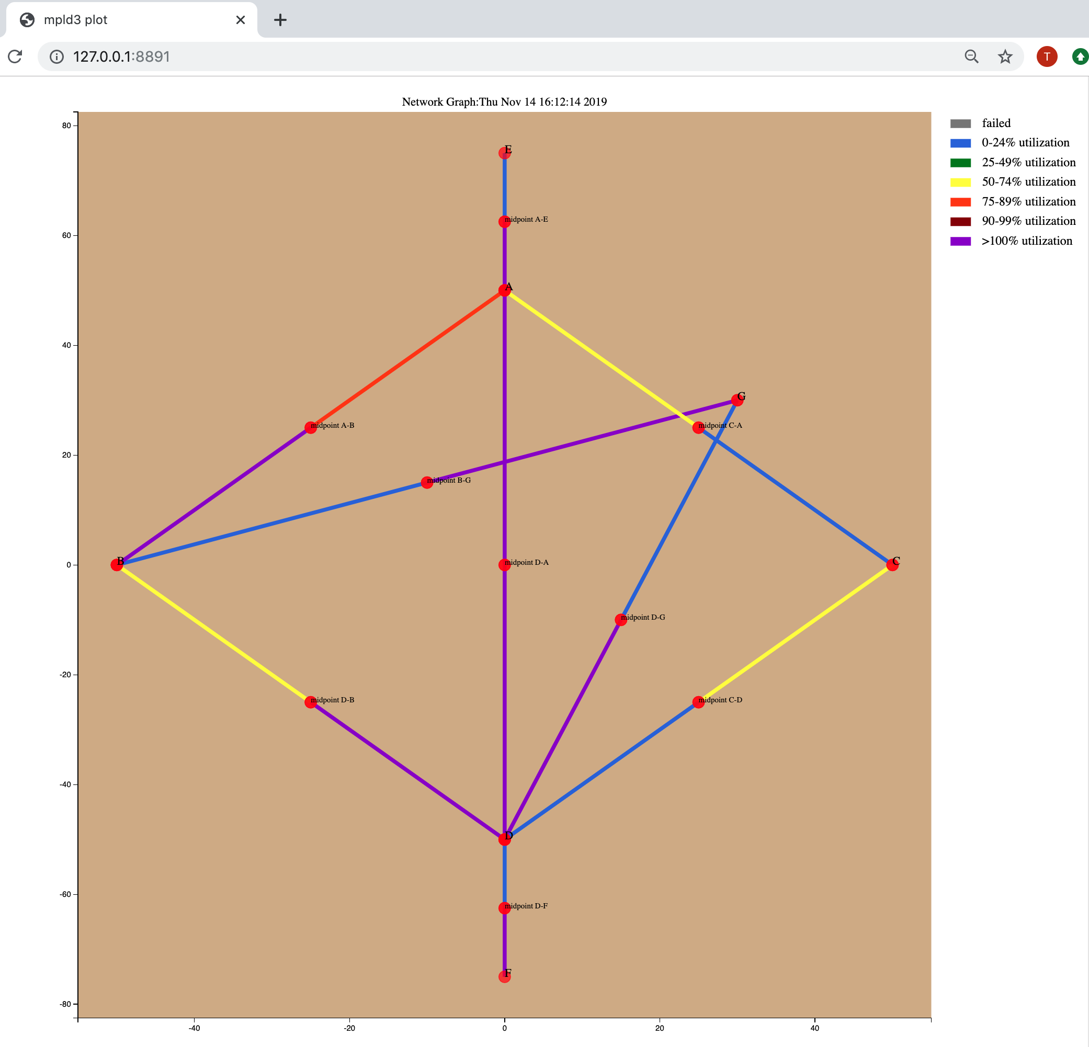

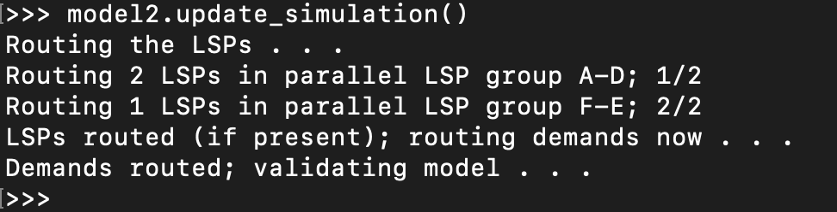
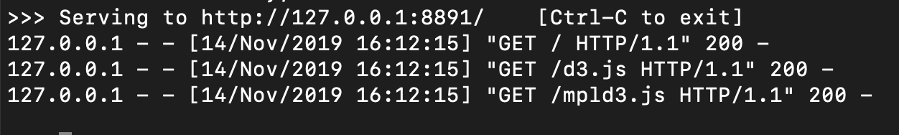
Visualization (beta) - optional
Requires full repository download from github or extract the module
Easy access via the virtual environment setup from earlier in this guide
Reference the Exercise setup earlier in this presentation for full instructions to set up the environment to use the repository
Make sure the model is converged!
model2.update_simulation() ← model2 is the Model object
graph_network_interactive.make_interactive_network_graph call
Takes Model object as argument
uses mpld3 python package under the covers
Produces interactive graph in browser with tool tips, an interactive legend, and draggable Nodes and Interface endpoints for easier viewing
Uses a Node’s lat/lon (y,x) attributes to position Node on layout
Tooltips appear when hovering over interfaces and nodes
The Interface from A to B is over 75-89% utilized
Interactive legend
All nodes and circuit midpoints are movable
The Interface from B to A is over 100% utilized

Slide 9
RSVP LSP types and behaviors
pyNTM supports two RSVP LSP types
Auto-bandwidth
Attempts to adjust signaled bandwidth and path to accommodate the amount of traffic on the LSP
Fixed bandwidth
Signaled bandwidth is fixed at a configured level, regardless of how much traffic is on the LSP
**pyNTM will route a Demand over RSVP LSPs only if the Demand and LSPs share the same source Node and destination Node

Slide 10
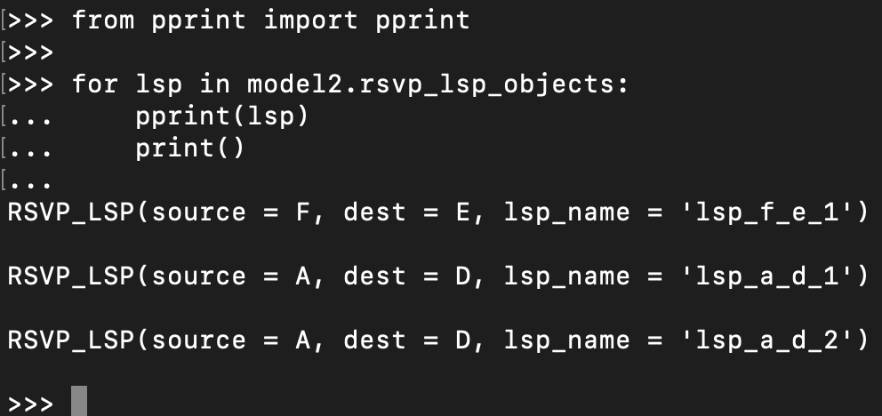
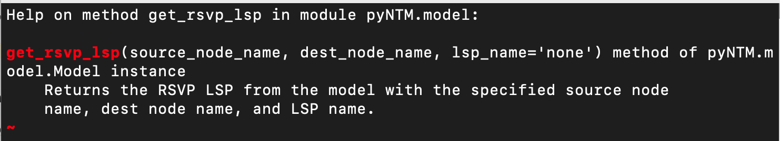
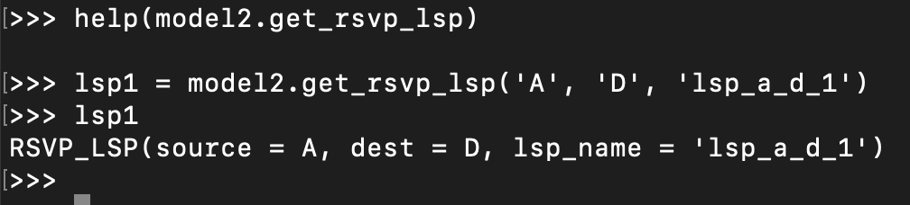
Working with an LSP
Show the LSP objects in the Model
Select an LSP for analysis

Slide 11
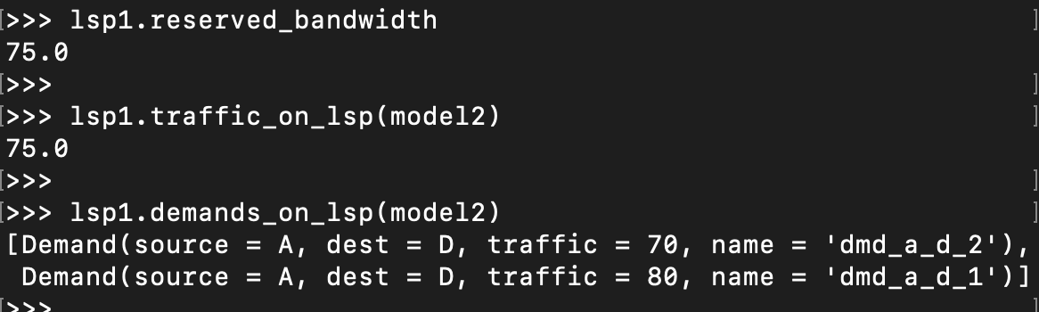
RSVP LSPs and traffic
Retrieve the LSPs reserved bandwidth
Retrieve the amount of traffic on the LSP
Retrieve the specific traffic demands on the LSP
What we learned:
This LSP has 75 units of traffic
This LSP has reserved 75 units of bandwidth
This LSP carries 2 demands

Slide 12
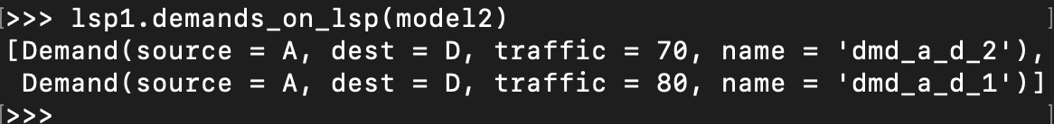
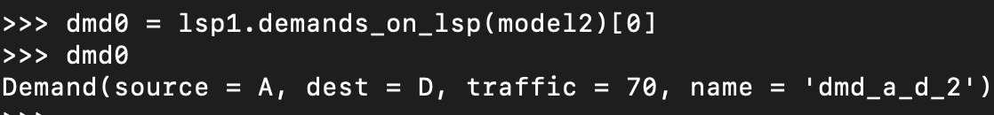
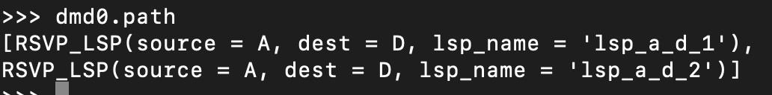
Further RSVP LSP traffic analysis
When a Demand is carried by an RSVP LSP, that LSP will make up the Demand’s path
In the example shown, we look at the first demand on the list of demands carried by lsp1
That demand is split across two LSPs
When a Demand is IGP routed, its path will contain Interface objects
Notice that the RSVP LSPs and Demand all share the same source and destination Nodes

Slide 13
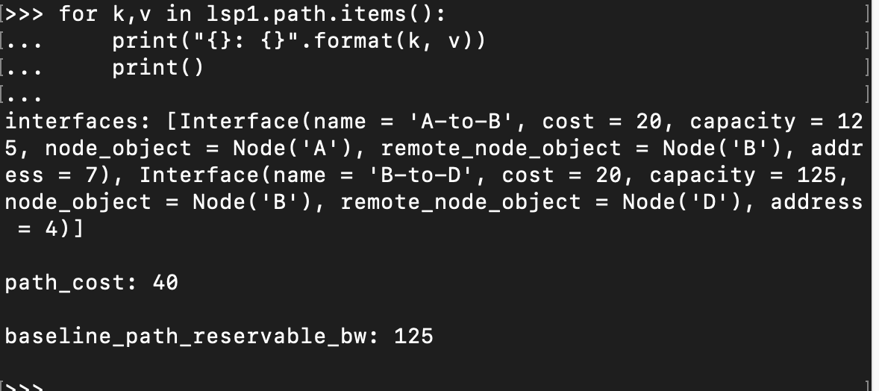
RSVP LSP Path Analysis
There is a wealth of information in the RSVP_LSP path object
Interfaces: a list of Interfaces the LSP takes, ordered from source to destination
Path cost: the cost of the LSP
Per the RSVP protocol, this will be the IGP shortest path metric, regardless of the actual path the LSP takes
Baseline path reservable bandwidth
How much reservable bandwidth was available on the LSP’s path when it was signaled

Slide 14
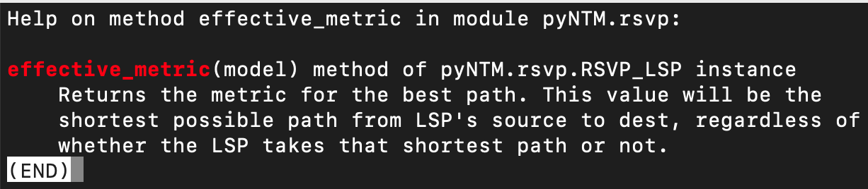
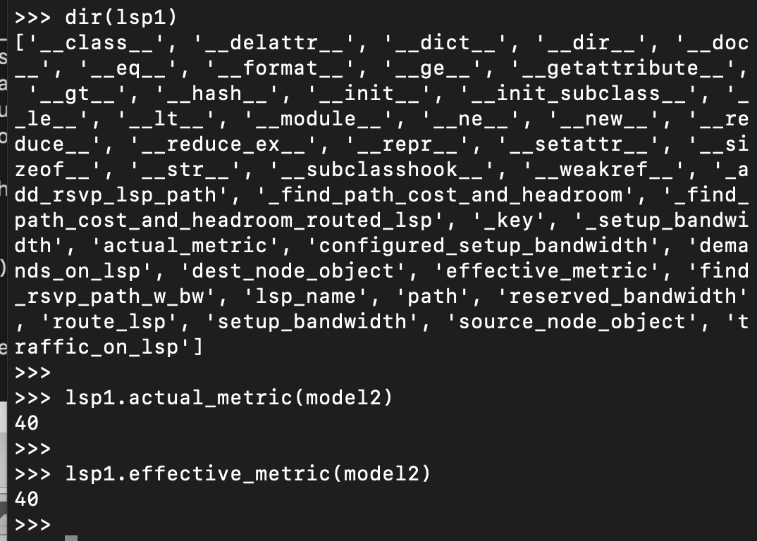
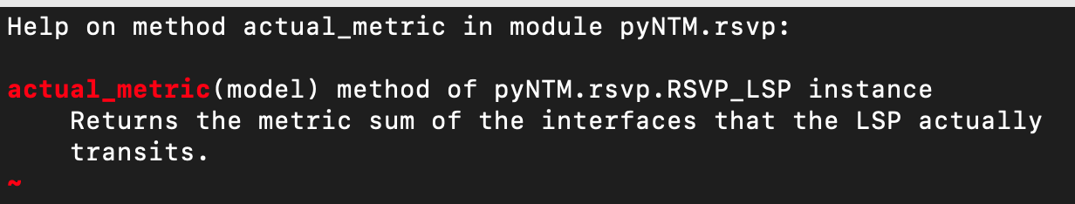
RSVP LSP Path Analysis (continued)
The RSVP LSP has a wealth of methods and attributes
Easily compare the LSPs effective metric to the LSP path’s actual metric
effective_metric is the IGP shortest path cost between the source and destination nodes
It is equivalent to path_cost in the LSPs path info
actual_metric is the path cost of the LSP’s signaled path
This allows you to easily analyze how many LSPs are on the shortest path and the cost differential between the shortest path and the LSP’s actual path

Slide 15
Comparing/configuring auto-bandwidth and static-bandwidth LSPs
If an RSVP LSP has a value for the configured_setup_bandwidth attribute, it is static-bandwidth
If the LSP does not have a value for this attribute, it is auto-bandwidth
See the example on the next page

Slide 16
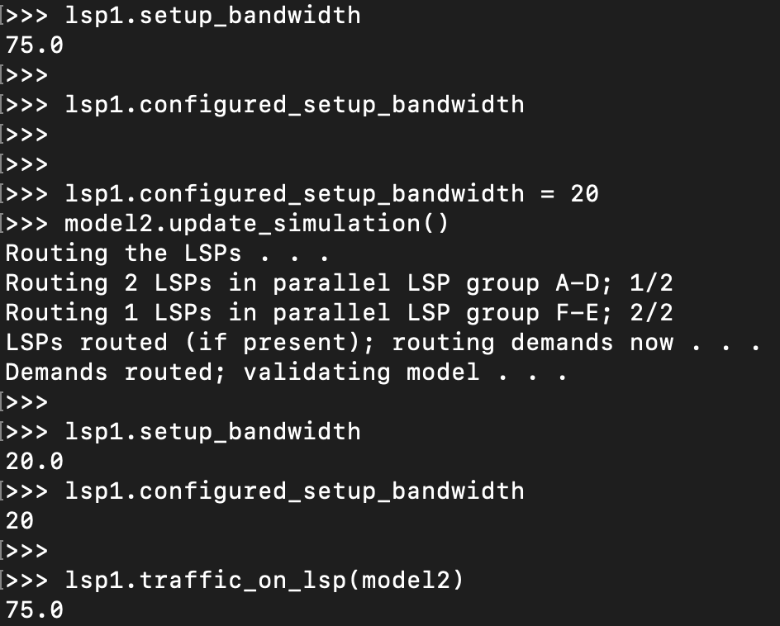
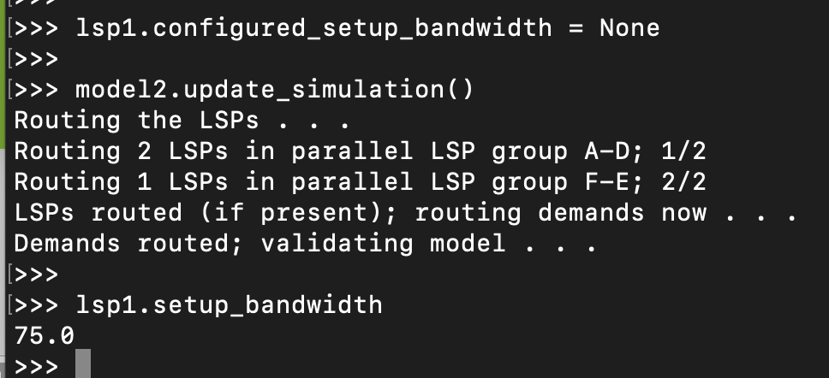
Example – Turn an auto-bandwidth LSP to a fixed bandwidth LSP and back again
lsp1 starts as an auto-bandwidth LSP
It tries to reserve the amount of bandwidth it is carrying
Configure a value for configured_setup_bandwidth value on lsp1
Remember to update the simulation after making this change!
It still carries 75 units of traffic but only signals for the configured 20 units
Change lsp1 back to auto-bandwidth mode by changing configured_setup_bandwidth attribute to None
The setup_bandwidth reverts back to how much traffic the LSP is carrying (75 units)

Slide 17
Shared Risk Link Groups (SRLGs)
A group of objects in the Model that all share the same risk of simultaneous failure
Failing an SRLG fails all the component objects
Unfailing an SRLG will unfail each component object as long as any given component object does not have another failure mode active
For example, if an Interface on a failed Node is also part of a failed SRLG and the SRLG unfails, the Interface will not restore until its host Node restores
SRLGs can contain Interface and Node objects

Slide 18
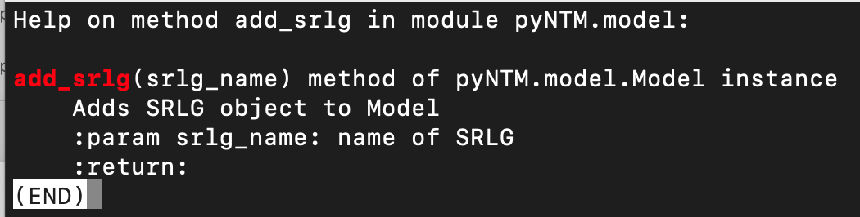
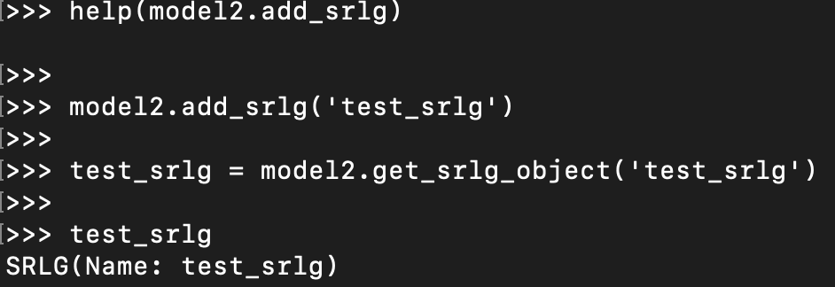
Adding an SRLG to a Model
Use the add_srlg Model method to create and SRLG

Slide 19
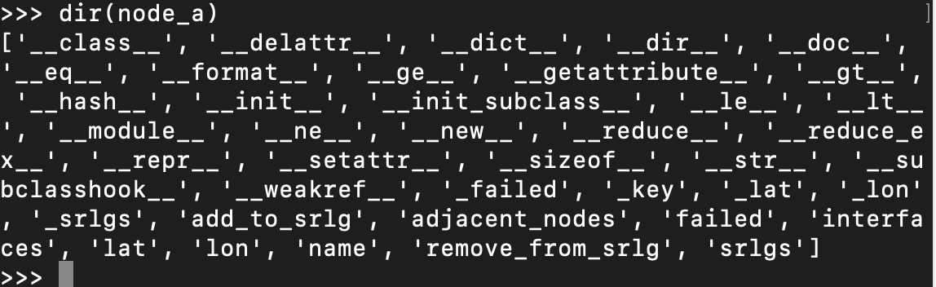
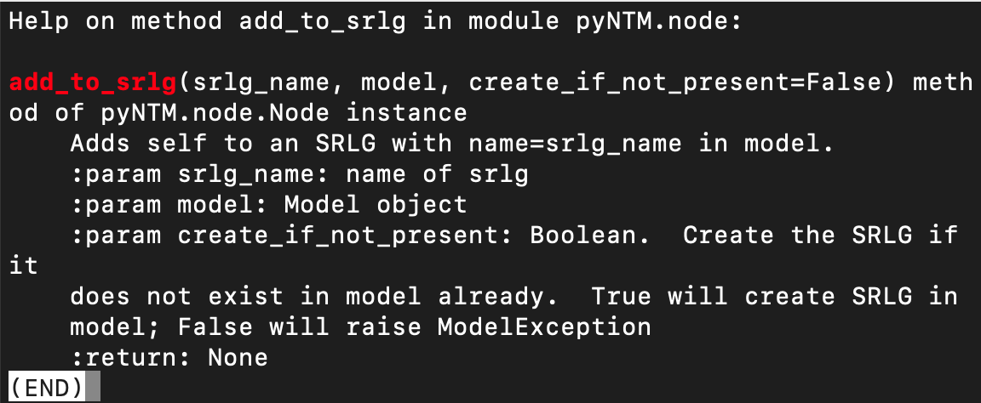
Adding objects to an SRLG
Interfaces and Nodes each have a method to add that specific object to an SRLG
When one Interface in a Circuit is added to an SRLG, the Circuit’s other Interface will also be added to that SRLG

Slide 20
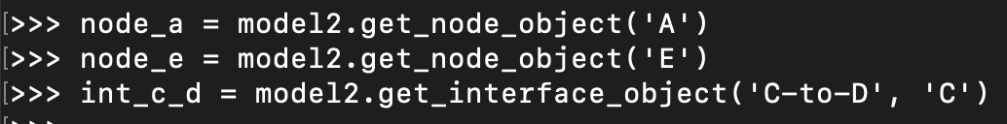
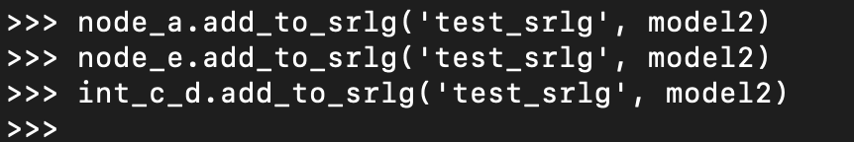
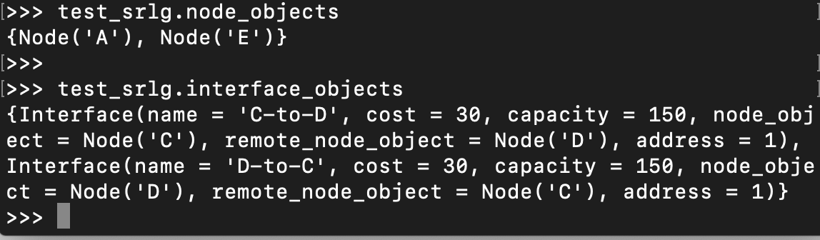
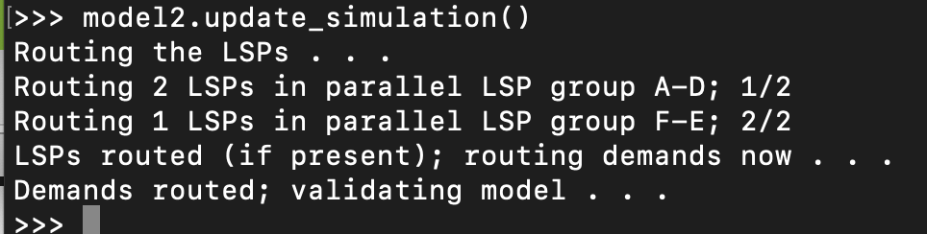
Adding objects to an SRLG (continued)
Get the desired Interface and/or Node objects in the Model
Use the add_to_srlg method from each object to add each to the SRLG
You can programmatically verify which Nodes and Interfaces are part of a given SRLG
Update the simulation!

Slide 21
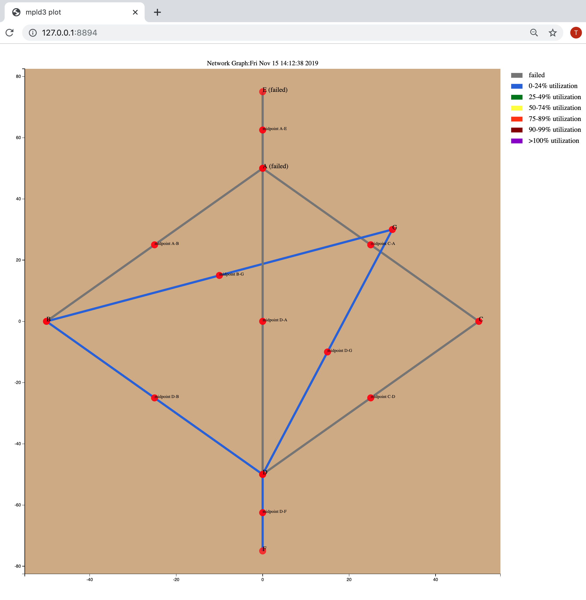
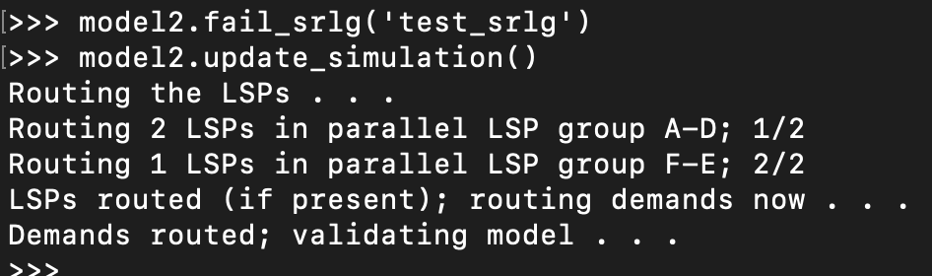
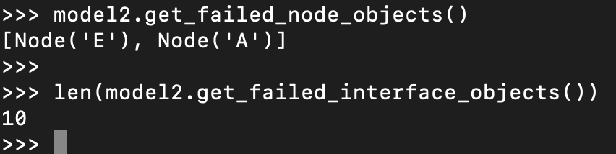
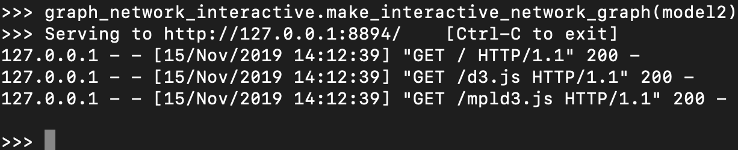
Failing an SRLG
Fail an SRLG with the Model fail_srlg method
Use Model’s get_failed_node_objects and get_failed_interface_objects methods to programmatically validate failed Nodes or Interfaces
Update the simulation!
Create network visualization (optional)

Slide 22
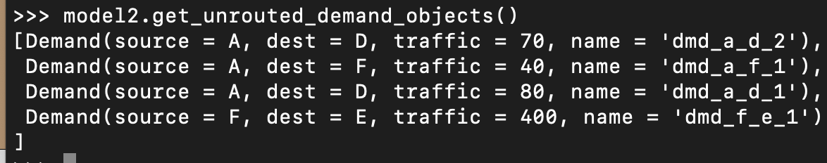
Assessing the impact of the failure
Our visualization show no Interface over 24% utilized
HOWEVER, use the get_unrouted_demand_objects Model method to assess which (if any) Demands are not able to route
Spoiler alert: None of the 3 existing demands can route after this devastating failure

Slide 23
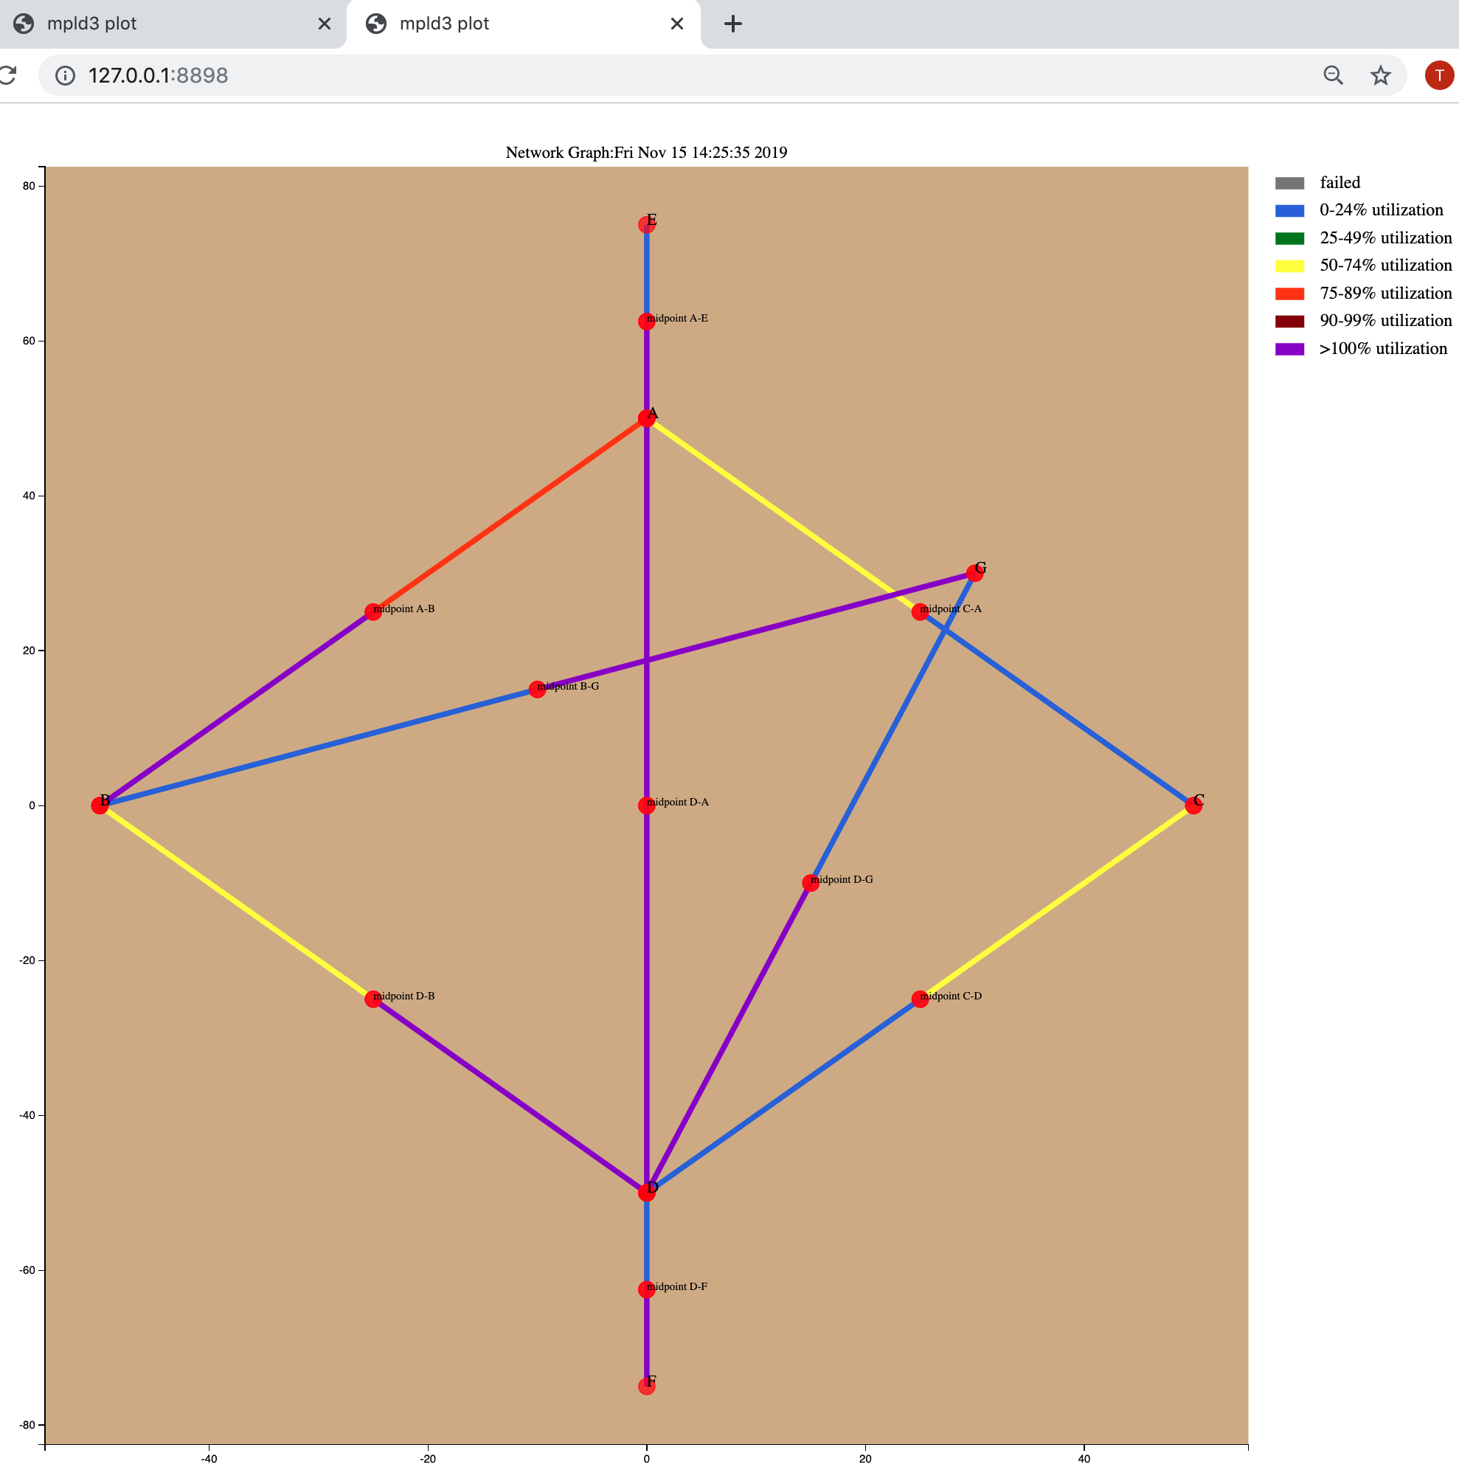
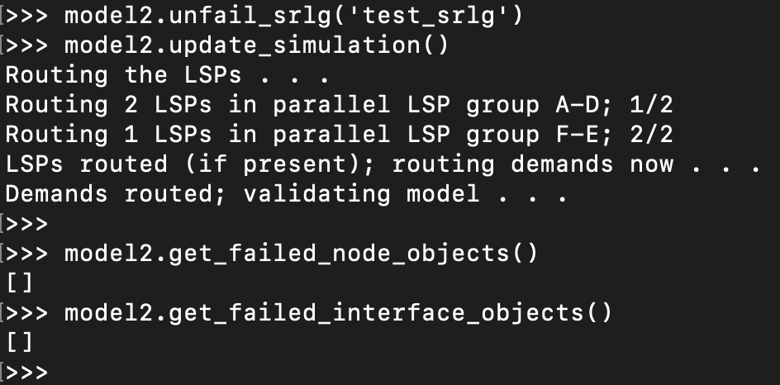
Unfail the SRLG
Use the unfail_srlg Model method to restore a failed SRLG
Use Model’s get_failed_node_objects and get_failed_interface_objects methods to programmatically validate no failed Nodes or Interfaces
Update the simulation!
Visualize the network (optional)
Visualization shows network back to its pre-failed state

Slide 24
FIN

