Slide 1

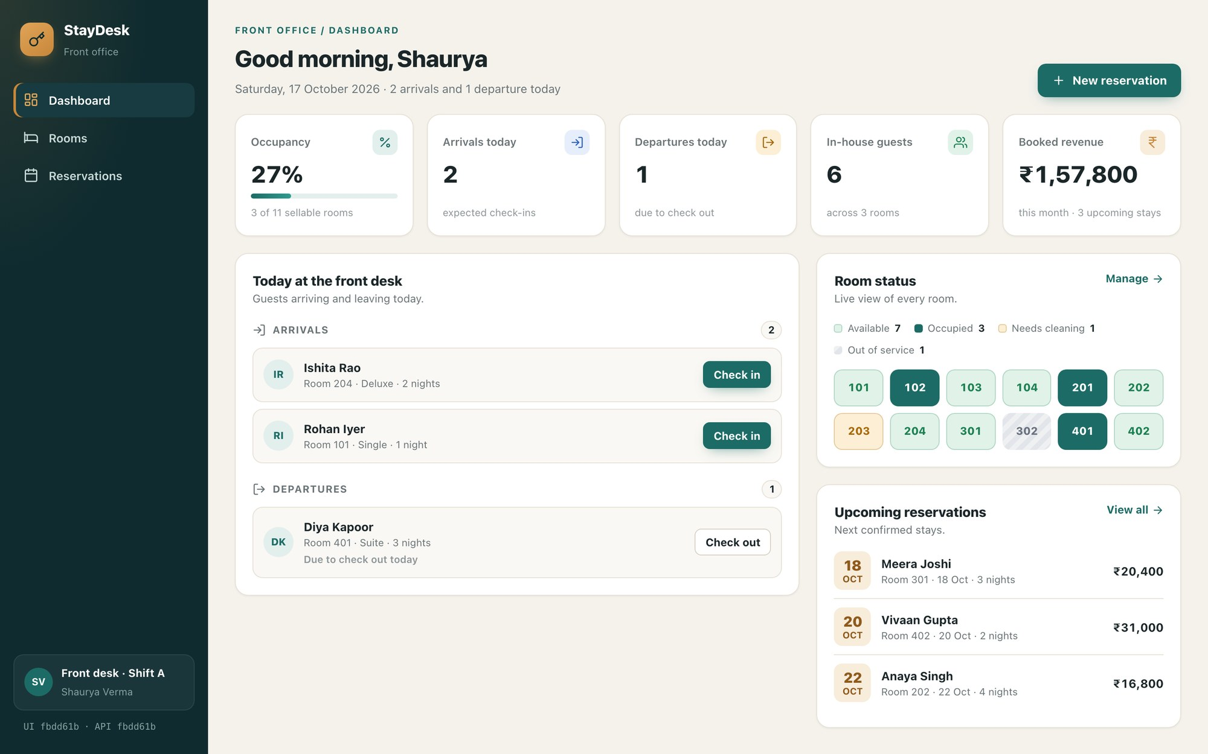
StayDesk
DEVOPS FINAL CAPSTONE · SESSION 21
A hotel front-desk app, shipped from a laptop to a monitored, autoscaled Kubernetes cluster on AWS
Live on Amazon EKS, served through the AWS load balancer
Shaurya Verma
github.com/Astro-Dude/staydesk
Notes:
Introduce StayDesk: a hotel front-desk app built for this capstone (my own domain, not the TaskBoard reference). The point of the talk is the journey from a commit on my laptop to a monitored, autoscaled deployment on AWS EKS. I'll walk the 13 stages from the brief, in order, and show real evidence from each.

Slide 2













The journey: 13 stages from commit to cluster
BUILD AND SHIP
01
Application
02
Git commit
03
CI pipeline
04
Docker image
05
Security scan
06
Registry
RUN ON AWS AND OPERATE
07
Terraform
08
Kubernetes
09
Helm
10
Ingress
11
Autoscaling
12
Monitoring
13
Troubleshooting
Each stage below shows what I built, why it exists, and a real capture from the running system.
Notes:
This is the path the brief asks every student to demonstrate. Top row is the developer side: app, git, CI, Docker image, security scan, registry. Bottom row is the platform side: Terraform builds AWS, Kubernetes + Helm run the app, Ingress exposes it, HPA scales it, Prometheus/Grafana watch it, and I finish with troubleshooting.

Slide 3
At a glance
49 tests
0 CVEs
3m 21s
pytest on an isolated database · 97% coverage
fixable HIGH or CRITICAL in either image (Trivy)
from git push to running on EKS (pipeline run #5)
61
2 → 6
≈ $0.40
AWS resources created by Terraform, then destroyed
backend pods added by the HPA under load
total AWS cost, paid from free-plan credits
Notes:
The headline numbers. Every one of these is backed by a screenshot in docs/EVIDENCE.md in the repo. The AWS run was deliberately short: build, deploy, prove, destroy.

Slide 4



Application: a real front-desk workflow
Staff see occupancy at a glance, take bookings safely and keep housekeeping in step.
No double bookings
Overlap check per room; the check-out day is free for the next guest
A real status flow
Booked → checked in → checked out; check-out marks the room dirty
Stack
React 19 + Vite · FastAPI · PostgreSQL 17 · Alembic · 20 REST endpoints
Dashboard served from EKS · the sidebar shows the deployed build (fbdd61b)
Stage 1 of 13 · Application
Notes:
DEMO: open the app, create a reservation (only free rooms are offered for the dates), check a guest in. Point out business rules enforced in the API and covered by tests: overlap detection, capacity, status transitions, check-out marks the room dirty. Swagger at /docs shows all 20 endpoints.

Slide 5
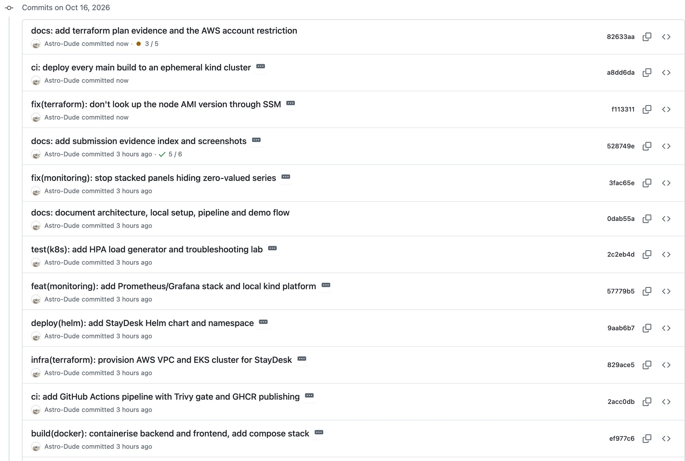
Git commit: small, described changes
25 commits
each one a single, working change with a typed message
.gitignore keeps .env, *.tfvars, Terraform state, node_modules and .venv out
History scanned: no keys or tokens were ever committed
github.com/Astro-Dude/staydesk/commits/main
Stage 2 of 13 · Git commit
Notes:
DEMO: make a small visible change (e.g. the dashboard greeting), git commit with a feat:/fix: message, git push. That push is what starts the pipeline on the next slide. Commit types follow the conventional style so the history reads like a changelog.

Slide 6
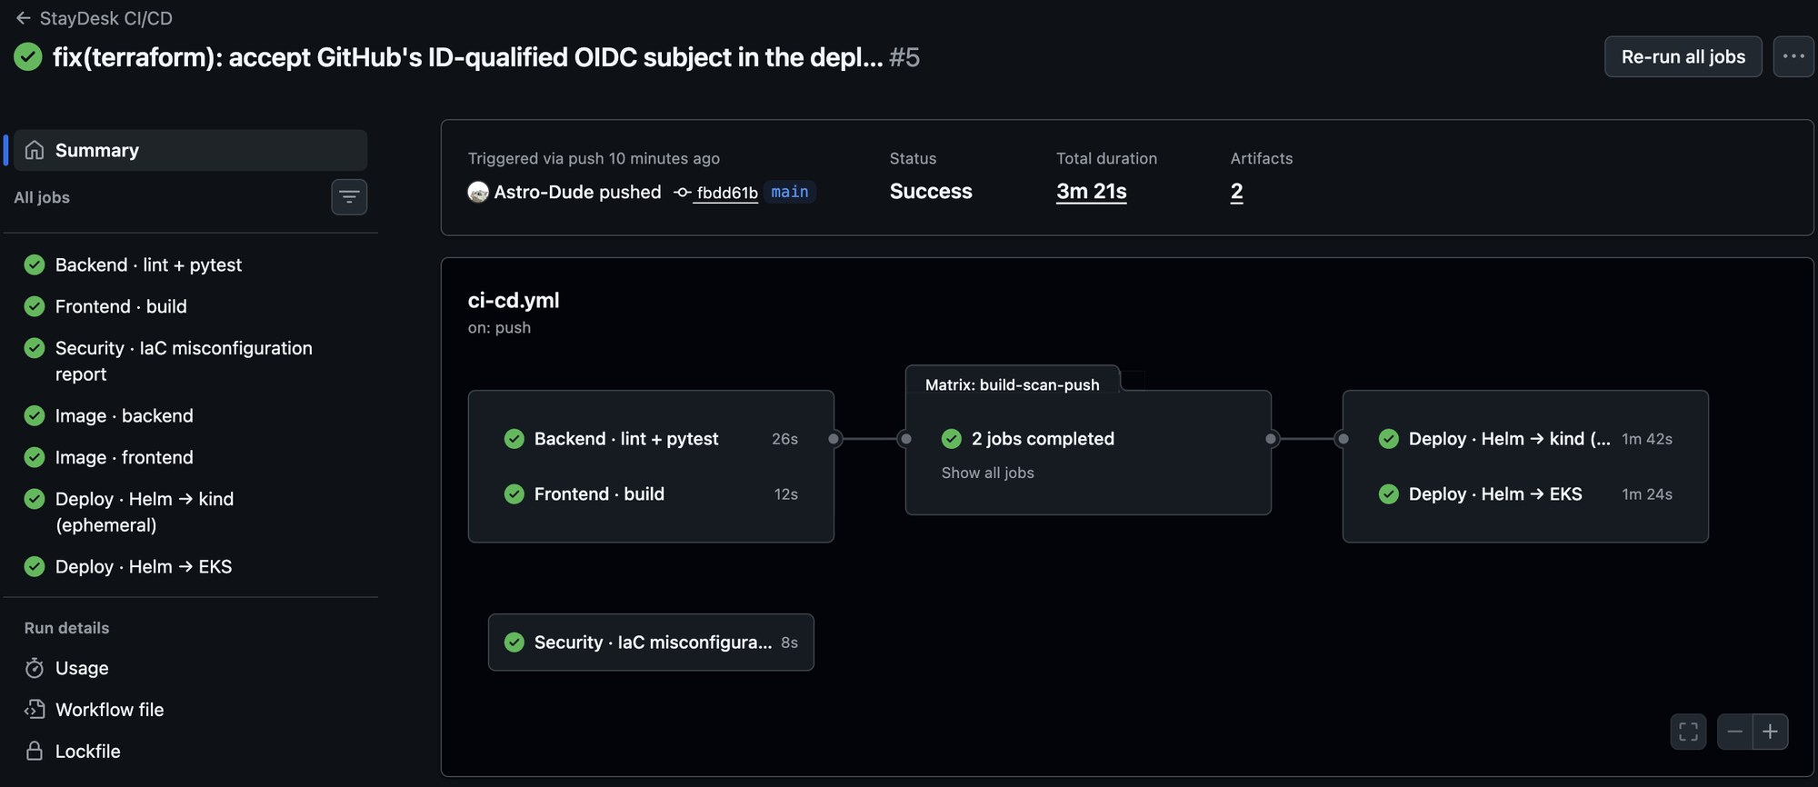

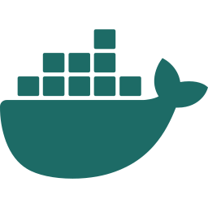


CI pipeline: test, scan and deploy on every push
3m 21s
from git push to the new build running on EKS
A failing test stops everything after it
Pull requests build and scan but never push or deploy
Every action pinned to a full commit SHA
Run #5: all seven jobs green, including Deploy · Helm → EKS
Test
Build
Scan
Deploy
ruff + 49 pytest tests, coverage gate ≥ 85%
both images tagged with the commit SHA
Trivy blocks fixable HIGH / CRITICAL CVEs
Helm → kind smoke test, Helm → EKS via OIDC
Stage 3 of 13 · CI pipeline
Notes:
DEMO: GitHub → Actions → the run triggered by my push. Jobs: backend lint + pytest, frontend build, IaC report, image build+scan+push (matrix), then two deploys. Why pin actions by SHA: in March 2026 attackers force-pushed 76 of 77 trivy-action tags to credential-stealing code; a SHA can't be moved.

Slide 7
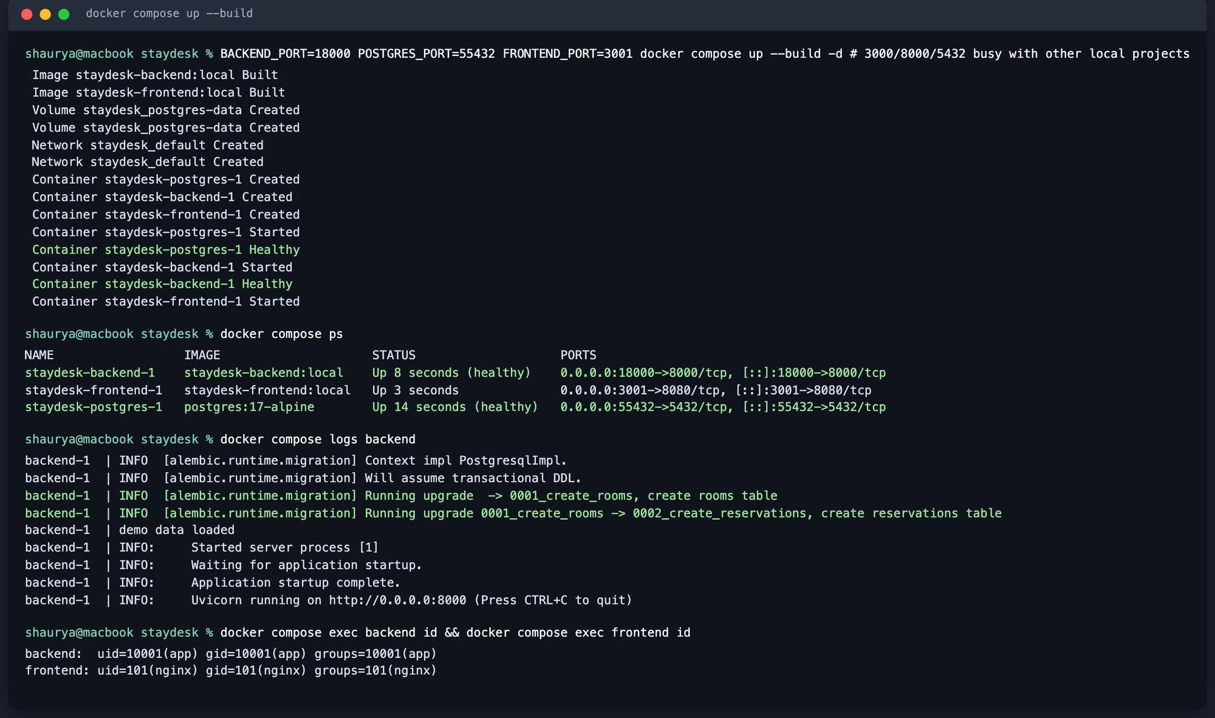


Docker image: small, non-root, built in stages
Backend image
python:3.13-slim, two stages
Only the venv ships; pip is removed
Runs as uid 10001
Entrypoint: wait for DB → migrate → seed → serve
Frontend image
node:22 build → nginx-unprivileged
26 MB runtime, no Node.js inside
Runs as uid 101 on port 8080
/api upstream injected at start
docker compose up --build: postgres, backend and frontend, health-gated
Stage 4 of 13 · Docker image
Notes:
Multi-stage builds keep build tools out of runtime images. Both containers run as non-root (M4 requirement), shown at the bottom of the capture with `id`. docker compose up --build runs the whole stack locally with one command; backend waits for Postgres to be healthy, frontend waits for the backend.

Slide 8
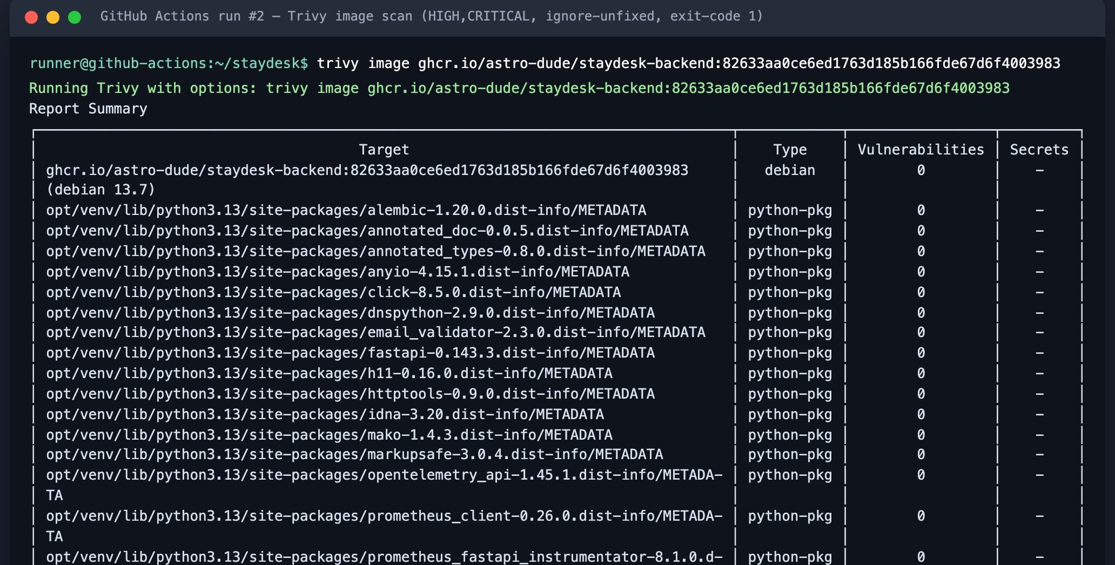
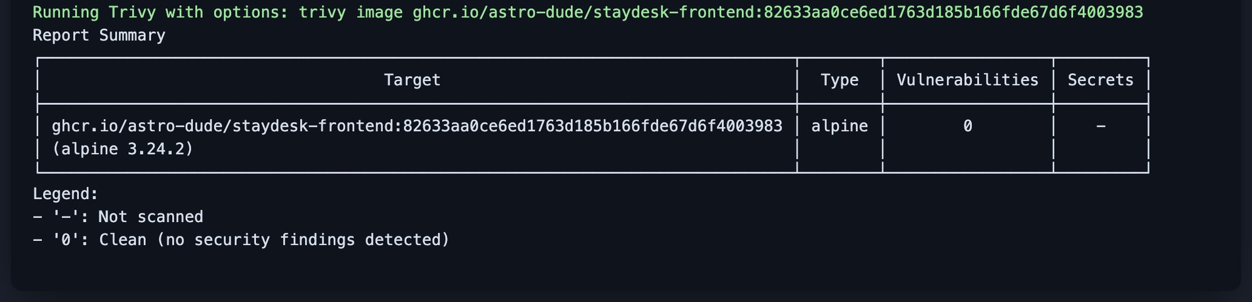
Security scan: Trivy is a hard gate
0
fixable HIGH or CRITICAL CVEs in either image
Scans OS packages and Python/npm libraries before the image is pushed
severity HIGH,CRITICAL · ignore-unfixed · exit-code 1
Separate report-only scan of Terraform, Helm and Dockerfiles
Clean today ≠ secure forever: new CVEs appear daily, so every build is rescanned
Trivy output from pipeline run #2: backend (Debian 13) and frontend (Alpine 3.24)
Stage 5 of 13 · Security scan
Notes:
Explain the result: Trivy checked the Debian/Alpine packages and every Python library; nothing HIGH/CRITICAL with a fix available. Small images help: no pip or compilers in the backend runtime, no Node in the frontend runtime. Image scanning is one layer next to dependency pinning, secret hygiene, IaC scanning and runtime hardening (non-root, read-only filesystems, restricted Pod Security).

Slide 9
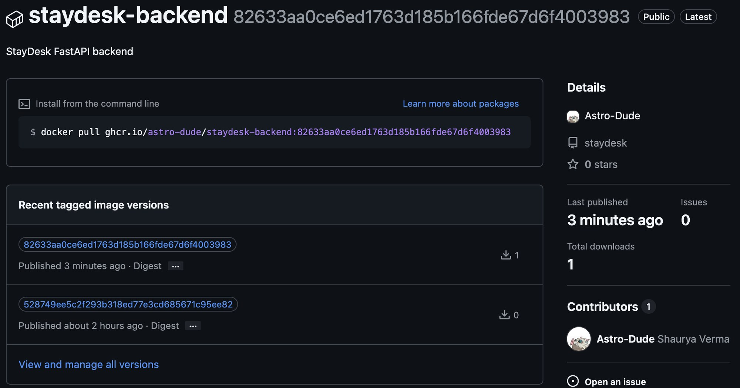
Registry: one image per commit in GHCR
commit A → image A
git commit fbdd61b
staydesk-backend:fbdd61b1…
staydesk-frontend:fbdd61b1…
No “latest” tag: every running pod traces back to one commit
Pushed only after tests and the Trivy scan pass
Public packages, so EKS pulls without a secret
ghcr.io/astro-dude/staydesk-backend: tags are full commit SHAs
Stage 6 of 13 · Registry
Notes:
GitHub Container Registry, pushed with the workflow's own GITHUB_TOKEN. Tag = commit SHA, so rollback = redeploy an older SHA, and `kubectl describe pod` tells you exactly which commit is running. The UI sidebar also prints the SHA of both containers.

Slide 10
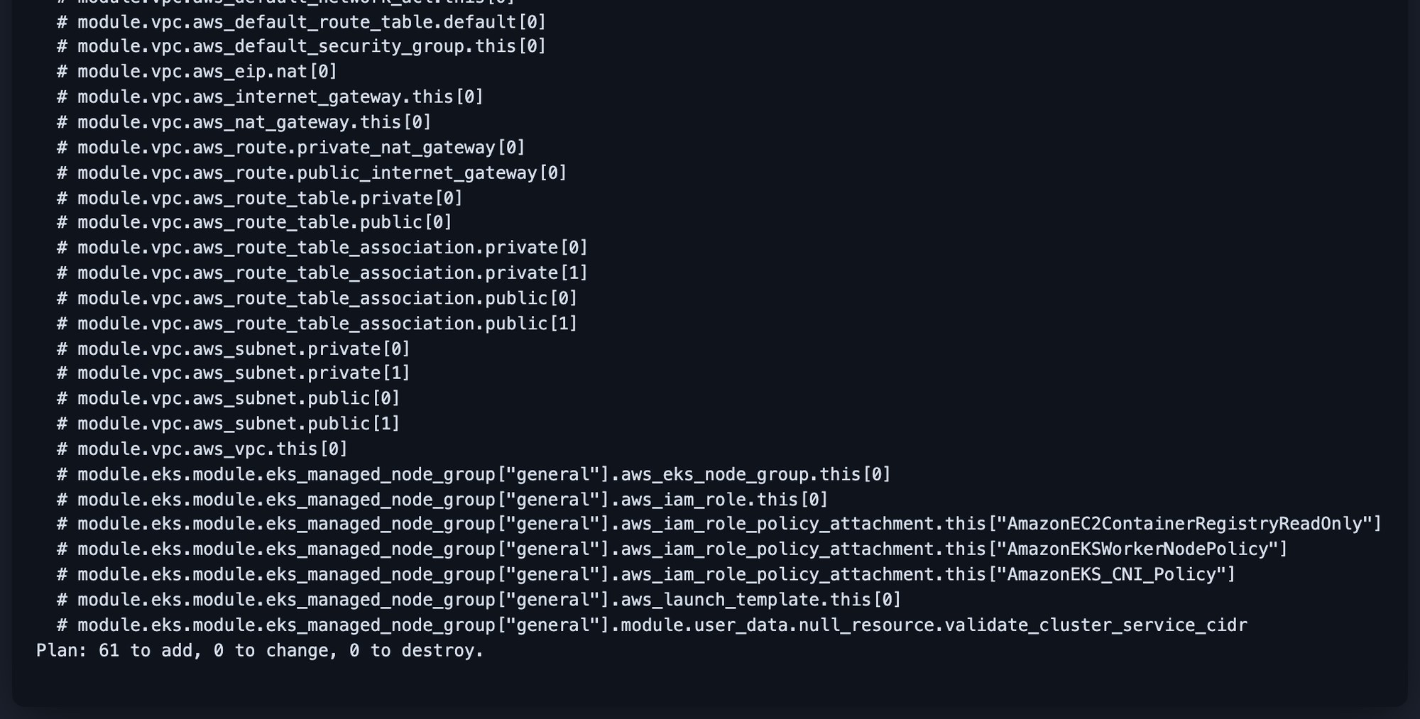
Terraform: the whole AWS platform as code
61
1.35
OIDC
AWS · ap-south-1 (Mumbai)
EKS control plane · Kubernetes 1.35 · managed by AWS
resources: plan → apply → destroy
EKS version, standard support only
GitHub deploy role, no AWS keys in CI
VPC 10.20.0.0/16
ap-south-1a
ap-south-1b
Public subnet
10.20.101.0/24
NAT gateway
Public subnet
10.20.102.0/24
Private subnet
10.20.1.0/24
c7i-flex.large worker
Private subnet
10.20.2.0/24
terraform plan: 61 to add, 0 to change, 0 to destroy
Stage 7 of 13 · Terraform
Notes:
Walk through terraform/: vpc.tf (2 public + 2 private subnets across two AZs, single NAT to save cost, ELB tags), eks.tf (EKS 1.35, managed node group, add-ons: VPC CNI, CoreDNS, kube-proxy, Pod Identity, EBS CSI with a default gp3 StorageClass, metrics-server), iam-github-oidc.tf (the role CI assumes). Kubernetes runs workloads; Terraform builds the platform underneath it. Infrastructure is reviewed as code instead of clicked in the console.

Slide 11
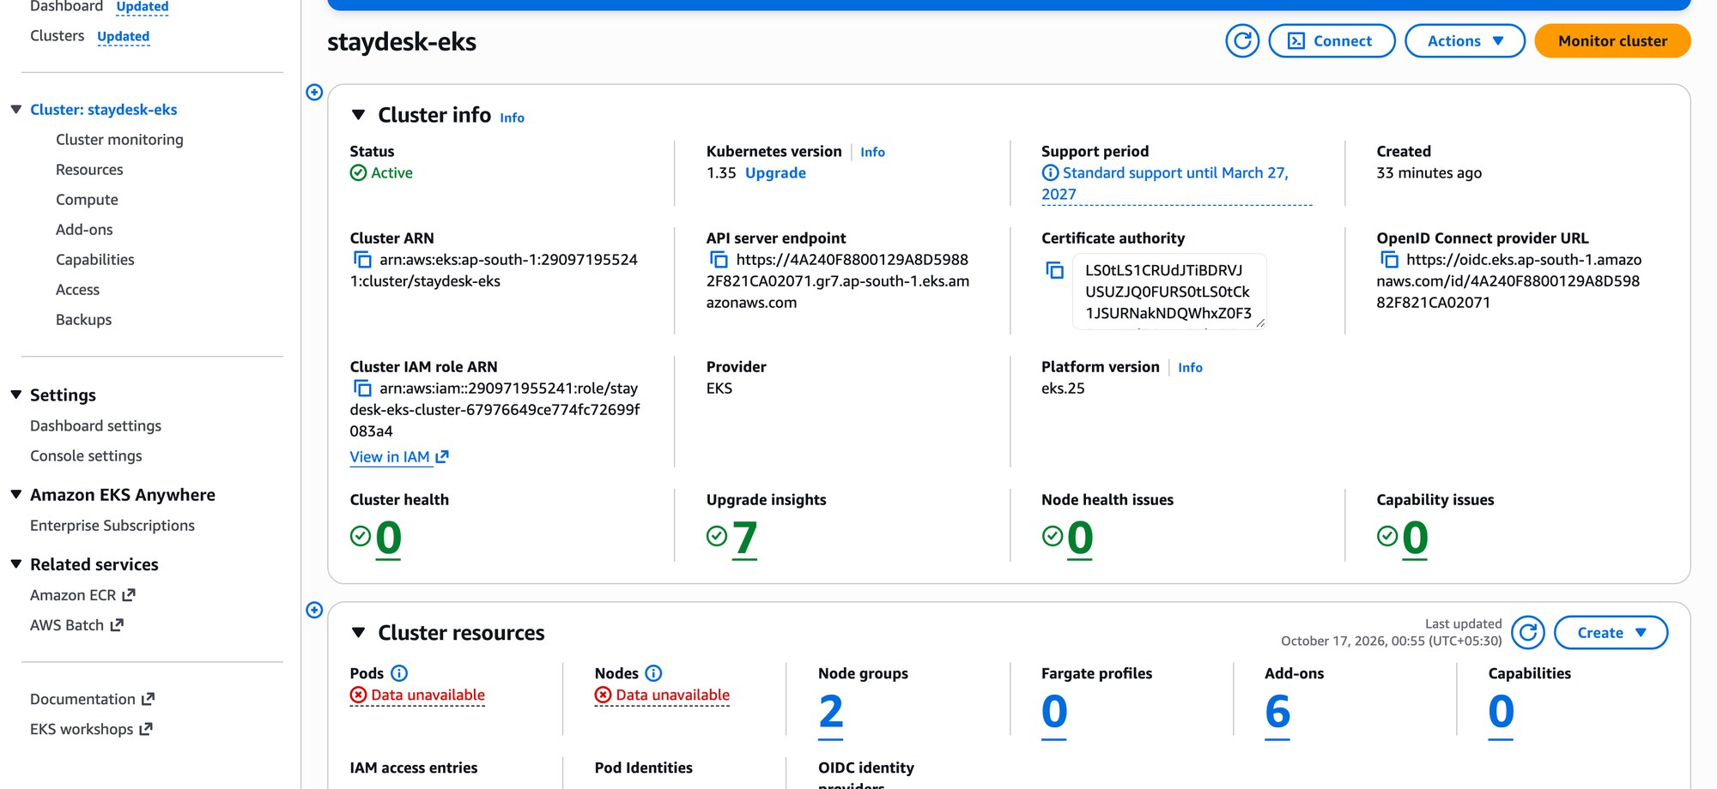
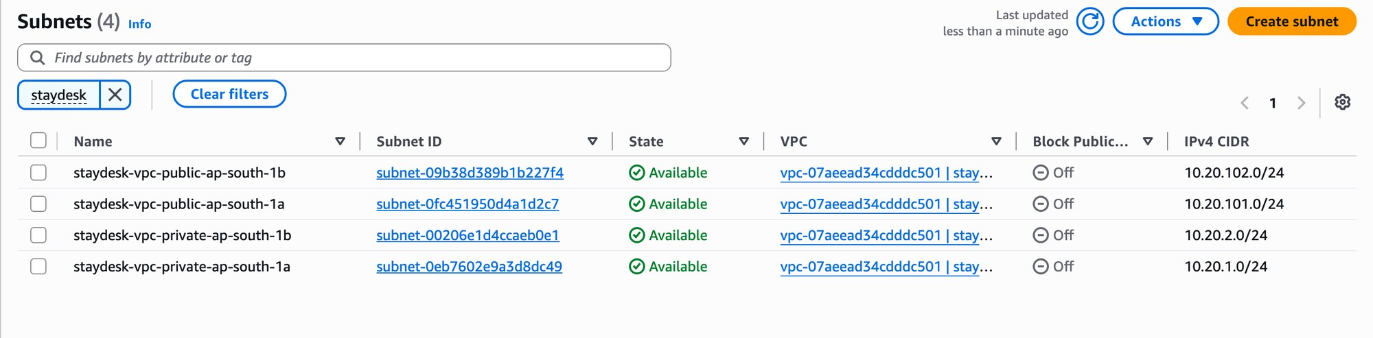
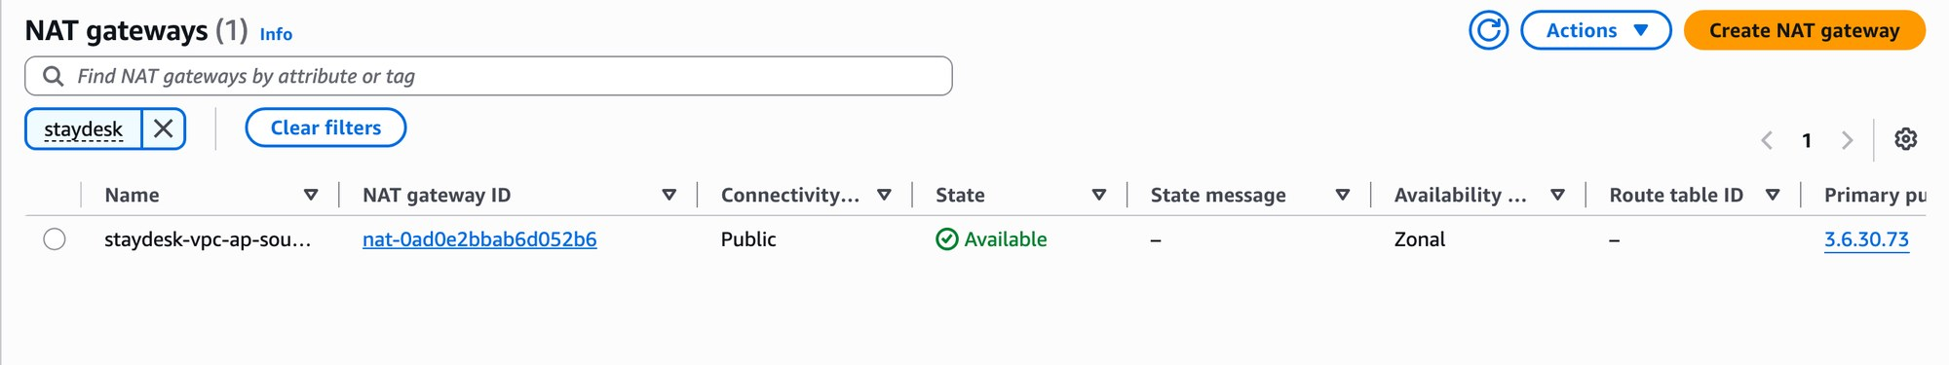
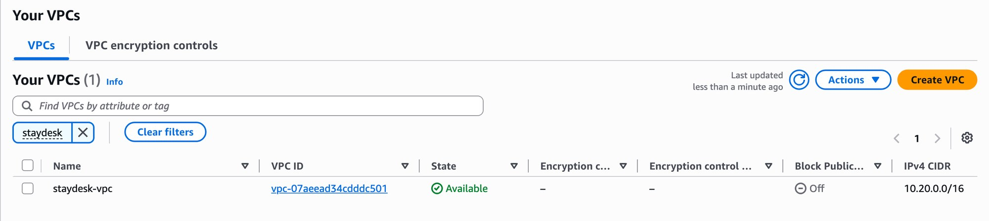
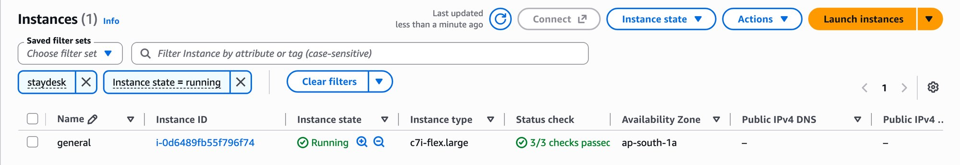
Terraform's output, as seen in the AWS Console
Four subnets: two public, two private
EKS cluster staydesk-eks: Active, 1.35, 0 health issues
NAT gateway for the private subnets
Worker node: c7i-flex.large, 3/3 checks passed
VPC staydesk-vpc · 10.20.0.0/16
Stage 7 of 13 · Terraform
Notes:
Real AWS Console captures from the run (account 290971955241). Taken with a temporary read-only federated session, so no console password was shared. After the demo everything was destroyed: 61 resources, total cost about forty cents of free-plan credits.

Slide 12
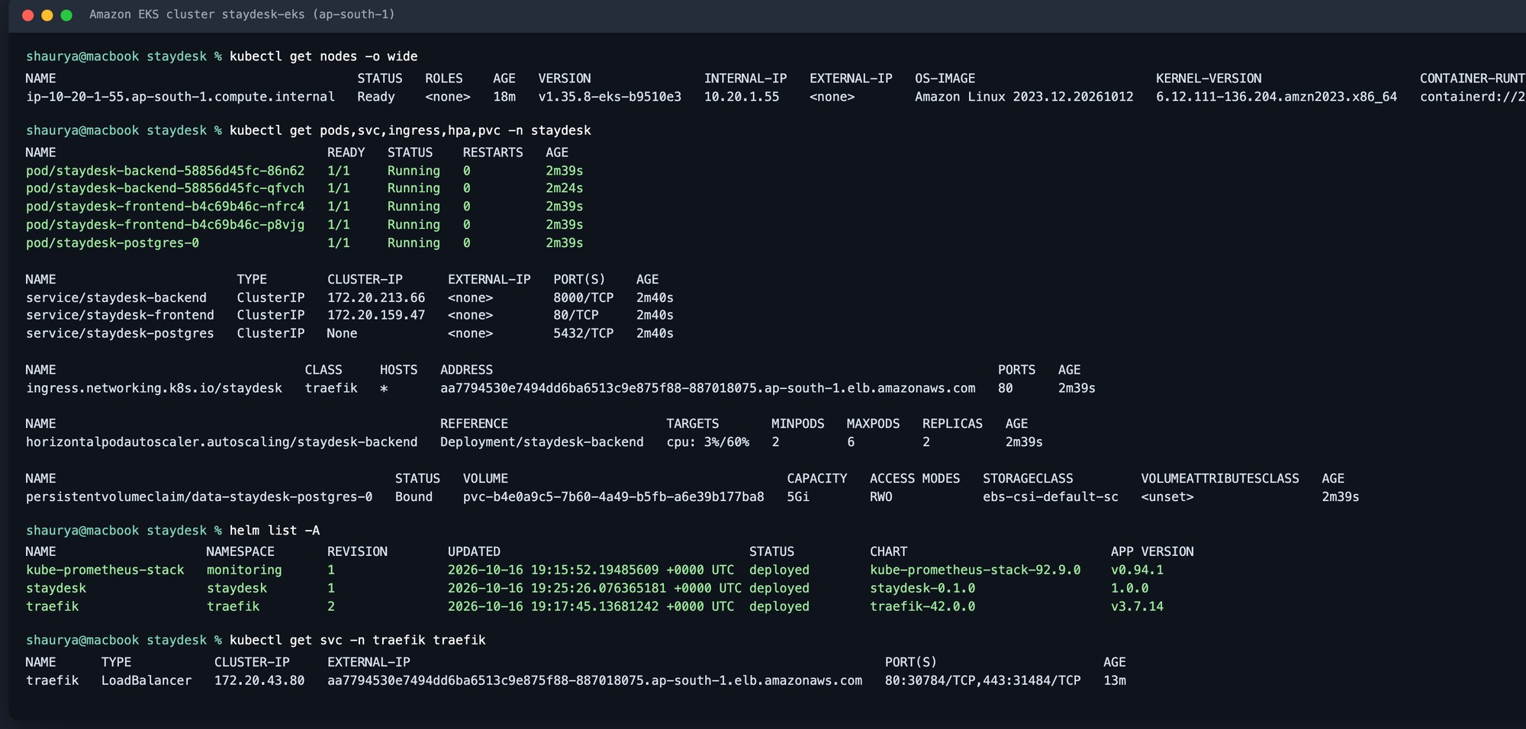
Kubernetes deployment: CI ships it to EKS
How the deploy job reaches the cluster
1
GitHub issues a short-lived OIDC token
2
AWS lets it assume staydesk-github-deploy
3
aws eks update-kubeconfig
4
helm upgrade --install --rollback-on-failure
5
Rollout verified, summary posted
kubectl on staydesk-eks after the pipeline deployed fbdd61b
2 backend + 2 frontend pods · PostgreSQL StatefulSet on an EBS gp3 volume · restricted Pod Security · 0 restarts
Stage 8 of 13 · Kubernetes
Notes:
DEMO: kubectl get pods,svc -n staydesk. Deployments keep replicas alive; Services give stable names in front of ephemeral pods (frontend → staydesk-backend). The deploy job never sees an AWS key: GitHub's OIDC token is exchanged for a role scoped to this repo's main branch, and that role has an EKS access entry.

Slide 13
Helm: the whole app as one versioned package
Template | What it gives us
Deployments ×2 | backend (init container runs migrations) and frontend, rolling updates
Services ×3 | stable ClusterIP names; headless Service for PostgreSQL
StatefulSet + PVC | PostgreSQL 17 on its own EBS volume
Secret | DATABASE_URL with a random password kept across upgrades
Ingress | / → frontend, /api /docs → backend
HPA + PDBs | 2–6 backend pods; one pod always survives a drain
NetworkPolicy | only backend pods may reach PostgreSQL
ServiceMonitor + dashboard | Prometheus scraping and a ready-made Grafana board
One chart, three environments
values.yaml
defaults
values-dev.yaml
local kind cluster
values-prod.yaml
AWS EKS
helm upgrade --install \
staydesk ./helm/staydesk
helm history staydesk -n staydesk
helm rollback staydesk <revision>
helm lint passes for all three value files
Stage 9 of 13 · Helm
Notes:
DEMO: helm list -n staydesk, helm history. Instead of many hand-edited YAML files, one chart with values per environment. The same chart deploys to kind in CI and to EKS. Concepts: chart, values, templates, release, upgrade, rollback.

Slide 14
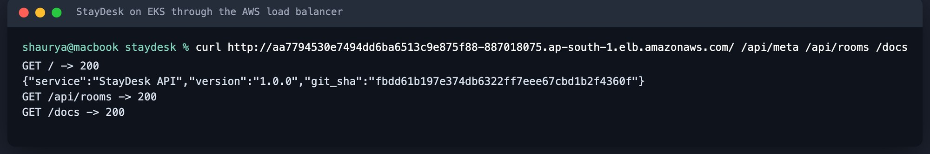
Ingress: one hostname, two backends
/
staydesk-frontend → React (nginx) ×2
Browser
AWS load balancer
(public)
Traefik
Ingress controller
/api /docs /openapi.json
staydesk-backend → FastAPI ×2–6
An Ingress is only configuration
A controller must implement it. I chose Traefik because the community ingress-nginx was retired in March 2026.
curl through the public load balancer: the API reports the deployed commit
Stage 10 of 13 · Ingress
Notes:
DEMO: open the app through the load balancer hostname (locally: http://staydesk.localhost via kind). The browser only calls relative /api URLs, so it never needs to know an internal hostname. Brand-new AWS accounts can't create NLB/ALB yet, so on EKS Traefik sat behind a Classic Load Balancer.

Slide 15
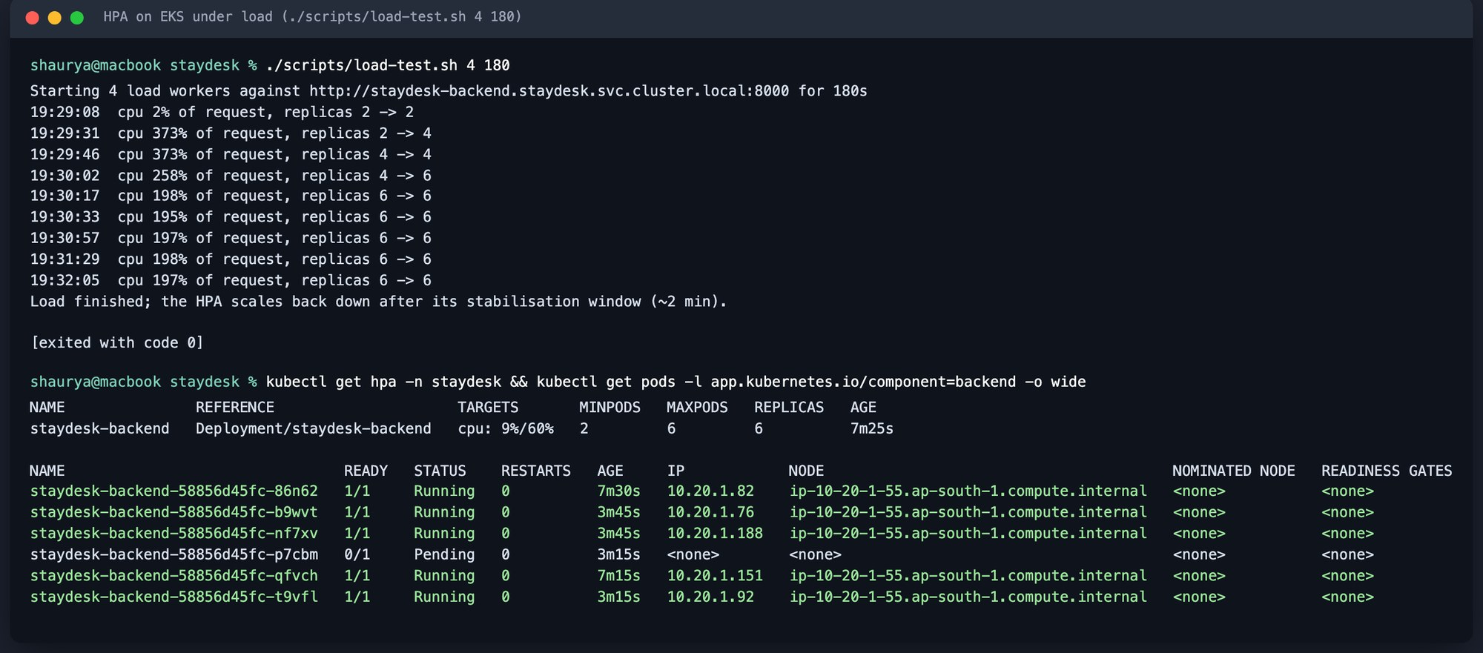

Autoscaling: the HPA reacts in under a minute
373%
2 → 6
peak CPU, measured against each pod's CPU request
replicas requested within 54 s
60%
2 min
CPU target in values-prod.yaml
scale-down stabilisation window
./scripts/load-test.sh on EKS: four in-cluster workers for 180 s
Lesson: the HPA scales pods, not nodes. The 6th pod stayed Pending because I ran one node to keep cost down. In production, Cluster Autoscaler or Karpenter would add a node.
Stage 11 of 13 · Autoscaling
Notes:
DEMO: kubectl get hpa -n staydesk -w in one terminal, ./scripts/load-test.sh in another. HPA needs two things: resource requests on the container and a metrics provider (metrics-server, installed as an EKS add-on by Terraform). The Pending pod is an honest result worth explaining, not hiding.

Slide 16
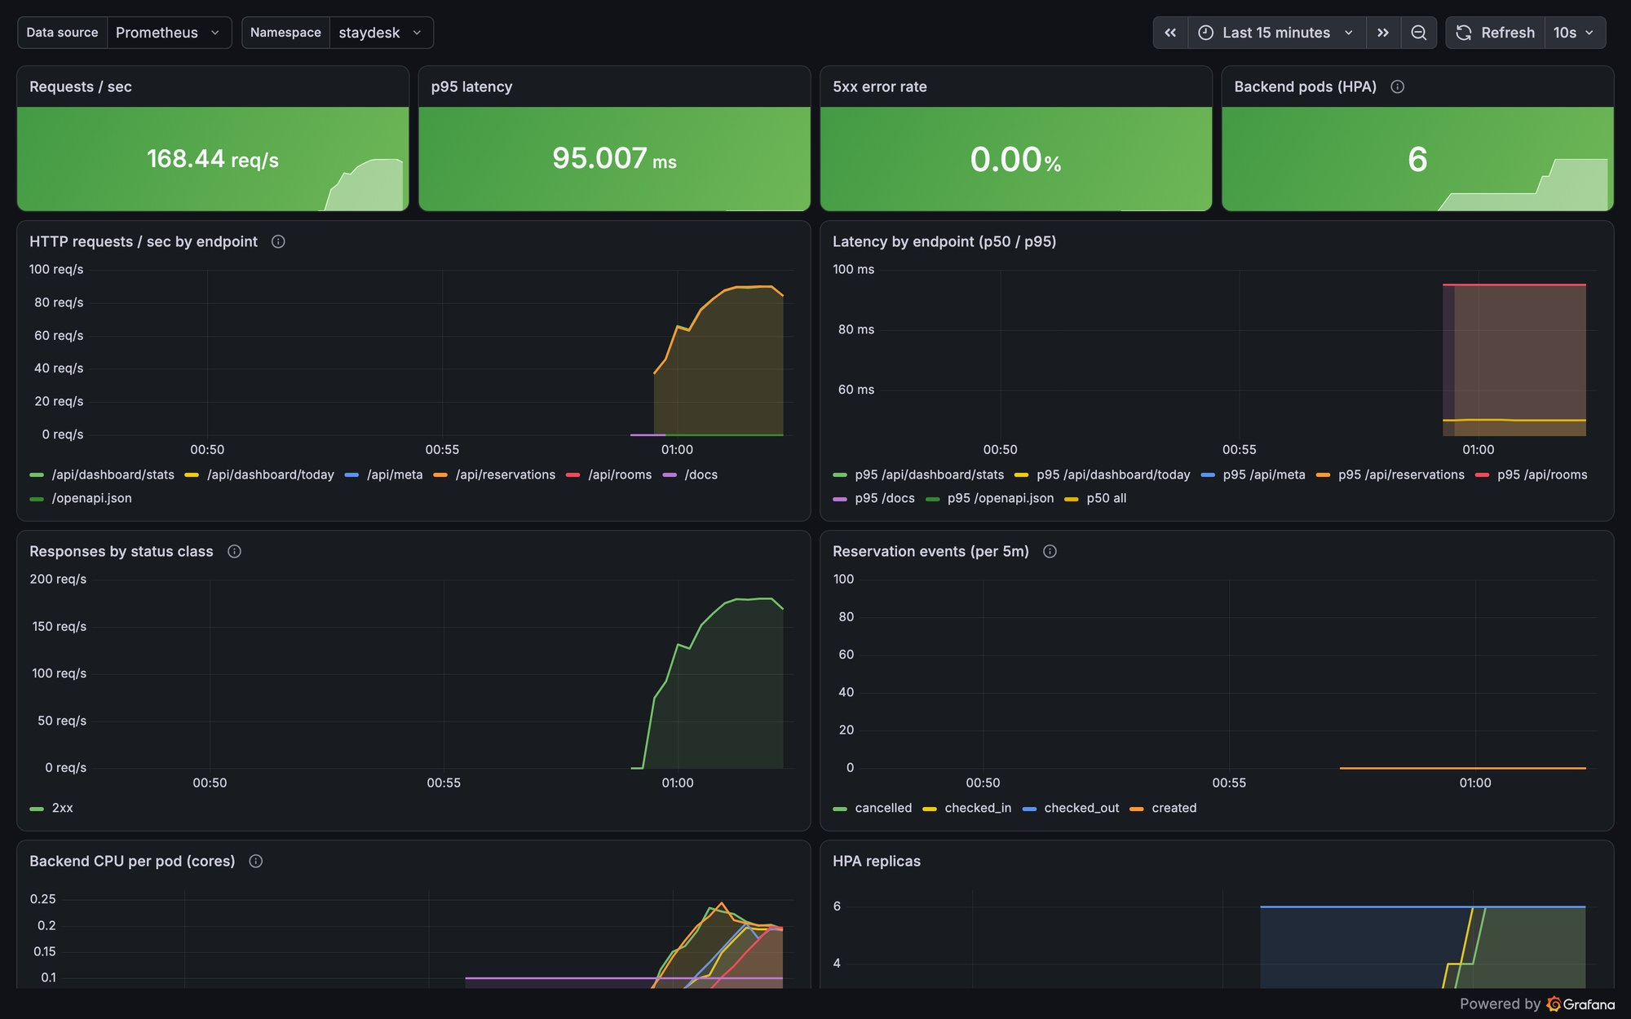
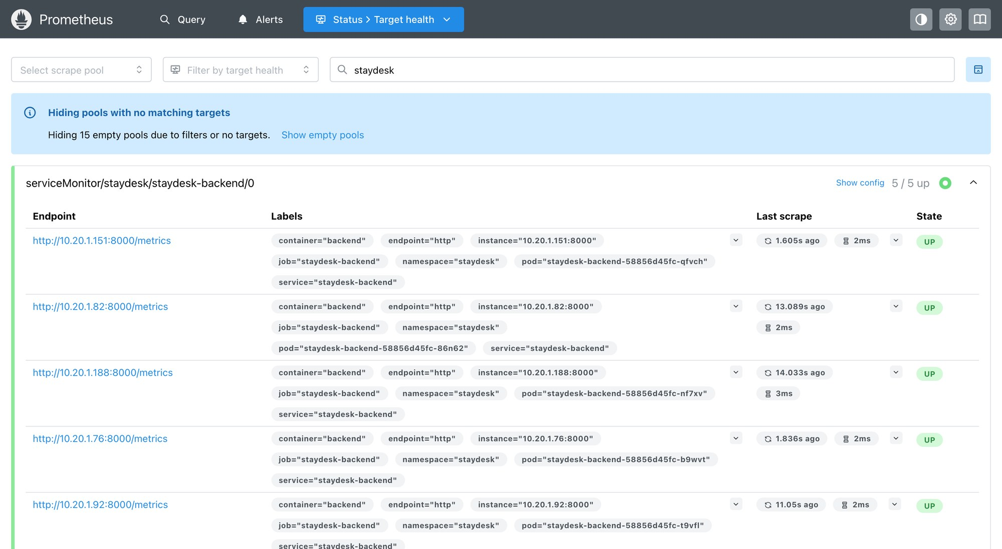
Monitoring: Prometheus scrapes, Grafana explains
Prometheus: every backend pod UP
168/s
95 ms
0.00%
requests
p95 latency
5xx errors
ServiceMonitor scrapes /metrics on every pod every 15 s
Custom metric: staydesk_reservation_events_total
Dashboard ships with the Helm chart
Grafana on EKS during the load test
Stage 12 of 13 · Monitoring
Notes:
DEMO: Prometheus → Status → Targets (staydesk-backend UP), then Grafana → StayDesk · API overview. Panels: request rate per endpoint, p50/p95 latency, status classes, reservation events, CPU per pod against its request, and HPA replicas. Good questions it answers: how much traffic, which endpoint is slow, are errors increasing, is the HPA scaling.

Slide 17



Troubleshooting: break it, then fix it live
ImagePullBackOff
Service with no endpoints
Running but not Ready
SYMPTOM
SYMPTOM
SYMPTOM
Pod never starts
Requests time out
0/1 READY, no restarts
DIAGNOSE
DIAGNOSE
DIAGNOSE
kubectl describe pod → Events
kubectl get endpointslices
describe → readiness 503
ROOT CAUSE
ROOT CAUSE
ROOT CAUSE
Image tag does not exist
Selector matches no pod labels
Database unreachable
FIX
FIX
FIX
Point the Deployment at a real SHA tag
Fix the selector: component=backend
Fix DATABASE_URL; liveness ≠ readiness
Manifests and step-by-step guide: troubleshooting/README.md
Stage 13 of 13 · Troubleshooting
Notes:
LIVE FAILURE: kubectl apply -f troubleshooting/broken-service.yaml → kubectl get svc (has a ClusterIP) → kubectl get endpointslices (empty) → kubectl get pods --show-labels → the selector asks for component=api, pods are component=backend → patch the selector → endpoints appear. Key lesson: a Service selects pods by label; no match, no endpoints, no traffic.

Slide 18
Real problems I hit on AWS, and how I fixed them
Problem | Root cause | Fix
Node group created, but no nodes ever joined | AWS Free plan only launches Free-Tier instance types | Switched t3.medium → c7i-flex.large
Ingress load balancer stuck in <pending> | New accounts can't create NLB/ALB yet | Classic load balancer for Traefik
CI deploy: AssumeRoleWithWebIdentity denied | GitHub's OIDC subject now carries repo and owner IDs | Trust policy accepts both subject formats
Grafana showed all traffic as 4xx | A stacked panel drew an idle series on top | Unstacked panels, fixed status colours
Laptop couldn't reach the EKS API | Local DNS failed to resolve eks.ap-south-1 | Ran the tools in Docker with public DNS
Each fix is a commit in the repo with the reasoning in its message.
Notes:
These are the debugging stories from the real AWS run: read the event or log, find the root cause, fix it in code, not by hand. The OIDC one was found by reading CloudTrail: GitHub sent repo:Astro-Dude@<id>/staydesk@<id>:ref:refs/heads/main.

Slide 19



Thank you: now the live demo
Repository
github.com/Astro-Dude/staydesk
Demo order
1. Commit a visible change
2. Watch the pipeline
3. New SHA in the UI
4. Load test → HPA
5. Grafana reacts
6. Break a Service, fix it
Pipeline run #5 (EKS deploy)
github.com/Astro-Dude/staydesk/actions/runs/38954572064
Evidence for every module
docs/EVIDENCE.md · 40+ real screenshots
AWS cleaned up
61 resources destroyed · ≈ $0.40 total cost
Notes:
Close by handing over to the live demo: commit → pipeline → deployment update (the sidebar SHA changes), then load test with the HPA watch, Grafana, and the broken-Service lab. Questions.

