Slide 1

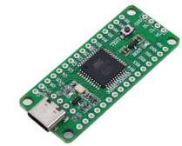
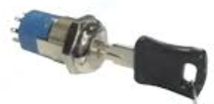
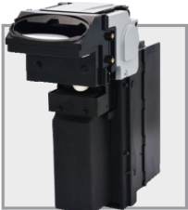
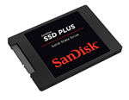
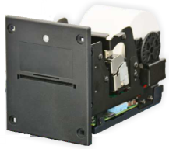

Online game services
J-type Slot
軟體設計(草稿)
API server
Web server
API
J-type slot machine
Motherboard / Ubuntu OS 24.04
HDMI
USB (touch)
USB
Astro Kernel
(Python)
Browser 1
Home/Game pages
Config
Web server
Browser 2
Operator menu
Bill Acceptor
Lib/Driver
CUPS
Keyboard Buttons/Key
RS-232 USB

