Slide 2
CONTENTS
1.Introduction
2.Objectives of Internship
3.Project /Task Overview/ Problem Statement
4.Technical Skills Acquired/ to be acquired
5.Challenges Faced
6.Achievements and Contributions
7.Learning and Insights
8.Result/Output (till now with screenshots)
9.Conclusion and future scope

Slide 3

Industrial Training Cyber Security

Slide 4
Introduction
CodTech IT Solutions Pvt. Ltd. is a forward-thinking technology company specializing in software development, IT consulting, and digital transformation services. Headquartered in India, CodTech is dedicated to delivering innovative, scalable, and reliable tech solutions to clients across various industries, including education, finance, healthcare, and e-commerce.
With a strong emphasis on quality, customer satisfaction, and technological advancement, CodTech empowers businesses by offering custom software development, web and mobile app development, data analytics, and cybersecurity services. The company fosters a collaborative environment for learning and growth, making it a valuable platform for interns and professionals to gain real-world experience in emerging technologies.

Slide 5
Objectives of Internship
The objective of this internship was to gain practical exposure to real-world IT solutions and enhance technical proficiency through hands-on experience in cybersecurity tools. The internship aimed to:
Apply theoretical knowledge to real-time projects.
Understand the workflow and methodologies used in the IT industry.
Develop skills in Python programming, API integration, and system security.
Contribute to the development of innovative solutions under professional guidance.
Learn collaborative development practices in a team environment.

Slide 6
Problem Statement
With the exponential growth of internet usage and digital communication, users are increasingly exposed to malicious URLs and stealthy background processes that pose serious threats to personal and organizational cybersecurity. Traditional antivirus software often fails to detect new or low-profile threats in real-time, especially those embedded in URLs or running silently in the background.
There is a need for a lightweight, real-time tool that can help users verify the safety of suspicious URLs and monitor running background processes for potential threats without requiring extensive technical knowledge.
KnoxGuard aims to address this gap by developing a Python-based security utility that uses the VirusTotal API to detect and report malicious URLs and potentially harmful background processes through a user-friendly interface.
.
.

Slide 7
Technical skills to be acquired
API Integration: Using REST APIs (specifically VirusTotal API) to fetch and process security-related data.
GUI Development: Designing interactive desktop applications Cybersecurity AwarePython Programming: Writing modular, efficient, andusing customtkinter for improved user experience.
Process Management: Working with psutil to monitor and analyze system background processes.
maintainable Python code for real-world applications.
Cybersecurity Awareness: Understanding threat detection mechanisms, malware analysis basics, and safe browsing practices.
Version Control: Using Git and GitHub for code collaboration, version tracking, and project documentation.
Package Management: Managing dependencies and working with pip and requirements.txt.
Error Handling & Logging: Writing robust code with proper exception handling and logging for diagnostics.

Slide 8
Challenges faced
API Rate Limitation: VirusTotal’s free API plan restricted the number of requests per minute, which limited testing and batch processing during development.
Identifying Malicious Processes: Accurately determining which background processes were malicious was complex due to a lack of hash data for many running processes.
GUI Optimization: Designing a user-friendly interface with customtkinter required extra effort to ensure responsiveness and cross-platform compatibility.
Error Handling: Managing various edge cases like invalid URLs, missing internet connection, or inaccessible processes required robust exception handling.
Data Interpretation: Parsing and interpreting the JSON response from the API to display meaningful results to the user took careful planning and testing.
Time Constraints: Balancing internship timelines with learning new tools and technologies presented scheduling challenges.

Slide 9
Achievements and Contributions
Successfully developed a Python-based application capable of detecting malicious URLs and suspicious background processes using the VirusTotal API.
Implemented an intuitive and responsive GUI using customtkinter to enhance user interaction and accessibility.
Integrated real-time threat intelligence from VirusTotal, enabling accurate and up-to-date security assessments.
Demonstrated effective handling of system processes with psutil, providing users visibility into running background tasks.
Overcame API rate limiting challenges by optimizing request handling and incorporating error management.
Enhanced practical skills in API integration, cybersecurity concepts, and Python programming.
Delivered a functional security tool that can be extended or adapted for further cybersecurity applications.
Contributed detailed documentation and testing protocols to ensure maintainability and ease of future developmen.

Slide 10
Learning and Insights
Gained hands-on experience with Python programming in developing real-world security applications.
Deepened understanding of API integration, particularly working with RESTful APIs like VirusTotal for threat intelligence.
Learned to design and implement graphical user interfaces using customtkinter, improving usability and user experience.
Acquired knowledge about system process management and how to monitor background tasks with psutil.
Understood the challenges and limitations of using free-tier APIs, including rate limits and data availability.
Developed skills in error handling and building robust applications that can manage edge cases gracefully.
Improved ability to interpret and analyze JSON data to provide meaningful and actionable security reports.
Recognized the importance of cybersecurity tools in early threat detection and their impact on user safety.
Enhanced teamwork and project management capabilities through collaborative development and documentatio.

Slide 11
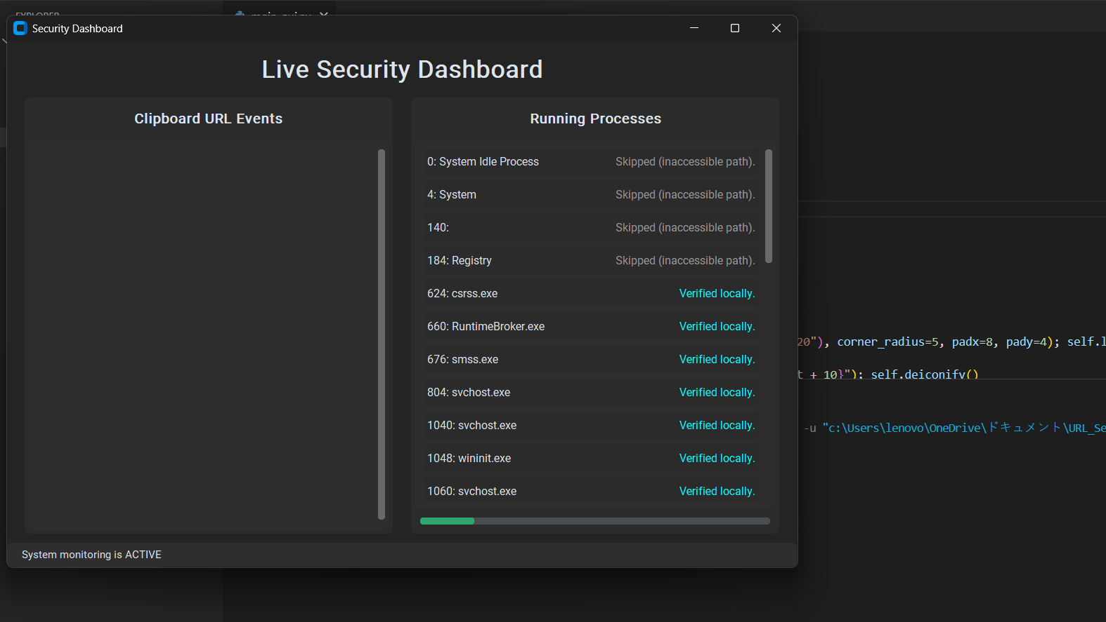
Result/Output

Slide 12
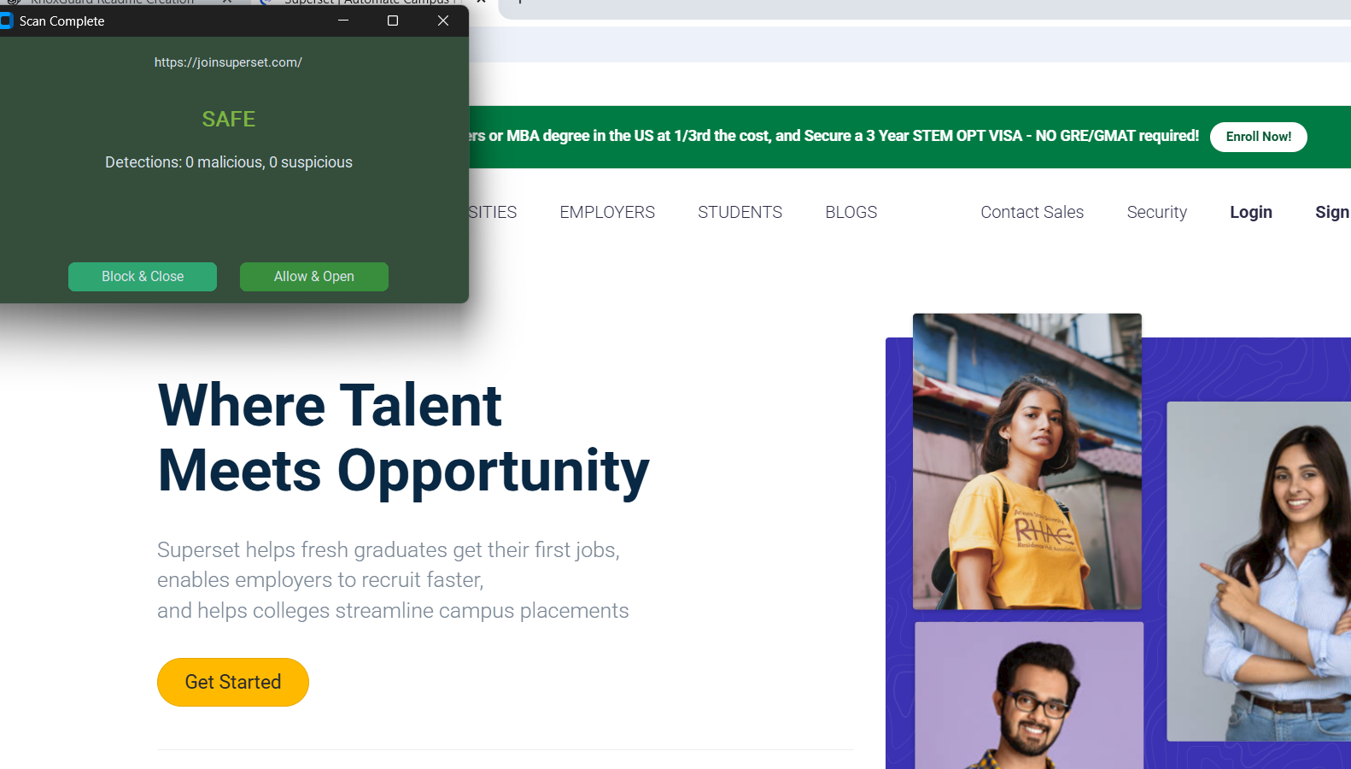

Slide 13
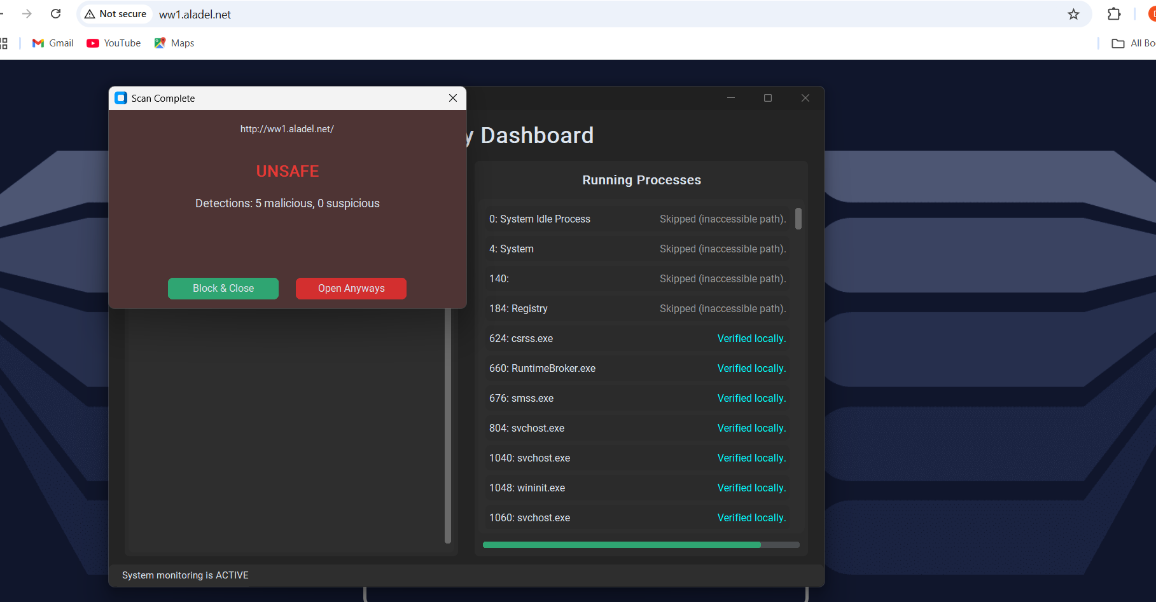

Slide 14
Conclusion and Future Scope
Conclusion:
The development of KnoxGuard marked a successful effort in creating a lightweight and efficient tool for detecting malicious URLs and monitoring background processes using Python and the VirusTotal API. The project not only enhanced awareness of real-time cybersecurity threats but also strengthened technical skills in programming, API usage, and GUI development. KnoxGuard offers a practical solution for basic threat detection, especially in environments lacking advanced security infrastructure.
Future Scope:
Real-Time Monitoring: Extend functionality to include continuous background monitoring and real-time alerts for suspicious activity.
File Scanning: Add support for scanning local files and attachments by integrating file hash analysis.
Browser Extension Integration: Develop a companion browser extension to automatically scan URLs before access.
Threat Reports: Generate and export detailed threat reports for professional or enterprise use.
Cross-Platform Support: Package the application for Windows, Linux, and macOS as standalone executables.
AI-Based Detection: Integrate basic machine learning models to predict and classify unknown threats based on patterns.

