Slide 1
BGI HACKATHON 2026
IDEA SUBMISSION
Theme-Smart Mobility, EVs & Logistics
Problem Statement ID –BT2P2
Problem Statement Title-EV Charging Station Locator & Slot Booking System
Problem Statement Category- Software(primary)/Hardware(optional)
Team ID-833
Team Name (Registered on portal) -CivicShield

Slide 2
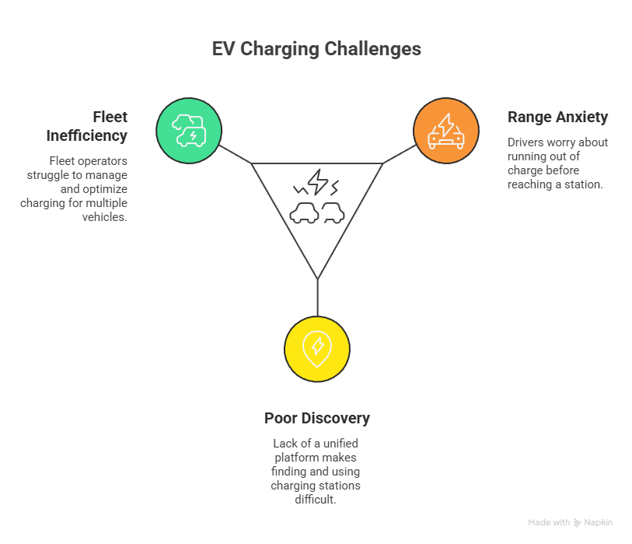
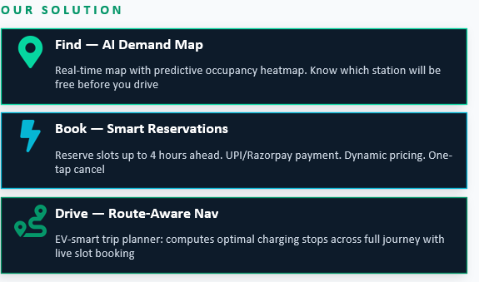

Slide 3
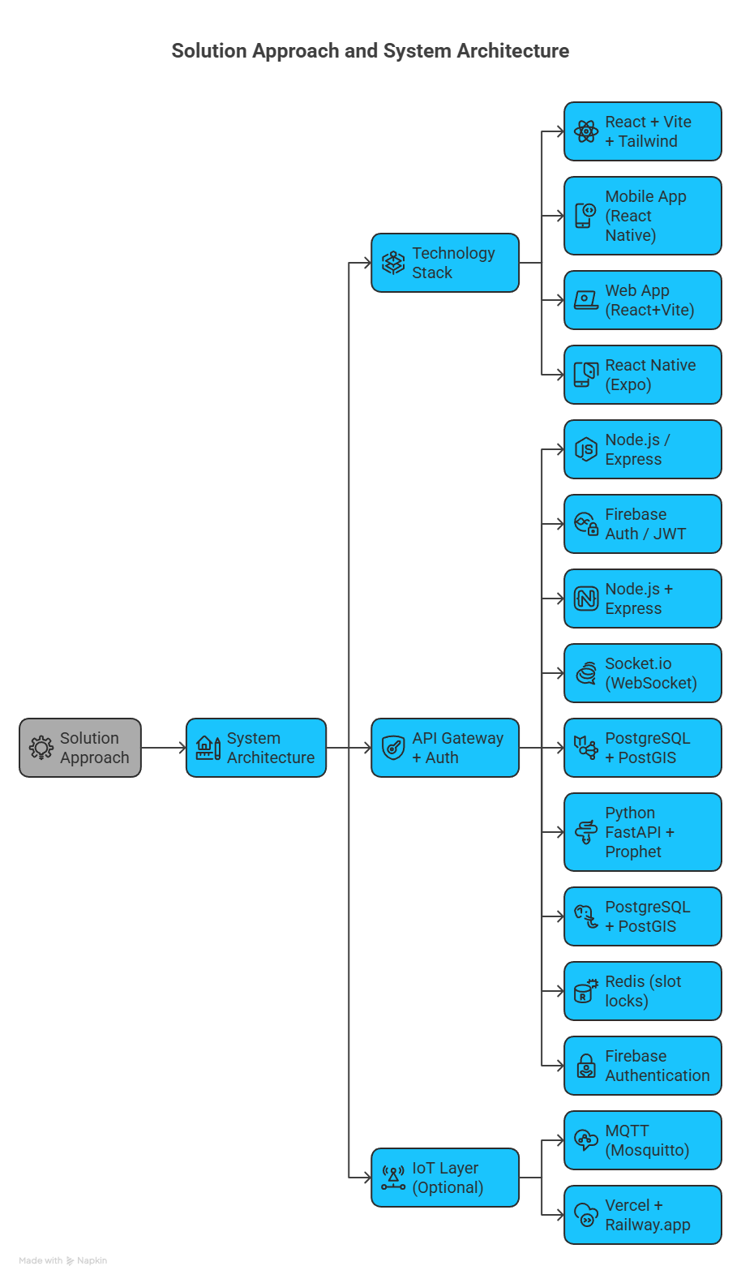
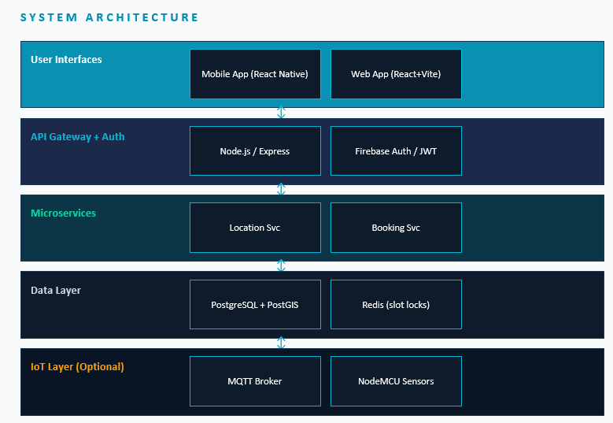

SOLUTION APPROACH
KEY TECHNICAL DECISIONS
Prophet ML for demand time-series forecasting
Redis slot-lock (3-min optimistic lock prevents double-booking)
PostGIS ST_DWithin for fast geo-radius queries
Socket.io rooms for per-station real-time updates

Slide 4
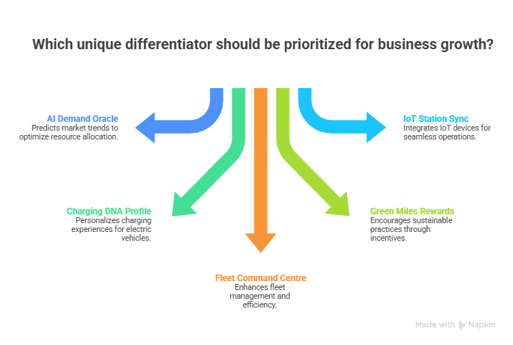
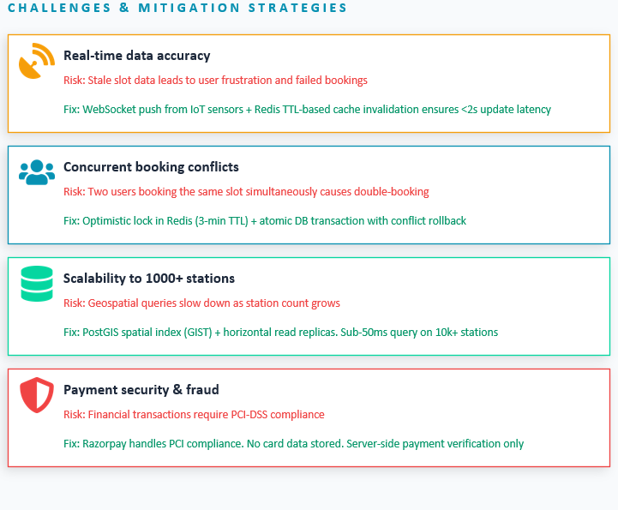

Slide 5
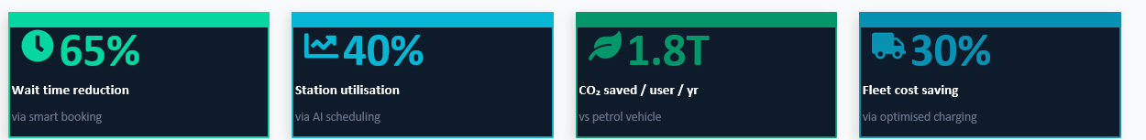
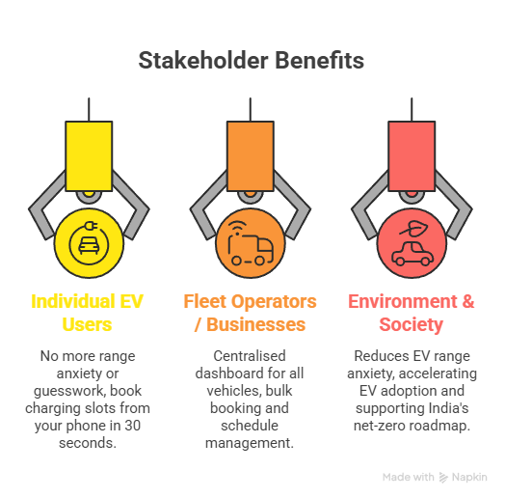
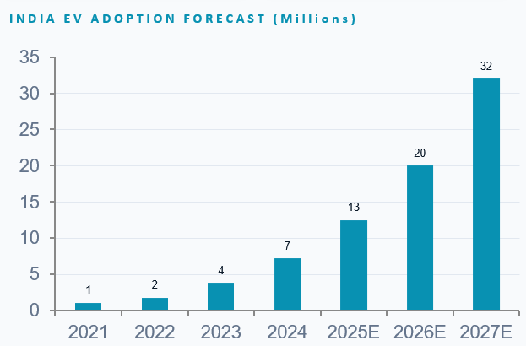

Slide 6
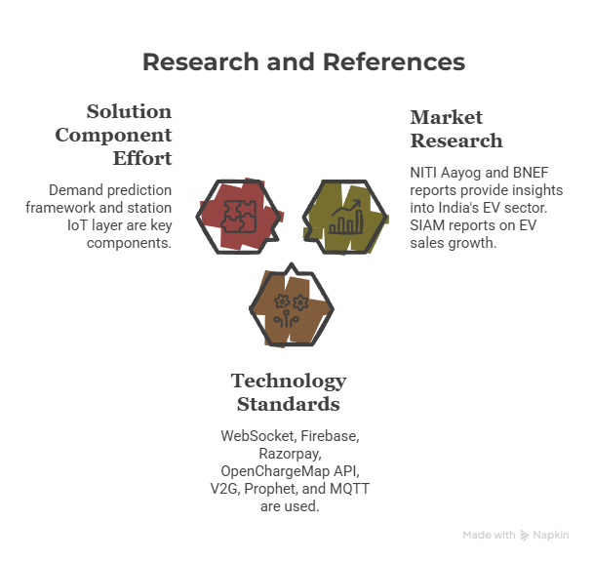
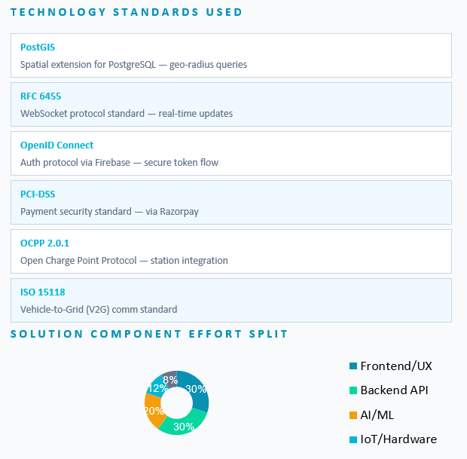
Reseach and References links NITI Aayog EV Report (PDF) BloombergNEF EV Outlook Report SIAM EV Industry Data (India)

