Slide 1

A case study on NYC Noise Complaints
Srinidheesh Ranganathan
College of Professional Studies, Northeastern University
EAI 6120: AI Communication and Visualization
Prof. John Wilder

Slide 2
Introduction:
In today's fast-paced world, data-driven strategies have emerged as game-changers in solving real-world challenges. By tapping into the vast sea of information provided by advanced data analysis, these strategies offer innovative solutions to complex problems. Through evidence-based decision-making, they empower leaders to allocate resources efficiently, overcome hurdles effectively, and implement targeted interventions. From healthcare to urban planning and environmental management, data-driven approaches have demonstrated their prowess in uncovering insights that were once hidden, driving progress and innovation. As we delve into the realm of data-driven solutions, it's clear that they are reshaping the landscape of problem-solving, ushering in a new era of transformative and impactful solutions.

Slide 3
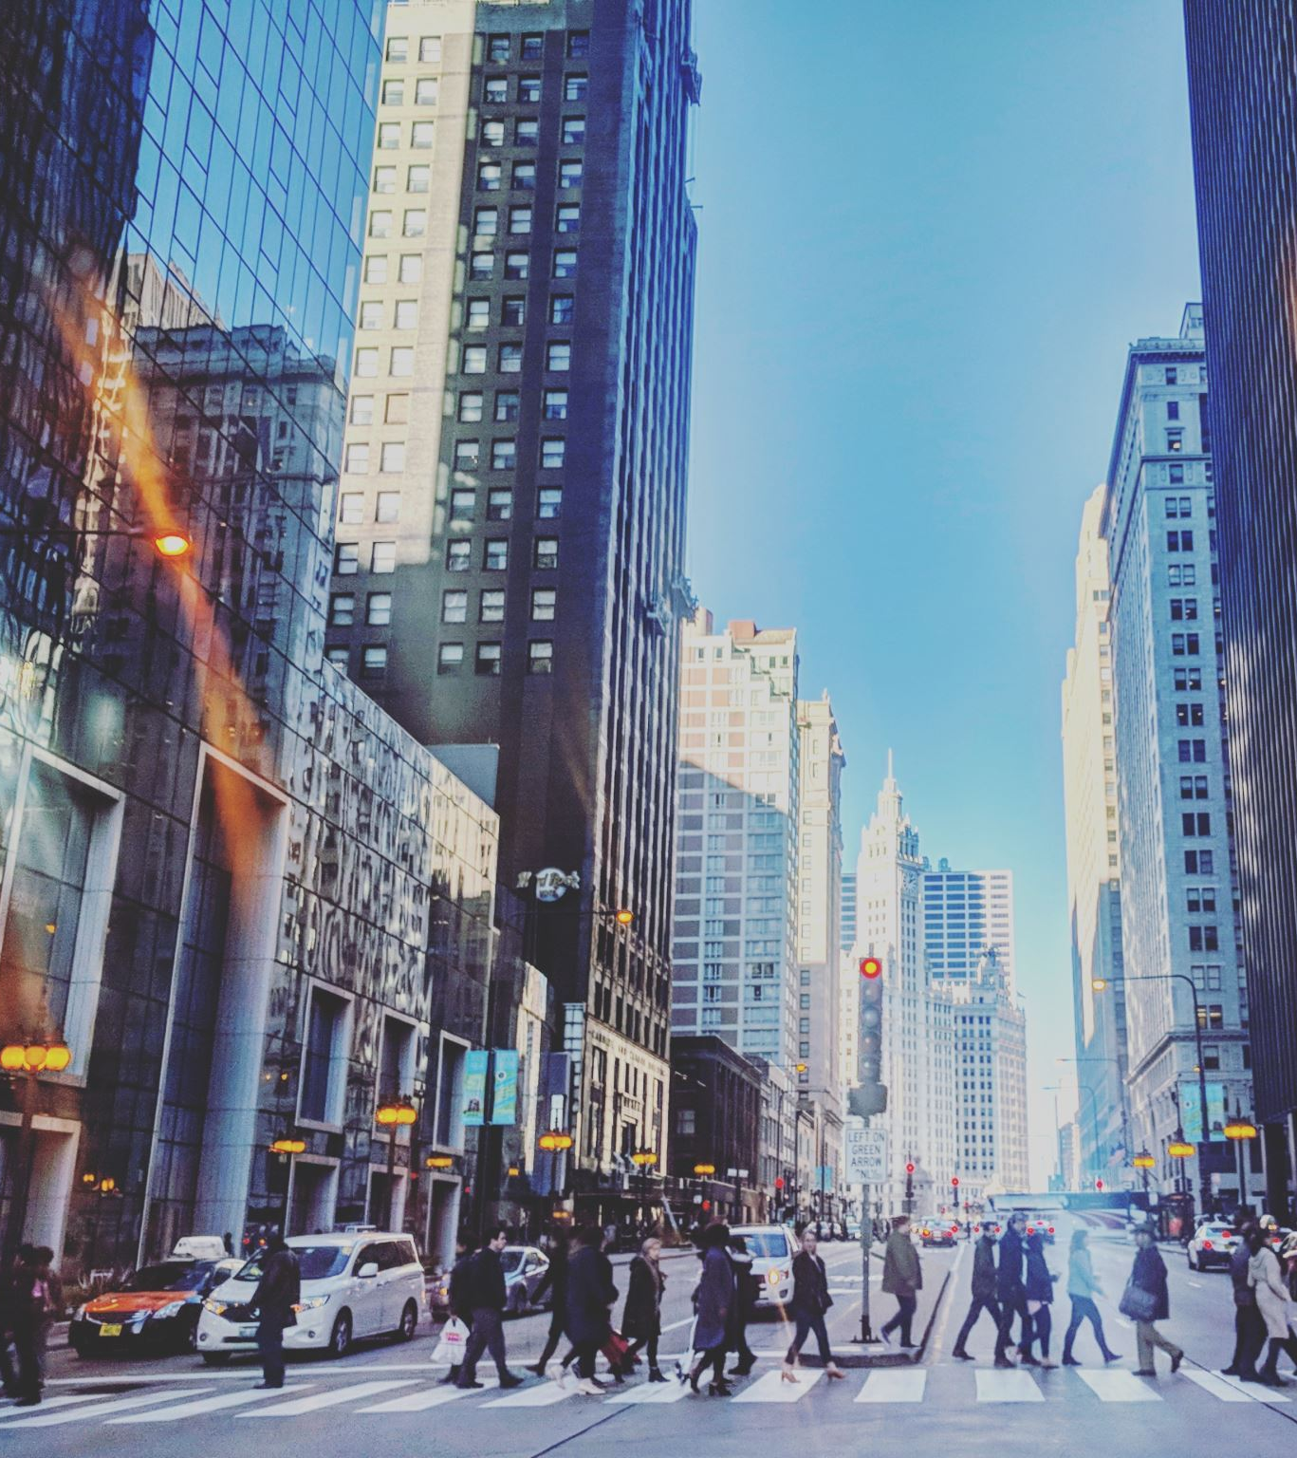
About the dataset
Dive into the NYC311 Customer Service Request Analysis dataset – a treasure trove of insights capturing the pulse of New York City's urban challenges. From noise complaints to street maintenance, this dataset offers a window into the city's service requests, unveiling trends that shape its dynamic urban landscape. It comes with around 33 million rows and 52 columns and is updated daily. The NYC311 Customer Service Request Analysis dataset is created and maintained by the City of New York.

Slide 4
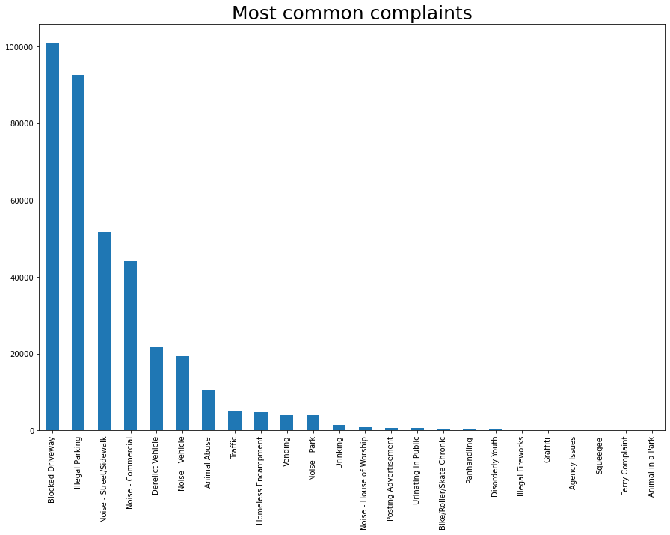
EDA

Slide 5
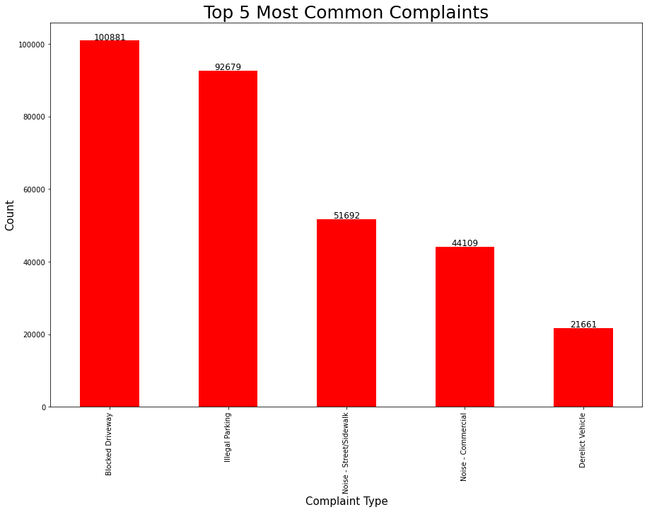

Slide 6
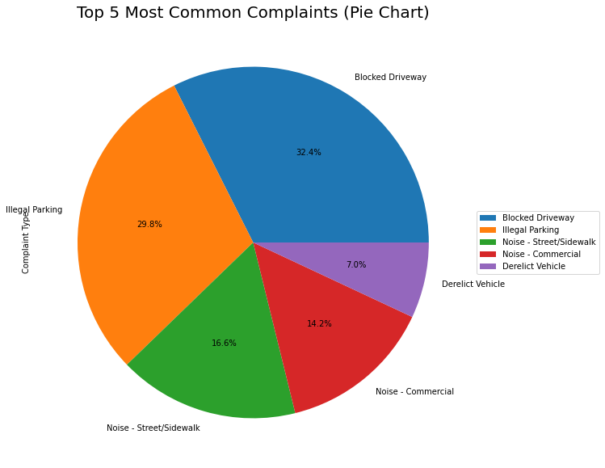

Slide 7
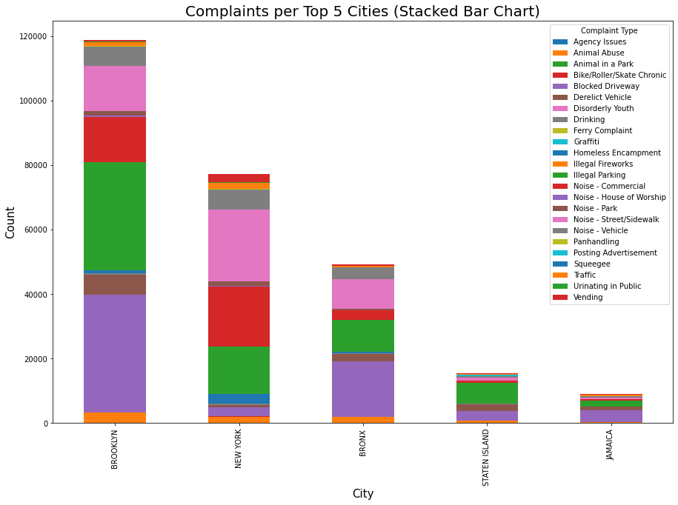

Slide 8
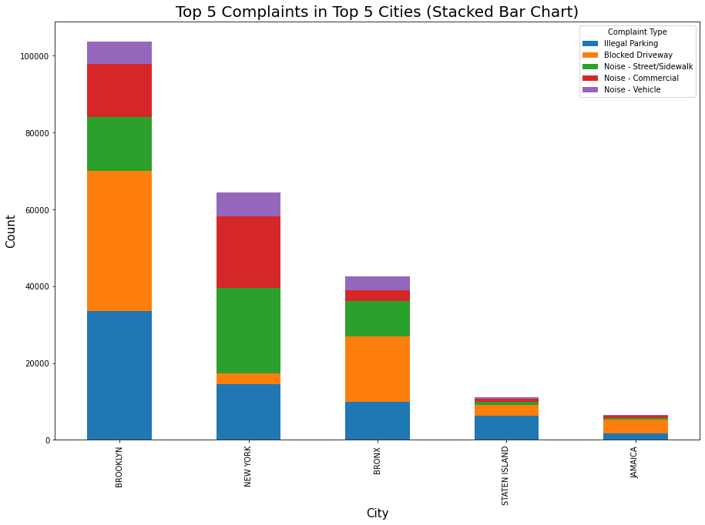

Slide 9
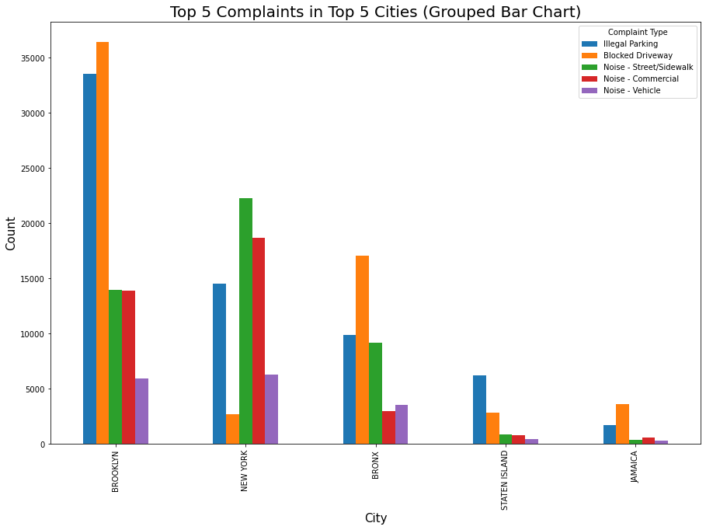

Slide 10
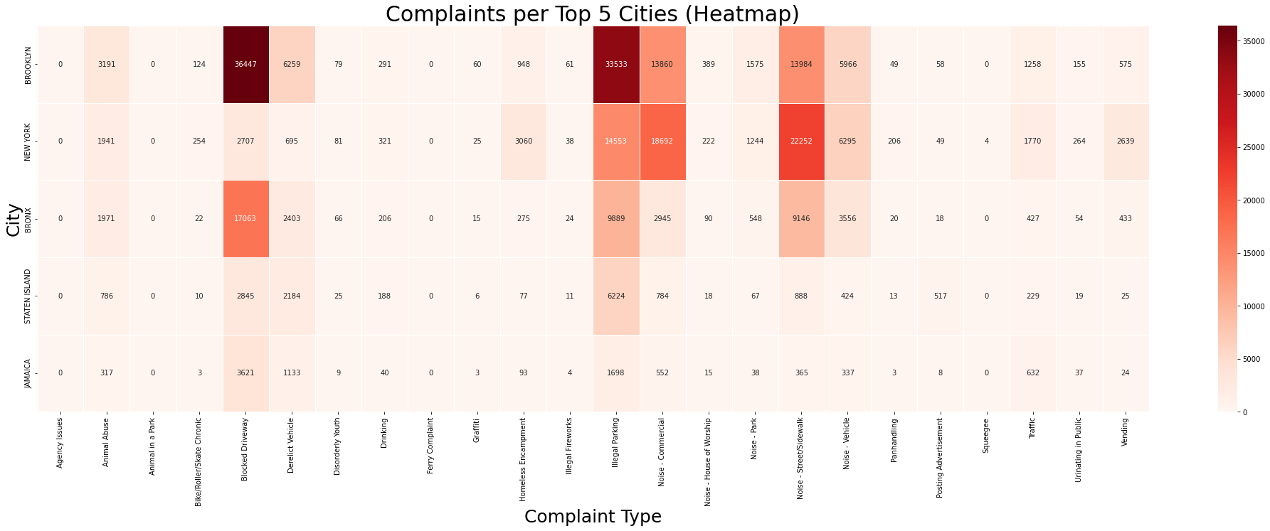

Slide 11
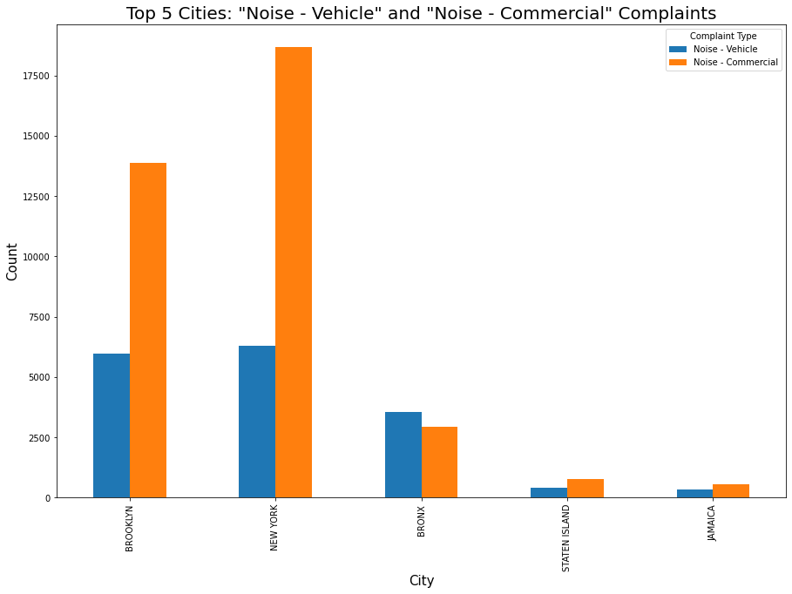

Slide 12
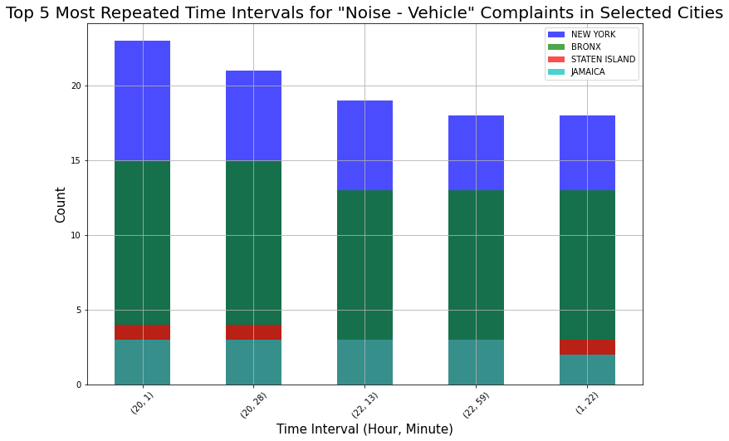

Slide 13
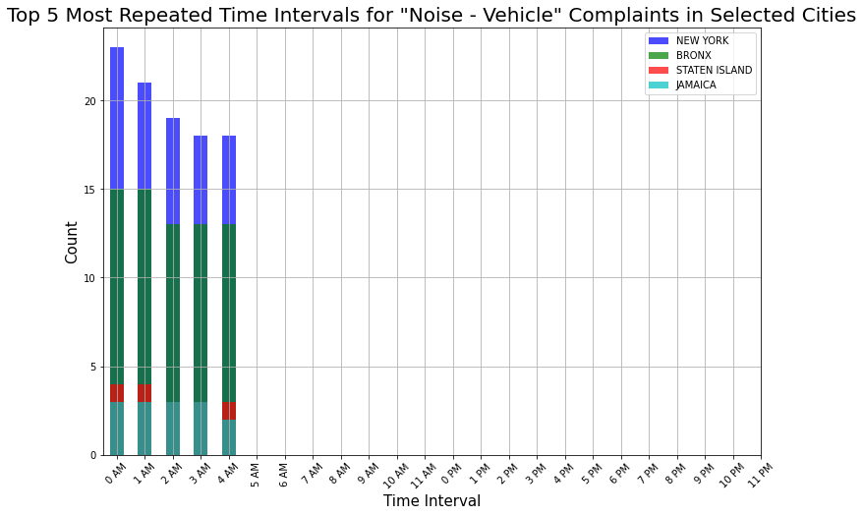

Slide 14
Proposed solution
To address the issue of high vehicle-related noise complaints during specific time intervals in different cities, here are four data-driven solutions that the mayor could consider:
Strategic Noise Patrols:
Deploy law enforcement officers and noise control teams during the identified peak hours (12 am to 4 am) in areas with frequent complaints. Utilize historical complaint data to prioritize patrolling routes and allocate resources effectively.
Targeted Public Awareness Campaigns:
Launch awareness campaigns to educate residents and businesses in the identified areas about noise regulations and courteous behavior during late-night hours. Use data insights to tailor campaign messages to each city's specific peak complaint times.

Slide 15
Cont.
Technology-Enabled Noise Monitoring:
Put up sensors in those noisy spots to track noise levels. If things get too loud, it'll send a signal to the right people to step in and address the issue.
Community Engagement and Reporting:
Create an easy way for people to report noise complaints through a mobile app or website. This way, residents can quickly report the issue and help keep their neighborhoods peaceful.
By utilizing data-driven solutions, the mayor can not only address the issue of high vehicle-related noise complaints but also enhance overall quality of life for residents in these cities

Slide 16
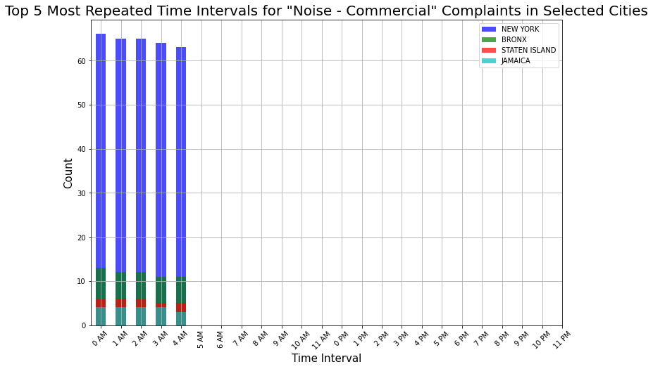

Slide 17
Proposed solution
The data-driven solutions that the mayor could consider to tackle the issue of high commercial-related noise complaints during the early hours (12 am to 4 am) in different neighborhoods:
Time-Dependent Zoning Regulations:
Implement stricter zoning regulations that limit commercial activities during the late-night hours. By restricting certain noisy activities during these times, you can help reduce the disturbance caused by commercial-related noise complaints.
Noise Monitoring and Alerts:
Install noise sensors in commercial areas that tend to have high complaint rates. These sensors can detect excessive noise levels and automatically notify business owners when they're getting too loud, allowing them to take corrective measures.

Slide 18
Cont.
Friendly Business Pacts:
Team up with local businesses to find ways they can keep things quieter at night. Maybe they can agree to tone down their noise or switch to quieter equipment during those late hours.
These down-to-earth ideas could help make the nights a lot more peaceful for everyone in the neighborhood.

Slide 19
Conclusion:
Data-driven strategies have emerged as powerful tools for tackling real-world challenges across various domains. By harnessing the wealth of information available through advanced data analytics, decision-makers can make informed and effective choices to address complex issues. These strategies enable evidence-based decision-making, leading to improved resource allocation, enhanced problem-solving, and targeted interventions. As demonstrated in various sectors, such as healthcare (Smith et al., 2020), urban planning (Batty, 2013), and environmental management (Turner et al., 2015), data-driven approaches provide insights that were previously inaccessible, driving innovation and progress. Through a synergy of data, technology, and informed decision-making, data-driven strategies offer transformative solutions to pressing challenges.

Slide 20
References
Batty, M. (2013). Big data, smart cities and city planning. Dialogues in Human Geography, 3(3), 274–279.
Smith, B. D., Smith, P., & Do, D. (2020). The role of big data and artificial intelligence in addressing the COVID-19 health crisis. Journal of Medical Internet Research, 22(7).
Turner, W., Rondinini, C., Pettorelli, N., Mora, B., Leidner, A. K., Szantoi, Z., & Burgess. (2015). Free and open-access satellite data are key to biodiversity conservation. Biological Conservation, 182, 173–176.
Matplotlib — visualization with python. (n.d.). Matplotlib.org. Retrieved August 20, 2023, from https://matplotlib.org/
pandas. (n.d.). Pydata.org. Retrieved August 20, 2023, from https://pandas.pydata.org/
Pandas tutorial. (n.d.). W3schools.com. Retrieved August 20, 2023, from https://www.w3schools.com/python/pandas/default.asp

