Slide 1

Cars24 Used Car Price Analysis
From web scraping to actionable market insights

Slide 2










Meet the Team
Our dedicated team of experts collaborated to deliver this comprehensive analysis.
Web Scraping
Data Analysing & Cleaning
Data Visualisation
Anand Raj (Team Lead)
Siddhesh Mali (Co Lead)
Linda Shalini T (Co Lead 2)
Atharv Kakade
Abhishek Mishra
Project Presentation
Project Report
Siddhesh Mali (Co Lead)
Anand Raj (Team Lead)
Himanshu Shakya

Slide 3




Project Aim and Objectives
Project Aim
To extract, clean, and analyze used car data from Cars24.com, focusing on Mumbai-based Hyundai listings. This will develop practical skills in web scraping, data processing, and Python analysis.
Key Objectives
Scrape key car details (Year, Kilometers, Fuel, Transmission, Price).
Organize and clean data into a structured CSV format.
Analyze and visualize data to derive market insights.
Present findings via Python Notebook, Report, and Presentation.
Scope & Coverage
Target Website: Cars24.com. Brand: Hyundai. Primary Location: Mumbai.

Slide 4








Technology Stack
Web Automation
Data Processing
Selenium WebDriver with ChromeDriver for dynamic page scraping
Pandas for manipulation, Regex for text parsing, CSV for storage
Visualisation
Environment
Matplotlib and Seaborn for statistical graphics
Google Colab and Jupyter Notebooks for development

Slide 5

Web Scraping Methodology
01
02
Automated Navigation
Data Extraction
Selenium controlled browser instances to traverse Cars24 listing pages systematically
Captured key attributes: Car Name, Year, Kilometres, Fuel Type, Transmission, Price,
03
Pagination Handling
Implemented robust logic to navigate through multiple pages whilst managing dynamic content loading
Technical Challenges
Overcame issues with dynamically loaded content, fragile CSS selectors, and inconsistent page structures across city-specific listings.

Slide 6

Data Cleaning & Preparation
Cleaning Operations
Derived Features
Duplicate Removal
Car_Age = 2025 − Year
Identified and eliminated redundant entries
Price_per_Km = Price ÷ Kilometres
Type Conversion
These engineered features enabled more sophisticated analysis of depreciation patterns and value metrics across the dataset.
Standardised numeric and categorical fields
Missing Values
Applied appropriate imputation strategies
Categorical Consistency
Normalised fuel types and transmission values

Slide 7


Feature Transformation
Transformed raw scraped data into analysis-ready features for deeper insight into pricing and usage
patterns.
1
2
Cleaned Car Name
Standardised Kilometers Driven
Removed year prefixes (e.g., 2016 Honda City → Honda City) for consistent brand and model grouping.
Converted all formats (e.g., “25k km”, “2.5L km”) into integer kilometers for accurate numeric comparison.
3
4
Normalized Price (INR)
Derived Car Age
Removed currency symbols and standardised ₹, lakh, crore values into a uniform INR scale.
Calculated as 2025 - Year to capture depreciation effects and support price–age relationship analysis.
5
Created Price per Kilometer
Derived from Price(INR) / Kilometers_Driven to identify value efficiency and pricing
anomalies.
Outcome
Ensured uniform numeric types for robust modeling and visualization.
Enabled comparative insights between car brands, fuel types, and usage patterns.
Prepared data effectively for advanced statistical analysis and machine learning models.

Slide 8
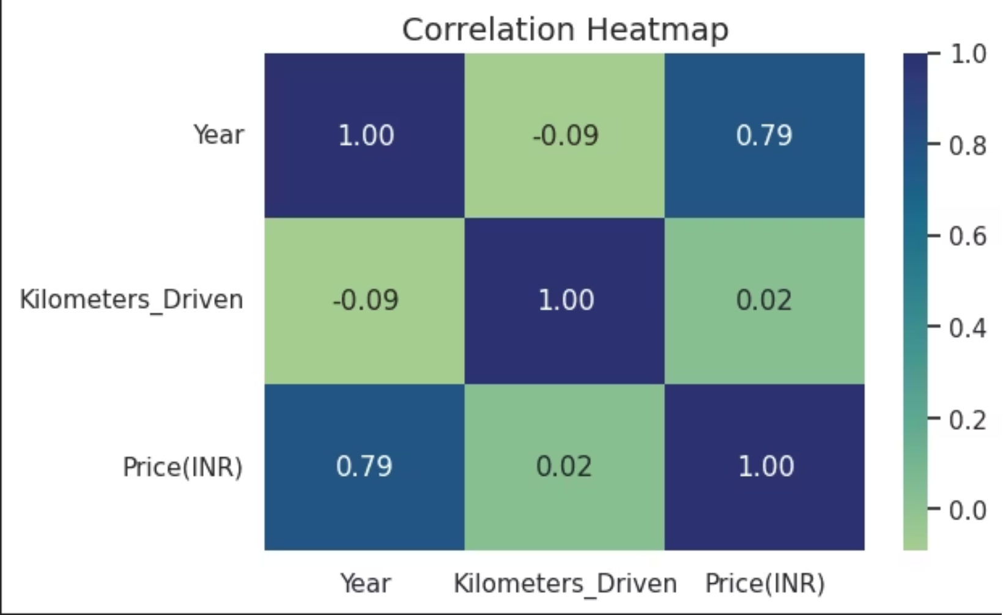
Exploratory Data Analysis
Univariate Analysis
Price distribution showed right-skewed pattern
Car age concentrated in 3–7 year range
Kilometre readings varied widely across listings
Bivariate Relationships
Strong negative correlation between price and vehicle age
Inverse relationship between kilometres driven and valuation
Correlation matrix revealed strongest predictive relationships, with age and mileage showing the highest negative correlation with price.
Transmission type significantly influenced pricing

Slide 9
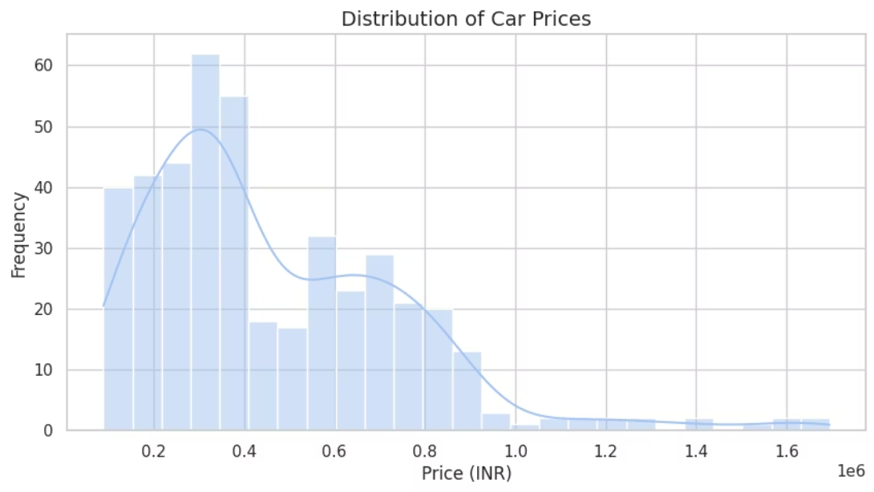
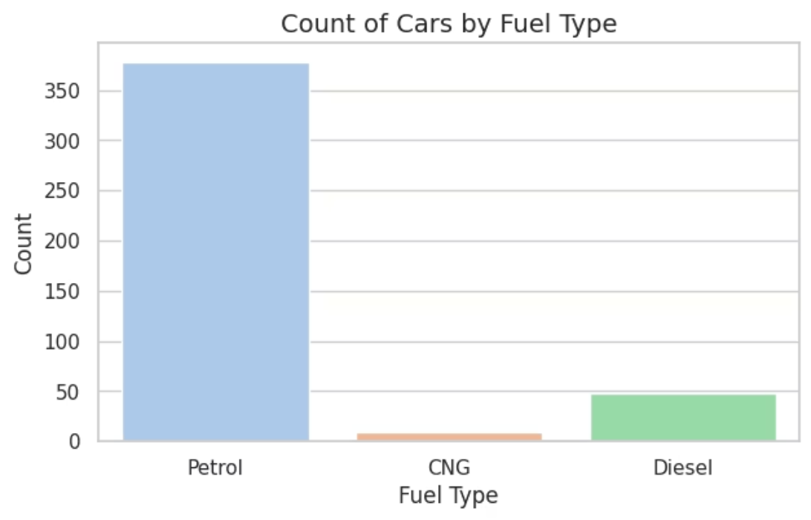
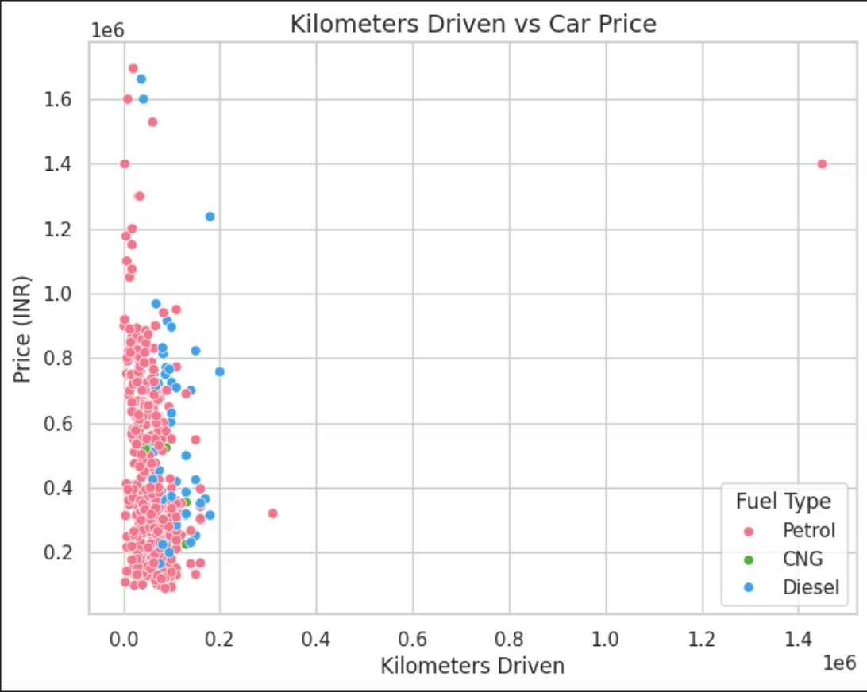
Visualisation Highlights
Price Distribution
Fuel Type Analysis
Price vs Kilometres
Right-skewed histogram indicating concentration in mid-range segment
Countplots revealed petrol dominance in the used car market
Scatterplot demonstrated depreciation with increased mileage by fuel type

Slide 10
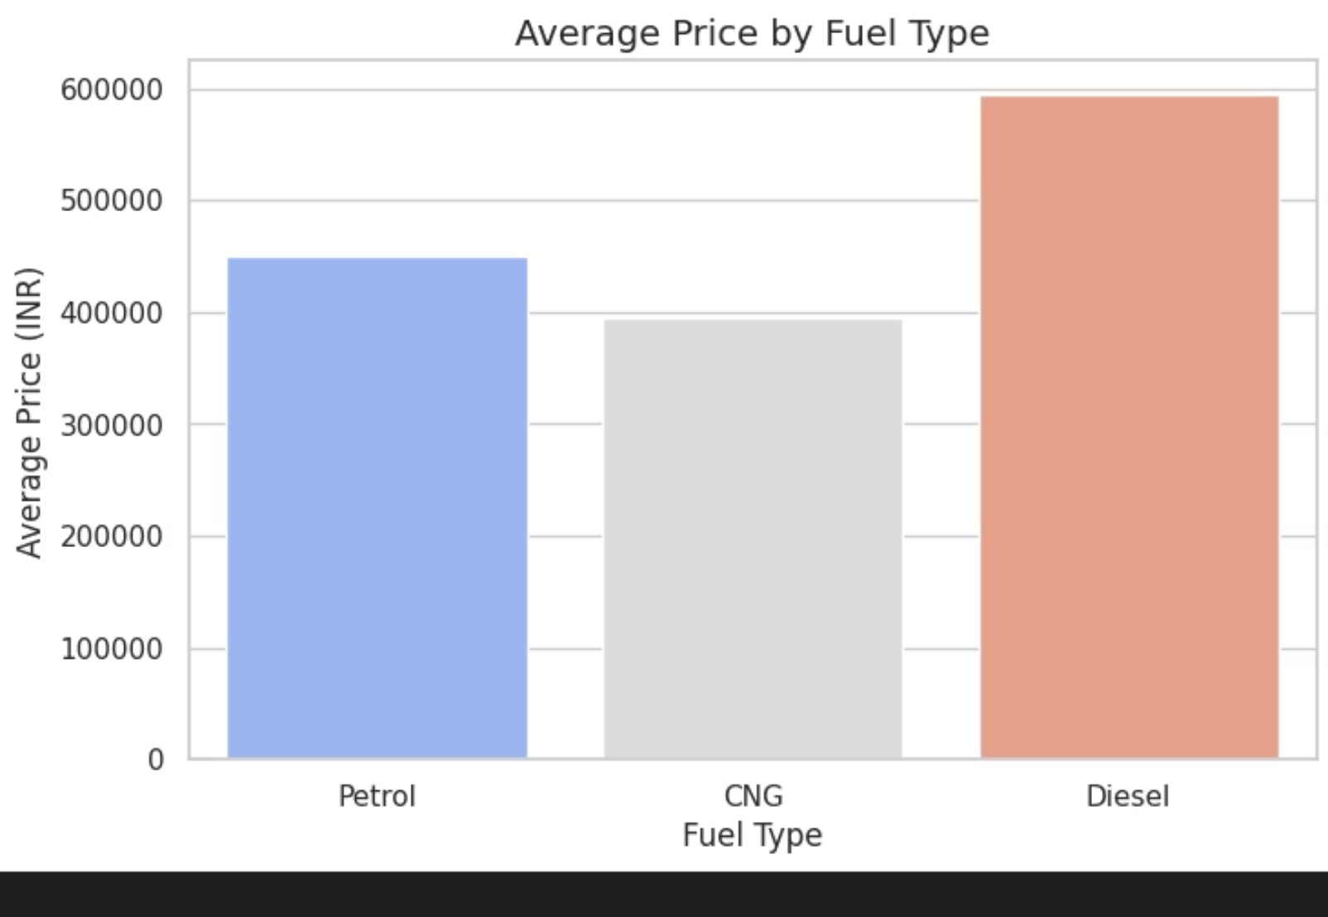
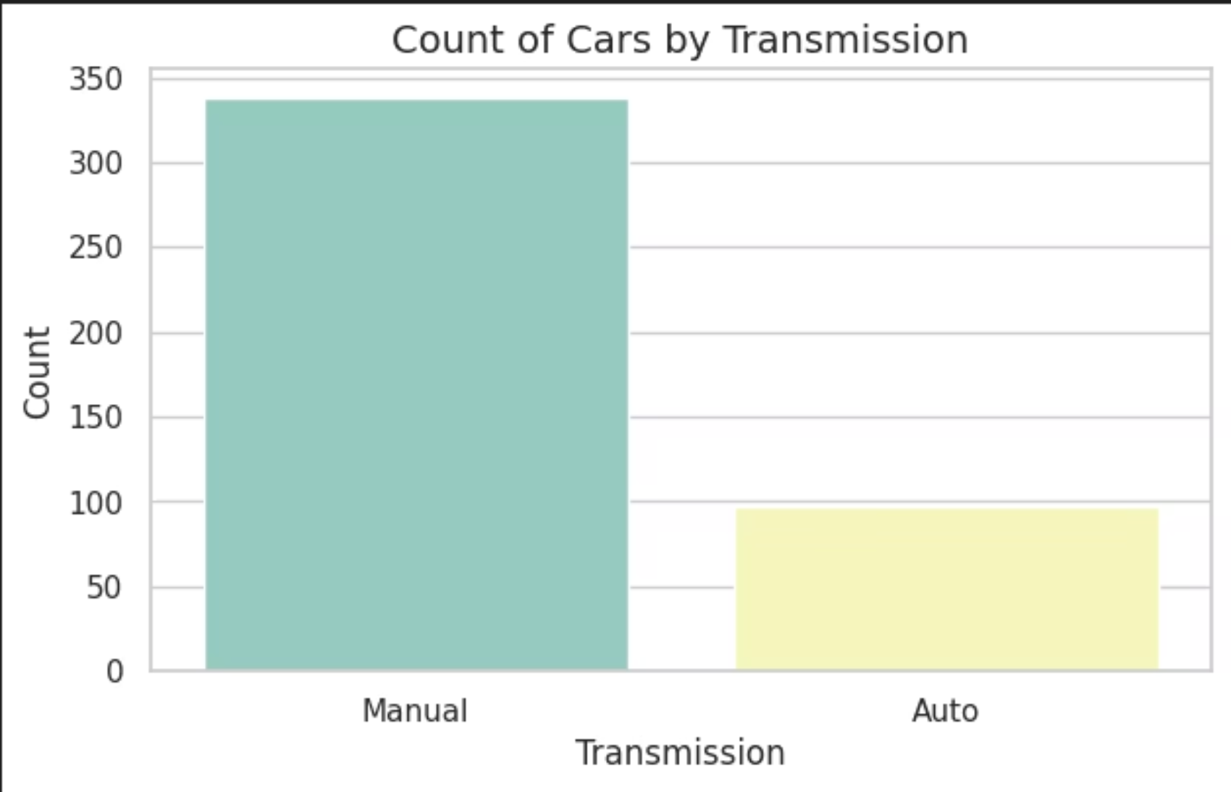
Deeper Dive into Market Trends
Average Price by Fuel Type
Count of Cars by Transmission
Diesel cars command the highest average prices (~₹6 lakh), reflecting their long-distance efficiency and perceived market value. Petrol models follow at ₹4–4.5 lakh, while CNG cars are the most affordable, catering to budget-conscious and eco-friendly buyers. This indicates fuel type is a strong predictor in pricing models.
Manual transmission vehicles dominate the market with listings three times higher than automatics, suggesting a strong preference among budget-oriented consumers. Automatic cars form a smaller, premium segment, appealing to urban users prioritising comfort. Transmission type significantly influences both market availability and demand.

Slide 11
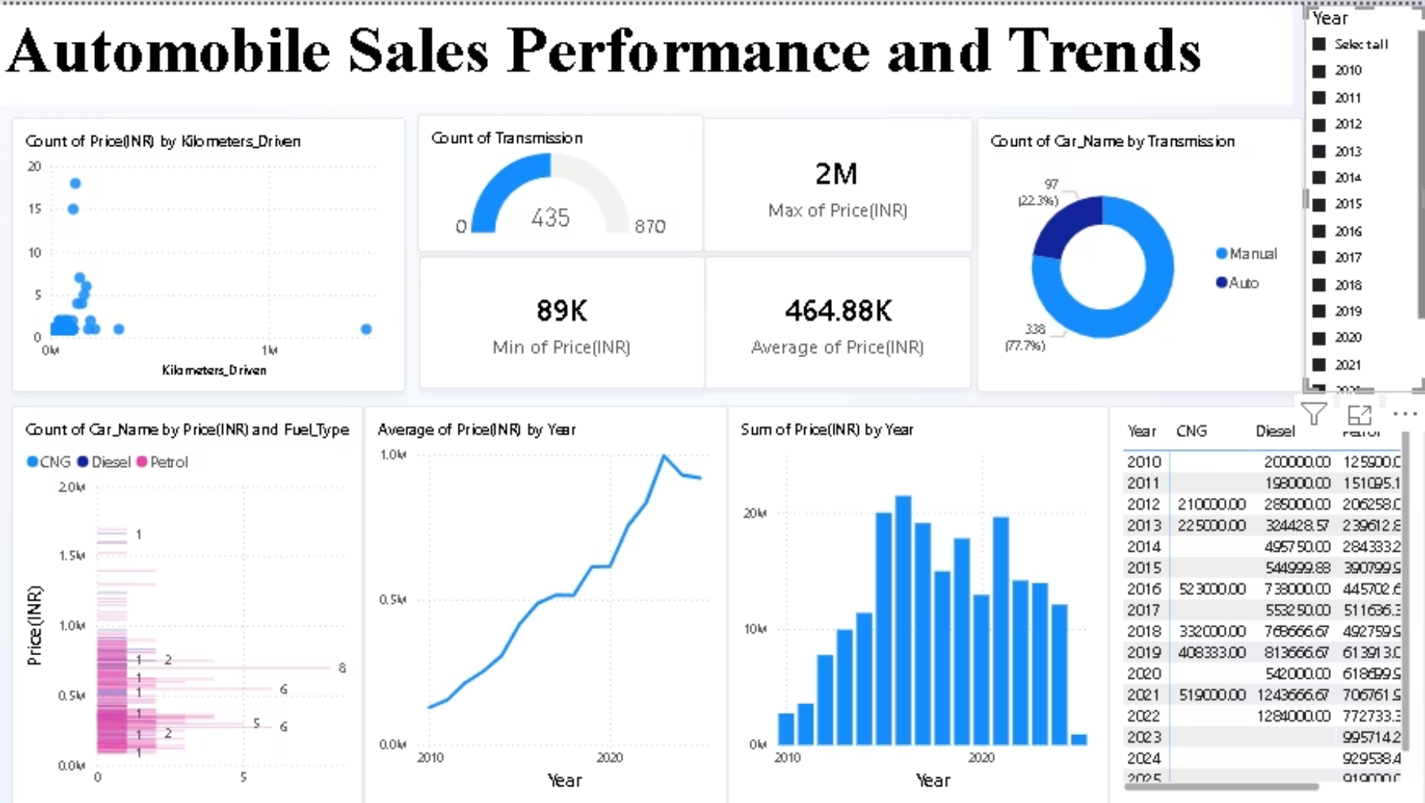
Automobile Sales Trends & Insights (Power BI Dashboard)
Key Observations from Dashboard
.
Price vs Kilometers Driven: As kilometers increase, car prices decrease, confirming mileage as a strong negative predictor of resale value.
Strategic Insights
Transmission Trends: Automatic cars dominate (870 units) compared to Manual (435), indicating a shift toward convenience-focused buyers. This suggests a changing market preference.
Factor
Observation
Impact
Mileage
Higher km → Lower price
Use in depreciation modeling
Fuel Type & Price Patterns: Diesel cars command the highest prices, followed by Petrol, while CNG remains the most budget-friendly. This confirms fuel type as a key factor in price modeling.
Transmission
Automatics rising
Market demand shift
Fuel Type
Diesel premium
Pricing & eco-strategy
Yearly Price Trends: Average and total prices show an upward trend from 2010–2020, reflecting market growth and rising consumer spending power.
Year Trend
Rising prices
Time-based forecasting

Slide 12



Conclusion & Future Directions
Project Accomplishments
Next Steps
1
Successfully scraped comprehensive vehicle data
Predictive Modelling
Develop ML algorithms for price estimation
2
Cleaned and engineered analytical features
Interactive Dashboard
Create Power BI visualisation platform
3
Generated actionable market insights
API Integration
Implement automated, scalable data collection
This project demonstrates the complete data science pipeline from raw data acquisition to meaningful business intelligence.

Slide 13
Thank You!
We appreciate your time and interest in our Cars24 Used Car Price Analysis project. We hope our insights provide valuable understanding of the market dynamics.

