Slide 1



Slide 2
What is it?
Immerse yourself into the magical world of Harry Potter and the Goblet of Fire and explore the riddles of the Triwizard Maze!

Slide 3

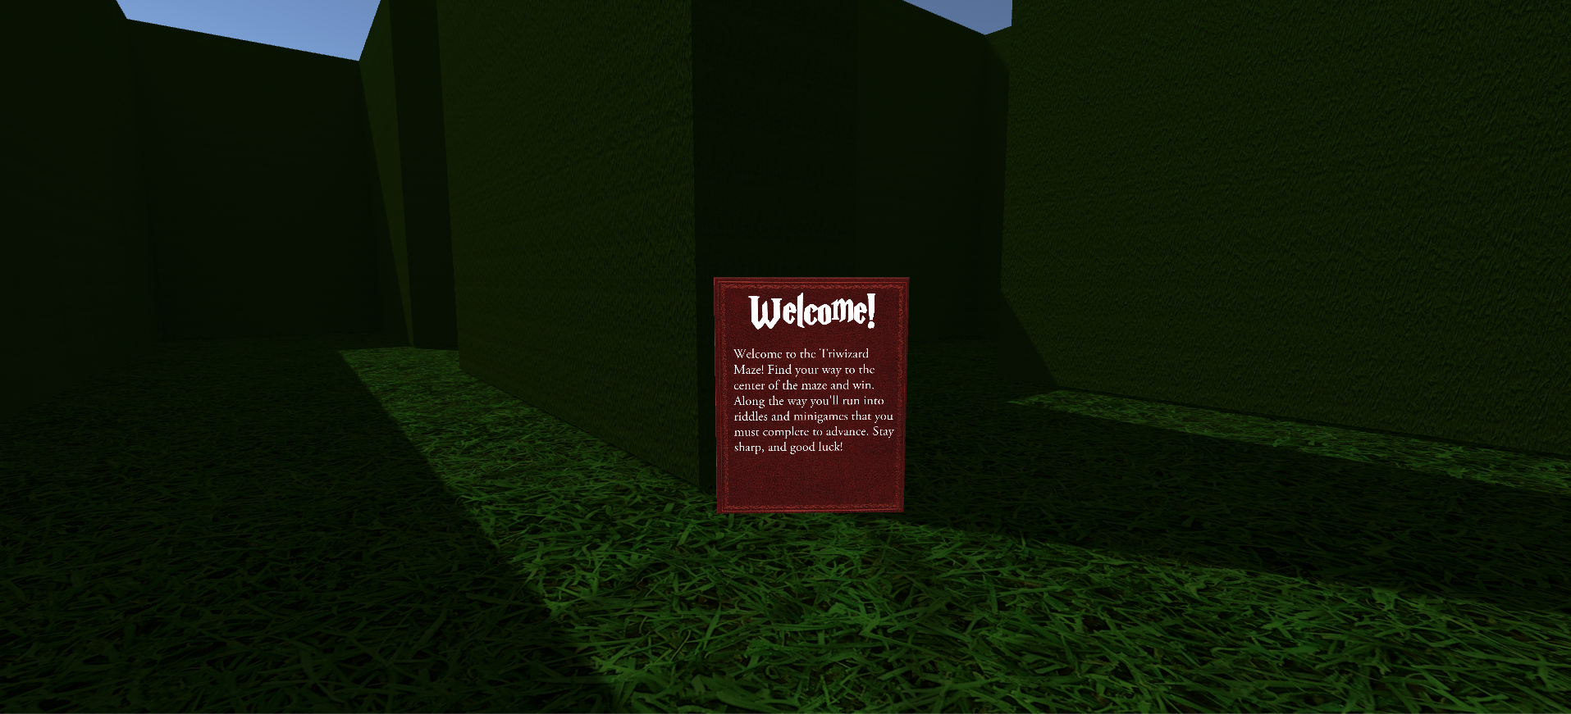

Slide 4
Gameplay: Summary
In VR Triwizard Tournament, the player navigate through a complex maze to get to the end. Along the way, the player will encounter riddles scattered across the correct path that must be solved in order to progress in the maze.

Slide 5
Gameplay:
Logistics
Navigation
Google Daydream TeleportationController
Tooltips included to help the user!
Rules
You have 10 minutes
No mercy -- one wrong answer means GAME OVER
5 riddles that lead the way

Slide 6

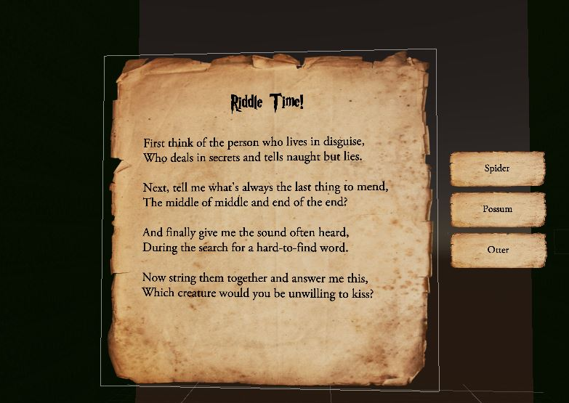

Slide 7


