Slide 1
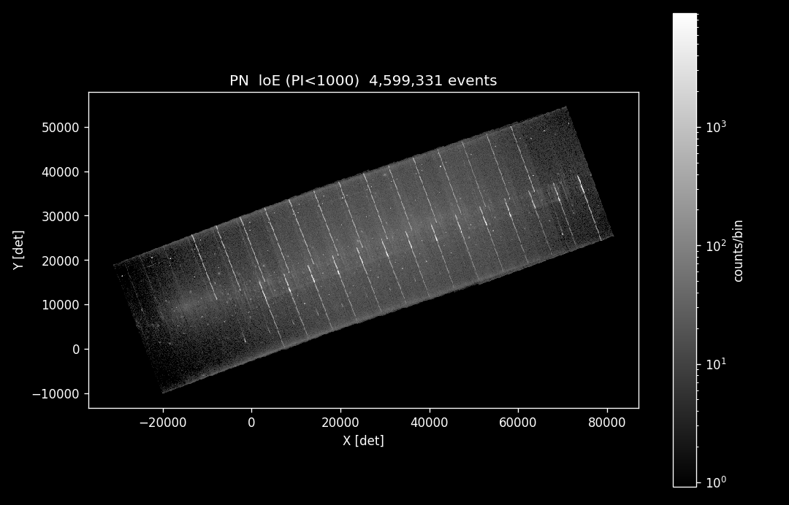
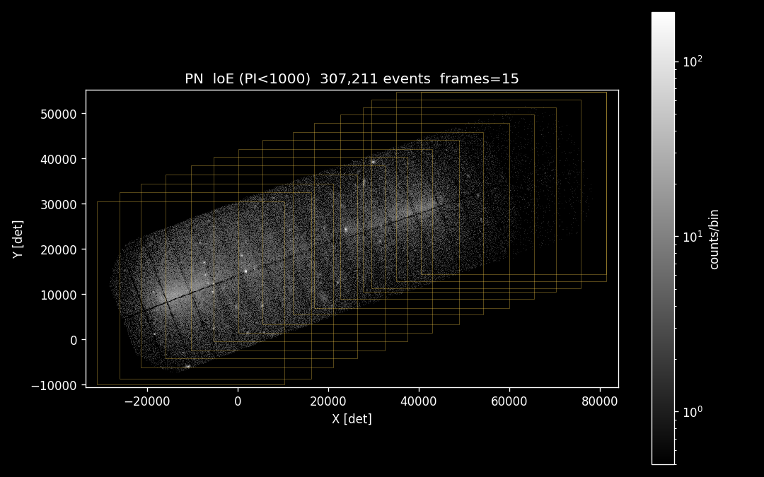
PN repro
PN cleaned, flare filtered

Slide 2
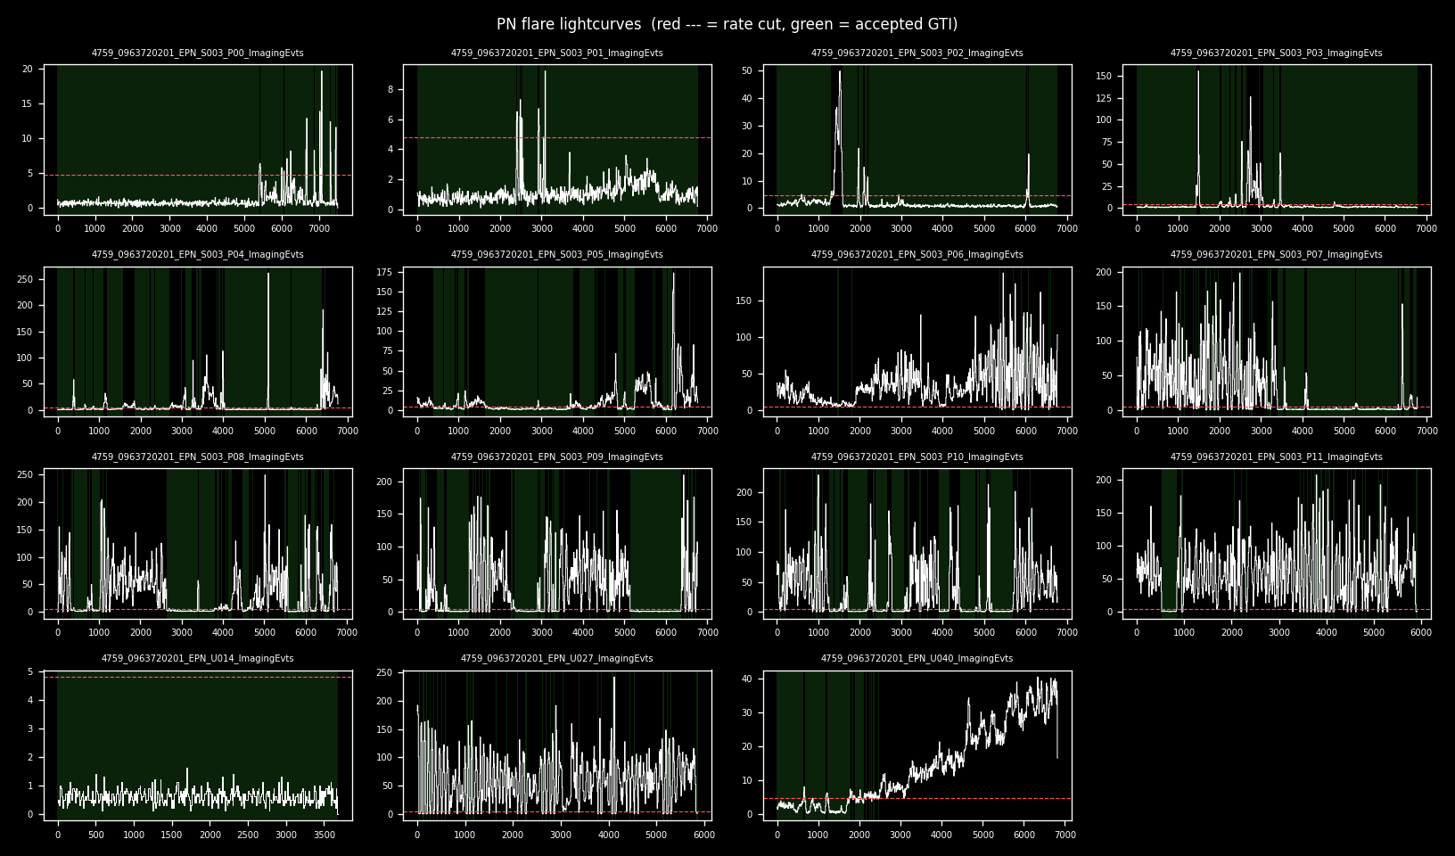
PN lightcurves and filtered intervals

Slide 3
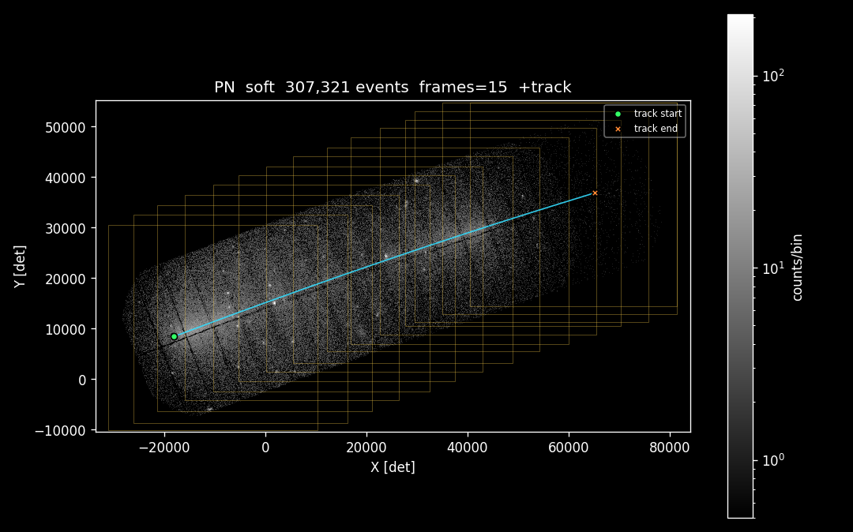
PN after additional cleaning, 200-1000 eV restricted
with comet trail

Slide 4
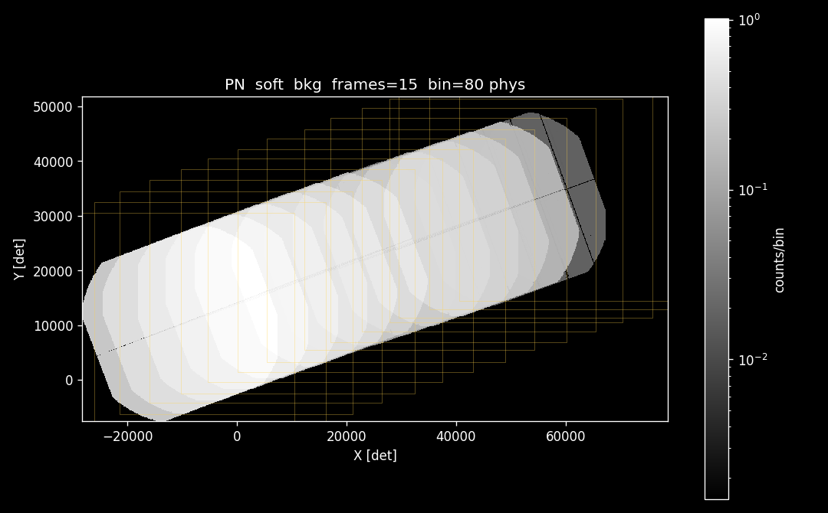
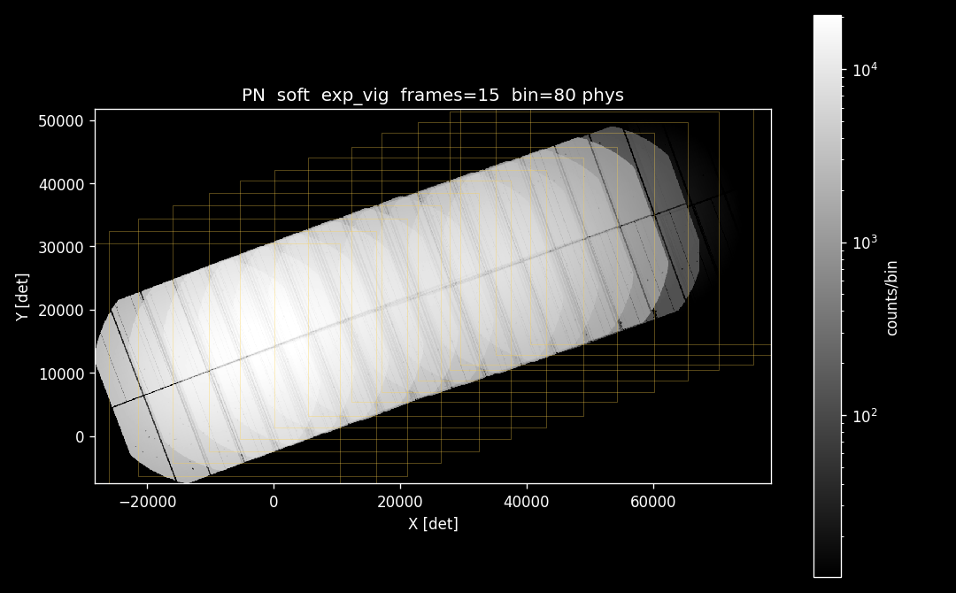
PN background map
(uniform approx.)
PN exposure map

Slide 5
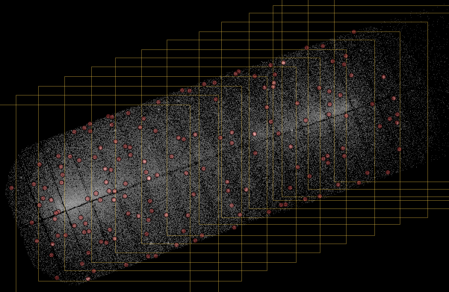
PN (soft band) with cheesed sources (from hard-band)

Slide 6
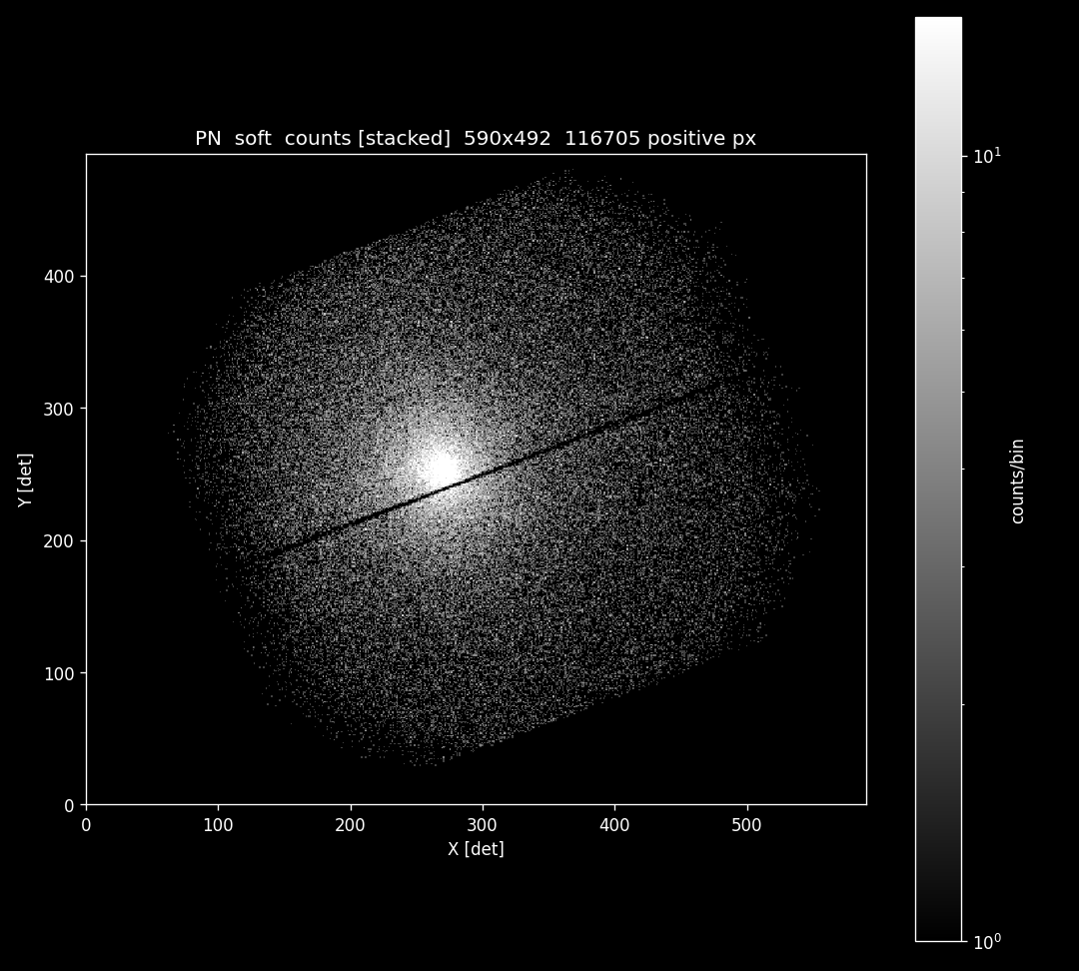
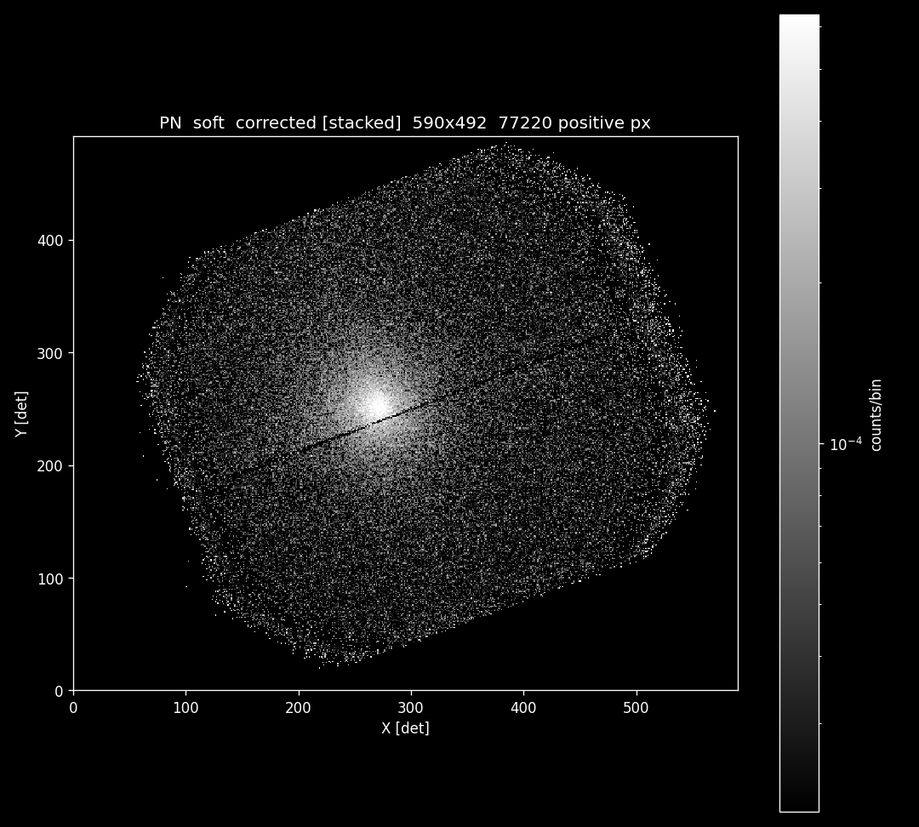
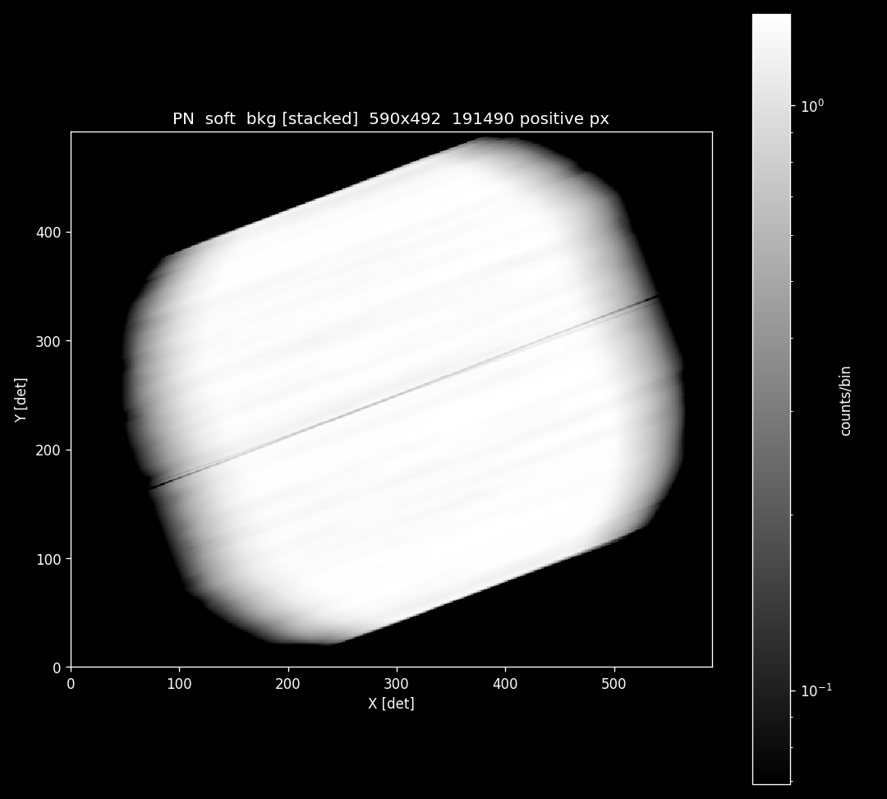
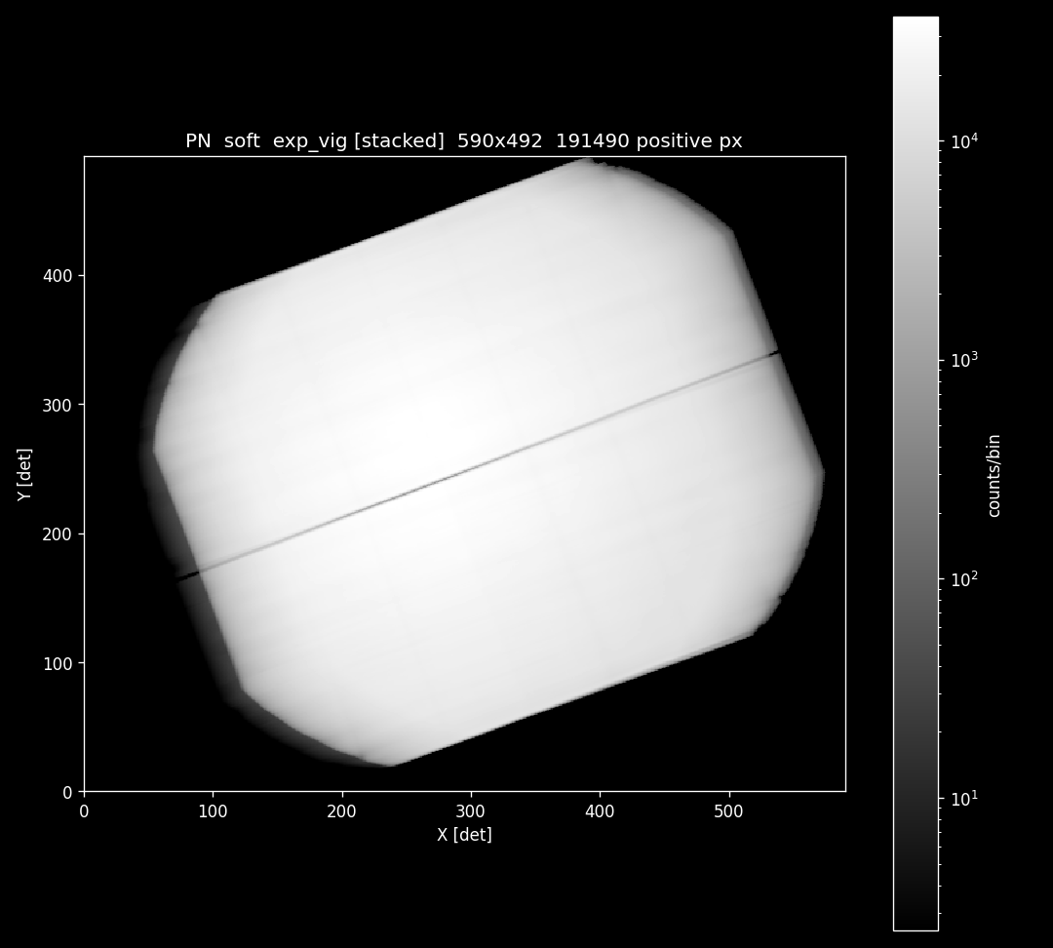
PN stacked corrected image
counts
background
exposure

Slide 7
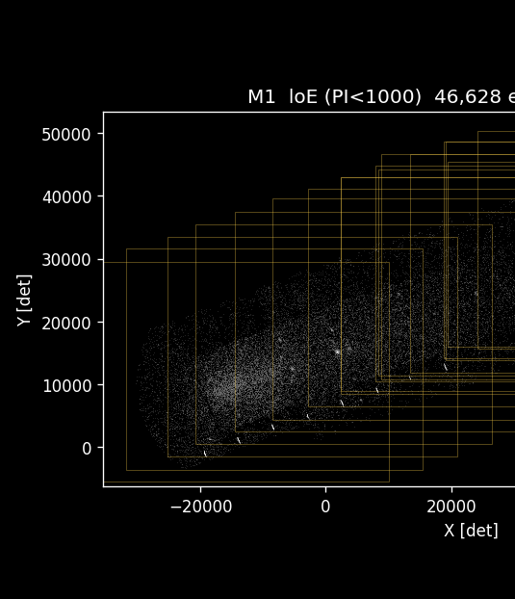
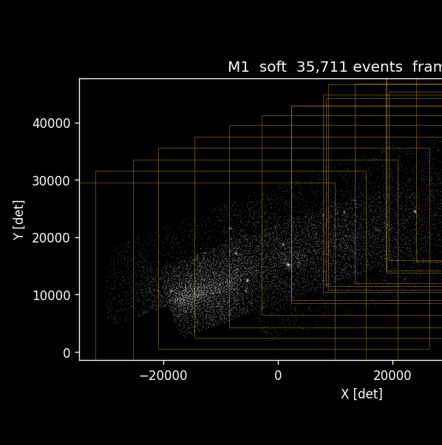
MOS1 artifacts removed with emanom

Slide 8
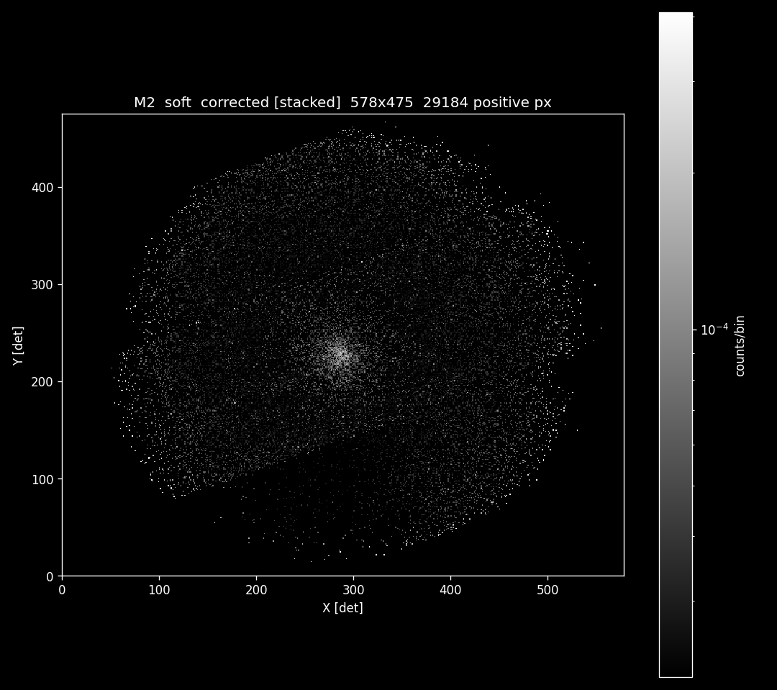
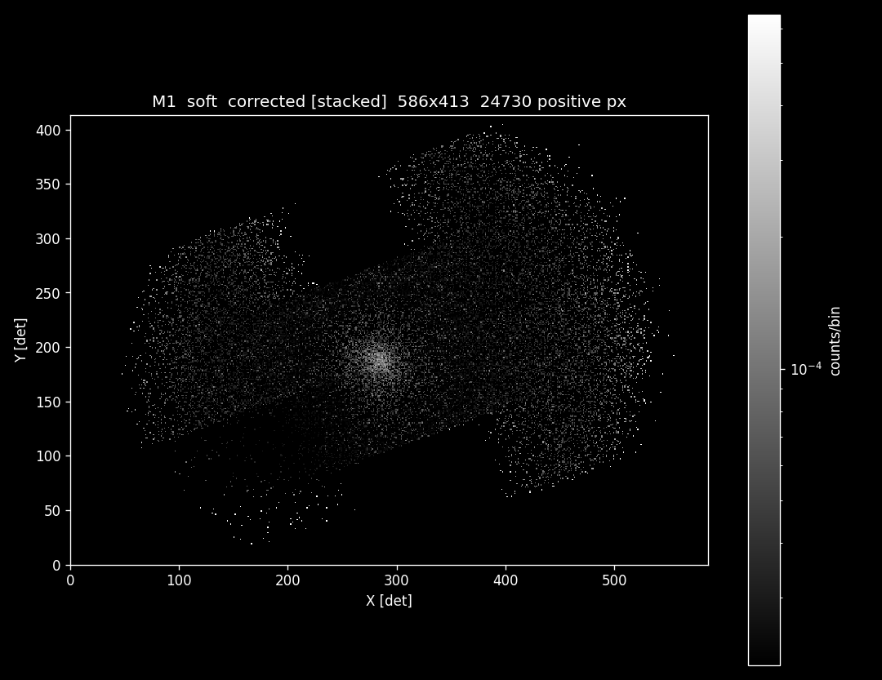
MOS1
corrected & stacked
MOS2
corrected & stacked

Slide 9
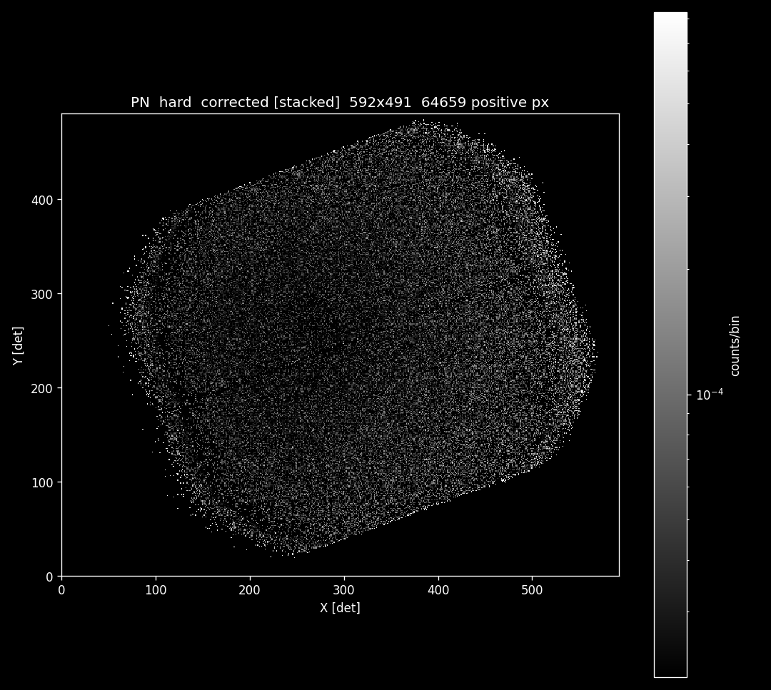
PN (200-1000 eV)
corrected & stacked
PN (1000-4000 eV)
corrected & stacked

Slide 10
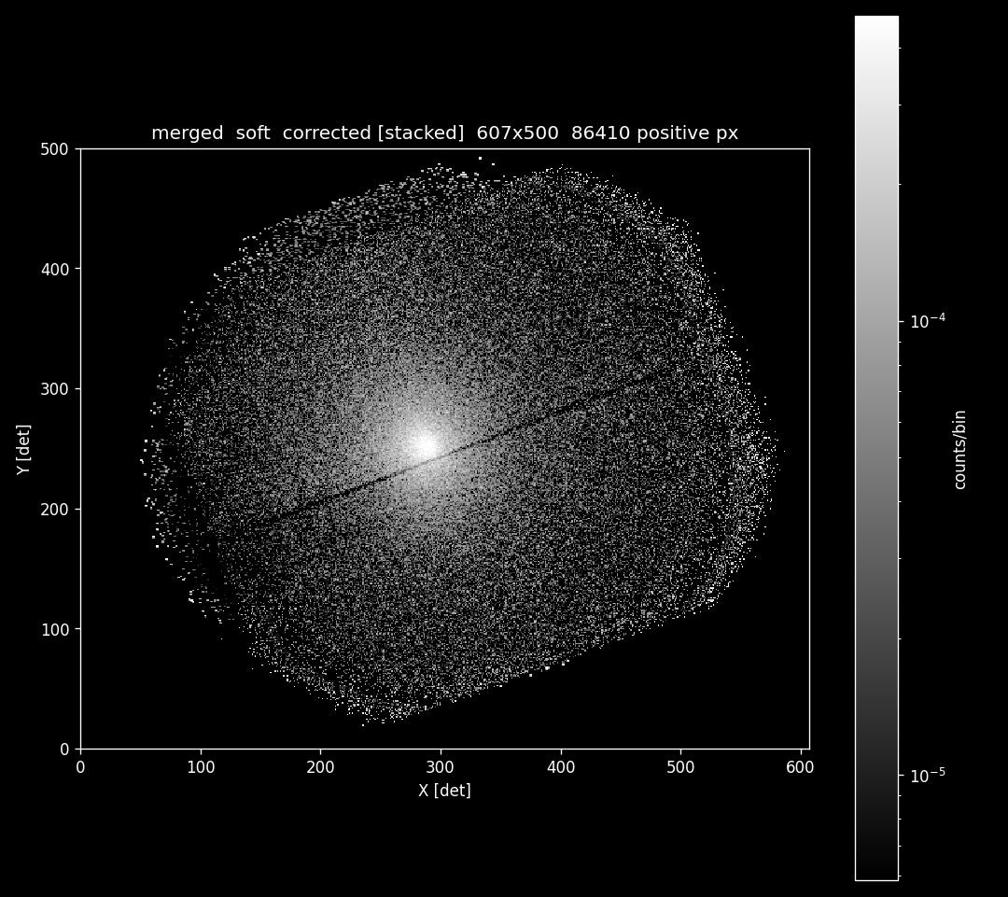
PN + MOS1 + MOS2
(200-1000 eV)
corrected & stacked

