Slide 1
BASIC PHONEBOOK OPERATIONS
SUBMITTED BY,
RAKESH KRISHNA,1831038
D.RESHMA,1831040
S.SANTHIYA,1831048
SIMON LEONARD,1831051 G.VIGNESH,1831030

Slide 2
AIM OF THE PROJECT
To create a phone book using datastructure concepts which enables the user to maintain contact details and to provide several search functions .

Slide 3
INPUT
Contact details of the person or Company like,
First name
Second name
E-mail id
Phone number

Slide 4
CONCEPTS USED
The following datastructure concepts were used :
Hashing
Structure
Arrays
Linear search
Merge sort

Slide 5
FUNCTIONS APPLIED
Divide and Conquer method – Merge sort
Linear Search
File manipulations
Compute unified device architecture - CUDA

Slide 6
FUNCTIONALITIES
The following are the outputs which are generated through this application :
The user can add more contact to the phone book.
The user can remove any contact if not needed.
The phone numbers are encrypted using parallel processing.[CUDA]

Slide 7
FUNCTIONALITIES
The user can also modify any contact detail.
The user can search for any contact details
If the user wants they can also view their recent search history.

Slide 8
METHODOLOGIES USED
The user can add more contact to the phone book.
For adding a number the user want to give the following details,
First name
Second name
E-mail
Phone number

Slide 9
METHODOLOGIES USED
The user can remove any contact if not needed.
This can be done by giving First name
as input .

Slide 10
METHODOLOGIES USED
The user can also modify any contact detail.
This can be done by giving First name
as input.

Slide 11
METHODOLOGIES USED
The user can search for any contact details
This can be done by giving either one of the following input,
First name
Second name
E-mail
Phone number

Slide 12
PHONE NUMBER ENCRYPTION
The phone numbers are copied from the files and they are kept encrypted by addition operation
To reduce the time complexity of the encryption the special feature CUDA is used.

Slide 13
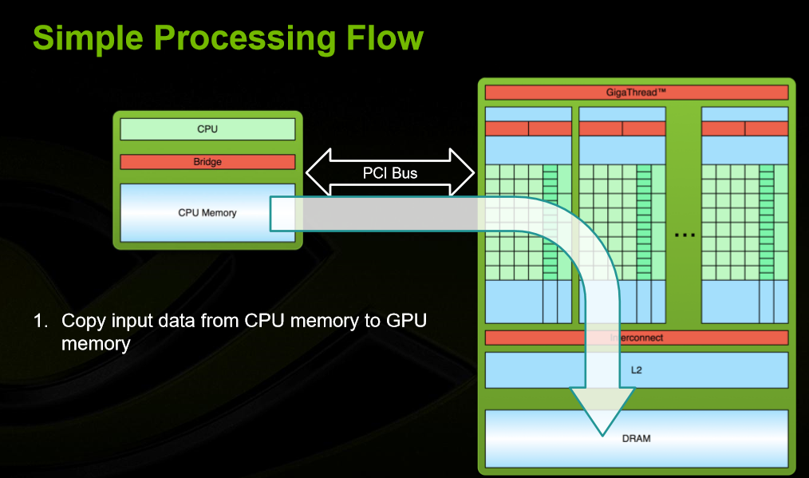
CUDA ALGORITHM

Slide 14
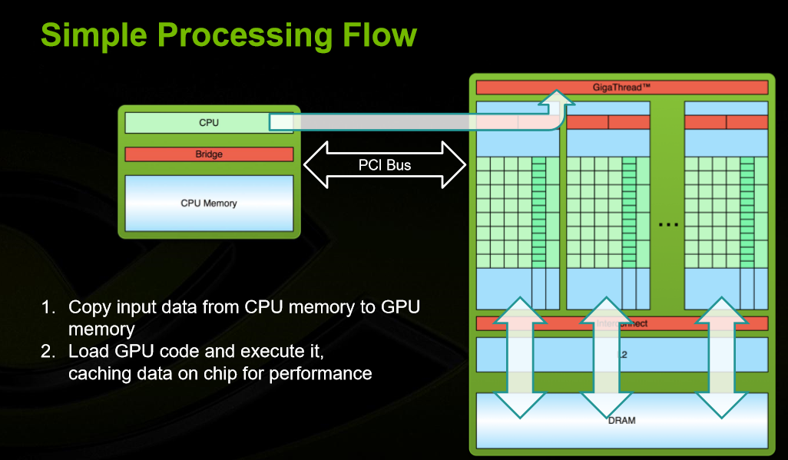

Slide 15
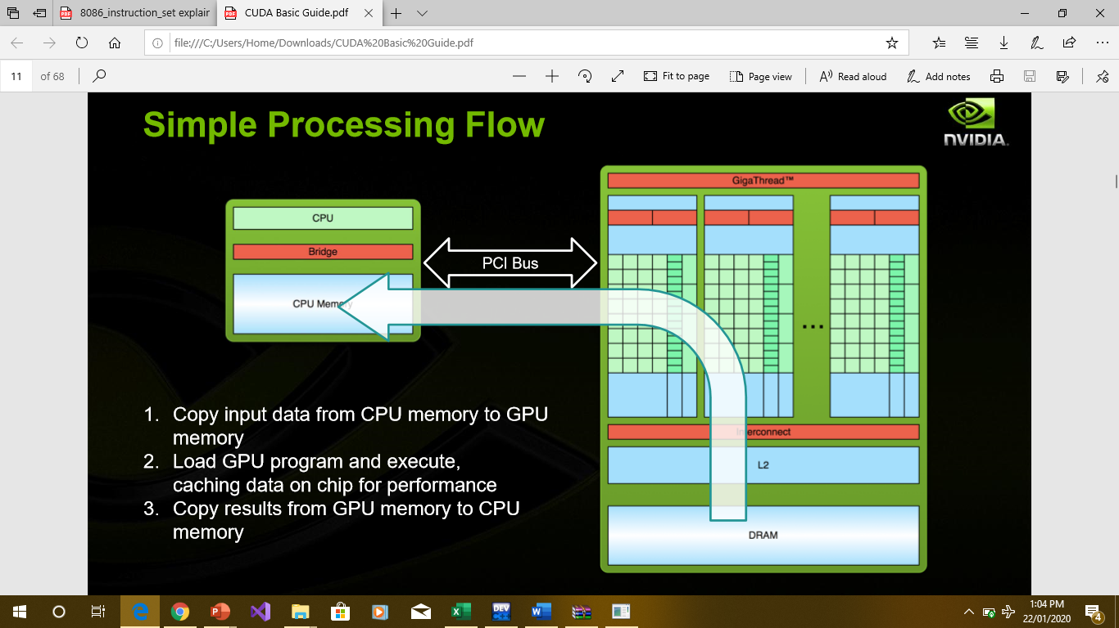

Slide 16
ADVANTAGES
It provides the complete phonebook application which gives the user the joy of organized contacts
There he/she can search the desired contacts using mobile numbers and names of the contacts
This application provides the full file system where the user can store, retrive and manipulate the contacts

Slide 17
The phone numbers are encrypted using CUDA
CUDA is the special platform which uses nvidia GPU to perform the array operation using parallel processing.
It drastically reduces the time complexity when compared to normal CPU processing.

Slide 18


