Slide 1
ESDC Design Scope and System Relations
Mass Power Heat Data Orbit
Payload
Orbit
Propulsion
On-board Computer
Attitude Determination & Control
Telemetry, Tracking & Control
Thruster
CPU
Actuator
Antenna
Propellant
RAM
Sensor
Transceiver
Power Supply
Storage
Tank
Power Supply
Thermal Control
Generation
Active
Conversion
Passive
Structure
Storage
Mass budget
Power budget
Heat budget
Margin
Margin

Slide 2

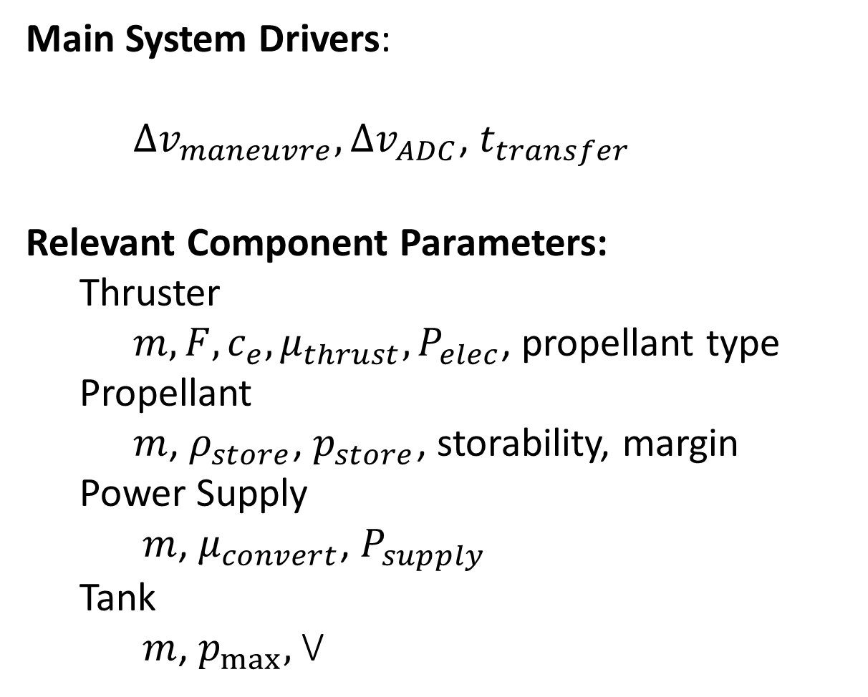
Propulsion System Relations
Mass Power Heat Data Orbit
Orbit
Propulsion
Main System Drivers:
$Δv_{maneuvre}, Δv_{ADC}$, $t_{transfer}$
Relevant Component Parameters:
Thruster
$m, F, c_{e}, μ_{thrust}, P_{elec}$, propellant type
Propellant
$m$, $ρ_{store}$, $p_{store}$, storability, margin
Power Supply
$m$, $μ_{convert}$, $P_{supply}$
Tank
$m$, $p_{max},$V
Thruster
Propellant
Power Supply
Tank
$\text{(1−}μ)P$ Waste heat
Health Monitoring Data Rate
Mass budget
Power budget
Heat budget
On-board Computer

Slide 3

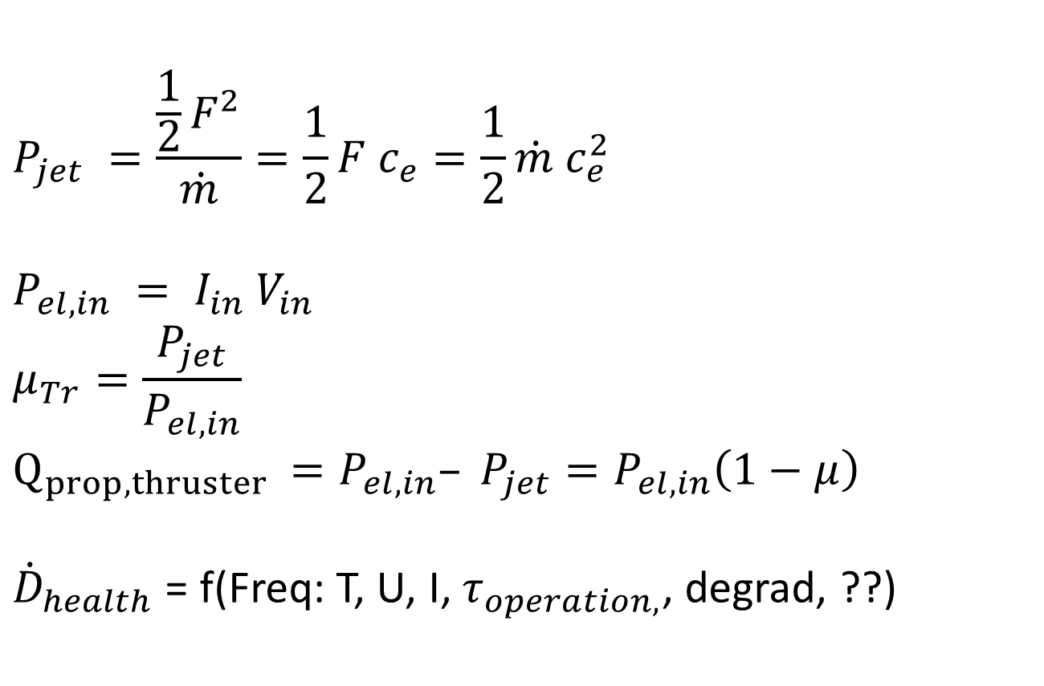
Propulsion System Relations
Mass Power Heat Data Orbit
Orbit
Thruster:
$$Δv=c_{e}\ln\left(\frac{m_{0}}{m_{b}}\right)=c_{e}\ln\left(\frac{m_{0}}{m_{0}−m_{prop}}\right)$$
$$m_{prop}=\left({1−e}^{−\frac{Δv}{c_{e}}} \right)m_{0}$$
$$F = \dot{m}c_{e}$$
$$\dot{m} \text{ =}\frac{c_{e}}{F}=\frac{m_{prop}}{τ_{burn}}$$
$c_{e}$= $\frac{F}{\dot{m}}$
$$m_{thruster} = f \left(thruster, propellant, c_{e}, F\right)$$
Propulsion
$$P_{jet} =\frac{\frac{1}{2}F^{2}}{\dot{m}}=\frac{1}{2}F c_{e}=\frac{1}{2}\dot{m} c_{e}^{2}$$
$$P_{el,in} = I_{in} V_{in}$$
$$μ_{Tr}=\frac{P_{jet}}{P_{el,in}}$$
$$Q_{prop,thruster }=P_{el,in}– P_{jet}=P_{el,in}\left(1−μ\right)$$
${\dot{D}}_{health}$ = f(Freq: T, U, I, $τ_{operation,}$, degrad, ??)
Thruster
Propellant
Power Supply
Tank
$\text{(1−}μ)P$ Waste heat
Health Monitoring Data Rate
Mass budget
Power budget
Heat budget
On-board Computer

Slide 4

Propulsion System Relations
Mass Power Heat Data Orbit
Orbit
Propellant:
$$m_{prop}=\left({1−e}^{−\frac{Δv}{c_{e}}} \right)m_{0}+m_{prop,Margin}$$
$$\dot{m} \text{ =}\frac{c_{e}}{F}=\frac{m_{prop}}{τ_{burn}}$$
$$V_{prop}=\frac{m_{prop}}{ρ_{prop}}$$
$$ρ_{prop}= f \left(propellant, p_{max,tank}\right)$$
Propulsion
Thruster
Propellant
Power Supply
Tank
$\text{(1−}μ)P$ Waste heat
Health Monitoring Data Rate
Mass budget
Power budget
Heat budget
On-board Computer

Slide 5

Propulsion System Relations
Mass Power Heat Data Orbit
Orbit
Propulsion
Power Supply:
$$P_{jet} =\frac{\frac{1}{2}F^{2}}{\dot{m}}=\frac{1}{2}F c_{e}=\frac{1}{2}\dot{m} c_{e}^{2}$$
$$P_{el,in} = I_{in} V_{in}$$
$$E_{maneuvre}= P_{jet} τ_{burn}$$
$$μ_{PS}=\frac{P_{PS_{out}}}{P_{PSin }}$$
$$Q_{prop,PS}= P_{PS,out}– P_{PS,in}=P_{PS,in}\left(1−μ_{PS}\right)$$
$$m = f (Thruster, P_out)$$
${\dot{D}}_{health}$= f (Freq: T, U, I, degrad, FDIR, ??)
Thruster
Propellant
Power Supply
Tank
$\text{(1−}μ)P$ Waste heat
Health Monitoring Data Rate
Mass budget
Power budget
Heat budget
On-board Computer

Slide 6
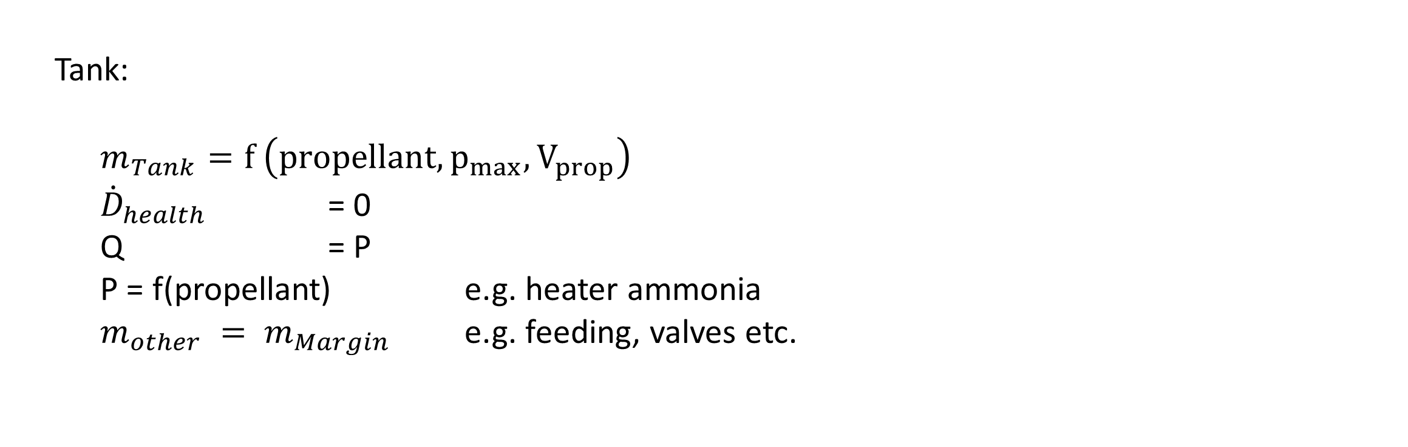
Propulsion System Relations
Mass Power Heat Data Orbit
Orbit
Propulsion
Tank:
$m_{Tank}=f \left(propellant, p_{max}, V_{prop}\right)$
${\dot{D}}_{health}$ = 0
Q = P
P = f(propellant) e.g. heater ammonia
$m_{other} = m_{Margin}$ e.g. feeding, valves etc.
Thruster
Propellant
Power Supply
Tank
$\text{(1−}μ)P$ Waste heat
Health Monitoring Data Rate
Mass budget
Power budget
Heat budget
On-board Computer

Slide 7

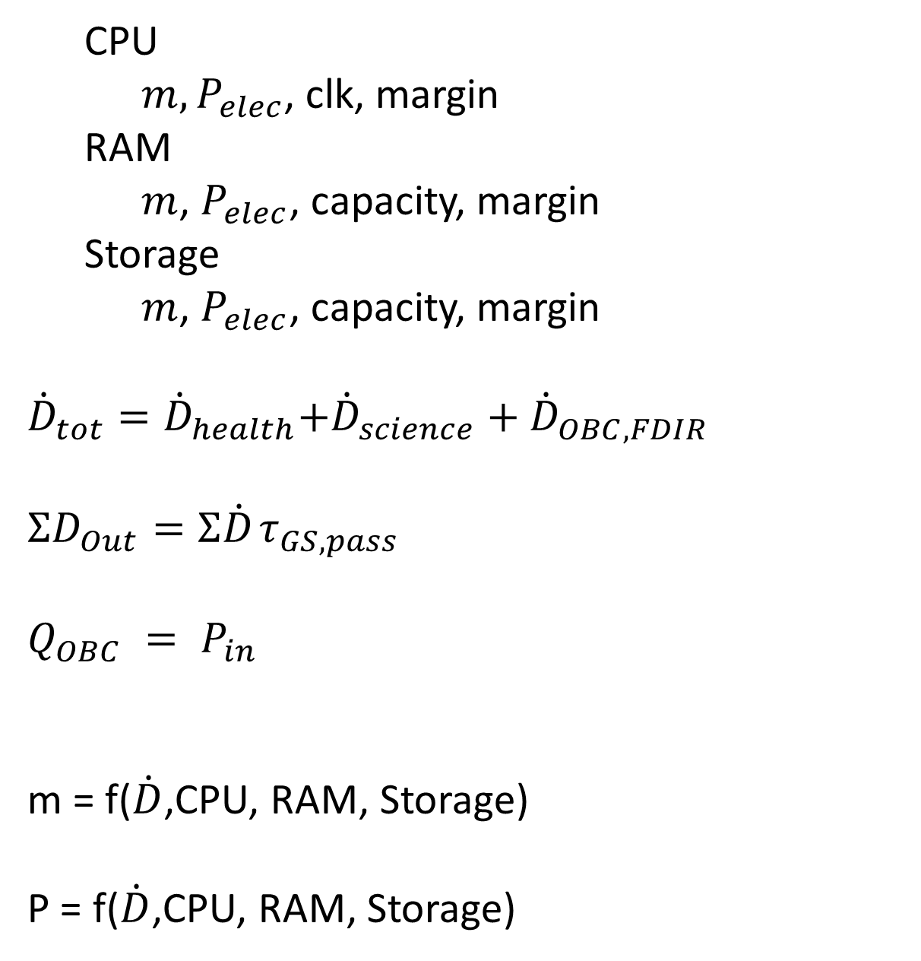
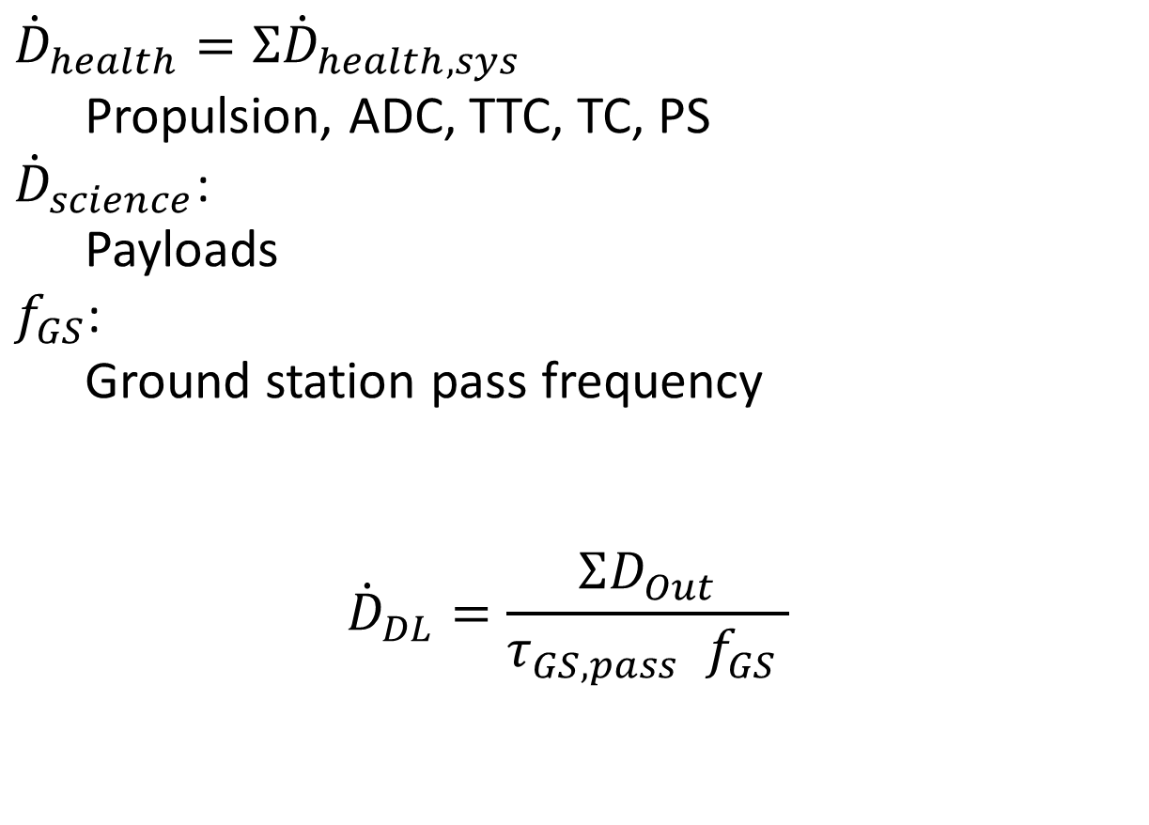
On-board Computer System Relations
Mass Power Heat Data Orbit
On-board Computer
CPU
$m, P_{elec}$, clk, margin
RAM
$m$, $P_{elec}$, capacity, margin
Storage
$m$, $P_{elec}$, capacity, margin
${\dot{D}}_{tot}={\dot{D}}_{health}$+${\dot{D}}_{science}$ + ${\dot{D}}_{OBC,FDIR}$
$$ΣD_{Out}=Σ{\dot{D}}_{ }τ_{GS,pass}$$
$$Q_{OBC} = P_{in}$$
m = f($\dot{D}$,CPU, RAM, Storage)
P = f($\dot{D}$,CPU, RAM, Storage)
CPU
$${\dot{D}}_{health}=Σ{\dot{D}}_{health, sys}$$
Propulsion, ADC, TTC, TC, PS
${\dot{D}}_{science}$: Payloads
$f_{GS}$: Ground station pass frequency
$${\dot{D}}_{DL}=\frac{ΣD_{Out}}{τ_{GS,pass}{ f}_{GS} }$$
RAM
Storage
$P$ Waste heat
Mass budget
Power budget
Heat budget

Slide 8
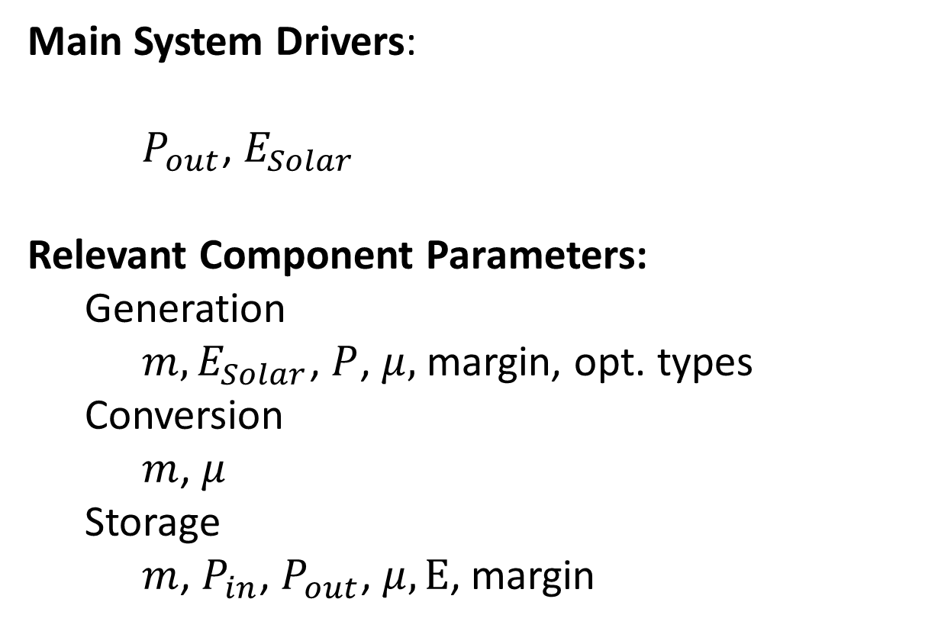
Power Supply System Relations
Mass Power Heat Data Orbit
Orbit
Power Supply
Main System Drivers:
$P_{out}$, $E_{Solar}$
Relevant Component Parameters:
Generation
$m,E_{Solar}$, $P$, $μ,$ margin, opt. types
Conversion
$m$, $μ$
Storage
$m$, $P_{in}$, $P_{out}$, $μ, E$, margin
Generation
Conversion
Storage
$\text{(1−}μ)P$ Waste heat
Health Monitoring Data Rate
Mass budget
Power budget
Heat budget
On-board Computer

Slide 9
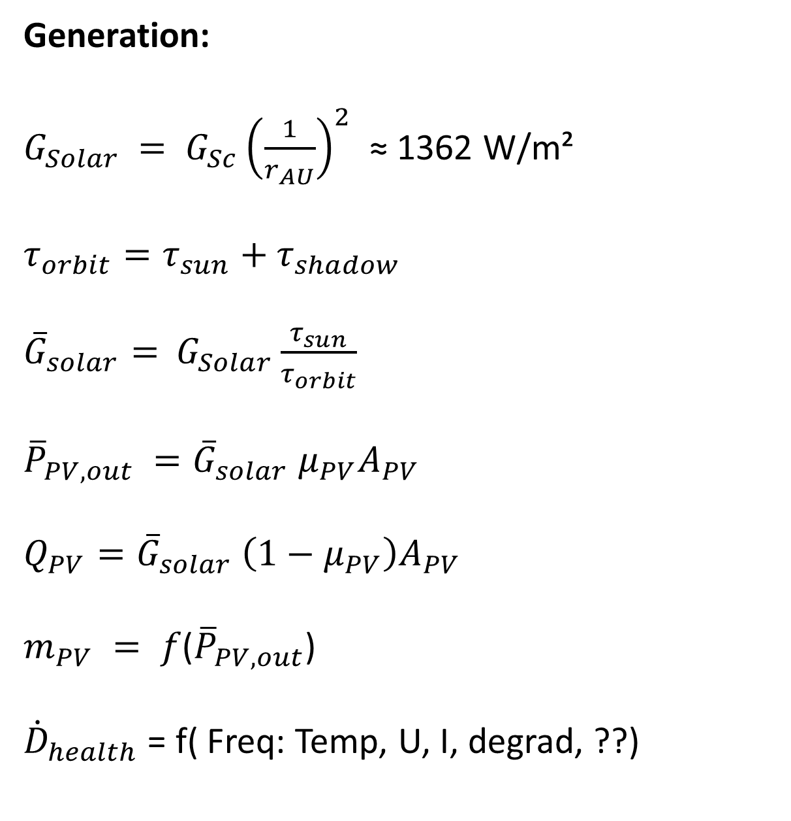
Power Supply System Relations
Mass Power Heat Data Orbit
Orbit
Power Supply
Generation:
$G_{Solar}$ $= G_{Sc}{\left(\frac{1}{r_{AU}}\right)}^{2}$ ≈ 1362 W/m²
$$τ_{orbit}=τ_{sun}+τ_{shadow}$$
${\overline{G}}_{solar}=$ $G_{Solar}\frac{τ_{sun}}{τ_{orbit}}$
${\overline{P}}_{PV,out} ={\overline{G}}_{solar} μ_{PV}A_{PV}$
$$Q_{PV}={\overline{G}}_{solar} \left(1−μ_{PV}\right)A_{PV}$$
$m_{PV} = f$(${\overline{P}}_{PV,out}$)
${\dot{D}}_{health}$ = f( Freq: Temp, U, I, degrad, ??)
Generation
Conversion
Storage
$\text{(1−}μ)P$ Waste heat
Health Monitoring Data Rate
Mass budget
Power budget
Heat budget
On-board Computer

Slide 10

Power Supply System Relations
Mass Power Heat Data Orbit
Orbit
Conversion
$$m_{PPU}=f\left(P_{in}, P_{sys,out},P_{sys,peak}\right)$$
$P_{in} =μ_{PPU,in}{\overline{P}}_{PV,out}$ ${= μ}_{PPU,in}I_{PV,out} V_{PV,out}$
$P_{sys,out} = μ_{PPU,in}$ ${\overline{P}}_{batt,out}$ = $I_{sys} U_{bus }$
$$P_{sys,out}=ΣP_{nominal}$$
$P_{sys,peak}=P_{sys,out}+max \left(P_{prop} OR P_{comm}\right)$ = $I_{sys,peak} U_{bus }$
$Q_{PPU}=(1−μ_{PPU,in}) {\overline{P}}_{batt,out} ={(1−μ}_{PPU,in}) {\overline{P}}_{PV,out}$
$$m_{harness} =a m_{0}$$
${\dot{D}}_{health}$ = f (Freq: Temp, FDIR, ??)
Power Supply
Generation
Conversion
Storage
$\text{(1−}μ)P$ Waste heat
Health Monitoring Data Rate
Mass budget
Power budget
Heat budget
On-board Computer

Slide 11

Power Supply System Relations
Mass Power Heat Data Orbit
Orbit
Power Supply
$$m_{batt}=f\left(P_{batt, out},P_{batt, peak}, C_{batt}, DOD\right)$$
${\overline{P}}_{sys,out} = μ_{batt,out}$ ${\overline{P}}_{batt,out}$
$I_{batt, peak}$ = $P_{batt, peak} {/U}_{bus}$
$Q_{batt} = {(1−μ}_{batt,out}$) ${\overline{P}}_{batt,out}$
$C_{batt, use}$ =$\left(P_{batt, peak} τ_{peak}+{\overline{P}}_{batt,out} τ_{shadow}\right)$
$C_{batt, nom}=\frac{C_{batt, use}}{(1−DOD)}$ , DOD = Depth of Discharge, DOD = 0 → empty
${\dot{D}}_{health}$ = f( Freq: $C_{batt, nom}$, Cycle, $I_{out}$, ??)
Generation
Conversion
Storage
$\text{(1−}μ)P$ Waste heat
Health Monitoring Data Rate
Mass budget
Power budget
Heat budget
On-board Computer

Slide 12
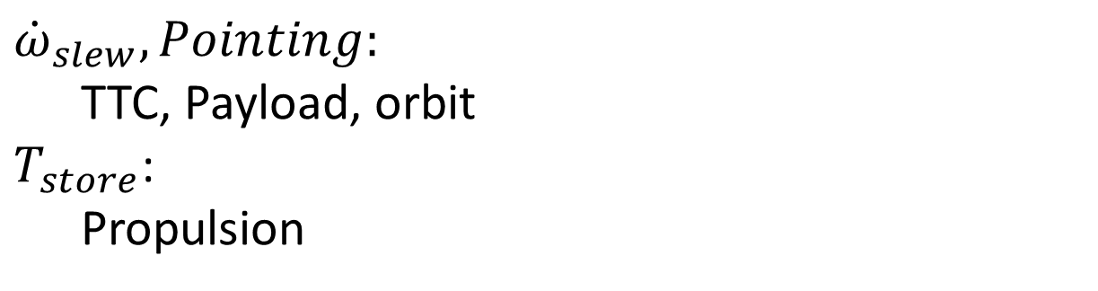
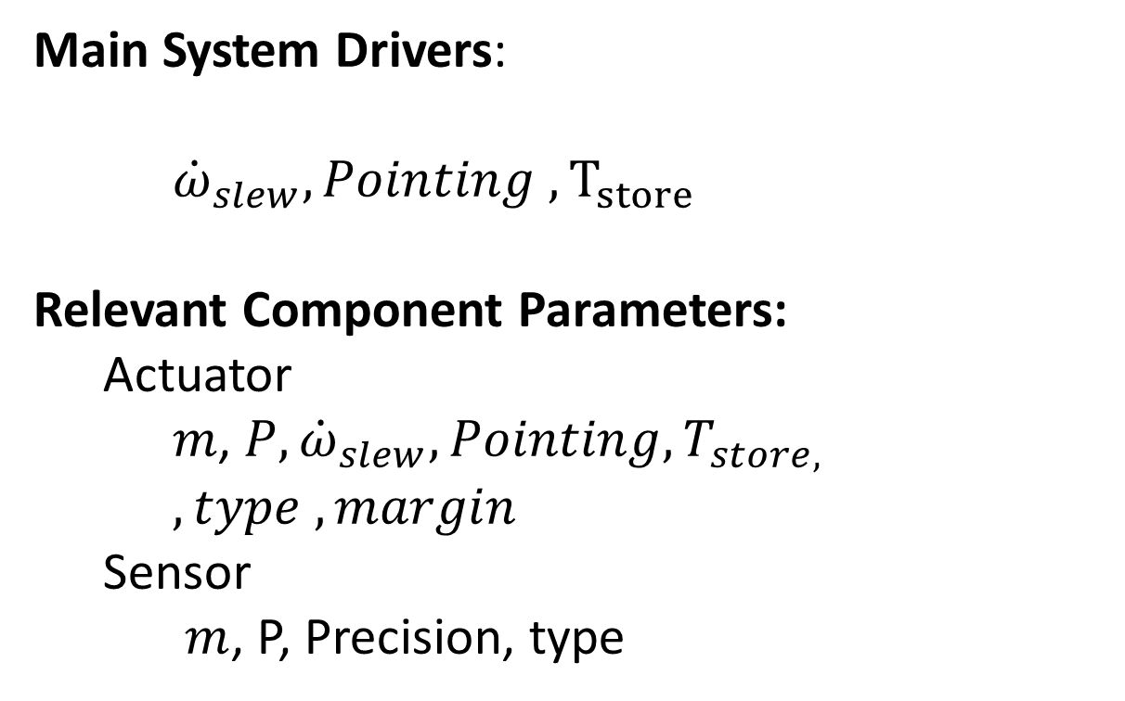

Attitude Determination & Control System Relations
Mass Power Heat Data Orbit
Orbit
Attitude Determination & Control
Main System Drivers:
${\dot{ω}}_{slew}, Pointing , T_{store}$
Relevant Component Parameters:
Actuator
$m\text{,} {P, \dot{ω}}_{slew},Pointing, T_{store,}$
$, type , margin$
Sensor
$m$, P, Precision, type
Actuator
$${\dot{ω}}_{slew}, Pointing:$$
TTC, Payload, orbit
$T_{store}$: Propulsion
Sensor
$P$ Waste heat
Health Monitoring Data Rate
Mass budget
Power budget
Heat budget
On-board Computer

Slide 13

Attitude Determination & Control System Relations
Mass Power Heat Data Orbit
Orbit
Attitude Determination & Control
$T_{mag} = m_{mag} x B = \left(n I A\right) x B$ , B = magnetic-field Earth, orbit dependance
$$T_{mech}= f\left(m, T, P_{in}\right)$$
${\dot{ω}}_{slew,i}= \frac{T}{J_{i}}$ = $\frac{T}{m_{sat} I_{sat,i}}$, $J_{i}$ = moment of inertia on axis I
$m_{ACS,act}$ = f(${\dot{ω}}_{slew}, Pointing , T_{store}$)
$m_{ACS,act,sys}$ = ${a m}_{ACS,act}$ , a = 4 (mech), a =3 (mag)
$P_{ACS,act}$ = f(${\dot{ω}}_{slew}, Pointing , T_{store}$)
$P_{ACS,act,sys}$ = ${b P}_{ACS,act}$ , b = 3 (mech), b =1 (mag)
$$Q = P_{el, ACS}$$
${\dot{D}}_{health}$ =f (${\dot{ω}}_{slew}, Pointing , T_{store}, FDIR$)
Actuator
Sensor
$P$ Waste heat
Health Monitoring Data Rate
Mass budget
Power budget
Heat budget
On-board Computer

Slide 14

Attitude Determination & Control System Relations
Mass Power Heat Data Orbit
Orbit
Attitude Determination & Control
Sensor
$m_{sens,act}$ = f($Pointing , Acc.,Type$) , Type: Star, mag, horizon, sun …
$P_{sens,act}$ = f($Pointing , Acc., Type$)
Q = $P_{sens,act}$
${\dot{D}}_{health}$= f ($Freq., Acc,Pos$)
Actuator
Sensor
$P$ Waste heat
Health Monitoring Data Rate
Mass budget
Power budget
Heat budget
On-board Computer

Slide 15
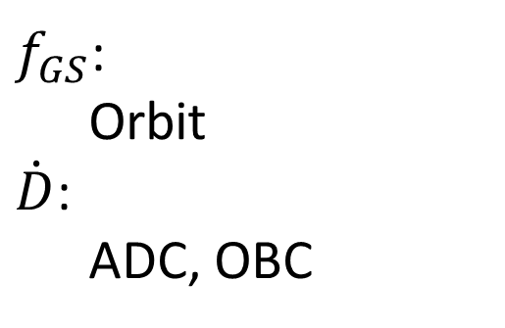
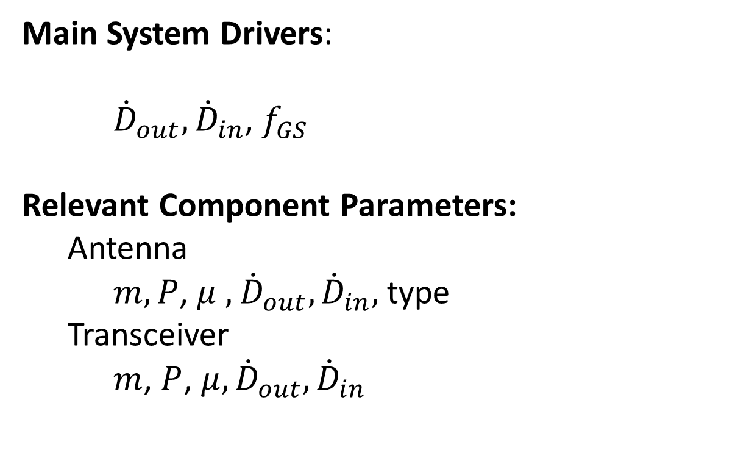
Telemetry, Tracking & Control System Relations
Mass Power Heat Data Orbit
Orbit
Telemetry, Tracking & Control
Antenna
Main System Drivers:
${\dot{D}}_{out}, {\dot{D}}_{in}$, $f_{GS}$
Relevant Component Parameters:
Antenna
$m, P$, $μ ,$ ${\dot{D}}_{out}, {\dot{D}}_{in},$type
Transceiver
$m$, $P$, $μ,{\dot{D}}_{out}, {\dot{D}}_{in}$
Transceiver
$f_{GS}$: Orbit
$\dot{D}$:
ADC, OBC
$\text{(1−}μ)P$ Waste heat
Health Monitoring Data Rate
Mass budget
Power budget
Heat budget
On-board Computer

Slide 16

Telemetry, Tracking & Control System Relations
Mass Power Heat Data Orbit
Orbit
Telemetry, Tracking & Control
Antenna
Antenna
$m_{Antenna}=f$(${P_{out},\dot{D}}_{out}, {\dot{D}}_{in}$, $G_{tx}$, type)
${\dot{ω}}_{slew,i}$ = f(orbit, G)
Transceiver
$\text{(1−}μ)P$ Waste heat
Health Monitoring Data Rate
Mass budget
Power budget
Heat budget
On-board Computer

Slide 17
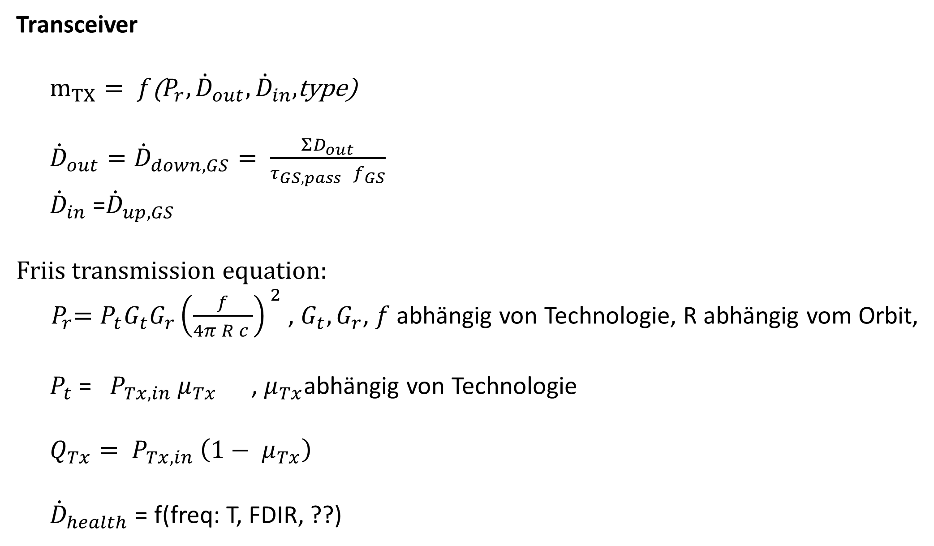
Telemetry, Tracking & Control System Relations
Mass Power Heat Data Orbit
Orbit
Telemetry, Tracking & Control
Transceiver
$m_{TX}= f$(${P_{r},\dot{D}}_{out}, {\dot{D}}_{in},$type)
${\dot{D}}_{out}={\dot{D}}_{down, GS}= \frac{ΣD_{out}}{τ_{GS,pass }f_{GS}}$
${\dot{D}}_{in}$ =${\dot{D}}_{up,GS}$
Friis transmission equation:
${ P}_{r}=P_{t}G_{t}G_{r}{\left(\frac{f}{4π R c }\right)}^{ 2}$ , $G_{t}, G_{r}$, $f$ abhängig von Technologie, R abhängig vom Orbit,
$P_{t}$ = $P_{Tx, in} μ_{Tx}$ , $μ_{Tx}$abhängig von Technologie
$Q_{Tx}= P_{Tx, in} \left(1− μ_{Tx}\right)$
${\dot{D}}_{health}$ = f(freq: T, FDIR, ??)
Antenna
Transceiver
$\text{(1−}μ)P$ Waste heat
Health Monitoring Data Rate
Mass budget
Power budget
Heat budget
On-board Computer

Slide 18
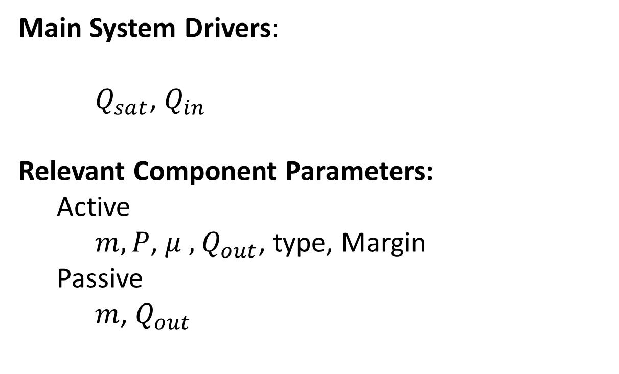
Thermal Control System Relations
Mass Power Heat Data Orbit
Orbit
Thermal Control
Active
Main System Drivers:
$Q_{sat}$, $Q_{in}$
Relevant Component Parameters:
Active
$m, P$, $μ ,$ $Q_{out}$, type, Margin
Passive
$m$, $Q_{out}$
Passive
$P$ Waste heat
Health Monitoring Data Rate
Mass budget
Power budget
Heat budget
On-board Computer

Slide 19

Thermal Control System Relations
Mass Power Heat Data Orbit
Orbit
TC System Drivers:
$$Q_{ín, tot}=Q_{in, ex}+ Q_{int}$$
$$Q_{int}=ΣQ_{sys,i }$$
$$Q_{in,ex} = Q_{sun}+ Q_{Earth}$$
$$Q_{sun}=α_{Sat}A G_{solar}$$
$$Q_{Earth}=α_{Sat,IR}A G_{\begin{aligned}Earth,IR\end{aligned}}$$
$α_{Sat}=ε_{sat}$
$$Q_{out, rad}=σ\left( ε_{Sat} A_{Sat}T_{Sat}^{4}+ε_{rad}A_{rad}T_{rad}^{4}\right)$$
m = f ($Q_{out, rad}$, $T_{rad}$, technology)
Passive:
P = 0
Active:
P = f($Q_{out}$, technology$) = Q_{TC}$ , during peak heat generation
D = f(freq: T, FDIR)
Thermal Control
Active
Passive
$P$ Waste heat
Health Monitoring Data Rate
Mass budget
Power budget
Heat budget
On-board Computer

Slide 20

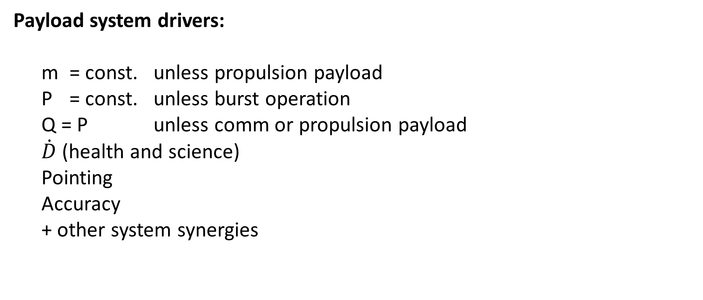
Payload System Relations
Mass Power Heat Data Orbit
Orbit
Payload
Payload system drivers:
m = const. unless propulsion payload
P = const. unless burst operation
Q = P unless comm or propulsion payload
$\dot{D}$ (health and science)
Pointing
Accuracy
+ other system synergies
$Q$ Waste heat
Science Data Rate
Health Monitoring Data Rate
Mass budget
Power budget
Heat budget
On-board Computer

Slide 21
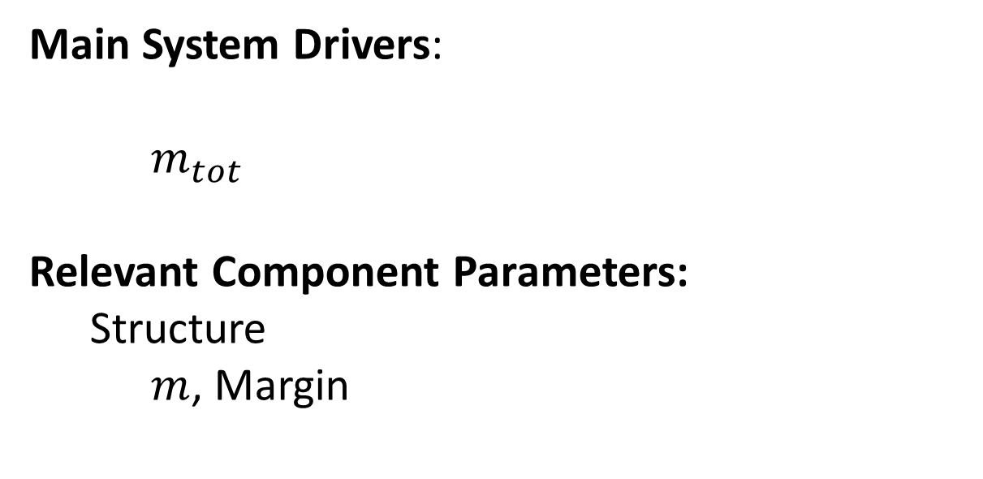
Structure System Relations
Mass Power Heat Data Orbit
Main System Drivers:
$m_{tot}$
Relevant Component Parameters:
Structure
$m$, Margin
Structure
Mass budget

