Slide 1
Coding Pandas Final Report
07/08

Slide 2
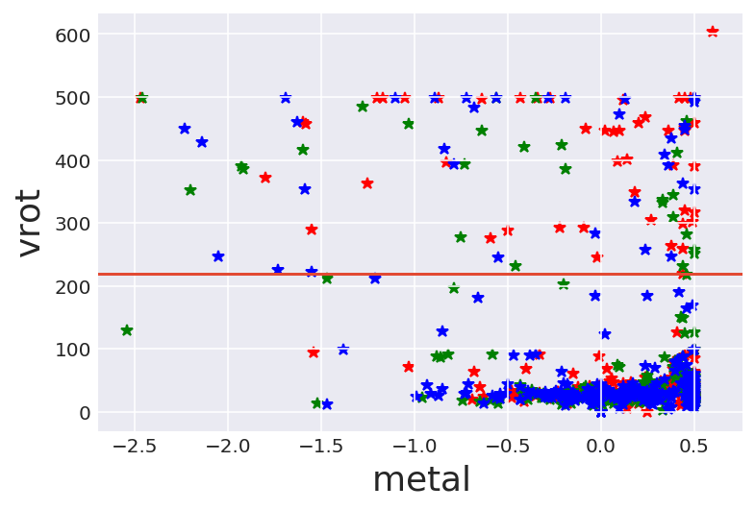
Plot RESLUTS
Rotational Velocity
Metallicity

Slide 3
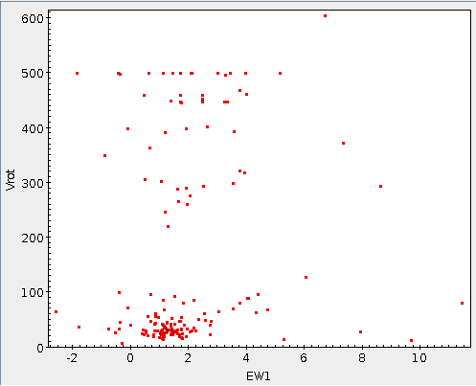
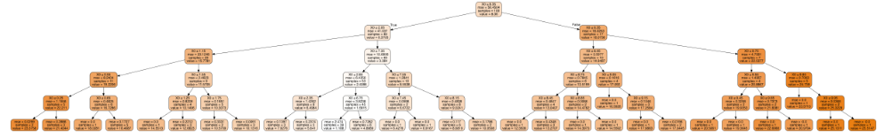
Classification
Unknown data
Machine Learning
Trees
KNN
Revolution

Slide 4
Git
A program you run from the command line, a distributed version control system
Keep the history of all the changes to their code
A codebase in Git is referred to as a repository, or repo, for short
Add files,commit, checking the log, making and cloning repositories, create a pull request

