Slide 1
Coding Pandas Daily Report
07/08

Slide 2
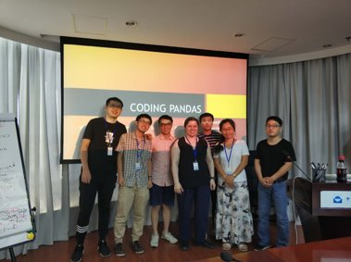
Introduction
Welcome New Pandas!
Our Task: Pandas of the Galaxy
  Pandas of the Galaxy (Tian YANG)
  EDA (Lang SHAO)
  Visualization (Yuchen LIU)
  Regression (Yingkang ZHANG)
  Classification (Xiao CHEN)
  Github (Lingling WANG)

