Slide 1
Coding Pandas Daily Report
07/08

Slide 2
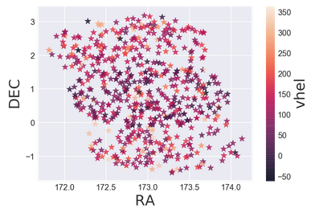
velocity

Slide 3
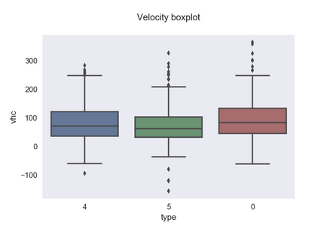
velocity

