Slide 1
Coding Pandas Daily Report
2018/08/06

Slide 2
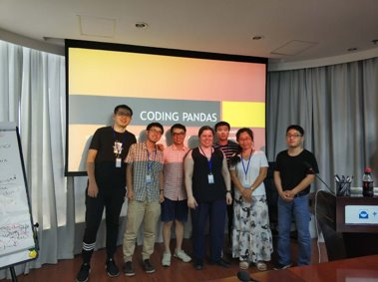
Introduction
Welcome New Pandas!
Tian Yang & Shaoguang Guo
Our Task: Pandas of the Galaxy
Pandas of the Galaxy (Tian YANG)
EDA (Lang SHAO)
Visualization (Yuchen LIU)
Regression (Yingkang ZHANG)
Classification (Xiao CHEN)
Github (Lingling WANG)

Slide 3
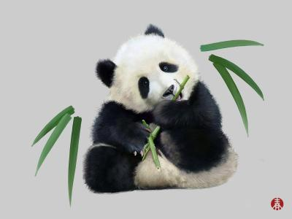
Pandas of the Galaxy
Explore the Unknown
1.Unknown area of Data
2. Spectra of Stars
3.What can we find

Slide 4
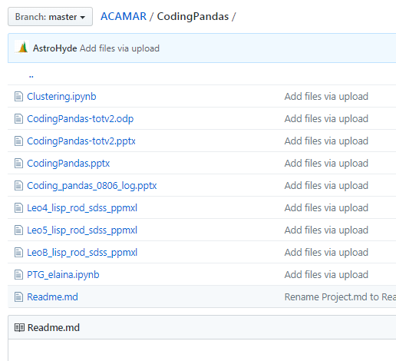
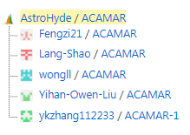
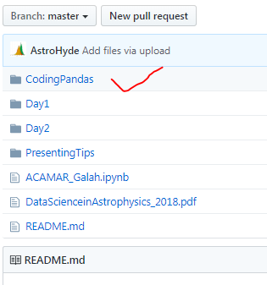
GitHub
Make a group
Rules:
PTG_name.ipynb
Heliantric velocity = vhc
Velocity error = herr
Right Ascension in degrees = Radeg
Declination in degrees = Decdeg
Upload
Notes:
Yesterday I introduce what is GitHub, today, we made a group on GitHub as a team, everyone could access the public repo and upload their code in there.
Of course , First of all We agreed the rule of the code

Slide 5
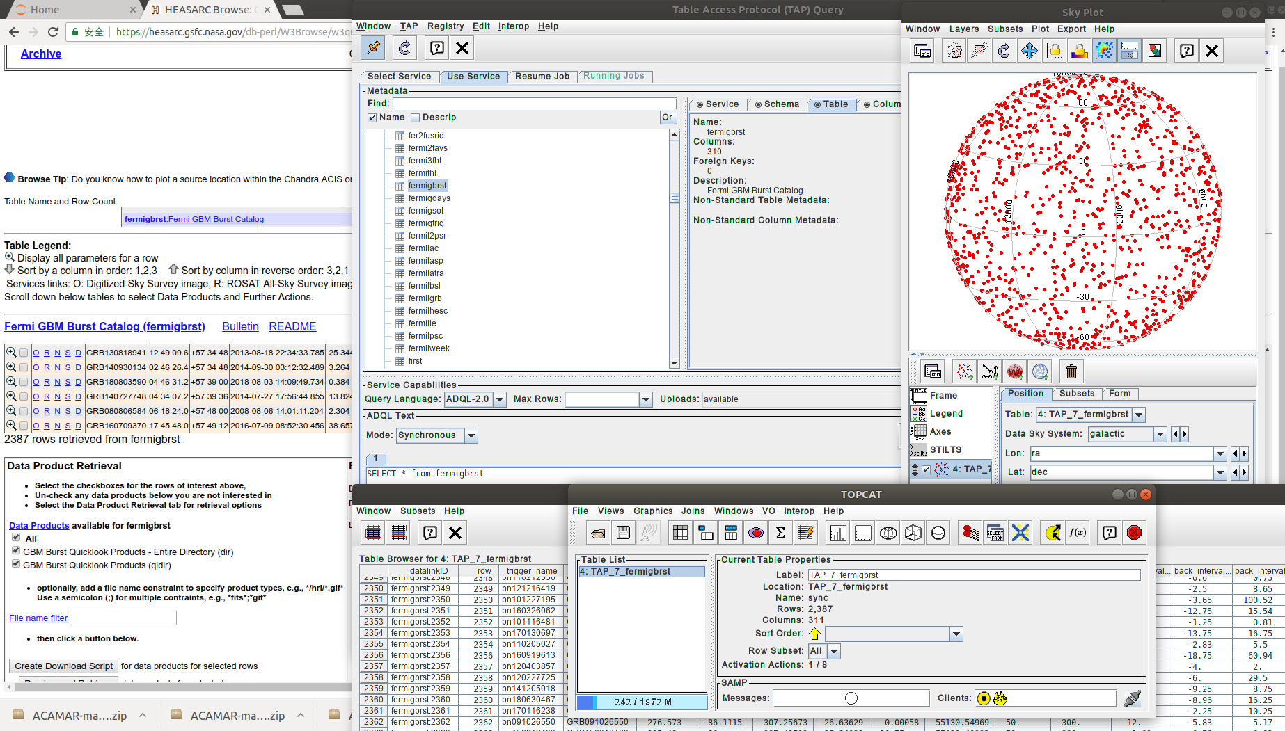
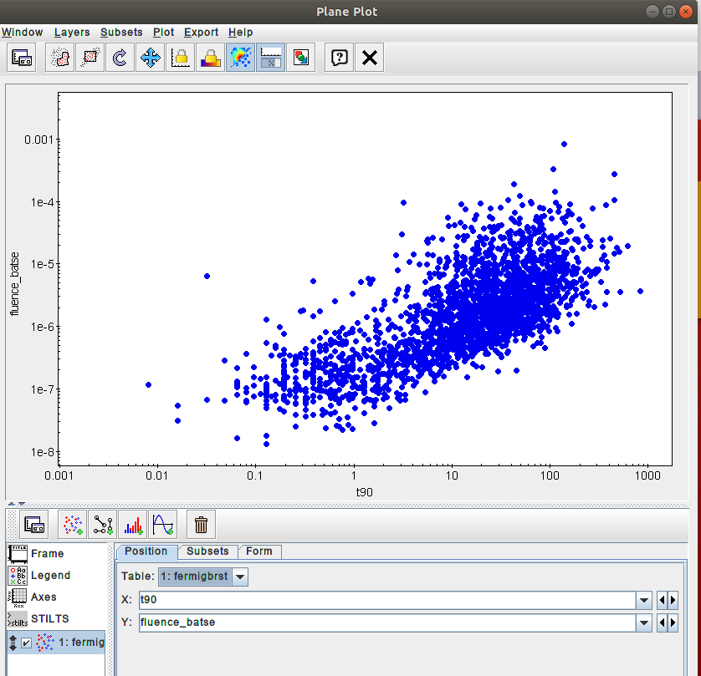
Exploratory Data Analysis with TOPCAT

Slide 6
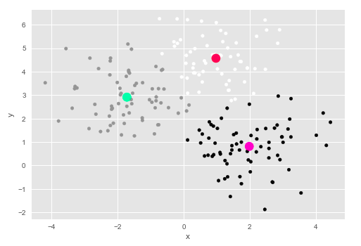
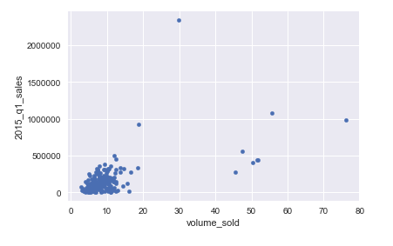
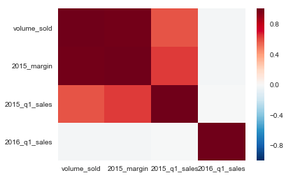
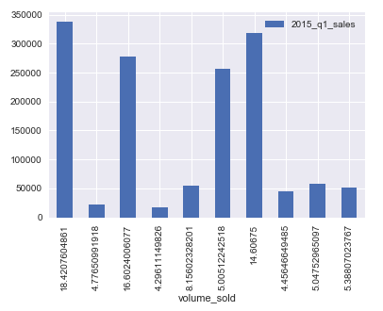
Visualisations

Slide 7
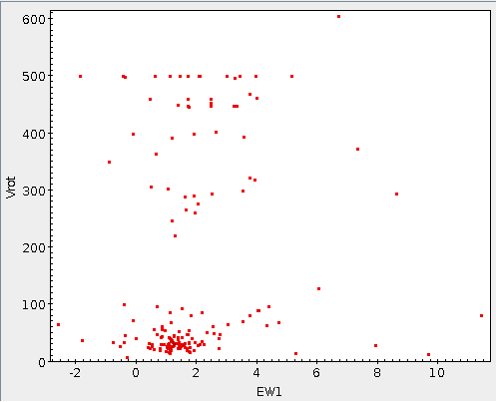
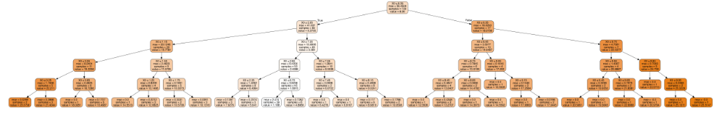
Classification
Unknown data
Machine Learning
Trees
KNN
Revolution

Slide 8
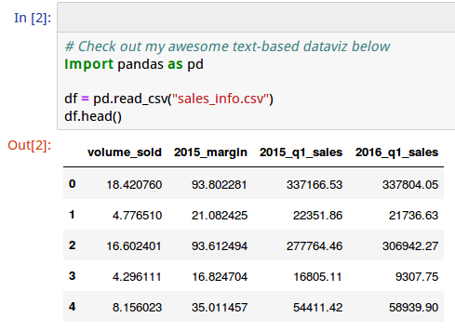
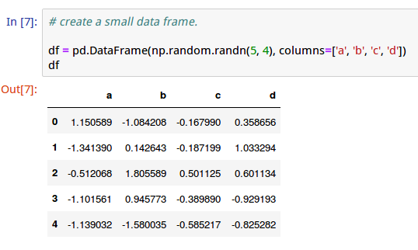
Pandas---a convenient python package to play with data
It helps exploring data by:
Formating
Data frame
Reading tables
pd.read_csv(table_files)
Ascii...
Plotting

Slide 9
Pandas---a convenient python package to play with data
It helps exploring data by:
Formating
Data frame
Reading tables
pd.read_csv(table_files)
Ascii...
Plotting

Slide 10
Thanks for listening!

