Slide 1
Coding Pandas –PANDAS of the Galaxy
Yihan 07/08

Slide 2
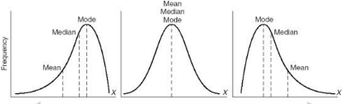
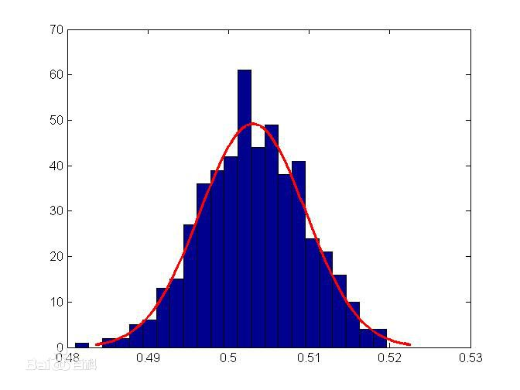
Descriptive Statistics
It is all about Frequency Distribution!
* Only used for univariate analysis

Slide 3
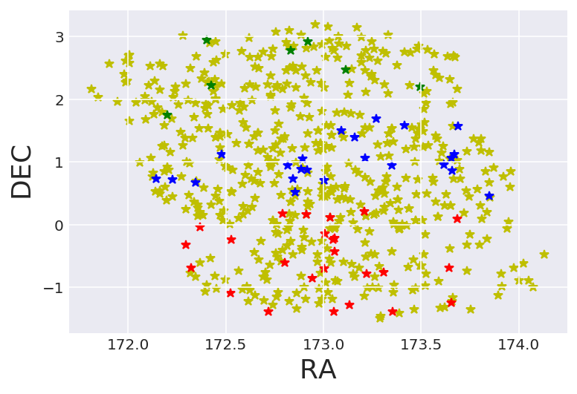
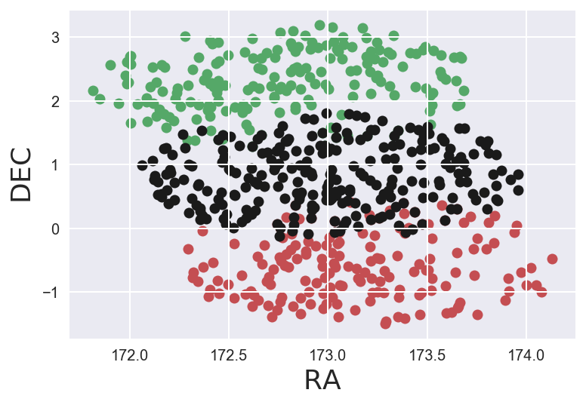
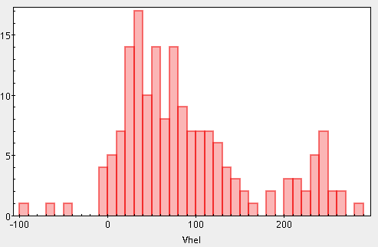
PANDAS OF THE GALAXY
LEO 4； LEO 5；area between
Explore the Mystery:
Two satellite Dwarf galaxy of the Milky Way. Associated? <---- AAOmega(Robot Telescope)
Velocity Differences? ---->Topcat it!

