Slide 1
Github Data Exploring
What is GitHub
What we have done with GitHub
How to access GitHub
Exploratory Data Analysis (EDA)
Machine Learning (ML)

Slide 2

What is github
HOSTING SERVICE for Git repositories
WEB INTERFACE to explore Git repositories
SOCIAL NETWORK of programmers
we all have INDIVIDUAL ACCOUNTS and put our codebases on our Github account
you can follow users and star your favorite projects
developers can ACCESS codebases on other PUBLIC ACCOUNTS

Slide 3
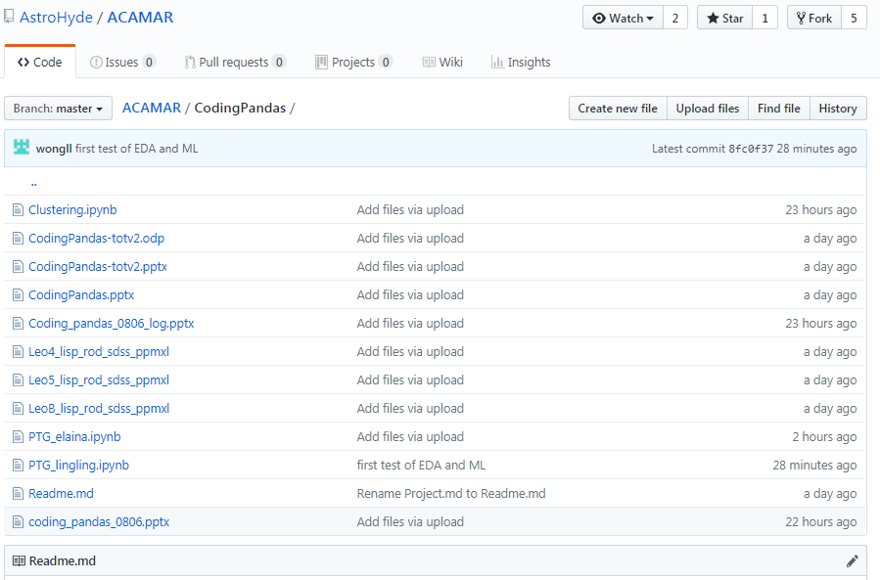
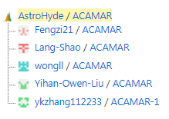
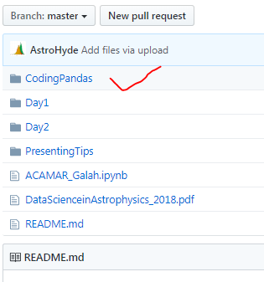
What we have done with GitHub
Made a group
Rules:
File name
PTG_name.ipynb
code
Heliantric velocity = vhc
Velocity error = herr
Right Ascension in degrees = Radeg
Declination in degrees = Decdeg
Upload & Download

Slide 4
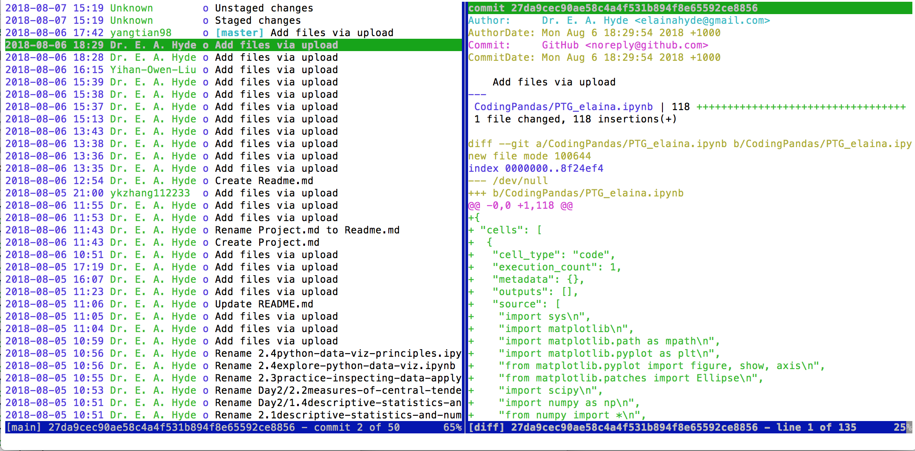
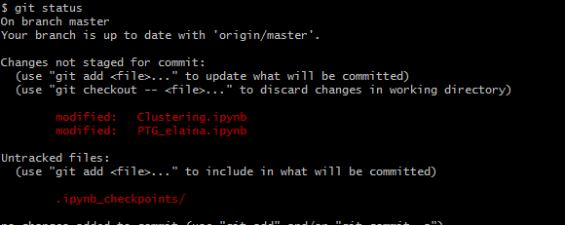
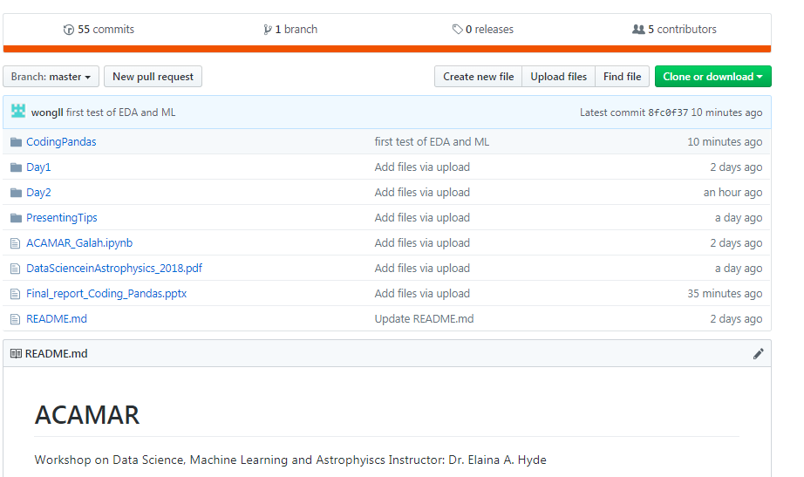
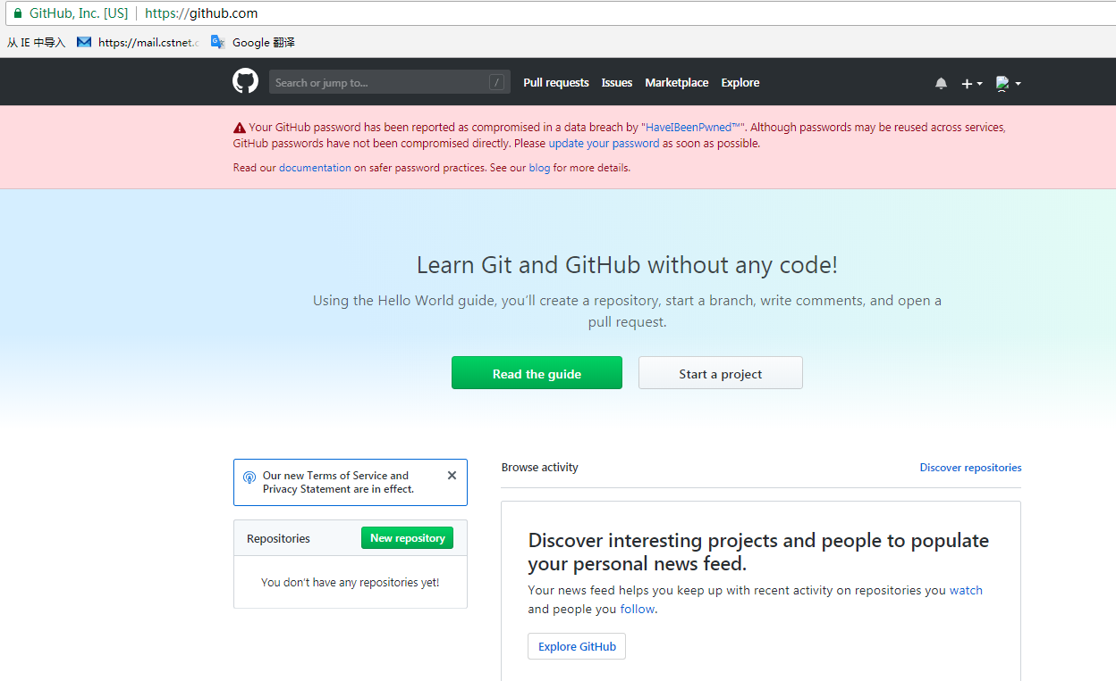

How to access Github
Command Line
Web Dashboard
SourceTree

Slide 5
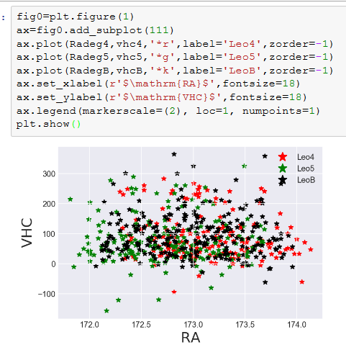
Data Exploring

Slide 6
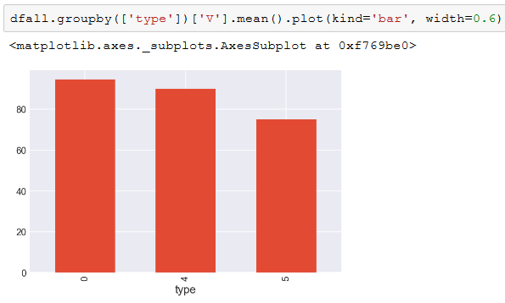
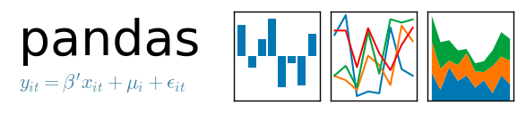

Data Exploring
Powerful & Easy
Velocity histogram

