Slide 1
CODING PANDAS
ACAMAR DAY 1 SUMMARY:
Git Style, Git Python, Git Pandas, Git Statistics, Git Prepared for Machine Learning
Team members: Elaina Hyde, Xiao Chen, Yihan Liu, Lingling Wang, Lang Shao, Yuchen Liu and Yingkang Zhang
Notes:
Intro the team
Intro team members

Slide 2
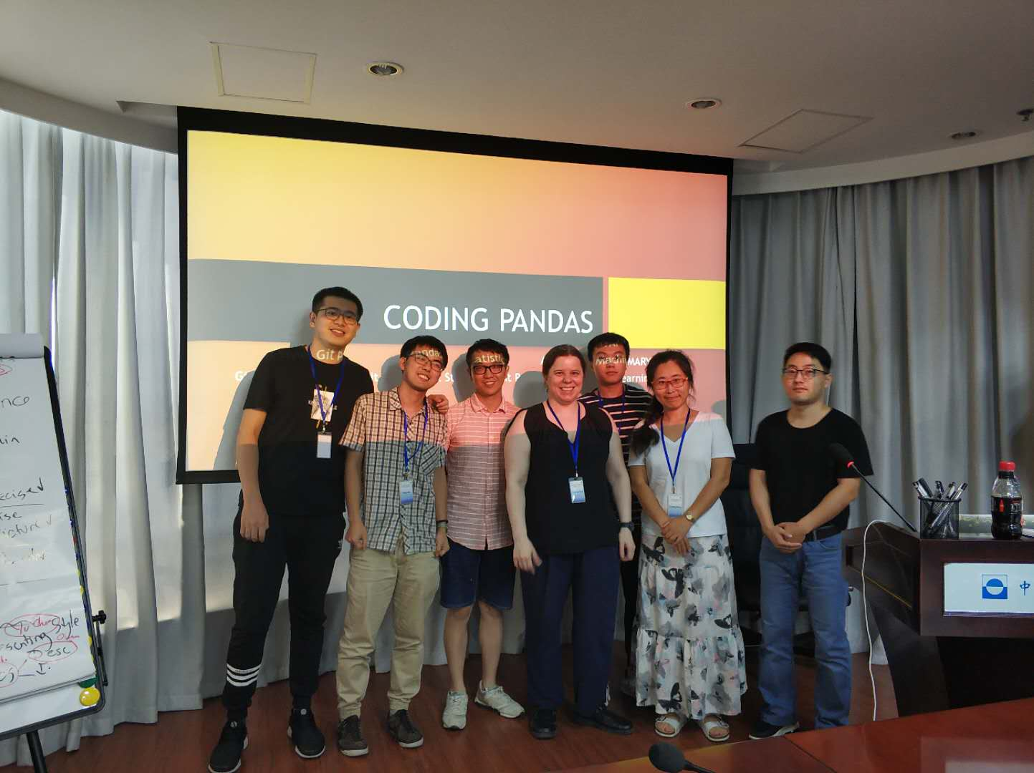
Introduction
What do Coding Pandas do?
Using python do Science data Statistics
Sharing through github
What are we presenting today?
How to make a good presentation (Yuchen Liu)
Git (Xiao Chen)
Github (Lingling Wang)
Statistics (Lang Shao)
Descriptive Statistics (Yihan Liu)
Notes:
We organised our presentation like this: each one prepare one slide for one point that we learnt this afternoon. We will introduce presentation styles,Git and Githubs, which are totallly 2 different things, and then we give a brief intro to Statistics and Descripteve Statistics. Now we will have Yuchen to begin the first introduction

Slide 3
Presenting Style
Font
Structured
Timing
Character Limitation
- Precision and Clarity
Colour and Contrast
Pictures

Slide 4
Presenting Style
Font
Structured
Timing
Character Limitation
- Precision and Clarity
Colour and Contrast
Pictures

Slide 5
Git
A program you run from the command line, a distributed version control system
Keep the history of all the changes to their code
A codebase in Git is referred to as a repository, or repo, for short.
Created by Linus Torvalds, the principal developer of Linux.
Add files,commit, checking the log, making and cloning repositories, create a pull request

Slide 6
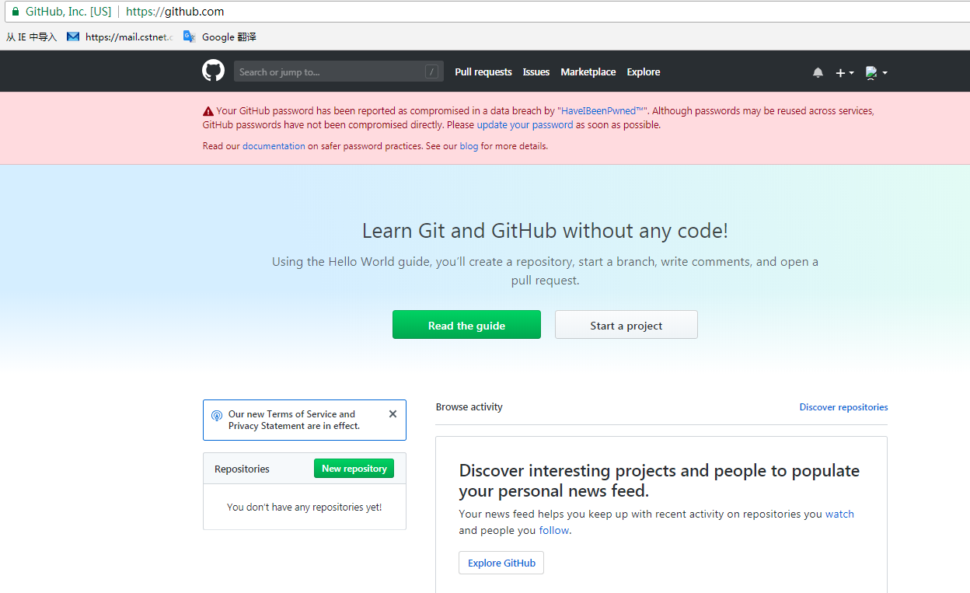
Github
HOSTING SERVICE for Git repositories
WEB INTERFACE to explore Git repositories
SOCIAL NETWORK of programmers
we all have INDIVIDUAL ACCOUNTS and put our codebases on our Github account
you can follow users and star your favorite projects
developers can ACCESS codebases on other PUBLIC ACCOUNTS
Notes:
we all have INDIVIDUAL ACCOUNTS and put our codebases on our Github account
<编号>

Slide 7
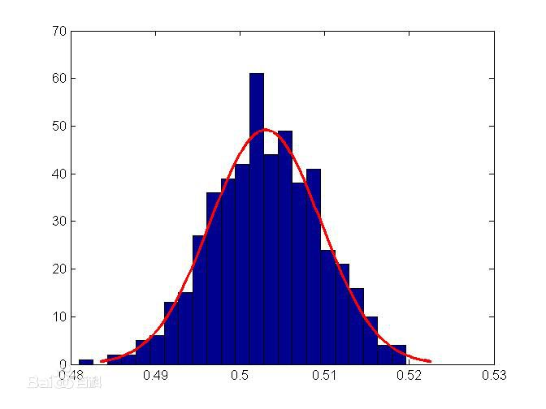
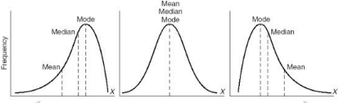
Descriptive vs Inferential Statistics
Descriptive Statistics
It is all about Frequency Distribution!
* Only used for univariate analysis

Slide 8
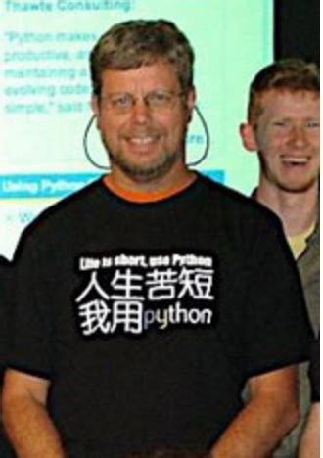
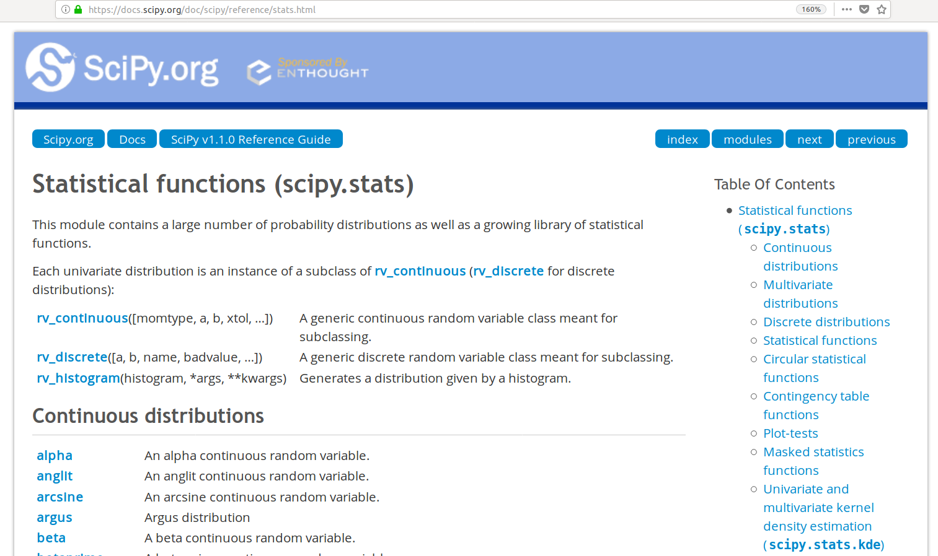
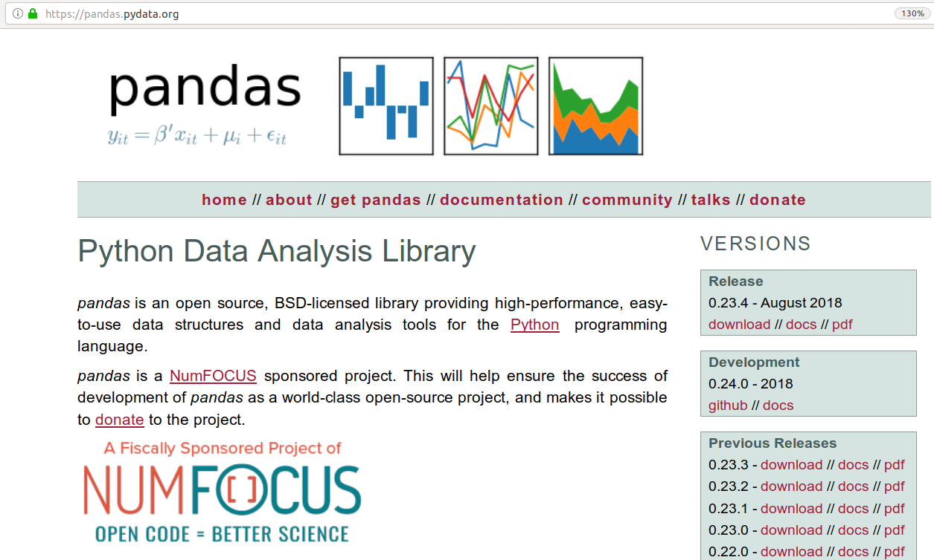
Statistics with python
“Life is short, use python.”
Notes:
/home/lang/Download/th.jpeg

Slide 9
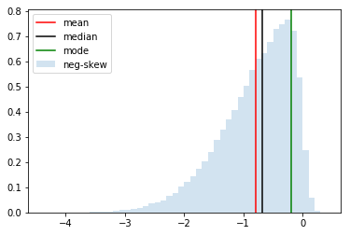
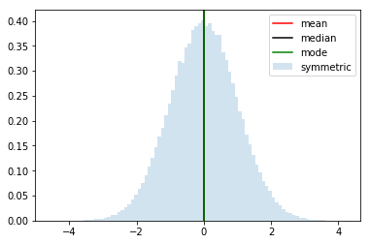
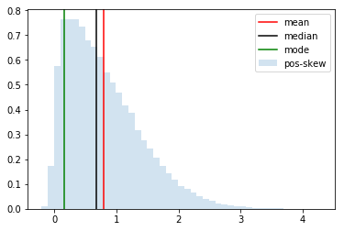
Skewness and Central tendency
with numpy, scipy and matplotlib
Negatively Skewed
Symmetric
Positively Skewed
mean < median < mode
mean == median == mode
mode < median < mean

Slide 10
Thank you

