Slide 1
Fake Currency Detector
Disruptive Technologies-1 23ECH-102

Slide 2
Members:
01
02
04
06
03
Kritika Ruhela
Ishant Singh
Jyoti
23BAI70138
23BAI70084
23BAI70615
05
Shalok
Devanshu
Ansh
23BAI70607
23BAI70183
23BAI70068

Slide 3
Contents:
Abstract
Methodology
Automated system detects counterfeit currency
Problem Statement
Python, OpenCV, NumPy, Matplotlib
Fake currency being circulated
Conclusion
References
Result & Analysis
Ensures currency authenticity
Research Paper, Web links, Books
Real-life Application

Slide 4

01
Abstract
Automated system detects counterfeit currency

Slide 5
Introduction
Counterfeiting of currency has become a real threat to the livelihood of people as well as the economy of our country. Though fake currency detectors are available, they are restricted to banks and corporate offices leaving common people and small businesses vulnerable.
So, in this project, we will investigate the various security features of Indian currency and then, prepare a software-based system to detect and invalidate fake Indian currency by using advanced image processing and computer vision techniques. This currency authentication system is designed completely using Python language in the Jupyter Notebook environment.

Slide 6
Objectives:
To examine the various security components of Indian currency notes.
Using a scanner or camera to gather paper money
To extract characteristics from the captured image by cropping and segmenting it.
Creating a feature localization algorithm.
Designing an extraction and recognition of features.
To determine the right money denomination
To distinguish between authentic and fake money notes

Slide 7
02
Problem Statement
Fake currency being circulated

Slide 8
Problem Scope
To test the authenticity of Indian currency notes by preparing a system which takes the image of currency bill as input and gives the final result by applying various image processing and computer vision techniques and algorithms.
Developing a counterfeit currency detection system to mitigate financial risks, ensuring the integrity of transactions and preserving economic stability.

Slide 9
03
Methodology
Python, OpenCV, NumPy, Matplotlib

Slide 10
Python Libraries Used:
OpenCV
Numpy
Matplotlib
Open source computer vision library
Numerical Python library for arrays
Plotting and visualization library

Slide 11

Feature of Currency Used
Security Thread:
A color-shifting security thread with the inscription Bharat (in Hindi), RBI, and 2000. The color changes from green to blue when it is tilted
Fig: Security Thread

Slide 12
Process
Image Acquisition
Critical image acquisition: clear, contrasting pictures enhance machine vision workflow efficiency.
RGB to Grayscale
RGB to grayscale: simplifies image, reduces computational complexity in processing.
Image Segmentation
Image segmentation enhances object detection, streamlining processing in various applications.
Feature Measurement
Finding Correlation
Classification
Feature detection computes image abstractions, identifies key points; feature space defines vectors.
Correlation: Load, normalize, down sample, calculate, visualize image alignment highlights.
Classification assigns labels based on data characteristics, aiding pattern recognition."

Slide 13
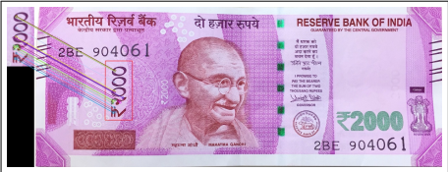
Input to Program
2000 Rupees Note

Slide 14
04
Result & Analysis
Discussion about results

Slide 15
Result objective
Objective:
The proposed system authenticates the input image of currency notes through image processing. The input image passes through various algorithms in which the image is processed and each extracted feature is thoroughly examined.

Slide 16
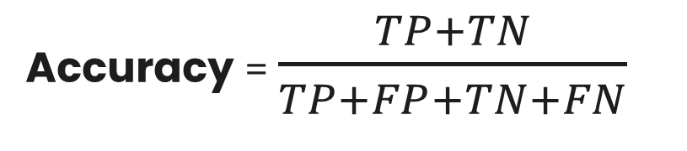
Computational Parameter:
Accuracy:
The percentage of accurately classified data samples over all the data is known as accuracy. Accuracy can be calculated by the following equation:
Accuracy = $\frac{TP+TN}{TP+FP+TN+FN}$

Slide 17
Performance Analysis
For testing of real notes:
9 real notes for Rs.2000
were considered, out of which
7 of the total 9 notes gave the
correct desired results.
Accuracy: 77%
For testing fake notes:
6 fake notes were taken
into consideration for which
5 of the 6 notes gave the correct
required output.
Accuracy: 83%

Slide 18
05
Conclusion
Effective image analysis enhances recognition accuracy and pattern identification significantly.

Slide 19
Project Conclusion
In this paper, a fake currency detection model has been proposed for the authentication of Indian currency notes of denominations 500 and 2000 and implemented using the OpenCV image processing library in Python3.

Slide 20
Thank You!
Under the guidance of:
Dr. Harjeevan Singh

